Slide 1
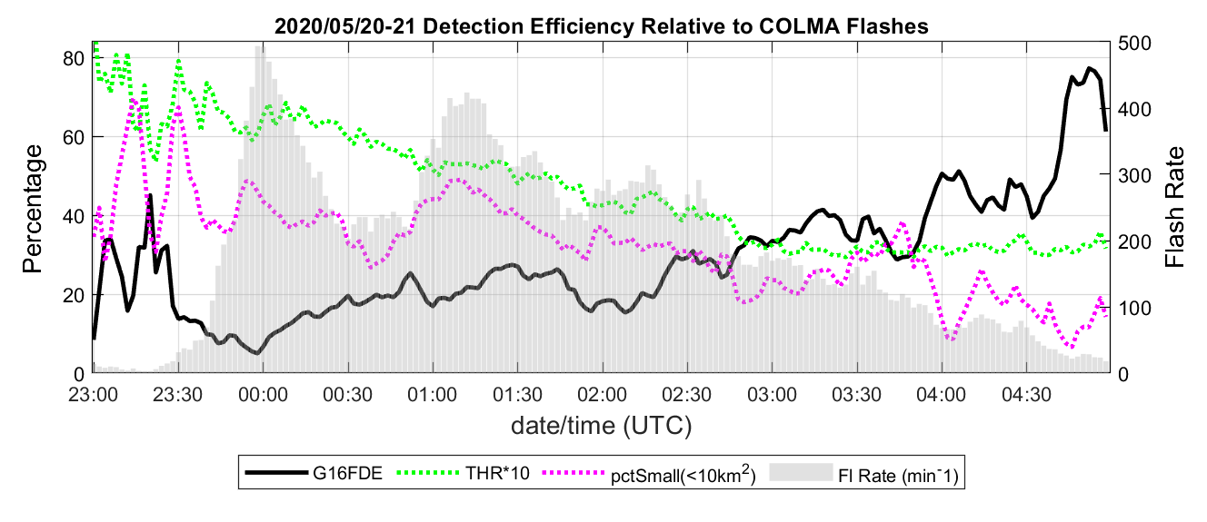
Colorado storm day: May 20, 2020
Threshold Animation (2-min frame rate)
GLM 2-minute event count
Region Median Threshold (fJ) Multiplied by 10
Full-region GLM flash DE
GLM Threshold within the region
% flash area < 10 km²
Note: final image is the per-pixel minimum over whole case
Threshold varies by region, and locally by a factor-of-two -- so we can benefit from Dynamic Tracking of pixel threshold
Notes:
Given that GLM detection threshold varies by region and by time-of-day, it would be helpful to have this information when interpreting GLM data in operational settings.
It is possible to compute the detection threshold for each GLM pixel in real-time with 2–5-minute temporal resolution by accumulating statistics from the event energy values reported in the operational L2 dataset. The left panel shows such a calculation for 2-minute intervals over a 6-hour period that includes full daylight, total darkness, as well as the transition period. The median threshold in the region (green line) starts out at about 7 fJ in full daylight and ends-up at about 3 fJ in full darkness after 03 UTC.
GLM flash DE relative to the local Lightning Mapping Array (thick black line) is quite low during daylight hours in this example, but it exceeded 50% after the median threshold reduced to about 3 fJ and the percentage of small flashes reduced to about 20%. The animation on the right panel shows the per-pixel threshold, color-codes between 1 and 7 fJ, in 2-minute periods. The final image in the panel shows the minimum threshold for each pixel for the duration of the storm.
It should be clear that real-time tracking of GLM threshold is both practical and useful

