Slide 1
Some discussion about lightning climatology
Robert Holzworth and Michael McCarthy
University of Washington
For NOAA GLM meeting, Huntsville Sept 2021

Slide 2
GLM ‘groups’ most closely associated with RF strokes
  GLM flashes can also work for climatology studies
  Energy comparison still all over the map
    Show a plot of group energy vs WWLLN energy (almost no relationship between GLM energy and RF energy)
New science directions
  Aerosol influence on thunderstorms and lightning
    Shipping lanes and sea spray
  Increase in lightning at high latitude
    Show polar plot, and latitude plots
  High energy strokes/causes, global distribution, effect
    Show global plot, emphasize Andes and mag equator

Slide 3
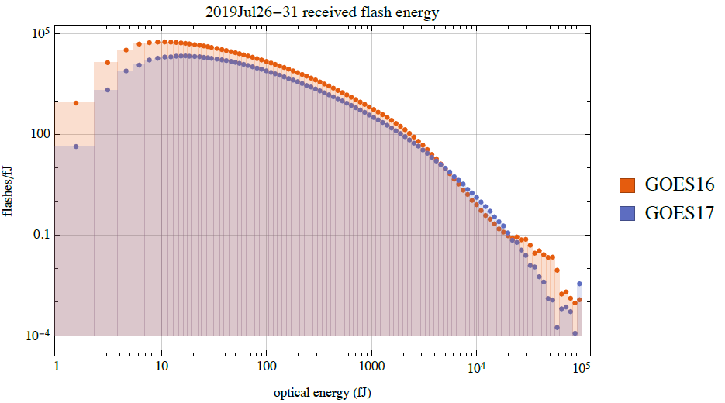
GLM sees a nice range of Flash (and Group) energy, not unlike RF distributions

Slide 4
BUT:
Very weak relation between GLM energy and WWLLN energy
Bright matches with WWLLN superbolts?
no matches of bright groups to any >100kJ WWLLN strokes.

Slide 5
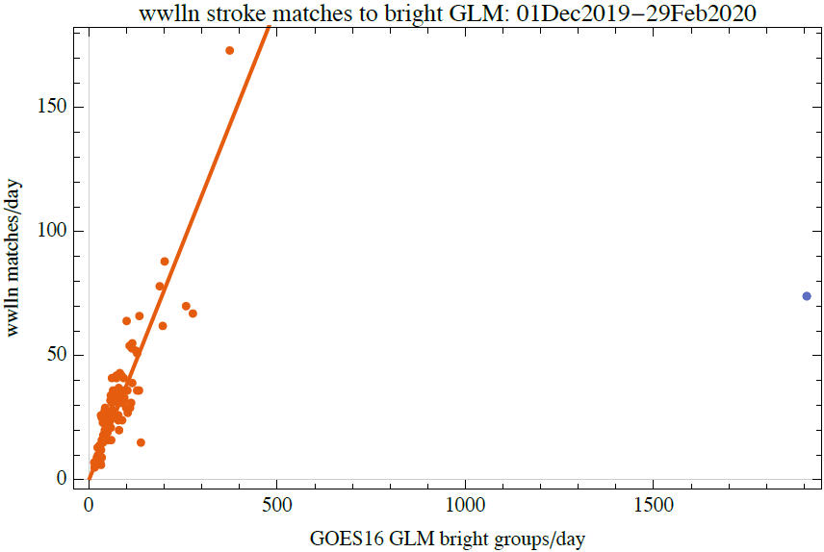
Daily GLM lightning climatologies can be built on summation of bright groups for a day, rather than using individual groups

Slide 6
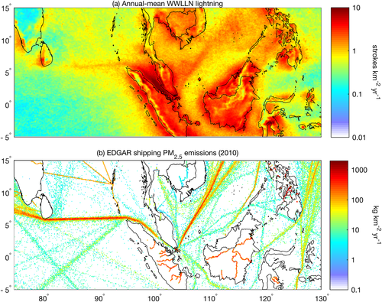
Aerosols are now known to influence lightning occurrence directly
Thornton et al, 2017
https://agupubs.onlinelibrary.wiley.com/doi/full/10.1002/2017GL074982

Slide 7
Sea spray kills thunderstorms
Large contrasting effects of fine and coarse marine aerosols on lightning
Zengxin Pan et al (Daniel Rosenberg and Joel Thornton’s groups)
Conclusion:
Increasing Coarse Sea Spray causes Deep Convective Cloud weakening, which is the opposite of fine aerosol Deep Convective Cloud invigoration.
This is manifested in warming Cloud Top Temperatures and decreasing lightning frequency for the same fine aerosol concentrations. The decrease is strongest (×0.2) for the largest fine aerosol concentrations, where the Coarse Sea Spray restores most strongly coalescences and warm rain on the background of the most suppressed coalescence
by fine aerosols.
Submitted to Science 2021

Slide 8
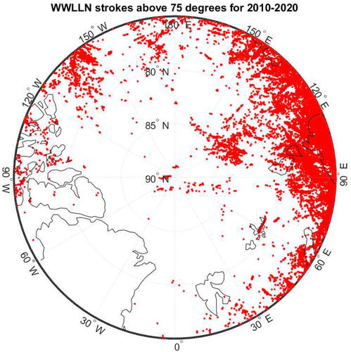
We are seeing a steady increase in lightning at high latitudes, including above latitudes GLM can reach

Slide 9
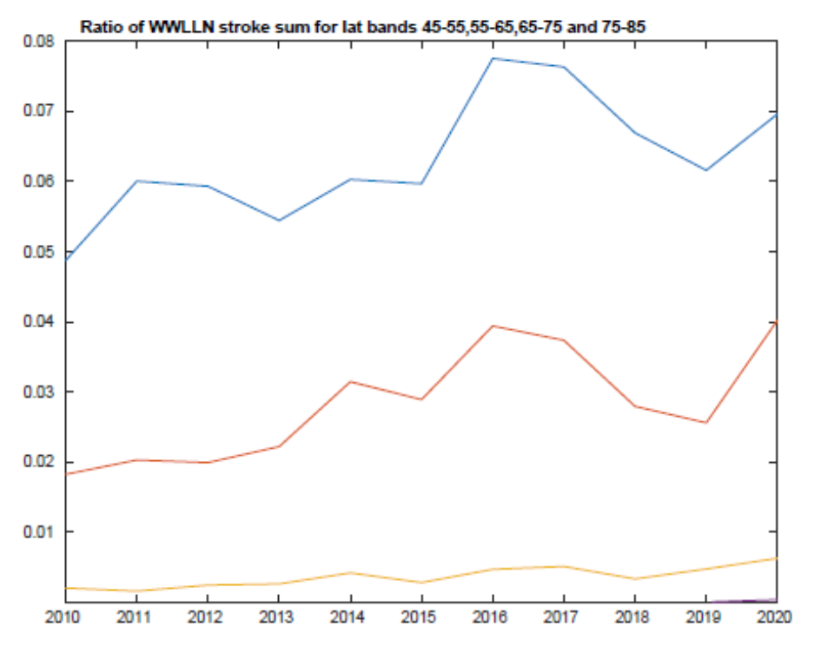
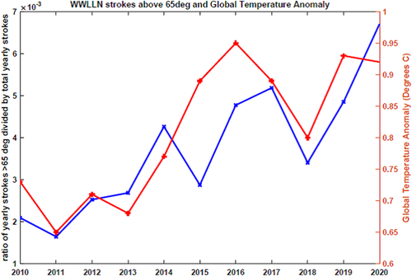
Lightning in the Arctic, Holzworth et al, 2021 https://dx.doi.org/10.1029/2020GL091366
GLM can see up to 65 degrees (lower two curves)

Slide 10
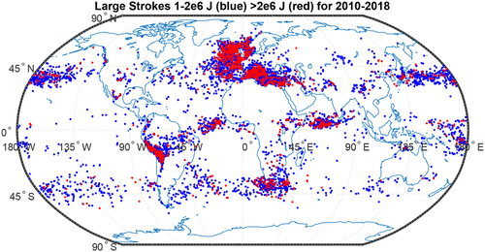
Global distribution of superbolts, Holzworth et al, 2019 https://doi.org/10.1029/2019JD030975
Prime region for GLM

Slide 11
Conclusions:
Lightning Climatologies are ‘easy’ to generate for WWLLN, or space based sensors (ISS/LIS or GLM), BUT understanding the causes for global variations leads to new science
1. GLM studies can help explain the lightning climatological peak of superbolts over the Andes, along the magnetic equator, high and low latitudes (near N and S 45 degrees)
2. Add to our understanding of increasing strokes at high latitudes
And
3. Help dig into influence of aerosols on lightning and thunderstorms.

