Slide 1
GLM validation during SOS-CHUVA field experiment
2017 GLM Annual Science Meeting – 12-14 September 2017 – Huntsville, AL
by Rachel Albrecht
with a lot of help from Luiz Machado, Vinicius Sperling, João Chinchay, and SOS-CHUVA Team
rachel.albrecht@iag.usp.br.

Slide 2
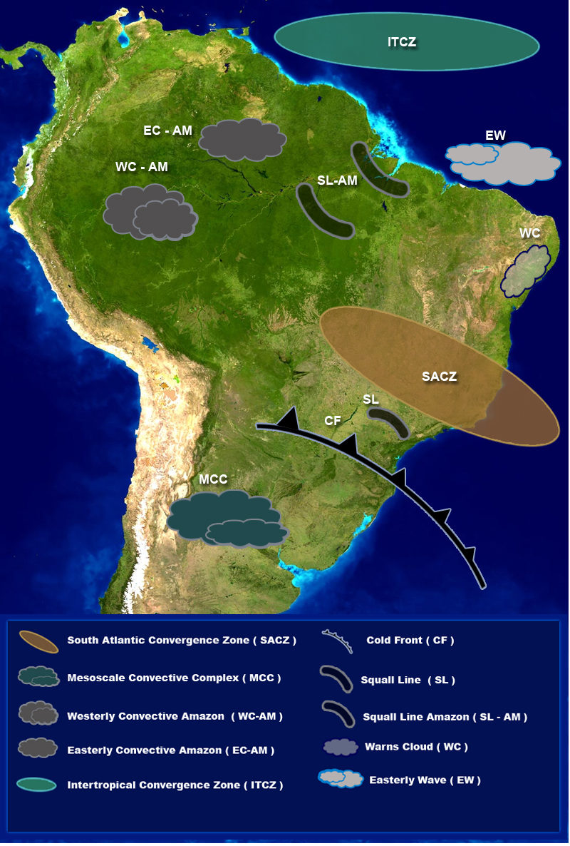
What is ”CHUVA”?
CHUVA Project (2010-2015)
Cloud processes of tHe main precipitation systems in Brazil: A contribUtion to cloud resolVing modeling and to the GPM (GlobAl Precipitation Measurement)
”Chuva” means rain in Portuguese
6
3
2
1
Belém-PA
Manaus-AM
Fortaleza-CE
4
GPCP (1979-2010) rainfall (mm/day)
Alcântara-MA
5
S.J.Campos-SP
Sta Maria -RS

Slide 3
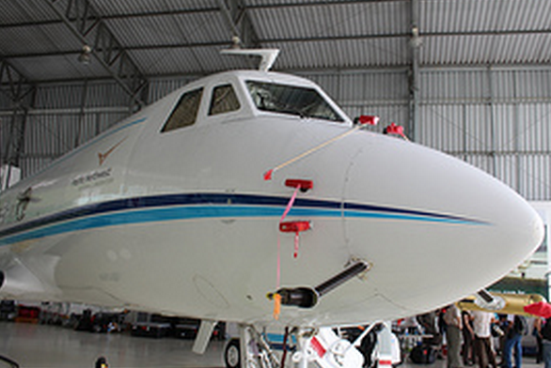
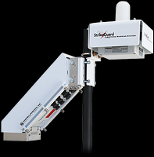
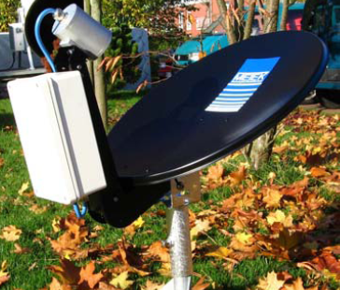
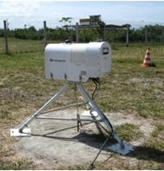
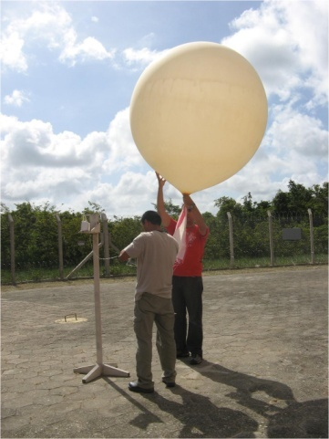
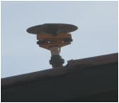
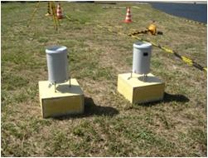
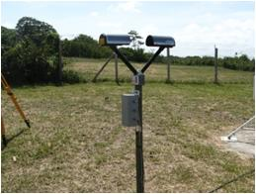
What is ”CHUVA”?
CHUVA Project (2010-2015)
Cloud processes of tHe main precipitation systems in Brazil: A contribUtion to cloud resolVing modeling and to the GPM (GlobAl Precipitation Measurement)
”Chuva” means rain in Portuguese
6
3
2
6
1
Belém-PA
Manaus-AM
Fortaleza-CE
4
4
GPCP (1979-2010) rainfall (mm/day)
Alcântara-MA
5
S.J.Campos-SP
Sta Maria -RS

Slide 4
What is ”SOS-CHUVA”?
SISTEMA DE OBSERVAÇÃO E PREVISÃO DE TEMPO SEVERO
= Observation System and Nowcasting of Severe Weather
SOS-CHUVA Project (2016-2019) objectives:
Apply cloud microphysics knowledge learned in CHUVA Project
Understand the evolution of cloud microphysics as they change to become extreme events
Build conceptual models and predict these changes
Develop a warning system of storm intensification
Make this information useful and reachable to the society:
Information sent directly to the Civil Defense
Information sent directly to the general public

Slide 5
1) Research topics in nowcasting:
What is ”SOS-CHUVA”?
Nowcasting using dual-polarization radar
Nowcasting using GOES-R satellite
Forecast models using lightning
Forecast models using GPS
2) Research topics in cloud physics:
Develop conceptual models of storm intensification and their extreme events
Microphysics parametrization improvement in CRM
Improvement of extrapolation models
Combine extrapolation models and CRM

Slide 6
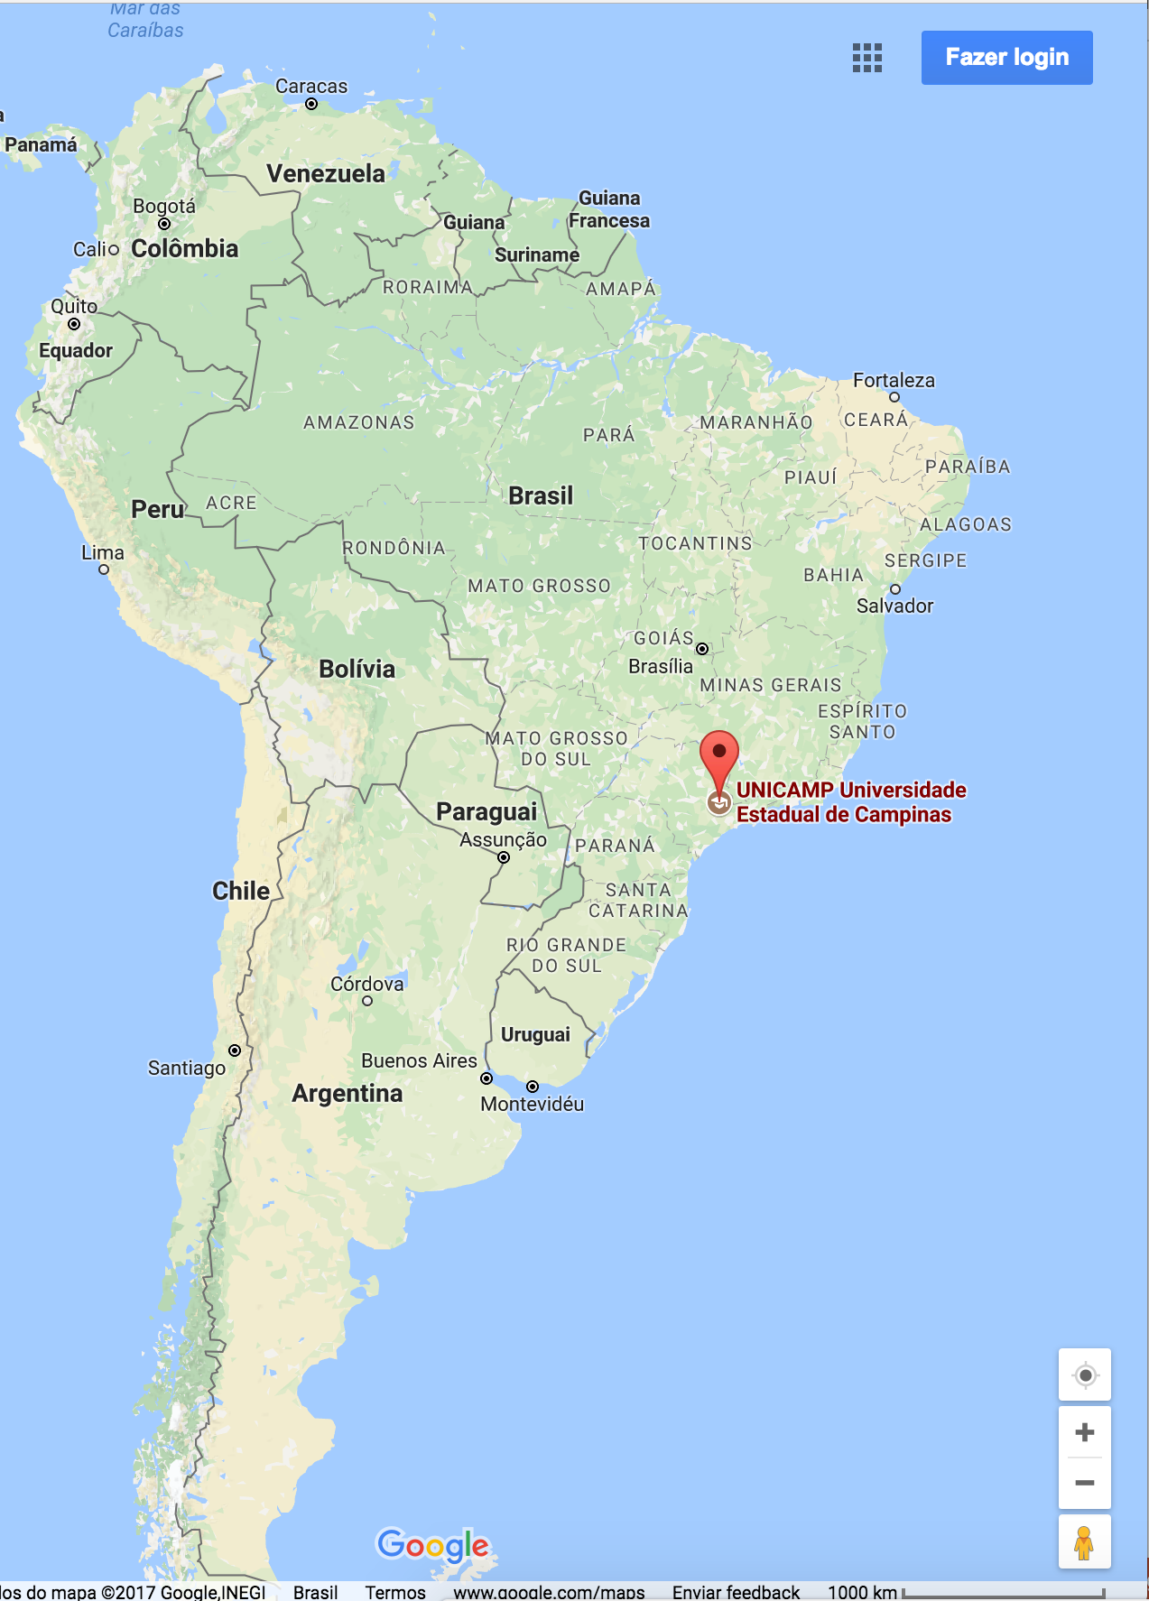
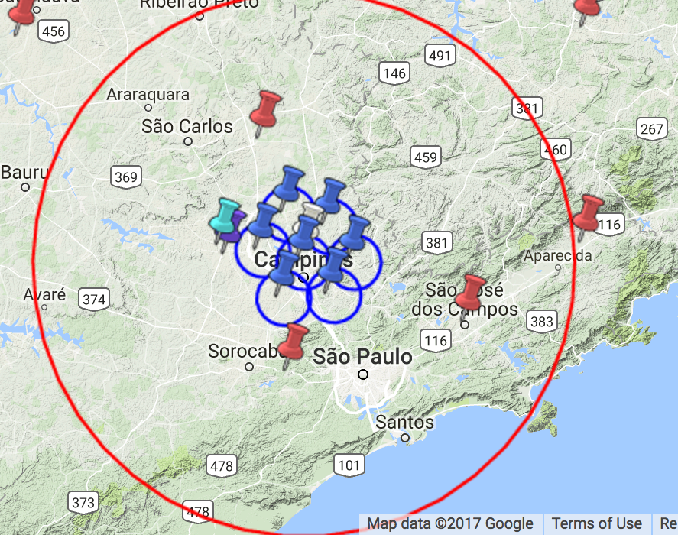
Location
What is ”SOS-CHUVA”?
Base site at Campinas-SP (~90km from São Paulo)
60km
200km

Slide 7
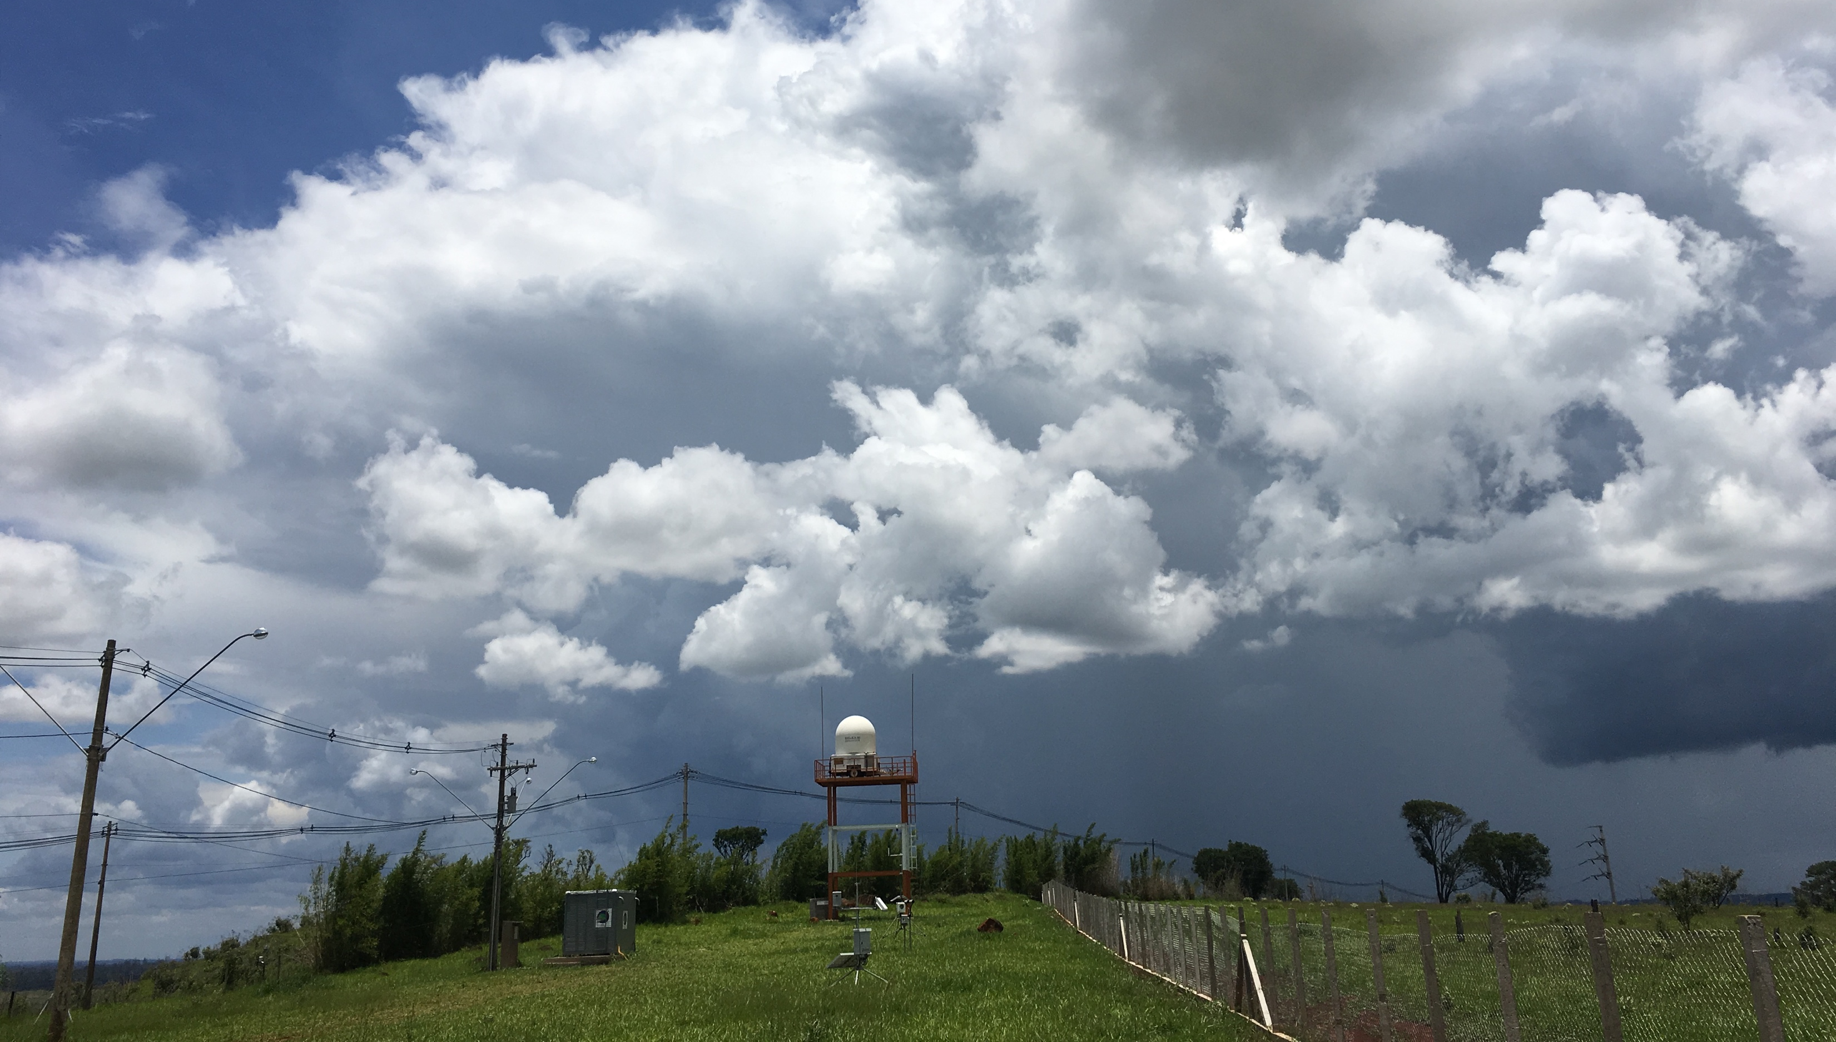
Instrumentation
What is ”SOS-CHUVA”?
At main base site Unicamp (University of Campinas):
Sellex X-Pol radar
Micro-Rain Radar
Radiometer
Disdrometers
Joss Waldvogel and Parsival
GPS total water vapor
Rain gauges
Aerosol size distribution
CCN concentration
Weather station

Slide 8
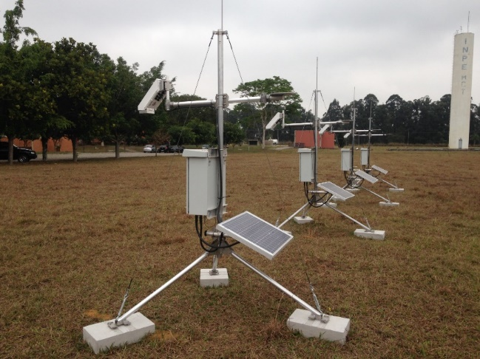
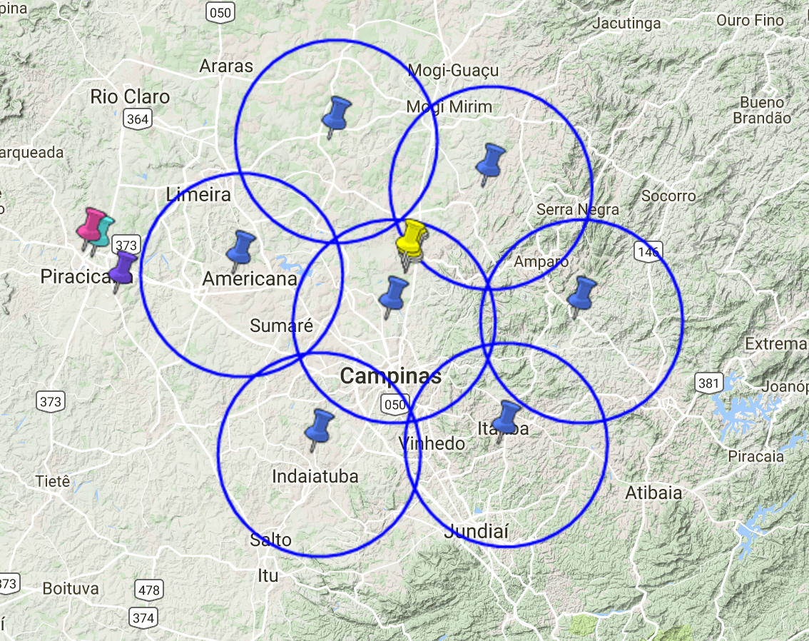
Instrumentation
What is ”SOS-CHUVA”?
Field Mill network
Data sent by internet cell phone
25-30 km baseline

Slide 9
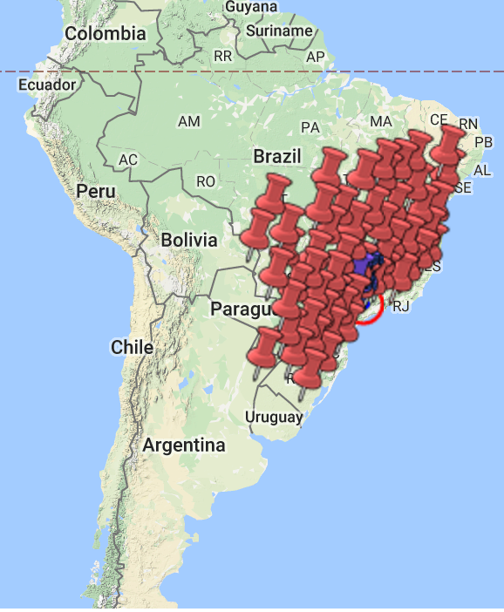
Instrumentation
What is ”SOS-CHUVA”?
Total (i.e., intracloud and cloud-to-ground) lightning network
BrasilDAT (EarthNetworks)

Slide 10
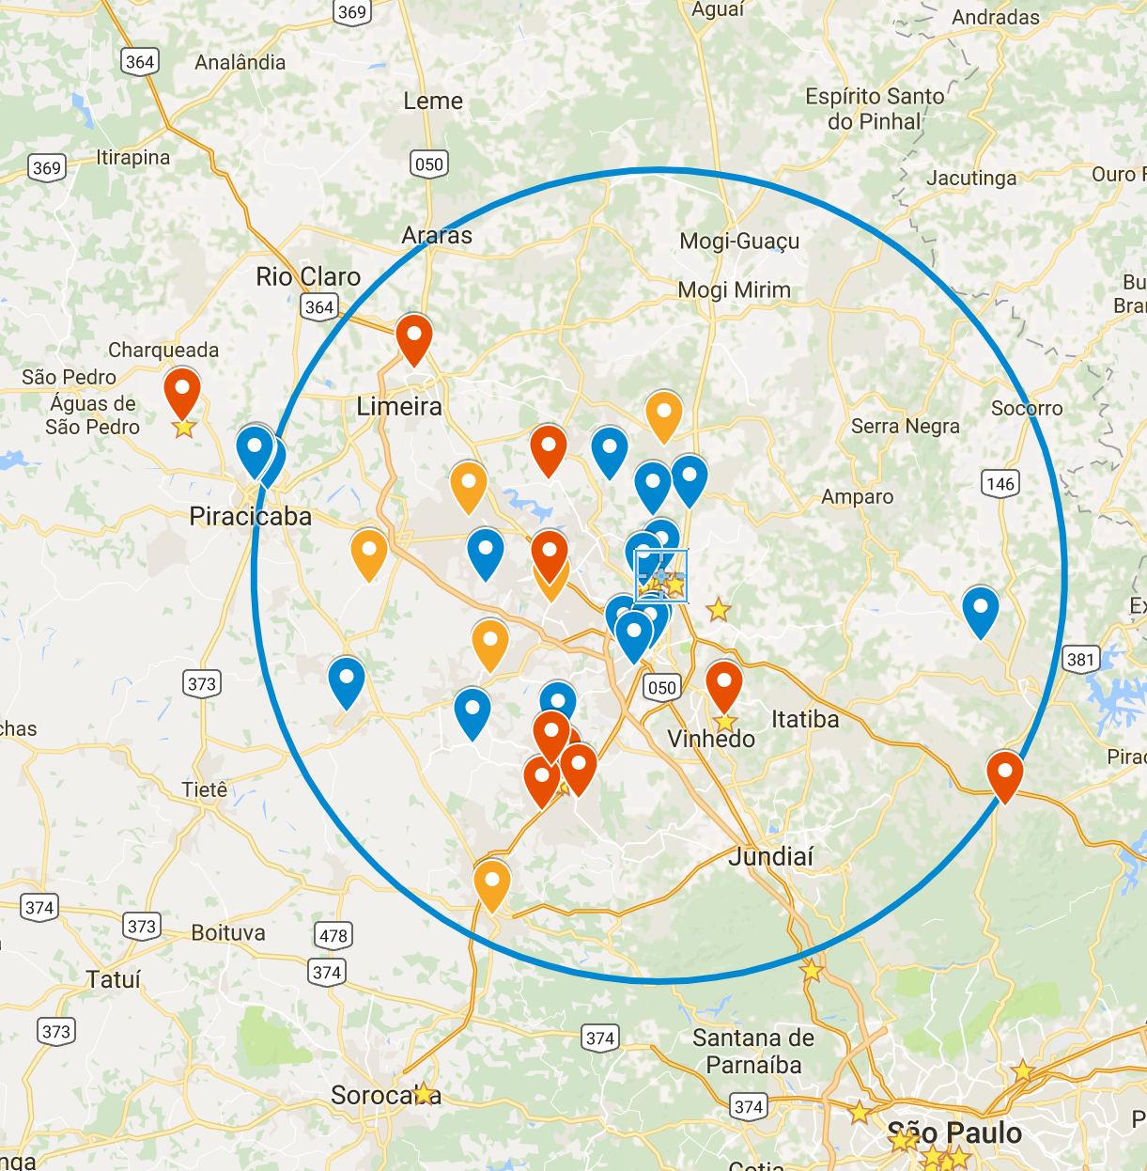
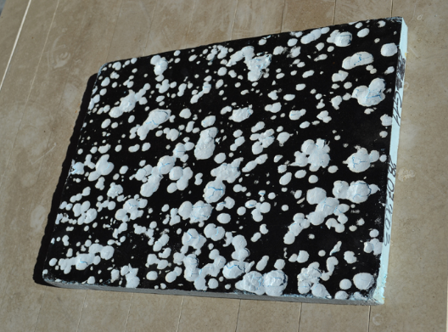
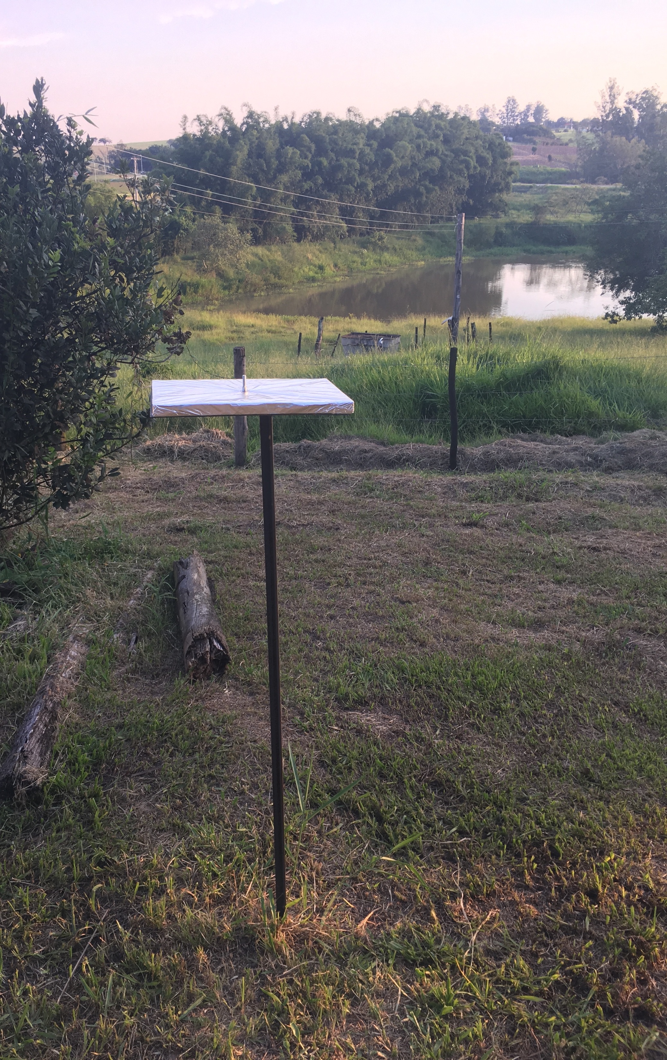
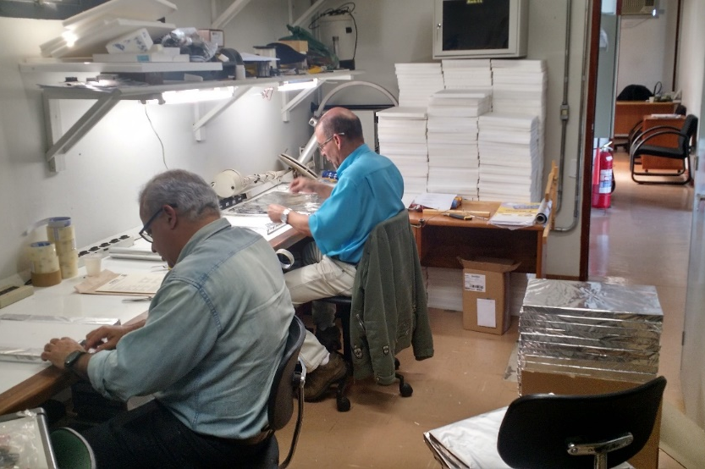
Instruments
What is ”SOS-CHUVA”?
Hailpad network

Slide 11
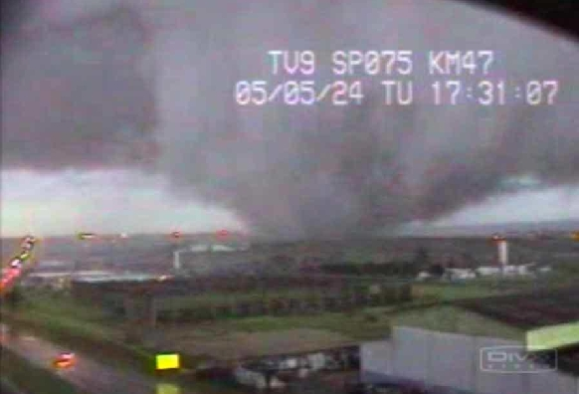
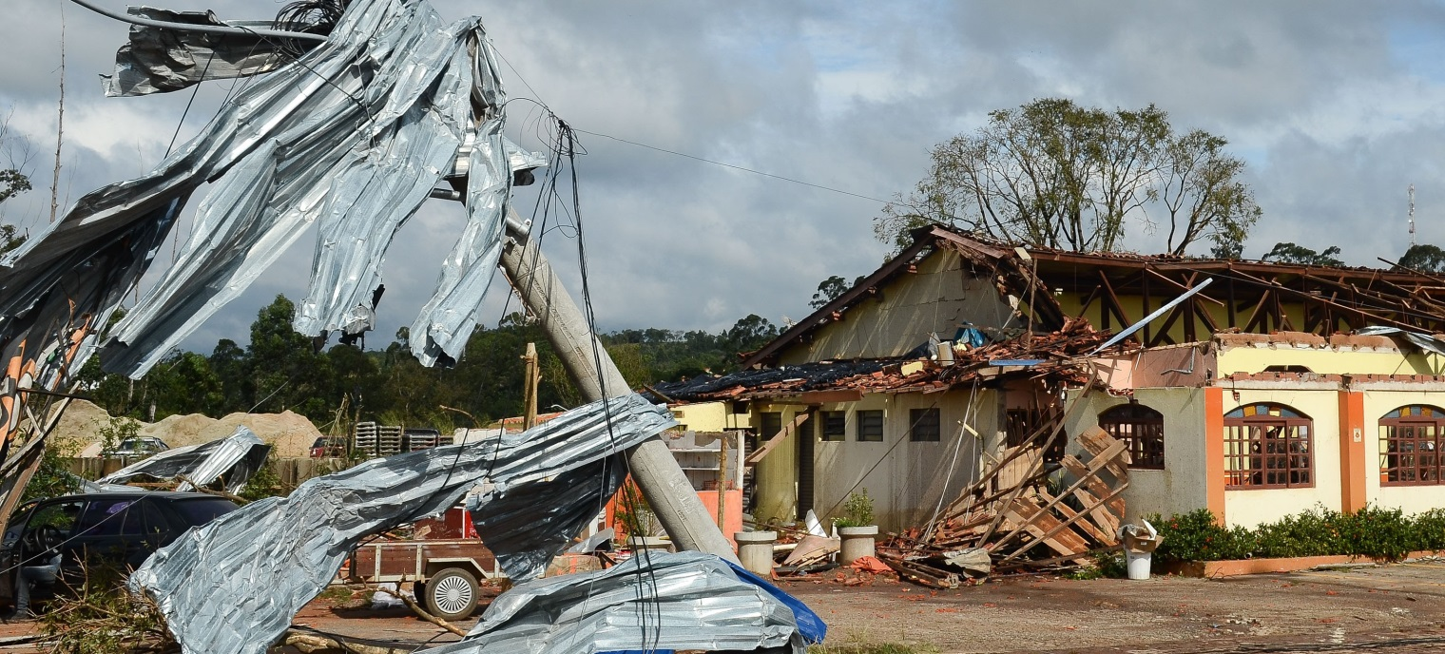
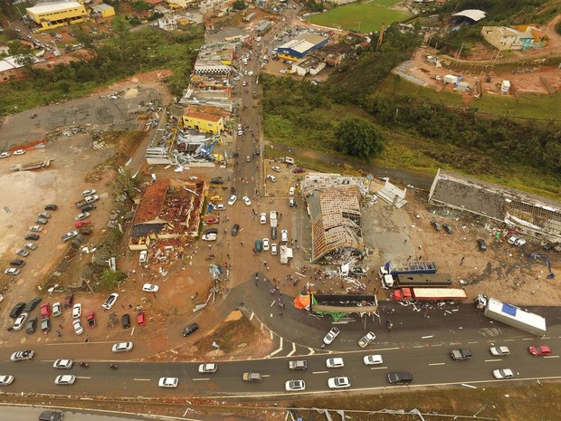
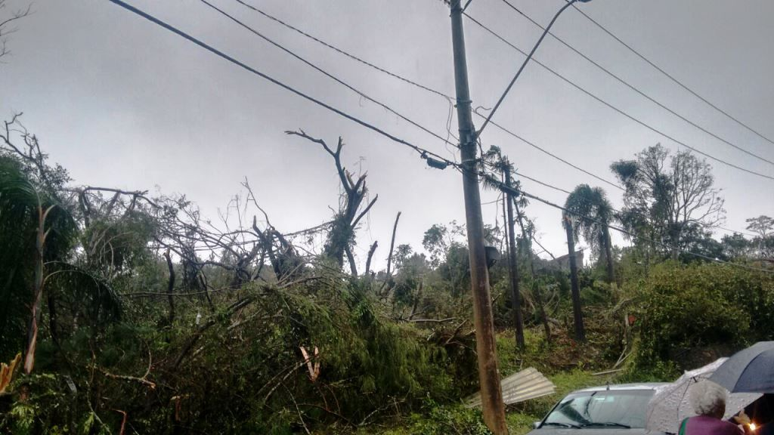
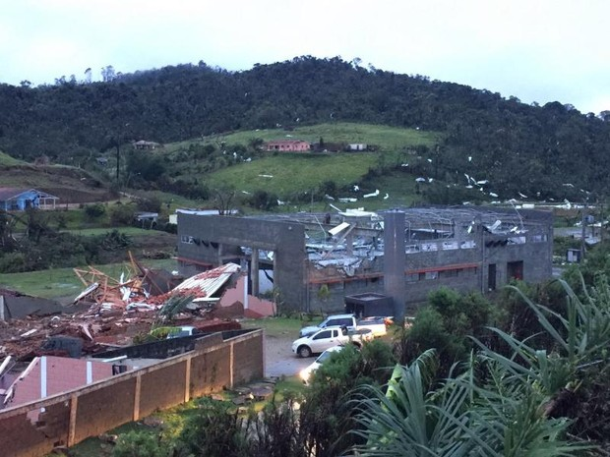
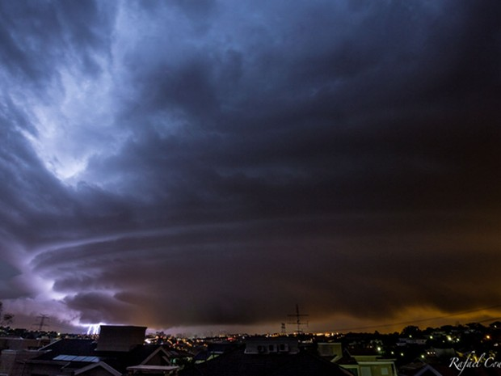
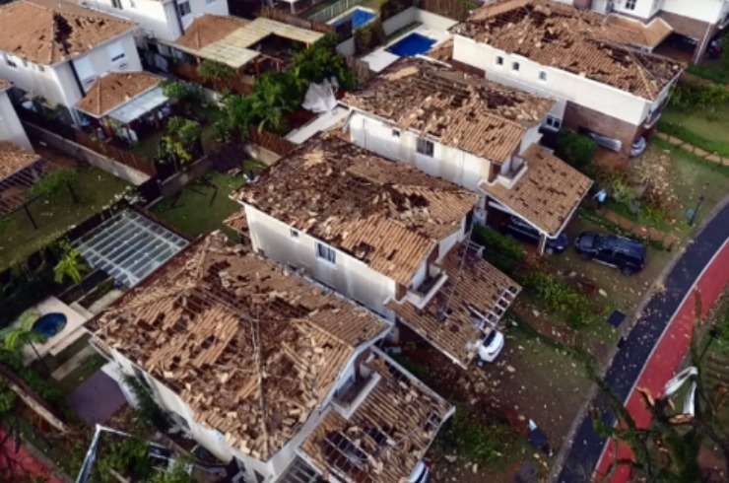
Why Campinas region?
What is ”SOS-CHUVA”?
This region is known for severe weather in state of São Paulo:
3-6 tornadoes reported per year
30 September 1991 – F3 tornado in Itu, SP
24 May 2005 – F1 and F3 tornadoes in Indaiatuba, SP
05 June 2016 (0330UTC) – Microburst in Campinas, SP
06 June 2016 (0045 UTC) – F3 tornado in Jarinú, SP
06 June 2016 (1840 UTC) – F2 tornado in São Roque, SP

Slide 12
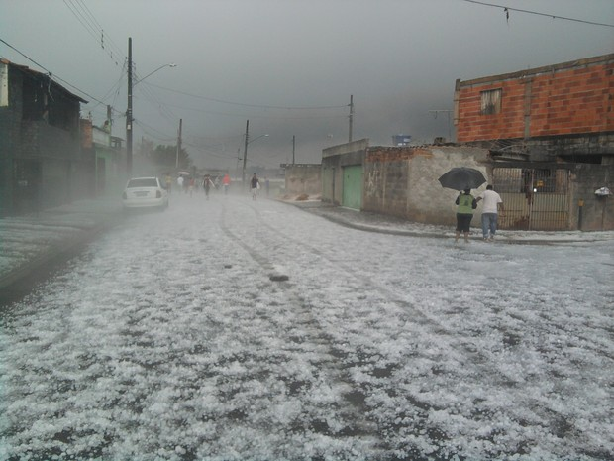
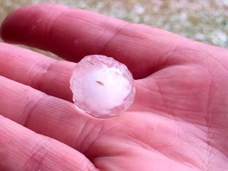
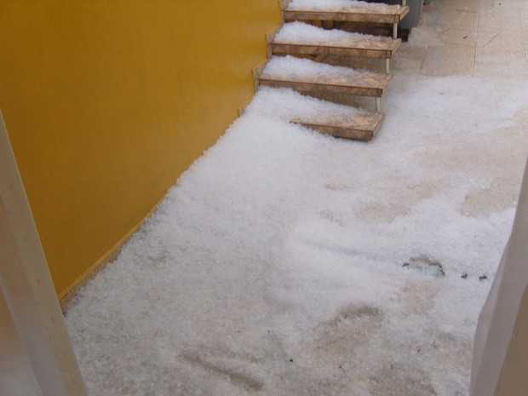
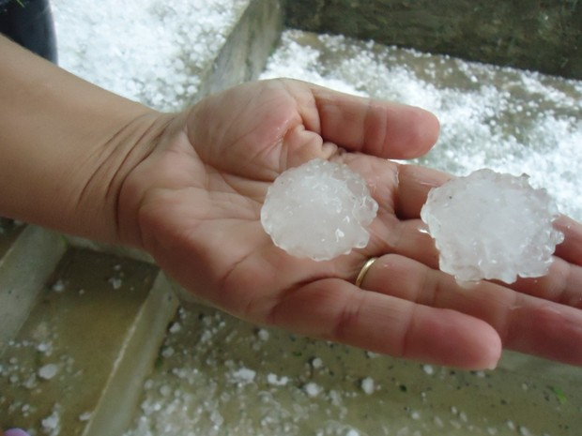
Why Campinas region?
What is ”SOS-CHUVA”?
This region is known for severe weather in state of São Paulo:
30 to 60 days per year with hail

Slide 13
GLM monitoring during SOS-CHUVA
Series of plots:
Only flashes with ”quality flag”=1
(2-D histogram)
(1-D histogram)
Hour (UTC)
Hour (UTC)
Day of month
Frequency
(1-D histogram)
Latitude (º)
(Density map)
Frequency
Day of month
Longitude (º)

Slide 14
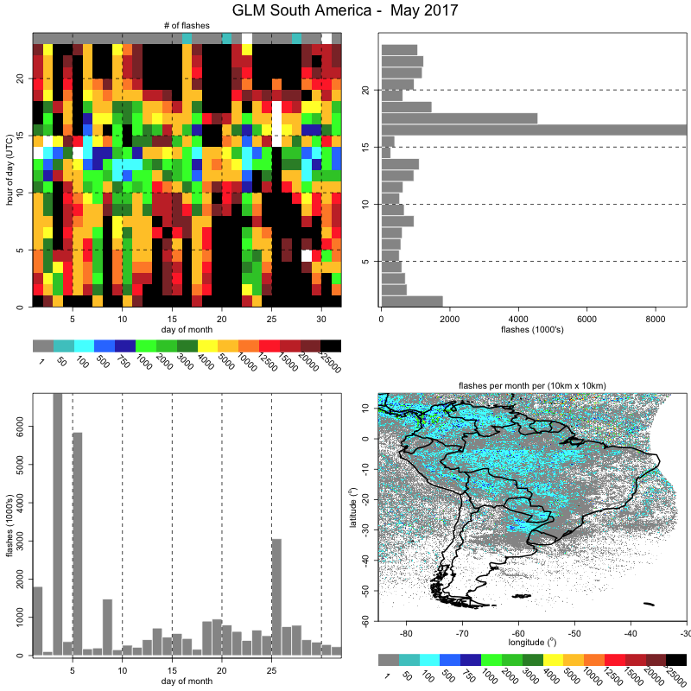
16 UTC
MAY (GLM flashes)
Longitude Band with missing data

Slide 15
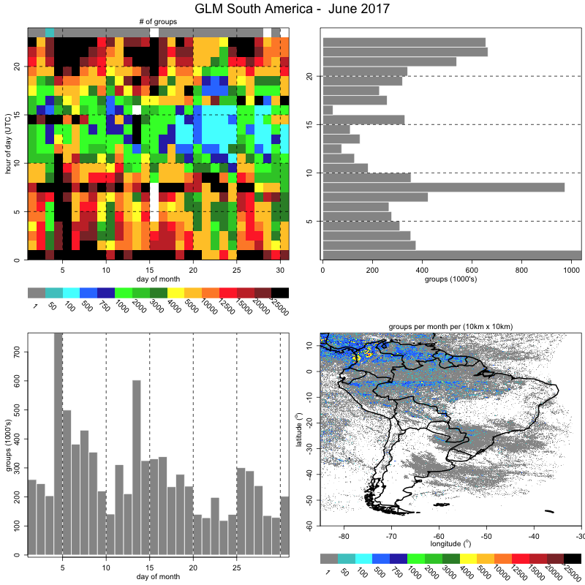
08 UTC
00 UTC
JUNE (GLM flashes)
Longitude Band with missing data

Slide 16
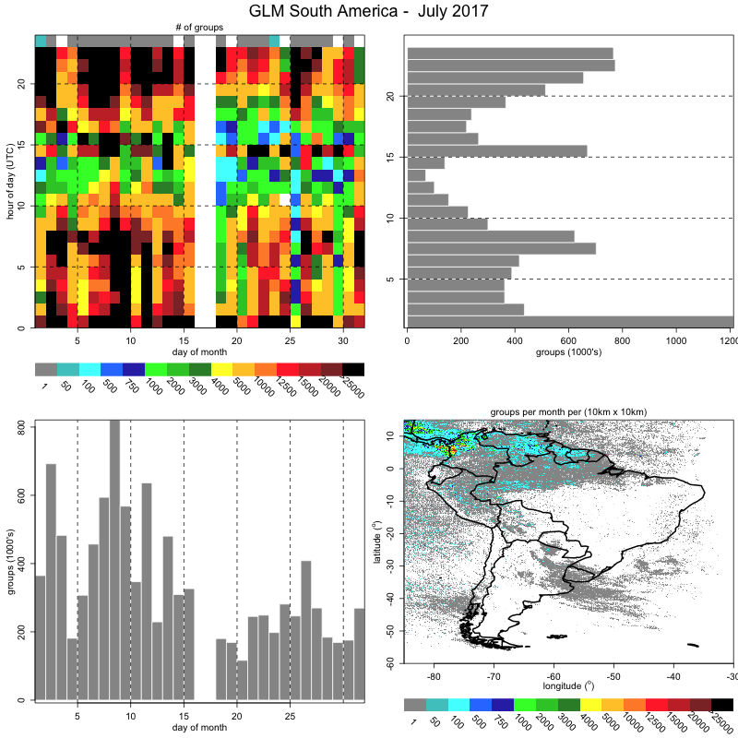
15 UTC
07-08 UTC
00 UTC
JULY (GLM flasnes)
Longitude Band with missing data

Slide 17
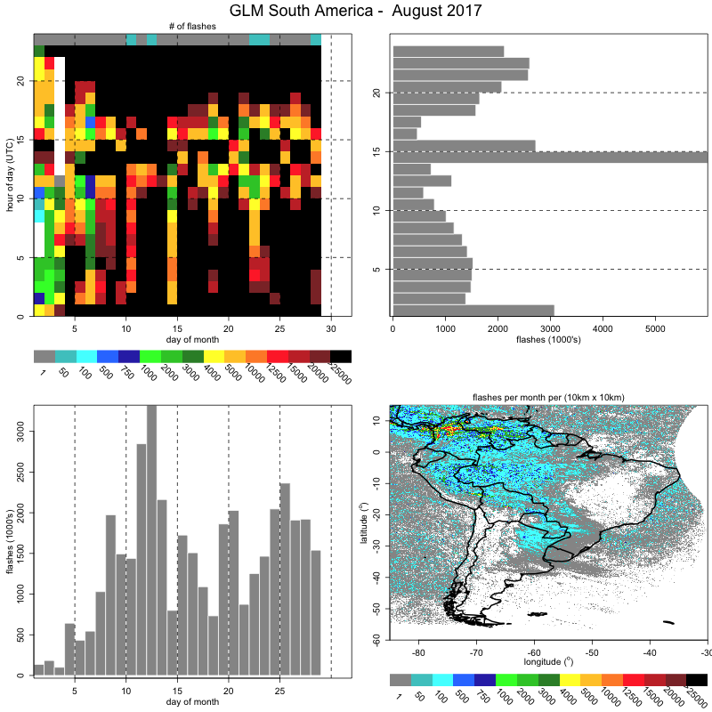
15 UTC
00 UTC
AUGUST (GLM flasnes)
Longitude Band with missing data

Slide 18
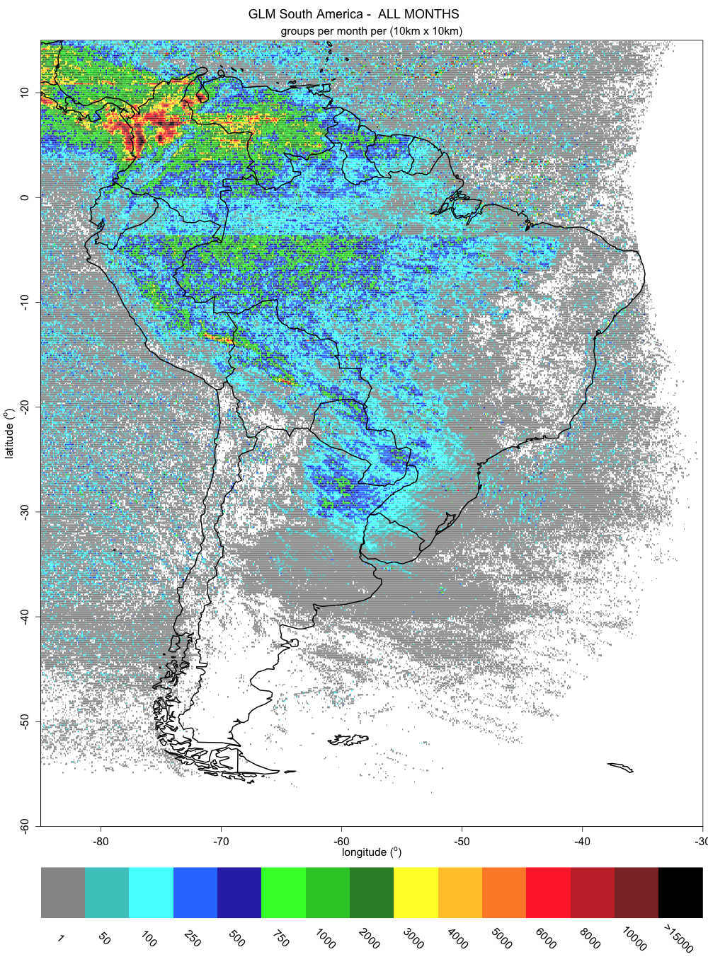
Longitude Band with missing data

Slide 20
Stripes (?)
Longitude Band with missing data

Slide 21
Close-up at SOS-CHUVA research area
200km

Slide 22
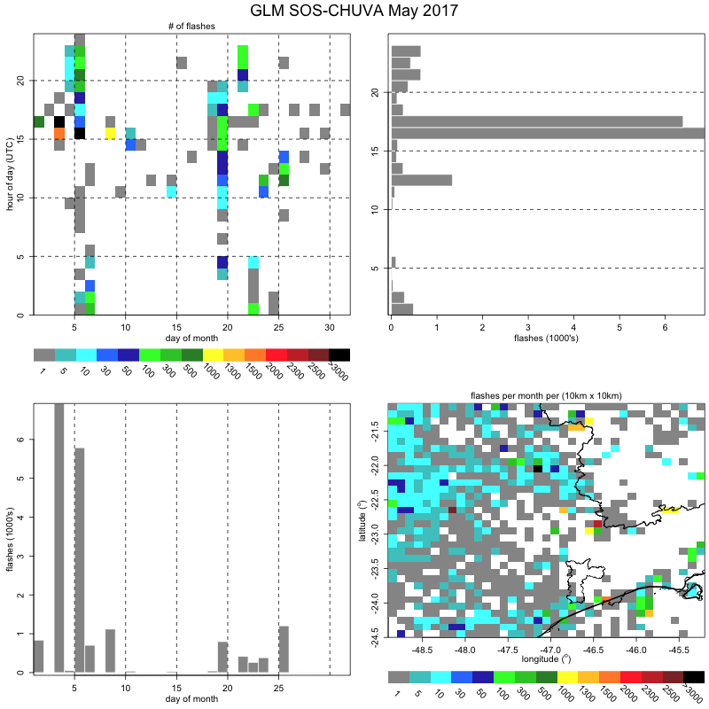
MAY - GLM flash data

Slide 23
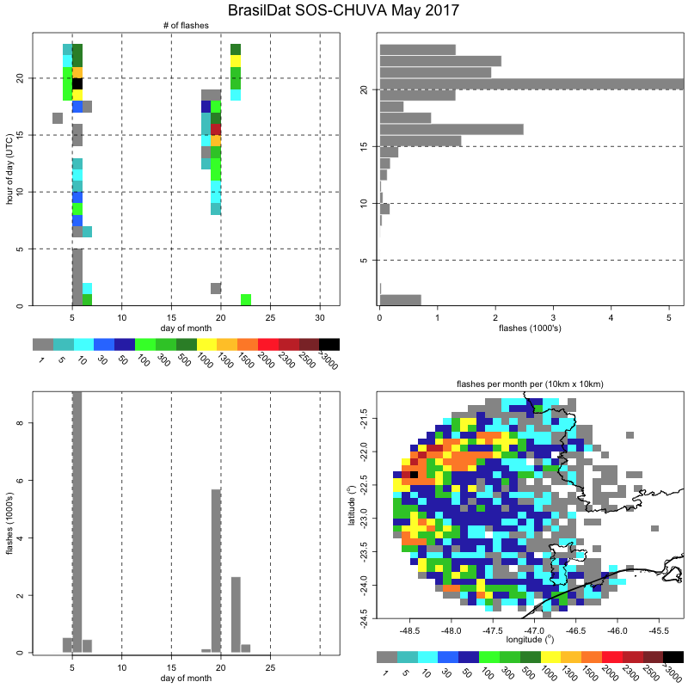
MAY - BrasilDat

Slide 24
MAY
JULY
+GLM
+BrasilDat
JUNE
AUGUST

Slide 25
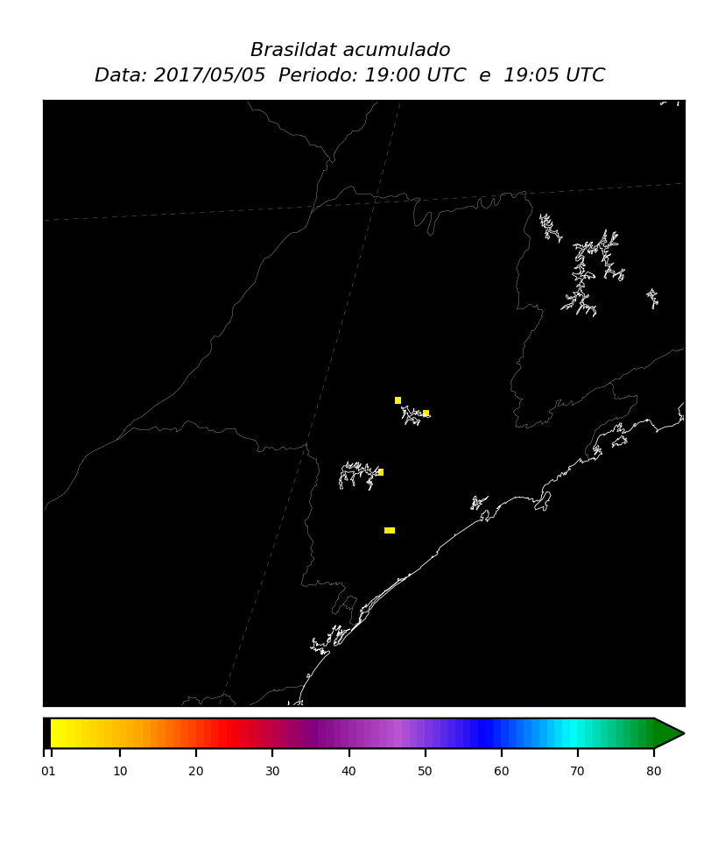
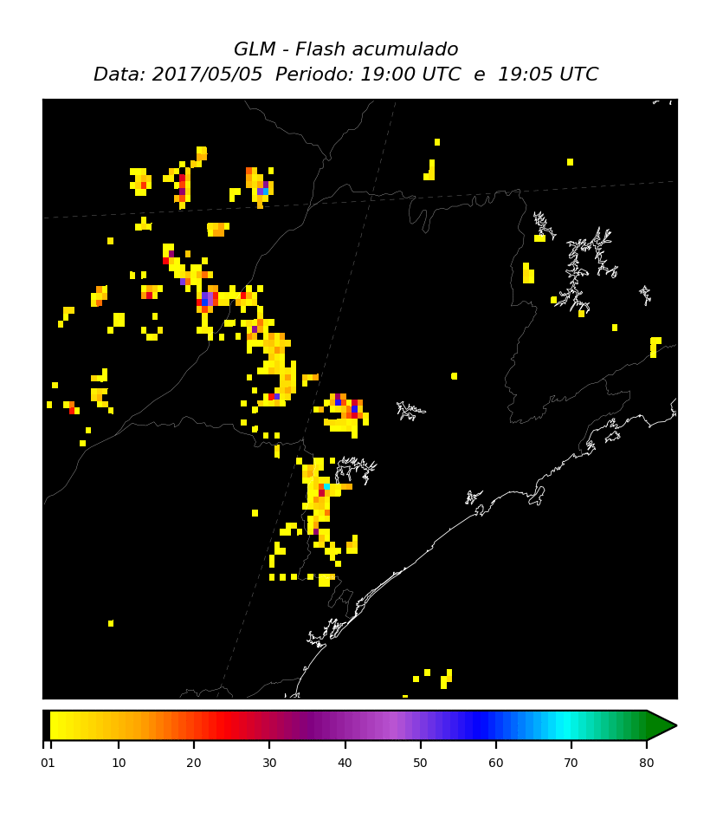
Squall line – 2017-05-05 (small hail in São Paulo)
BrasilDat area with data
Courtesy of João Chinchay

Slide 26
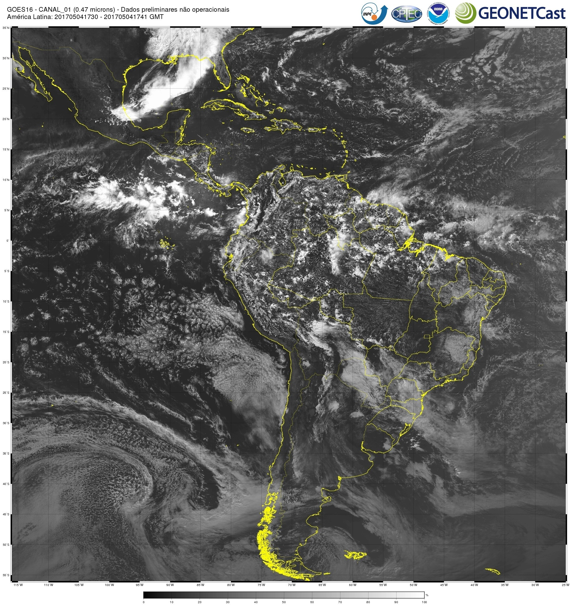
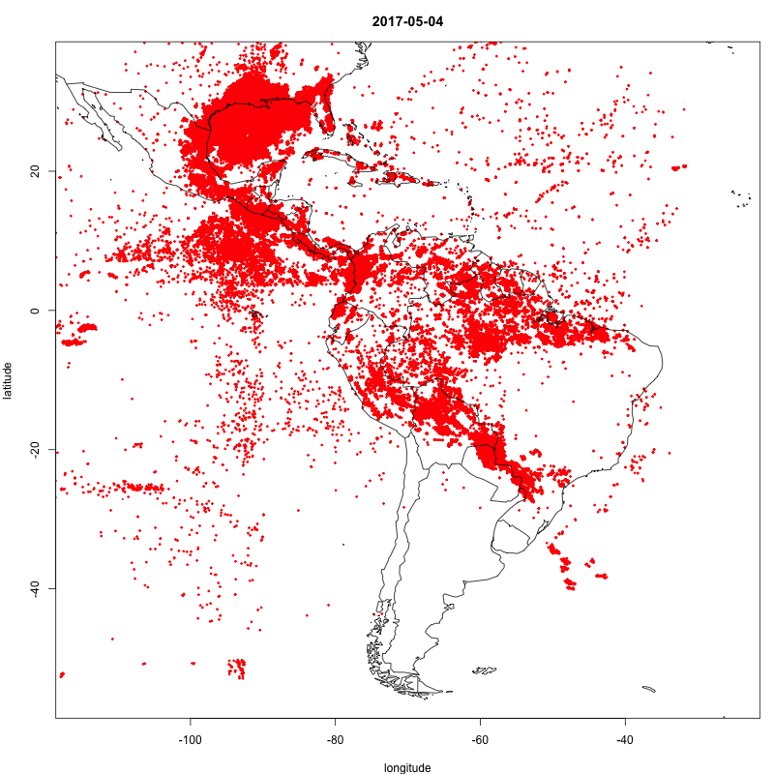
”weird arc cloud” in South Pacific – 2017-05-04

Slide 27
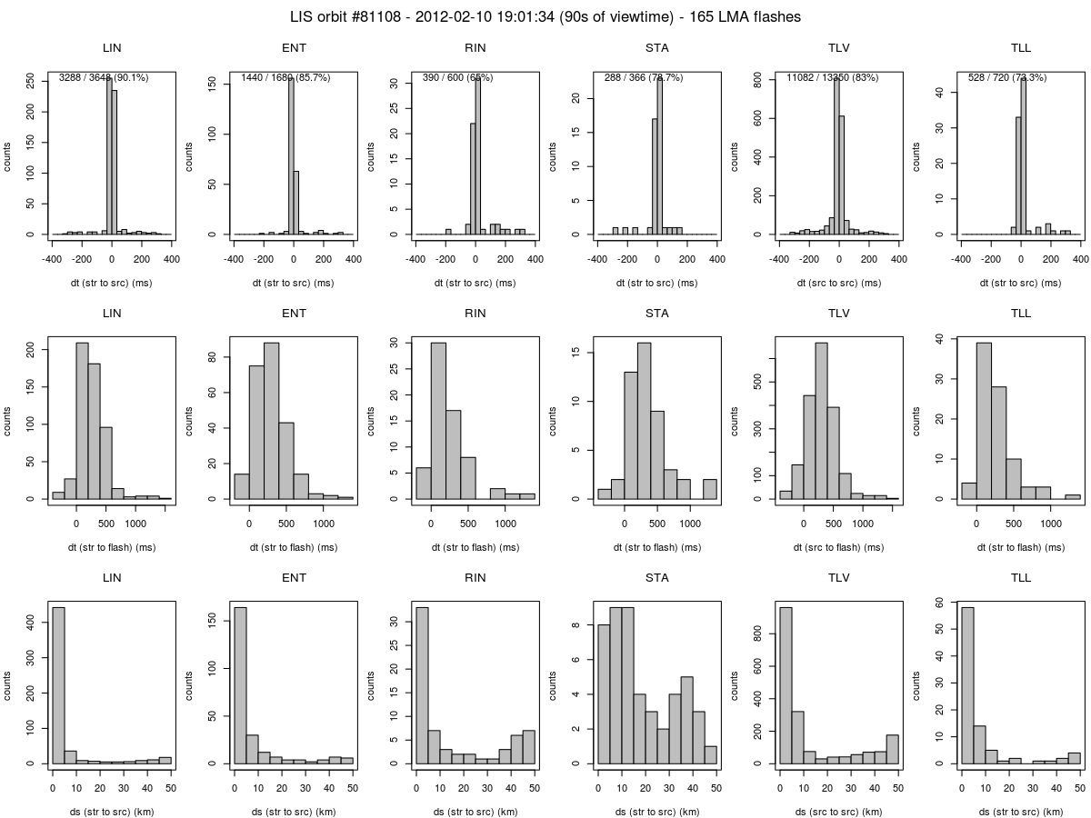
Future: GLM on SOS-CHUVA web page
Basic Cal/Val web page updated daily with histograms
Real time intercomparison
Number of strokes/flashes/groups
Monitor:
Δt entre flashes/groups e strokes
Δs entre flashes/groups e strokes

Slide 28
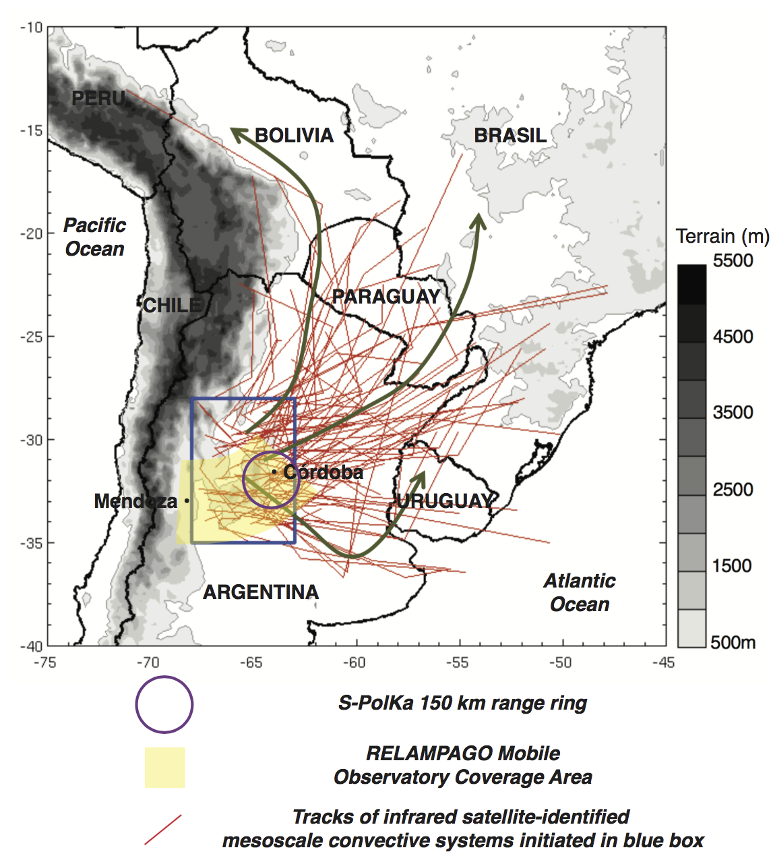
Future: SOS-CHUVA during RELAMPAGO
LMA in
São Borja, RS
( + XPOL radar, disdrometer, MRR)
LMA in
Córdoba, AR
LINET in
North Argentina
Courtesy of Luciano Vidal and Paola Salio

Slide 29
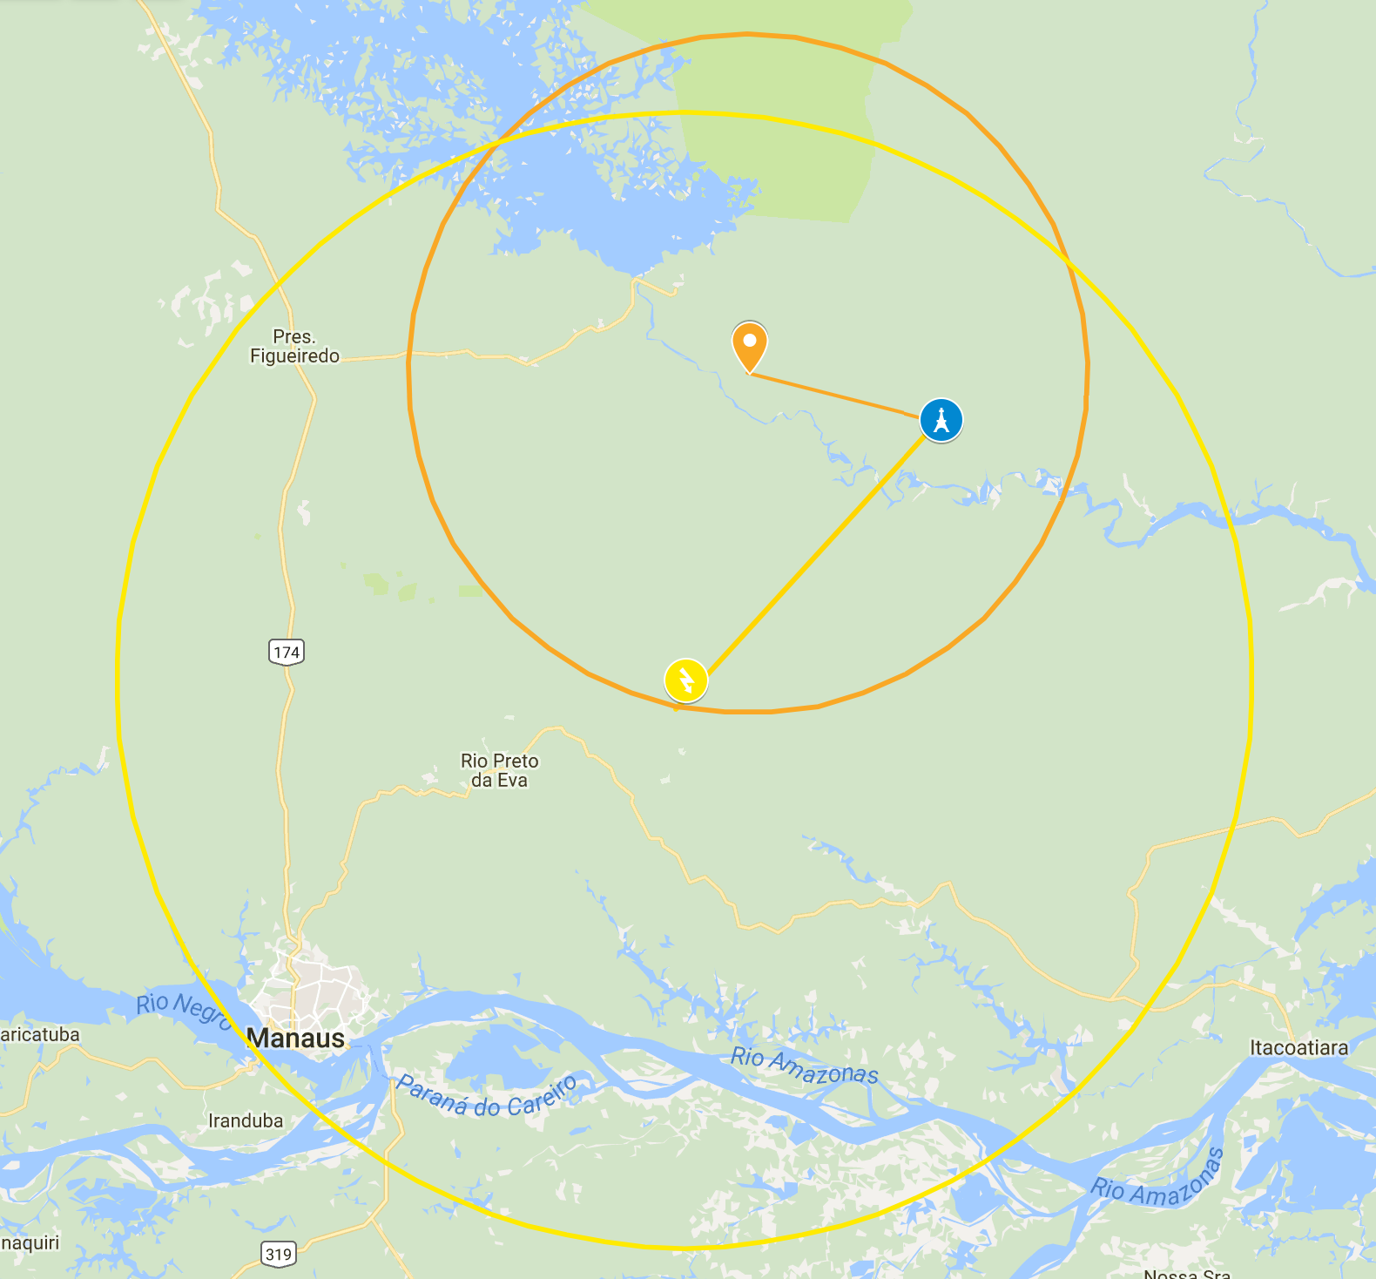
Future: LMA in the Amazon (for ~3 years)

Slide 30
Thank you!

