Slide 1
GLM Performance Review and
Post Launch Test Results
GLM Science Meeting
12 Sept 2017
Samantha Edgington and Clem Tillier
Lockheed Martin Advanced Technology Center, Palo Alto, CA
© 2017 Lockheed Martin Corporation. All Rights Reserved.

Slide 2
Agenda
Data highlights
Post Launch Test
  Image quality
  RTEP thresholds
  Solar intrusion
  Event filter and navigation parameter tuning
Long term trends
GLM performance
  DE / FAR estimates
  Navigation performance
  Calibration
  Impacts to performance from environment
Ground system validation
Future
  Data Quality Product
  Algorithm Enhancements
Questions for the Community

Slide 3

GLM data highlights
As of the day of this presentation, GLM has acquired 10.9 billion full disk images of the Earth

Slide 4
GLM data highlights
Event totals as of 2017-09-06
Lightning | 1.36e10
Mask | 2.08e9
2nd Level Threshold | 3.08e9
CCD Frame Transfer | 5.73e7
Radiation | 1.73e9
Coherency Fail | 1.98e9
Contrast Leakage | 7.63e9
Glint | 4.26e7
Burst | 1.66e8
Crosstalk | 2.54e6
Overshoot | 1.19e9
Noise time-out | 4.91e10
TOTAL | 8.07e10

Slide 5
GLM data
Every day, GLM sees about 50 million lightning events and about 1 million lightning flashes

Slide 6
GLM data
Hurricane Irma showed spectacular “Ring of Fire” eyewall lightning

Slide 7
Post Launch Test Overview
Each post launch test module is fully documented in CDRL121 PLT Report
PLT Follows Signal Chain:
Electrons → DN
DN → Events (downlink) Events → Level 1b Lightning
Instrument tuning completed
GLM-001
1/4 - 1/7
GLM-007
1/7 - 2/21
GLM-002
12/19 - 4/20
GLM-003&004
4/20 - 5/5
GPA Parameters are due to be loaded in ground system September 2017
12/9/16
1/4/17
Assess Image Quality
On-Orbit Cal
Tune RTEPs
Tune Ground Processing Algorithms
Normal Mode
Open
Door
Hand-off
to PLPT
First Light
GLM-INR-001&002
2/9 - 5/12
PS-PVR
6/9/17
GLM-006
2/27 - 4/18
We tuned thousands of parameters in the flight hardware and ground processing algorithms. They were delivered under CDRL079 Calibration Data Books (currently at Revision H)
Tune Coastline ID and Event Navigation
Assess Eclipse Stray Light Effects
(x,y) to (lat, lon)

Slide 8
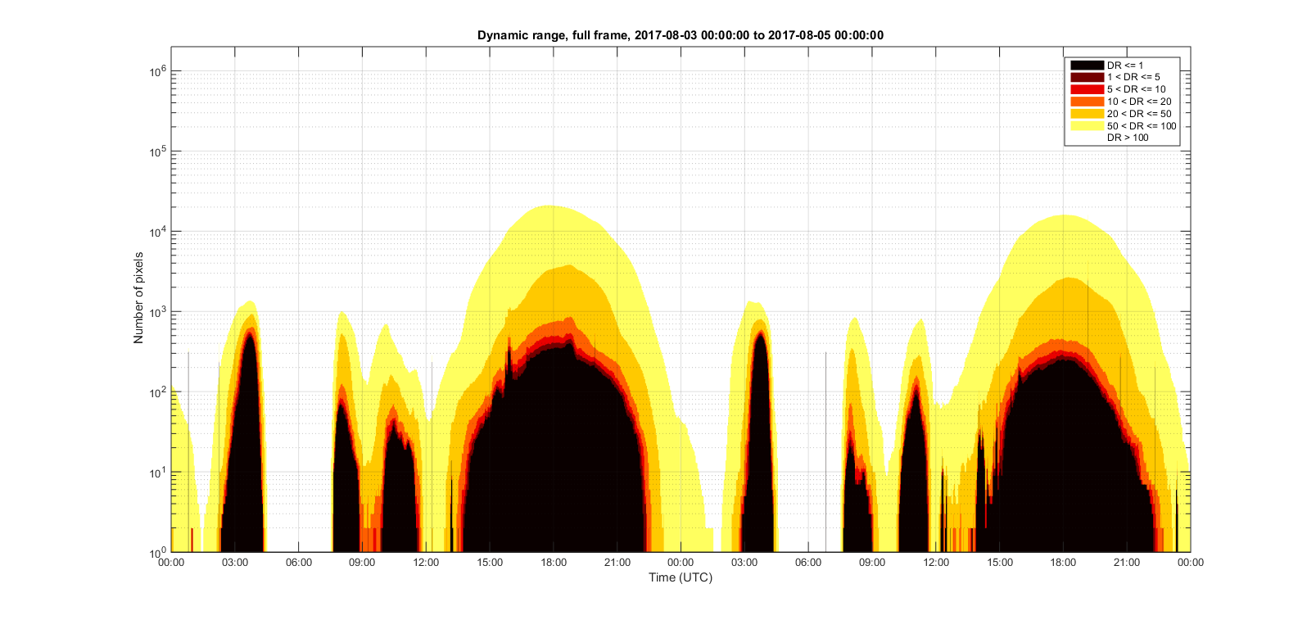
Image saturation statistics (1 of 2)
Example: 2 days of saturation statistics. Dynamic Range = headroom to saturation / threshold
GLM has 1.8
million pixels
Noon. ~300 pixels saturated, primarily from overshoot
DR <= 1 means
no lightning detection
Sunrise glint, primarily from blooming
Note log scale
Sunset glint, primarily from blooming
Night time
Night time
2017-08-03
2017-08-04

Slide 9
Image saturation statistics (2 of 2)
This plot shows ~5 months of saturation data. On average, ~330 pixels are saturated at noon.
Eclipse stray light blooming
Sunset glint
Sunrise glint
Noon
Dropped packets
Midnight
Each blue dot = one GLM background frame

Slide 10
RTEP threshold evolution during PLT
Once on orbit, the thresholds were tuned to account for the complex Earth scene and on orbit conditions
Thresholds were significantly lowered at high backgrounds
  Lower thresholds = greater DE than pre-launch predictions
Maximum event rate now at ~10,000 per second – excluding blooming and maneuver events
  There is room for further performance improvement by lowering thresholds
Ground test thresholds
Final PLT iteration (April 20th)
These are average thresholds across all 56 channels

Slide 11
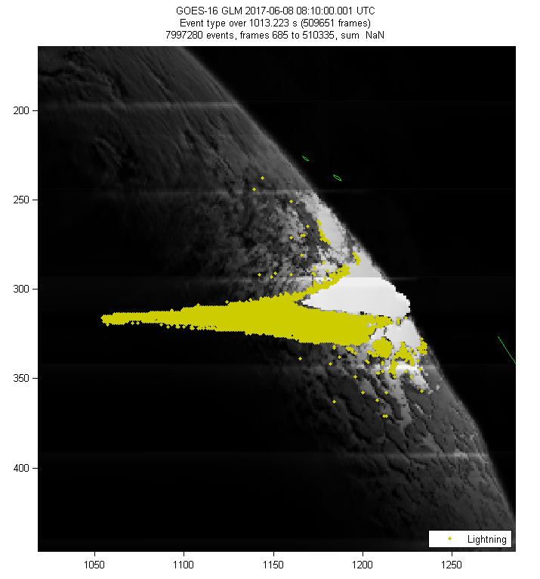
Blooming due to solar glint
The solar disk is ~50,000x brighter than the brightest clouds GLM observes
Solar glint occurs from specular reflections on bodies of water. The sun does not directly illuminate GLM optics.
  Sunrise
  Rivers, lakes, and calm oceans
  Sunset
The specular reflection from a ~200 m wide river can temporarily saturate a GLM pixel. This is a feature of the detection method of GLM
  Users can be advised via future GLM data quality product
17 minutes of sunrise glint
~8 million “lightning” events
Greatest extent of
blooming over 17 min.
Bloomed pixels
(no events)
Blooming false events
(yellow dots) occur
on edge of charge “puddle”

Slide 12
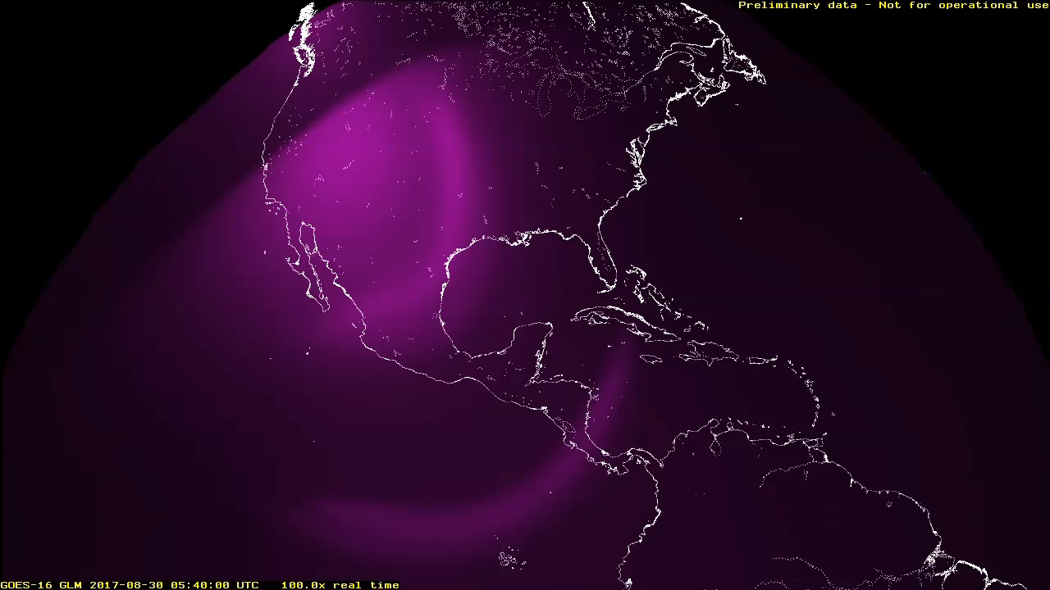
Solar intrusion (GEO eclipse season)
Solar intrusion is when the sun shines directly into the GLM optics, near sub-satellite midnight during “eclipse season”
MAGENTA = background (updated every 150 seconds)
GREEN = events, including fronts of blooming false events. Normal event detection continues, to the extent allowed by data overflows.
Most (not all) blooming occurs inside ZRDQ (Zones of Reduced Data Quality)

Slide 13
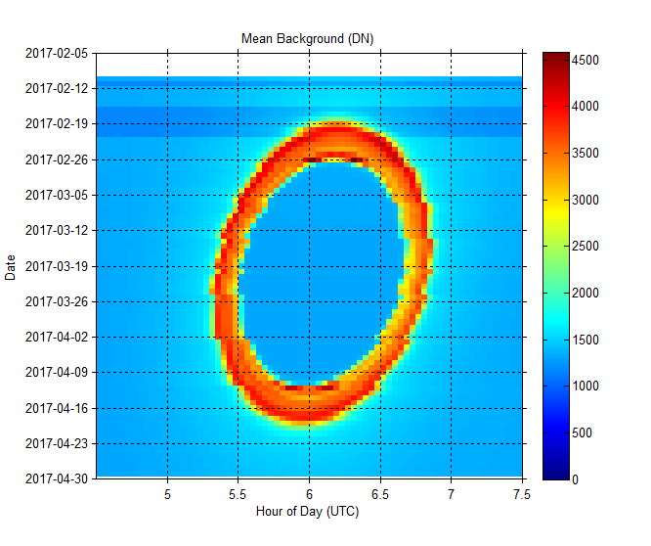
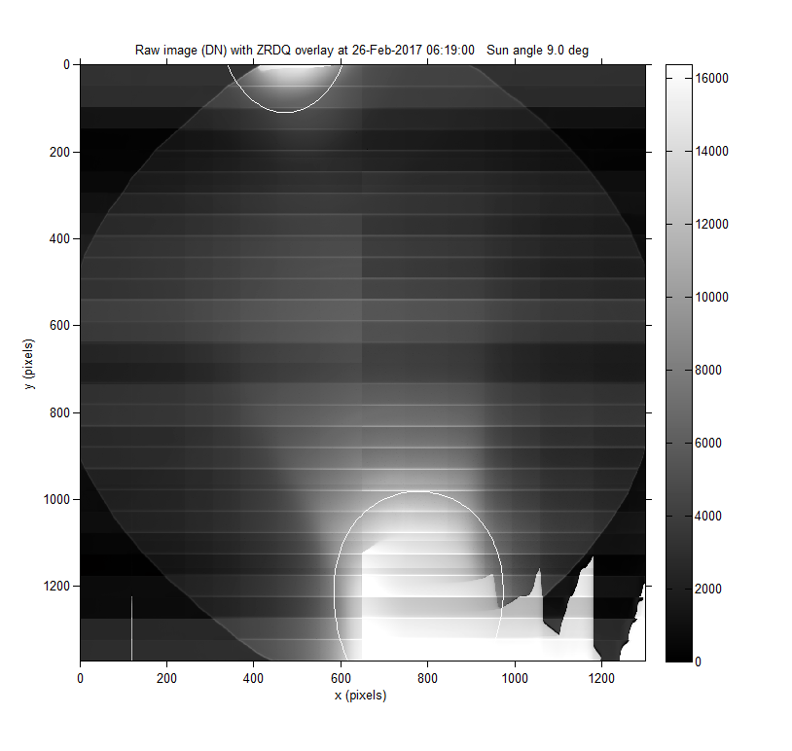
Spring 2017 solar intrusion statistics
Overview of Spring 2017 eclipse season.
The worst effect on GLM is during grazing passes (just before and after eclipse season)
The worst-case observed intrusion in Spring 2017.
Lightning detection continued unabated outside of bloomed areas.

Slide 14
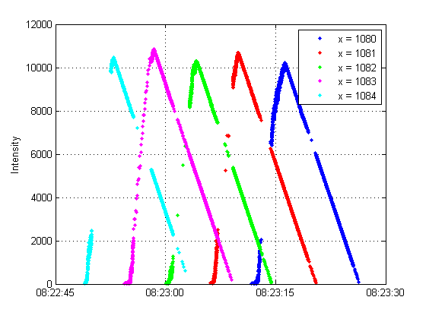
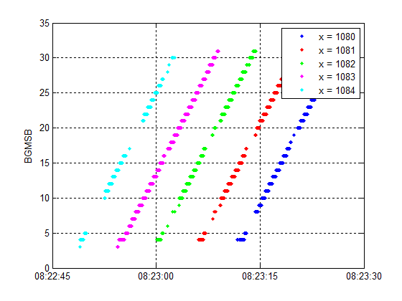
Blooming false events
Whether from glint or direct solar intrusion, blooming has a very distinct signature in GLM event data
Event Intensity (DN)
Event Background (5 MSB)
Example: events occurring in 5 pixels during a 45-second time span
The “puddle” of bloomed charge is advancing at 1 pixel every 6 seconds
Each pixel goes from normal to bloomed in about 15 seconds
Blooming events currently pass the coherency filter to become lightning. However, their distinct signature lends itself to being picked up by a new blooming event filter

Slide 15
GPA parameters
False event filters
  During PLT we set the parameters for the ground processing algorithms
  On-orbit data essential for setting algorithms for a new instrument
  Coherency filter does the heavy lifting – need to balance DE vs FAR
  Extremely stable platform lessens the need for contrast leakage filtering
Navigation
  Navigation depends on identifying and registering coastlines in the background images
  Set the parameters to perform this registration with on-orbit backgrounds
Ground system is not yet using final GPA parameters

Slide 16
Trend data
All telemetry data is processed for trending metrics. We ingest the entire L0 data stream with no bits left behind.
Diurnal cycle of the lightning event rate is offset from the noise event rate – as expected
Navigation trending shows the GLM offset angles have a stable and predictable diurnal cycle

Slide 17
Lightning detection performance
Predicted DE using:
  On orbit thresholds, ground calibration data, & 1987 U2 data as “truth”
  No adjustments made for GPA removing true flashes – this will need to be evaluated during PLPT
  Expect significant updates during PLPT and comparisons to ground validation ER-2 flights
Mean = 86%

Slide 18
Lightning detection performance
Predicted FAR using:
  LM L1B implementation
  Single events isolated in time and space were considered false events
  Depends on GPA parameters which can be adjusted
Requirement for FAR average
FAR average

Slide 19
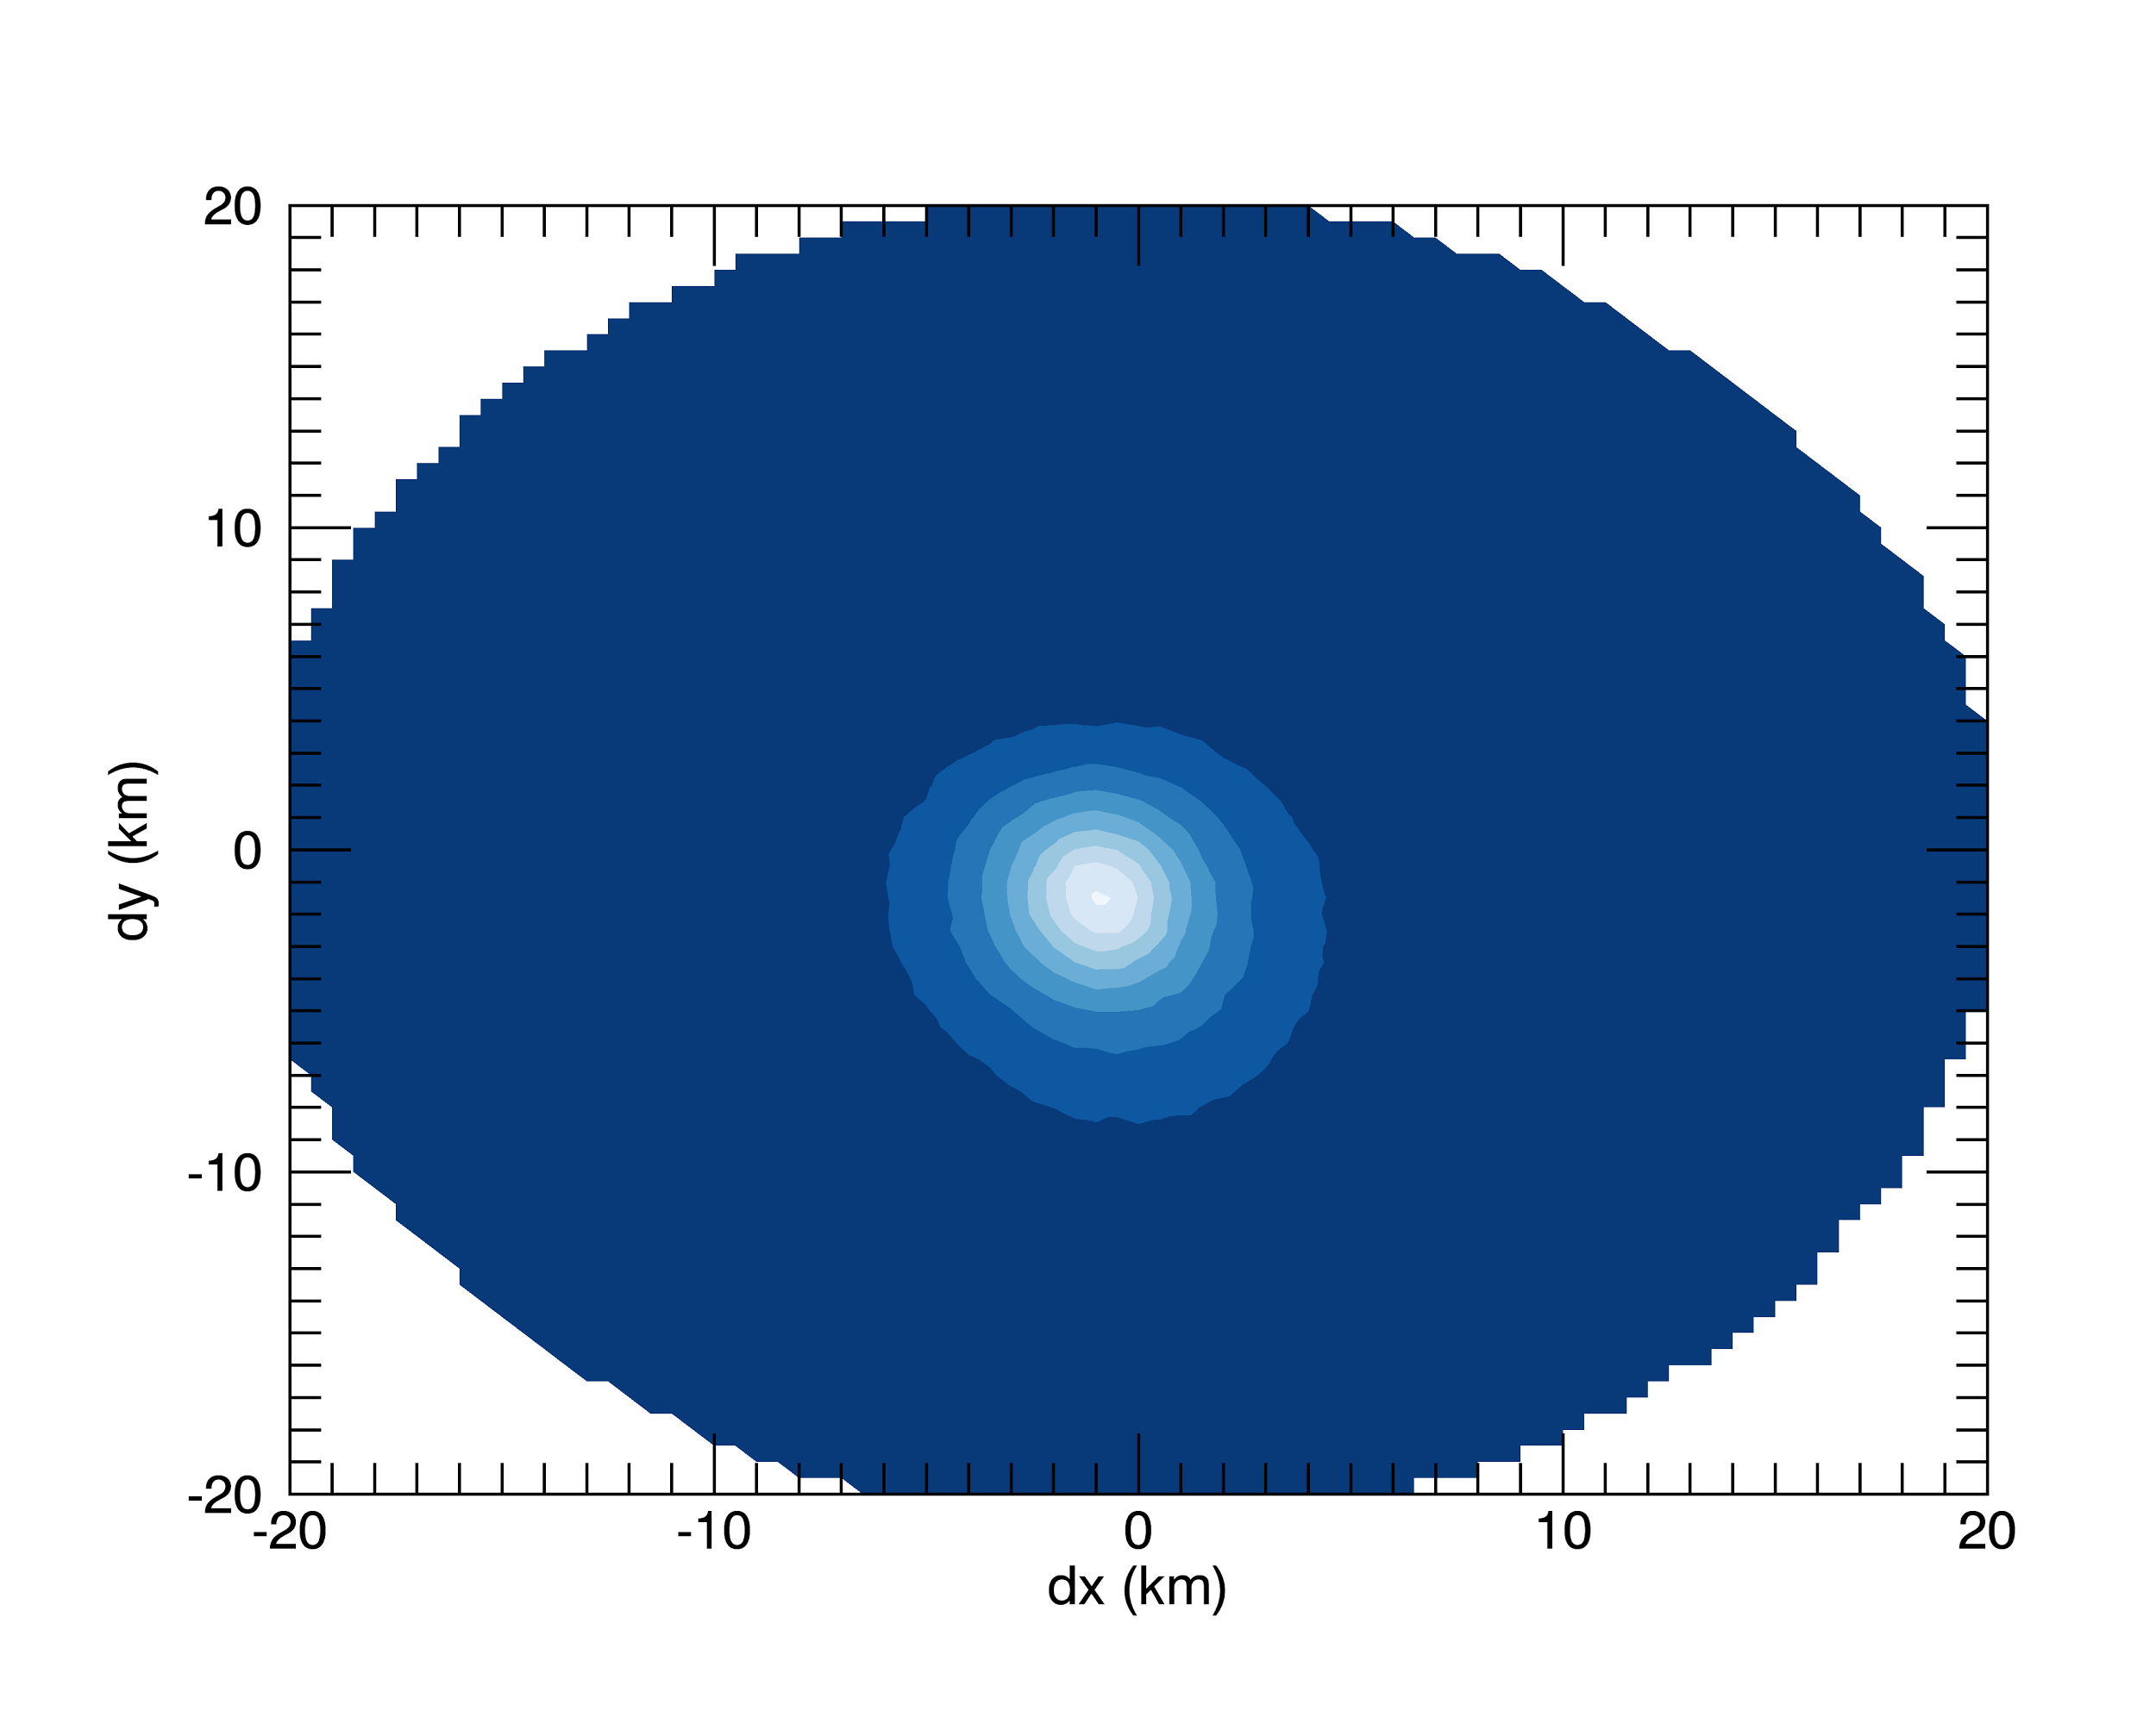
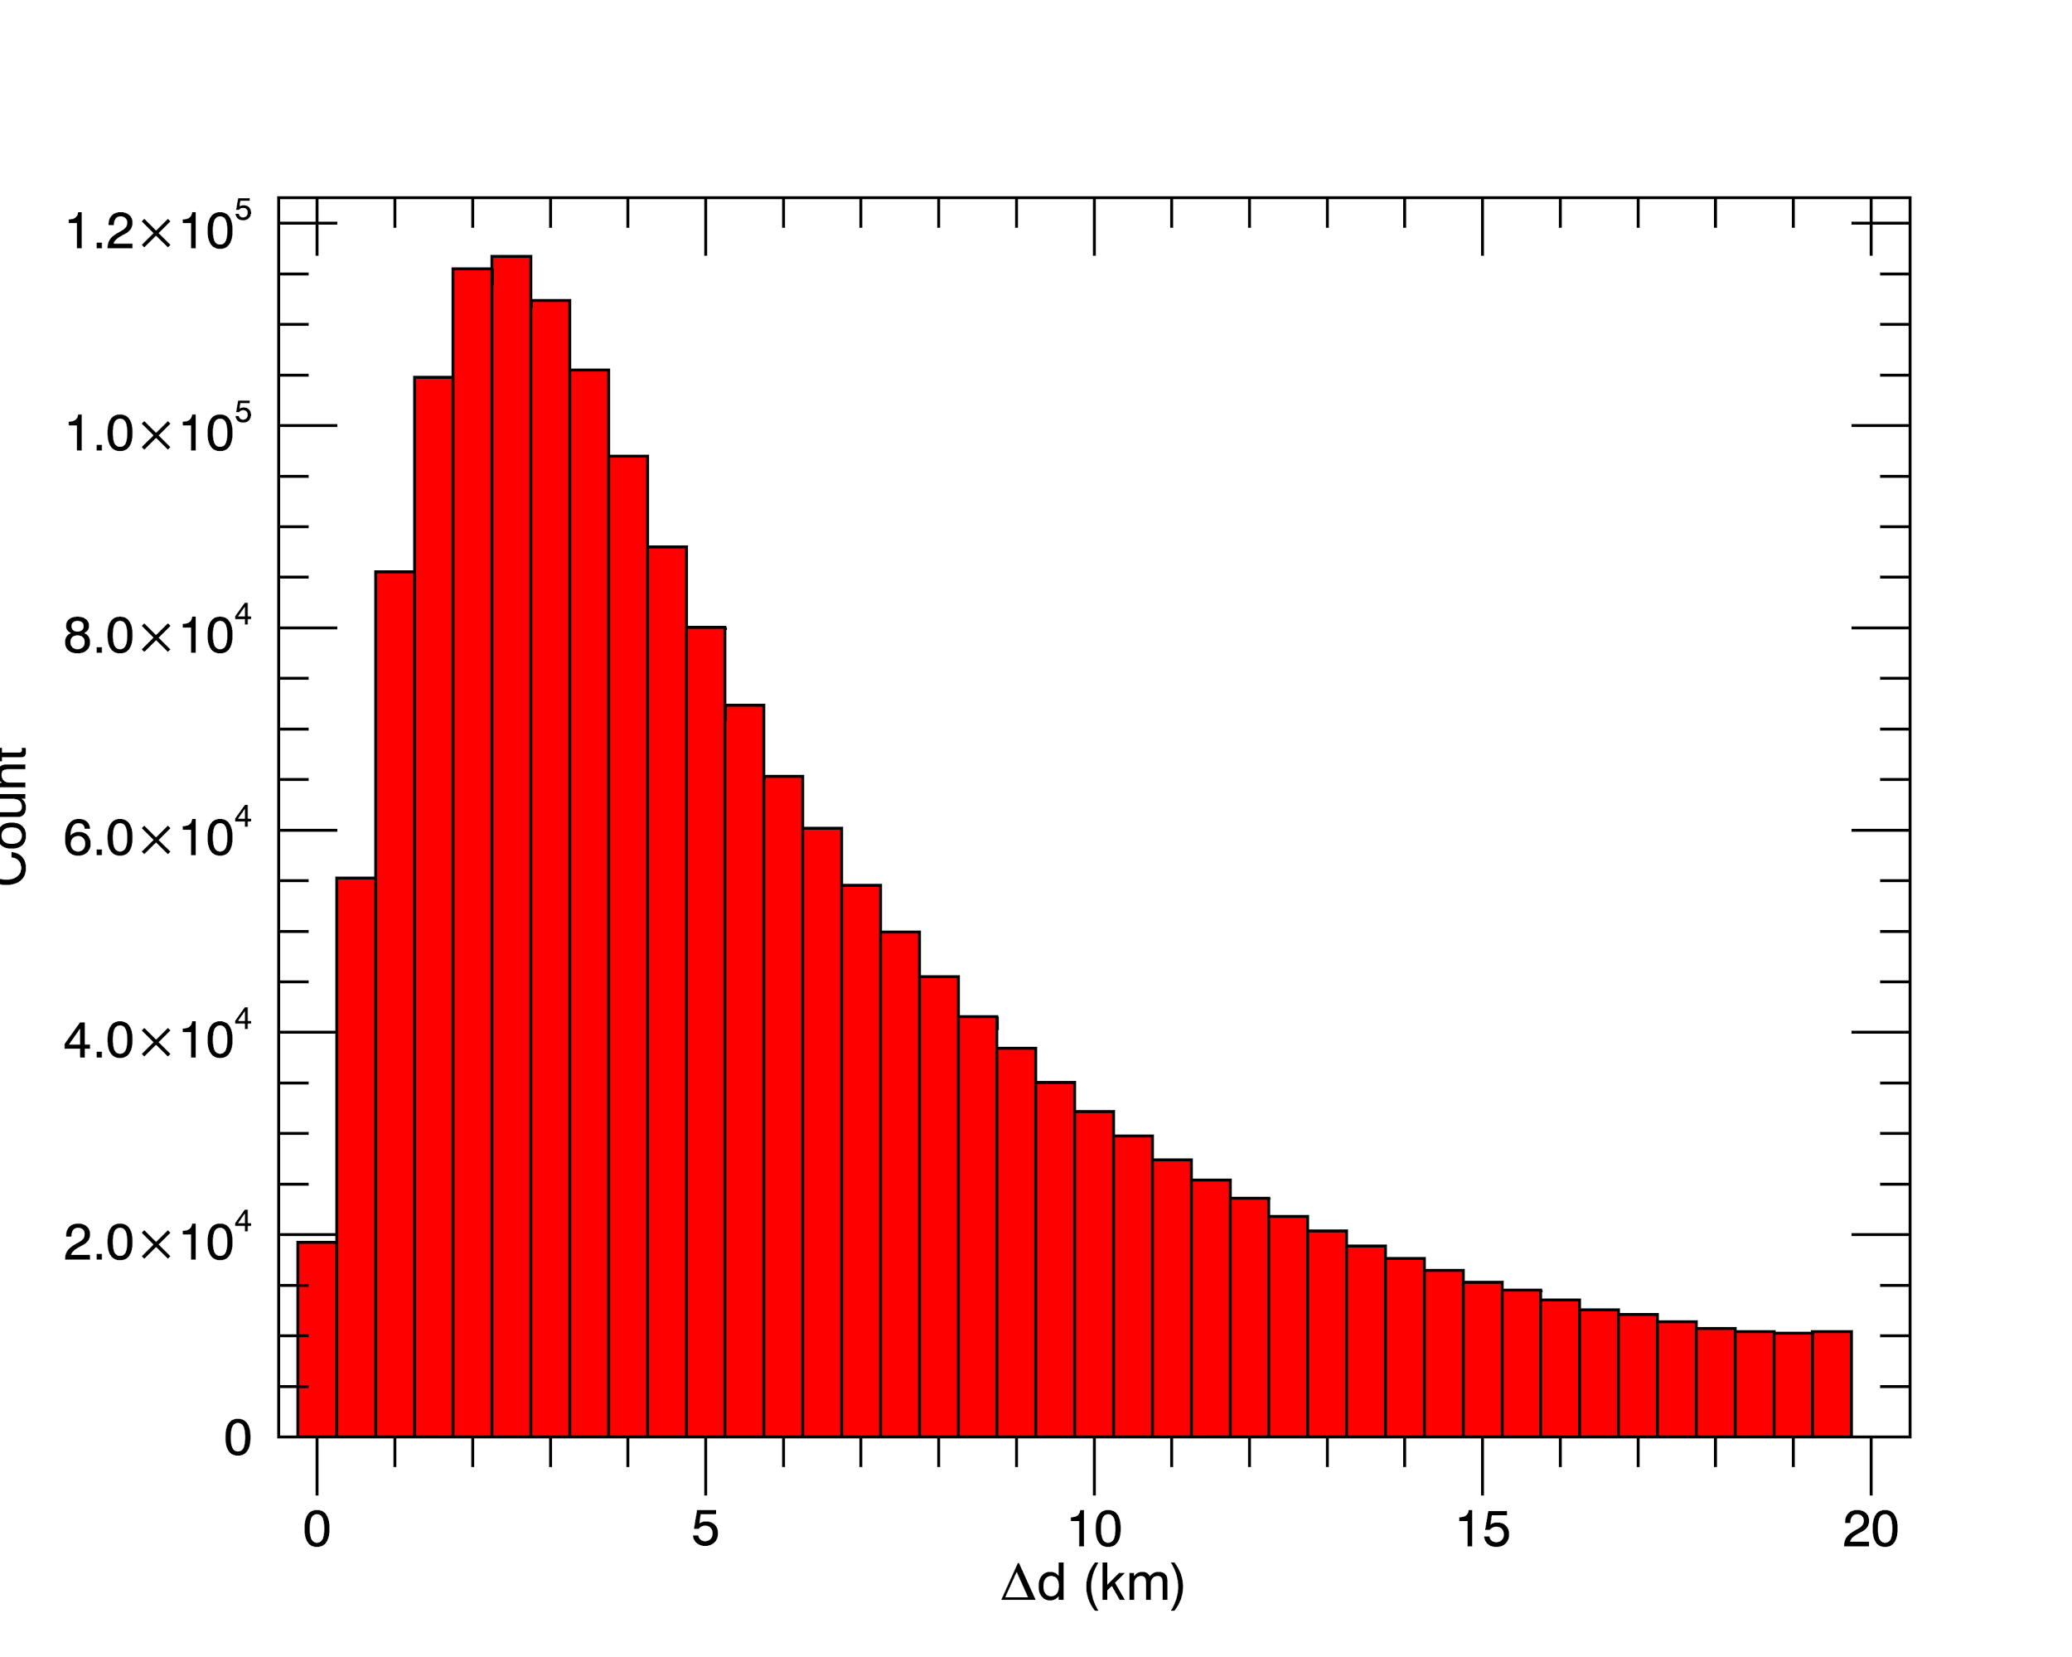
Navigation performance
Coastline registration achieves < ½ pixel navigation error
Error statistics referenced to ground RF detections include all of these:
1) GLM nav errors
2) ground nav errors
3) phenomenology
(RF vs. optical)
GLM group centroid error referenced to NLDN / GLD360
2017-05-04
Credit: P. Bitzer
Position error
Median ~5 km
Navigated coastlines (magenta) overlaid on background image of northern Gulf of California

Slide 20
Use of calibration in operations
L2 data includes the energy of the events, groups, and flashes in Joules
At L1B we calibrate the events using ground calibration data
  Each pixel has its own calibration
  The calibration gives the event energy in Joules at the GLM aperture
  The ground calibration test determines mW/(sr-cm²-µm) per DN for each pixel
  The calibration look up table delivered to the ground segment accounts for:
    Size of the ground footprint for each pixel
    The oxygen triplet throughput for each pixel
The following plots show power density and group area density in the fixed grid
  Group density shows number of groups in each fixed grid bin, plotted on a log scale
  Power density shows total energy in each fixed grid bin, divided by time (2 minutes), and scaled to estimate the emitted power rather than the power at GLM aperture, plotted on a log scale

Slide 21
Use of calibration in operations
Energy per bin in fixed grid
Groups per bin in fixed grid
2
2
1
1
Note regions 1 and 2 have similar energy density but more than an order of magnitude different group density

Slide 22
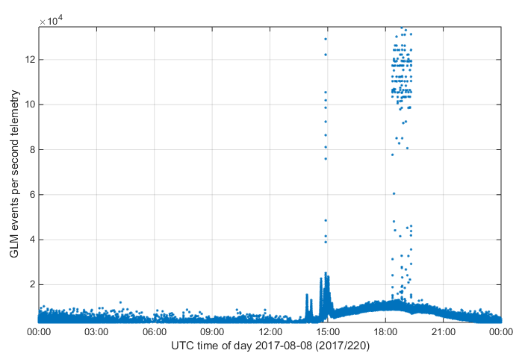
Impacts to on-orbit performance
Solar intrusion (eclipse season)
Glint blooming
Daily momentum adjust maneuvers
SPP maneuvers for solar instrument calibrations
Station keeping maneuvers have no effect (low-thrust arc jets)
SPP
motion
Momentum adjust
Sunrise glint

Slide 23
Evolution of the ground segment
Ground segment validation is still ongoing, with numerous bugs still to be resolved
LM is able to reprocess data from L0 against the reference implementation of the GPAs
Long lead times for bug fixes are in conflict with planned provisional milestone for GLM
Deployment Milestone | Type | Date | Notes
DO.04.04 to OE | Software | 2017-04-24 20:20Z | Filter parameters not yet tuned (lots of false events, poor DE)
CDRL079 Rev G to OE | GLM Parameters | 2017-07-05 17:00Z | First data flow to GRB Prelim GPA filter tuning (May)
DO.05.00 to OE | Software | 2017-07-24 17:00Z | Large nav errors, “duplication dots”, etc.
CDRL079 Rev H to OE | GLM Parameters | 2017-09-06 (anticipated) | Improved GPA filter tuning per results of PLT GLM-004 (June)
DO.06.00 to OE | Software | 2017-10-30 (anticipated) | Expect continued large nav errors, “duplication dots”, etc.

Slide 24
Ground segment validation
This is a highly abbreviated list of GLM ground segment issues that are being attacked in continued validation efforts between NASA, Lockheed Martin and Harris Corp.
Event Filters
  “Duplication dots” or spurious duplicated events on 20-second product boundaries that pass coherency
  “Radiation dots” or single-pixel radiation hits that combine with instrument noise to pass coherency and drive up the flash false alarm rate
    These can be removed at L2 using a new filter in the LCFA
Navigation
  Coastline ID does not currently produce the correct roll / pitch / yaw GLM offset angles, resulting in 10s of km event geolocation errors
  Event origination time is miscalculated by a factor of 1000 due to a unit conversion error
    This appears to end users as a failure to account for time of flight
  “Charlie Brown stripes” or group centroid locations showing abnormal stripe artifacts

Slide 25
Ground processing enhancements
After we finish the ground system validation, we will have a working implementation of the ground processing algorithms as they were envisioned before launch. After analyzing almost a year of on-orbit data produced by GLM, a number of improvement opportunities are emerging.
Blooming false event filter
Data Quality Product
Navigation improvement by accounting for diurnal variation
  Use ground networks to provide full-disk 24/7 reference dataset
Add flash filtering in LCFA
Use of lightning event energy density rather than flash density in operational products
It will be advantageous to incorporate the lessons learned from PLT and PLPT to enhance the ground processing algorithms to extract even greater lightning detection performance out of GLM

Slide 26
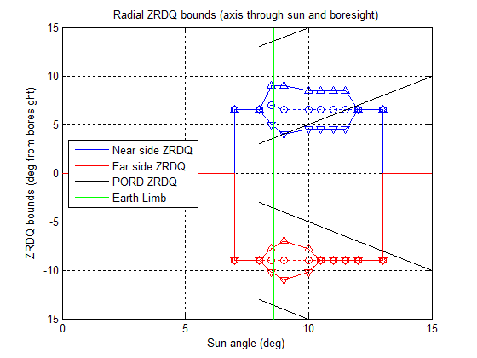
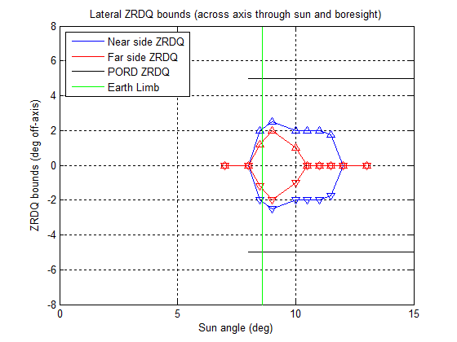
Status of data quality product
The data quality product is a map of the GLM FOV showing areas where detection efficiency may be compromised
  Must be separate from the lightning product – can’t tag an event that doesn’t exist
  Shows the following features:
    Where solar glint may occur
    Where solar intrusion may occur (see ZRDQ at right)
    Where events were dropped
    Where pixels are near-saturated or saturated
PLT solar intrusion test determined the ZRDQ parameters
Latest ground processing algorithm description document (CDRL080) defines the GLM data quality product
Next step: consideration by Algorithm Review Board

Slide 27
Questions to the Science Community
How can we improve GLM data products?
  For forecasters – what do you see on your display? What would you rather see?
  For scientists – is there anything you need to know about the instrument that you don’t already know?
What is the right balance between DE and FAR?
  Currently favors FAR at expense of DE, until L2 filtering is implemented
Are there useful things to be done with GLM East/West stereo views of lightning?
What would you like to see improved or added in a next-generation GLM?

