Slide 1
Results of GV measurements of STARNET and LINET in Brazil
Carlos Augusto Morales Rodriguez
University of São Paulo
http://www.starnet.iag.usp.br

Slide 2
STARNET
VLF LONG RANGE LIGHTNING DETECTION NETWORK
COVERAGE: MAINLY SOUTH AMERICA AND SURROUNDING OCEANS
11 SENSORS
LOCATION ACCURACY: 2-5 km
DETECTION EFFICIENCY: 50-70% (CG)

Slide 3
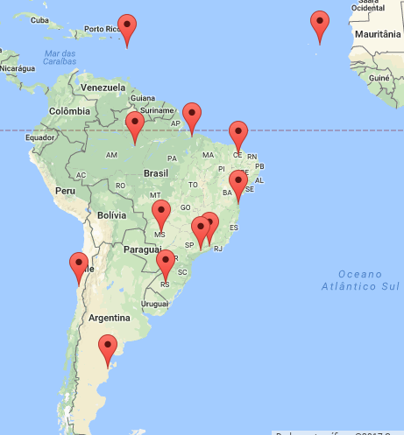
STARNET CONFIGURATION

Slide 4
STARNET – DETECTION EFFICIENCY

Slide 5
LINET
VLF/LF Total lightning detection system
COVERAGE: MAINLY STATE OF SÃO PAULO
9 SENSORS
LOCATION ACURRACY: 0.5-2 km
DETECTION EFFICIENCY: NOT COMPUTED YET
Cooperation: DLR+NOWCAST

Slide 6
LINET CONFIGURATION

Slide 7
GROUND VALIDATION
STARNET: 90-30W and 40S-10N
May and June 2017
Flash and Group X Sferics: Thunderstorms (258 K)
Diurnal variation
Latitude/Longitude
Size of thunderstorms
LINET: São Paulo State
August 20th 2017
Time series

Slide 8
STARNET ANALYSIS

Slide 9
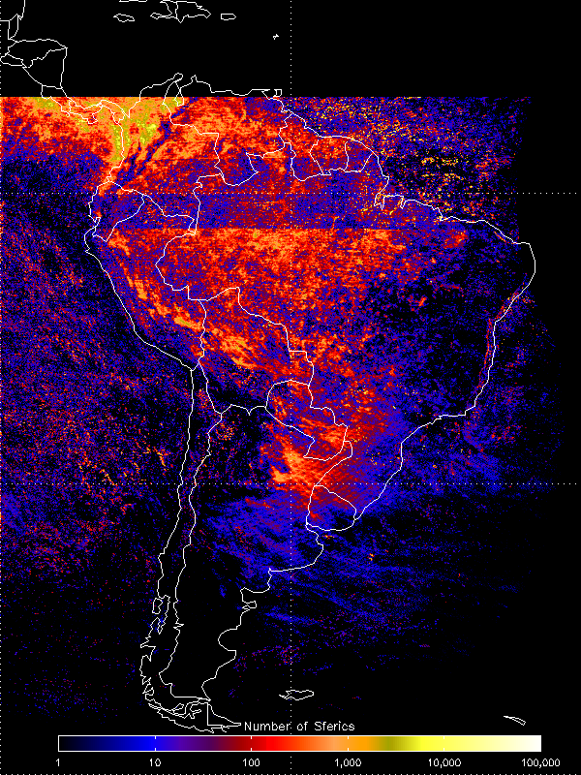
MAY AND JUNE 2017 GLM STARNET

Slide 10
MAY AND JUNE 2017 GLM STARNET

Slide 11
THUNDERSTORM CLUSTERS – 258K

Slide 12
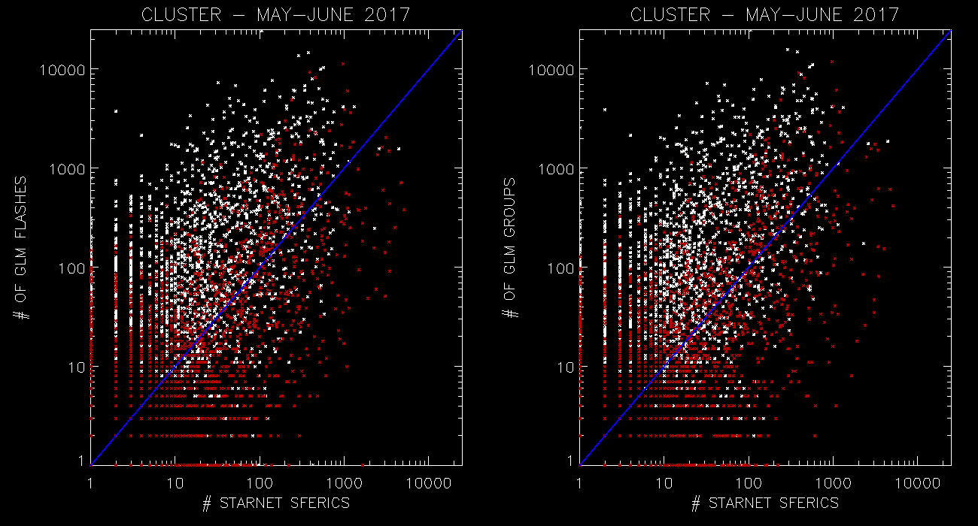
THUNDERSTORM CLUSTERS – 258K day-night

Slide 13
GLM GROUPS / STARNET SFERICS
All | 90-70W | 70-50W | 50-30W
0-20N | 15,19 | 20,10 | 2,86
20S-0 | 10,41 | 7,63 | 5,11
40S-20S | 2,38 | 1,64 | 0,76
Day | 90-70W | 70-50W | 50-30W
0-20N | 4,98 | 4,21 | 1,25
20S-0 | 4,93 | 2,88 | 0,86
40S-20S | 0,92 | 0,28 | 0,21
Night | 90-70W | 70-50W | 50-30W
 | 26,25 | 42,33 | 4,67
 | 16,94 | 13,79 | 8,08
 | 4,32 | 4,24 | 1,32

Slide 14
20 x 20 degrees: (daytime)
20N-0
90-70W
70-50W
50-30W
0-20S
20-40S

Slide 15
< 100 km radius (daytime)
20N-0
90-70W
70-50W
50-30W
0-20S
20-40S

Slide 16
100-300 km radius (daytime)
20N-0
90-70W
70-50W
50-30W
0-20S
20-40S

Slide 17
300-500 km radius(daytime)
20N-0
90-70W
70-50W
50-30W
0-20S
20-40S

Slide 18
> 500 km radius (daytime)
20N-0
90-70W
70-50W
50-30W
0-20S
20-40S

Slide 19
0-100 km | 90-70W | 70-50W | 50-30W
0-20N | 15,60 | 12,02 | 5,67
20S-0 | 7,85 | 7,95 | 4,54
40S-20S | 2,80 | 0,97 | 0,00
100-300km | 90-70W | 70-50W | 50-30W
0-20N | 18,68 | 23,81 | 3,86
20S-0 | 14,50 | 7,23 | 6,00
40S-20S | 2,58 | 0,06 | 1,50
300-500km | 90-70W | 70-50W | 50-30W
0-20N | 8,65 | 31,13 | 3,11
20S-0 | 6,81 | 6,43 | 3,15
40S-20S | 2,25 | 4,00 | 0,50
> 500km | 90-70W | 70-50W | 50-30W
0-20N | 7,18 | 18,53 | 0,40
20S-0 | 8,11 | 9,78 | 5,90
40S-20S | 2,15 | 1,92 | 0,79
ALL DAY

Slide 20
DAYTIME
NIGHTTIME
0-100 km | 90-70W | 70-50W | 50-30W
0-20N | 6,67 | 5,34 | 2,00
20S-0 | 4,17 | 3,32 | 0,96
40S-20S | -9,00 | 0,73 | 0,00
100-300km | 90-70W | 70-50W | 50-30W
0-20N | 3,39 | 3,58 | 0,20
20S-0 | 6,79 | 2,12 | 0,79
40S-20S | 0,50 | 0,00 | 0,00
300-500km | 90-70W | 70-50W | 50-30W
0-20N | 1,92 | 1,43 | 5,33
20S-0 | 0,50 | 1,84 | 0,20
40S-20S | 2,50 | 0,53 | 0,50
> 500km | 90-70W | 70-50W | 50-30W
0-20N | 3,35 | 4,25 | 0,14
20S-0 | 4,00 | 3,55 | 1,50
40S-20S | 0,00 | 0,17 | 0,21
0-100 km | 90-70W | 70-50W | 50-30W
0-20N | 27,25 | 28,15 | 3,00
20S-0 | 12,31 | 14,88 | 12,04
40S-20S | 2,80 | 1,62 | -9,00
100-300km | 90-70W | 70-50W | 50-30W
0-20N | 30,09 | 48,28 | 7,14
20S-0 | 23,37 | 12,57 | 5,62
40S-20S | 4,33 | 0,17 | 3,00
300-500km | 90-70W | 70-50W | 50-30W
0-20N | 18,53 | 56,91 | 0,00
20S-0 | 16,17 | 12,19 | 5,57
40S-20S | 4,25 | 13,86 | -9,00
> 500km | 90-70W | 70-50W | 50-30W
0-20N | 9,76 | 26,32 | 1,50
20S-0 | 11,20 | 19,89 | 9,17
40S-20S | 6,25 | 3,88 | 1,26

Slide 21
LINET GV

Slide 23
CONCLUSIONS
ALTHOUGH WE DID NOT EXPLORE TOO MUCH AND HAVE THE FINAL STATISTICS IT IS POSSIBLE TO STATE THAT:
DETECTION EFFICIENCY VARIES ACCORDING TO:
LATITUDE: DECREASES AT HIGHER LATITUDES
LONGITUDE: DECREASES EASTWARD
DAYTIME HAS LOWER DE
NIGHTTIME HAS HIGHER DE

