Slide 1
GLM Assessment During ER-2 Campaign over Colorado
Kyle Hilburn
14 September 2017
GLM Annual Science Team Meeting

Slide 2
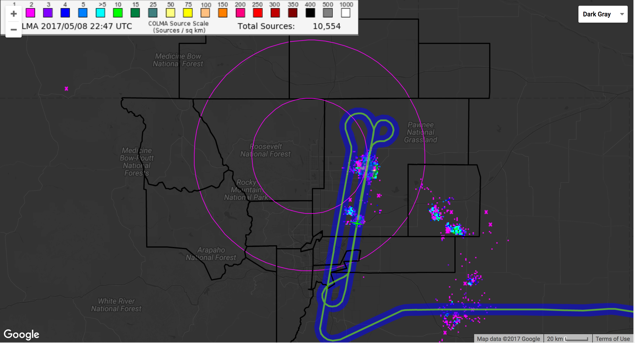
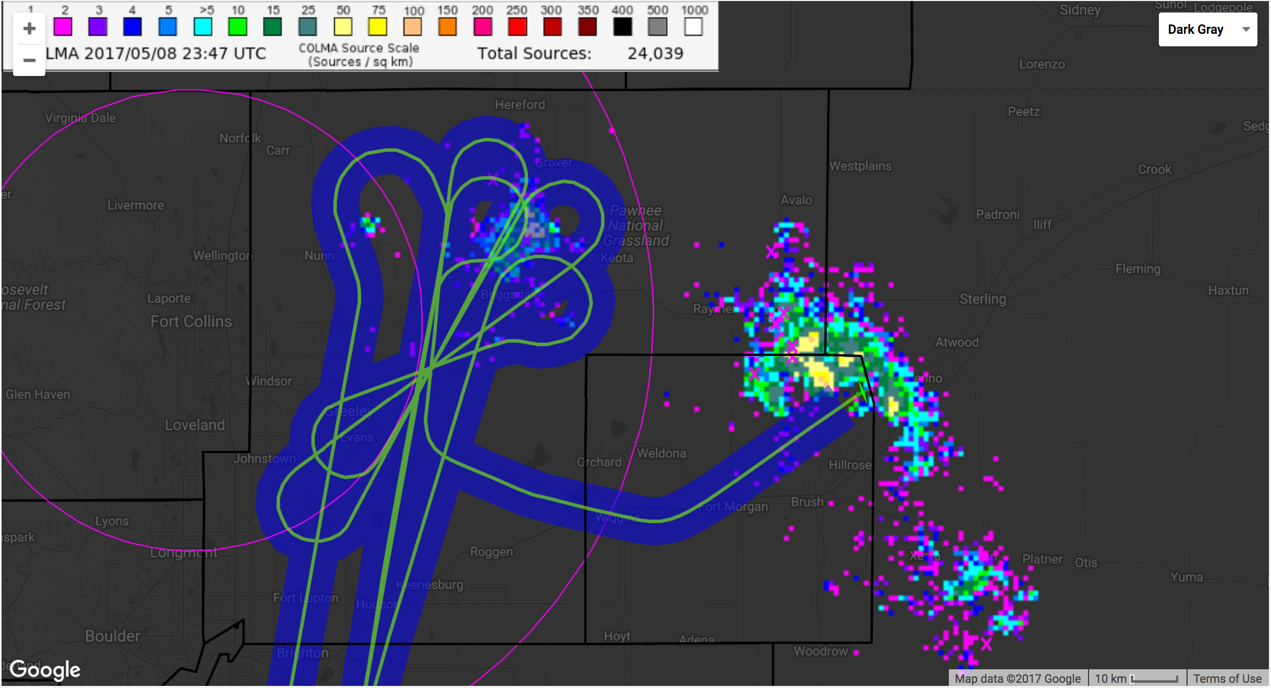
ER-2 Sampling on 8-May-2017
Flew dog-bone pattern over Denver and Greely storms from 22:00-23:02Z
Flew bow-tie pattern over Greeley storm from 23:02-23:45Z
Flew racetrack pattern over Fort Morgan storm from 23:45-01:00Z
This provided sampling over both normal polarity (Fort Morgan) and inverted polarity (Greeley) storms
Greeley
storm
Denver
storm
Fort Morgan
storm
Figures from Francis Padula’s field campaign notes

Slide 3
Motivation
Storms over NE plains of Colorado represent a challenging regime for space-borne optical remote sensing of lightning due to large ice water path above the flash
How does lightning measured with ground-based radio frequency observations COLMA and ENTLN compare with GLM?
How did GLM data improve from version 1 to 2?
How much of spatial/temporal variability in detection efficiency can we explain with environmental and lightning parameters?
Hypothesis: GLM detection efficiency will depend on a combination of the brightness of the flash and obscuring by hydrometeors and modulated by proportion of IC/CG flashes
Acknowledgements: Thank you to Max Marchand for providing ENTLN data, Karly Reimel for providing post-processed COLMA and re-processed GLM data, and Brody Fuchs for providing real-time COLMA data.

Slide 4
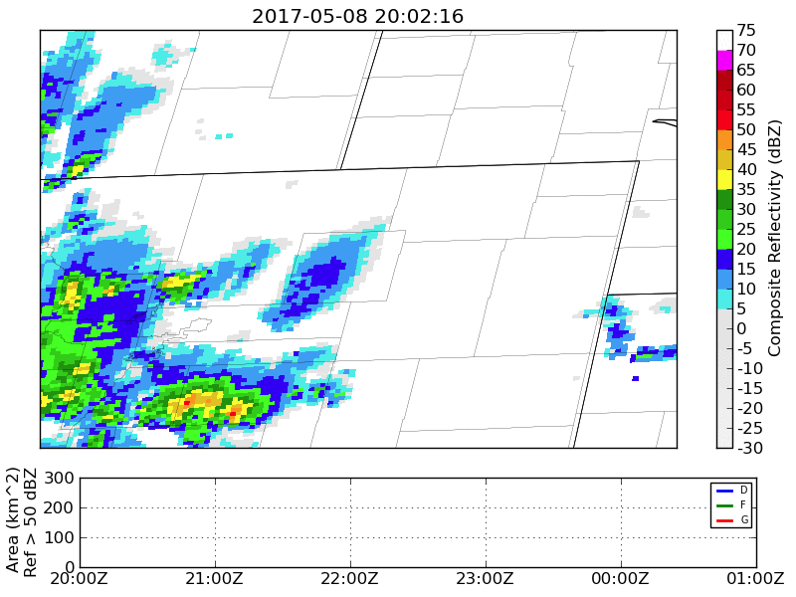
MRMS Identified Storms
Using MRMS composite reflectivity (resampled onto HRRR 3 km grid at time nearest to ABI CONUS time) to identify features with reflectivity > 35 dBZ and area > 81 km^2
Chose initial/final fixes and radius for each storm of interest
This avoids complications of merging/splitting and change in feature area over time in statistics
Some notable features:
Just before 21:00, cell splits from G storm and heads west
Just after 21:30, cell splits from F then joins D/G around 23:00Z, with D quickly dissipating
Around 23:00Z, the easternmost cell of F moves southeast out of radius

Slide 5
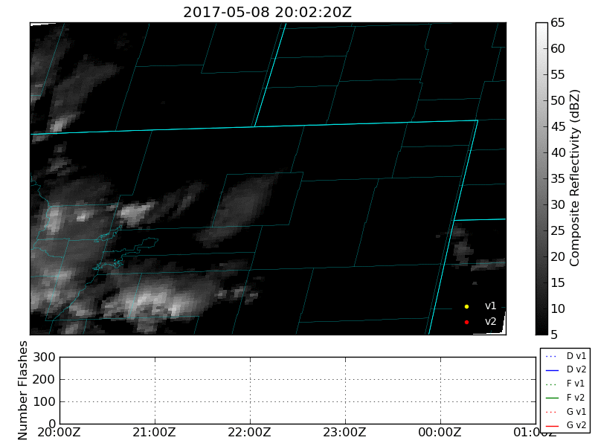
GLM Data
For the whole region shown, there are about 1% more flashes in V2
For Fort Morgan and Greeley about 10% more in V2; but for Denver about 5% less in V2 due to location shift for cell coming from Fort Morgan storm
Location offset with V1 to the southwest and V2 to the northeast

Slide 6
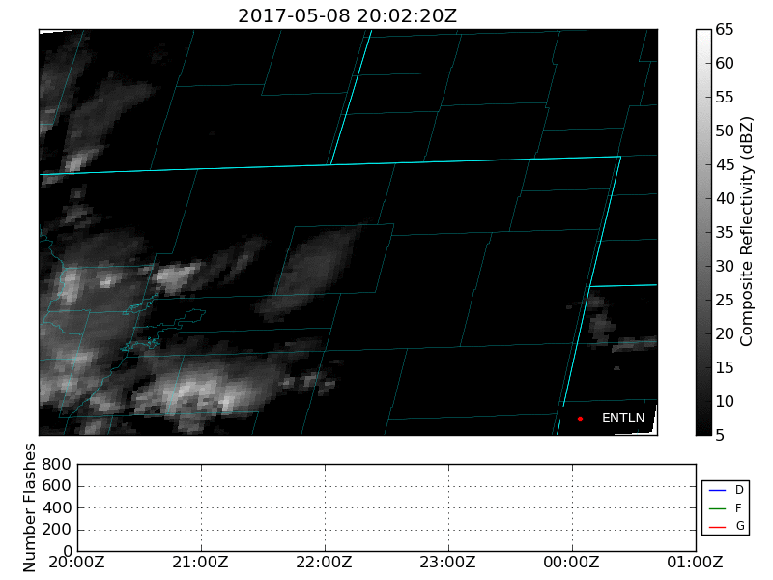
ENTLN Data
ENTLN provides about 2x as many flashes as GLM
Despite that, ENTLN and GLM have similar temporal variability in flash number for each storm
The additional flashes form denser clusters than GLM

Slide 7
COLMA Data
Post-processed COLMA has wide scatter of points and occasional arc-like artifacts
This is despite q/c and removal of singleton events in lmatools
Used DBSCAN clustering algorithm with clustering parameters to match GLM:
Distance = 16.5 km
Time = 0.33 s
Duration = 3.0 s
Quality-control:
Number stations >= 6
Chi-squared < 1
Altitude < 20 km
Time variability in datasets not consistent between real-time and post-processed data

Slide 8
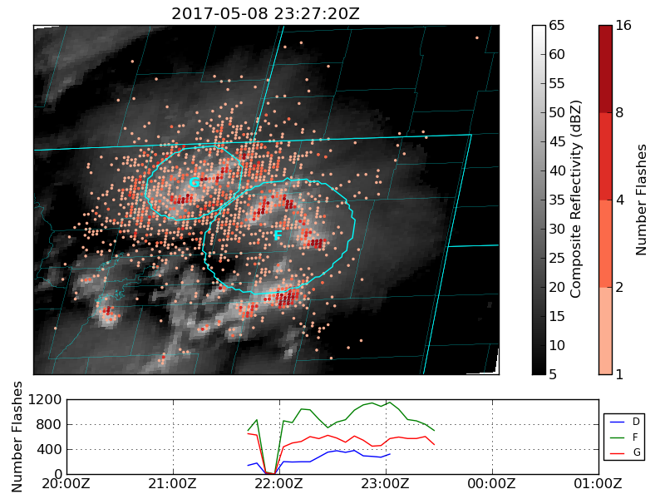
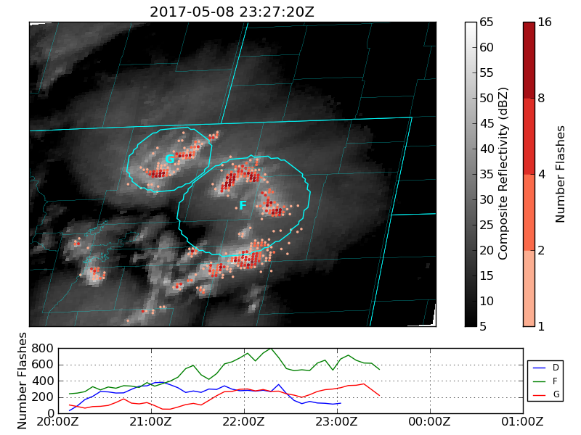
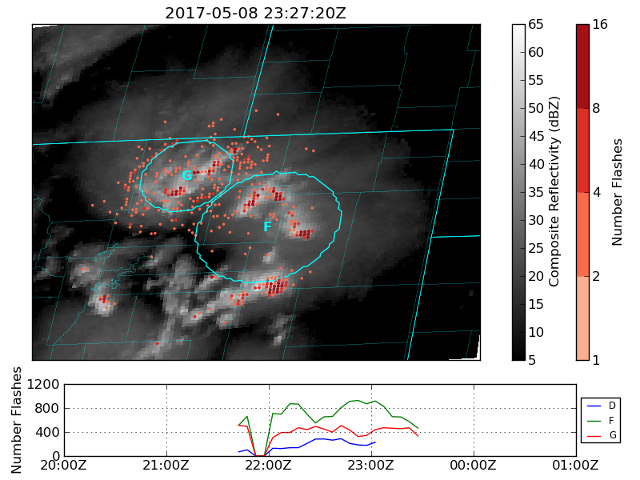
COLMA Scattered Points
Most of the scattered COLMA lightning observations are pixels with only a single group
Removing these points (lower right) cleans up maps, but does not make much change to the time variability
Note that ENTLN (lower left) has larger clusters
Fortunately, this scatter is unimportant to an analysis conditioned on GLM
COLMA (all)
ENTLN
COLMA (N>1)

Slide 9
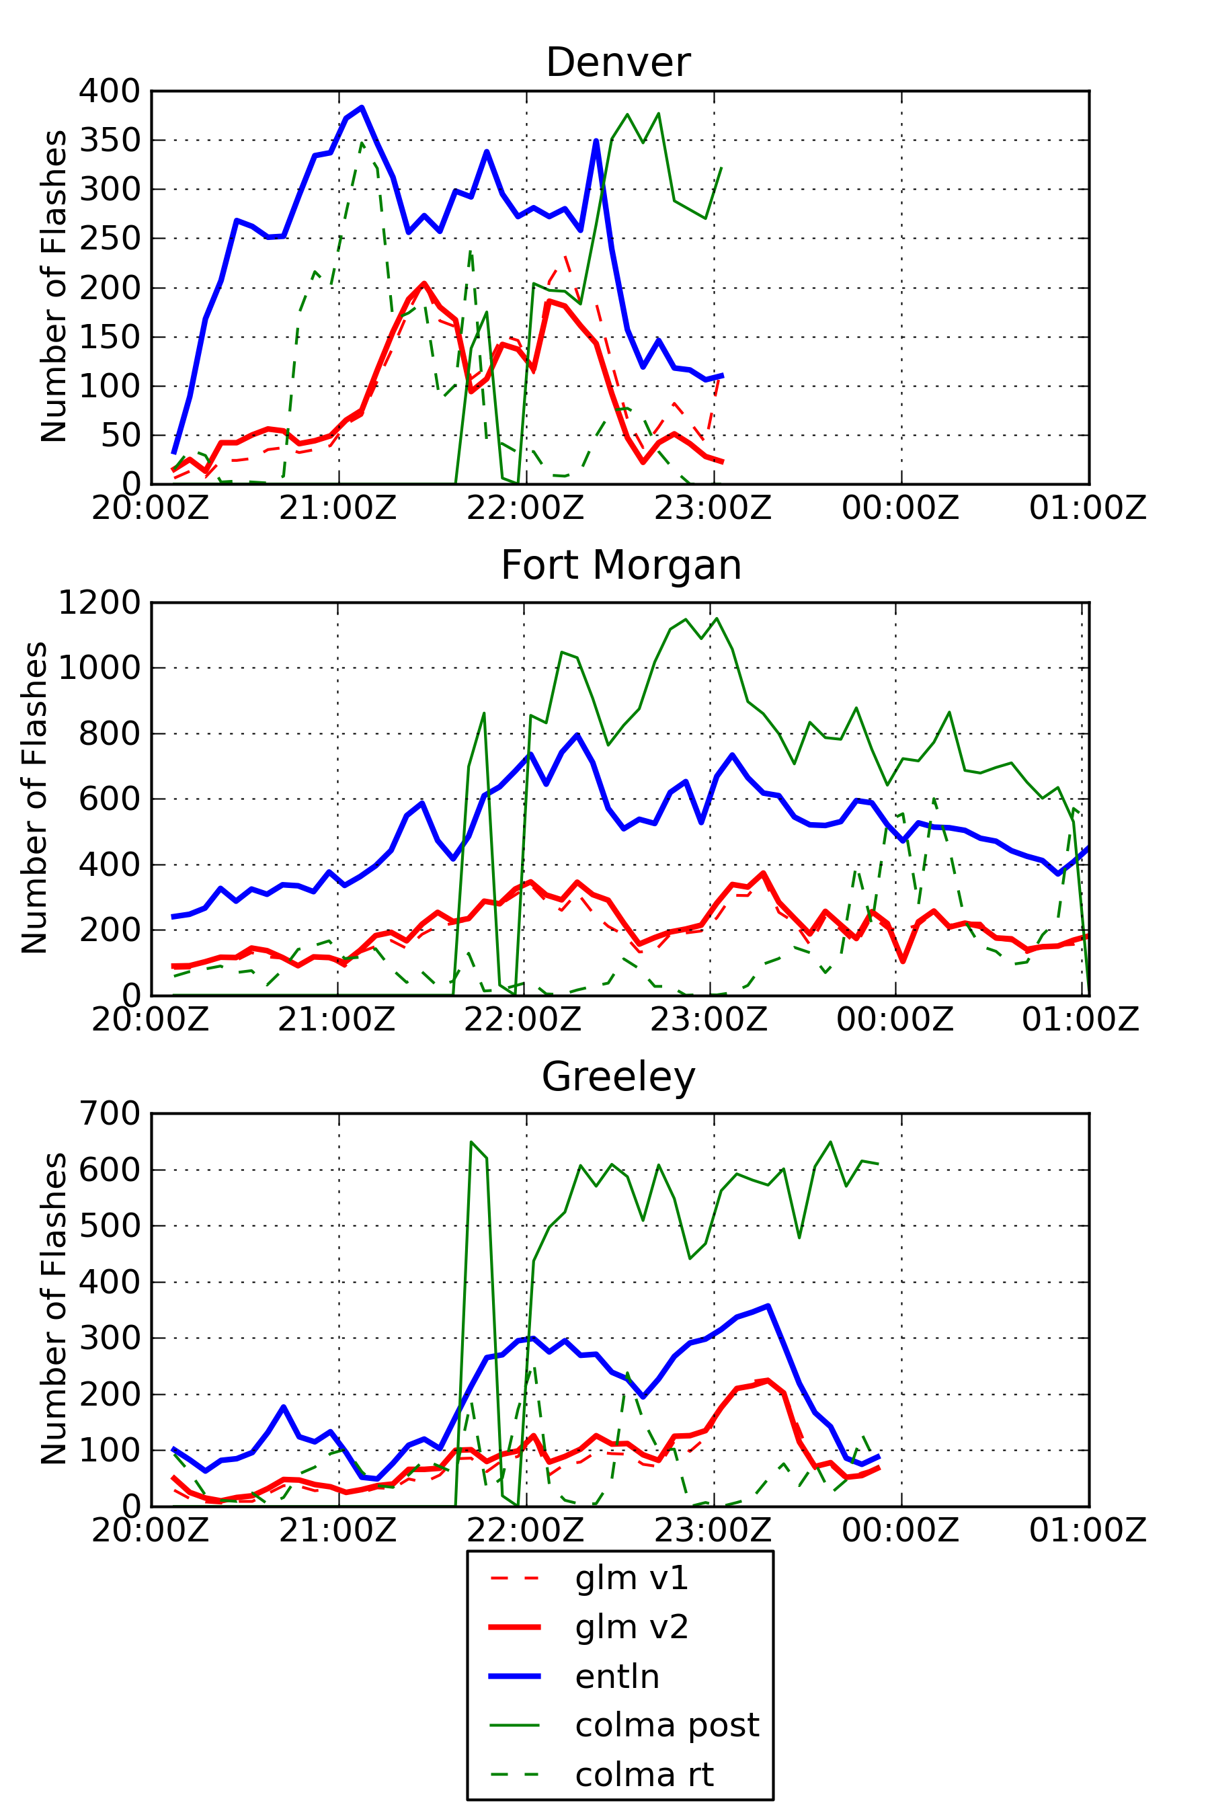
Time Series Comparison
For Denver storm, GLM has slow ramp up in flashes, while ENTLN has two rapid jumps. After reaching peak, variability is anti-correlated until dissipation stage when both have large drops
For Fort Morgan storm, good agreement in variability and roughly constant offset/scaling over time
For Greeley storm, variability matches well. Good agreement around 21:30 with larger disagreement before and after

Slide 10
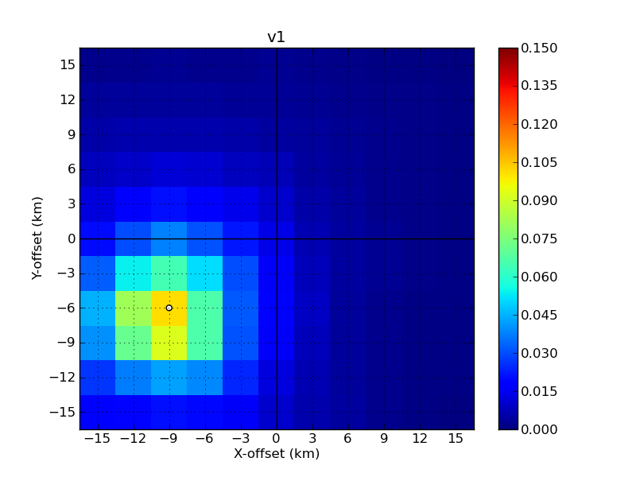
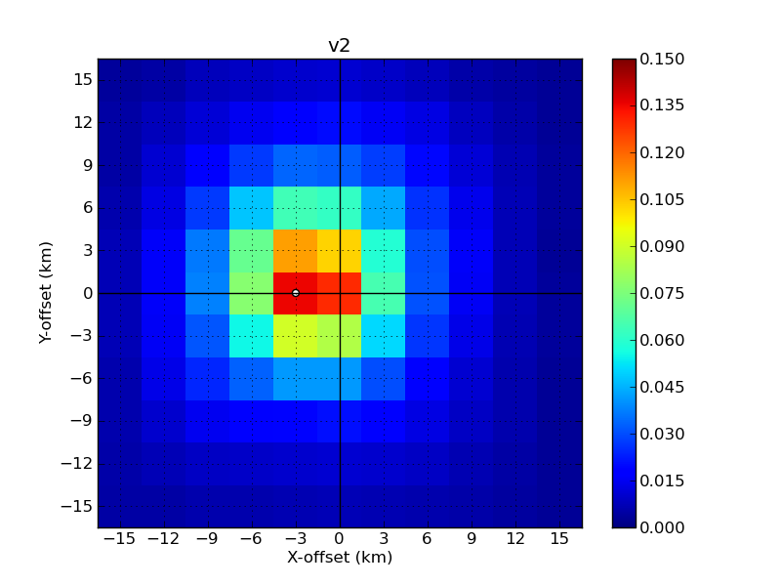
V1 vs V2 GLM Flash Locations
Figures show correlation (R²) between ENTLN and GLM with X,Y offsets calculated over the 5 hour period of the event and subset to the region of interest (105.5-102.0W, 39.0-42.0N)
Version 1 GLM (top) has offsets 9 km west and 6 km south of the ENTLN location
Version 2 GLM (bottom) has highest correlation (0.136) for offsets 3 km west and 0 km north of ENTLN, but note that zero offsets has R²=0.130
Also note that correlation between GLM and ENTLN has increased from V1 to V2
For the detection analysis to follow, will use zero offset for GLM V2 data

Slide 11
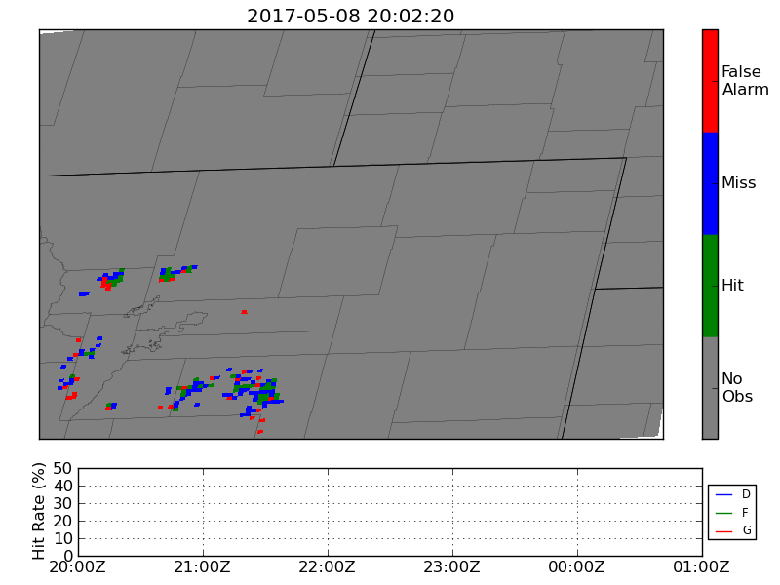
Hit/Miss/False Alarm Statistics
Loop compares GLM V2 to ENTLN
Hits and misses tend to come in clusters, while false alarms are more scattered
Hit rates reach maximum of 50%, and generally range 30-50% during middle of storm with lower values (as low as 20%) during beginning
Slight tendency, especially near end of loop, for false alarms on west side of storms, which is why the location analysis found small west shift

Slide 12
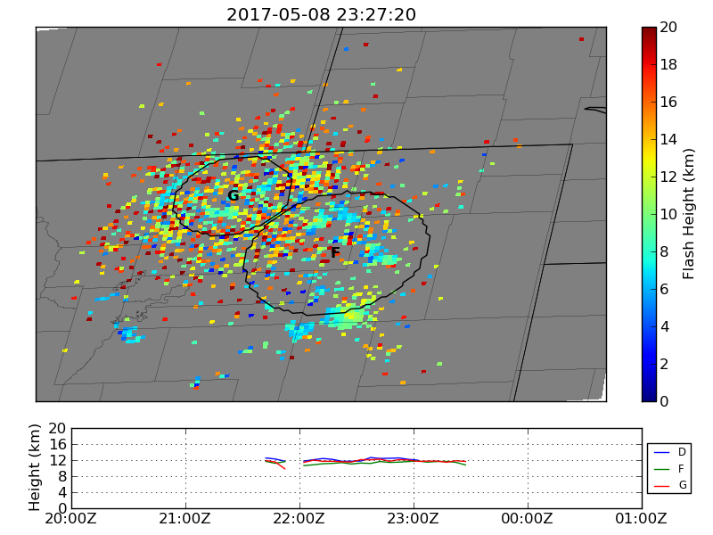
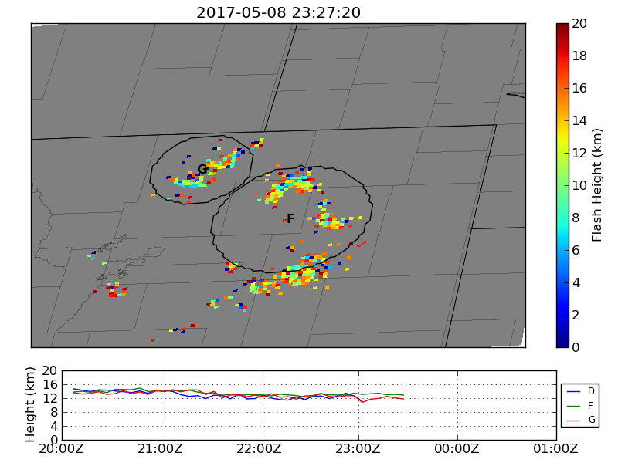
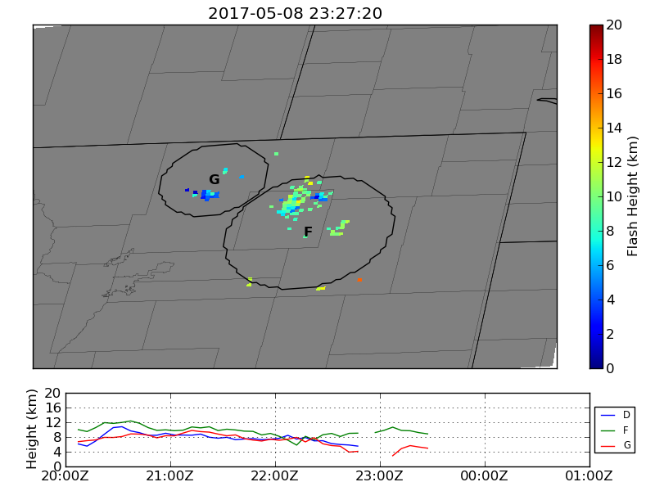
Flash Heights
COLMA (post)
To test our hypothesis, we need flash heights to calculate IWP above the flash
Of all three sources, real-time COLMA is least noisy spatially, but also lower by 2-6 km
ENTLN
COLMA (rt)

Slide 13
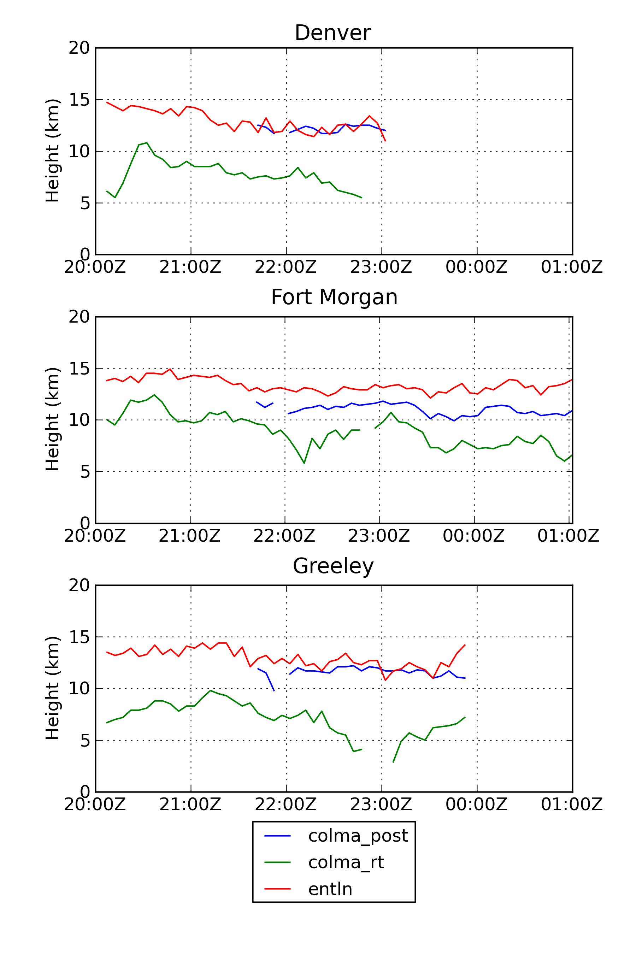
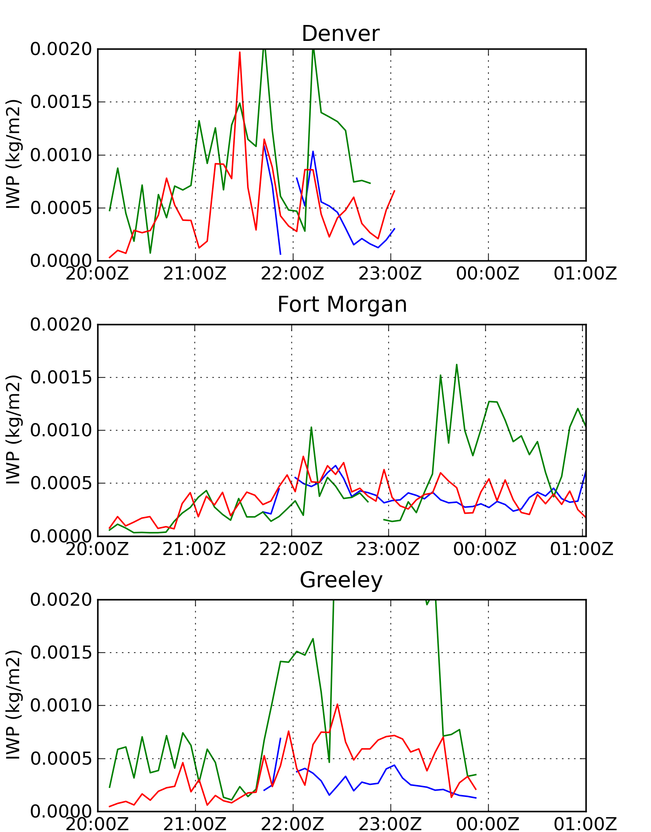
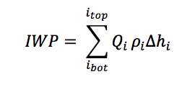
Heights and IWP
Flash heights from post-processed COLMA are a reasonably good match to ENTLN
Calculate IWP above flash from MRMS reflectivity using relationship in GSD cloud analysis package, vertically integrate using standard atmosphere density:
The lower real-time COLMA heights provide much higher IWP
Keep in mind that these are averages over different sets of locations
Height
IWP

Slide 14
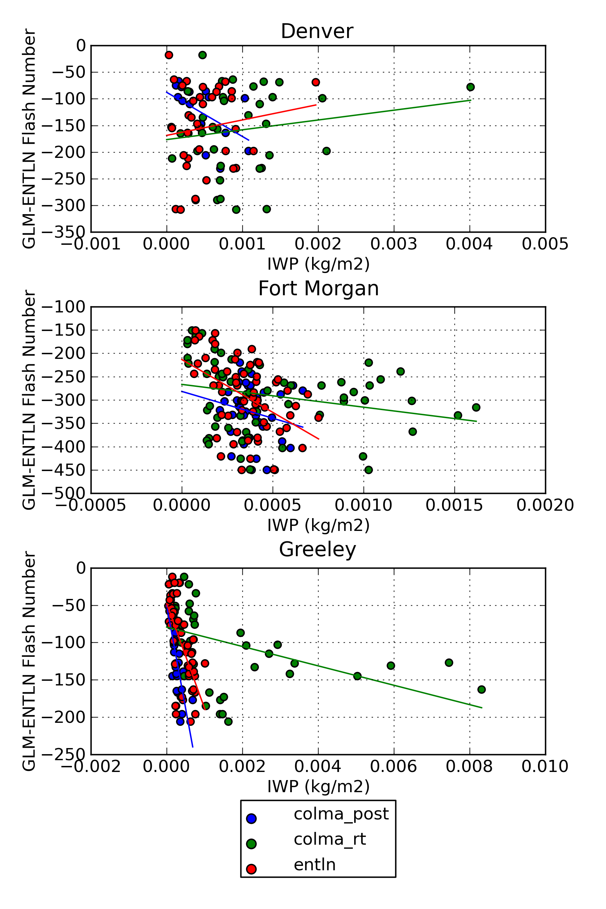
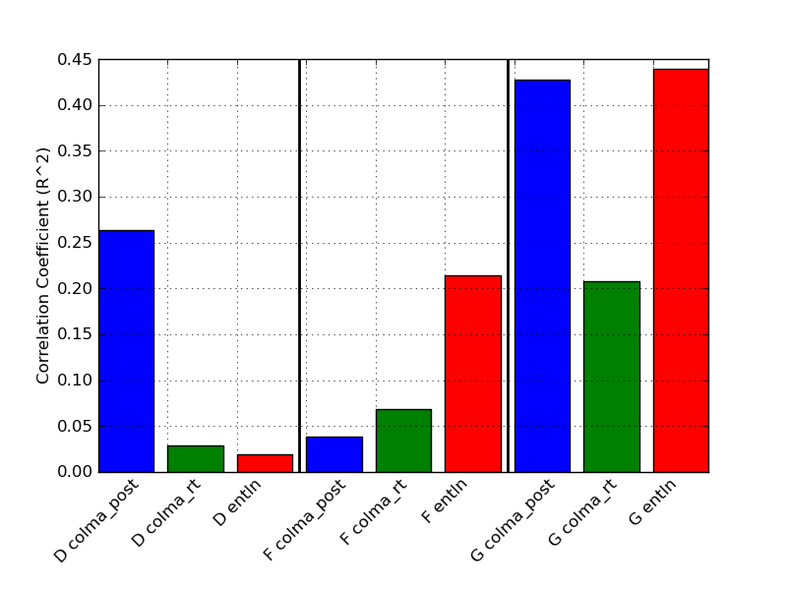
IWP Correlation with GLM-ENTLN
The Greeley storm has strongest correlation between GLM under-detection and IWP
ENTLN has highest correlation, except for Denver storm where it finds opposite to expected slope
For following analysis, use ENTLN-derived IWP for Fort Morgan and Greeley storms, but COLMA-post for Denver storm

Slide 15
Denver Storm GLM-ENTLN Correlation and Slope
Strongest correlation with G-E is peak current, has positive slope
Second highest correlation is IWP with negative slope
Also note negative correlation between PC and IWP
Example below at time of peak hit rate (22:17Z) for GLM shows spatial correlation between hits and higher peak current
The positive correlation is obvious in time series (lower right)
Denver | G-E | IWP | PC | ICR
G-E |  | -3.2E-6 | 9.8E-3 | -2.1E-4
IWP | 0.26 |  | -1.9E+3 | -1.7E+1
PC | 0.43 | 0.37 |  | -1.8E-2
ICR | 0.11 | 0.03 | 0.19
Below diagonal: Correlation Coefficient (R²)
Above diagonal: Slope
Units: G-E (number), IWP (kg/m2), PC (kA), ICR (non-dim)

Slide 16
Fort Morgan GLM-ENTLN Correlation and Slope
Strongest correlation with G-E is IC ratio, has positive slope
Second highest is IWP with negative slope
Also note negative correlations between ICR/IWP and ICR/PC
Example below at time of peak hit rate (22:32Z) shows negative spatial correlation
Analysis based on matching flashes has shown that low peak current ICs have lower detection than CGs with same current
The positive correlation shown in table relates to temporal variability, shown in time series (lower right)
Fort Morgan | G-E | IWP | PC | ICR
G-E |  | -9.5E-7 | -3.4E-3 | 3.1E-4
IWP | 0.21 |  | 3.2E+3 | -1.9E+2
PC | 0.04 | 0.13 |  | -1.8E-2
ICR | 0.38 | 0.57 | 0.40
Below diagonal: Correlation Coefficient (R²)
Above diagonal: Slope
Units: G-E (number), IWP (kg/m2), PC (kA), ICR (non-dim)

Slide 17
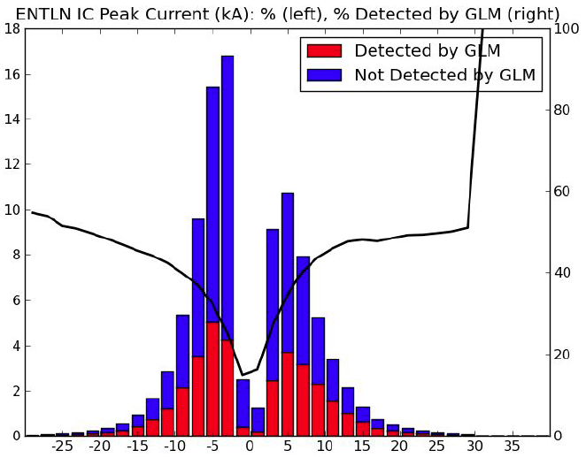
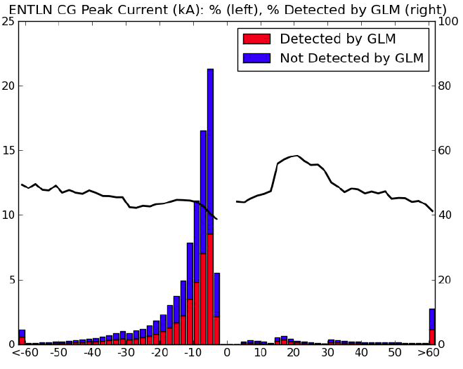
Detection vs Peak Current and Type
Figures show results from a matched flash analysis by Max Marchand for the Northern Plains region
GLM detection of IC flashes relative to ENTLN is strong function of peak current with 20% detection at low current and 50% at high
For CG flashes, detection is around 40-50% regardless of peak current

Slide 18
Greeley GLM-ENTLN Correlation and Slope
Strongest correlation with G-E is IWP, with negative slope
Second highest is ICR with positive slope
Also note negative correlation between ICR and IWP
Example from time of peak hit rate (23:17Z) shows that high IWP sometimes corresponds with locations of misses
But high IWP correlated with more CGs which have better detection
The inverse correlation between IWP and G-E shows up clearly in temporal variability (lower right)
Greeley | G-E | IWP | PC | ICR
G-E |  | -3.1E-6 | 2.0E-2 | 5.4E-4
IWP | 0.44 |  | 4.0E+2 | -1.4E+2
PC | 0.09 | 0.00 |  | -2.8E-3
ICR | 0.36 | 0.53 | 0.04
Below diagonal: Correlation Coefficient (R²)
Above diagonal: Slope
Units: G-E (number), IWP (kg/m2), PC (kA), ICR (non-dim)

Slide 19
Summary and Conclusions
We have analyzed available lightning datasets for the three storms sampled during the ER-2 Campaign over northeast Colorado on 8-May-2017
GLM detects less lightning than ground-based radio frequency detectors, with hit rates of 20-50%
Despite the close proximity of these storms, different factors are required to explain the detection efficiency
The Denver storm has a strong relationship (R²=0.43) with higher peak current associated with better detection
This relationship was less obvious for Fort Morgan and Greeley storms because at beginning of storms (before 21:30Z) there was good detection but relatively low peak current
The Fort Morgan storm has a temporal relationship (R²=0.38) with greater IC ratios associated with better detection
Greeley storm has similar relationship in temporal variability
Does not hold for spatial variability due to ICR correlations with IWP and PC
The Greeley storm has temporal relationship (R²=0.44) with greater LWP associated with worse detection
Denver and Fort Morgan storms also have this temporal relationship, but half the correlation
Less obvious this holds for spatial variability due to negative correlation with ICR
For the inverted polarity storm (Greeley) the strongest relationship with detection efficiency was IWP, while for the regular storms peak current and IC/CG ratio were more important

Slide 20
Backup slides

Slide 21
Tracking Parameters
Storm | Radius (km) | Latitude | Longitude | Time
Denver | 30 | 39.556 | -105.422 | 2017-05-08T20:07:20
 |  | 40.231 | -104.577 | 2017-05-08T23:02:20
Fort Morgan | 55 | 39.263 | -104.481 | 2017-05-08T20:07:20
 |  | 40.56 | -103.151 | 2017-05-09T01:02:20
Greeley | 35 | 40.208 | -104.964 | 2017-05-08T20:07:20
 |  | 40.701 | -104.411 | 2017-05-08T23:52:20

