Slide 1
WWLLN – GLM studies
R. Holzworth, M. McCarthy
Univ. of Washington, Seattle
Outline:
WWLLN: what do we expect?
High rate, Spatial shift problems example
Matching (events>3, energy>20)

Slide 2
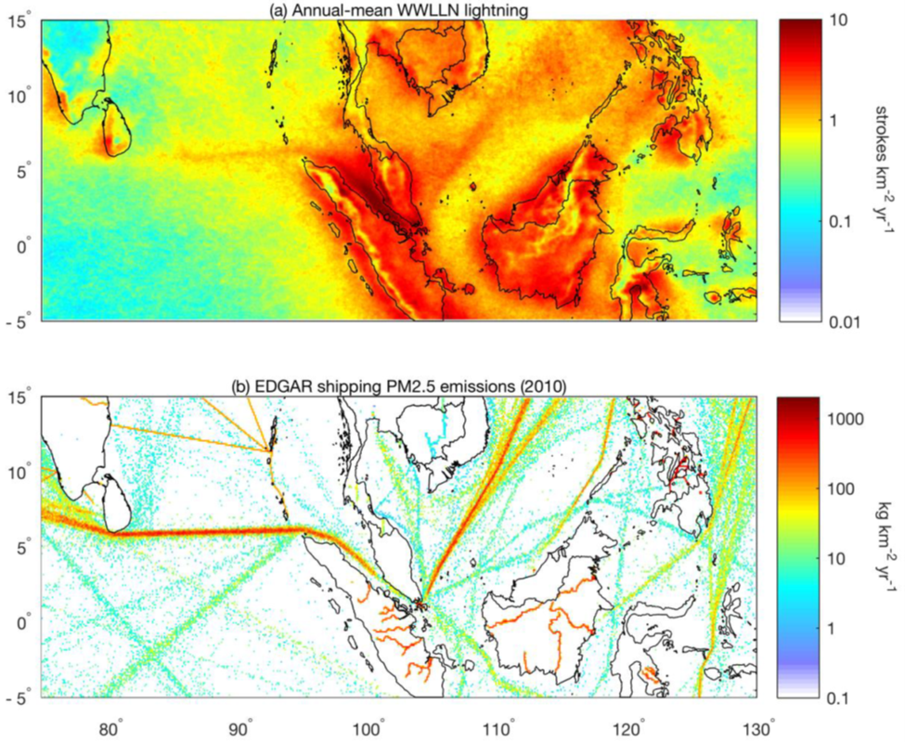
The clearest evidence to date of aerosol pollution persistently affecting storm development and intensity.
WWLLN Lightning
Factor of Two Lightning increase over ship tracks compared to adjacent regions
From recent Ship tracks paper using 0.1 degree pixels.
SHIP TRACKS
Aerosol
PM2.5
Lightning
Seasonal lightning
Latest Result from UW Atmos. Sci, ESS, JISAO and NASA:
Joel A. Thornton, Katrina S. Virts, Robert H. Holzworth, and Todd P. Mitchell,
Lightning Enhancement Over Major Oceanic Shipping Lanes , Geophys. Res. Letters. (accepted 8/24/17) (in press) 2017
Aerosols
CAPE
Conclusion: first evidence that ships affect storm intensity and lightning.
Notice how both Lightning peak, and Aerosol PM2.5 is centered on 6 degrees latitude. Notice that CAPE shows no such relationship (so not a natural weather phenomenon

Slide 3
July & August
Stroke Density distribution from 6 years of WWLLN data

Slide 4
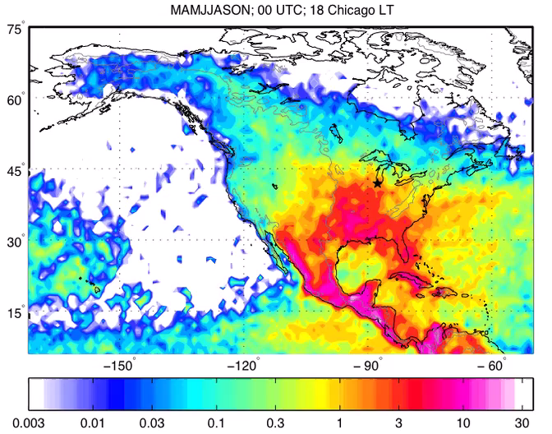
Or go to:
http://wwlln.net/climate/clim/ltghr_all_namer.mov

Slide 5
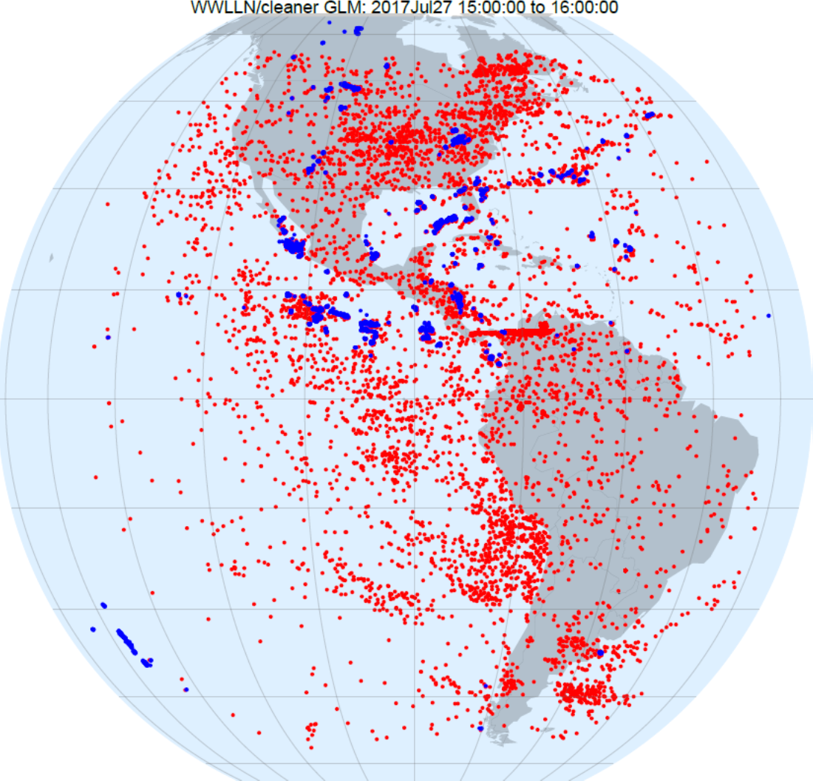
One Hour GLM Flashes
GLM flashes, uncut
Left: one 20-second period
Right: everything else

Slide 6
Minimum 15 – 17 UT
2-orders variation in events

Slide 9
WWLLN strokes in GLM FOV this day
Expected variation in Strokes:
Less than factor of 2
Minimum near 12 – 13 UT
(centroid ~ 06 Local)

Slide 10
GLM is at 90 degrees West, or about 6 hours behind UT

Slide 15
Matches

Slide 16
Another Sample
(01 to 02 UT)
Toggle with next slide
This one:
WWLLN (blue) on top
GLM (red) on bottom

Slide 17
Another Sample
(01 to 02 UT)
Toggle with last slide
This one:
WWLLN (blue) on bottom
GLM (red) on top

Slide 18
Matched
WWLLN strokes
GLM Flashes
Best timing?
Best Spatial?
TBD

Slide 19
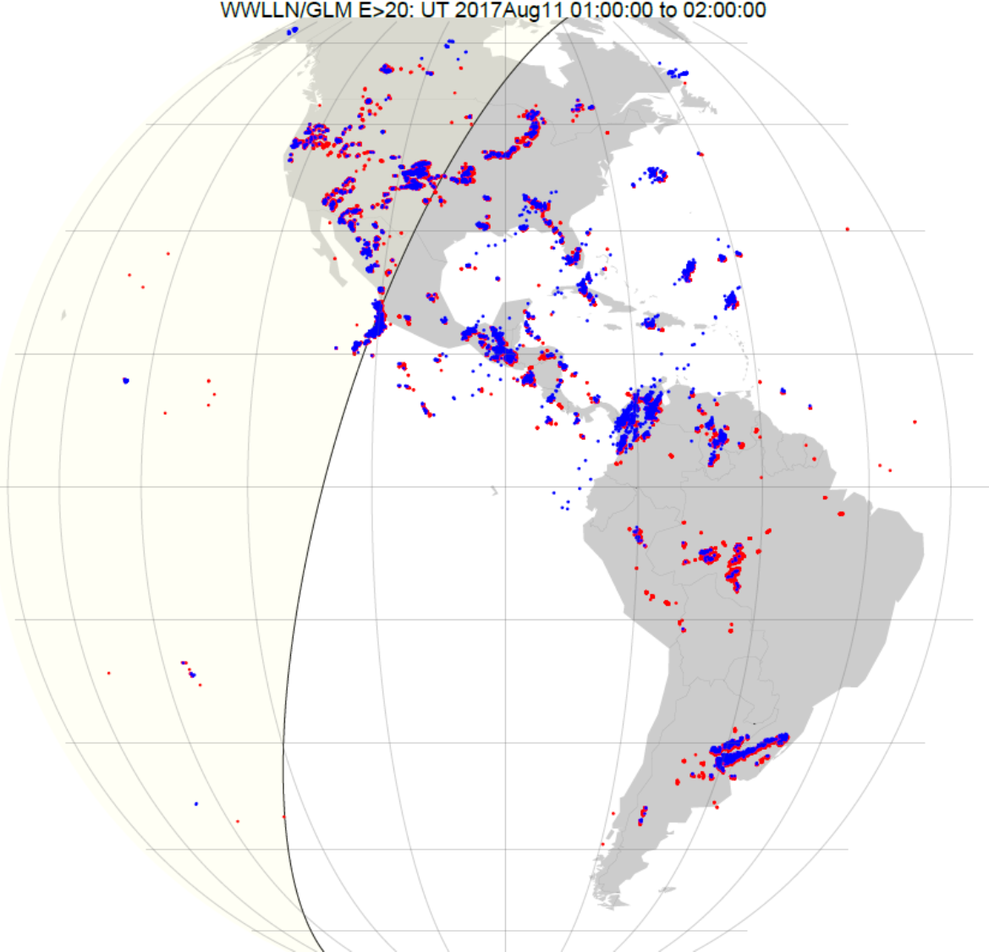
(01 to 02 UT)
Energy >20

Slide 21
Northern Hemisphere:
GLM shifted South and East
Southern Hemisphere:
GLM shifted South and West
(i.e. shifted South in both hemispheres)

Slide 22
WWLLN high latitude strokes, not seen by GLM
No GLM above about 57 degrees

Slide 23
GLM – WWLLN comparisons: work in progress
To do:
Settle on the best matching conditions (eliminate known spurious data)
Large scale comparisons (days months)
Seasons
New-WWLLN
Case studies

