Slide 1
Road to GLM Full Validation: Overview, Processes, and Status
GLM Science Meeting, Huntsville AL
Sept. 11, 2018
William Koshak, NASA/MSFC
(with inputs from additional Team Members)

Slide 2
OUTLINE
The PS-PVR Process
Tools & Tests
Historical Highlights
Upcoming Milestones
The ADR/WR Process & Updates

Slide 3
THE PS-PVR PROCESS

Slide 4
PS-PVR
PS-PVR = Peer Stakeholder - Product Validation Review
Assesses product quality relative to Program definitions
PS-PVR Chair decides if products have achieved the product maturity level
Provides guidance on work expected to achieve the next maturity level
PS-PVR
CWG/AWG PLPTs
Customer Forum Feedback
Instrument Vendor PLTs
Success
Product Maturity Level Declared
data to public via GRB (beta)
& submit Read_Me file

Slide 5
Product Maturity Levels
e.g., blooming, data gaps, parallax, …
Ref: GLM Readiness, Implementation, and Management Plan (Fig. 1 of RIMP v1.2; 416-R-RIMP-0313)

Slide 6
Primary Emphasis for GLM
  Flash Detection Efficiency
  GLMPORD74: The flash detection probability shall be at least 70% after L1b processing.
  The time span for this computation is 24 hours.
  Flash False Alarm Rate
  GLMPORD75: The flash false alarm probability shall be less than 5% after L1b processing.
  The time span for this computation is 24 hours.
  Location Accuracy
  GLMPORD94: The GLM navigation error shall not exceed ±112 µrad ∼ ½ pixel
  (MRD1259, pg. 46: Product Mapping Accuracy 5 km)
  Time Accuracy
  GLMPORD98: The GLM shall time tag each event to an accuracy of 1 msec
  … also benchmarking for DCC and lightning energy.
Reference: GLM PORD (Performance and Operational Requirements Document) V2.16, 4 Aug 2016

Slide 7
Team Organization
PS-PVR Panelists
Chair: Matt Seybold, Backup Chair: TBD (was W. Mackenzie); others.
PS-PVR
presentation
(Koshak, Armstrong, et al.)
PS-PVR
decisions
GOES-R Series Prog. Sci.
Scott Rudlosky (Dan Lindsey Funding Side)
[both positions formerly Steve Goodman who is now a consultant]
CVCT PRO, AART/ARB
Matt Seybold, Liz Kline, Jon Fulbright,
Randy Race, Dave Pogorzala, Ryan Williams, Janet Larsen, …
CWG Leads
Changyong Cao, Fred Wu
Cal/Val Team
Core:
Koshak, Armstrong, Mach, Buechler, Bateman, Bitzer, Virts, Blakeslee, Quick,
Burchfield
Remote (Primary):
Cummins, Krehbiel, Thomas, Rison, Bruning, MacGorman, Rutledge, Pickering,
Peterson, Sonnenfeld
Others: Both local & remote
AWG Lead
Jaime Daniels
Flight
Marc Rafal, Ruth Cholvibul
GLM INR (Lasers)
Dennis Buechler
LMATC/UAH
S. Edgington, C. Tillier,
H. Christian
CVCT: Cal/Val Coordination Team
PRO: Product Readiness and Operations
AART: Algorithm Action Review Team
ARB: Algorithm Review Board

Slide 8
TOOLS & TESTS

Slide 9
Primary Tools
Item | Tool | Description | Code Language | Developer
1 | VaLiD | Validate Lightning Data tool performs shallow/deep dives of GLM data using wide range of ground-based datasets discussed in RIMP. | C | Bateman/USRA
2 | Cluster/Filter | In-house code for L0-L1b and L1b-L2 processing | Matlab | Mach/USRA
3 | HUDAT | Huntsville Area Marx Meter Array (HAMMA) User Data Analysis Technology with emphasis on lightning energy/physics. | IDL | Bitzer/UAH
4 | STROKE | STorm Retrievals frOm KSC E-Fields examines ground-based electric fields, lightning field changes, and the charges deposited by lightning in KSC, Florida. | IDL | Koshak/MSFC
5 | INR/Parallax | Validates GLM INR with comparisons to well-located ground points and employs GLM background images & lightning, ABI background images, and Laser beacon data | IDL | Buechler/UAH
6 | TT/DCC | Trending Tools for long-term trending of Deep Convective Clouds. | IDL | Buechler/UAH
7 | TT/Lightning | Trending Tools for long-term trending of lightning counts, flash duration, and lightning energy. | IDL | Buechler/UAH Koshak/MSFC
8 | LMT | 24/7 Lightning Monitoring Tool (aka "Product Monitor") that alerts of problematic GLM performance | TBD | Product Area Lead (PAL, Wayne MacKenzie)
9 | CompareLLS | Compare Lightning Location System tool performs shallow/deep dives of GLM data using wide range of ground-based datasets discussed in RIMP. | Matlab | Cummins, UA
10 | XLMA | X Lightning Mapping Array tool for making standard 4-D plots of flashes. | IDL | Krehbiel & Rison of NMT
11 | lmatools | Analyzes LMA data [sort VHF source data into flashes; calculate flash areas, volumes, and channel lengths; produce gridded products; time series statistics of flash rate and size data; simulate LMA performance]. | Python | Bruning/TTU
12 | FEGST | Fly's Eye GLM Simulator Tool: Data acquisition, display, and storage software [Note: s/w for analyzing FEGS data & inter-comparing it with other lightning optical datasets (e.g. GLM, ISS/LIS) will be done by beginning of Spring 2017 Field Campaign & some of these processing tools will be piggybacked to VaLiD.] | IDL | Quick/NPP
13 | ADTs | Ancillary Dataset Tools will be developed for processing datasets such as ABI, NEXRAD, SEVERI, WWLLN; some of these tools will be piggybacked to VaLiD. | Matlab & McIDas scripts | Mach/USRA Bateman/USRA
14 | SITs | Specialized Impromptu Tools written “on-the-fly” to handle any analyses that are needed, but that were unexpected. | C, IDL, Matlab, Mathematica | Mach/USRA Bateman/USRA Buechler/UAH Koshak/MSFC
15 | LATA | Location And Time Accuracy (LATA) Tool: Produces a variety of plots/histograms that characterize the overall location/time accuracy of GLM flashes/groups/events. | Matlab | Virts/NPP

Slide 10
Post Launch Product Tests
Test ID | Abbreviated Test Titles for GLM
PLPT-GLM-001 | Validate DE/FAR using med/long-range networks (e.g., NLDN, EN, GLD360)
PLPT-GLM-002 | Validate DE/FAR using short-range networks (e.g., LMAs)
PLPT-GLM-003 | Validate Storm DE and Storm FAR using very long range systems (WWLLN, NEXRAD)
PLPT-GLM-004 | Validate DE/FAR using very short range optical systems (FEGS)
PLPT-GLM-005 | Validate DE/FAR using orbit-based optical systems (e.g., ISS/LIS)
PLPT-GLM-006 | Validate DE/FAR using ground-based E-field networks (e.g. HAMMA)
PLPT-GLM-009 | Validate L1b-L2 Cluster/Filter by comparing w/Spec (i.e. Mach) code
PLPT-GLM-010 | Validate L0-L1b Filter Algorithms by comparing w/Spec (i.e. Mach) code
PLPT-GLM-011 | Validate GLM INR w/comparisons to well-located ground points
PLPT-GLM-012 | Validate GLM BG DCC radiances with trendings & comparisons
PLPT-GLM-013 | Validate GLM Event Energies with trendings & comparisons
MSFC/MIT-LL CWG is conducting these tests to evaluate the L2 product quality.
Full test plans and procedures are given in the GLM Readiness, Implementation, and Management Plan (RIMP v1.2; 416-R-RIMP-0313)
FAR here refers to Flash False Alarm Rate

Slide 11
HISTORICAL HIGHLIGHTS

Slide 12
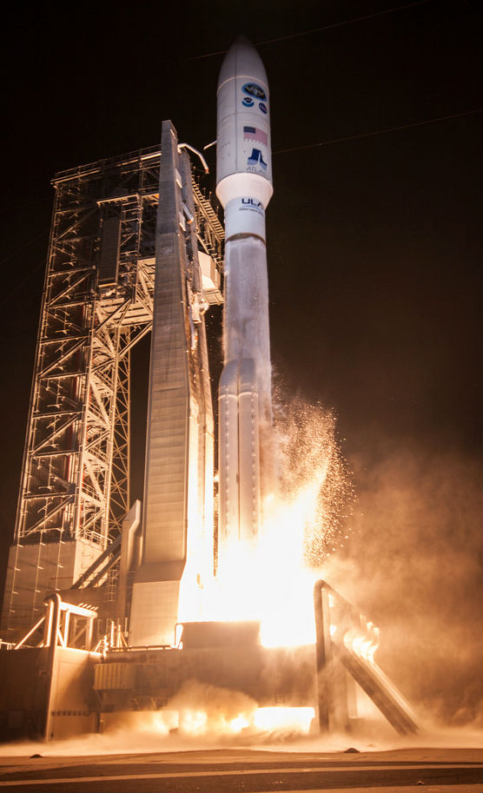
Highlights
19 Nov 2016 GOES-R Launch
29 Nov 2016 GEO orbit attained (became GOES-16)
19 Dec 2016 1st RTEP table uploaded
04 Jan 2017 Opened GLM Door
Jan - late Apr 2017: Too many GS software issues … VAL could not begin.
24 Apr 2017 @ 19:52 UTC (DO.04.04.00) GLM Beta Validation Began
  Clearquest shows 29 fixes associated with DO.04 (+ patches/emergency)
09 Jun 2017 PS-PVR Beta
05 Jul 2017 GLM data to GRB (i.e. delay to GRB to mitigate noise/position errors w/patches)
24 Jul 2017 DO.05.00.00
31 Oct 2017 DO.06.00.00
28 Nov 2017 DO.06.02.00
Some INR averaging but interrupted for:
  Spacecraft Drift to East Slot
  7 d INR averaging
20 Dec 2017 Began Crunching Data for PS-PVR PROV
19 Jan 2018 PS-PVR Provisional
01 Mar 2018 GOES-S Launch (GLM powered on Mar 27, Door opened Apr 12, …
21 Aug 2018 DO.07.00.00 fixes placed in DE … marks start of FULL VAL
GS Software Fixes: DO (“Data Operations”).XX (Version).YY(Patches).ZZ (Emergency Patches)
GOES-16 became the operational GOES-East in Dec 2017

Slide 13
UPCOMING MILESTONES

Slide 14
GLM-16:
01 Nov 2018: Full PS-PVR
GLM-17:
02 Oct 2018: Beta PS-PVR
03 Dec 2018: Prov PS-PVR
XX Sep 2019: Full PS-PVR

Slide 15
THE ADR/WR PROCESS & UPDATES

Slide 16
ADR to WR Overview
Flight WRs
Cal/Val Team
PLPTs
Tools
Data
ADRs
s/w Fix
DO’s, PR’s
Harris/other
s/w Programmers
PRs
faster route
(parameter changes)
Verbal/Email
(parameter changes)
CVCT PRO
Jon Fulbright, Liz Kline,
Randy Race, Dave Pogorzala, Wayne Mackenzie (PAL), Ryan Williams
WRs
(Work Requests)
“Traffic Jam”
CLEARQUEST
system
(Algorithm Discrepency Reports)
AART & ARB
Randy Race, Janet Larsen, others …
Other Instr
Teams

Slide 17
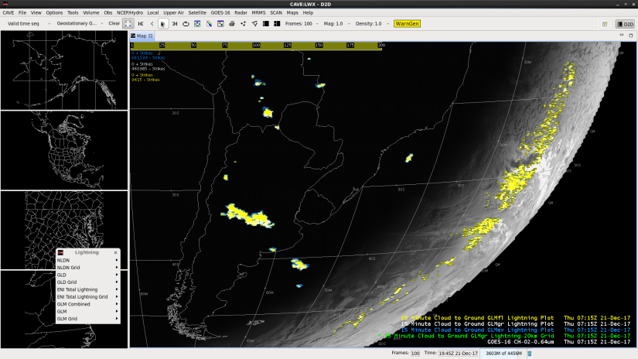
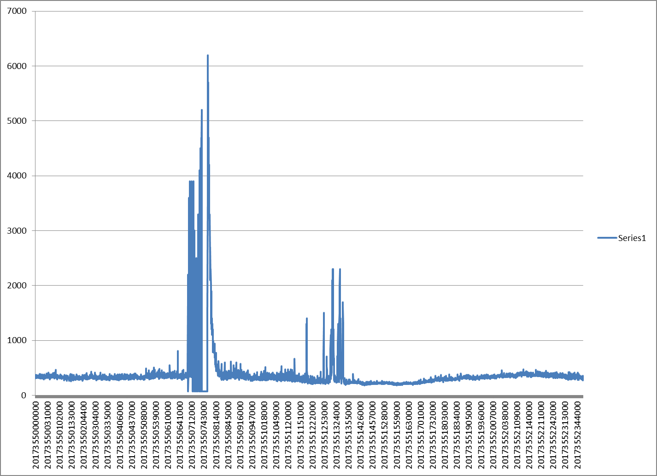
Blooming Example (WR 4697F/5937)
blooming
Other glint or maneuver ?
blooming
(“sun rise”)
data spikes
21 Dec 2017
analyses: Rudlosky (AWIPS)
These GOES-16 data are preliminary, non-operational data and are undergoing testing. Users bear
all responsibility for inspecting the data prior to use and for the manner in which the data are utilized.

Slide 18
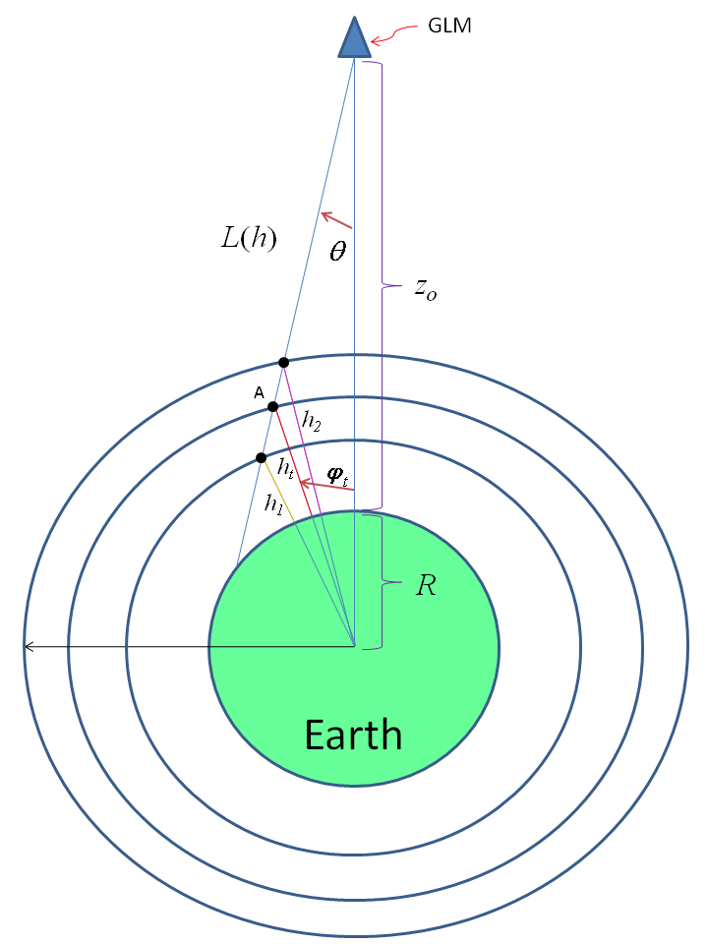
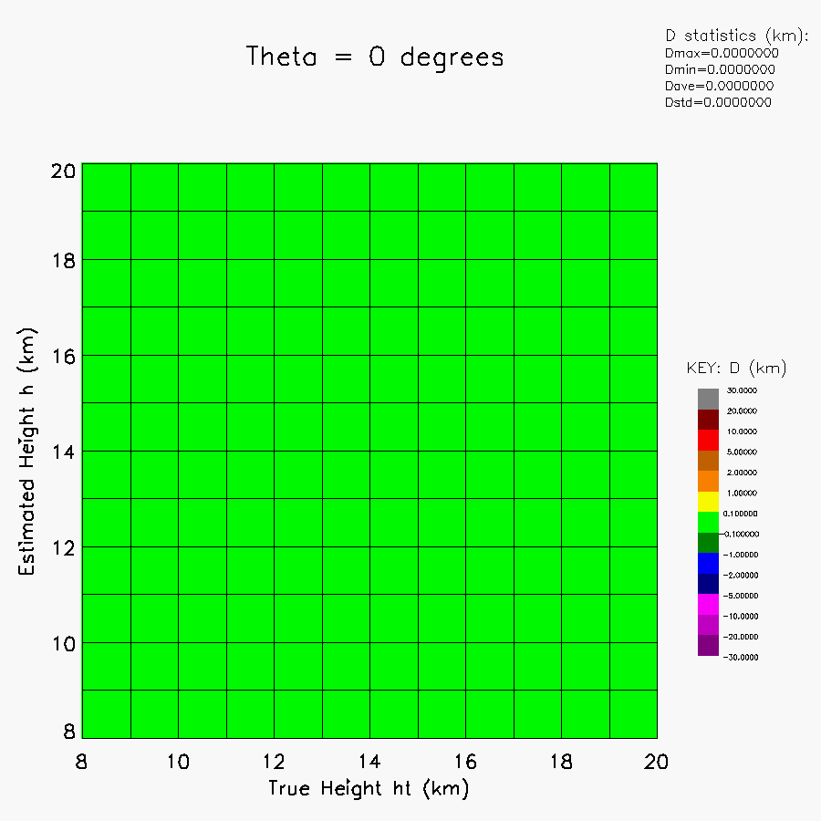
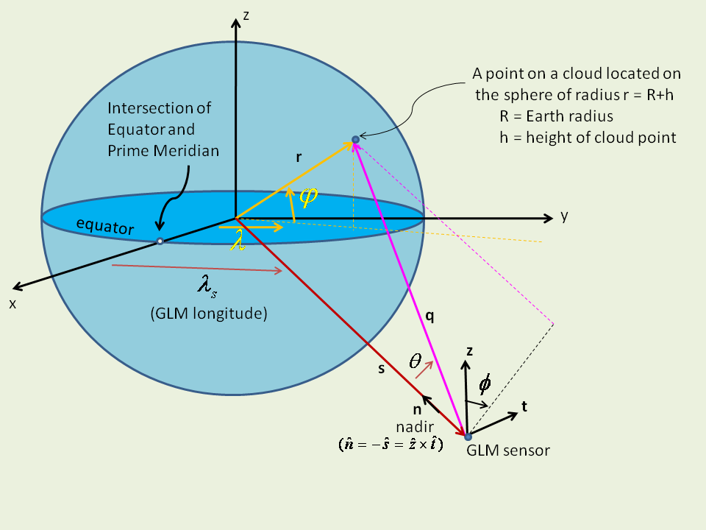
ADR 637/645 Parallax
some history first …
16 June 2010 Report (Koshak): Insight on Choosing an Optimal Thundercloud Top Height for Minimizing GLM Parallax Error
A fixed cloud-top height (~ 12 km) was the initial plan, but this 2010 Report demonstrated parallax errors would violate location accuracy spec
Report also included more complex generalizations

Slide 19
ADR 637/645 Parallax
(cont.)
Virts authored 637/645
Tillier provided ellipsoid model code
637: Optimized 2-parameter (eq/pole) heights in ellipsoid model
645: Created optimal monthly 3ºx3º res cloud-top height “topography”
See Virts talk for details (great parallax mitigation)

Slide 20
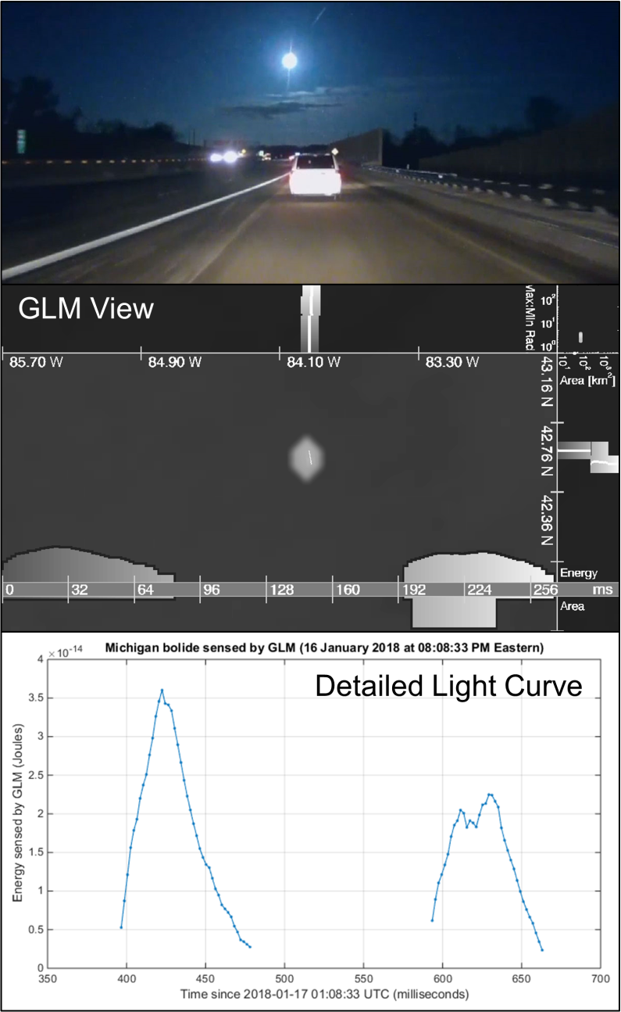
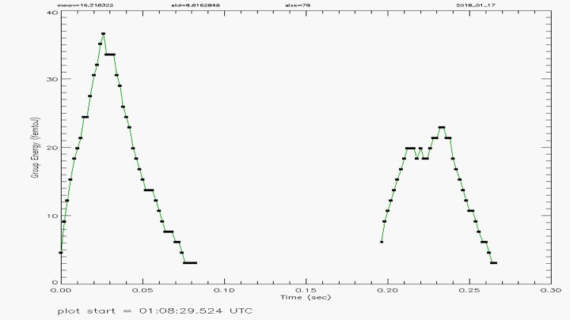
ADR 738 Energy Scale/Offset
From Rudlosky/LMATC/Peterson …
Problem discovered by Koshak in comparing LMATC/Rudlosky Jan 2018 Michigan Bolide to PDA data.
Problem deep-dived by Armstrong and he suggested following fix:
GLM L2 Group Energy
from PDA
 | Current (L2+PUG values) |  | Recommended Update
Lightning | scale_factor | add_offset | scale_factor | add_offset
Events | 1.52597E-15 | 0 | 9.567E-18 | 2.870E-16
Groups | 1.52597E-15 | 0 | 4.275E-16 | 2.870E-16
Flashes | 1.52597E-15 | 0 | 3.750E-15 | 2.870E-16
These GOES-16 data are preliminary, non-operational data and are undergoing testing. Users bear
all responsibility for inspecting the data prior to use and for the manner in which the data are utilized.

Slide 21
∼ 2018 Activity Summary
36 fixes:
  6 PRs (since 15 Dec 2017)
    Update CDRL 79 Rev J [Parallax Lite, 2nd lev filter to remove Bahama Bar] now in DE but to OE Oct 9 or later; 5 others completed.
  7 for DO.07 (DE: 21 Aug 2018; OE: 9 Oct 2018)
    Adj evt times (TOF, etc), Grp/Flsh areas, family links, 4 others not as important.
  13 targeted for DO.08 (DE: ~ 4 Feb 2018; OE: TBD)
    Blooming, burst/outage, 2nd Level Threshold, Coherency LUT (sooner?), Data Burst Filter, Glint Box, Time Order, Event geolocation, 5 others not as important.
  10 with target date uncertain
    Parallax, INR Diurnal Variation, INR optical monitoring, LCFA Radiation Filter (SGF), GPA keep 1st Event in Flash, Data Quality Product, Gridded Product, Optical Energy Distortions in PDA, Double Events/Groups, Dark Flashes.

