Slide 1
Summary of GLM gridded products
Eric Bruning
TTU Department of Geosciences
Atmospheric Science Group
Examples via Kristin Calhoun (NSSL/CIMMS/HWT)
Credit to the implementation team: NESDIS, Lockheed Martin, NWS OPG & TOWR-S, NSSL HWT, NASA SPoRT
9 mo from initial plan to rollout of first grids to >115 WFOs!
GLM Science Meeting, Huntsville, AL
11-13 September, 2018

Slide 2
GLM imagery suits meteorological time series analyses better than point displays
(Loop by Scott Rudlosky/ NESDIS/UMD)
Goal: quantitatively visualize flash properties available at GLM L2 and depict flash spatial extent
Produced as a CONUS pre-operational demonstration in ISatSS instance at AWC/OPG and disseminated via LDM
Open source implementation (glmtools)

Slide 3
seven GLM products:
think of NEXRAD level 2 BASE DATA
✅ Available ✳️ In testing ✴️ Being produced | Flash | Group | Event
Centroid density
Extent density
Average area
Optical energy
✴️
✴️
Useful for counting by a machine.
✅
✴️
Visualizes flash and group properties by linking them to the spatial extent of events.
✳️
✴️
✳️
What you see with your eyes!

Slide 4
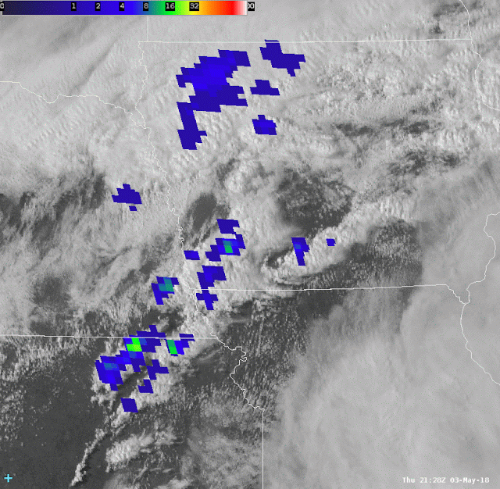
First product: flash extent density
1 min vs. 5 min accumulation, 1 min updates.
The original GLM detector pixels are 8-10 km.
GLM products are delivered on the 2 km ABI fixed grid with the same parallax.
The product is oversampled to depict the shape of the original pixel while preserving the maximum flash rate in the center of those pixels

Slide 5
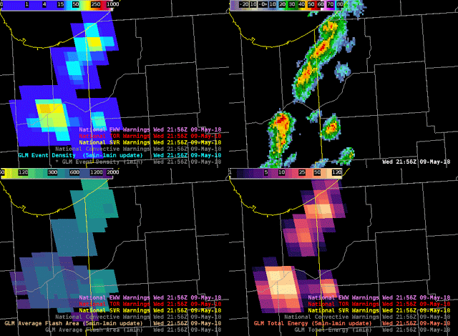
“Traditional” Lightning jump
with average flash area and Total optical Energy
Small flashes and a compact core of greater optical energy accompany flash rate jump during mixed phase updraft pulse. Reverse as as pulse subsides.
FED
AFA
TOE

Slide 6
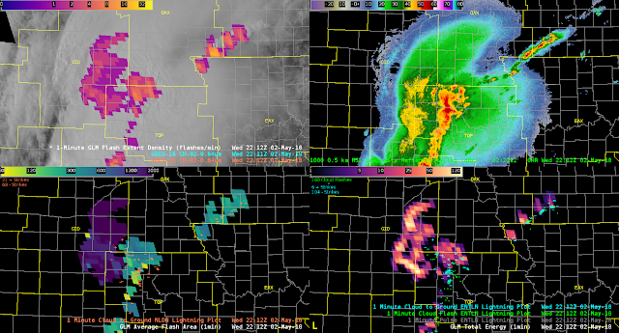
Area product distinguishes cores from stratiform region and optical energy shows evidence of channel shape
Flash extent density
Average flash area
Total energy

Slide 7
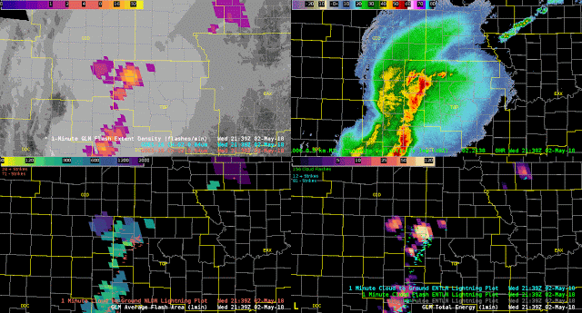
All three lightning properties match the conceptual model of lighting hazard in MCSs, and highlight risk from developing new storms

Slide 8
GLM imagery is ready for use
20 offices continue to evaluate average flash area and total optical energy
HWT feedback: seeing all fields gives me confidence that I understand the lightning data!
Feedback from offices with less expert, on-site guidance: not sure what I’m supposed to do with these!

