Slide 1
GLM Observations of Bolides
Randy Longenbaugh
Clemens Rumpf
Observational Entry Data
Asteroid Threat Assessment Project
NASA Advanced Supercomputing Division
NASA Ames Research Center

Slide 2
GLM Bolide Detection History
Tagliaferri et al. (1998), twenty years ago, foresaw the practical use of NASA's proposed space based Lightning Mapper for the detection of meteoroid impacts
GOES-16 with the first GLM launched November 19th 2016
Peter Jenniskins and Jim Albers (NASA CAMS) also suspected GLM would detect meteoroid impacts and approached the Lockheed Martin GLM team (early February 2017)
First known GLM detection of a meteoroid impact February 6th, 2017
September of 2017 NASA Ames started collecting GLM level 2 data for meteoroid research
NASA/PDCO met with NOAA/GLM team to discuss GLM collaboration (November 2017)
  Agreed to evaluate and document the GLM meteoriod detection capability
  Collaborative work between NASA, NOAA, Lockheed Martin (Palo Alto), and others
GOES-17 with the second GLM launched March 1st 2018
First multi-sat GLM detection of a meteoroid impact May 8th, 2018

Slide 3

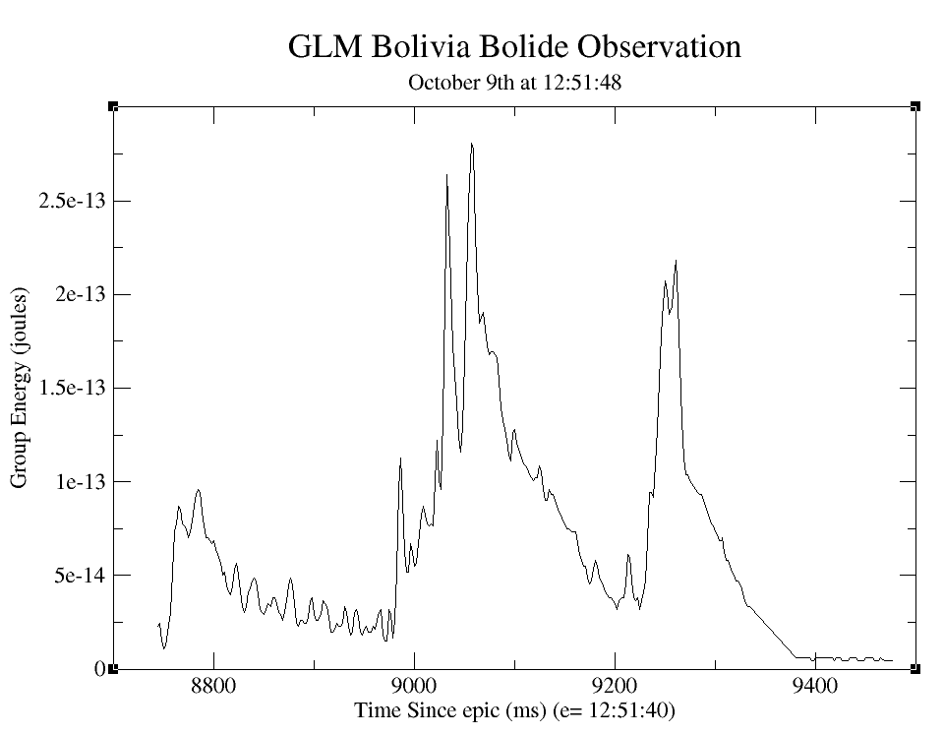
Why is Observational Data Important?
Observational data including GLM Light Curves (LC) are needed by NASA’s Planetary Defense Program to better understand the threat posed by larger asteroids hitting Earth
  LCs are measurements of narrow-band visible spectrum optical intensity as a function of time that record the disintegration of a Small Asteroid (SA) as it impacts the earths atmosphere
  LCs can be used to infer SA pre-entry characteristic (structure/strength, size, mass)
  LCs can inform development of physics models (fragmentation models, ablation models, and airburst models)
  LCs provide high fidelity, high cadence “snapshot” of the breakup, fragmentation and ablation of SA impactors – no other data is as rich in informing and constraining the fragmentation processes needed to improve impact models
Once developed GLM data could be used as a data product for the NASA/Planetary Defense Coordination Office (PDCO) automated bolide reporting system

Slide 4
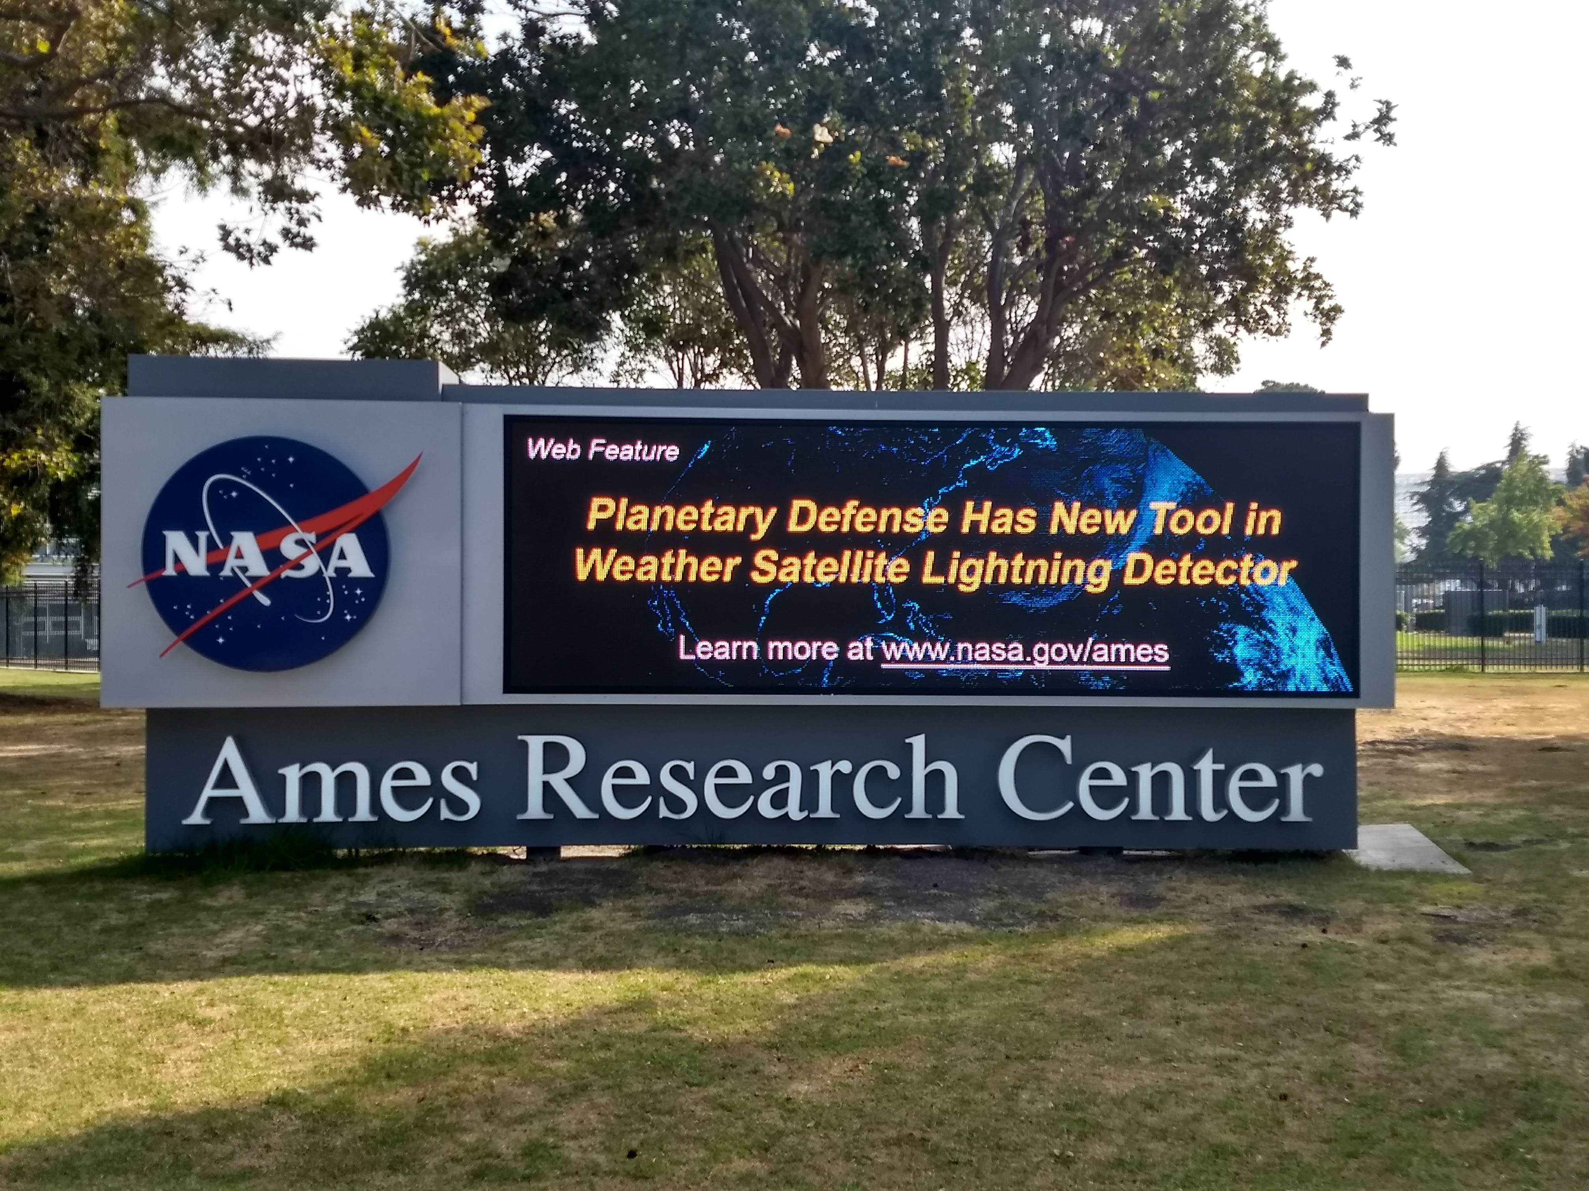
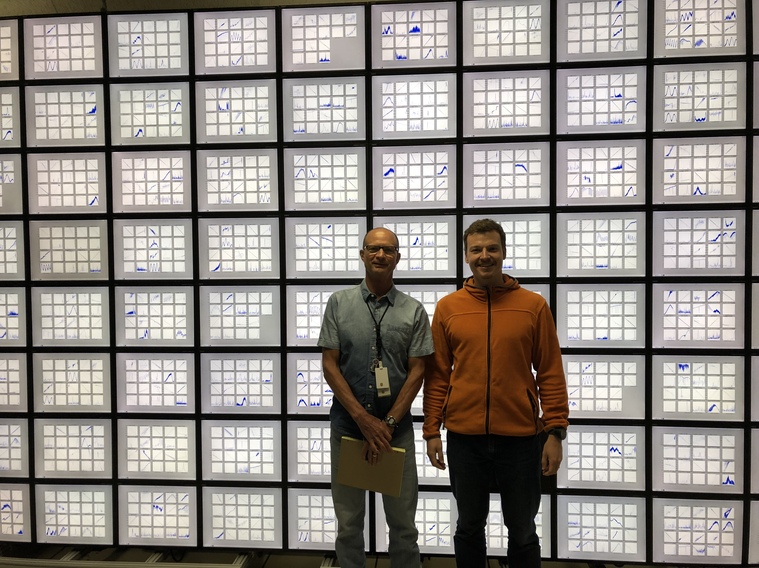
GLM Work at Ames
Recent publication in Meteoritics and Planetary Sciences (MaPS) journal
  “Detection of meteoroid impacts by the Geostationary Lightning Mapper on the GOES‐16 satellite” (July 15th, 2018)
Other articles
  Space.com “Flash, Bam, Alakazam: Lightning-Detecting Satellite Also Spots Meteors”
  Ames press release –
Clemens Rumpf, Randy Longenbaugh, and Chris Henze are developing algorithms to find bolides autonomously in the GLM L2 data
  “Algorithmic Approach for Detecting Bolides with the Geostationary Lightning Mapper”

Slide 5
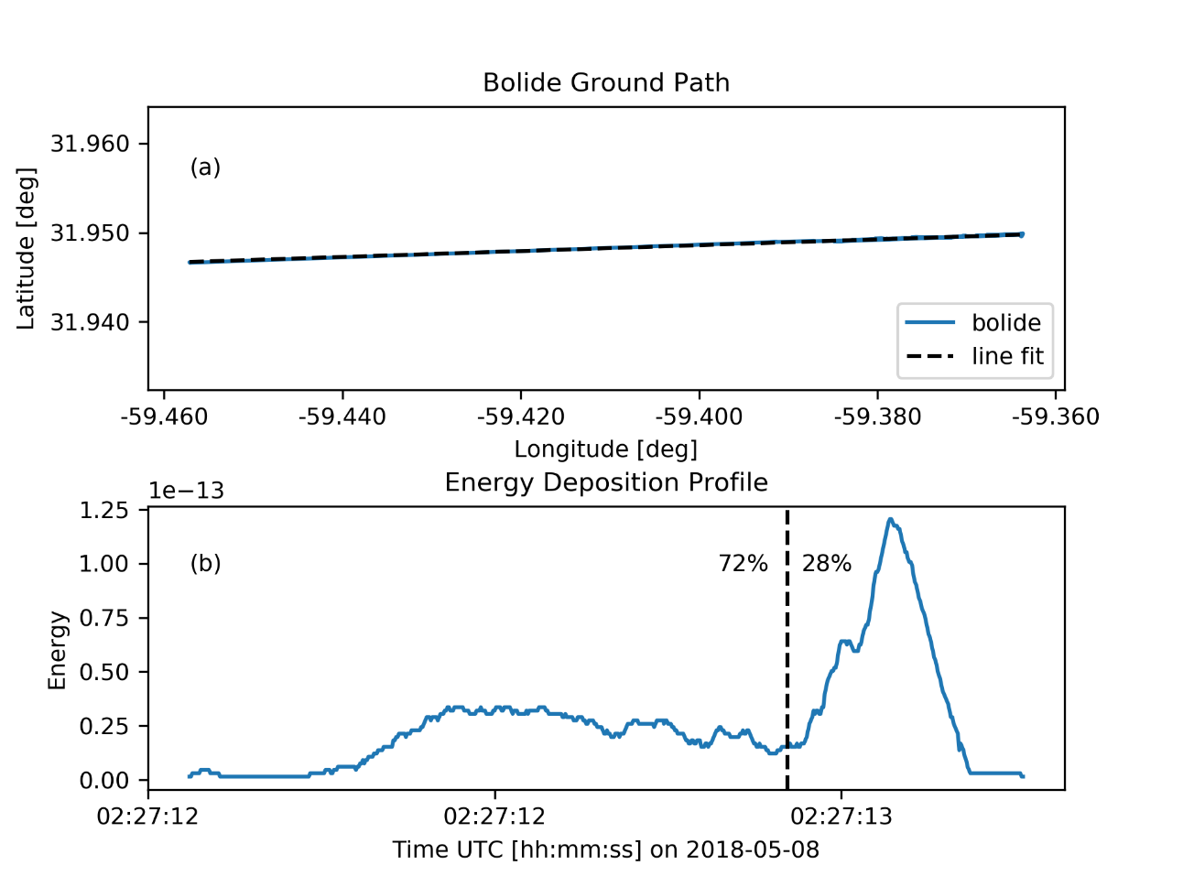
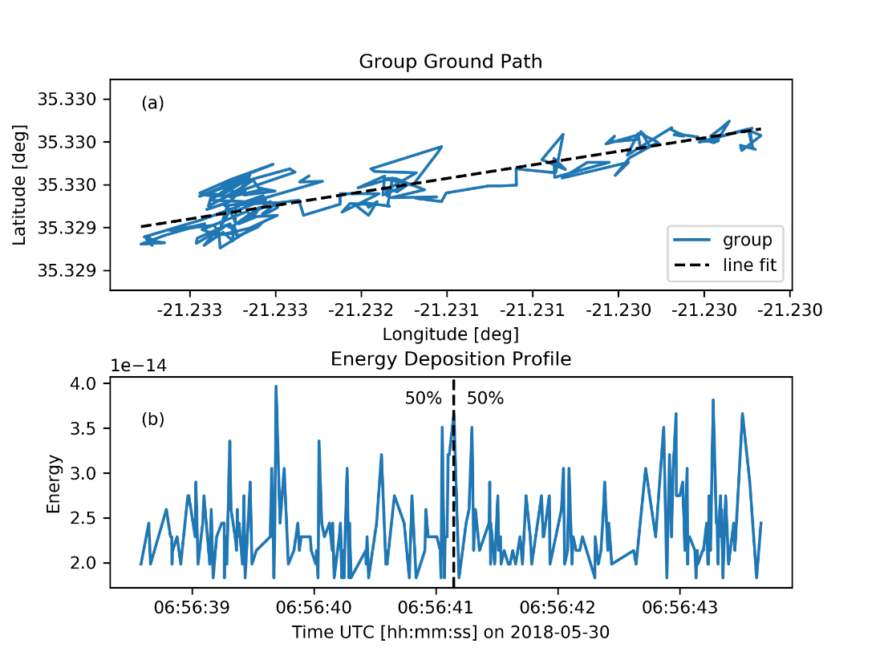
Automated Processing
Regularity of Light Curve
Ground Track Straightness
Energy Profile
Bolide Candidate Bucket
L2 Data
…
Ground Track
Multiple tests assess similarity with bolide signature
Yes
Extract Groups
Bolide-similar?
Light Curve
No
Discarded
Real Bolide
Artefact Signature

Slide 6
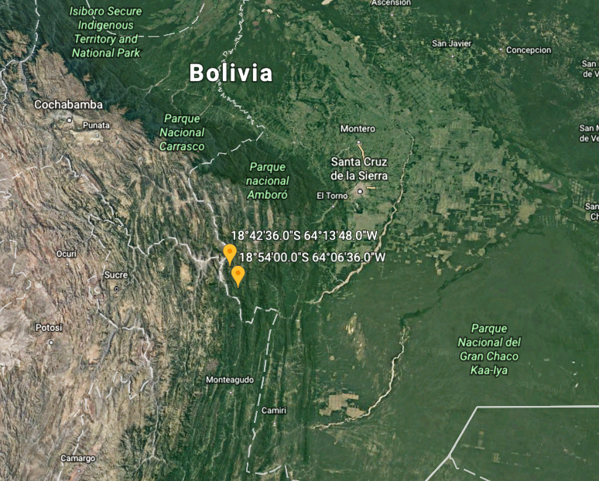
Bolivian Fireball Observation (10/9/2017)
Observation extracted from the Level-2+ GLM netCDF4 data product
  Used Group data
Also detected by US Government sensors (JPL Fireball website: https://cneos.jpl.nasa.gov/fireballs/)

Slide 7
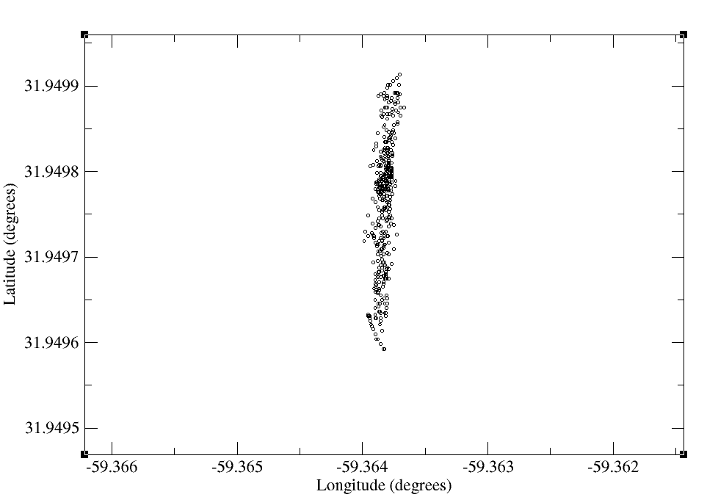
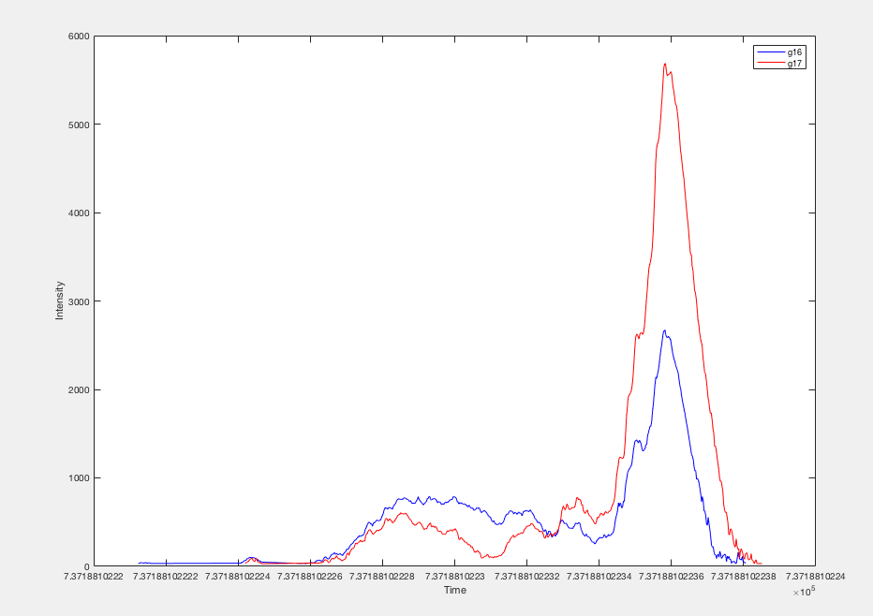
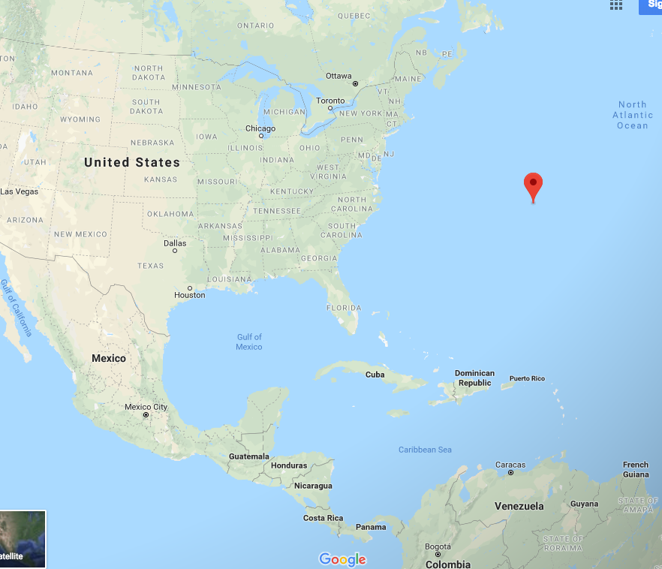
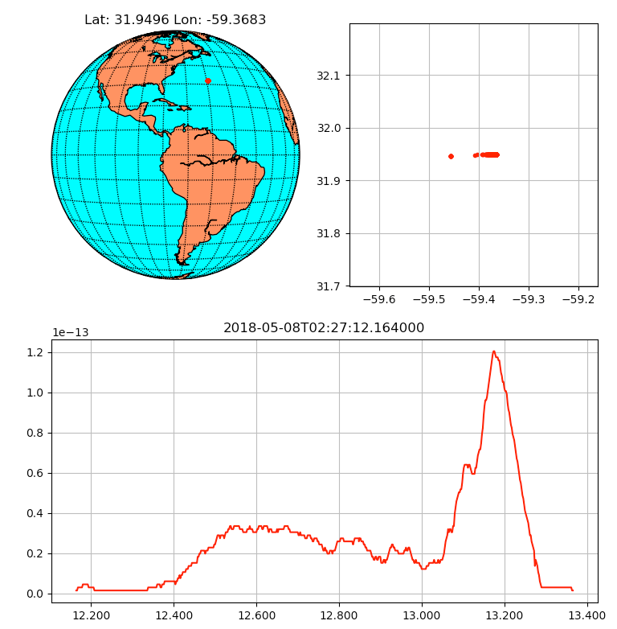
Two-Ball GLM Bolide Detection
May 8th, 2018
Northern Atlantic Ocean
  31.95 north, 59.37 west
Differences in light curve intensities suggest anisotropic radiation
Also reported by USG sensors
  https://cneos.jpl.nasa.gov/fireballs/
Note: G17 not operational. Data provided by GLM team at Lockheed Martin
GLM-16
GLM-17
Intensity (counts)
Time (seconds)

Slide 8
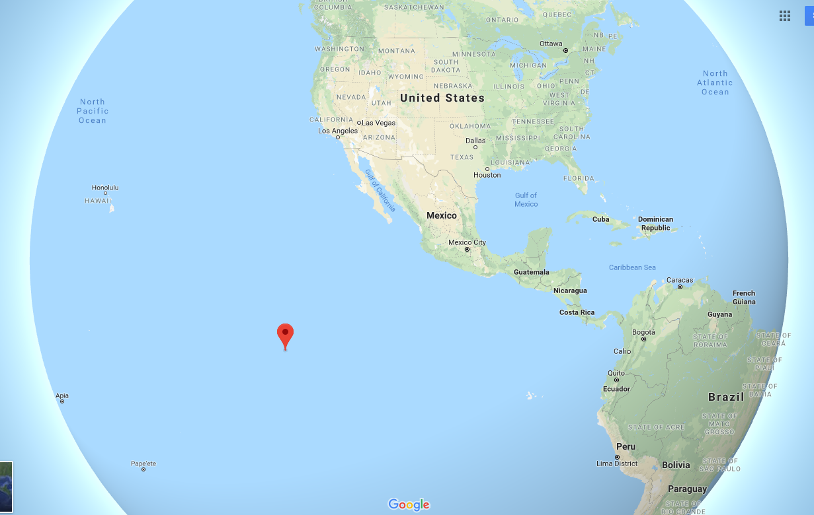
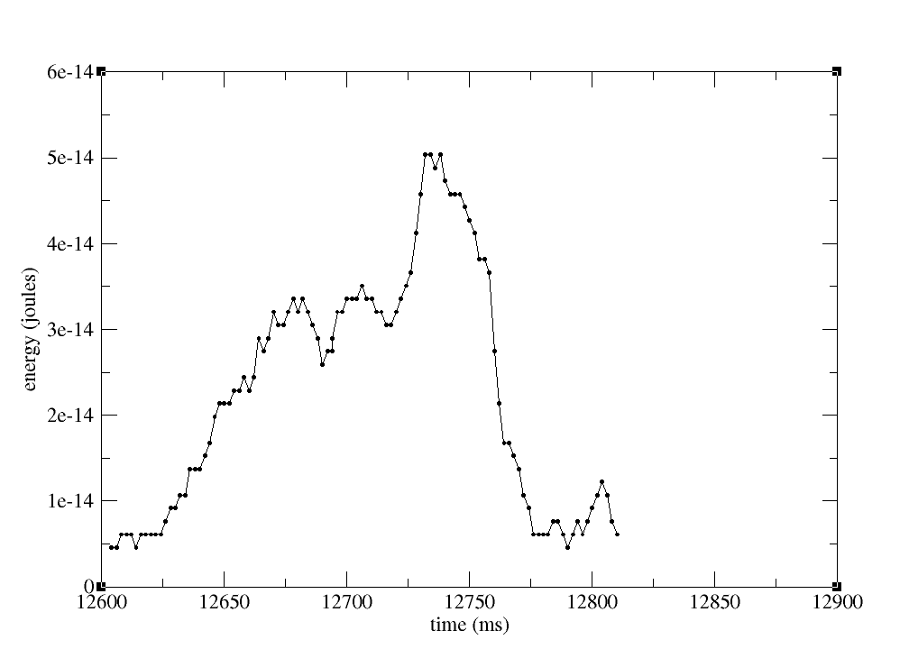
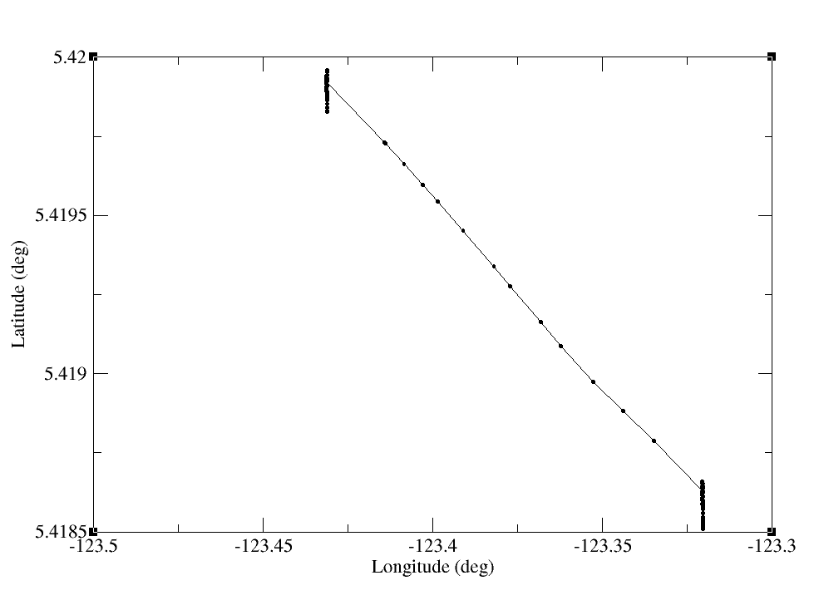
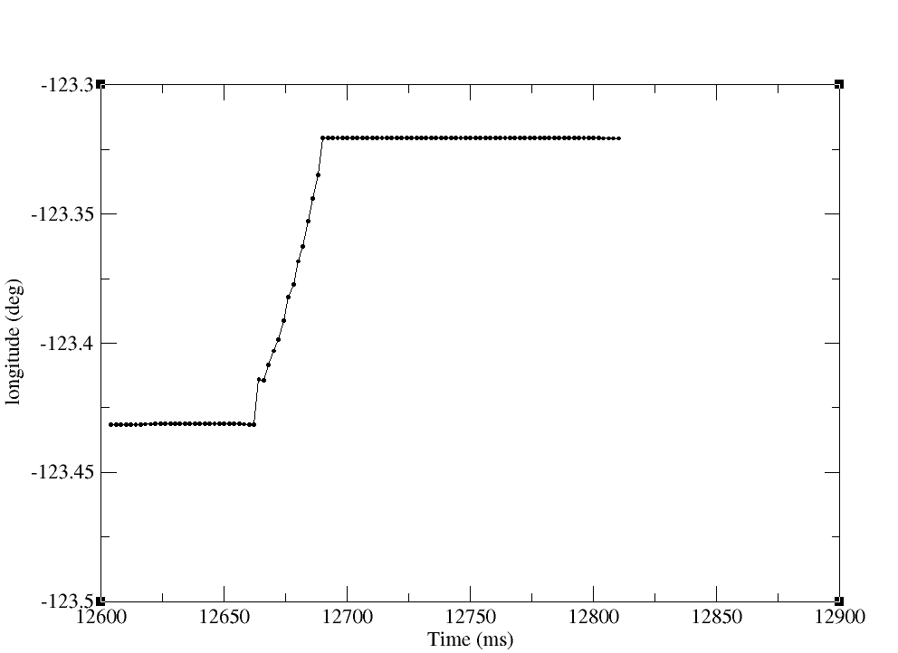
Probable Bolide
GLM-16
12.2 km
GLM-16
July 30th, 2018 – 14:09:12
Found using proto-type bolide detection algorithms (GLM-16 only)
Not reported by USG sensors
Also detected by GLM-17
GLM-16

Slide 9
Path Forward
Compare GLM L0 and L2 data for meteoroid events
  Compare light curves
  Investigate LC distortions due to instrument effects
    i.e. CCD blooming, pixel saturation, and background effects
  Investigate geo-location and timing parallax offsets for higher bolide altitudes
Collaborate with NOAA/GLM and NASA/PDCO to develop a level 0 processing capability for non-lightning events
Develop GLM data processing to provide event reports to NASA/PDCO automated bolide detection system
Investigate differences between broad-band USG sensor data and the GLM narrow-band data
  Waiting for USG data release
  Investigate differences in integrated luminous energies
NASA is investigating the acquisition of level 0 data

Slide 10
Backup Slides

Slide 11
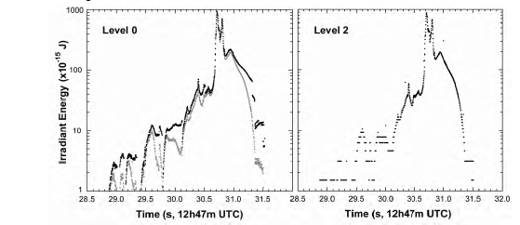
GLM Prelim
GLM has a meteoroid detection threshold of about an absolute (distance = 100 km) -14 visual magnitude meteor (GLM capable of detecting several dm to meter-sized asteroids impacting Earth atmosphere)
Comparison with other light curve measurements implies that GLM samples the meteoroid disintegration light curve nearly completely unaffected by onboard processing and downlink processes tailored to lightning data
Calculated total optical radiant energies correspond well to those reported from broad-band USG sensor data which suggests that during the meteoroid’s peak brightness the GLM pass-band is dominated by continuum emission, rather than O I line emission
Saturation limitations for large events (14 bits of dynamic range)
Meteoroid impact assessment must account for instrument effects such as CCD blooming, event FIFO overflows, background noise influences, LSB limitations, and assumed lightning altitudes to produce best representation of the light curve recording, best geo-location, and timing
December 29th, 2017 Atlantic Ocean bolide as detected by GLM Level 2 (top) and Level 0 (bottom)
Dark curve background correction Gray curve no background correction

