Slide 1
GLM 16 and 17 Comparisons to WWLLN Strokes to GLM FLASHES
Report by Robert Holzworth and Michael McCarthy
GLM meeting Huntsville Sept 2018
WWLLN stroke locations matched at nearly the same rate by Both NOAA16 and 17 GLM FLASHES
GLM 16 still has obvious areas of disagreement
List of other issues in present nc files

Slide 2
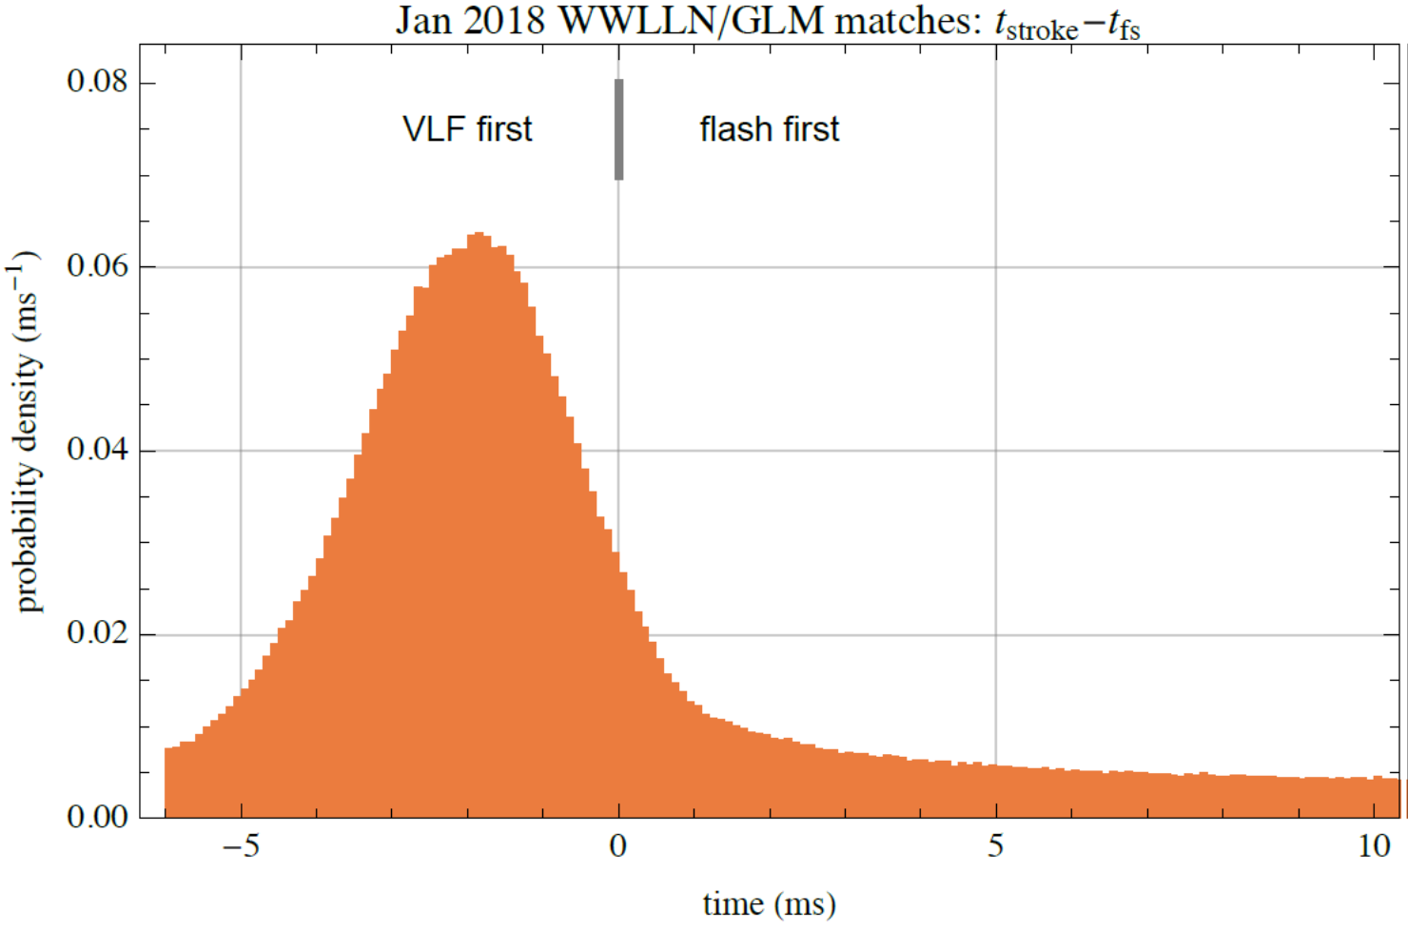
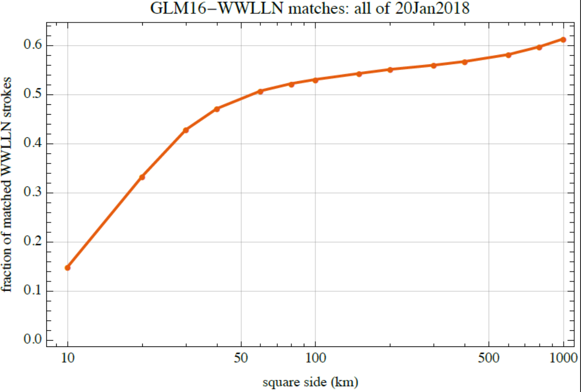
Discussion of Methods for Matching GLM and WWLLN events
WWLLN stroke times can be several msec prior to the GLM Flash time, and up to 3000 ms after the flash time.
We used 200 ms before flash start, to 200 ms after flash end
And within 100 km
TIME: See Next Slide
Distance- see following slide

Slide 6
GLM16
GLM17

Slide 7
ALL WWLLN strokes (blue) over plotted with GOES16 GLM Matches

Slide 10
ERRORS
GLM
WWLLN
LEFT: same as earlier slide (all WWLLN (blue) over plotted with Matches)
RIGHT: JUST THE OPPOSITE: ALL GLM-16 (red) over plotted with Matches

Slide 11
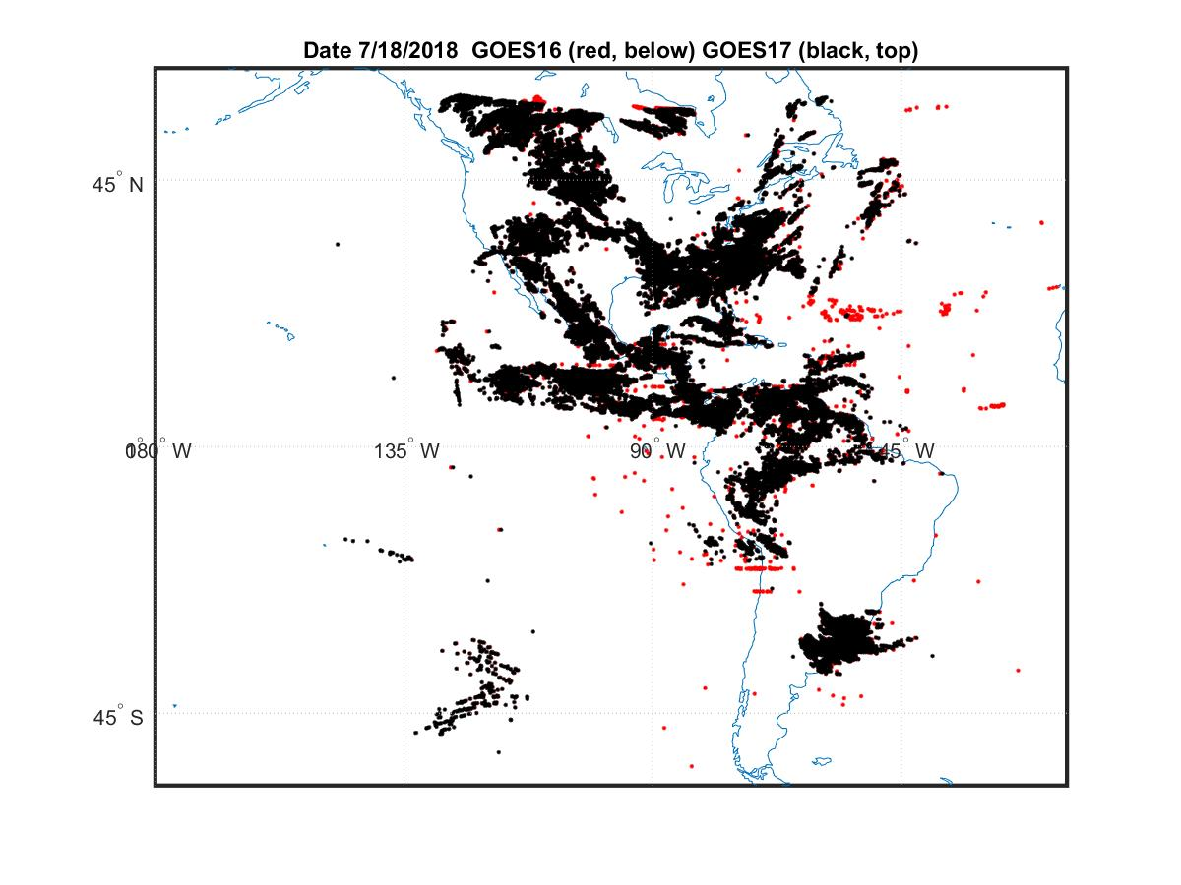
ALL FLASHES
GOES16
And
GOES17
FLIP with next slide
ALL GLM17 flashes (black) plotted on top of ALL GLM16 (red) flashes

Slide 12
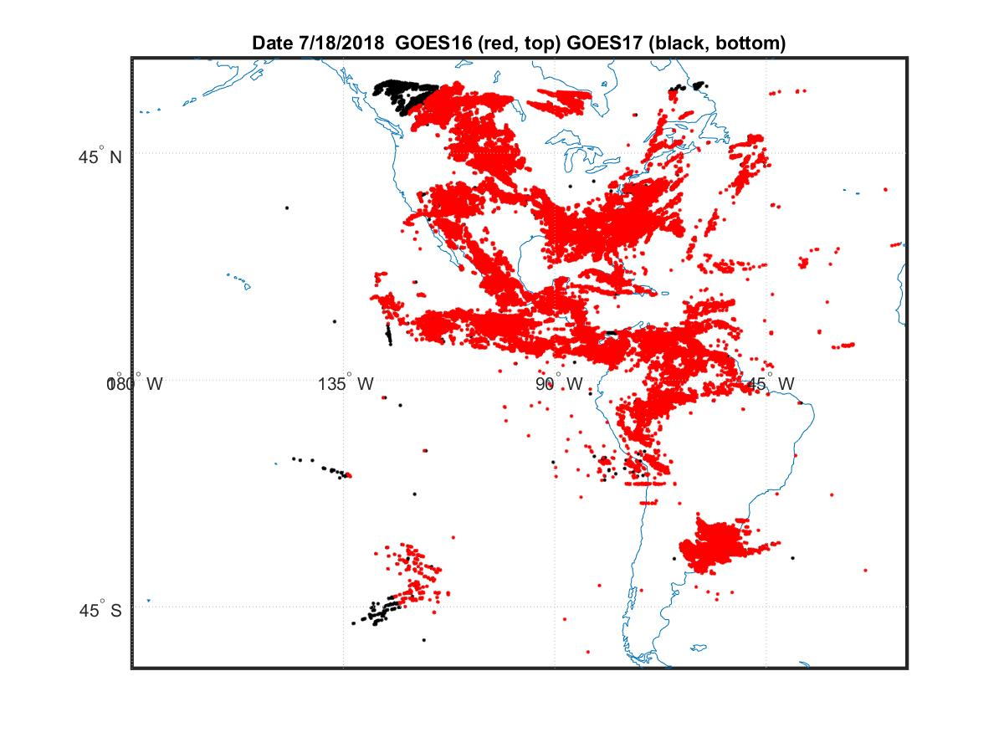
ALL GLM16 flashes (red) plotted on top of all GLM17 flashes (black)

Slide 13
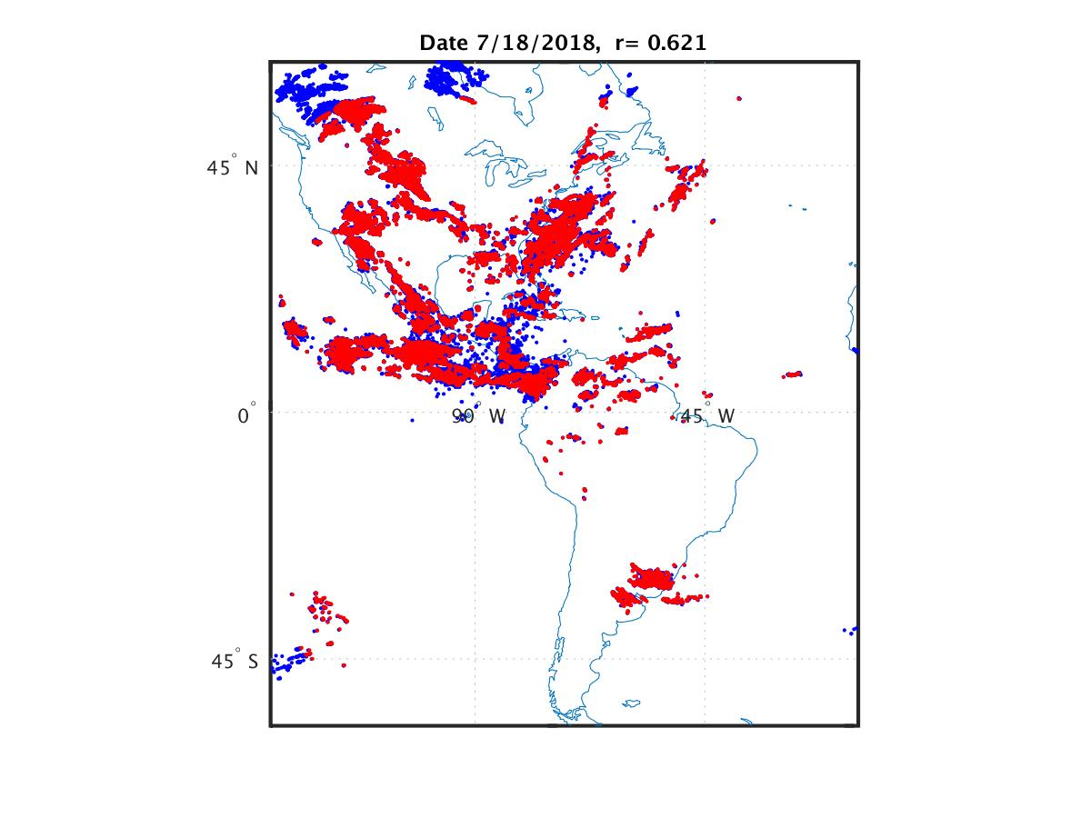

Slide 14
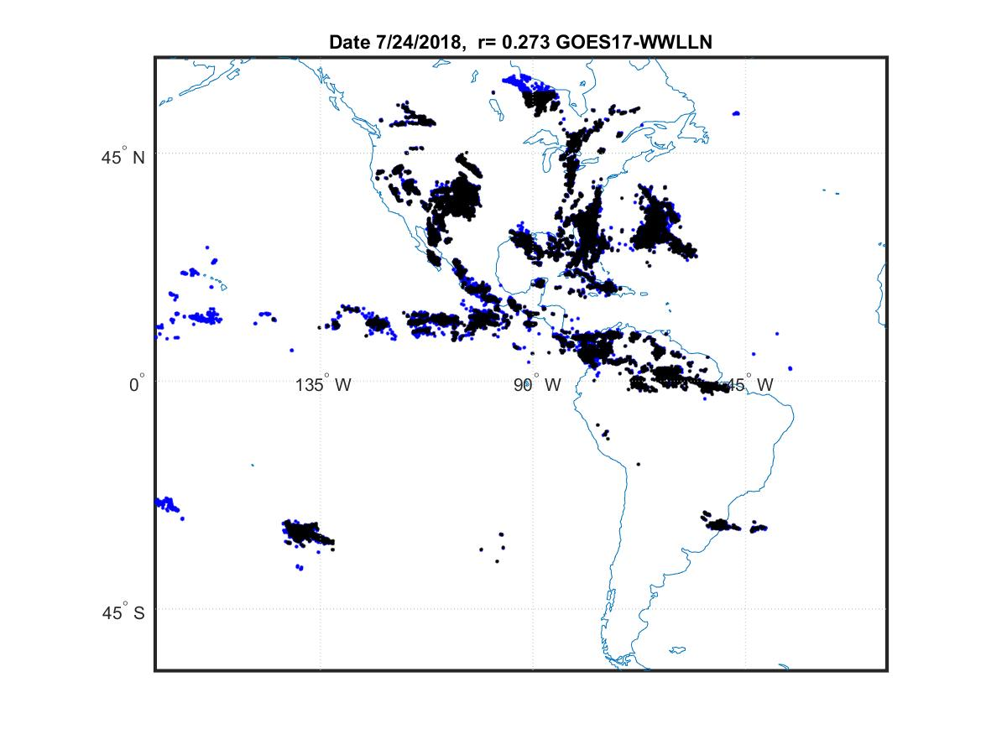
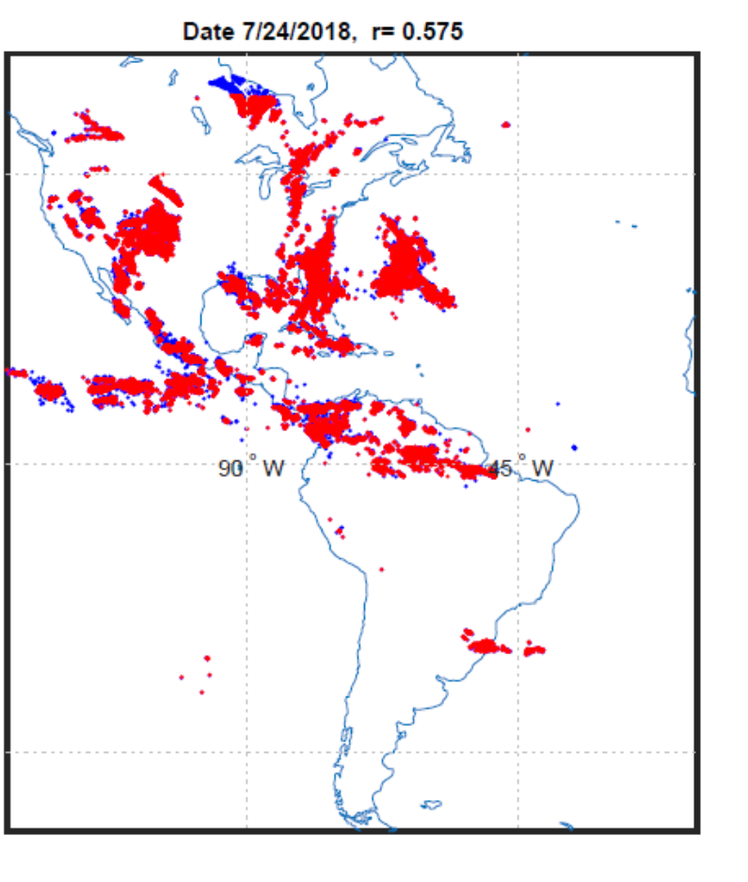
WWLLN
GLM17
MATCHED
WWLLN
GLM16
MATCHED

Slide 15
Other notes from Michael McCarthy:
1. Fill value is sometimes used in the file time stamp. Sometimes a series of files each have time stamp with the fill value (-999). Excepting the last file in the series, each has no {event,group,flash} data. Is data in the last file good even though the time stamp is fill?
Example from day 09Jul2018/GOES16:
OR_GLM-L2-LCFA_G16_s20181901547200_e20181901547200_c20181901548106.nc
OR_GLM-L2-LCFA_G16_s20181901547400_e20181901547400_c20181901548305.nc
OR_GLM-L2-LCFA_G16_s20181901548000_e20181901548000_c20181901548505.nc
OR_GLM-L2-LCFA_G16_s20181901548200_e20181901548200_c20181901549105.nc
OR_GLM-L2-LCFA_G16_s20181901548400_e20181901548400_c20181901549305.nc
OR_GLM-L2-LCFA_G16_s20181901549000_e20181901549000_c20181901549506.nc
OR_GLM-L2-LCFA_G16_s20181901549200_e20181901549200_c20181901550105.nc
OR_GLM-L2-LCFA_G16_s20181901549400_e20181901549400_c20181901550304.nc
Each has time stamp -999. Except the last file, each has no {event,group,flash} data. Last file has 2369 events, 772 groups, 27 flashes. Same thing happened on 3 days in July 2018 for GOES16.
2. Conflicting/incorrect count values in .nc files This problem was discussed some at last year's meeting, and is not new. Over July 2018, GOES16/GLM had 132,286 20-second L2 files. Discrepancies between the claimed and actual number of (events,groups,flashes) in a file appeared in (28, 27, 116) files for events, groups, and flashes respectively. For example, the file starting 10Jul2018 at 21:11:40 has 536 events, although the event count field in the .nc file indicates there should be 10264 events. Oddly, there is data for 563 flashes, implying several flashes have zero events.
3. I don't think we pursued the problem shown in the flashDurations figure. The distribution of flash durations shows artifacts at 0s, near 0.2s, and after 3.0s.
4. I attached a figure associated with some WWLLN strokes appearing before a flash is detected, and the brief write-up that I uploaded last March.

Slide 16
Thanks for listening

