Slide 1
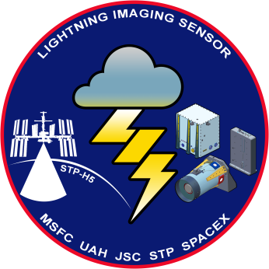
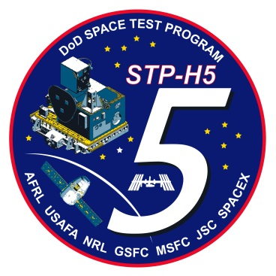




Lightning Imaging Sensor (LIS) on International Space Station (ISS):
Status and Plans
Richard Blakeslee / NASA Marshall Space Flight Center
GLM Science Team Meeting
12 September 2018

Slide 2
Mission Overview
Mission
Fly a flight spare LIS on ISS as a follow-on to TRMM, taking advantage of unique capabilities provided by the ISS (e.g., high inclination, real time data).
LIS integrated as a hosted payload on the DoD Space Test Program-Houston 5 (STP-H5) and launched on a SpaceX rocket for a minimum 2-year mission.
Measurement
NASA MSFC, the University of Alabama in Huntsville (UAH) and their partners developed and demonstrated the effectiveness and value of using space-based lightning observations as a remote sensing tool.
LIS measures lightning (amount, rate, radiant energy) during day and night, with storm scale resolution, millisecond timing, and high detection efficiency.
Need and Benefit
LIS on ISS will extend TRMM time series observations, expand latitudinal coverage, provide real time data to operational users, and enable cross-sensor calibration.
Lightning is quantitatively coupled to both thunderstorm and related geophysical processes, and therefore provides important science inputs across a wide range of disciplines (e.g., weather, climate, atmospheric chemistry, lightning physics).
Sensor Unit (legacy hardware)
Optical Assembly
128 x 128 CCD Focal Plane
Lightning and background detection
Electronics Unit (legacy hardware)
Real Time Event Processor, Data formatting
Power conversion and control
Interface Unit (new hardware)
Power conversion, timing, and control
ISS interface

Slide 3
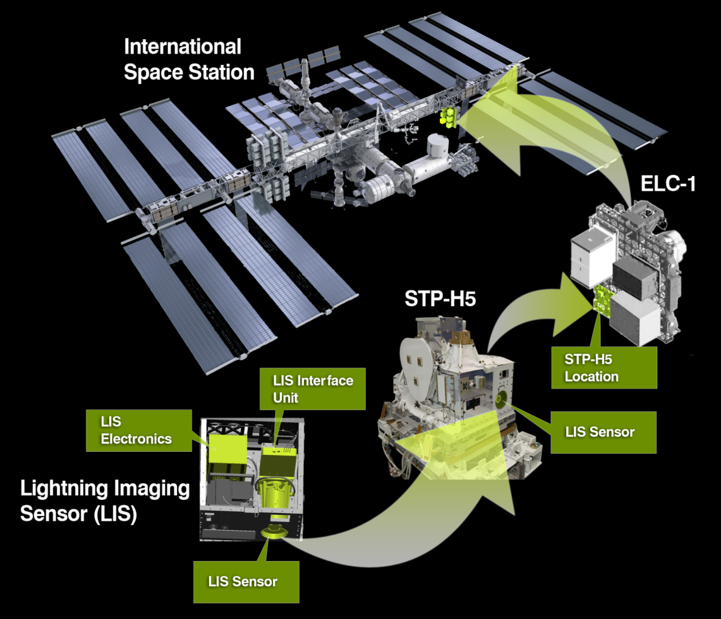
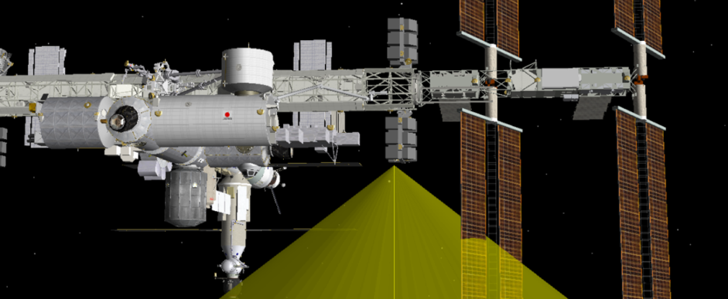
Launch and Operation
Operation (minimum 2 years)
LIS launched aboard Space X Cargo Resupply Service-10 (CRS-10) mission on 19 February 2017.
STP-H5 payload robotically installed with LIS in an Earth viewing position.
On-orbit activation occurred February 27, 2017. Data collection has continued with only one short interruption since this date.
51.6° inclination orbit, ~405 km altitude (LIS detects to ~ 55° N/S latitude) , ~600 x 600 km FOV.
60 days required for a complete sample of diurnal cycle.

Slide 4
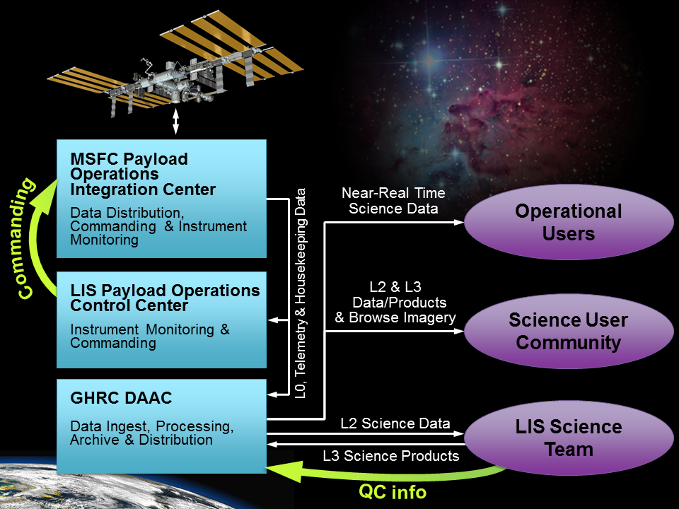
Data Handling
The well-established and robust data handling infrastructure used for LIS on the Tropical Rainfall Measuring Mission (TRMM) was adapted for ISS.
Therefore, lightning observations from LIS on ISS can be quickly delivered to and used by science and applications users.
Data now provided in both the familiar HDF4 format and a new netCDF-4/CF format.
Data are produced for LIS on ISS, by NASA’s Global Hydrology Resource Center (GHRC) Distributed Active Archive Center (DAAC).
LIS data can be obtained from the GHRC DAAC at https://ghrc.nsstc.nasa.gov/lightning/

Slide 5
LIS Accomplishments
Significant LIS Accomplishments since the 2017 GLM Science Team Meeting
Initial public release of Beta level data occurred September 2017.
Post Launch Assessment Review (PLAR) was successfully completed in October 2017 following careful assessment by the Science and Operation Teams, after which LIS was declared fully operational, recognizing that it was meeting or had an identified path to meet all of its Level 1 science requirements.
Provisional data first publically released in January 2018 with sub-millisecond timing accuracy.
Version 2 of the Provisional level data (P0.2) publically released in June 2018 that now also included sub-pixel geolocation accuracy. If you are using LIS data, P0.2 is the version you need to use.
With P0.2, LIS has now met all of its Level-1 Science Requirements, with the last two − timing accuracy/ stability and geolocation accuracy − being the successful result of a focused effort by the LIS Science Team.
Also with P0.2, Cal/Val and initial science studies can now be ramped up.
  Acknowledgements: Katrina Virts, Doug Mach, Dennis Buechler, Amy Lin, and GHRC DAAC team.

Slide 6
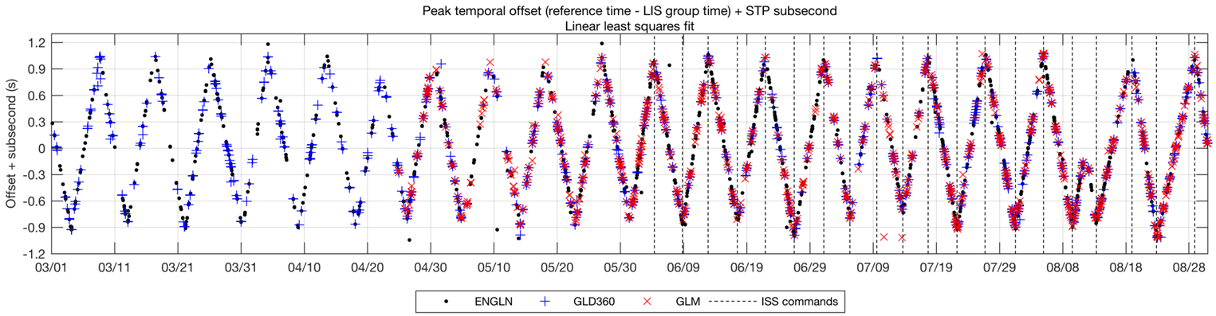
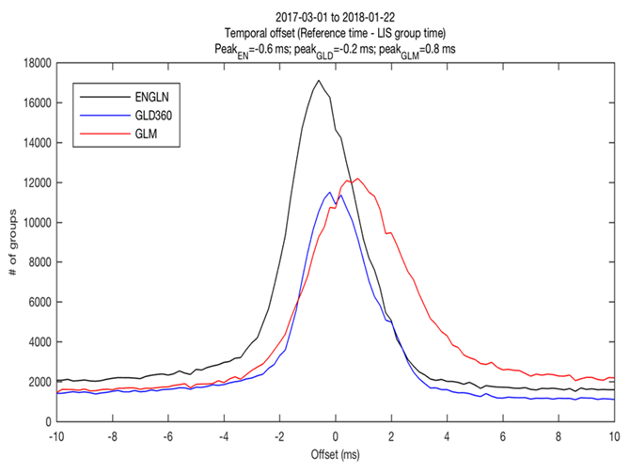
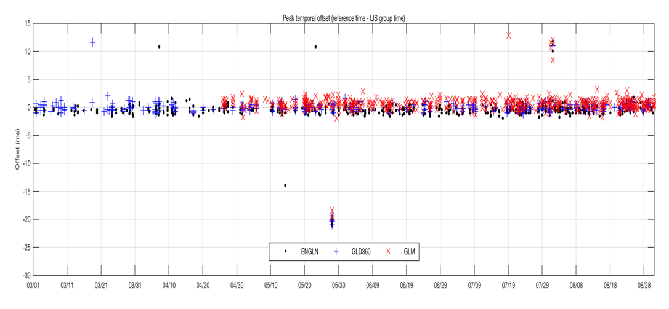
Timing Accuracy
The on-board time-tag for LIS science data traces to ISS Broadcast time, which the LIS team initially thought corresponded to GPS time.
Comparison to three reference systems showed the time varied between +/- 1 second from GPS.
Time offset of LIS data time-tagged with uncorrected ISS broadcast time compared to three reference “truth” sources.
ISS Broadcast time is managed manually to keep it within +/- 1 second of GPS, which would be unacceptable if it were not possible to correct.
Fortunately, an error correction term enables accurate and stable time to be obtained.
GPS Time = Broadcast Time – Time Error
(note: correction applied in both real time and post processing)
Reference Lightning “Truth” Data Sources:
Earth Networks Global Lightning Network (ENGLN)
Vaisala GLD360
Geostationary Lightning Mapper (GLM)
Corrected time now provides sub-millisecond timing.
Peak time offsets (30 s bins) demonstrate excellent stability over 6-months.

Slide 7
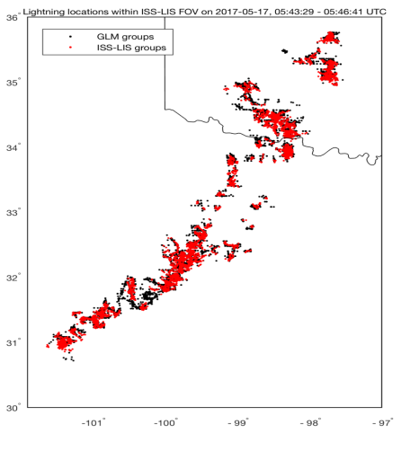
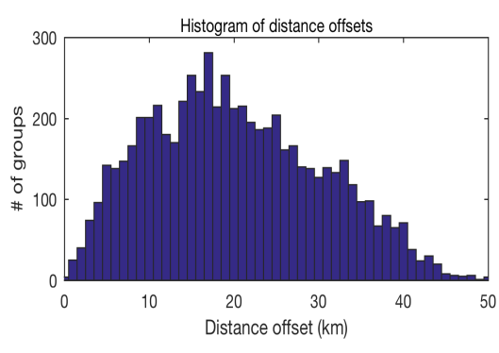
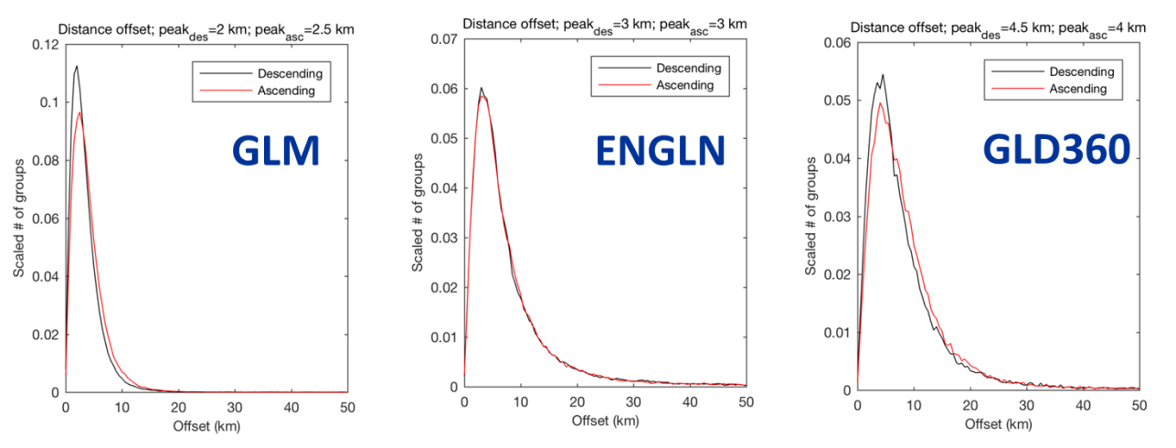
Geolocation Accuracy
Ephemeris (position and velocity) is bundled and time-tagged with Pointing and Support (PS) Time that provides accurate GPS with no correction. Attitude (quaternion and rate) also use PS time but require correction. Star tracker is primary for attitude (but ISS data also good).
Even with correct timing applied to navigation variables, peak distance offsets as large as 20-30 km still remained (plot to the left) .
Therefore, applying fine turning to roll, pitch, yaw and lens distortion gives subpixel pointing (see excellent agreement between LIS and GLM in overpass of a Texas-Oklahoma storm system in the plot to the right).
Distance offsets in untuned descending orbit
Fine-tuned geolocation
Distance offset of LIS compared with GLM ( “apples – to – apples optical” ) shows sharp peak with sub-pixel accuracy of 2-2.5 km (plot far left).
Distance offsets of LIS compared with the long-range Earth Networks and GLD360 RF systems further verifies this excellent geolocation accuracy.

Slide 8
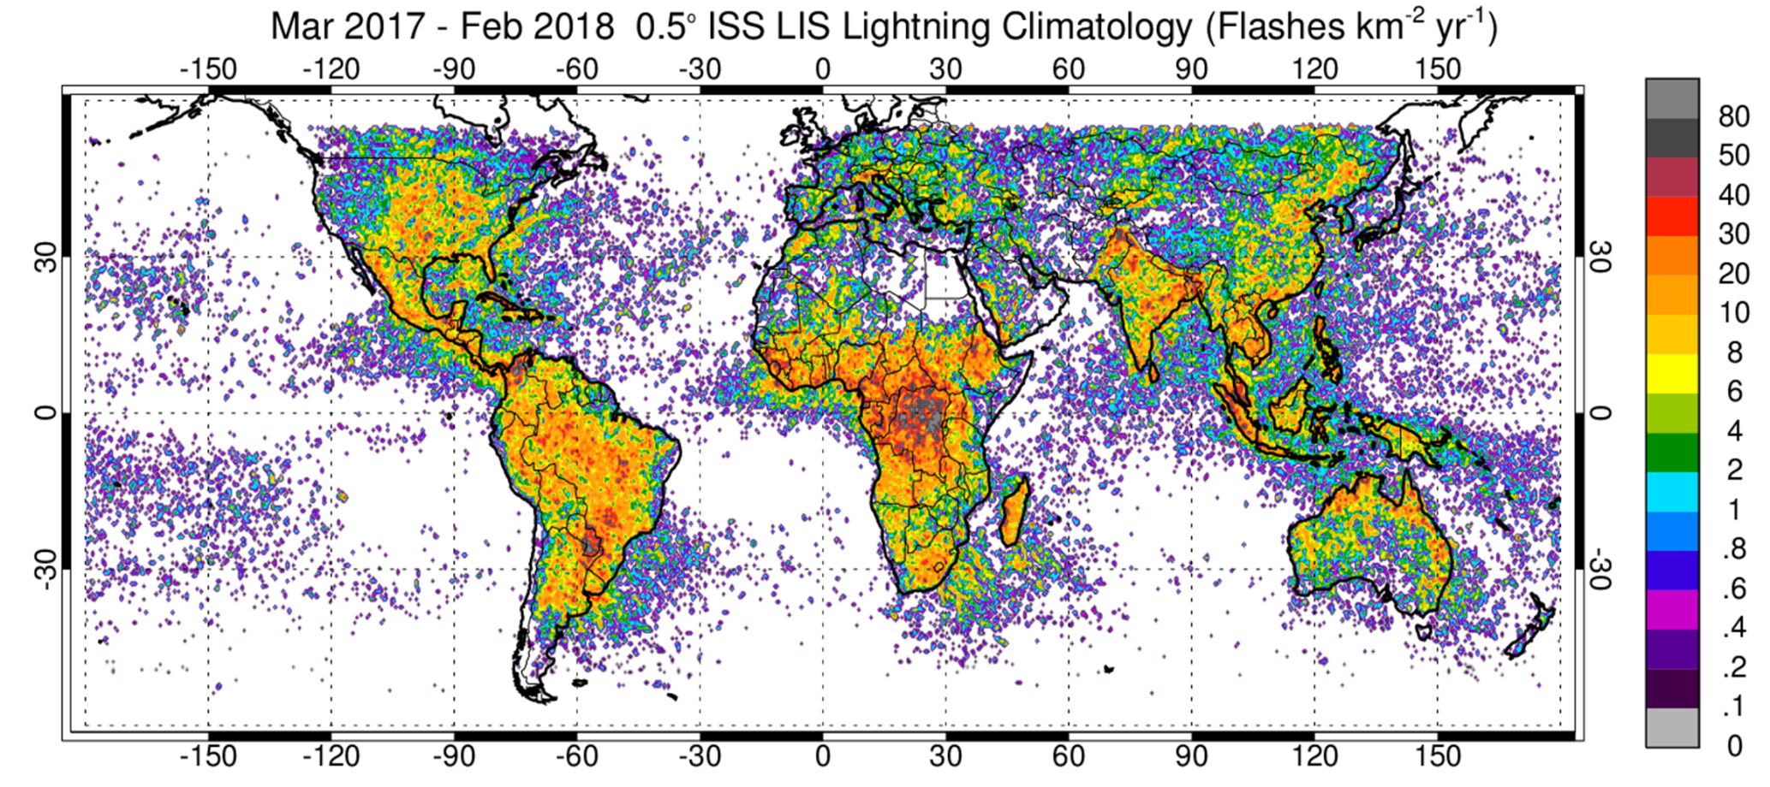
Annual Global Flash Rate
Annual global lightning flash rate (Flashes km2 yr-1) from LIS on ISS over the first year with corrections for view time and detection efficiency applied. Results are similar to prior OTD/LIS climatology in both frequency and distribution.

Slide 9
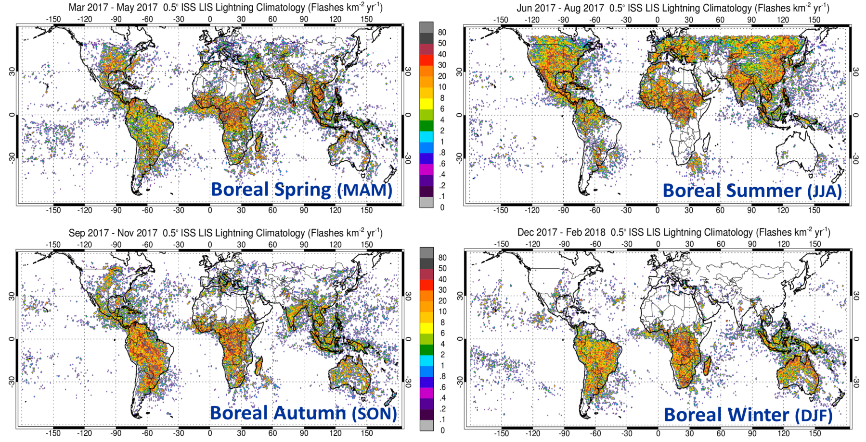
Seasonal Global Flash Rate
Seasonal global lightning flash rates from LIS on ISS similar to annual flash rate show in previous slide. Again, the results are similar to prior OTD/LIS climatology in both frequency and distribution.

Slide 10
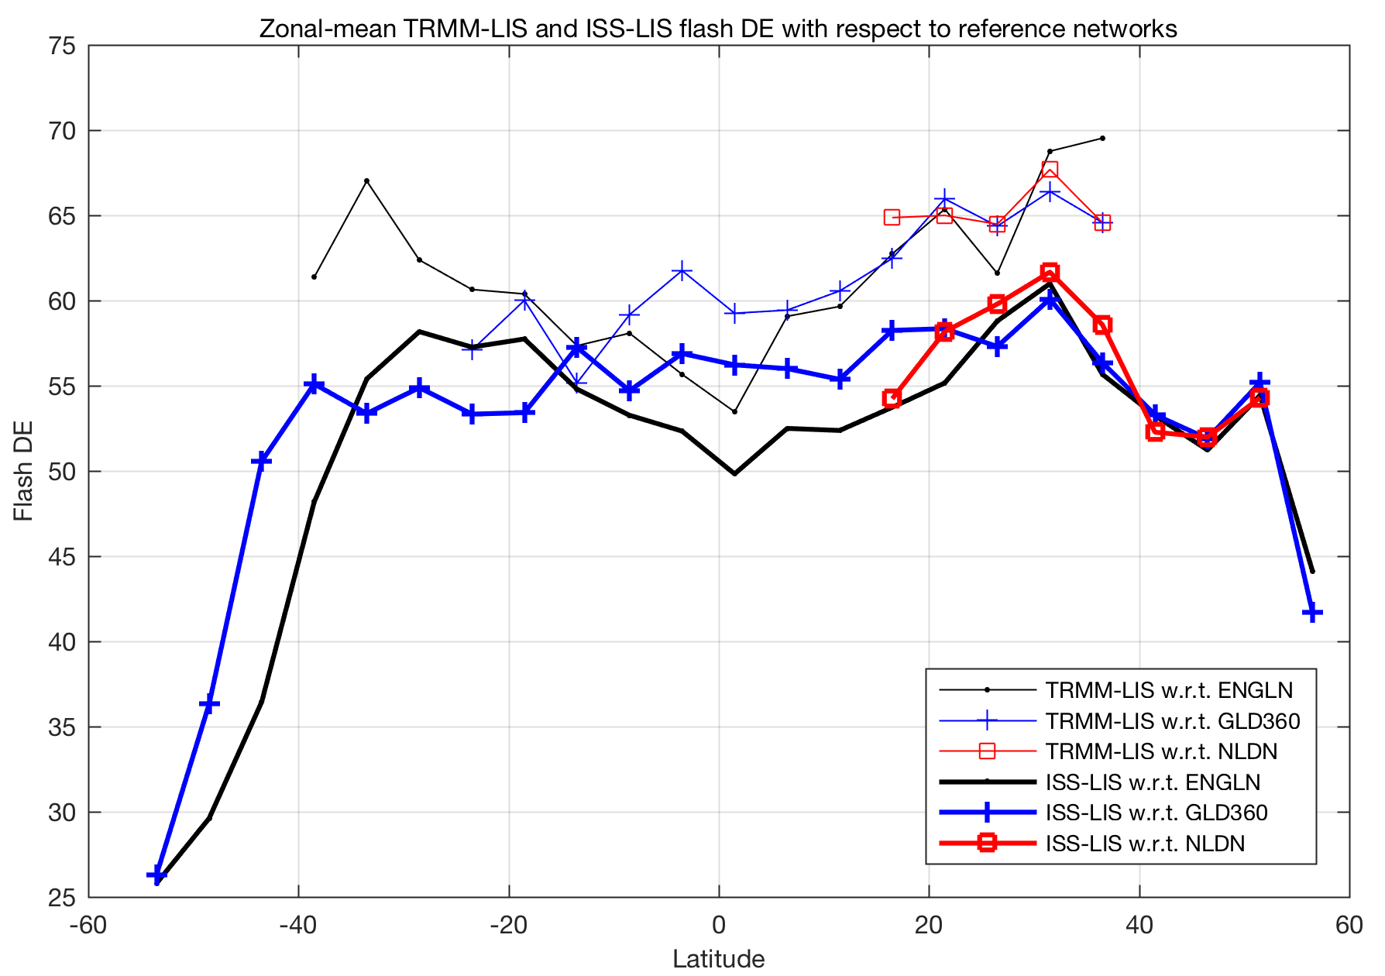
On Orbit Performance
(ISS vs TRMM)
Laboratory calibrations of flight spare LIS on ISS and TRMM LIS were in close agreement so that similar on-orbit performance anticipated.
Relative DE of LIS with respect to three ground-based reference systems (see plot) shows the relative DE for LIS on ISS on the order of 5% less than DE for TRMM LIS. Reasons could include:
  This preliminary analysis does not take into account improvements in the reference DE’s which has occurred since end of TRMM.
  The effect of ISS solar panel/radiator passing through portion of LIS field-of-view reducing LIS view time not yet included (this deterministic calculation will lead to 1-2% improvement).
  Lens contamination could result in DE degradation but evidence for this is weak.
  Thresholds could be revisited (currently using TRMM LIS values)
Analysis does show DE drop off at higher latitudes. This behavior requires further investigation.

Slide 11
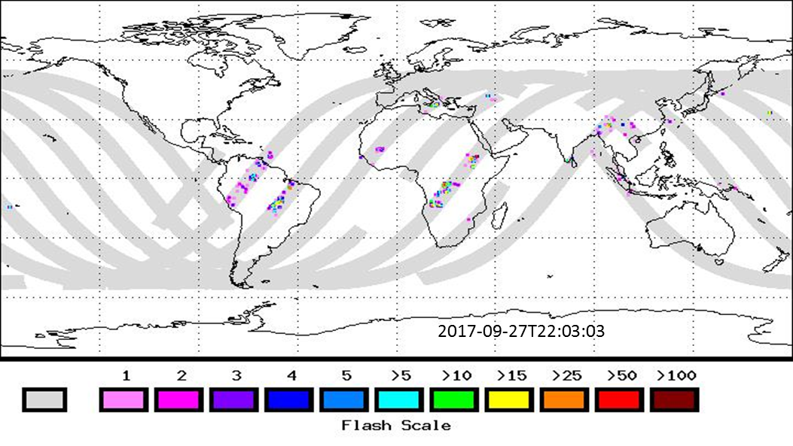
Real Time Data Production
LIS on ISS data is processed in real time in 2-minute processing increments.
This data is now available from GHRC DAAC and NASA’s Land, Atmosphere Near real-time Capability for EOS (LANCE).
Both 2 minute and 12 hour browse images are created in real time and displayed at:
https://lightning.nsstc.nasa.gov/isslisib/isslisnrt

Slide 12
LIS Plans
Upcoming Milestones
Fall 2018 (exact date TBD): Public release of Validated LIS data.
  Data will be classified as fully Validated once the quality control process is verified, fully implemented and applied to the LIS data collection (we use same definition for Beta. Provisional and Validated as GOES program).
  Additional reprocessing will occur as necessary to incorporate refinements in view time and DE.
March 2019 (exact date TBD): Conduct End of Prime Mission Review. This may now combine with or replace NASA’s Senior Review process to determine mission extension following the completion of the current 2-year nominal mission.
  Guidance on timing and approach will be obtained by close interaction with the NASA Headquarters Program Executive for Operating Missions (Charles Webb) in the Science Mission Directorate (SMD) Earth Science Division (ESD).
  Planning/coordination for mission extension is now being led by ESD, which is now fully engaged with the ISS Program Office via the MiPROM (Multi-Increment Payload Resupply and Outfitting Model) process.

Slide 13
Thank you!
Questions?

Slide 14
Backup slides

Slide 15
LIS Issues
There are no major issues, challenges, concerns, or threats facing the LIS science and mission operations.
An on-going minor issue continues to be radiation induced Single Event Upset (SEU) of the LIS Electronics Unit that occasionally results in a LIS reset or lock up.
  The mitigation using on-board autonomous commanding to either prevent lock up or minimize data loss when lock up occurs is working exceptionally well. Since this was fully implemented there has been no need for either commanding by the Payload Rack Officer (PRO) or LIS POCC personnel.
  These events most often occur in the South Atlantic Anomaly (SAA), a region in near-Earth space where energetic particles from the lower Van Allen radiation belts extend to lower altitudes.

Slide 16
Blockage by Solar Panels
  Some LIS CCD pixels experience periods of blockage due to the nearest port-side solar panels and ISS radiator passing periodically through the LIS FOV.
  Blockage is deterministic so that LIS view time calculation can be automatically performed using a dynamic mask (not yet implemented in LIS processing).
  STK modeling indicated the worse case is less than 3.5% mean obscuration and less than 12.5 % peak blockage. Estimate science impact less than 1-2%.
Background images showing solar panel passing through LIS FOV. The Alpha joint and Beta gimbal angles allow deterministic calculation of the blockage.
Note
Scale only goes to 14%
array
Max = 12.3%
array
Plot at left shows percent pixel obscuration over one orbit at β = -70º (worse case).
Example starts at end of an array obscuration and proceeds through orbit.
On-orbit observations (plot at top right) confirm pre-flight STK analysis.
Avg per Orbit
3.5%
radiator

Slide 17
Data Maturity Levels
Beta
  Product intended to enable users to gain familiarity with the parameters and the data format. Errors, some serious, may exist.
Provisional
  Product is defined to facilitate data exploration and process studies that do not require rigorous validation.
  These data are partially validated and improvements are continuing: quality may not be optimal since validation and quality assurance are ongoing.
Validated
  Products are high quality data that have been fully validated and quality checked, and are deemed suitable for systematic studies such as climate change, as well as for shorter term process studies.
  These are publication quality data with well defined uncertainties, but they are also subject to continuing validation, quality assurance and further improvements in subsequent versions.
  Users are expected to be familiar with quality summaries of all data before publication of results; when in doubt, contact the appropriate instrument team.

