Slide 1
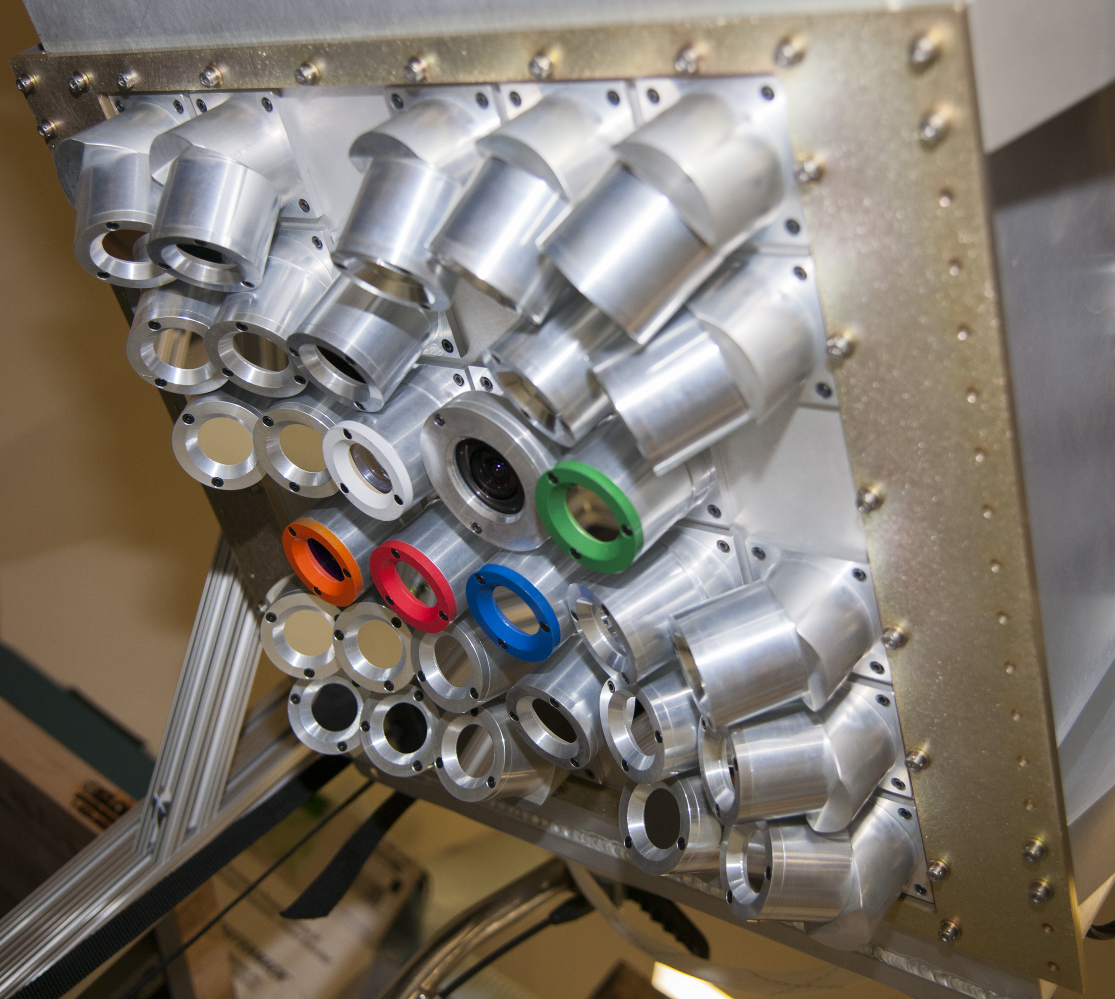
FEGS Spatial and Temporal Analysis
FEGS Version 2 Dataset
Mason G. Quick
September 2019
GLM Science Meeting

Slide 2
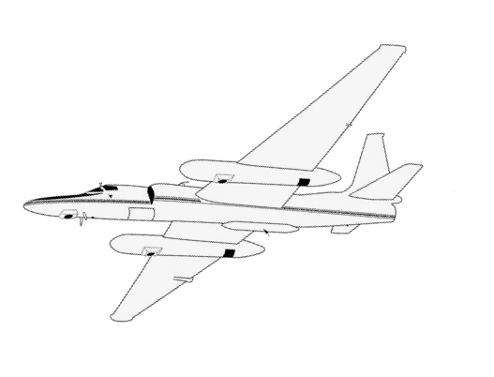
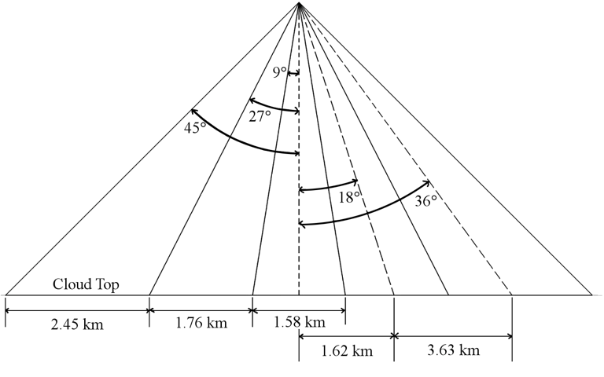
Fly’s Eye GLM Simulator (FEGS)
Projected FEGS Viewing Angles
Array of 30 radiometers
5 x 5 main radiometer
777 nm OI emission;
5 additional spectral
1080p Digital Video Camera
10x10 km footprint at cloud-top;
2x2 km nominal resolution;
100 kHz sample rate
Optical to Optical comparison
10 km
10 km
FEGS Footprint

Slide 3
2017 GOES-R Validation Flight Campaign
11 GLM flights, over 10k flashes, over 100k pulses
Oceanic, continental, coastal storms
Convective initiation to Supercell storms
Coordinated ground observations
Data Quality Control Removes
Observed during a turn (bad radiometry)
Observed at night (amplifier undershoot issue)
High likelihood of false detection (noisy pixels)
GLM Overall Daytime Flash DE: 61%
Range 51 – 85%
Lower limit daytime FDE

Slide 4
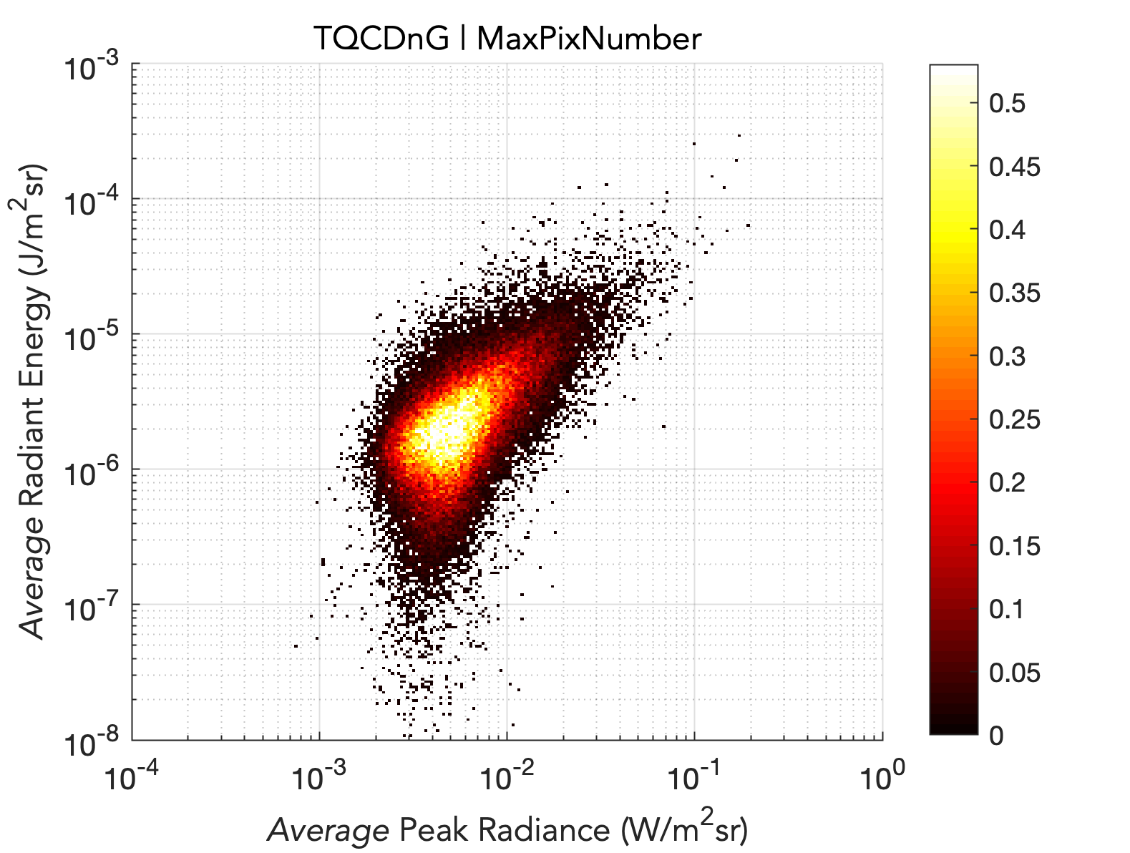
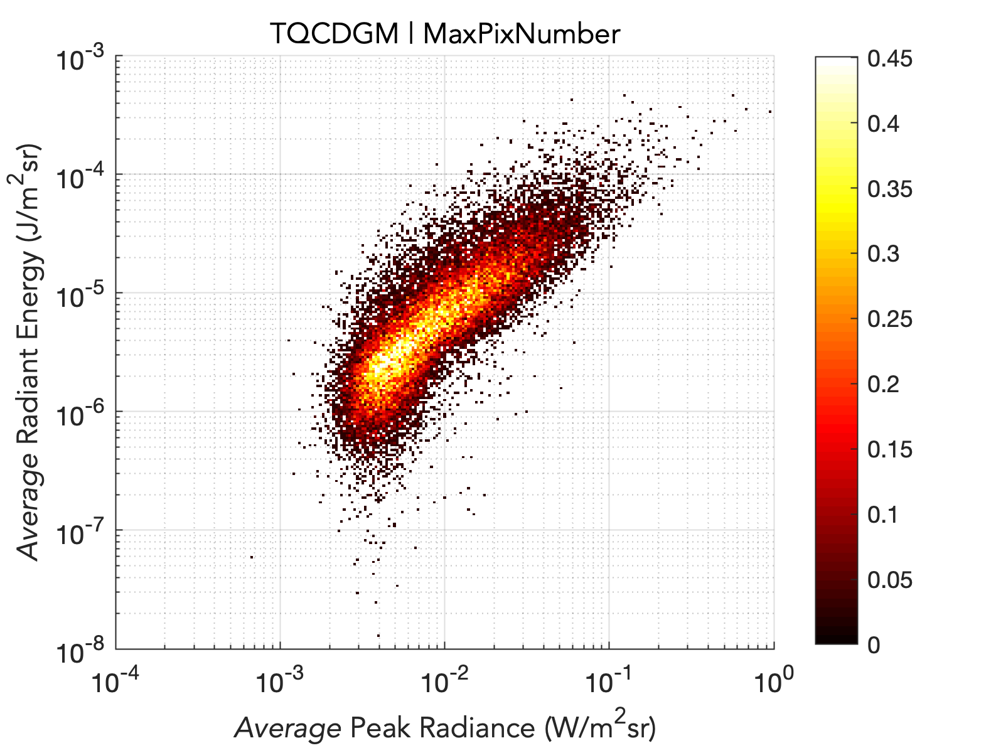
Pulse Radiance Distributions
GLM MISS
GLM MATCH
25% of the total optical energy observed by FEGS
GLM Pulse DE: 29%
75% of the total optical energy observed by FEGS

Slide 5
Pulse Temporal Characteristics
GLM MISS
GLM MATCH
10-90% - matches have 44% longer risetime
50-50% - matches have 38% longer fwhm
10-10% - matches have 46% longer duration

Slide 6
How does the source size affect GLM DE?

Slide 8
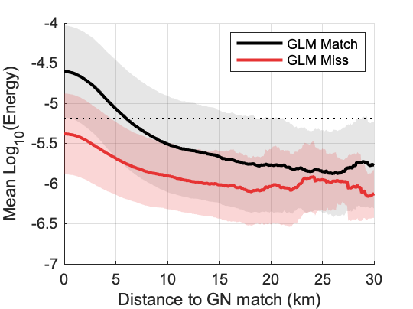
Accumulated Average Pulse Radiance Radial Profiles
Median
Match: 10.5km (350km²)
Miss: 6.6km (140km²)
Campaign GLM median group footprint = 140 km²

Slide 9
Inner Pixel Pulses
Special cases where FEGS observes the entire radiance pattern.
Max Size: 8 x 8 km
6.7% of dataset (N=6329)
Similar percentage each flight
Low power/energy through cloud-top
Relatively short duration (60% of median)
GLM detects 3.5 %
Ground networks detect 5 %
94% classification IC
I_{P} distribution skewed toward low amplitude negative ICs

Slide 11
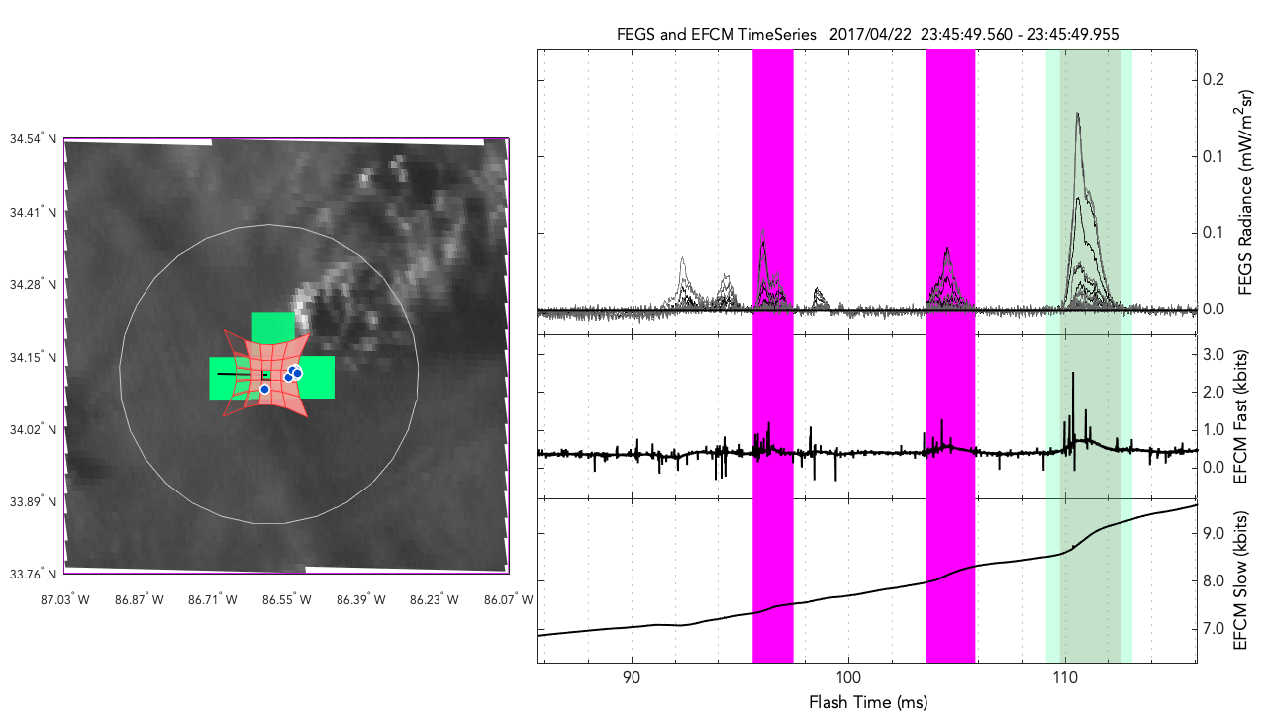

Slide 12
End Thank You

Slide 13
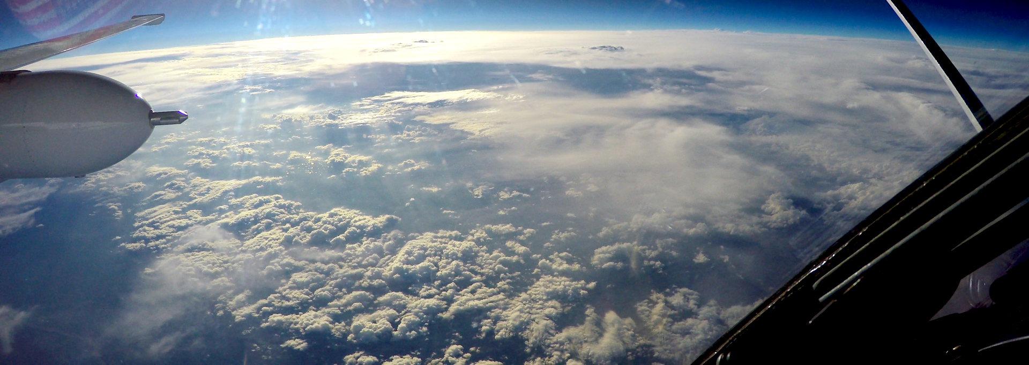
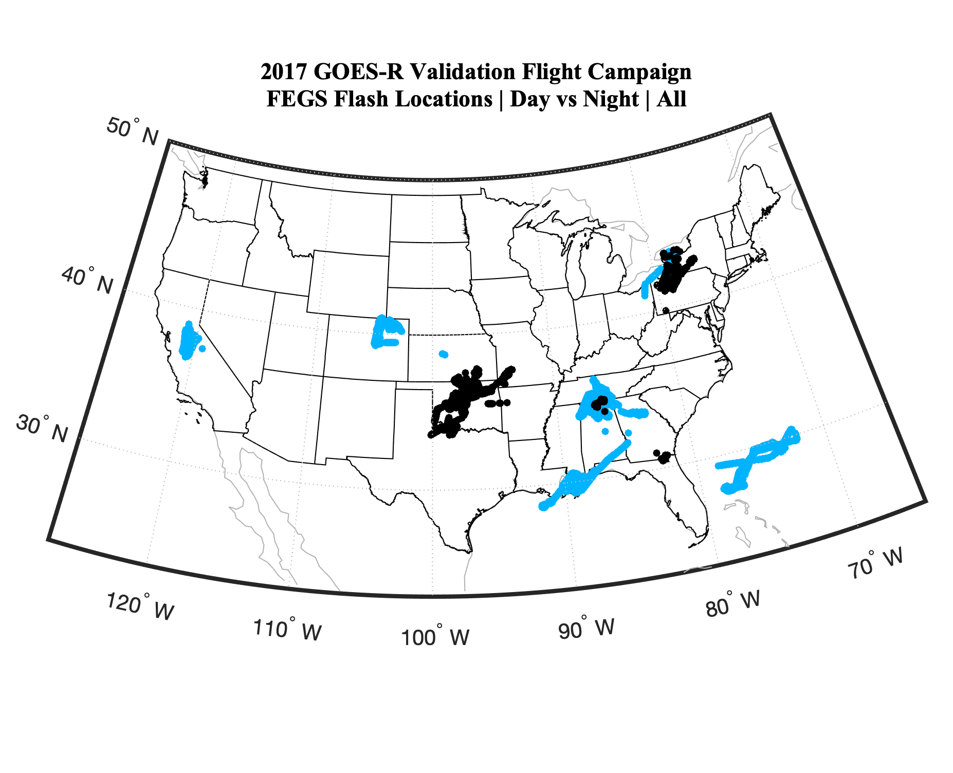
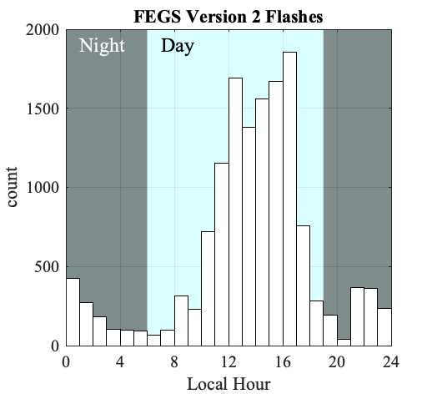
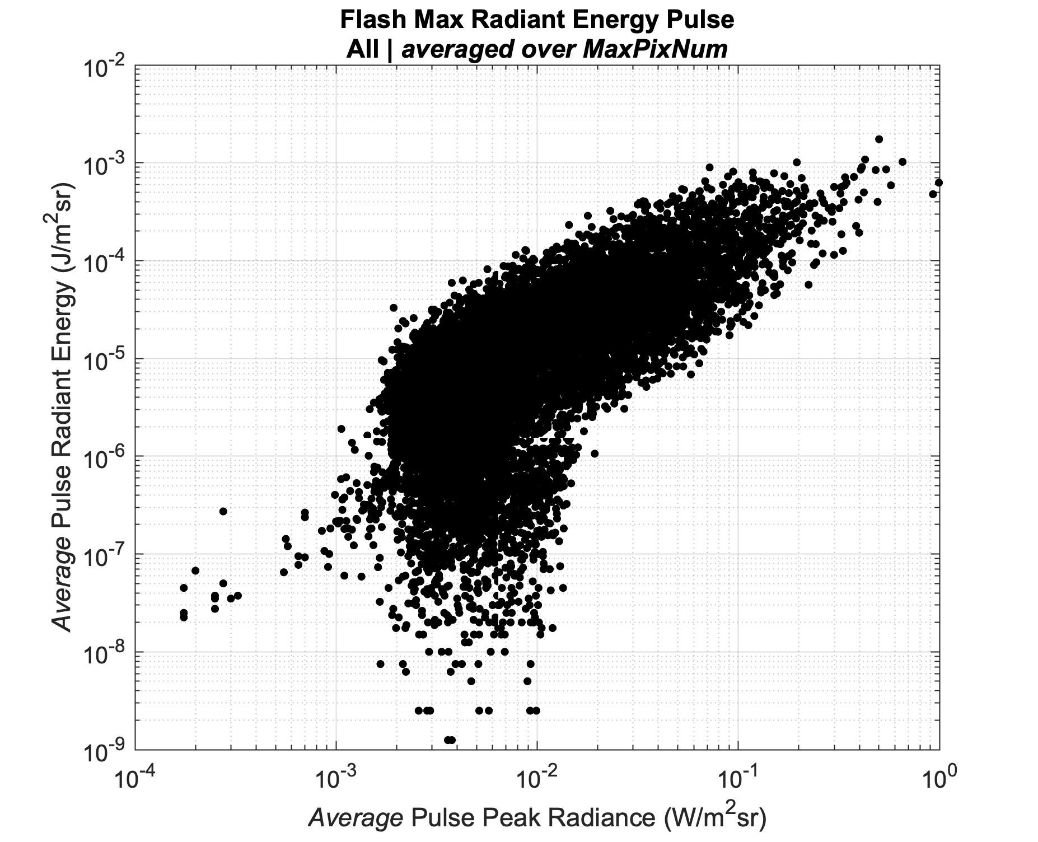
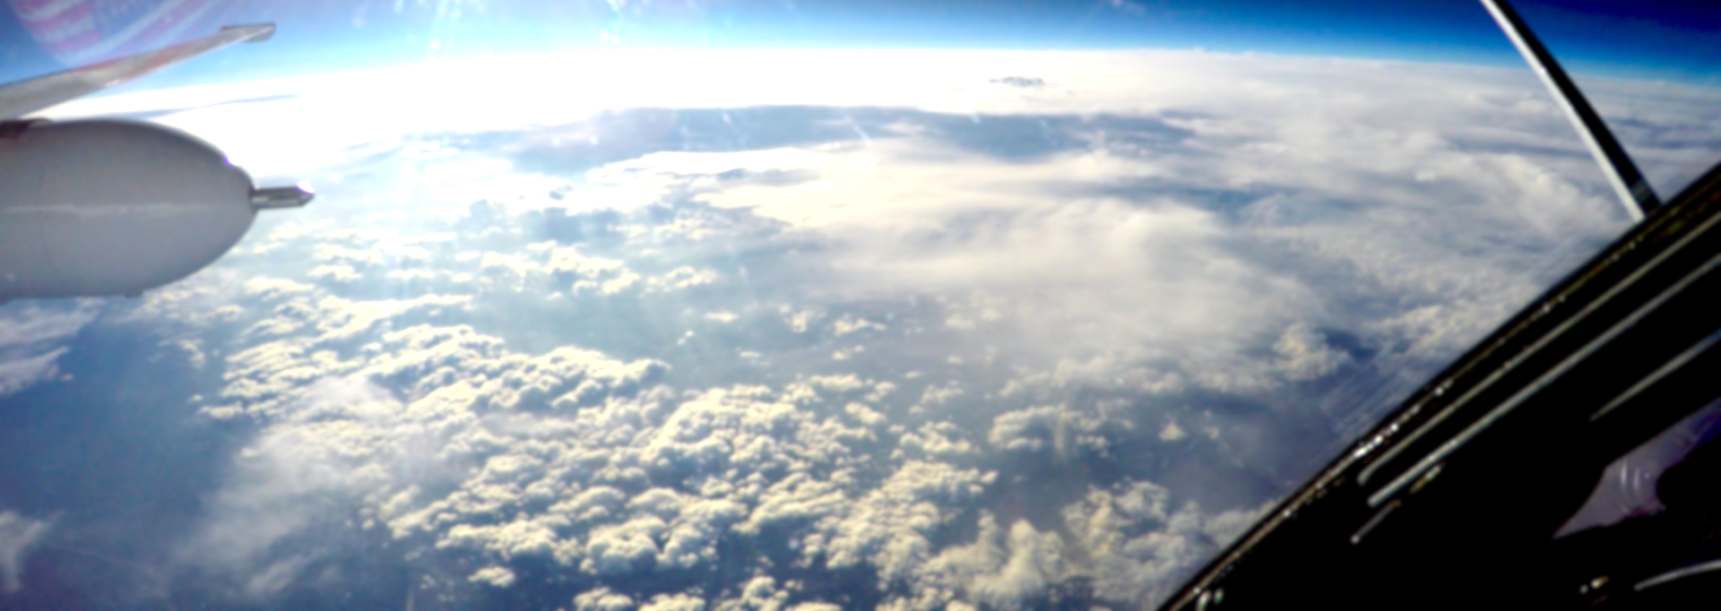
GOES-R Validation Flight Campaign (2017)
From March to May of 2017, FEGS flew as a primary payload on the ER2 as part of the GOES-R Validation Flight Campaign. Of the 16 flights, 11 were GLM focused and targeted thunderstorms. A variety of thunderstorm phenomenology were observed including oceanic, continental, and coastal storms, convective initiation and supercell storms, during both day and night at locations across the continental United States and Atlantic Ocean. During the 45 flight hours observing thunderstorms, over 10,000 lightning flashes containing over 100,000 optical pulses were observed; a factor of 10 increase over datasets collected in previous airborne lightning campaigns. These measurements were taken in conjunction with ground based observation networks such as LMAs, radar, and long range lightning detection networks.

Slide 14
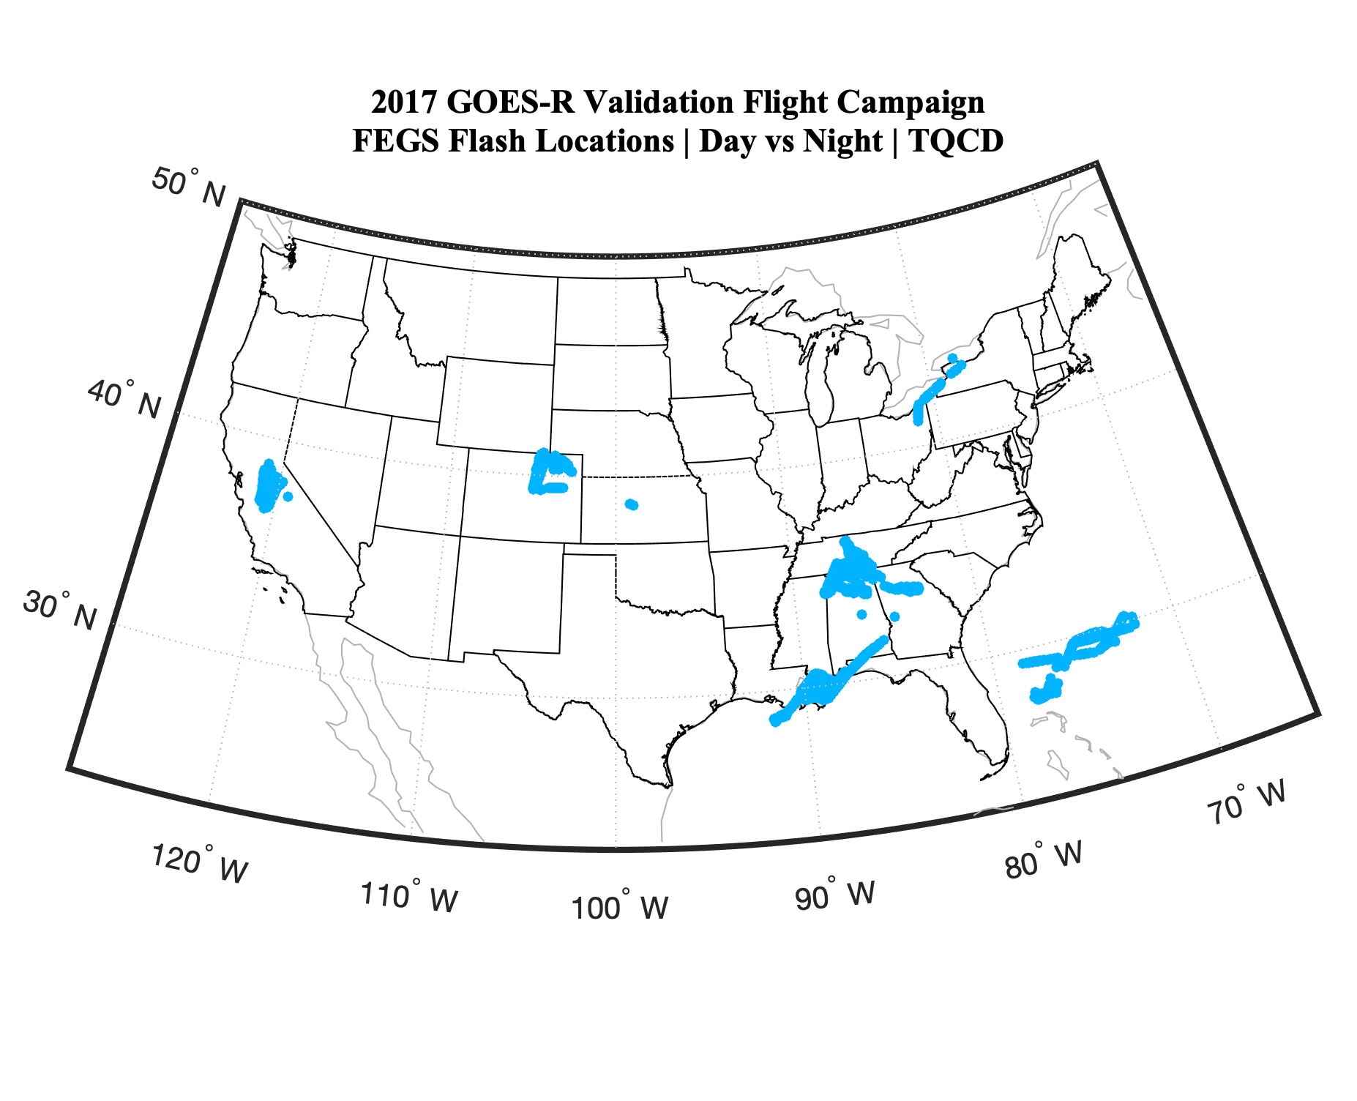
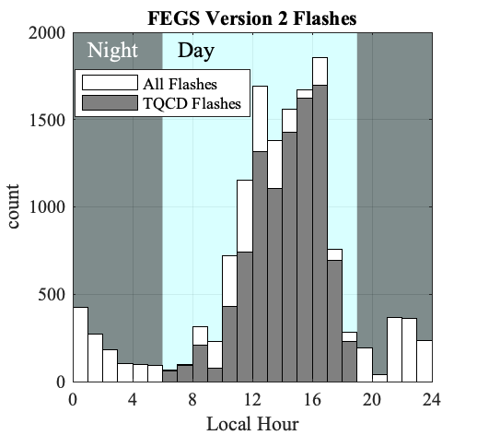
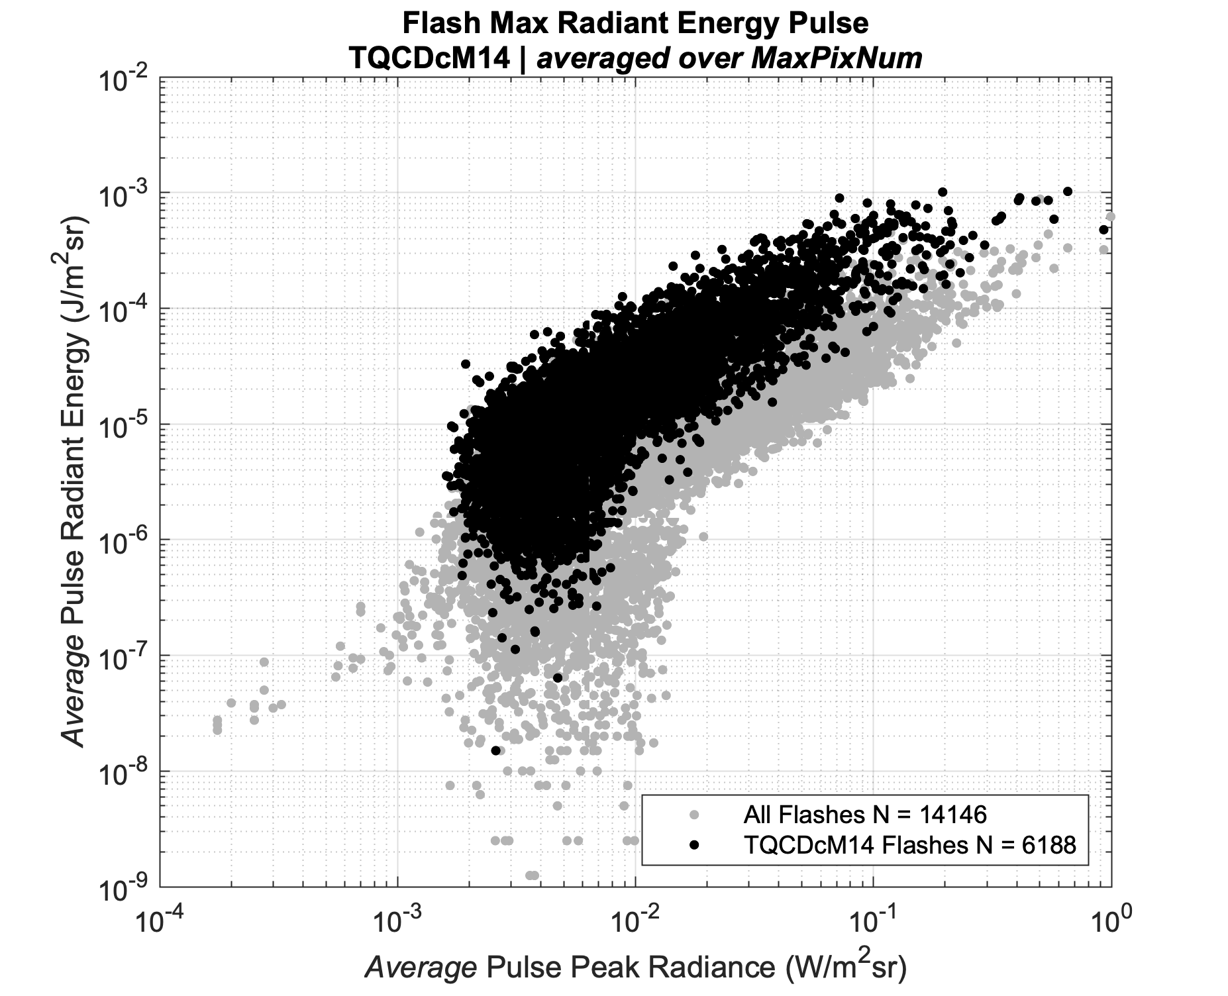
Dataset Quality Control
QC dataset removes optical pulses there were:
Observed during a turn (bad radiometry)
Observed at night (amplifier undershoot issue)
High likelihood of false detection (noisy pixels)
Quality Detections can be further filtered by:
Simultaneous detection from airborne EFCM
Simultaneous detection with GLM or Ground Network
Distance to simultaneous detection

Slide 15
FEGS Version 2 Dataset – QC Statistics
ID | QC Filter | Flashes | % | Pulses | % | Pulse J | Flash J
0 | All Data | 14,146 | 100 | 115,213 | 100 | 4.48E-07 | 1.50E-6
1 | Flat Wings | 13,144 | 93 | 108,249 | 94 | 4.52E-07 | 1.60E-6
2 | True | 12,540 | 89 | 113,607 | 99 | 4.60E-07 | 2.36E-6
3 | Daytime | 11,781 | 83 | 102,830 | 89 | 4.29E-07 | 1.34E-6
4 | AND(1,2,3) | 9,704 | 69 | 94,850 | 82 | 4.47E-07 | 2.23E-6
5 | GN #1 match | 11,027 | 78 | 23,949 | 21 | 9.57E-07 | 3.06E-6
6 | GN #2 match | 8,291 | 59 | 10,200 | 9 | 1.20E-06 | 3.85E-6
7 | EFCM match | 5,476 | 39 | 50,865 | 44 | 6.14E-07 | 5.01E-6
8 | OR(5,6,7) | 11,433 | 81 | 63,186 | 55 | 6.35E-07 | 2.96E-6
9 | AND(4,8) | 8388 | 59 | 49,186 | 43 | 6.12E-07 | 3.28E-6

Slide 16
GLM Daytime Flash Detection Efficiency
22% of FEGS flashes are single pulse

Slide 18
GLM Daytime Flash Detection Efficiency Version 2 FEGS dataset
DATE | LOCATION | STORM TYPE | DAY/NIGHT | Flash Count | QC Flash Count | QC GLM FDE
03/21 | California | Active QLCS | Daytime | 2289 | 2181 | 51
04/16 | Oklahoma | Large MCS | Night/Dawn | 390 | 61 | 85
04/18 | Huntsville | Convective Initiation | Day | 348 | 316 | 44
04/20 | Toronto | Org. Convection | Dusk | 394 | 58 | 74
04/22 | Huntsville | Tornadic QLCS | Day/Dusk | 2654 | 2423 | 73
04/27 | Huntsville | Horiz. Extensive LFR | Night | 39 | - | -
04/29 | Oklahoma | Supercell | Night | 1064 | - | -
05/08 | Colorado | Severe Hail | Day | 2454 | 2311 | 54
05/12 | Louisiana | Weak QLCS | Day | 2674 | 1714 | 65
05/14 | Atlantic/KSC | Org. Convection LFR | Day | 1234 | 640 | 64
05/17 | Oklahoma | Active QLCS | Night | 606 | - | -
 |  |  | Day | 11781 | 9704 | 61
 |  |  | Night | 2365 | - | -
Spatio-temporal comparison performed by Katrina Virts

Slide 19
FEGS Pulse (sub-flash) Statistics
DATE | LOCATION | Pulse Count | TQCD Pulse Count | TQCD GLM PDE
03/21 | California | 29934 | 28573 | 16
04/16 | Oklahoma | 1710 | 440 | 61
04/18 | Huntsville | 2370 | 1905 | 36
04/20 | Toronto | 1879 | 470 | 49
04/22 | Huntsville | 24150 | 22269 | 37
04/27 | Huntsville | 634 | 0
04/29 | Oklahoma | 5324 | 0
05/08 | Colorado | 21428 | 20285 | 17
05/12 | Louisiana | 16353 | 14555 | 46
05/14 | Atlantic/KSC | 7653 | 6353 | 48
05/17 | Oklahoma | 3778 | 0
 | Day | 115213 | 94850 | 29
 | Night | 9736 | - | -

Slide 20
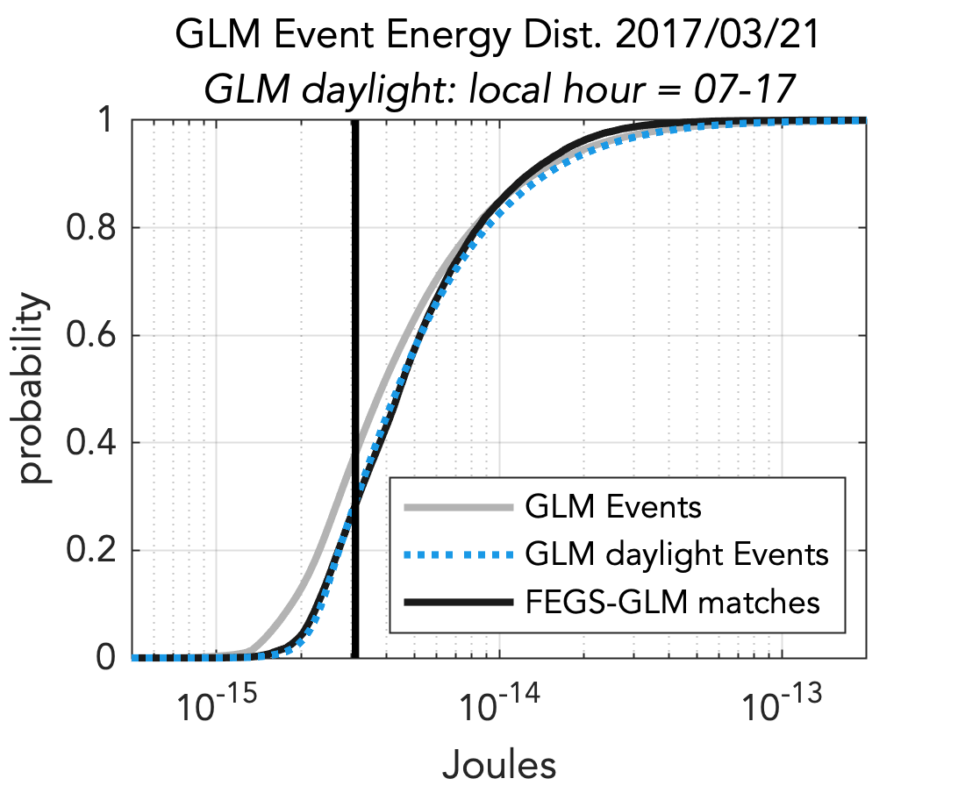
GLM Daytime Radiance Detection Threshold Version 2 FEGS dataset
6.4 μJ/m²-sr

Slide 21
Pulse Widths – IC vs CG
IC N=19289
CG N=2761
CG median pulse rise-time and widths are 100-200 us longer than IC (~20% longer).
No identifiable difference in Peak Radiance or Radiance Energy distributions.

Slide 23
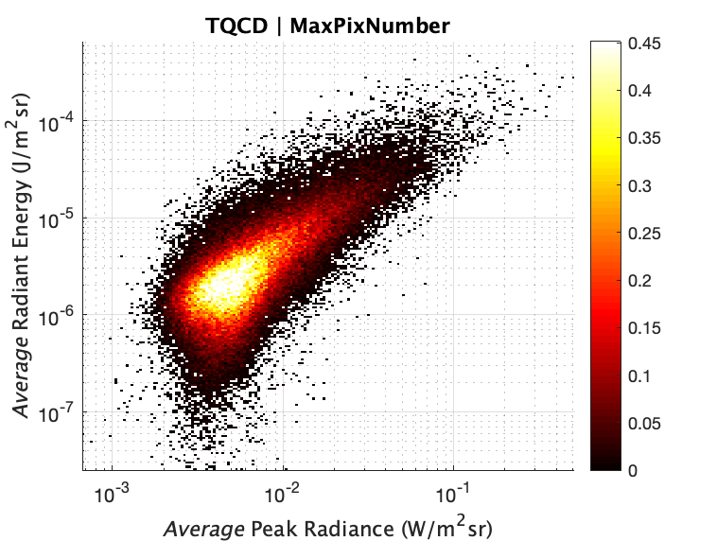
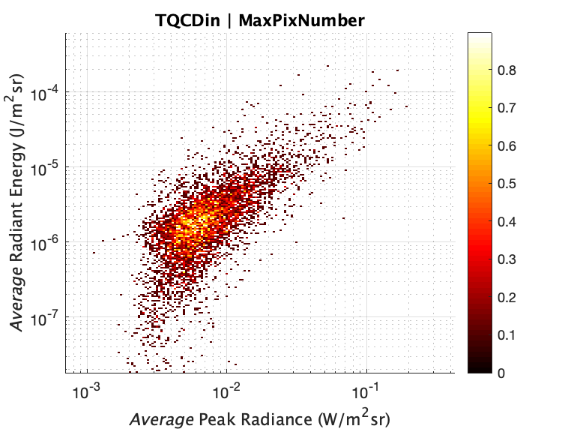
Inner Pixel Pulses
Special case where FEGS captures the entire cloud-top radiance pattern.
Max Size: 8 x 8 km
Most underfill the 3x3 array
6.7% of dataset (N=6329)
Similar percentage each flight
Low optical power/energy through cloud-top
Relatively short duration (60% of median)

Slide 24
Estimated Peak Current Distributions
All Pulses
Inner Pulses
Peak Current (kA)

