Slide 1
GOES-16/17 Candidate Field Campaigns
Steve Goodman
GOES-R Program Senior Advisor
2019 GLM Science Meeting
NSSTC, Huntsville, AL
September 10-12, 2019

Slide 2
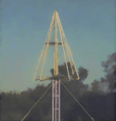
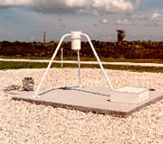
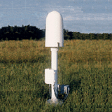
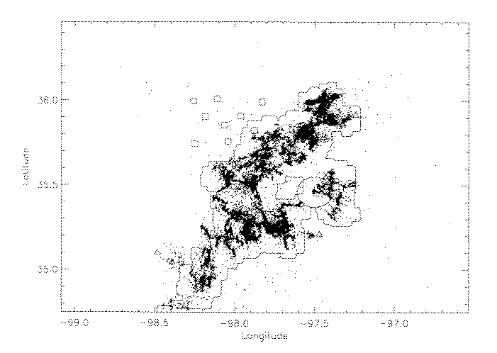
GLM Validation Data
Ground Truth Datasets:
Short-Medium Range Lightning
LMA North Alabama (NASA-NOAA), DC (NASA-NOAA), Oklahoma (OU CIMMS-NSSL), West Texas (TTU), NMTech, Colorado Front Range (CSU), NASA-KSC and Wallops, Atlanta (GTRI), Toronto, Canada (EC)
HAMMA/Delta-E Array (North Alabama)
High Speed Video Cameras
KSC Field Mills (KSC Florida)
NLDN (CONUS)
Long Range Lightning
GLD360
WWLLN
ENGLN
GLM optical
outline
LMA
VHF
2

Slide 3
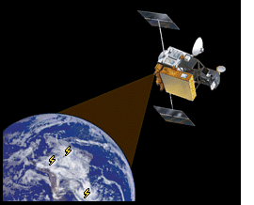
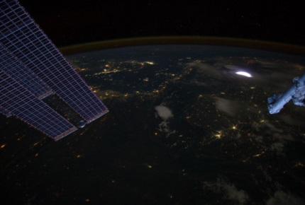
GLM Validation Data
Airborne GLM Simulator
Airborne (ER-2) high resolution optical (and electrical) measurements as a GLM simulator (pre- and post-launch)
Post launch field campaigns- 2017 and beyond (GOES-R PLT, RELAMPAGO, VORTEX-SE)
Satellite Observations
LIS for GLM proxy data development
Pre-post launch validation simulations (including val tool testing)
ISS-LIS International Space Station (Feb. 2017)-transfer radiometer
ISS-ASIM (Atmosphere-Space Interactions Monitor)
TARANIS (Tool for the Analysis of RAdiation from lightNIng and Sprites)
STPSat-6 SENSER (Space and Endo-atmospheric Nuclear detonation detection Surveillance Experimentation and Risk-reduction)
Cross-Calibration of GLM and MTG LI at 777.4 nm (2021)
NESDIS-EUMETSAT Cooperation (MOU)
EUMETSAT Visiting Scientist Program
TRMM LIS
ISS LIS
3
Notes:
TARANIS- Guest Investigator Program

Slide 4
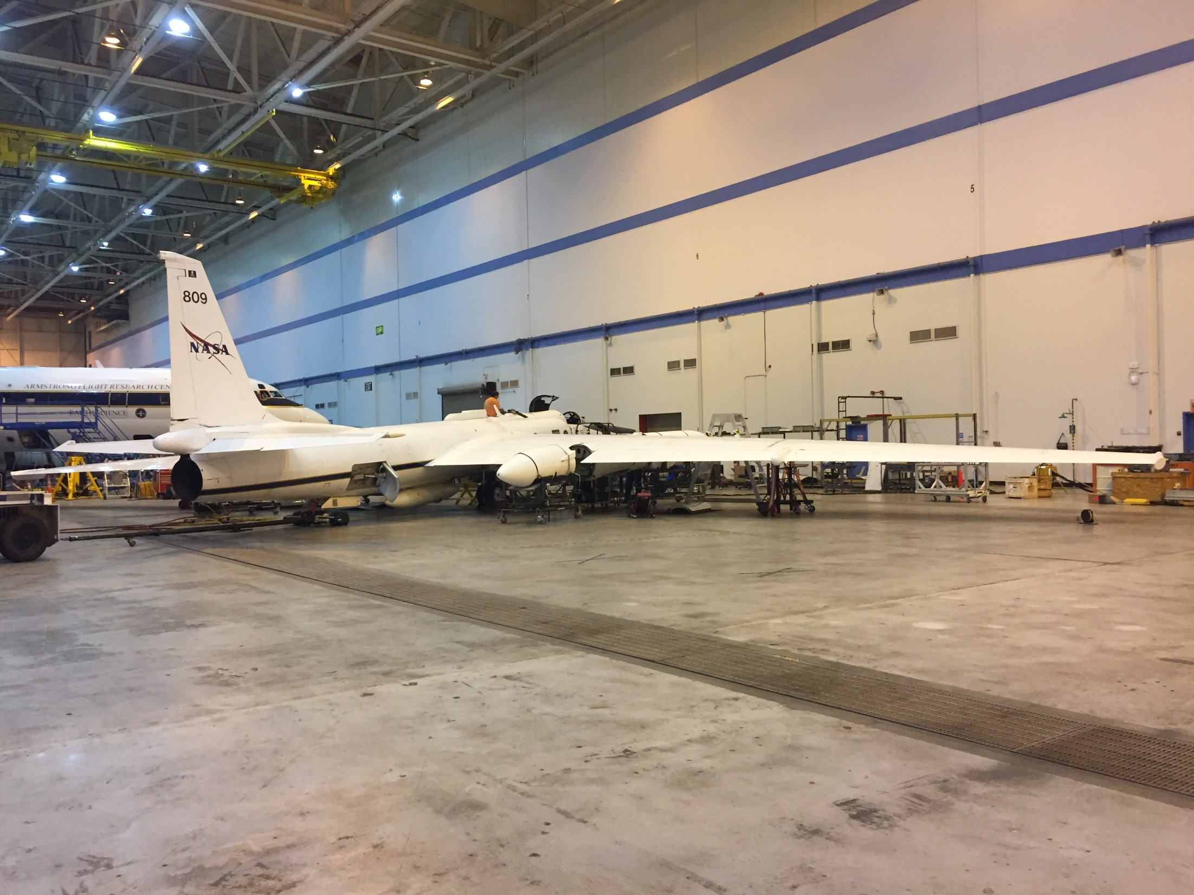
ER-2 high-altitude aircraft preparing for GOES-16 validation flights

Slide 5
GOES-R Field Campaign ER-2 Based Instruments
Candidate Instruments
AVIRISng | Next-Generation Airborne Visible/Infrared Imaging Spectrometer
S-HIS | Scanning High-resolution Interferometer Sounder
FEGS | Fly’s Eye GLM Simulator
LIP | Lightning Instrument Package
CPL | Cloud Physics Lidar
CRS | 94-GHz (W-band) Cloud Radar System (CRS)
GCAS | GeoCAPE Airborne Simulator (GCAS)
Instrument | Type | Spectral Range | Spectral Res. | GSD | FOV | Swath Width
AVIRISng | HSI | 380 – 2510 nm | 5 nm | 0.3 m to 20 m | 34 deg | ~11 km
S-HIS | Hyperspectral | 3.3 - 18 µm | 0.5 cm⁻¹ | 2 km | 40 deg | 40 km
FEGS | Passive EO | near-infrared (777.4 nm) | 10 nm |  |  | ~10 km
LIP | Passive Electrical
CPL | Lidar | 1064, 532, & 355 nm |  | 30x200 m
CRS | Doppler Radar | 94 GHz (W-band; 3 mm wavelength) |  | na
GCAS | Hyperspectral | 300 – 490 nm; 480 -900 nm | 0.6 nm; 2.8 nm | 350 x 1000 m; 250 x 250 m | 45 deg; 70 deg
ABI & GLM combined campaign provides an opportunity for data collection with broad suite of instruments
Critical Set of Instruments
Add-on Capability

Slide 6
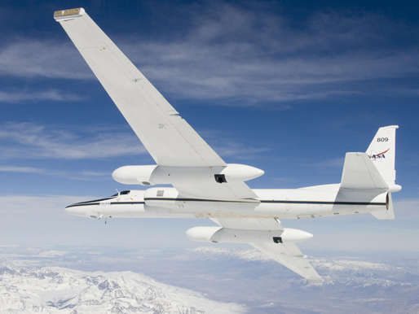
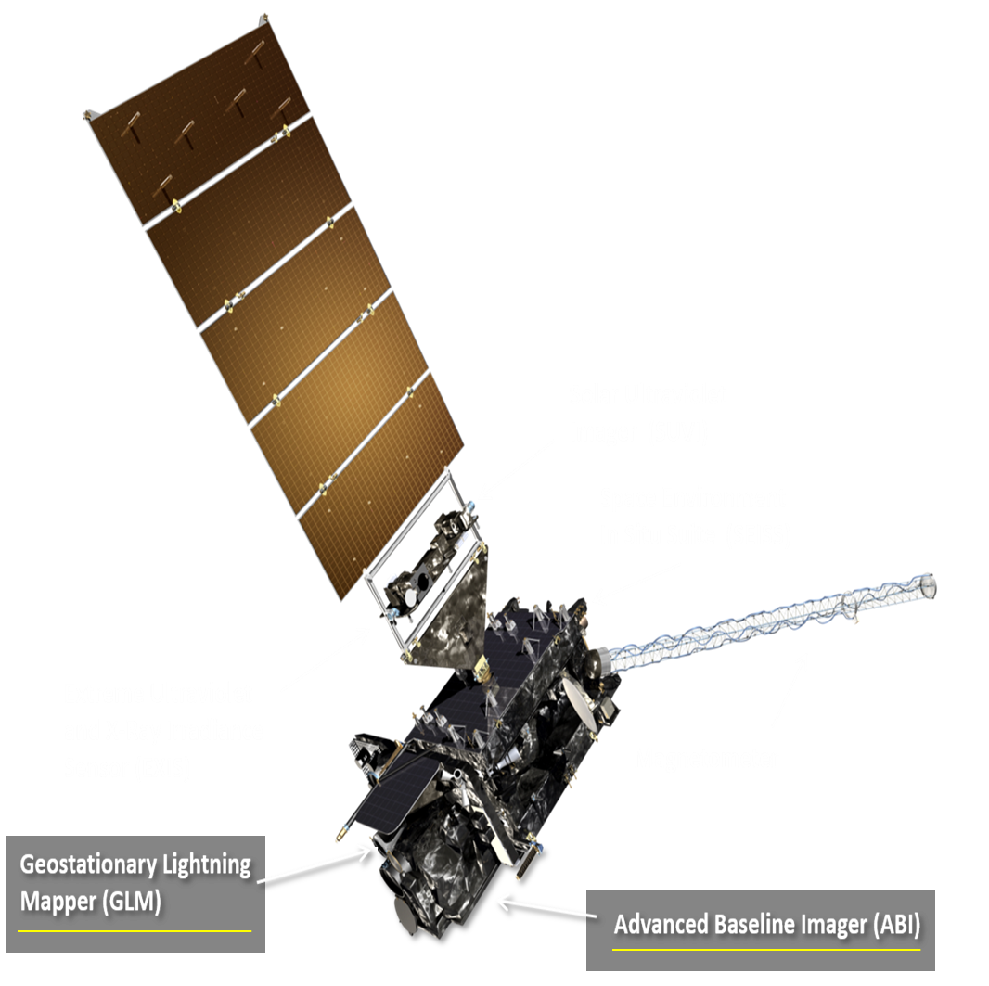
GOES-R Field Campaign Overview
The purpose of the GOES-R field campaign is to support post-launch validation of L1b & L2+ products:
Advanced Baseline Imager (ABI) & Geostationary Lighting Mapper (GLM):
Planning ~6 week field campaign (~100 flight hours) with the high-altitude NASA ER-2 platform coordinated with ground based and near surface observations over several Earth targets
An official flight request has been submitted to the NASA ER-2
Program:
April – June 2017
GOES-R Spacecraft

Slide 7
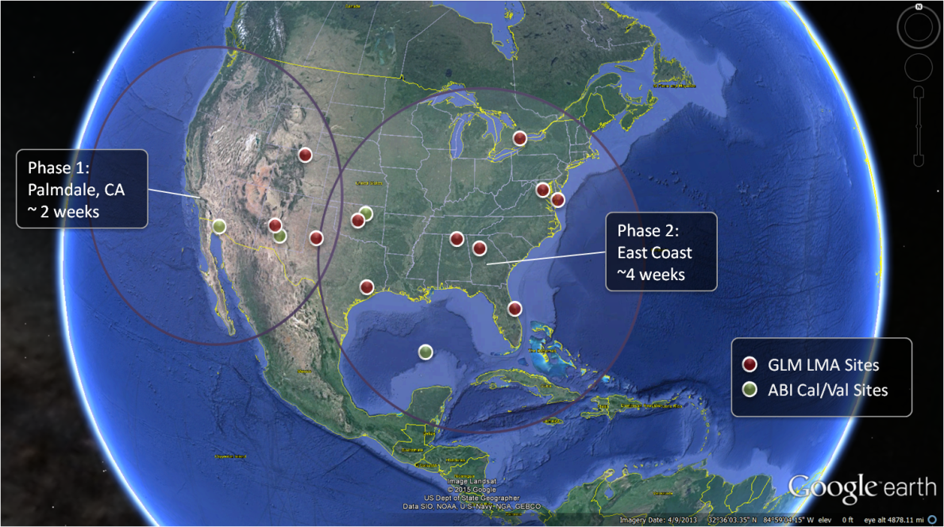
GOES-R Field Campaign Overview
GOES-R Field Campaign Workshop – April 8-9, 2015:
Established a baseline consensus of the GOES-R field campaign validation plan for L1b & L2+ products - http://www.goes-r.gov/users/2015-Campaign-Workshop.html
Underflights to be collected, when possible, with low Earth orbit environmental satellites
which may include S-NPP, Terra/Aqua, METOP, Landsat, ISS & GPM
We plan to have an open data access policy
Two Phased Approach
April – June 2017
Phase 1 (2 weeks)
ER-2 Based at Palmdale, CA (U.S. West Coast)
Phase 2 (4 weeks)
ER-2 Based at Warner Robins AFB, GA

Slide 8
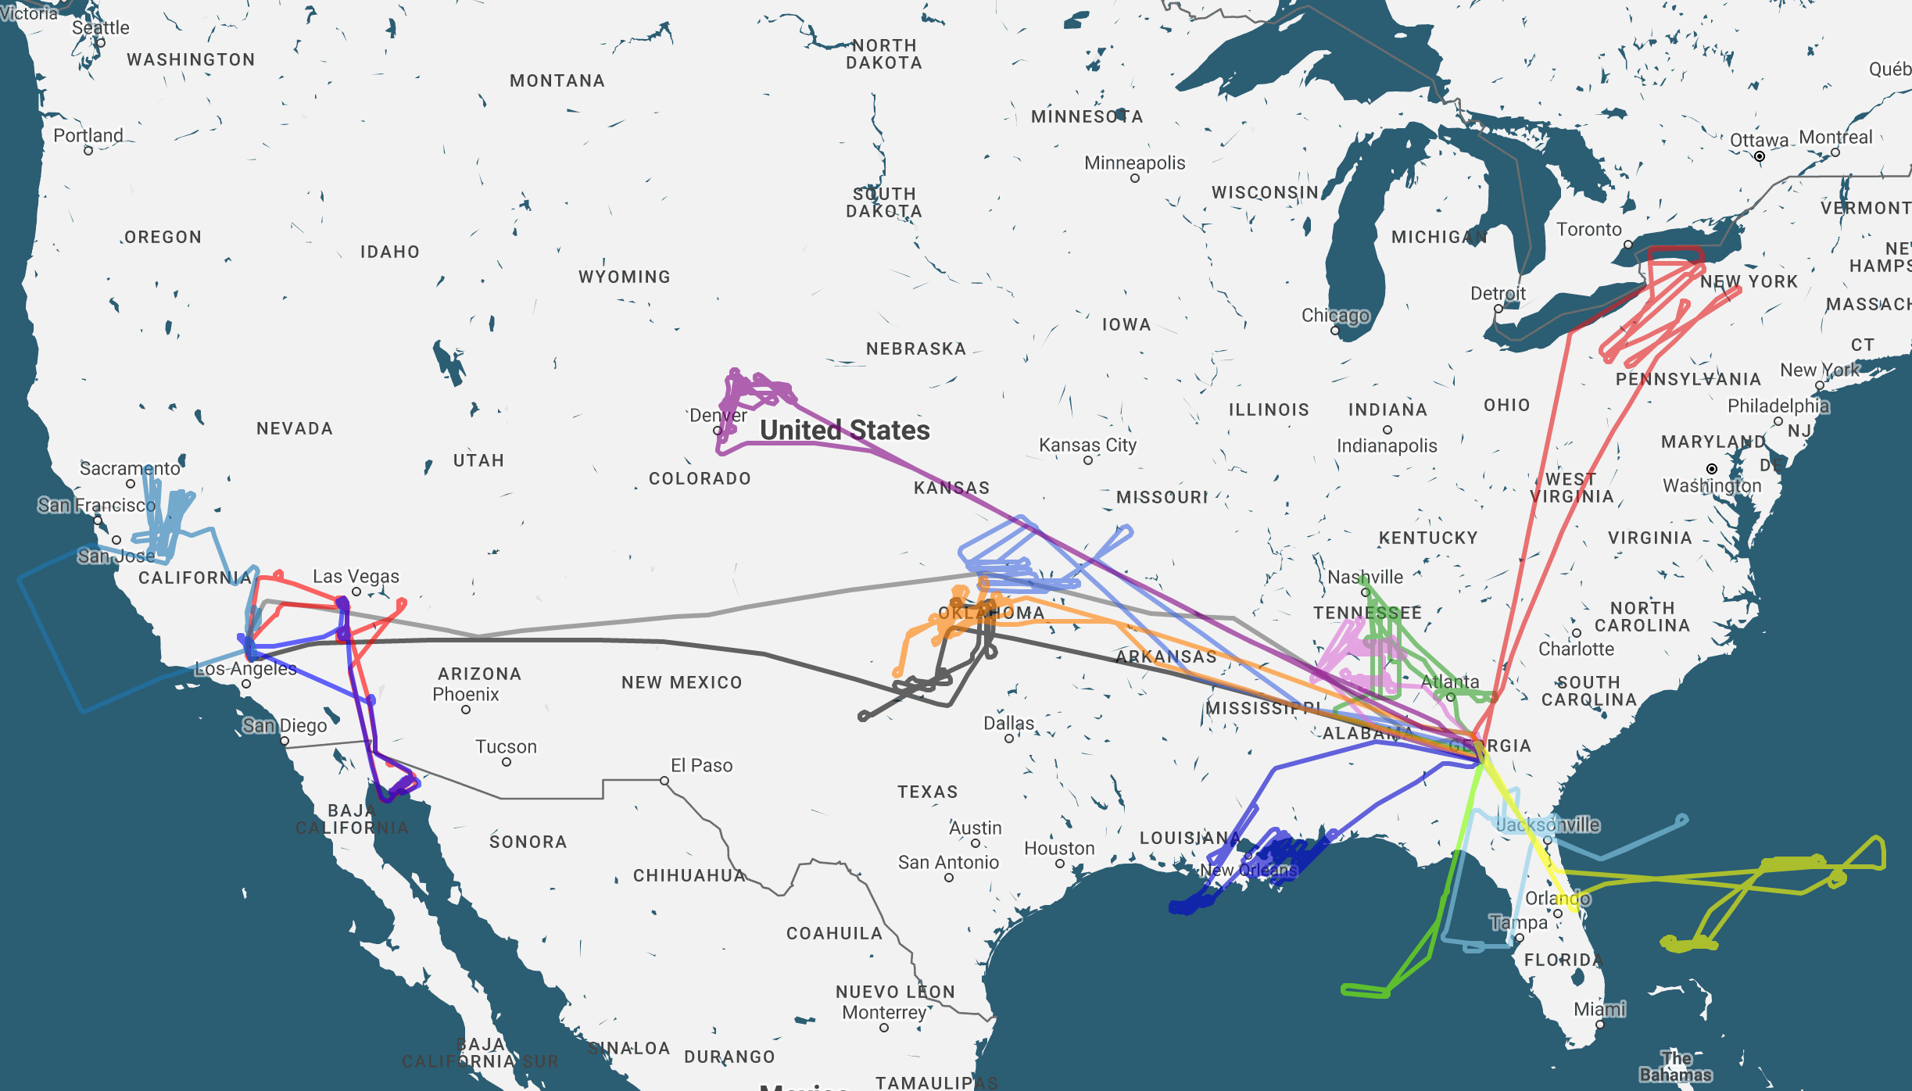
GOES-R Field Campaign Validation Flight Summary
<< Click on the Mission Number Icon for More Information >>
13
8
1
3
6
10
4
9
11
7
2
16
14
12
15
5
*Flight #10 - April 27, 2017 - Huntsville, AL not shown due to aircraft navigation not reporting

Slide 9
GOES-R Field Campaign Phase 2 Operations Date: April 16, 2017 Mission Objective: GLM Primary Validation - Norman, OK Supersite (Night, Twilight, Day) Takeoff: 0631 Z Landing: 1417 Z Flight Duration: 7.8 hrs
Mission Scientist: Timothy Lang, Francis Padula Weather Forecast Leads: Austin Clark, Bruno Medina (Forecast support: Emily Kinkle, Alex McVey)
Lightning Collection
Crude FEGS Flash Count: 430
Major Highlights:
Targeted a large Mesoscale Convective System (MCS) during the transition from late night into daylight hours that produced near continuous lightning over the northern range of the Norman, OK total lightning supersite.
ABI 30-second imagery collected coincident and collocated with the ER-2 aircraft
Table Summary
Map Summary
6
Mission Number

Slide 10
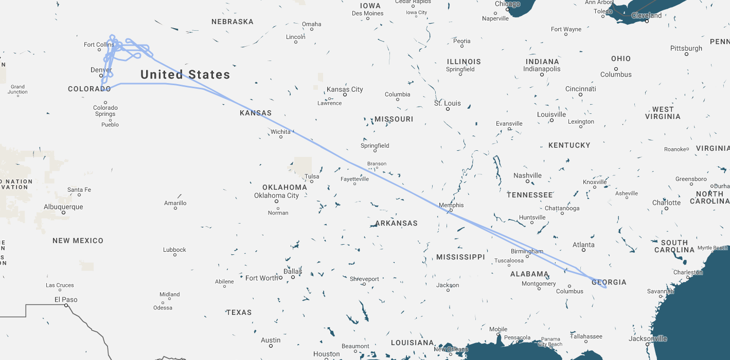
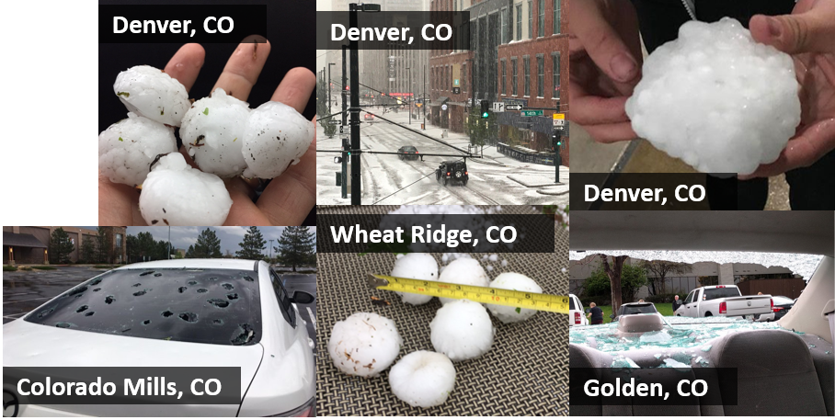
GOES-R Field Campaign Phase 2 Operations Date: May 8, 2017 Mission Objective: GLM Validation – CO LMA Takeoff: 1857 Z Landing: 0358 Z Flight Duration: 9 hrs
Mission Scientist: Steve Goodman, Hugh Christian, Francis Padula Weather Forecast Leads: Austin Clark, David Haliczer, Nathan Curtis, Cameron Kowalski
Lightning Collection
Crude FEGS Flash Count: 1,962
Major Highlights:
Collected 3 hours of a variety of compact and horizontally extensive high flash rate lightning producing storms coincident and co-located with the Colorado total lightning supersite during daylight and early twilight hours.
ABI 30-second imagery collected coincident and collocated with the ER-2 aircraft
Table Summary
Map Summary
13
Mission Number

Slide 11
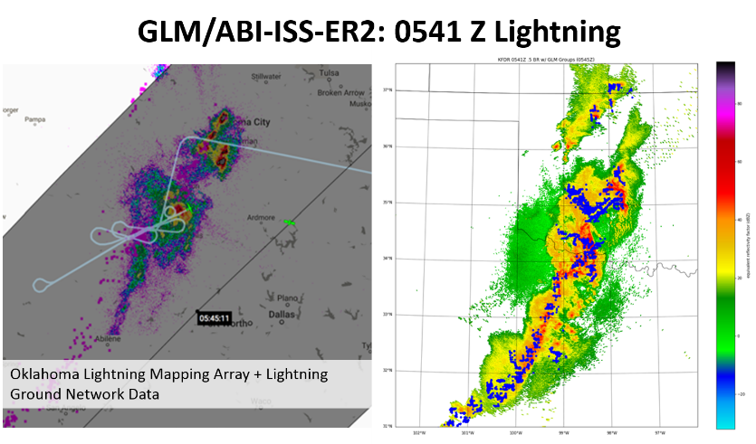
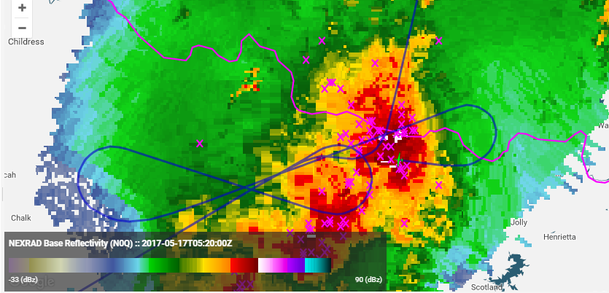
GOES-R Field Campaign Phase 2 Operations Date: May 17, 2017 Mission Objective: GLM Validation – OK/West TX LMA Takeoff: 0200 Z Landing: 0951 Z Flight Duration: 7.8 hrs
Mission Scientist: Dan Cecil, Hugh Christian, Francis Padula Flight Coordinator (All Flights): Jan Nystrom
Weather Forecast Leads: Austin Clark, Nicholas McVey, David Haliczer, Cameron Kowalski
Lightning Collection
Crude FEGS Flash Count: 894
Major Highlights:
Collected 3 hours of a variety of compact & horizontally extensive high flash rate lightning producing storms co-located with the Oklahoma & West Texas total lightning supersites at night. A coincident and co-located ISS/LIS overpass was collected over an active line of high flash rate thunderstorms near the Southern Oklahoma/Northern Texas border.
ABI 30-second imagery collected coincident and collocated with the ER-2 aircraft
Table Summary
Map Summary
16
Mission Number

Slide 12
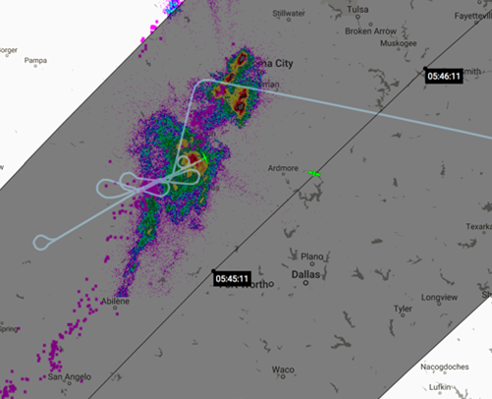
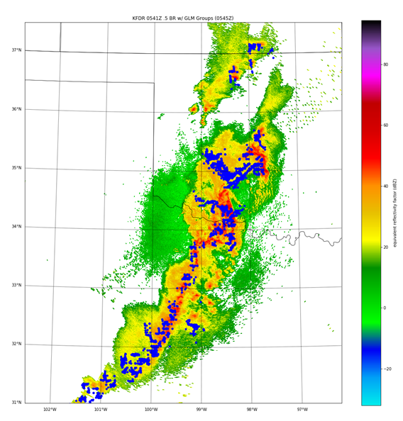
Post Launch Testing: GLM/ABI-ISS-ER2
GLM
ER2
ISS
0541 Z Lightning, May 17, 2017
AWG GLM and Field Campaign Team

Slide 13
Thank you
For more information visit www.goes-r.gov
www.facebook.com/GOESRsatellite
www.youtube.com/user/NOAASatellites
twitter.com/NOAASatellites
Steven.J.Goodman@noaa.gov
steven.goodman@nasa.gov

