Slide 1
Geostationary Lightning Mapper Flash Characteristics in Electrified Snowfall Events
Sebastian Harkema
The University of Alabama in Huntsville, NASA SPoRT

Slide 2
Methodology
Thundersnow – overlap of GLM groups and NESDIS merged Snowfall Rate (mSFR) product data
Created an algorithm that can objectively identify this phenomena
Collected 21 heavy snowfall cases from January-April 2018 in eastern CONUS
Compared thundersnow flashes identified by GLM to NLDN flashes
Classification: Tower, non-tower, IC-only, no NLDN
Characterized snowfall rates, accumulations, and snow-to-liquid ratios of locations that experienced thundersnow identified by GLM
GLM data overlaid on mSFR product in AWIPS at 2018-01-04 1410 UTC

Slide 3
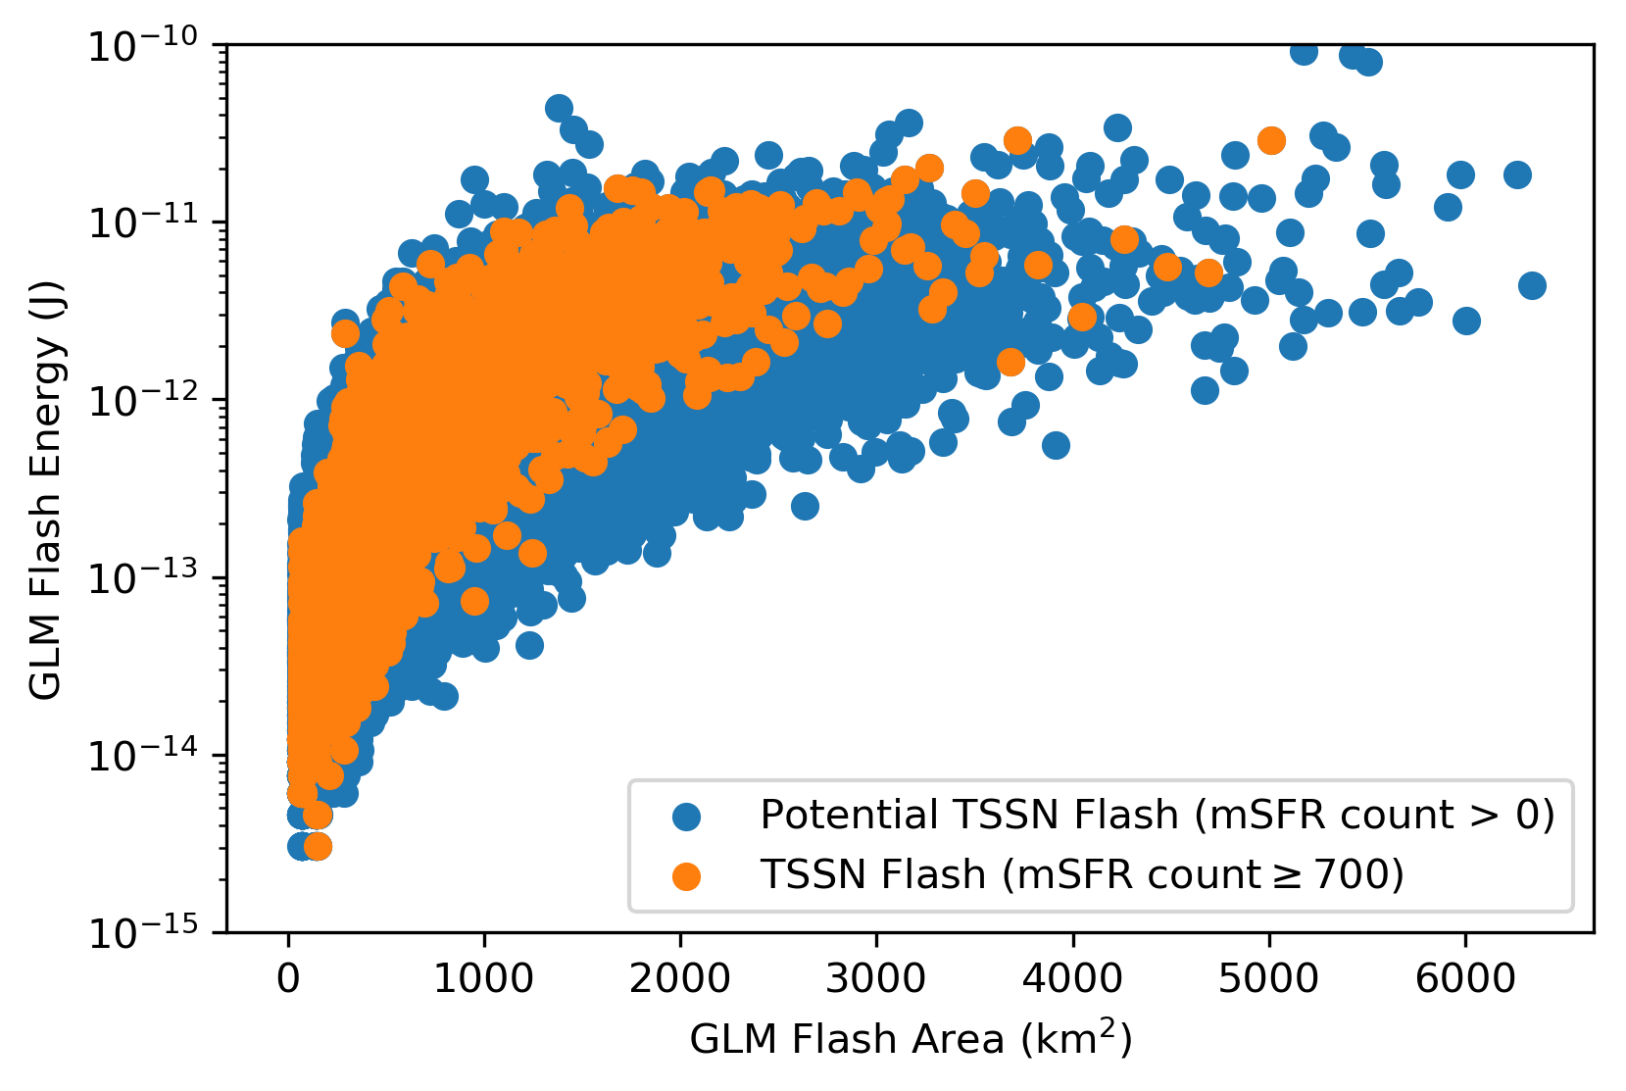
Thundersnow Flash Characteristics
50,000+ potential thundersnow flashes observed by GLM
2,214 were classified as thundersnow
Mean thundersnow flash observed by GLM
Flash area (754 km²), Flash duration (402 ms), Flash energy (1,342 fJ)
Values between the 50th and 99th percentile of all flashes within the GLM field-of-view (Rudlosky et al. 2019)
Thundersnow flashes observed by GLM also appear to have more total optical energy per flash area than non-thundersnow flashes
Tend to have less variability in the flash energy/area spectrum

Slide 4
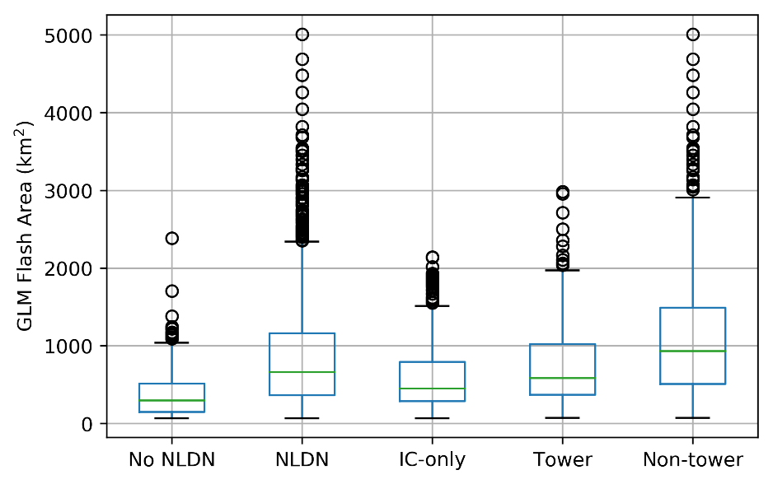
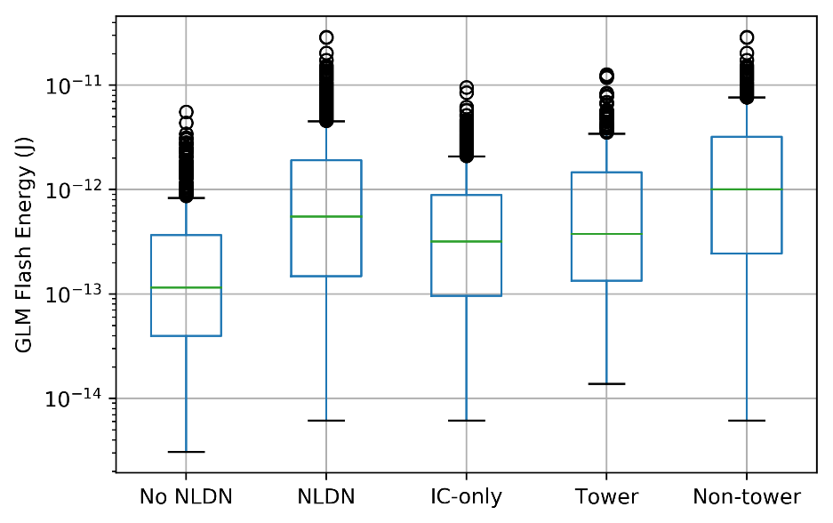
Thundersnow Flash Characteristics
2,214 thundersnow flashes observed by GLM were matched up with NLDN flashes
10,005 NLDN flashes corresponded to 1,709 thundersnow flashes observed by GLM
On average, 5.85 NLDN flashes were assigned to a single GLM flash
Statistically significant (p<0.01) differences in flash area and flash energy were found between GLM flashes that were observed by the NLDN and those that were not
On average, thundersnow flashes observed by GLM and associated with NLDN CGs were:
Spatially larger (1,013 vs. 572 km²), contain more total optical energy (2,098 vs. 732 fJ), and have a longer duration (476 vs. 358 ms) than thundersnow flashes associated with only NLDN ICs
11.1% of thundersnow flashes observed by GLM were associated with NLDN CG flashes that occurred within 500 m of a tall human-built object like an antenna or wind turbine

Slide 5
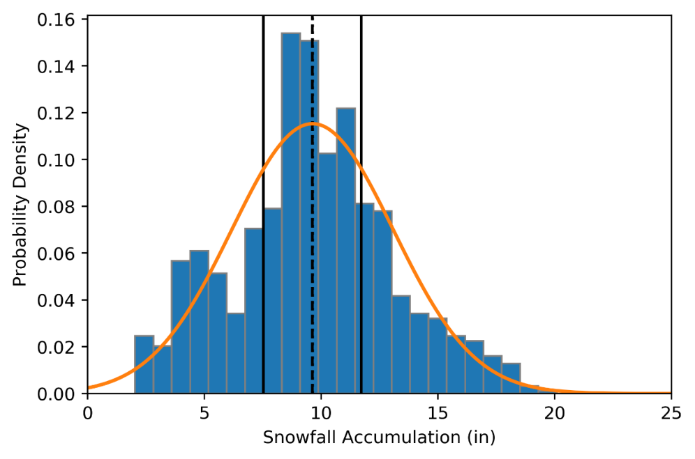
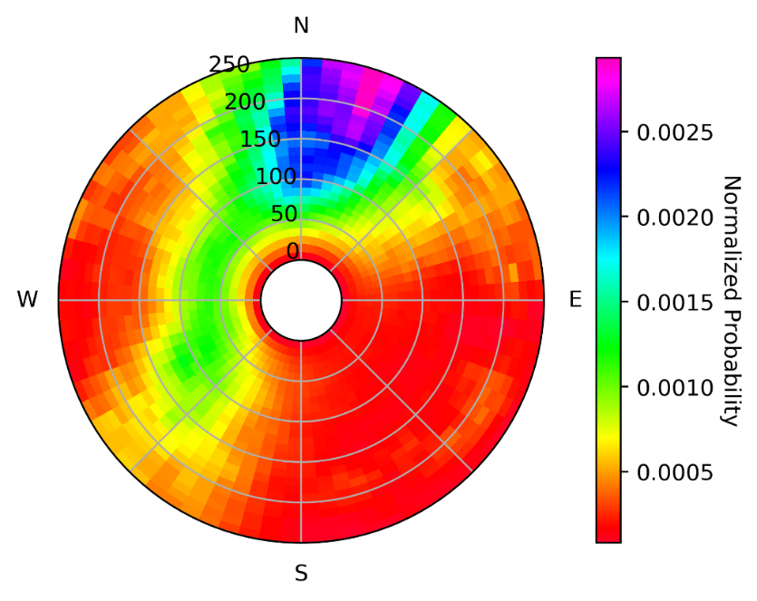
Snowfall Related Characteristics
Thundersnow does not occur in locations that experience the largest amounts of snowfall accumulation
On average ~10 in. of snow accumulation can be expected if thundersnow is observed when snowfall accumulation is expected
More likely to occur in:
Snow-to-liquid ratios between 8:1-10:1
Snowfall rates less than 1.0 in h⁻¹
Spatial offsets of 131±65 km between lightning flash and heaviest snowfall rates

Slide 6
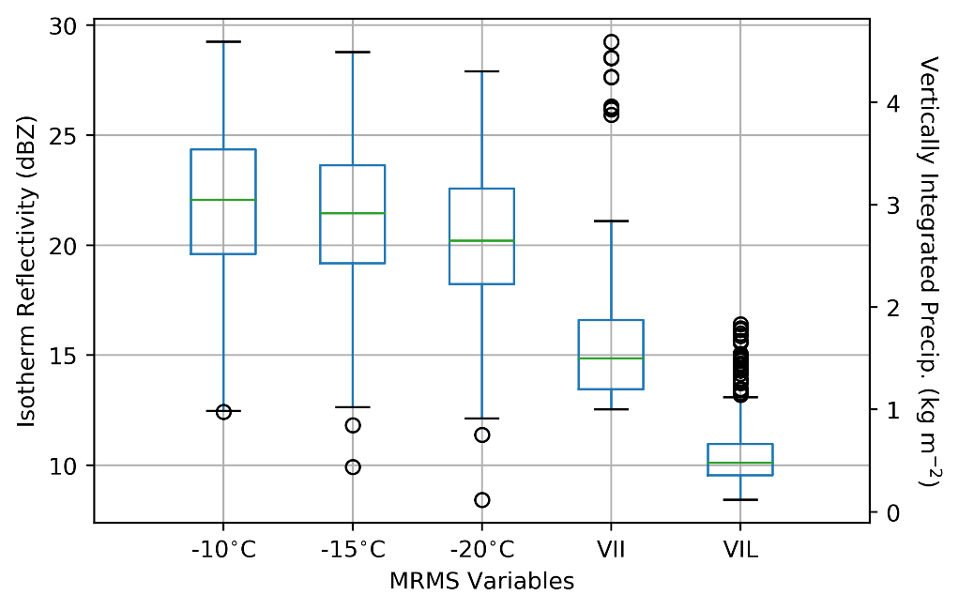
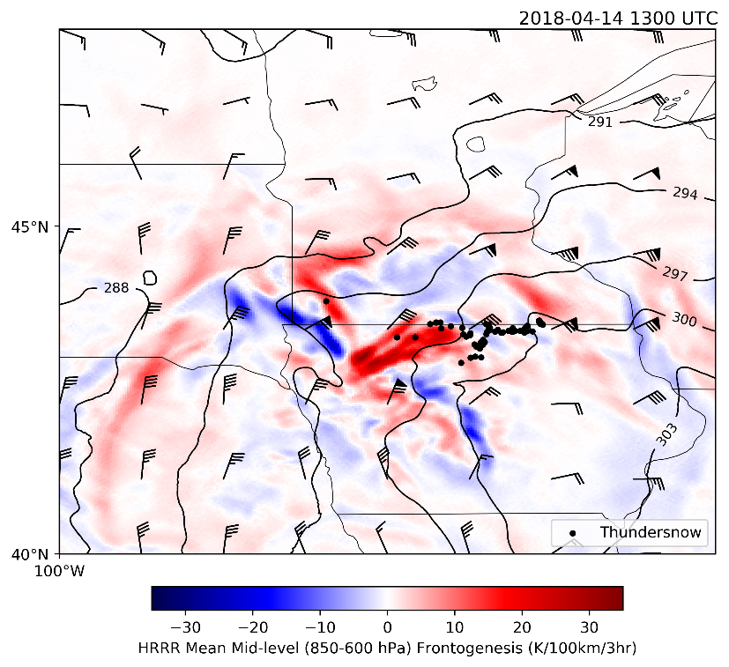
Other Related Characteristics
Occurred in MRMS isothermal reflectivity values less than 30 dBZ
VII and VIL mean values of 1.70 and 0.57 kg m⁻²
Tower thundersnow flashes occurred in higher snowfall rates and snow-to-liquid ratio values while also occurring in regions with lower isothermal reflectivity, VIL, and VII compared to non-tower and IC-only thundersnow flashes
Thundersnow is more likely to occur on the equator-side of snow bands and potentially connected with mesoscale processes that drive heavy-banded snowfall

Slide 7
Conclusions
Mean thundersnow flashes observed by GLM are between the 50th and 99th percentiles of all flashes within GLM field-of-view for flash area, flash energy, and flash duration
Thundersnow flashes observed by GLM also appear to have more total optical energy per flash area than non-thundersnow flashes
Spatial offsets of 131±65 km between thundersnow flashes and heaviest snowfall rates
Thundersnow is more likely to occur on the equator-side of snow bands and potentially connected with mesoscale processes that drive heavy-banded snowfall
NASA Investigation of Microphysics and Precipitation for Atlantic Coast-Threatening Snowstorms (IMPACTS) provides a great opportunity for the investigation of thundersnow in much greater detail

Slide 8
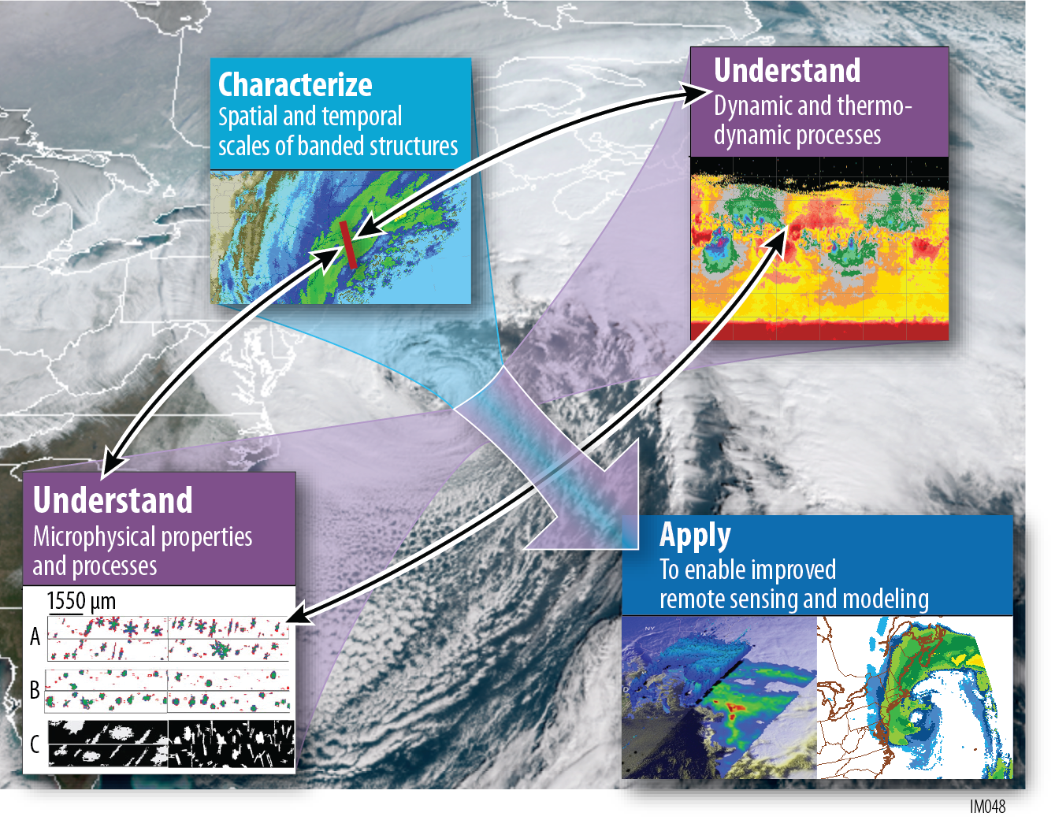
Snowbands in East Coast Snowstorms
Characterize spatial and temporal scales and structures of snowbands
Understand the dynamical, thermodynamical and microphysical processes
Apply this understanding to remote sensing and modeling of snowfall

Slide 9
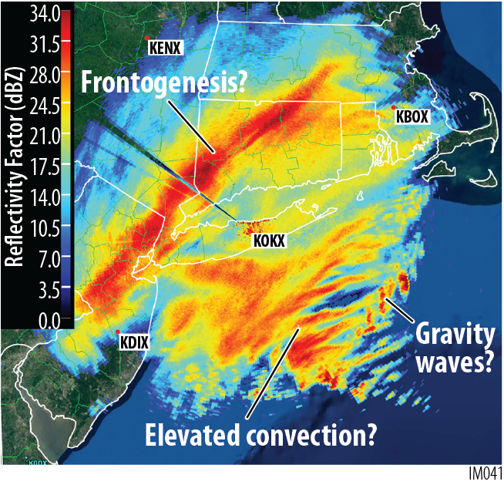
Snowbands in East Coast Snowstorms
Science Questions and Hypotheses: ‘Characterize’
What are the vertical and horizontal structures and scales of bands and how do these structures evolve with development of the cyclone?

Slide 10
Snowbands in East Coast Snowstorms
Science Questions and Hypotheses: ‘Understand’
What dynamical and thermodynamical processes determine the initiation, size, evolution and longevity of snowbands?
What mesoscale processes (gravity waves, elevated convection?) are associated with multi-bands?
Are areas of enhanced reflectivity in bands related to increased snow water content or changes in particle characteristics?

Slide 11
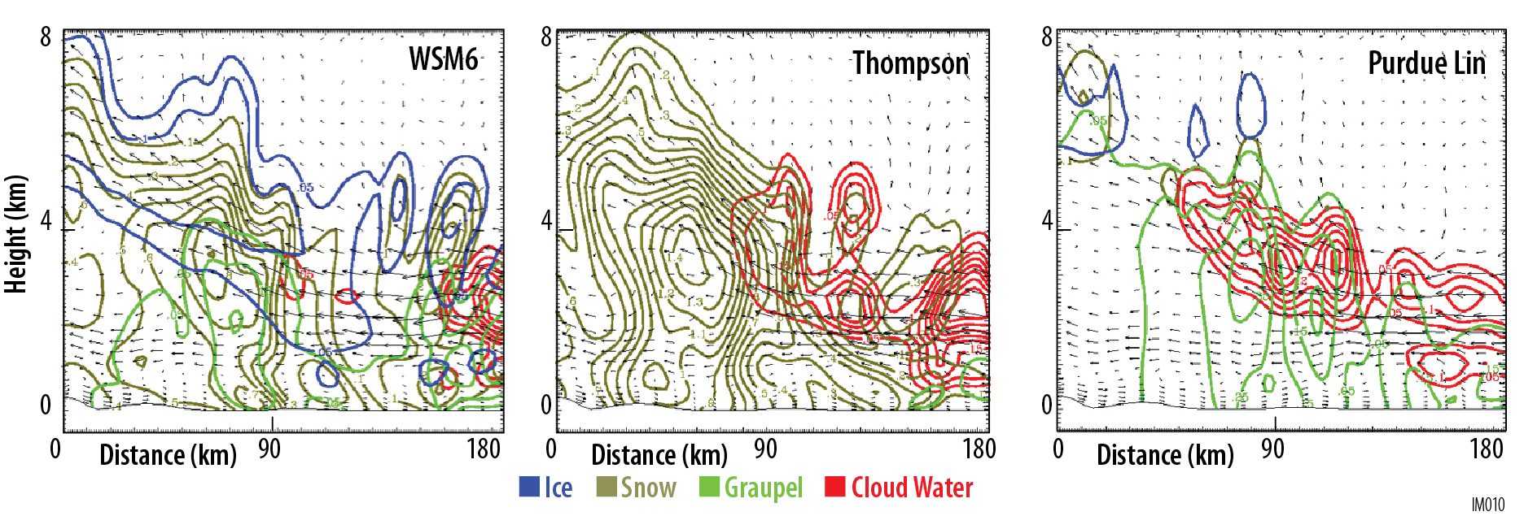
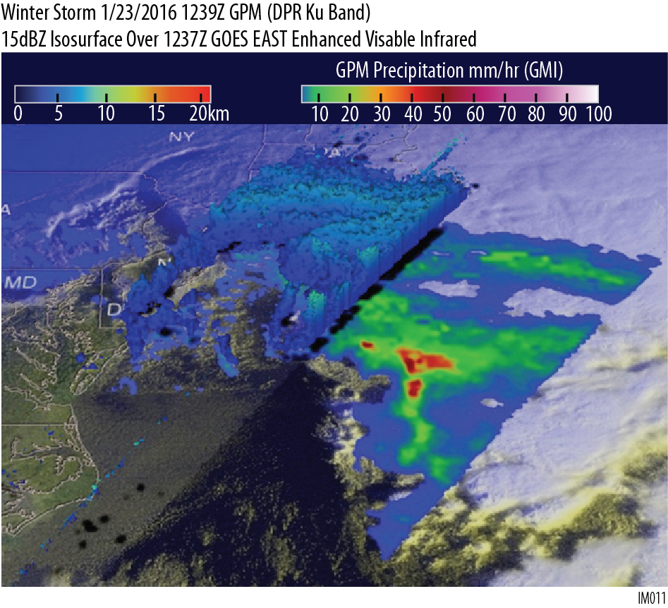
Snowbands in East Coast Snowstorms
Science Questions and Hypotheses: ‘Apply’
Microphysics schemes exhibit large differences in mixing ratios for all hydrometeor types
IMPACTS will make direct measurements of these quantities to help determine which schemes best simulate vertical structure of cloud water, ice and snow mixing ratios.
Remote sensing of snow and ice in winter storms faces several challenges that will be addressed by IMPACTS in situ and remote sensing measurements.

Slide 12
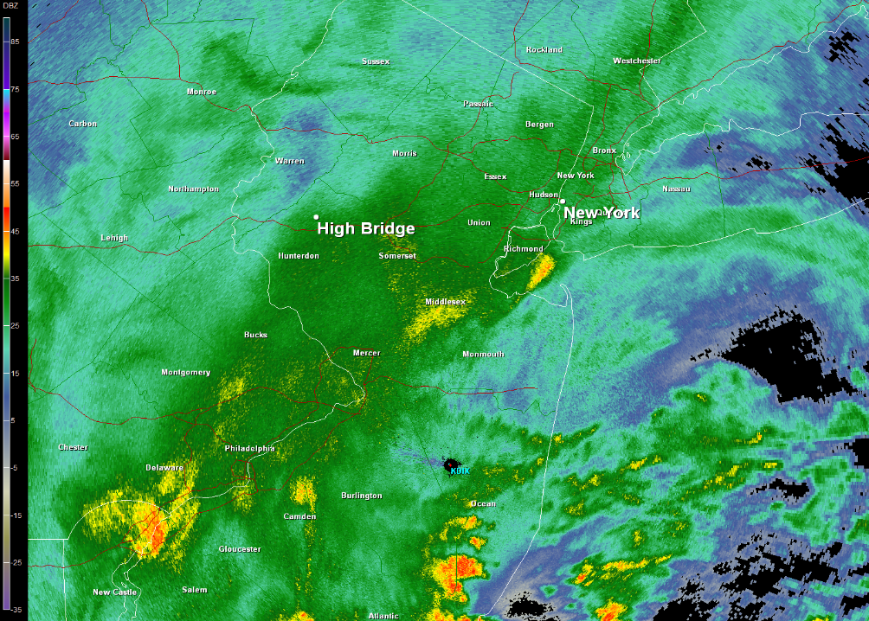
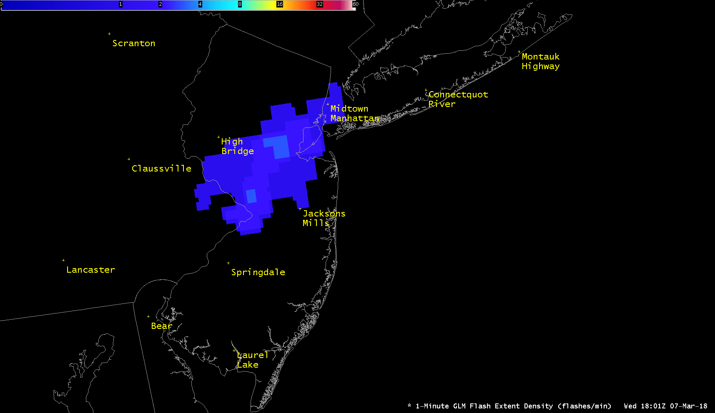
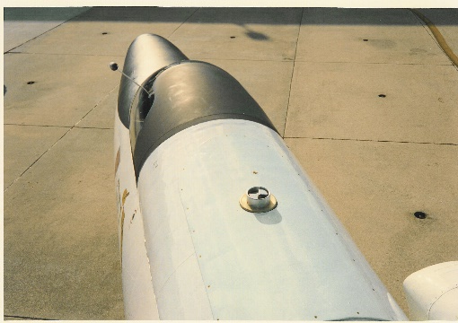
Utility of the Lightning Instrument Package for IMPACTS
KDIX 1801 UTC 7 March 2018
Lightning flashes observed in heavy snowfall events are in the top 90th percentile of flash size, total flash energy, and flash duration (Schultz et al. 2018, Rudlosky et al. 2019, Harkema et al. 2019, WAF, submitted)
The flash properties are dependent upon the mixed phase microphysical structure within snowbands that will be studied by IMPACTS, specifically coupling cloud liquid water content and the magnitude of the electric field of the cloud (both lightning producing and non-lightning producing clouds).
Furthermore, given the LIP information can be disseminated in real-time, the electric field observations can provide an idea of the most electrified clouds, helping the P-3 aircraft avoid areas of potential lightning and severe icing.
GLM Flash Extent Density 1801 UTC 7 March 2018

