Slide 1
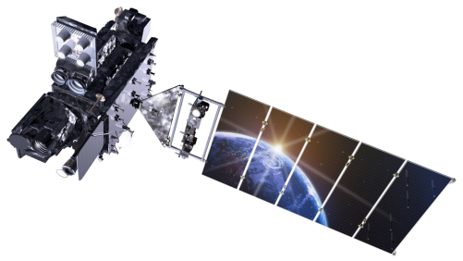
Status of GLM Products in Operations Scott Rudlosky (NOAA/NESDIS/STAR) GLM Science Week (10-12 September 2019)

Slide 2
GLM Research at CICS CISESS
GLM Team at CISESS
Scott Rudlosky^{1,2}, Mason Quick², Jonathan Smith², Daile Zhang², Feng Zhang², Ryo Yoshida³, Jason Chen⁴, Idris Akala⁴, Ayyub Abdulrezak⁴
¹NOAA, ²ESSIC, ³JMA, ⁴ERHS
Main GLM Foci at CISESS
Calibration/Validation
Product Evaluation/Development
NWS Application/Implementation
Data Visualization/Outreach
Mean Values | Land | Ocean | Land* | Ocean*
Flash Area (km²) | 431 | 570 | 473 | 627
Flash Duration (ms) | 293 | 345 | 297 | 396
Flash Energy (fJ) | 230 | 420 | 247 | 508
Groups per Flash (#) | 15.4 | 21.3 | 17.0 | 29.1
Events per Flash (#) | 39.3 | 57.0 | 42.6 | 74.1
From Rudlosky et al. (2019) and Peterson (2019)* https://doi.org/10.1029/2018GL081052
https://doi.org/10.1029/2019JD031054

Slide 3
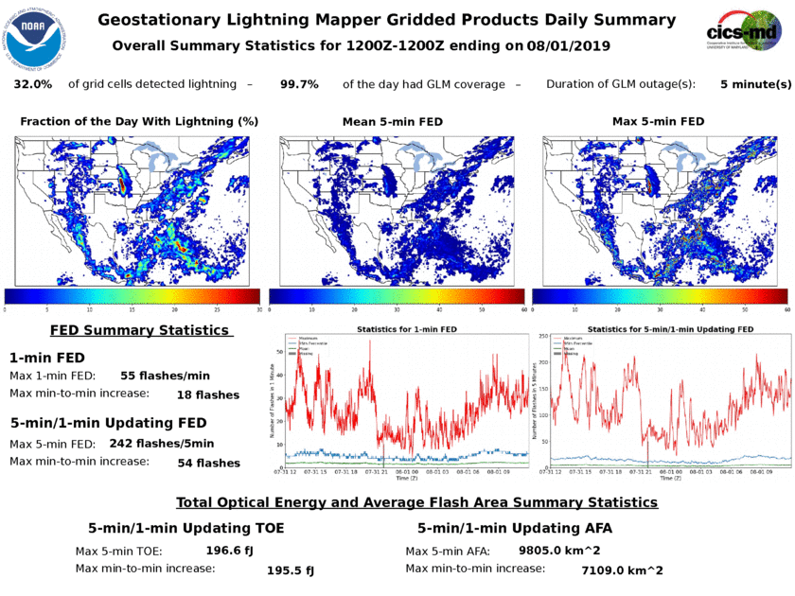
GLM Research at CISESS
Calibration/Validation
Routine monitoring
Stop gaps biding time for a formal data quality product
Daily Gridded Product Status
Planned transition of offline tools developed by GLM team (e.g., Cummins) to routine operations using AWIPS feeds
Supporting GS evolution
Gather/Relay NWS feedback
Inform community of changes

Slide 4
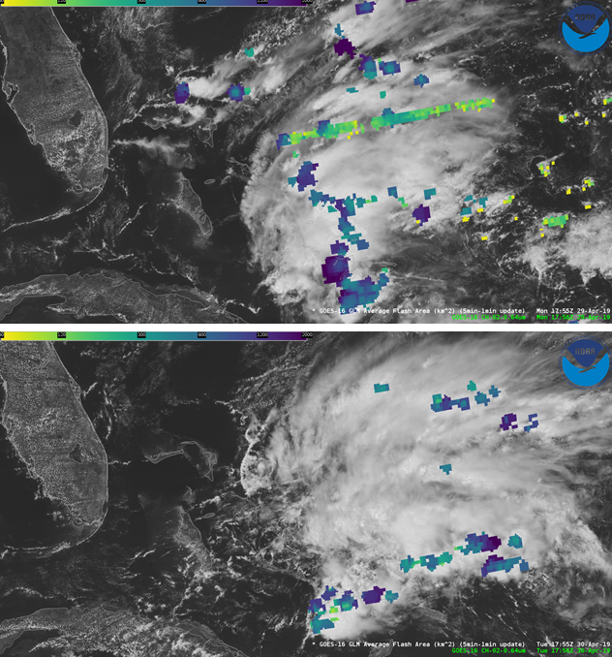
GLM L2 Product Status
https://lightning.umd.edu/documents/GS_Status/
GLM_GS_Status_8_21_19.pdf - lists all known GLM-related changes to the Ground System (GS) software since initial deployment
GOES16_GLM_FullValidation_ProductPerformanceGuide.pdf summarizes key performance metrics and existing issues of the GOES-16 GLM L2 data product found on November 1, 2018
Variable performance must be better documented, understood, and communicated
With time, as the onboard settings and GS processing evolve
Within the FOV (i.e., diurnal, regional, and storm-scale variability)
Bahama Bar Before and After

Slide 5
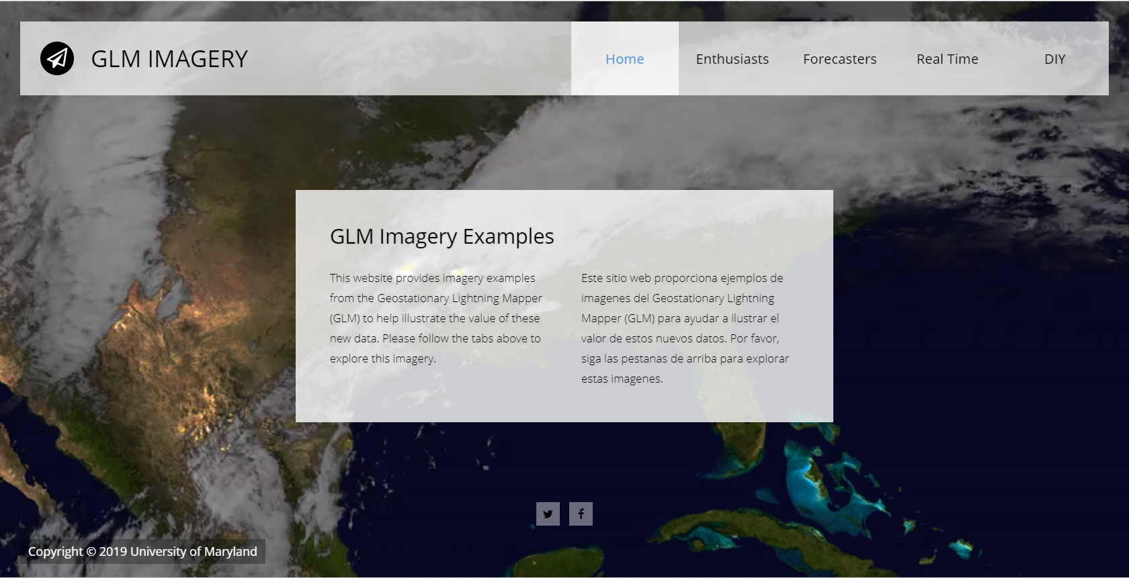
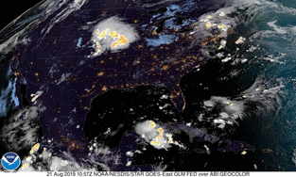
GLM Research at CISESS
Data Visualization and Community Outreach
Promoting proper data use and interpretation (e.g., short courses)
New visualization website https://lightning.umd.edu/glm/
Requesting help with some simple tutorials on how to work with the L2 data and/or gridded products

Slide 6
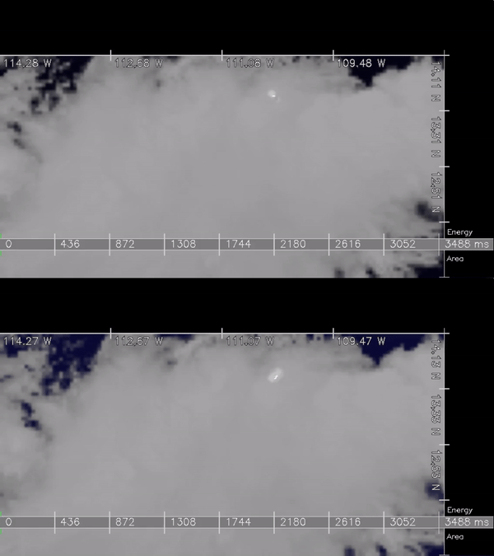
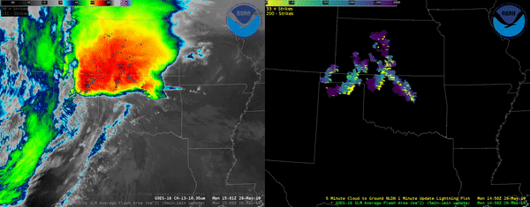
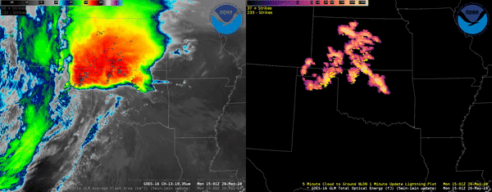
GLM Research at CISESS
G16
Product Development and Evaluation
Official Level 2 product (events, groups, and flashes)
Gridded Product Suite (JTTI Project, OAR/NWS)
NWS Application and Implementation
Develop training (quick guides, use cases, etc.)
Vlab Webpage (https://go.usa.gov/xV4FB)
Facilitate Field Demonstrations
G17
GLM-AFA
GLM-TOE

Slide 7
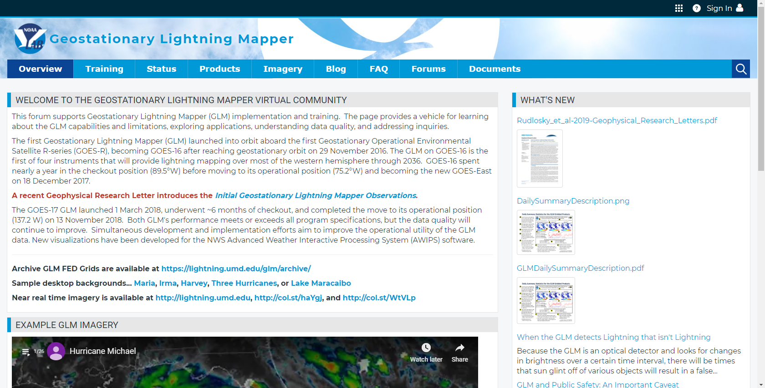
NWS Virtual Lab Page
https://vlab.ncep.noaa.gov/web/geostationary-lightning-mapper/

Slide 8
GLM Field Demonstration
General feedback form (https://forms.gle/bE9TsxBgaLZMv8Jn7)
Specifically requesting
Locally relevant use cases developed in conjunction with forecasters
Details on incorporation into AWIPS displays for different scenarios
How the GLM can be used in conjunction with ground-based lightning networks
How useful were the GLM products for monitoring convective development and evolution during storm warning operations or Decision Support Services?
How useful were the training resources provided for understanding the GLM products?
NWS Regions

Slide 9
GLM Field Demonstration
Many thanks to these forecasters for their survey contributions…
Matthew Bunkers
Steve Hodanish
Benjamin Herzog
Jonathan Welsh
Jaclyn Ritzman
Randall Hergert
Linda Gilbert
Keith White
Linda Gilbert
Brian Guyer
Rachel Cobb
“In 3 panels I have sat data and then the GLM/NLDN data in the. I have one of these procedures for nighttime NSE and another for daytime NSE. I like having this data to see both initiation and where (and the amount) the ltg is occurring. IMO, I don’t even plot total lightning data anymore as the GLM takes care of this for me. Its really easy for me to see where total lightning (GLM) is occurring along with the NLDN flashes.”
“I need to stress that the GLM over the mtns is very helpful, especially for initiation and for wintertime ltg. Radar coverage in the mtns is poor to say the least and having the GLM and NLDN helps us know where the stronger convection is.”
“As for using this for severe weather ops, the GLM is helpful on seeing where the stronger convection is, as you can observe the changes in GLM intensity with time.”

Slide 10
GLM Field Demonstration
Many thanks to these forecasters for their survey contributions…
Matthew Bunkers
Steve Hodanish
Benjamin Herzog
Jonathan Welsh
Jaclyn Ritzman
Randall Hergert
Linda Gilbert
Keith White
Linda Gilbert
Brian Guyer
Rachel Cobb
“The GLM products are nice for confirming that a storm is strong, or developing, but radar is still the best choice for monitoring storm evolution. It was nice though to observe that the AFA product identified a developing cell (in bright green at 23:47) and increasing lightning activity directly over the airport as we were hearing the first thunder, which was not picked up be the NLDN right away. Early detection of lightning is important because we are supposed to notify airport operations when lightning is within 5 miles.”
“It was useful showing the lightning activity within a storm cell being updated every one minute. In a data sparse area with poor radar coverage in many areas of the CWA, this certainly helps in providing greater temporal and spatial coverage where the radar may not pick up the full column of an updraft.”
“GLM highlighted areas of concern for lightning. At times, GLM picked up on lightning that ground-based networks failed to.”

Slide 11
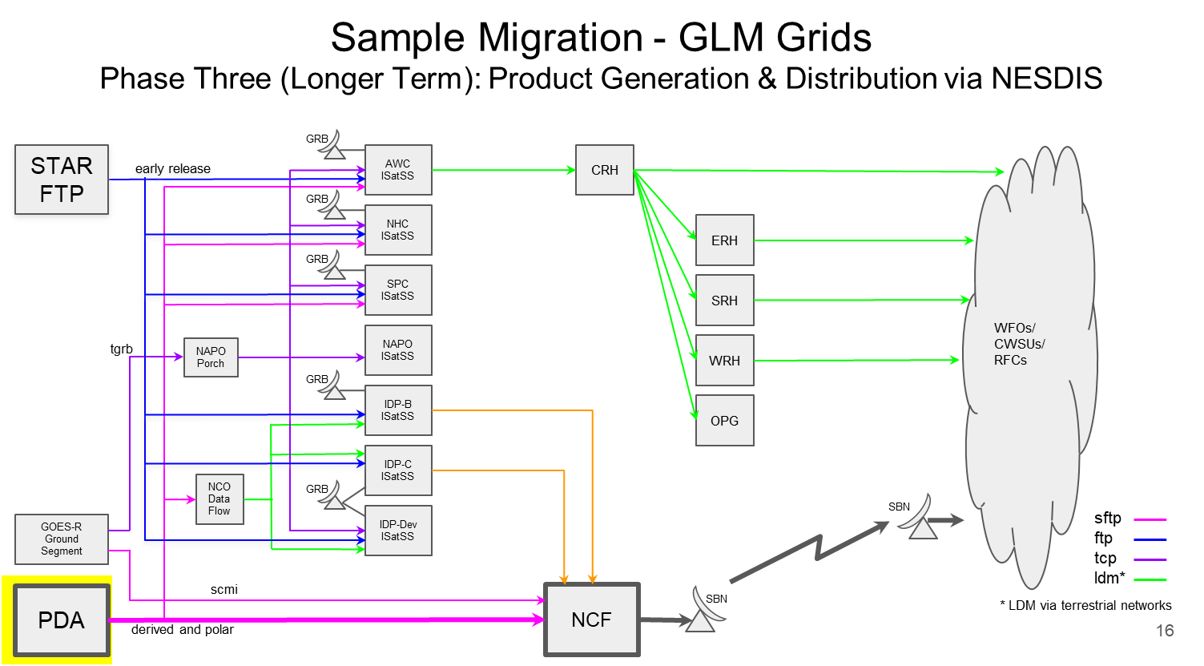
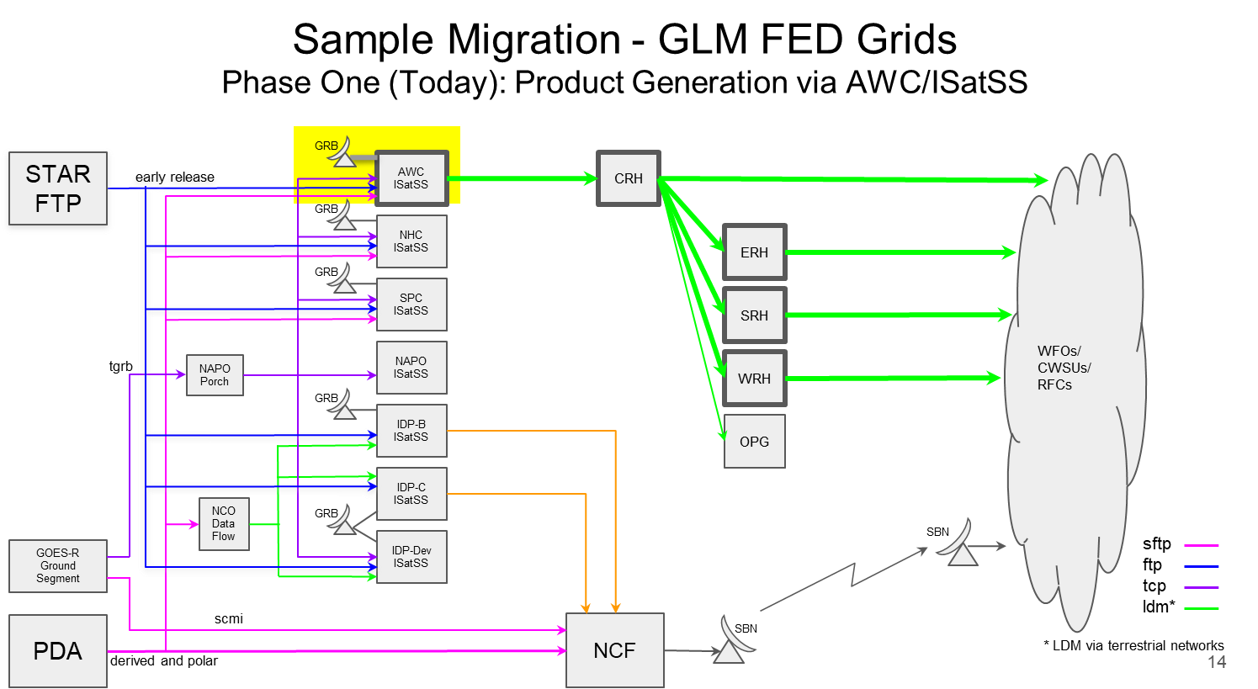
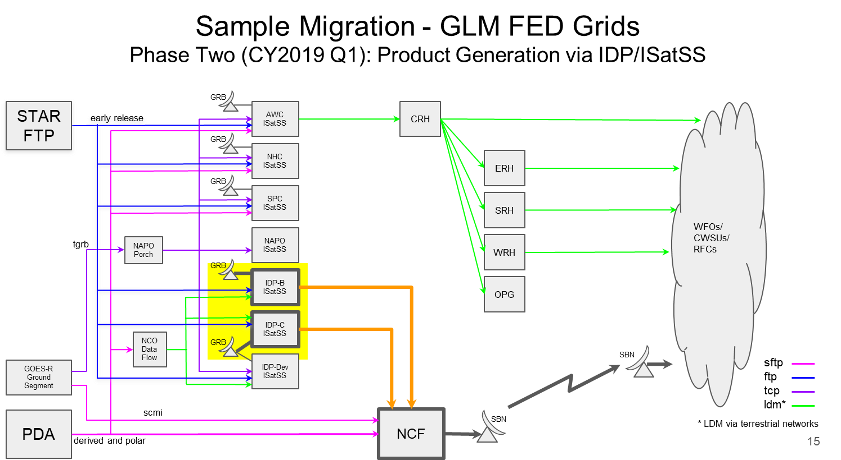
Work Remains
More than can be listed here, much of it discussed this week
Gridded products in the ground system (including data quality product)
Requires formal NWS request
NESDIS Process/Mechanisms
GLM Storms (akin to LIS areas)
Next Generation Sensors
Discussion should not be GLM vs hyperspectral sounder
*Several National Centers create their own full-disk grids in house using glmtools and ISatSS

Slide 12
Making Tremendous Progress!
Many projects feed back into the larger GLM implementation effort
This session describes many of these projects
Chad Gravelle (NWS Southern Region HQ) – Use of GLM for Long stratiform flashes
Stephanie Stevenson (NOAA HRD) – GLM in Tropical Cyclones: Operational and Research Developments
Kristin Calhoun (NOAA NSSL) – GLM Use, feedback, and development in the HWT
Jason Jordan (NWS Lubbock) – GLM at an NWS WFO: First thoughts and Experiences
Steve Cobb (NWS Tulsa) – Operational Analysis of GLM during QLCS Transition Events
Geoffrey Stano (UAH) - Ongoing lightning activities at the GHRC
Reminder of our new visualization website https://lightning.umd.edu/glm/

