Slide 1
Stephanie N. Stevenson
Cooperative Institute for Research in the Atmosphere, Colorado State University, Fort Collins, CO
NOAA/NWS/NCEP National Hurricane Center, Miami, FL

Slide 2
Outline
Part 1: Operational developments
Updates on GLM integration into operations
  Full-disk grids in AWIPS-II
  NHC’s TAFB feedback and vision
  Lightning-based rapid intensification index (RII)
Part 2: Research developments
Initial look at GLM flashes in Dorian
Research topics still of interest to maximize use of lightning in TCs

Slide 3
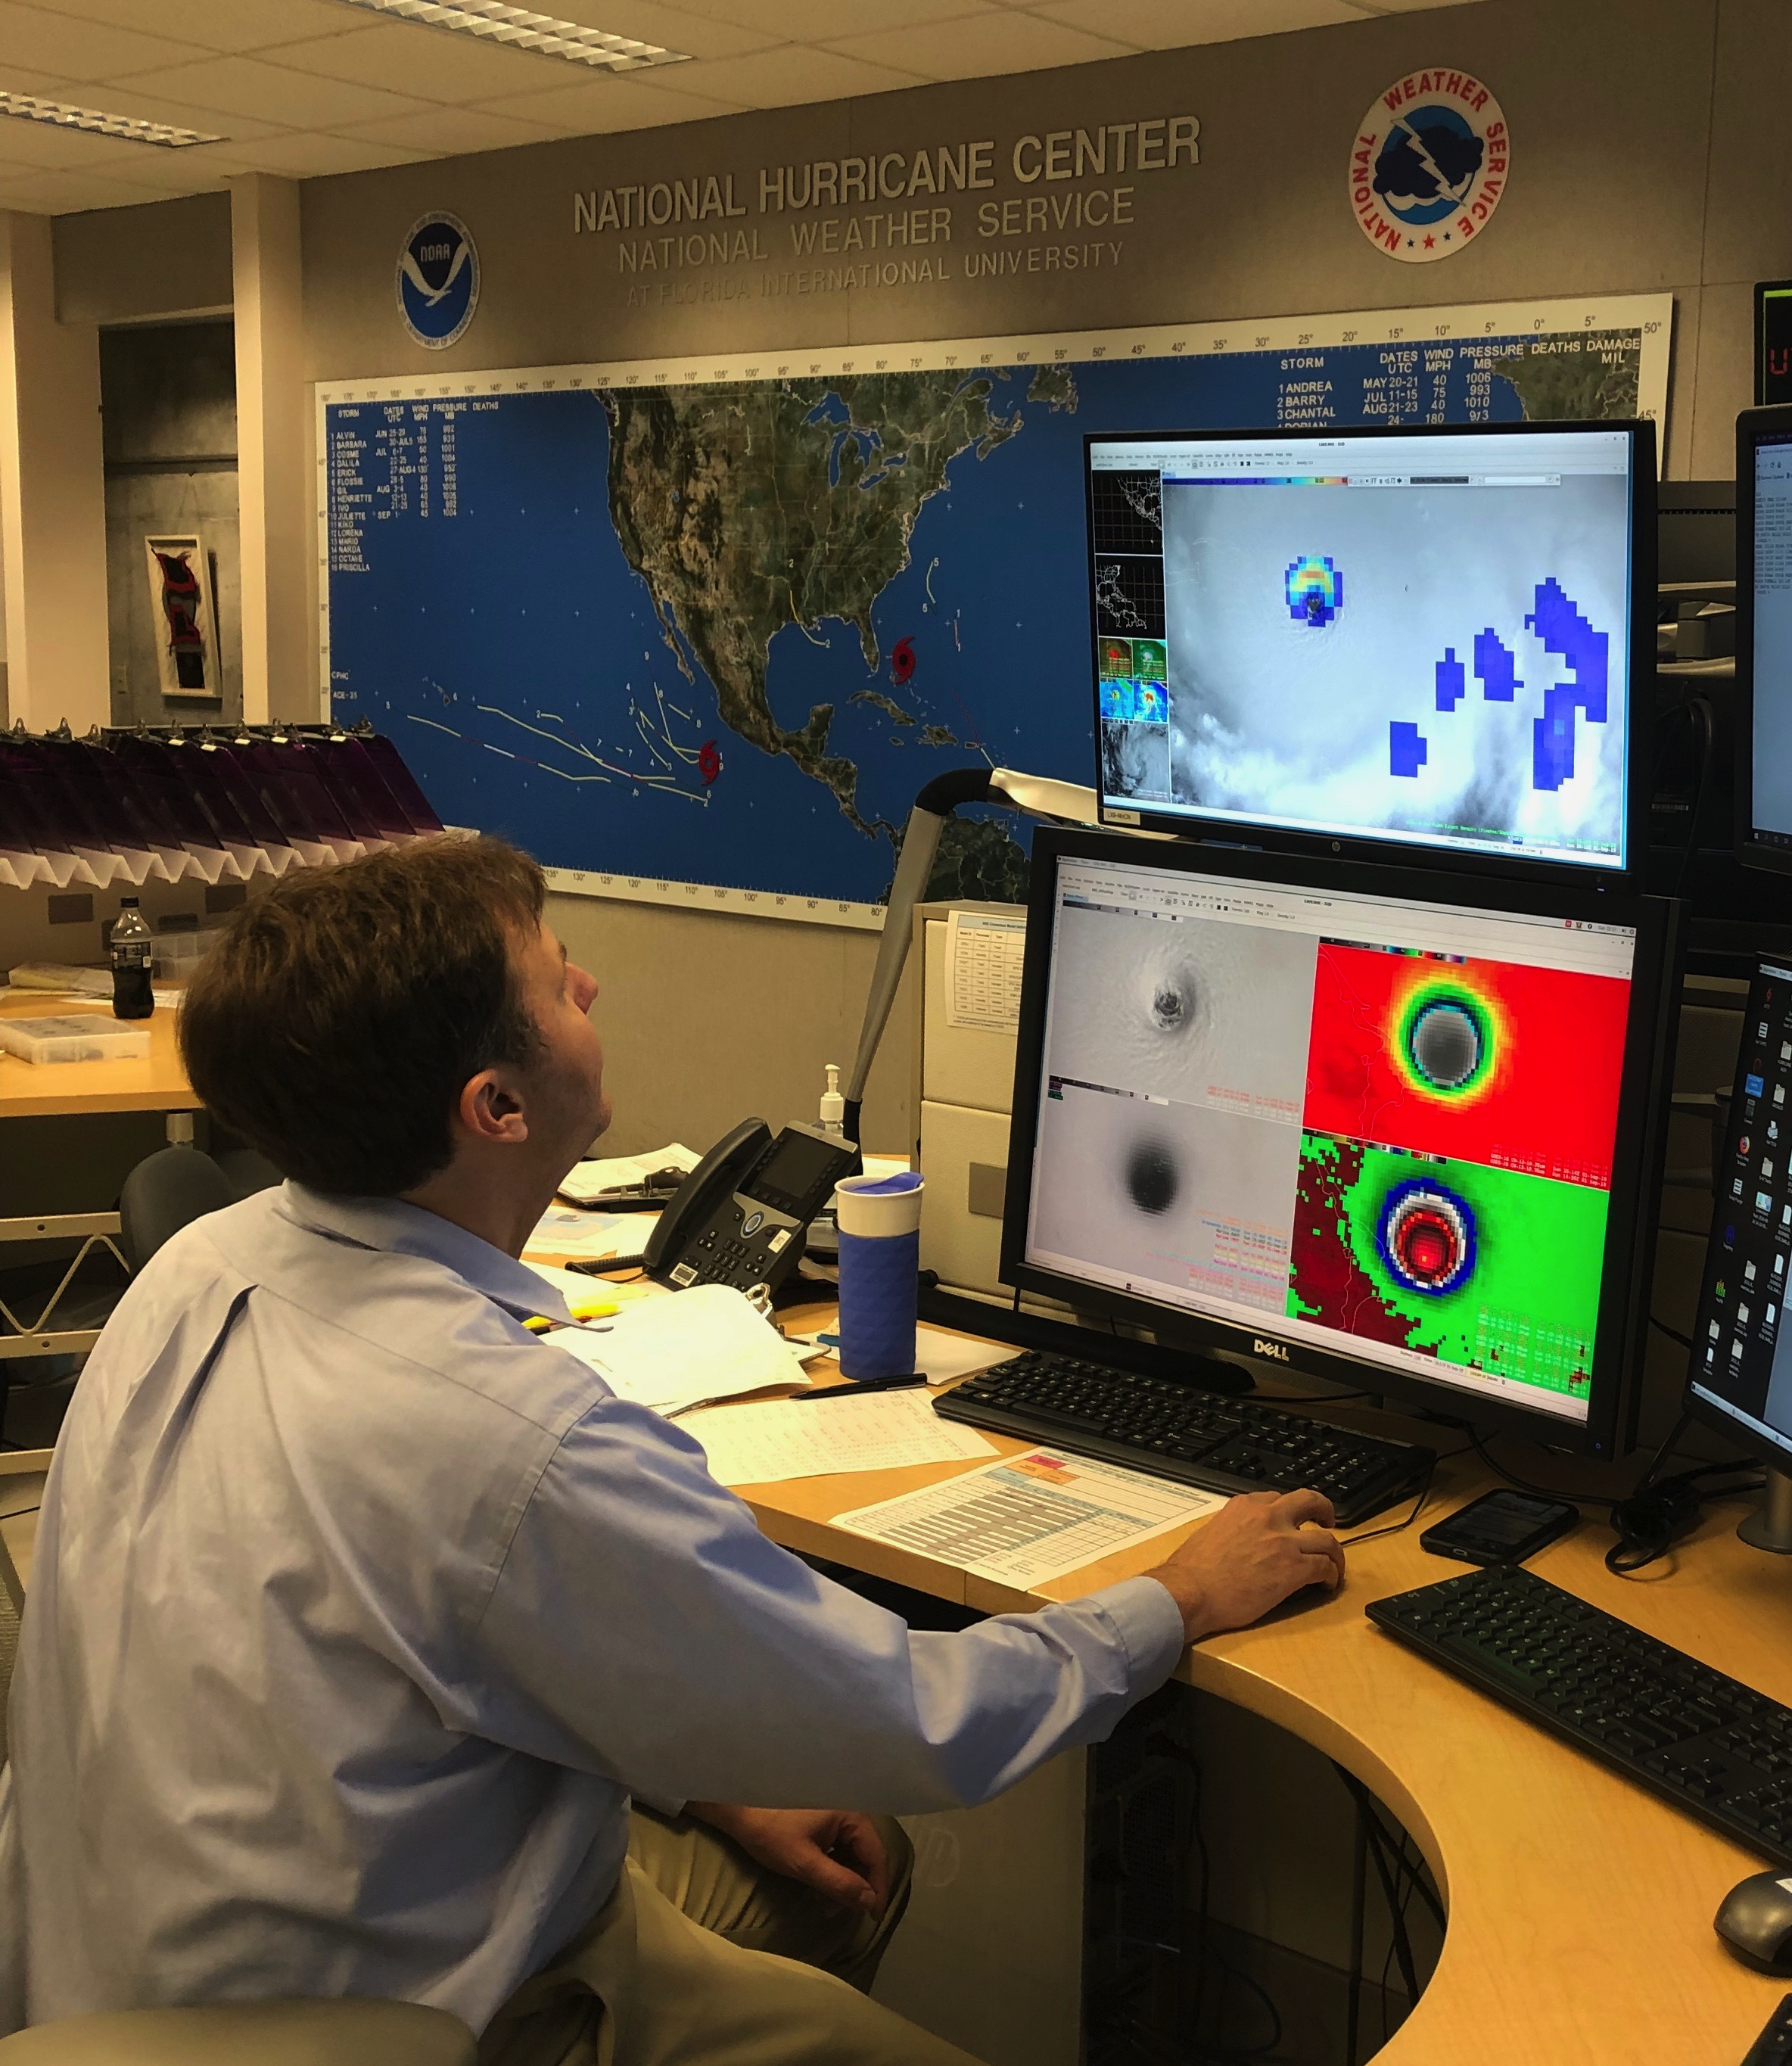
Operational developments:
Full-disk grids in AWIPS-II
2018 hurricane season:
  No GLM products
2019 hurricane season:
  CONUS GOES-16 GLM grids (from AWC)
    Resolution: 2 km
    Time accum: 1 min , 5 min
    Grids: FED
  Full-disk GOES-16/17 GLM grids
    Resolution: 4 km
    Time accum: 5 min, 10 min, 30 min
    Grids: FED, AFA, TOE
1 Sep 2019, 11:15 AM EDT:
Hurricane Specialist Eric Blake looking at GLM data in Hurricane Dorian–1.5 hours before 1st landfall in Elbow Cay, Abacos

Slide 4
Operational developments:
Full-disk grids in AWIPS-II
NHC’s technical setup
  GLM grids currently generated on developmental ISatSS virtual machines at NHC
Operational ISatSS 1
GOES-16
Operational ISatSS 2
AWIPS-II
Spare
Development ISatSS 1
GOES-17
Development ISatSS 2
Intended for GLM research
Development ISatSS 3

Slide 5
Operational developments:
Full-disk grids in AWIPS-II
Challenges
  Stability of grid generation in the ISatSS framework
    Frequently requires manually restarting processes
*
* Local GRB issue not related to ISatSS/glmtools

Slide 6
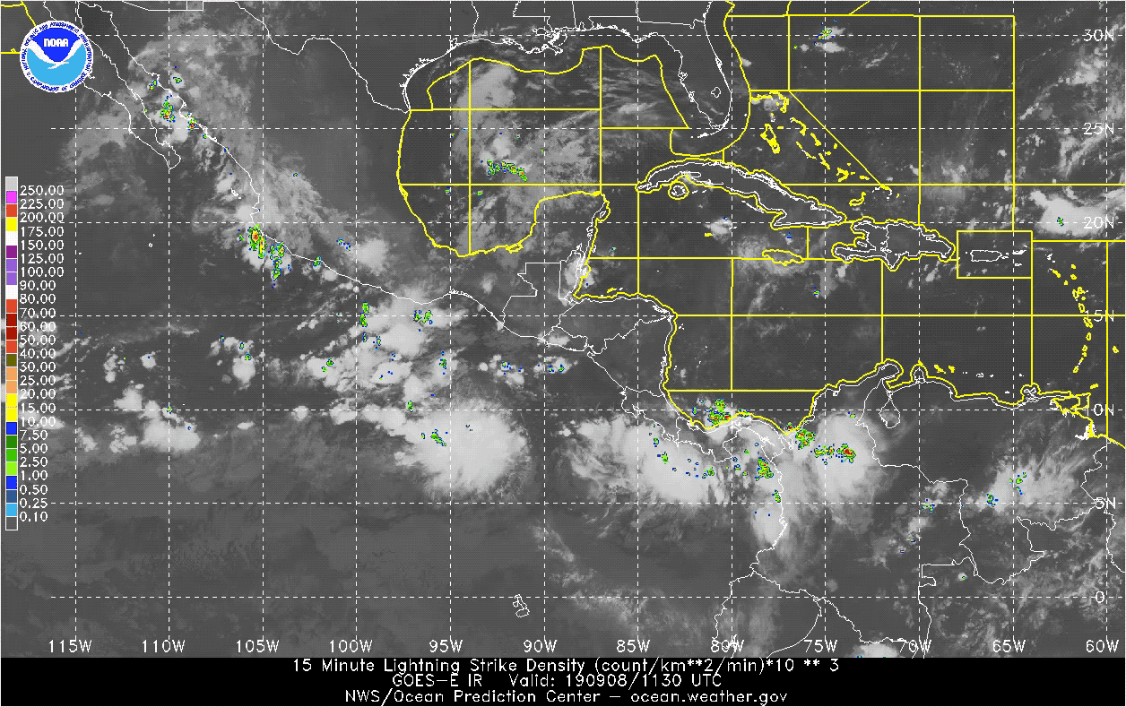
Operational developments:
TAFB feedback
They prefer the colormap currently used for the gridded GLD data in N-AWIPS because it “looks more like radar”

Slide 7
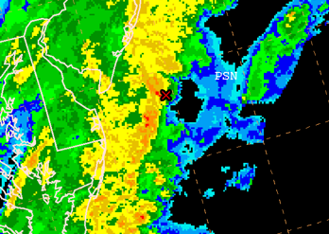
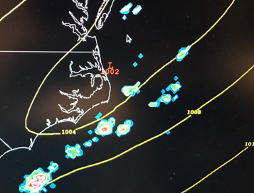

Operational developments:
TAFB vision
TAFB is considering the use of GOES GLM and other met sources to produce Severe Marine Thunderstorm Warnings with polygons
  They are just beginning to explore this idea and still in the early stages

Slide 8
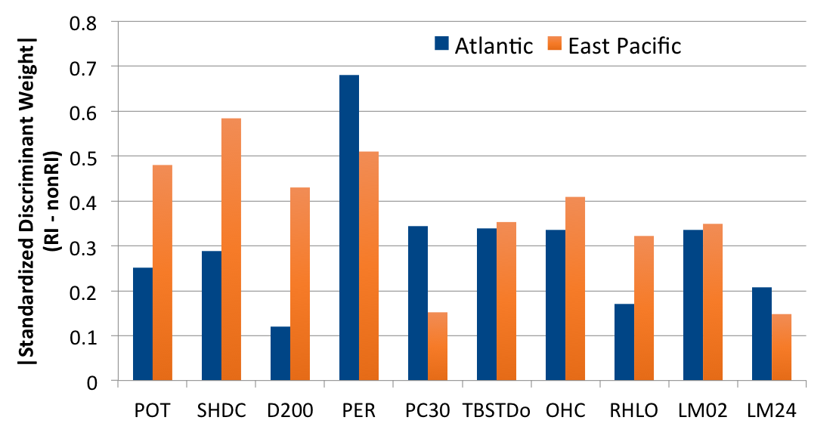
Operational developments:
Lightning-based RII
Real-time experimental version almost ready
  To be run at NHC:
    GLD version
      WorldMerge was an obstacle, so GLD-only feed set up for NHC
    GLM version
      Longevity of dataset still a challenge for statistical training
  To be run at CIRA:
    WWLLN version
      Longest oceanic dataset
Lightning predictors
POT: SST Potential
SHDC: Shear
D200: Divergence
PER: Persistence
PC30: % IR pixels < -30°C
TBSTDo: GOES IR brightness temp standard deviation
OHC: Ocean heat content
RHLO: Relative humidity
LM02: Inner-core lightning
LM24: Outer-rainband lightning

Slide 9
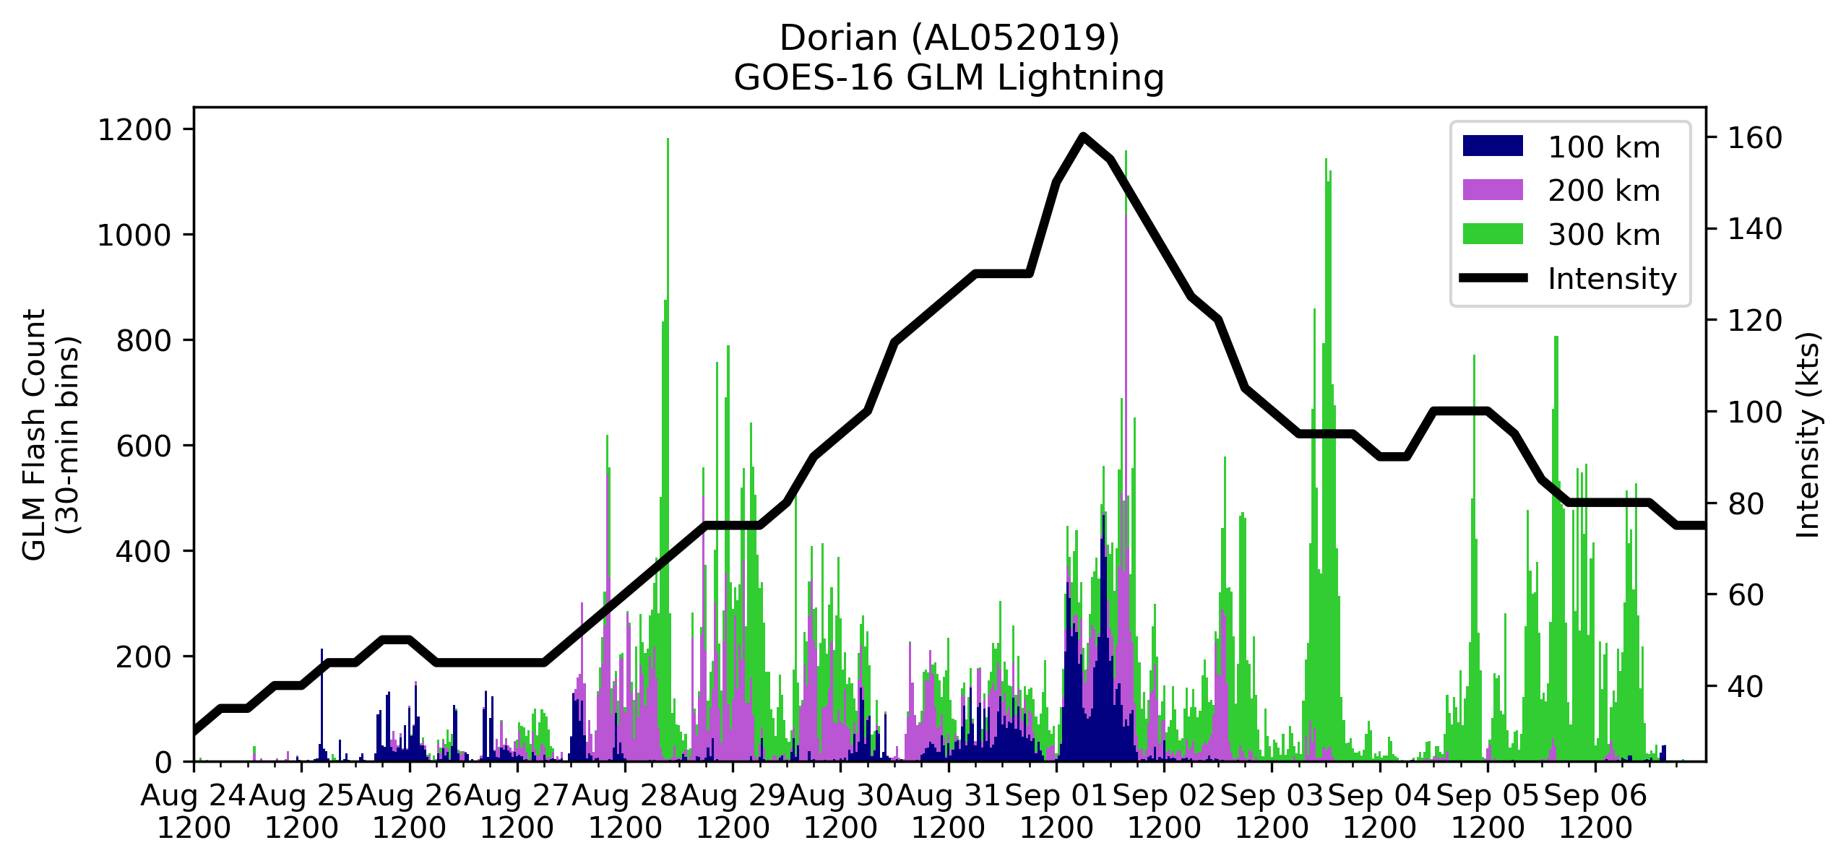
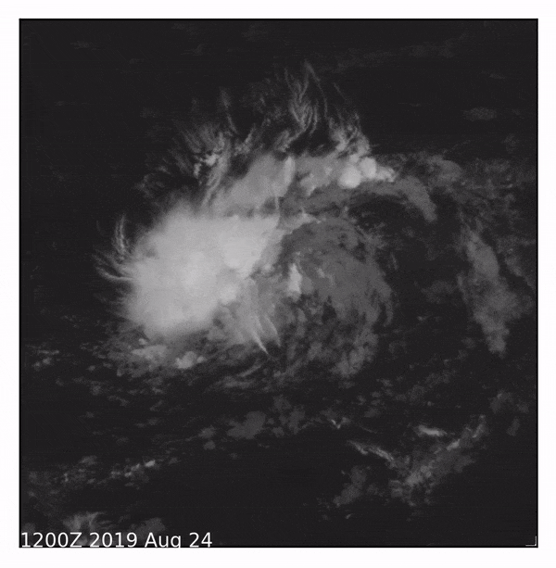
Research developments:
Hurricane Dorian (2019)
Eyewall lightning prior to landfall had everyone’s attention, including NHC forecasters
ABI: IR Channel 13
GLM: Flash Centroids
Rapid Intensification
(Definition: 30 kt / 24 h)
30 kt in 12 h (!!)
Prolonged eyewall lightning

Slide 10
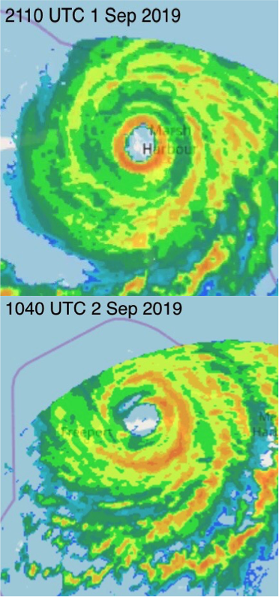
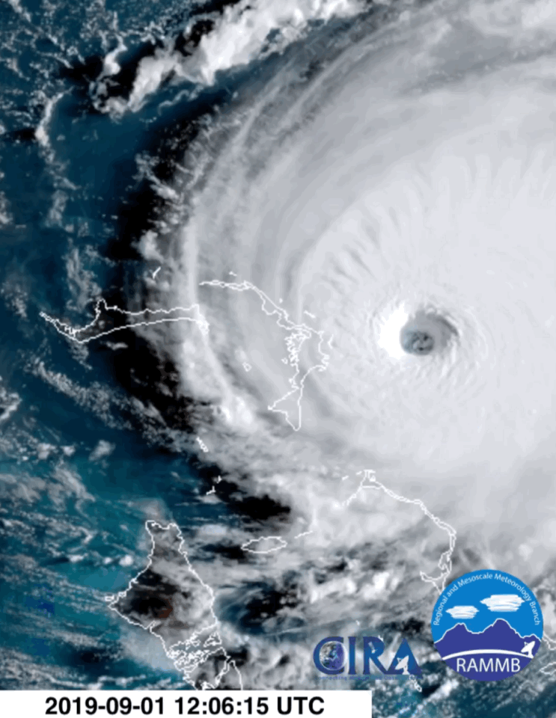
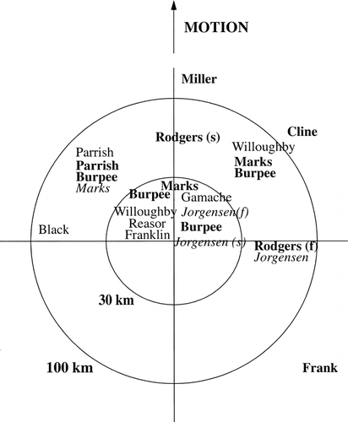
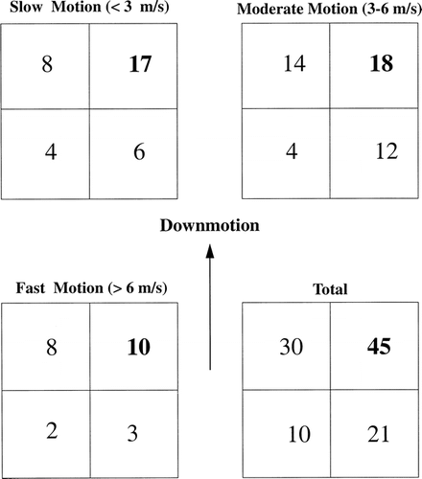
Research developments:
Hurricane Dorian (2019)
Eyewall lightning prior to landfall had everyone’s attention, including NHC forecasters
  Nearly continuous eyewall lightning for several hours (12 h loop shown here)
  GLM predominately captured lightning in northern eyewall (front right quadrant)
Rainfall/Convection
Lightning
Corbosiero and Molinari 2003

Slide 11
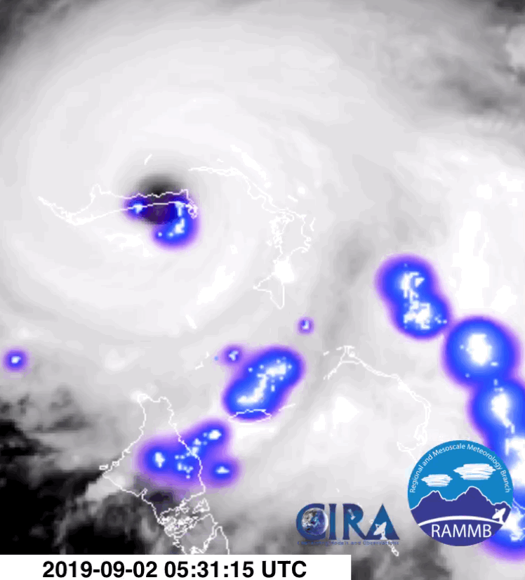
Research developments:
Hurricane Dorian (2019)
Eyewall lightning prior to landfall had everyone’s attention, including NHC forecasters
  Nearly continuous eyewall lightning ceased when the inner eyewall began to weaken
  GLM may help monitor eyewall replacement cycles (ERCs)
Note:
Tons of data for this case (aircraft, radar, dropsondes, etc.)

Slide 12
Research developments:
Research avenues for GLM in TCs
Most prior research
More research needed
TC lightning patterns
TC structure
TC intensity change
TC lightning frequency
More is needed to link observed lightning to TC structural changes at various stages of maturity
  TC intensification is complex process with many factors involved
  Utility of GLM in TCs is likely to advance more if lightning patterns and frequency can be tied to evolution of TC structure (e.g., ERC)
    Can GLM help simulate TC structures found in microwave imagery?

Slide 13
Research developments:
Research avenues for GLM in TCs
Most prior research
More research needed
TC lightning patterns
TC structure
TC intensity change
TC lightning frequency
What are typical lightning characteristics in TCs and do they change with TC structural and intensity changes?
  GLM: flash area, energy, etc.
  Ground-based networks: IC/CG ratio

