Slide 1
Performance of the Optimal Estimated Detection Height for G16
Katrina S. Virts and William J. Koshak
UAH, NASA/MSFC
2019 GLM Science Team Meeting
11 September 2019

Slide 2
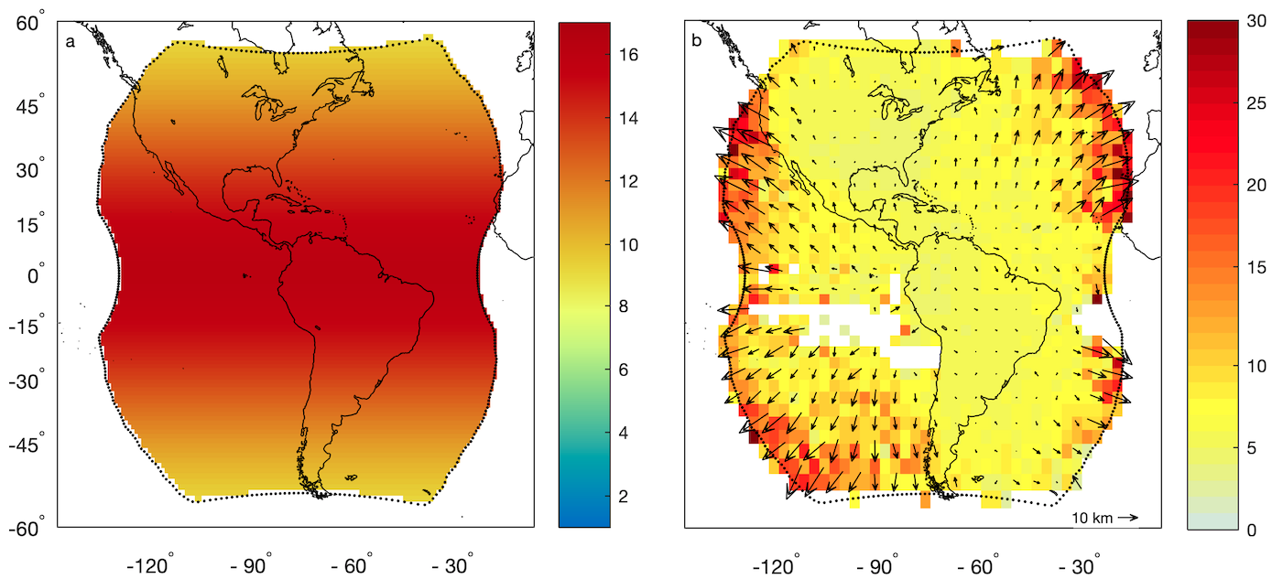
Motivation: Large location errors near GLM limb
Notes:
Comparison of GLM group data with ENGLN and GLD360

Slide 3
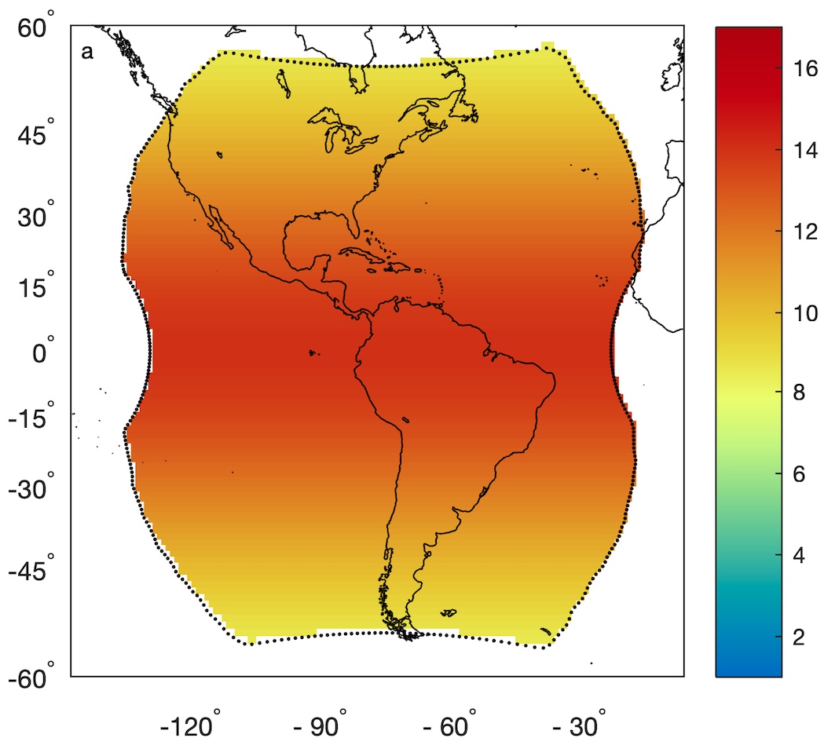
Lightning ellipsoid
Assumes GLM detects illumination at cloud top, approximated as:
  Originally: 16 km (equator) and 6 km (poles)
  As of fall 2018: 14 km and 6 km
Lowest ellipsoid height in GLM FOV is ~9 km
Produces location errors if:
  Cloud top is below/above the ellipsoid
  GLM observes side-cloud illumination or below-cloud lightning flashes

Slide 4
Lightning ellipsoid limitations
Assumes detection height varies only as function of latitude, not as a function of:
  Longitude
  Season
  Time of day
  Thunderstorm life cycle
  Regional differences including land/ocean
  Flash type

Slide 5
What is the optimal detection height?
Renavigate groups from (lat₁, lon₁) for (e₁, p₁) to (lat₂, lon₂) for (h₂, h₂)
  h₂ = 1, 1.5, …, 17 km
Match renavigated GLM data with reference networks (ENGLN and GLD360)
Identify h₂ that produces smallest mean error for each grid box for each month
Notes:
If you don’t limit yourself to an ellipsoid…

Slide 6
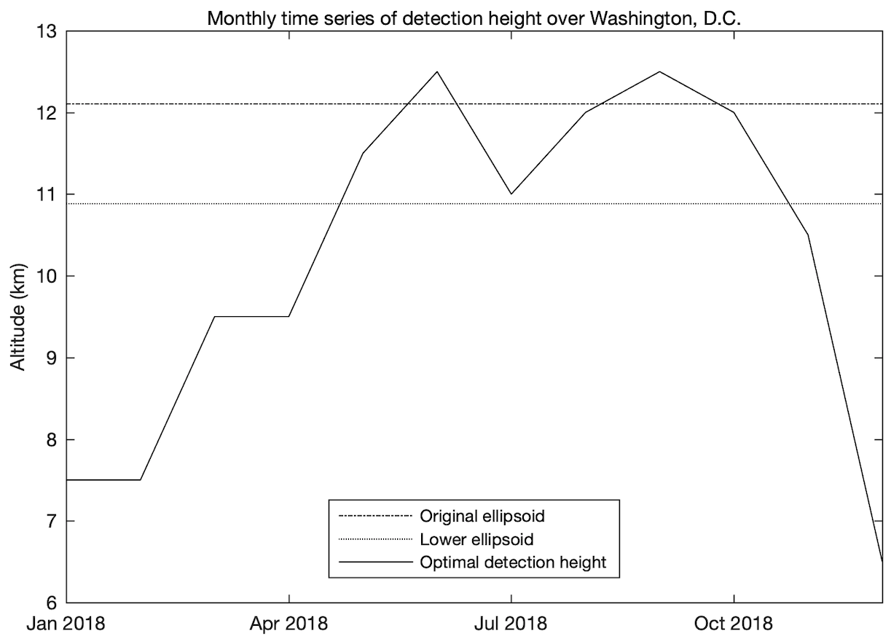
What is the optimal detection height?

Slide 7
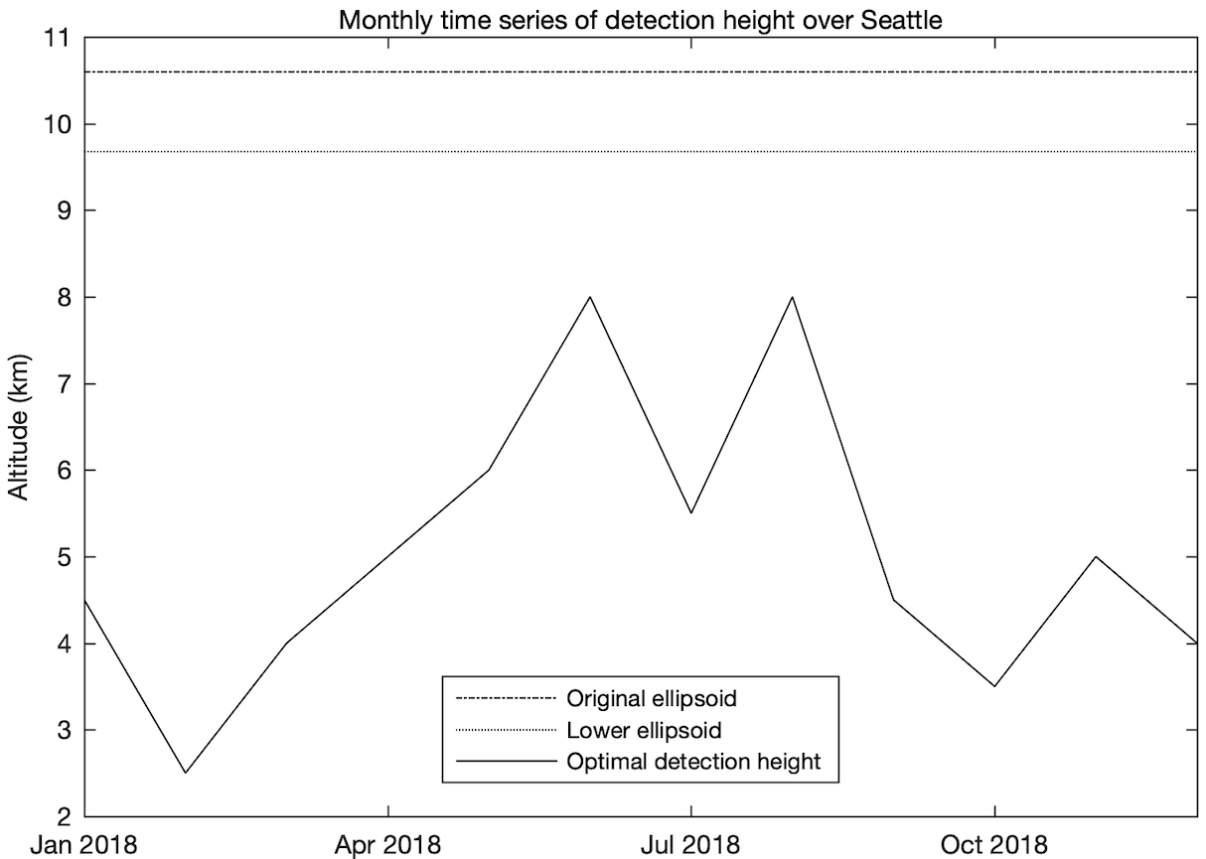
What is the optimal detection height?

Slide 8
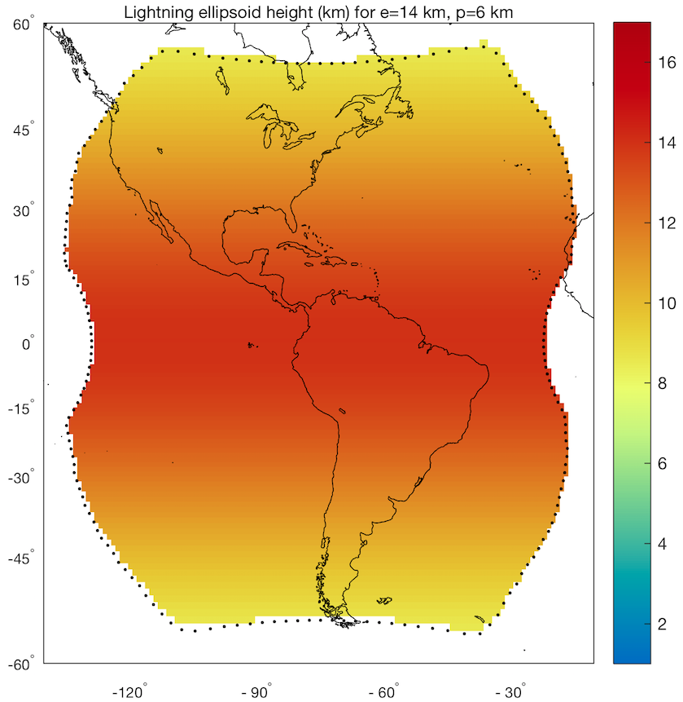
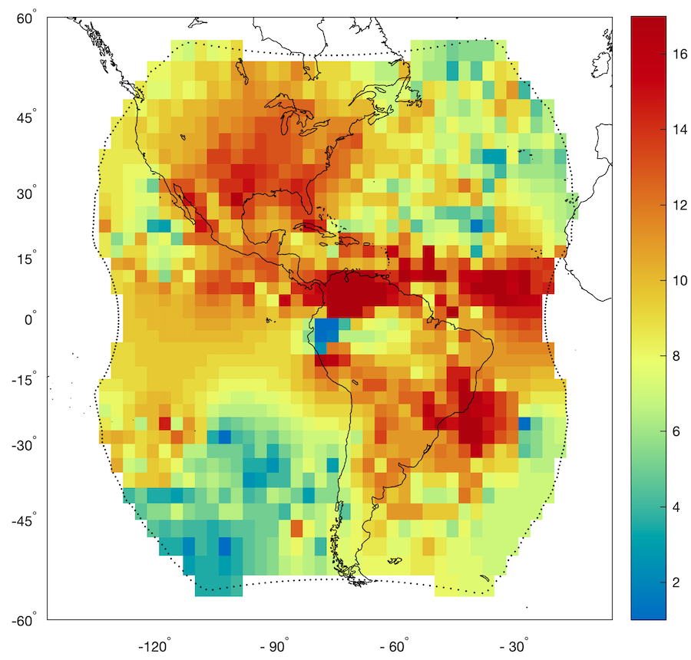
Optimal detection height – August 2018
New ellipsoid
Optimal
Notes:
Address dipole near satellite subpoint

Slide 9
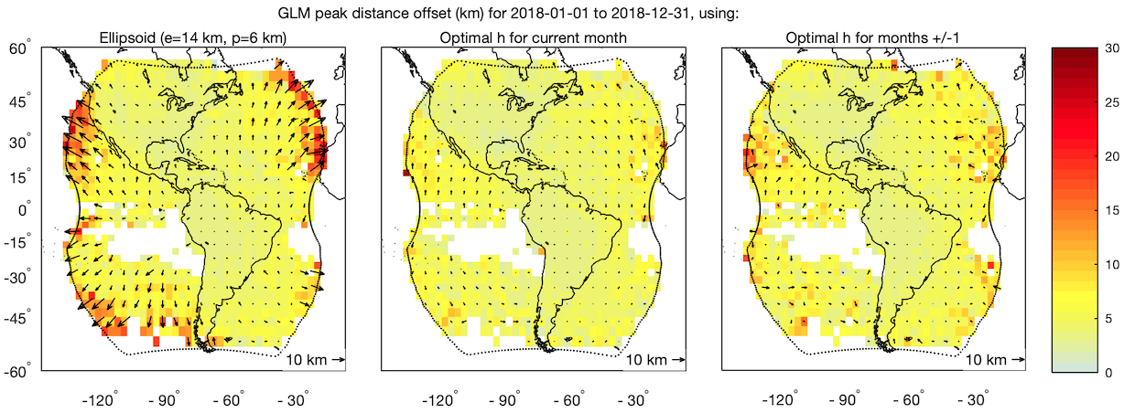
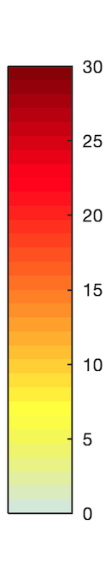
Performance of optimal detection height

Slide 10
Performance of optimal detection height

Slide 11
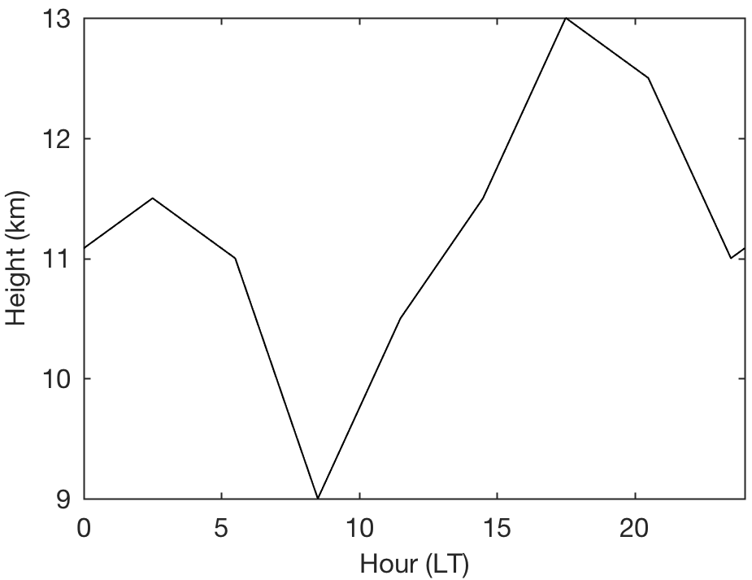
Other factors affecting detection height: Diurnal cycle
3-hourly optimal detection height for Washington, D.C. during August 2018
Optimal detection height varies by ~4 km diurnally

Slide 12
Other factors affecting detection height: Flash type
Assign GLM group type based on the “best match” ground network stroke type

Slide 13
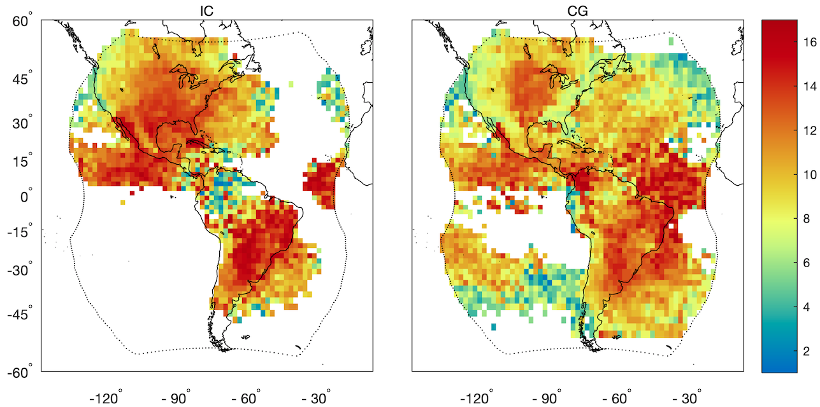
Other factors affecting detection height: Flash type
Assign GLM group type based on the “best match” ground network stroke type

Slide 14
What about using ABI cloud-top height?
Renavigate GLM groups to the ABI fixed grid
Extract ABI CTH associated with GLM group centroids
  Use most recently completed full-disk CTH image
Renavigate GLM groups using ABI CTH, then match with reference networks

Slide 15
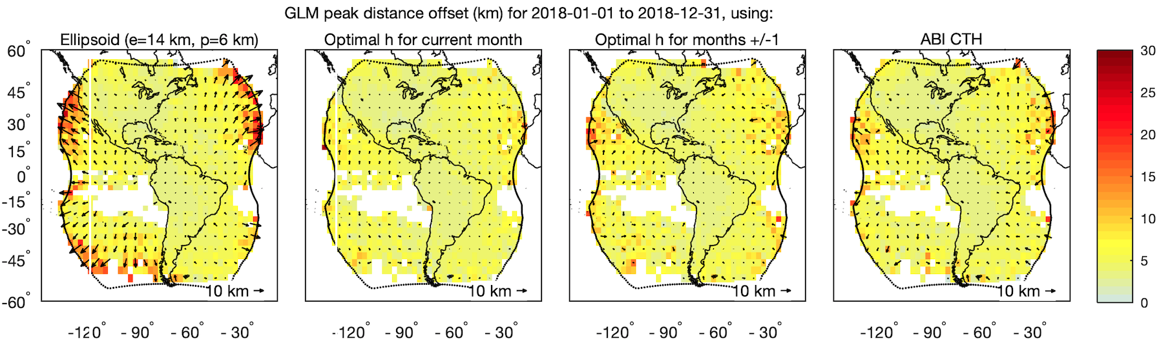
What about using ABI cloud-top height?

Slide 16
Conclusions
Lightning ellipsoid used operationally displaces observations toward nadir; largest location errors near the limb
Lower ellipsoid (e=14 km, p=6 km) was implemented in fall 2018
Monthly optimal detection height maps are available that significantly improve location accuracy near the limb
Further refinements possible for diurnal cycle and/or flash type

Slide 18
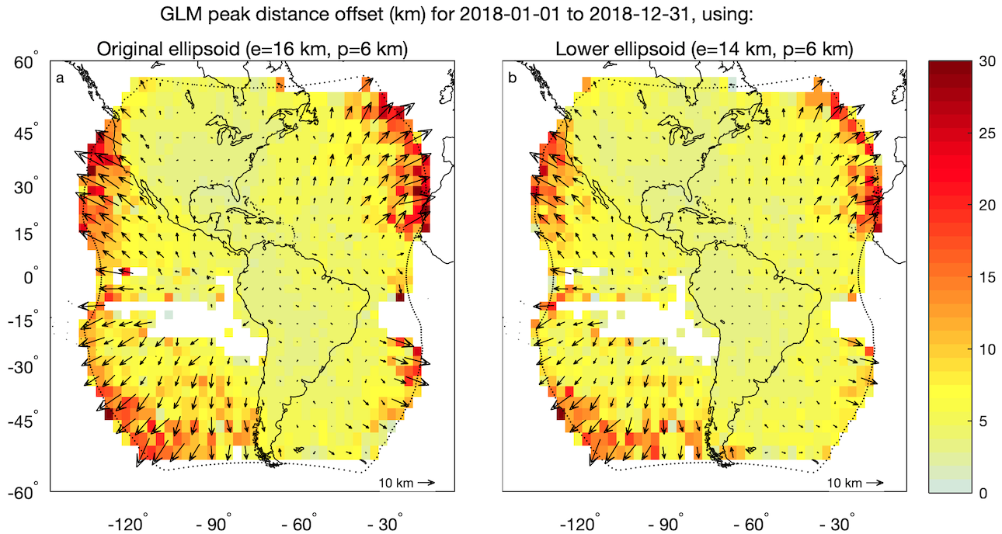
Performance of optimal ellipsoid
GLM groups are still too close to nadir → ellipsoid is generally too high
Notes:
Lower ellipsoid produces smallest mean location error for full GLM domain

