Slide 1
Meteosat Third Generation Lightning Imager performance assessment
¹Bartolomeo Viticchiè, ¹Mounir Lekouara, ¹Marcel Dobber,
¹Claude Ledez, ¹Gary Fowler, ¹Katja Hungershoefer & ²Philip Willemsen
¹EUMETSAT, Germany
²ESA ESTEC, The Netherlands

Slide 2
Outline
Meteosat Third Generation program
LI instrument
  Development status
  Detection principle and DT data
LI data processing and Reference Processor
  Level 0
  Level 1b
  Level 2
LI performance assessment
  Pre-launch
  In-orbit
Summary and future activities

Slide 3

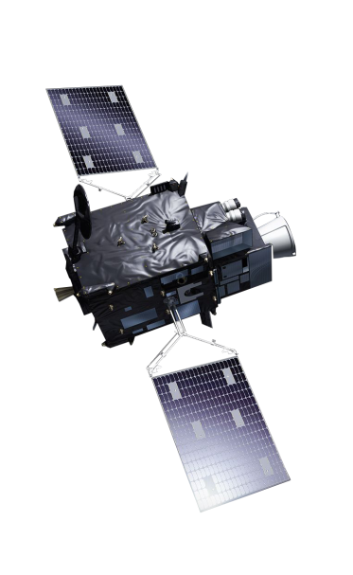
MTG-I imaging mission
Imagery mission implemented by two MTG-I satellites
Full disc imagery every 10 minutes in 16 bands (FCI)
Fast imagery of Europe every 2.5 minutes (FCI)
New Lightning Imager (LI)
Start of operations in 2021
Operational exploitation: 2021-2042
Thales Alenia Space France is the MTG-I prime and Leonardo Italy is the instrument supplier

Slide 4
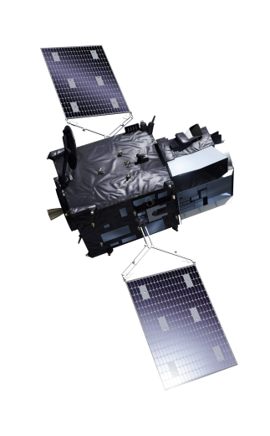
MTG-S sounding mission
Hyperspectral infrared sounding mission (IRS)
3D weather cube: temperature, water vapor, O3, every 30 minutes over Europe
Air quality monitoring and atmospheric chemistry in synergy with Copernicus Sentinel-4 instrument (UVN)
Start of operations in 2023
Operational exploitation: 2023-2042

Slide 5
MTG full operational configuration
MTG-I in Rapid Scan Service on EUMETSAT member states
MTG-I in Full Scan Service
MTG-S Sounding Service

Slide 6
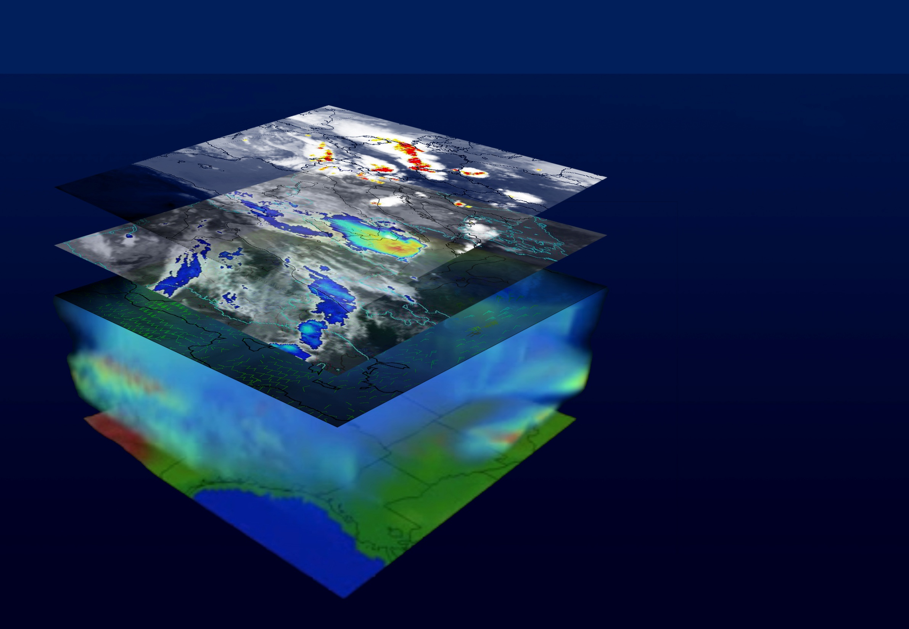
MTG-I + MTG-S: 4D weather cube
Lightning
Convection
Winds
Atmosphere

Slide 7
LI instrument development status
LI Optical Head Structural Model and Thermal Model test campaigns completed
Telescope Qualification Model test campaign completed
Flight hardware procurement completed
LI Main Electronic (LME) and Optical Head (LOH) Flight Model integration started
Selected detector units already delivered to instrument manufacturer
Detector characterization tests on-going
  QE well above specification (spec at 70 %)
  Noise parameters well within specification
Instrument Engineering Model (EM) testing on-going
Lower level CDRs closed; the instrument CDR is currently on-going
LI Optical Head Thermal Model
LI telescope Validation Model

Slide 8
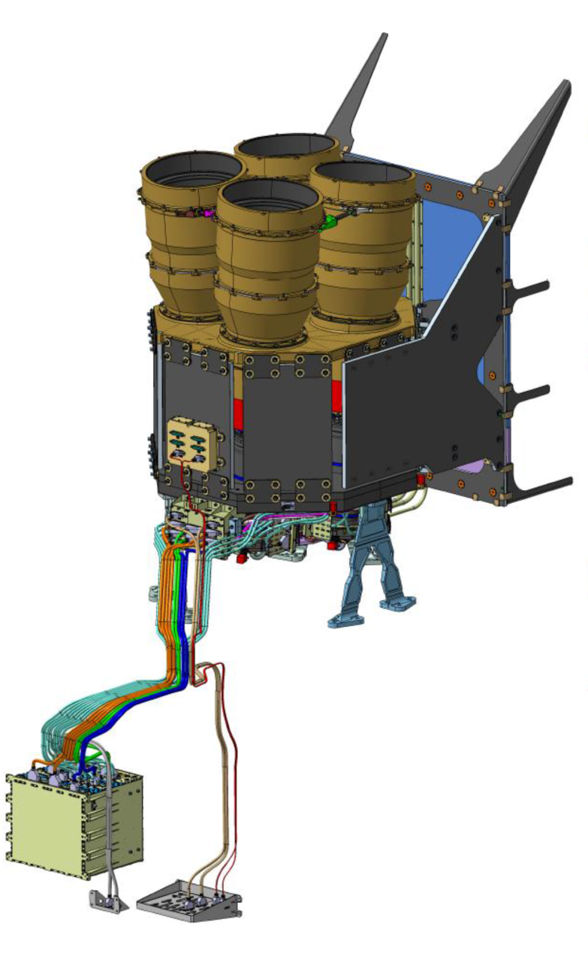
LI instrument and detection principle
LI in a nutshell
Spatial Resolution at Nadir | 4.5 km (variable throughout the Filed of View, FOV)
Spectral band | 1.9 nm narrow band
Detector(s) | 1000 x 1170 pixel (x 4) CMOS operated at 293 K
Frame rate | 1 ms (1 kHz acquisition frequency)
Background | 4 navigated images produced every 30 sec (baseline)
Data bandwidth | 30 Mbps (fully exploited) Radiometric noise Micro-vibrations 3x3 window for measurement and background
Mass and Power | 110 kg and 300 W
On-board processing | Background subtraction On-board filtering → to match the bandwidth

Slide 9
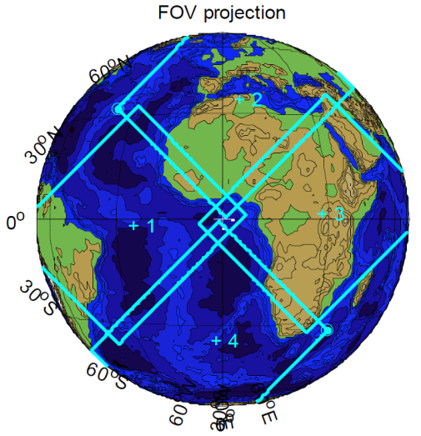
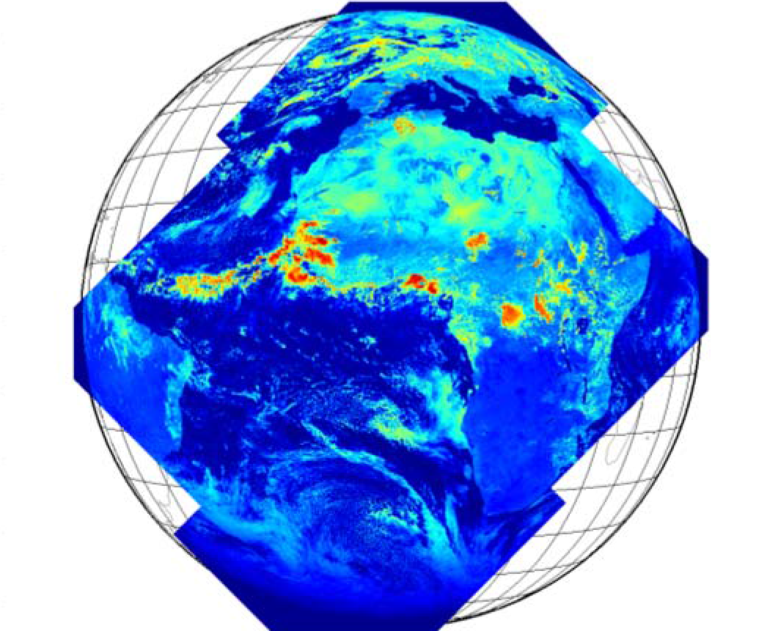
LI instrument and detection principle
LI in a nutshell
Spatial Resolution at Nadir | 4.5 km (variable throughout the Filed of View, FOV)
Spectral band | 1.9 nm narrow band
Detector(s) | 1000 x 1170 pixel (x 4) CMOS operated at 293 K
Frame rate | 1 ms (1 kHz acquisition frequency)
Background | 4 navigated images produced every 30 sec (baseline)
Data bandwidth | 30 Mbps (fully exploited) Radiometric noise Micro-vibrations 3x3 window for measurement and background
Mass and Power | 110 kg and 300 W
On-board processing | Background subtraction On-board filtering → to match the bandwidth

Slide 10
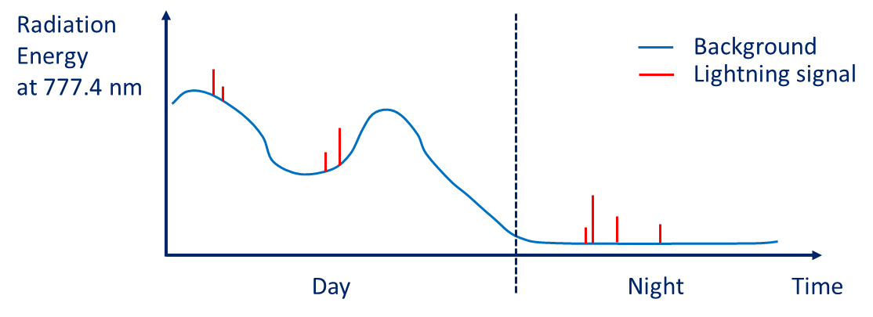
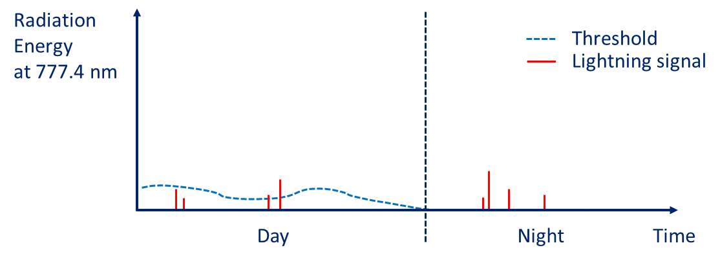
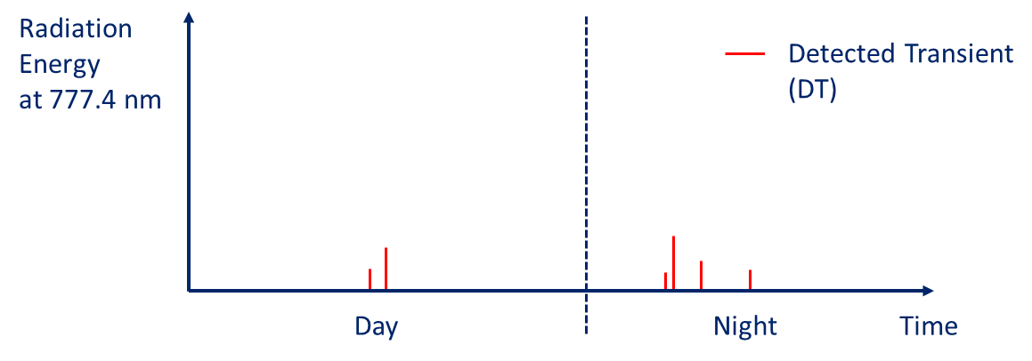
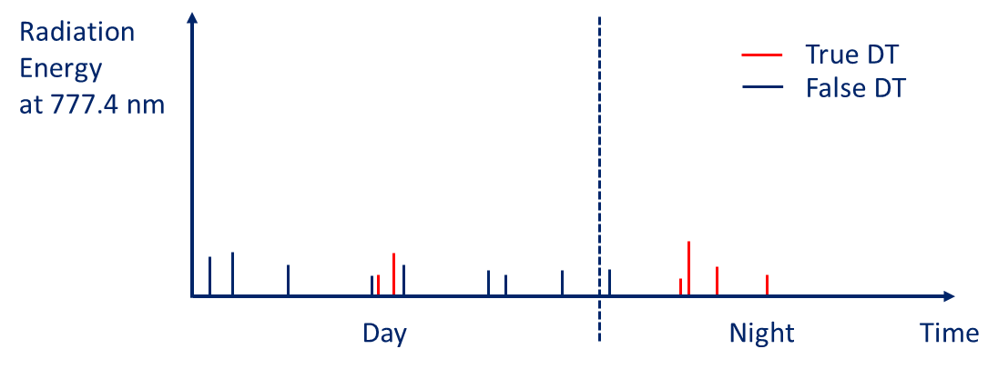
LI instrument and detection principle
Typical pixel signal
Background removal and detection threshold computation
Detection (ideal case)
Sources of false transients:
Radiometric noise;
Micro–vibration of the platform;
particle impacts on the focal plane;
Sun glint;
…
Detection (real case)

Slide 11
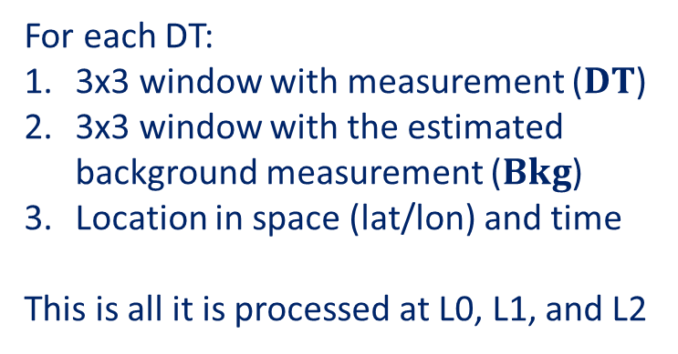
LI instrument DT data
Radiation
Energy
at 777.4 nm
True DT
False DT
Day
Night
Time
Sources of false transients:
local fluctuations of the radiometric noise;
micro – vibration of the platform;
particle impacts on the focal plane;
Sun glint;
…
1 | 2 | 3
4 | 5 | 6
7 | 8 | 9
For each DT:
3x3 window with measurement ($DT$)
3x3 window with the estimated background measurement ($Bkg$)
Location in space (lat/lon) and time
This is all it is processed at L0, L1, and L2

Slide 12
LI data processing
Here is where the detection takes place
LI instrument
detection and filtering
Level 1b
processor
Level 2
processor
ESA and LDO
Design: ESA, EUM, and LDO
Operational implementation: TAS and EUM
Design: EUM
Operational implementation: Thales and EUM
EUM: EUMETSAT
ESA: European Space Agency
LDO: Leonardo
TAS: Thales Alenia Space

Slide 13
LI data processing in the end-to-end Reference Processor (RP)
Here is where the detection takes place
Simulated Level 0 data
Simulated Level 1b data
Simulated scene
Instrument simulator
Level 1b
prototype processor
Level 2
prototype processor
Simulated Level 2 data
Inputs:
Modified SEVIRI VIS0.8 background
Simulated optical pulses
Observation geometry
Micro-Vibration
Radiometric detection including noise
Real Time Pixel Processor (RTPP) detection
Single detection filter (SDT)
Micro-Vibration filter (MVF)
Level 1b background radiometric processing
Level 1b DT radiometric processing
Level 1b DT on-ground filtering:
  pre-processor (sanity checks)
  jitter reconstruction filter
  spatio-temporal coherency filter
  hybrid filter
DT acceptance for Level 2 processing
Group computation
Group filtering
Flash computation
Flash filtering
Flash accumulation
from this step on DTs are organized in groups and flashes

Slide 14
One example
30 sec simulation over central Europe
Flash “seeds” from GLD360
Properties of pulses in flashes derived from LIS statistics
Minimum required detectable pulse size and energy (from LI System Requirements)
Visualization through a prototype of the LI Processing Visualization Tool (LI PVT)

Slide 15
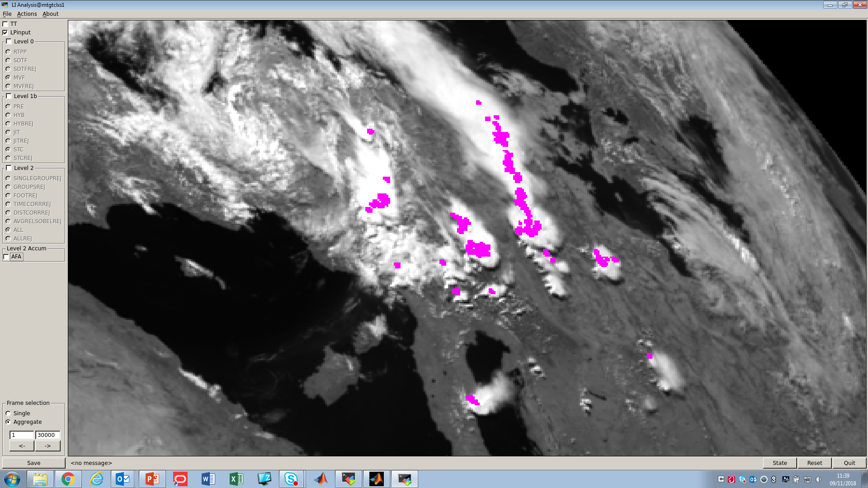
Simulation input
purple = location of input pulses
cyan = DTs through Level 0 proc.
green = DTs through Level 1b proc.
orange = DTs in the Level 2 product

Slide 16
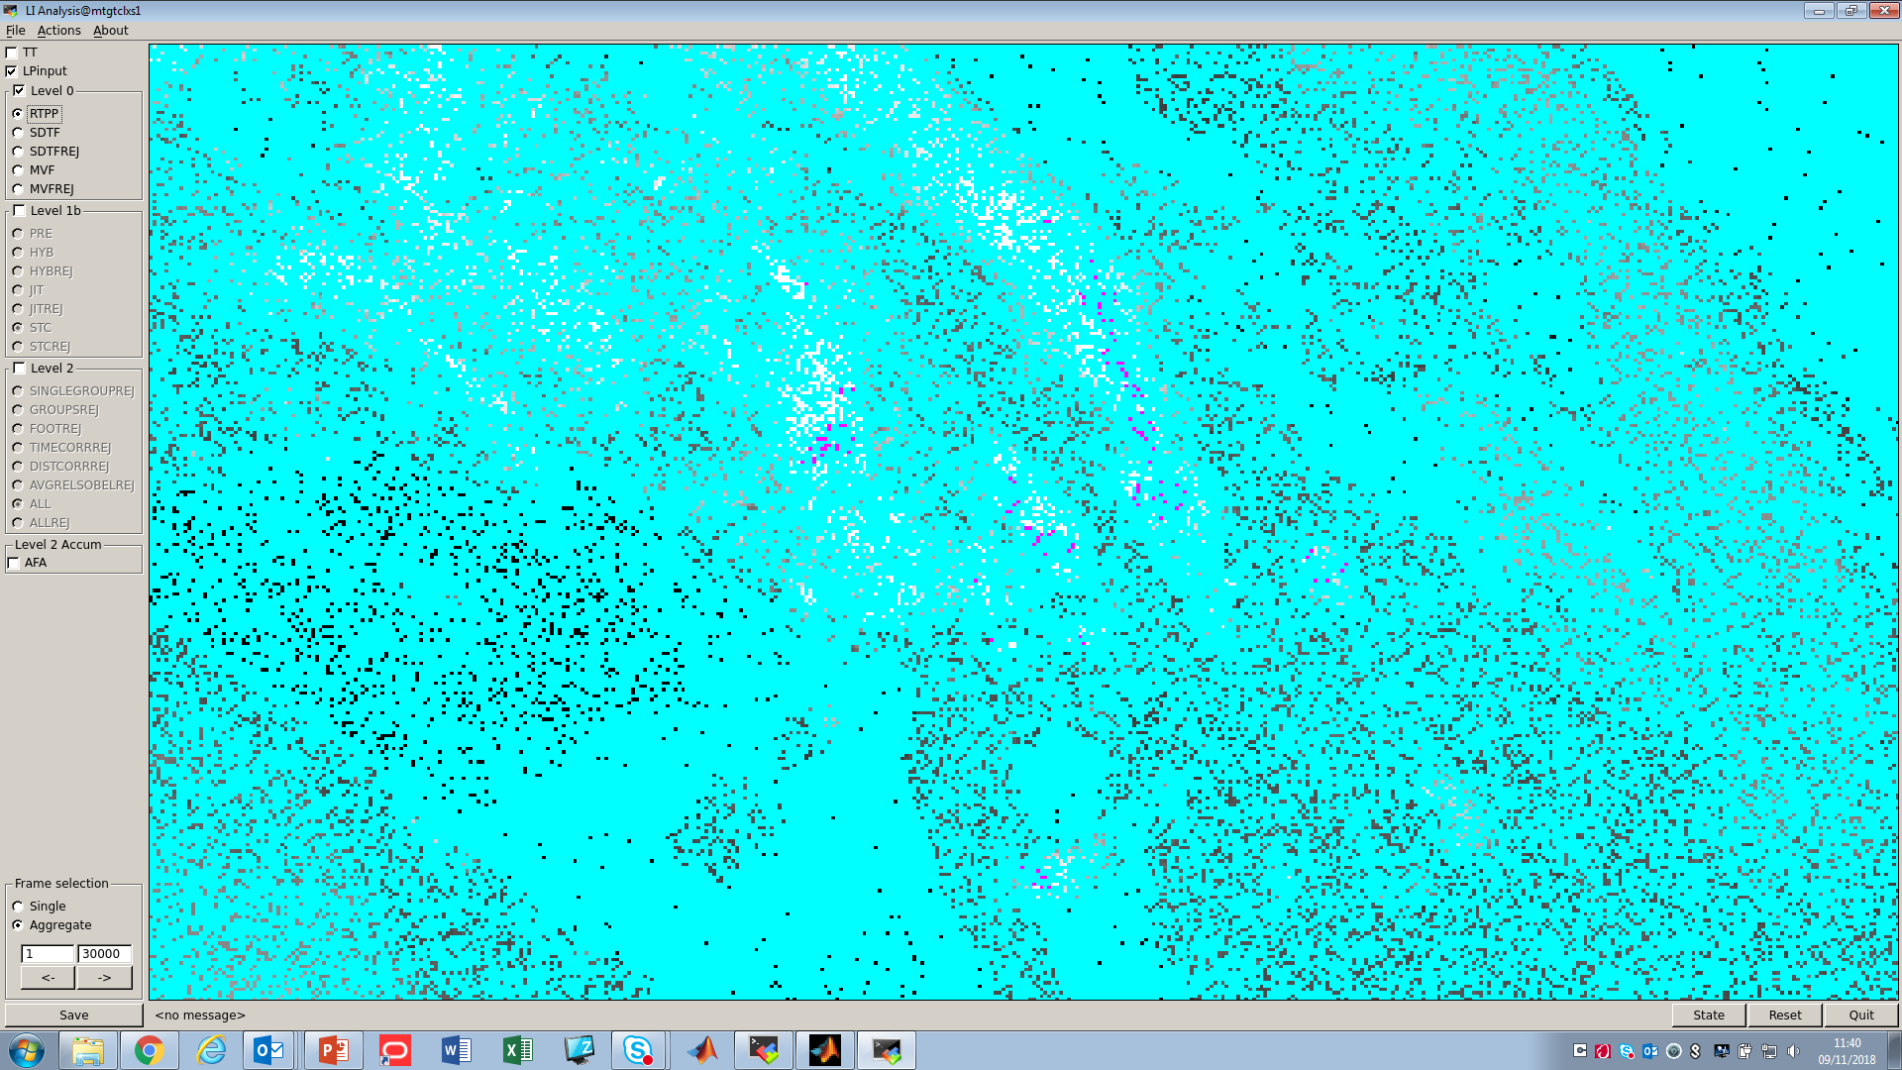
DTs at Level 0 RTPP
purple = location of input pulses
cyan = DTs through Level 0 proc.
green = DTs through Level 1b proc.
orange = DTs in the Level 2 product

Slide 17
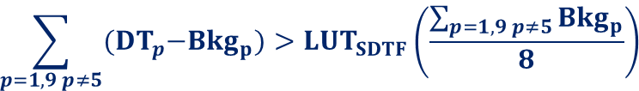
DTs at Level 0 RTPP
1 | 2 | 3
4 | 5 | 6
7 | 8 | 9
Single Detection (DT) Filter (SDTF): check the content of the 8 neighbors
$$\sum_{p=1,9 p≠5}{{(DT}_{p}−{Bkg}_{p})>{LUT}_{SDTF}\left(\frac{\sum_{p=1,9 p≠5}{{Bkg}_{p}}}{8}\right)}$$
purple = location of input pulses
cyan = DTs through Level 0 proc.
green = DTs through Level 1b proc.
orange = DTs in the Level 2 product

Slide 18
DTs at Level 0 RTPP
purple = location of input pulses
cyan = DTs through Level 0 proc.
green = DTs through Level 1b proc.
orange = DTs in the Level 2 product

Slide 19
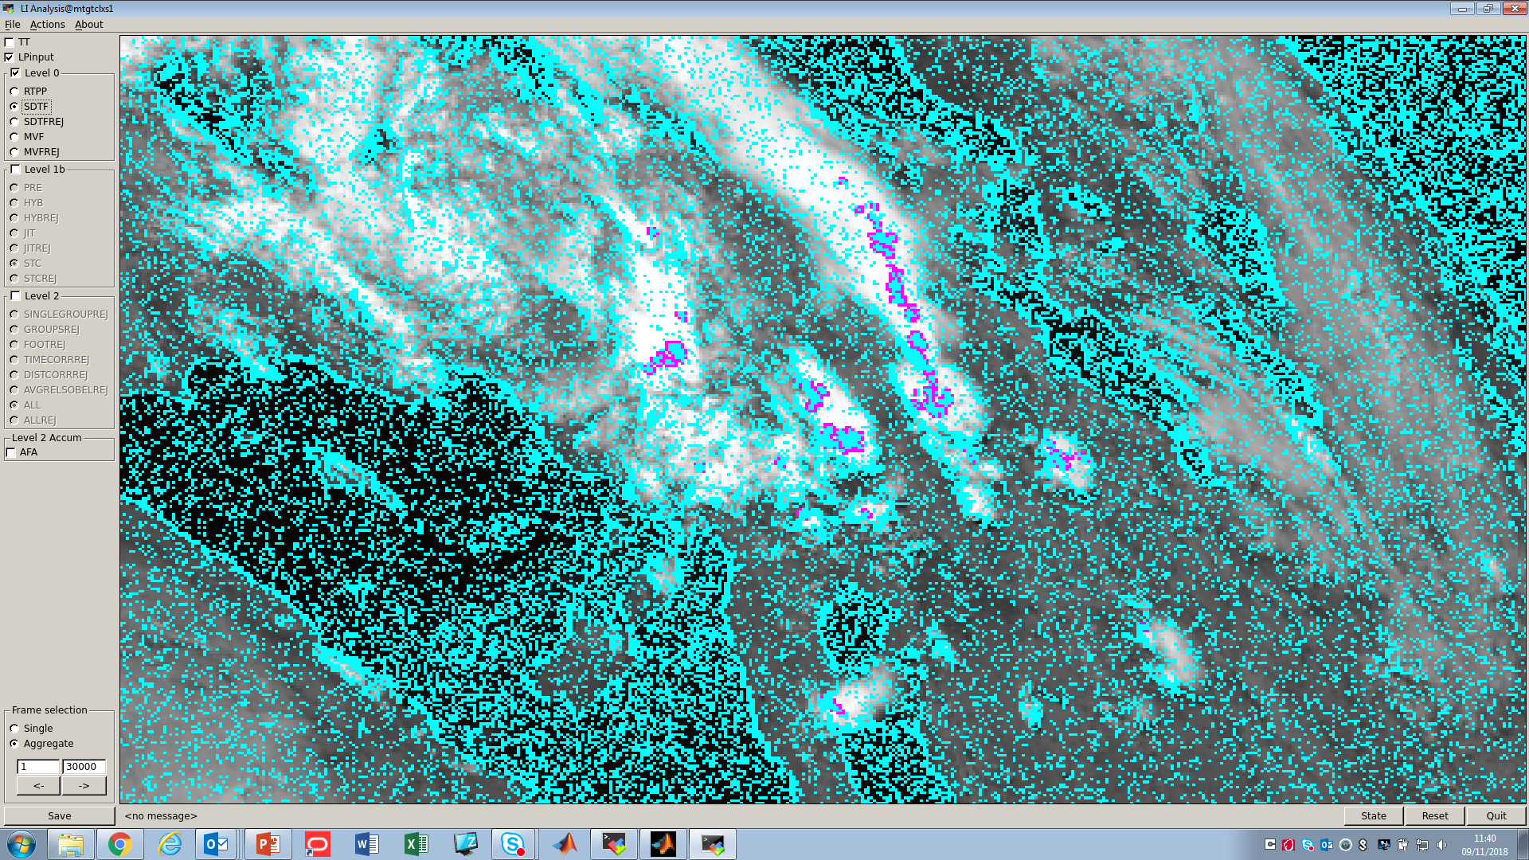
DTs at Level 0 SDTF
purple = location of input pulses
cyan = DTs through Level 0 proc.
green = DTs through Level 1b proc.
orange = DTs in the Level 2 product

Slide 20



DTs at Level 0 SDTF
1 | 2 | 3
4 | 5 | 6
7 | 8 | 9
Micro Vibration Filter (MVF): check the background gradient
${Sobel}_{Bkg}=\sqrt{{{Sobel}_{x}}^{2}+{{Sobel}_{y}}^{2}}$
$$S_{x}=\left[\begin{matrix}1 & 0 & −1 \\ 2 & 0 & −2 \\ 1 & 0 & −1\end{matrix}\right], { S}_{y}=\left[\begin{matrix}1 & 2 & 1 \\ 0 & 0 & 0 \\ −1 & −2 & −1\end{matrix}\right]$$
$${Sobel}_{Bkg}>{Thld}_{MVF}\left[\sum_{p=1,9 }{{(DT}_{p}−{Bkg}_{p})}\right]$$
purple = location of input pulses
cyan = DTs through Level 0 proc.
green = DTs through Level 1b proc.
orange = DTs in the Level 2 product

Slide 21
DTs at Level 0 SDTF
purple = location of input pulses
cyan = DTs through Level 0 proc.
green = DTs through Level 1b proc.
orange = DTs in the Level 2 product

Slide 22
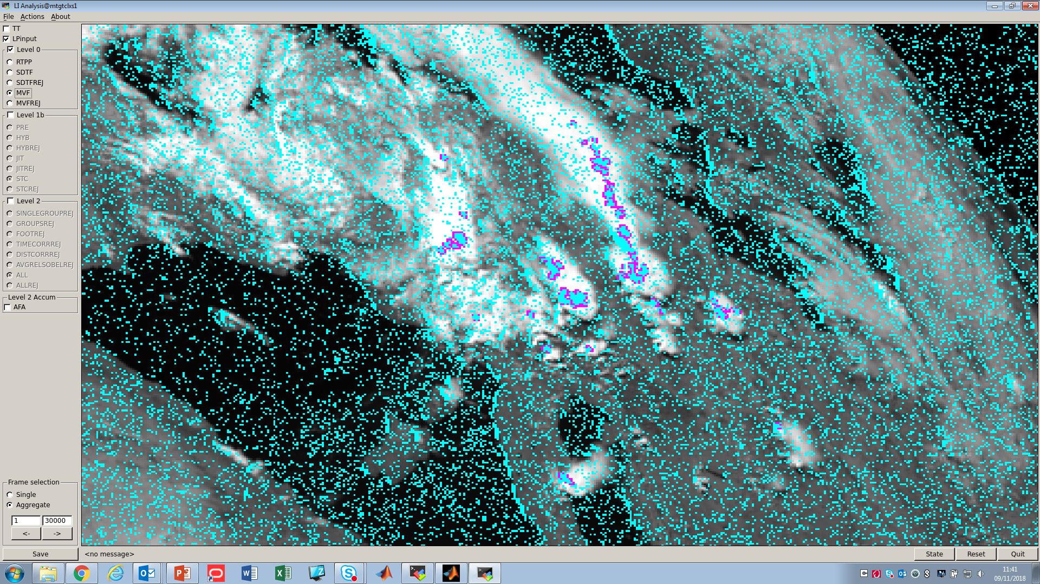
DTs at Level 0 MVF
purple = location of input pulses
cyan = DTs through Level 0 proc.
green = DTs through Level 1b proc.
orange = DTs in the Level 2 product

Slide 23
LI data processing in the end-to-end Reference Processor (RP)
Simulated Level 0 data
Simulated Level 1b data
Simulated scene
Instrument simulator
Level 1b
prototype processor
Level 2
prototype processor
Simulated Level 2 data
Inputs:
Modified SEVIRI VIS0.8 background
Simulated optical pulses
Observation geometry
Micro-Vibration
Radiometric detection including noise
Real Time Pixel Processor (RTPP) detection
Single detection filter (SDT)
Micro-Vibration filter (MVF)
Level 1b background radiometric processing
Level 1b DT radiometric processing
Level 1b DT on-ground filtering:
  pre-processor (sanity checks)
  jitter reconstruction filter
  spatio-temporal coherency filter
  hybrid filter
DT acceptance for Level2 processing
Group computation
Group filtering
Flash computation
Flash filtering
Flash accumulation
Properties of the single DTs and their background (including windows) over 1 ms
from this step on DTs are organized in groups and flashes

Slide 24
DTs to be processed on-ground (Level 0 data)
purple = location of input pulses
cyan = DTs through Level 0 proc.
green = DTs through Level 1b proc.
orange = DTs in the Level 2 product

Slide 25
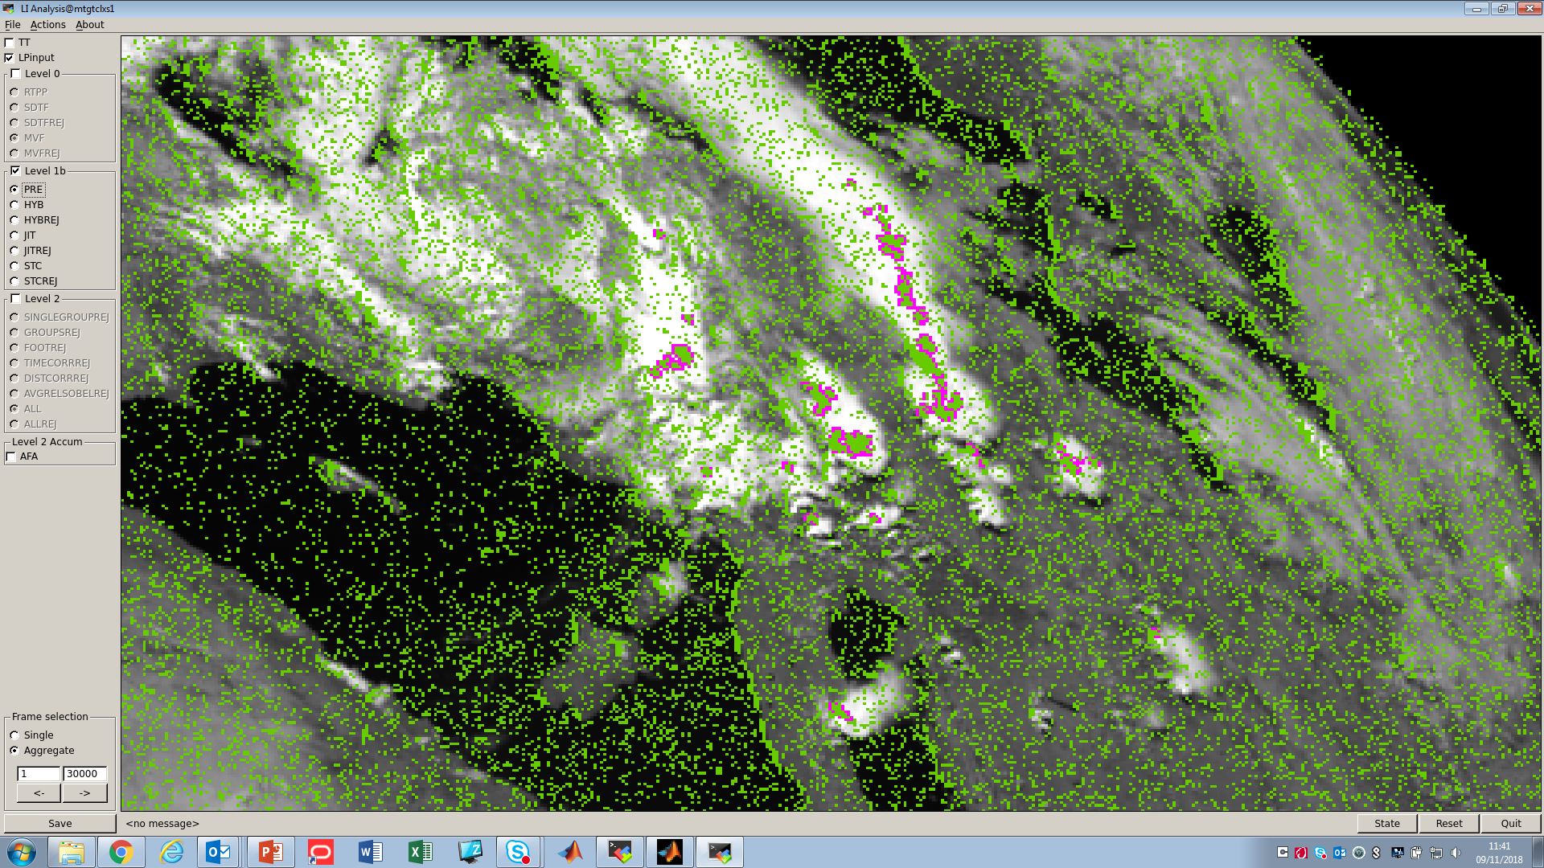
DTs at Level 1b pre-processing
purple = location of input pulses
cyan = DTs through Level 0 proc.
green = DTs through Level 1b proc.
orange = DTs in the Level 2 product

Slide 26

DTs at Level 1b pre-processing
Hybrid Filter (HYB): combined check on the margin with which the on-board SDTF and RTPP conditions were passed.
If the margin at SDTF is larger than a threshold the DT is classified as true.
If the margin at SDTF is smaller than the threshold the check is done on the margin at RTPP. If the test is passed the DT is classified as true.
If the margin at RTPP is also smaller than a threshold a [0, 1] descriptor for the DT is computed: 1 meaning certainly false DT according to the filter.
purple = location of input pulses
cyan = DTs through Level 0 proc.
green = DTs through Level 1b proc.
orange = DTs in the Level 2 product

Slide 27
DTs at Level 1b pre-processing
purple = location of input pulses
cyan = DTs through Level 0 proc.
green = DTs through Level 1b proc.
orange = DTs in the Level 2 product

Slide 28
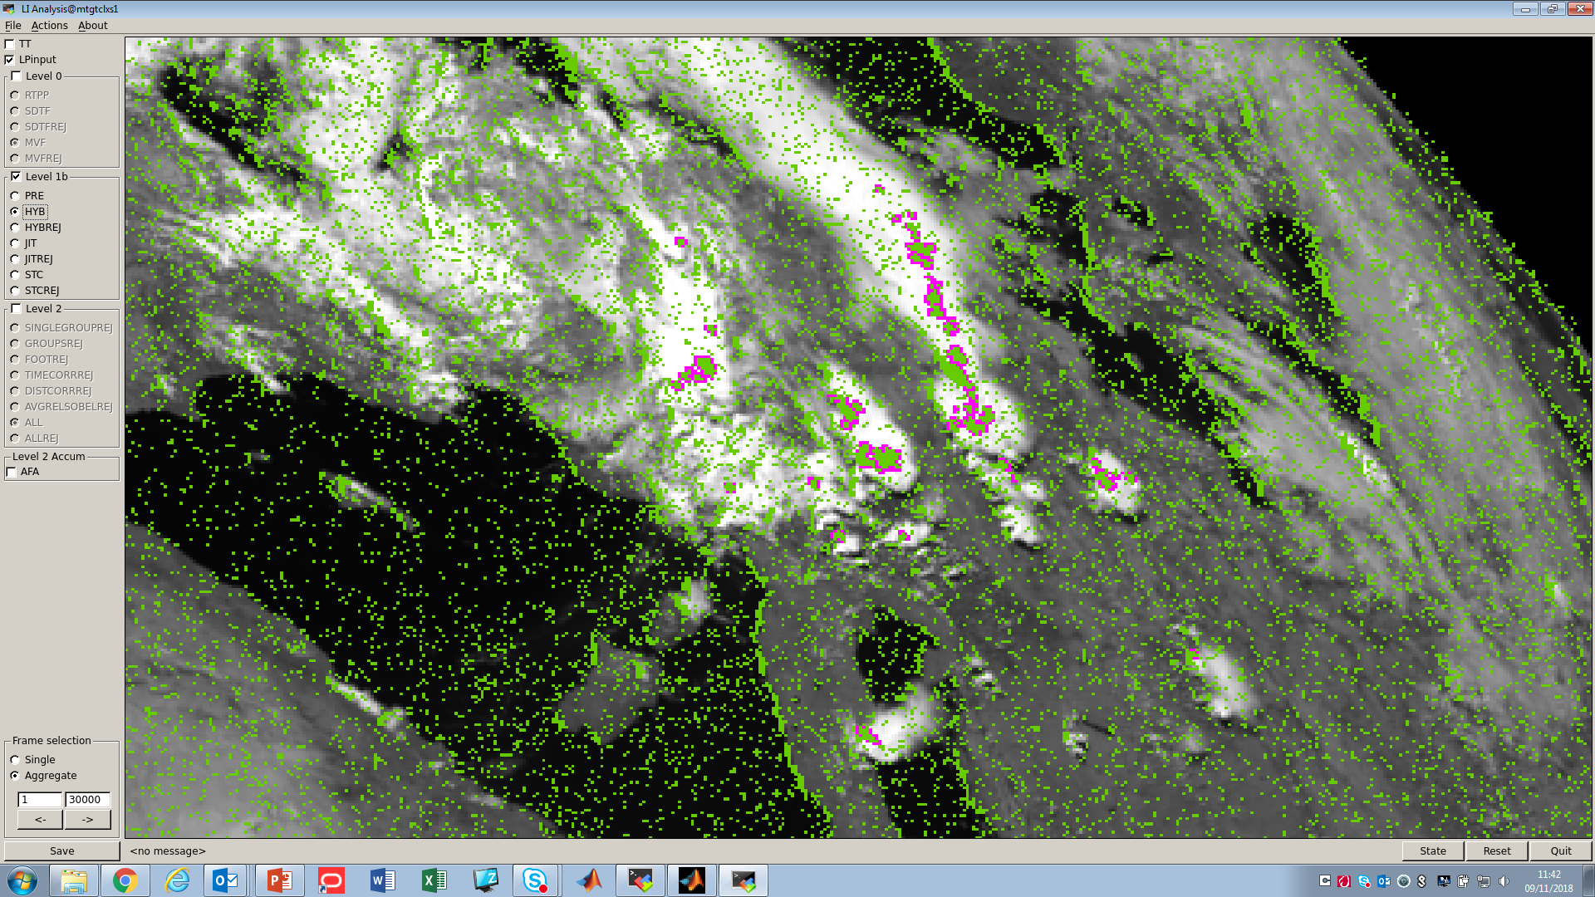
DTs at Level 1b HYB
purple = location of input pulses
cyan = DTs through Level 0 proc.
green = DTs through Level 1b proc.
orange = DTs in the Level 2 product

Slide 29

DTs at Level 1b HYB
Jitter-Reconstruction Filter (JIT):
Computation for all the DTs of the ratio between the lightning signal (i.e., $\sum_{p=1,9 }{{(DT}_{p}−{Bkg}_{p})}$) and the background gradient.
Individuation of “beacons” with particularly low ratio.
Estimation of the jitter movement from the “beacons” properties.
Computation of a corrected value $DT^{′}=DT−{DT}_{X}^{JIT}−{DT}_{Y}^{JIT}$.
New RTPP detection run to see if the clean-from-jitter measurements would have passed the detection; the outcome is provided with a [0, 1] descriptor.
purple = location of input pulses
cyan = DTs through Level 0 proc.
green = DTs through Level 1b proc.
orange = DTs in the Level 2 product

Slide 30
DTs at Level 1b HYB
purple = location of input pulses
cyan = DTs through Level 0 proc.
green = DTs through Level 1b proc.
orange = DTs in the Level 2 product

Slide 31
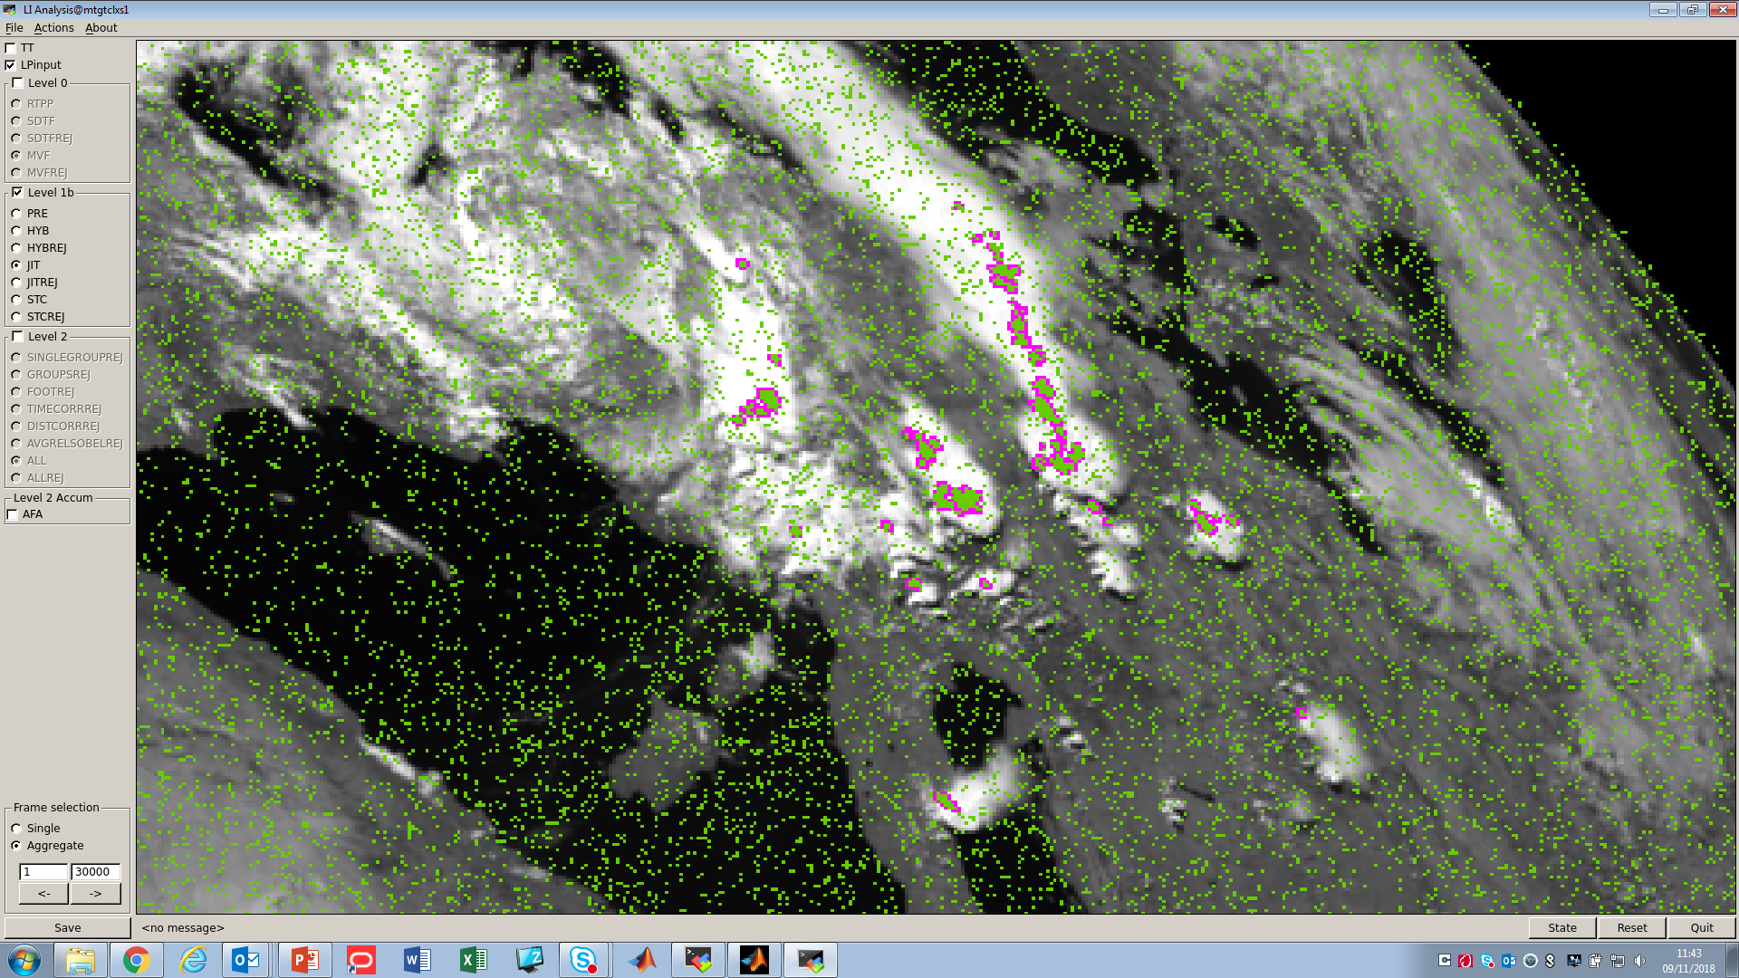
DTs at Level 1b JIT
purple = location of input pulses
cyan = DTs through Level 0 proc.
green = DTs through Level 1b proc.
orange = DTs in the Level 2 product

Slide 32

DTs at Level 1b JIT
Spatio-Temporal Coherency Filter (STC): check on the correlation between each DT and the other DTs in a spatio-temporal window of 0.5 sec (rolling window) and 50 km respectively.
purple = location of input pulses
cyan = DTs through Level 0 proc.
green = DTs through Level 1b proc.
orange = DTs in the Level 2 product

Slide 33
DTs at Level 1b JIT
purple = location of input pulses
cyan = DTs through Level 0 proc.
green = DTs through Level 1b proc.
orange = DTs in the Level 2 product

Slide 34
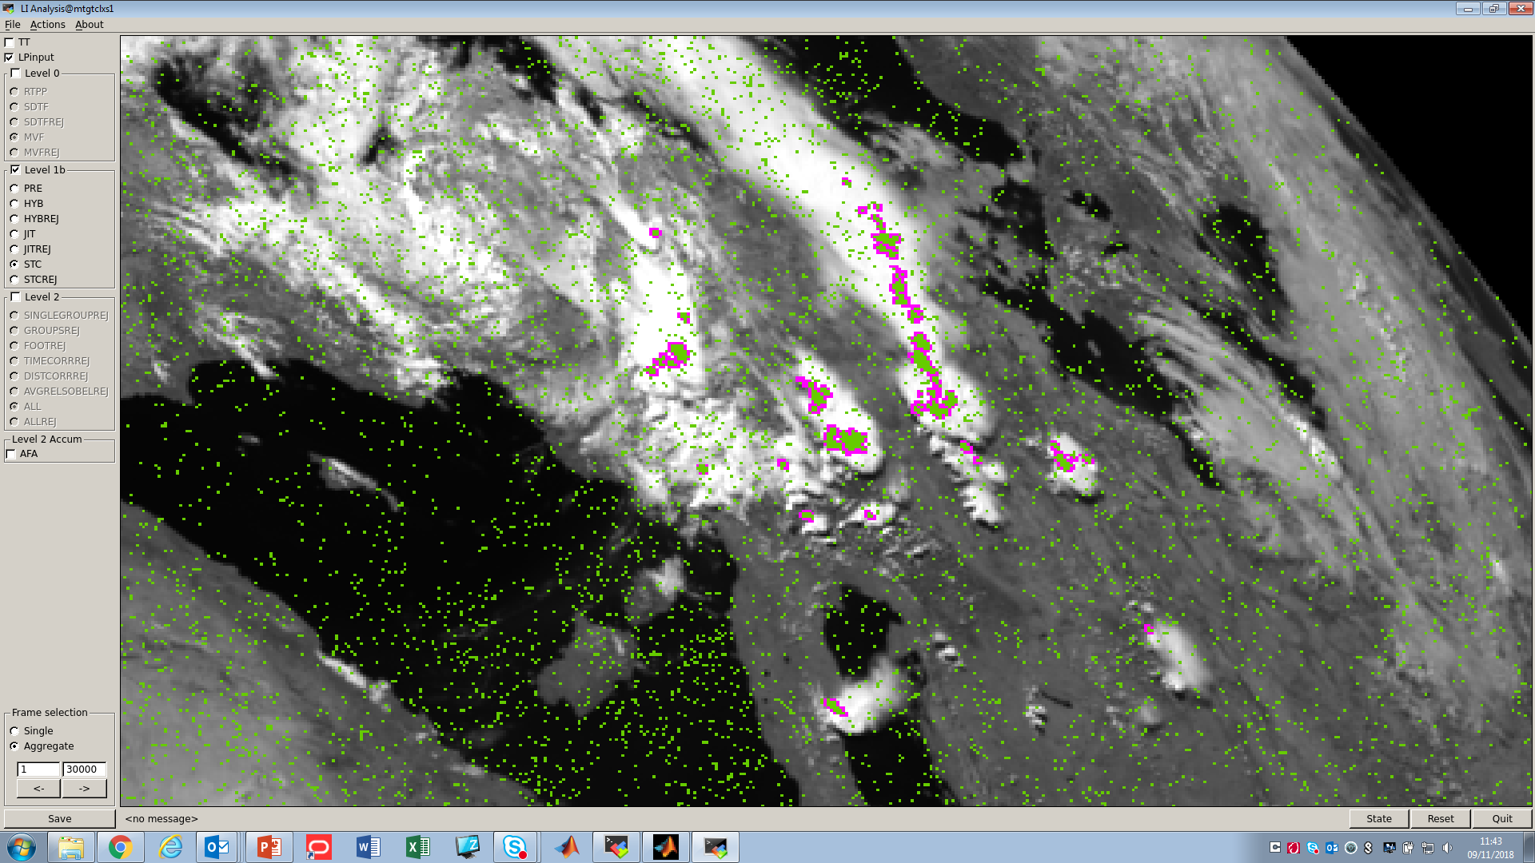
DTs at Level 1b STC
purple = location of input pulses
cyan = DTs through Level 0 proc.
green = DTs through Level 1b proc.
orange = DTs in the Level 2 product

Slide 35
LI data processing in the end-to-end Reference Processor (RP)
Simulated Level 0 data
Simulated Level 1b data
Simulated scene
Instrument simulator
Level 1b
prototype processor
Level 2
prototype processor
Simulated Level 2 data
Inputs:
Modified SEVIRI VIS0.8 background
Simulated optical pulses
Observation geometry
Micro-Vibration
Radiometric detection including noise
Real Time Pixel Processor (RTPP) detection
Single detection filter (SDT)
Micro-Vibration filter (MVF)
Level 1b background radiometric processing
Level 1b DT radiometric processing
Level 1b DT on-ground filtering:
  pre-processor (sanity checks)
  jitter reconstruction filter
  spatio-temporal coherency filter
  hybrid filter
DT acceptance for Level2 processing
Group computation
Group filtering
Flash computation
Flash filtering
Flash accumulation
Properties of a buffer of DTs and their background accumulated over 1 sec
from this step on DTs are organized in groups and flashes

Slide 36
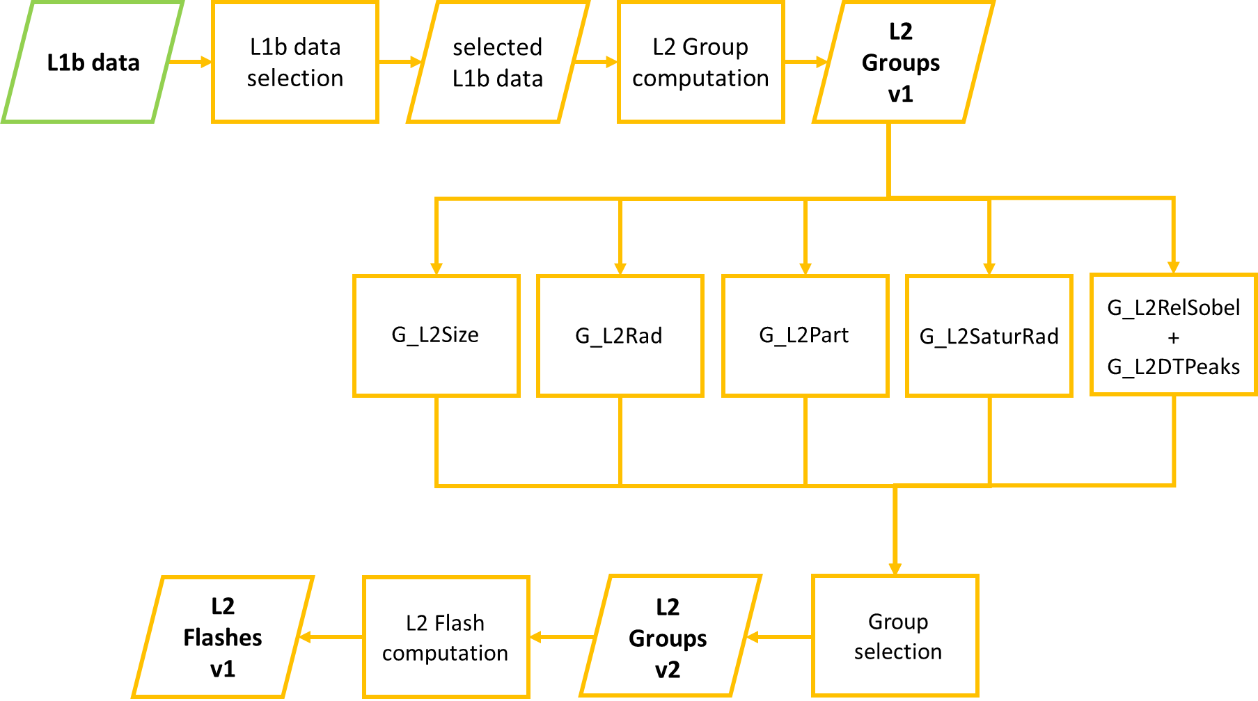
LI Level 2 processing (1 of 2)

Slide 37
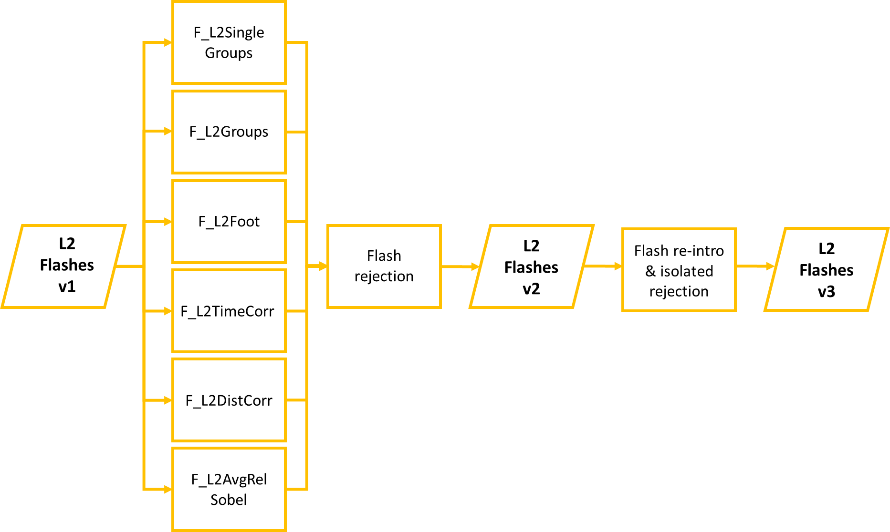
LI Level 2 processing (2 of 2)

Slide 38
DTs at Level 1b STC
purple = location of input pulses
cyan = DTs through Level 0 proc.
green = DTs through Level 1b proc.
orange = DTs in the Level 2 product

Slide 39
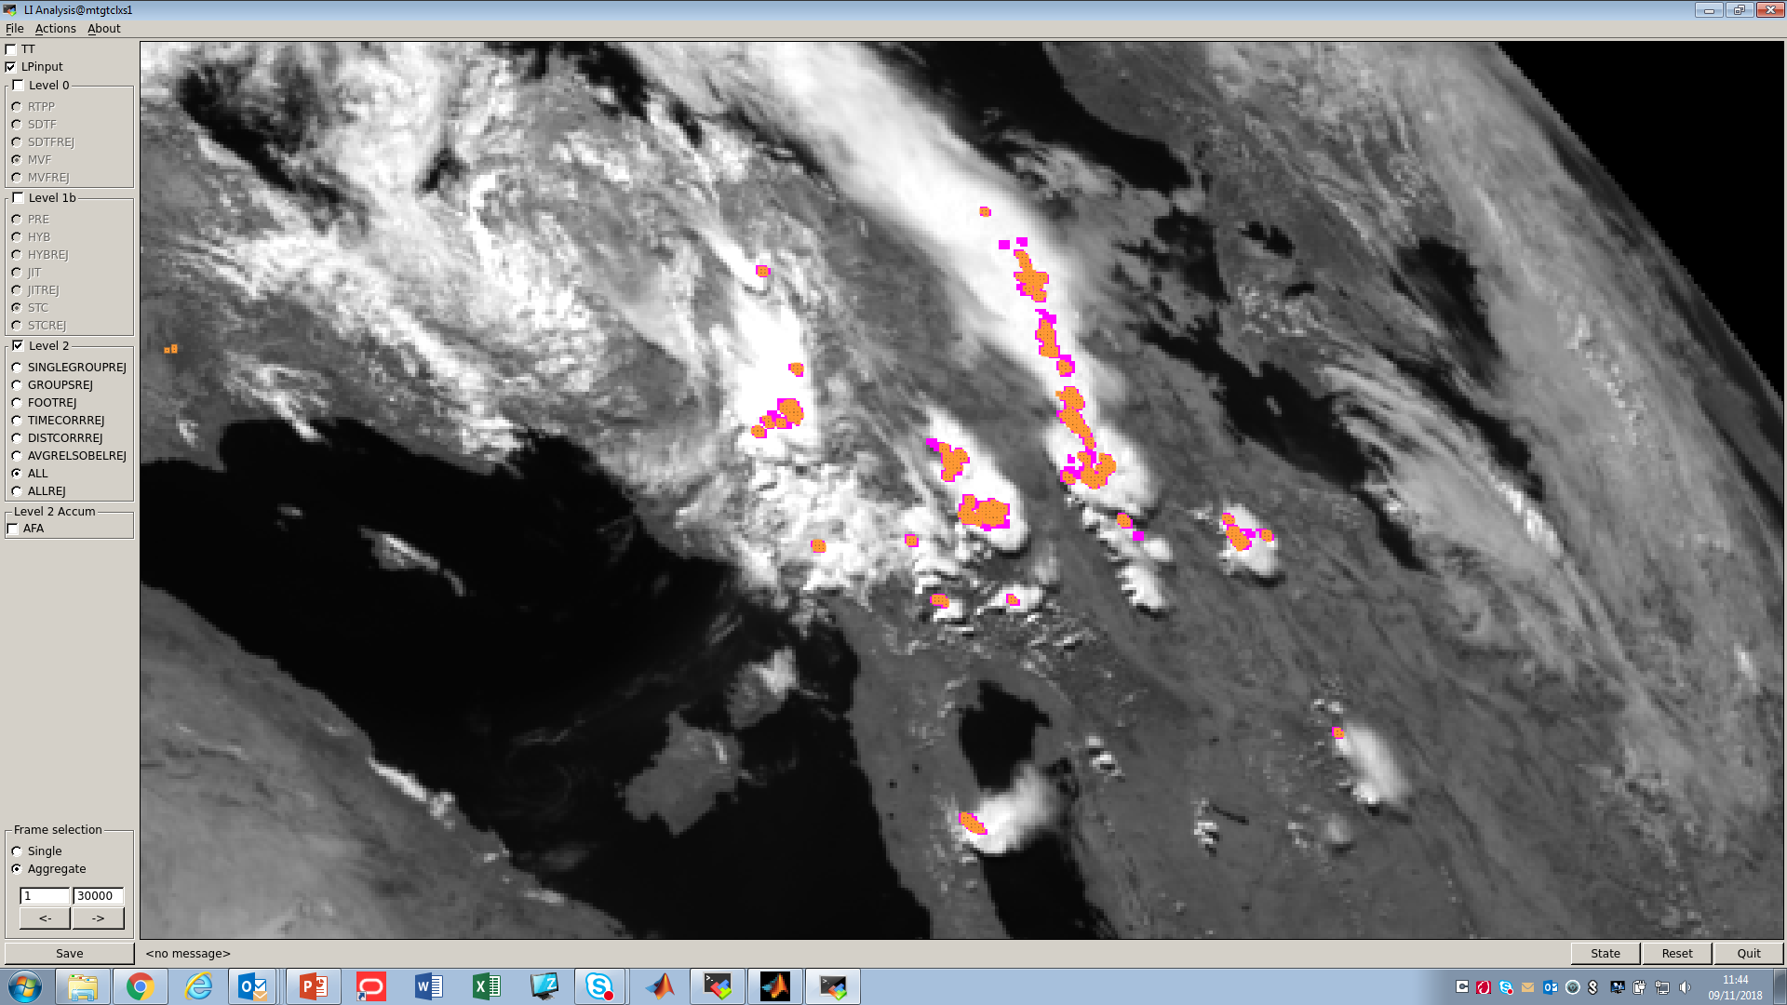
DTs at Level 2
purple = location of input pulses
cyan = DTs through Level 0 proc.
green = DTs through Level 1b proc.
orange = DTs in the Level 2 product

Slide 40
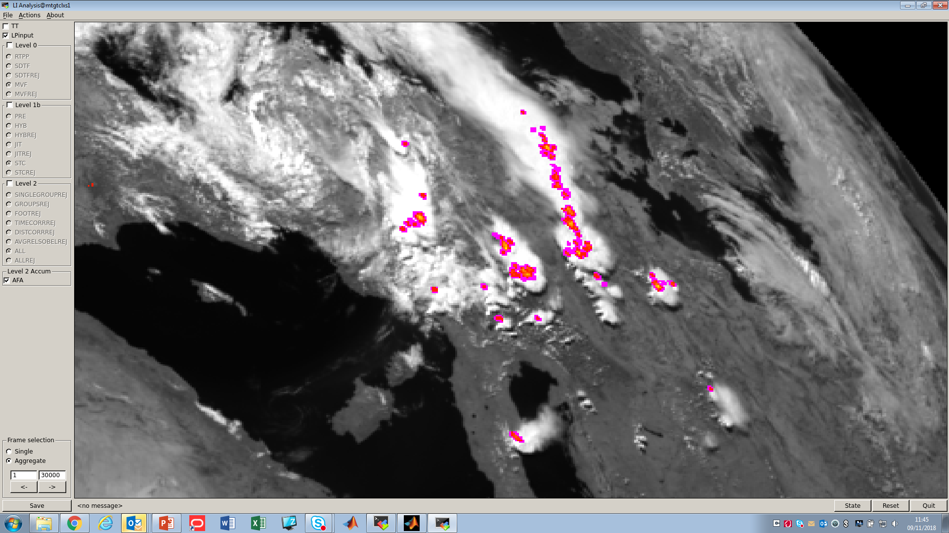
Level 2 Accumulated Product

Slide 41
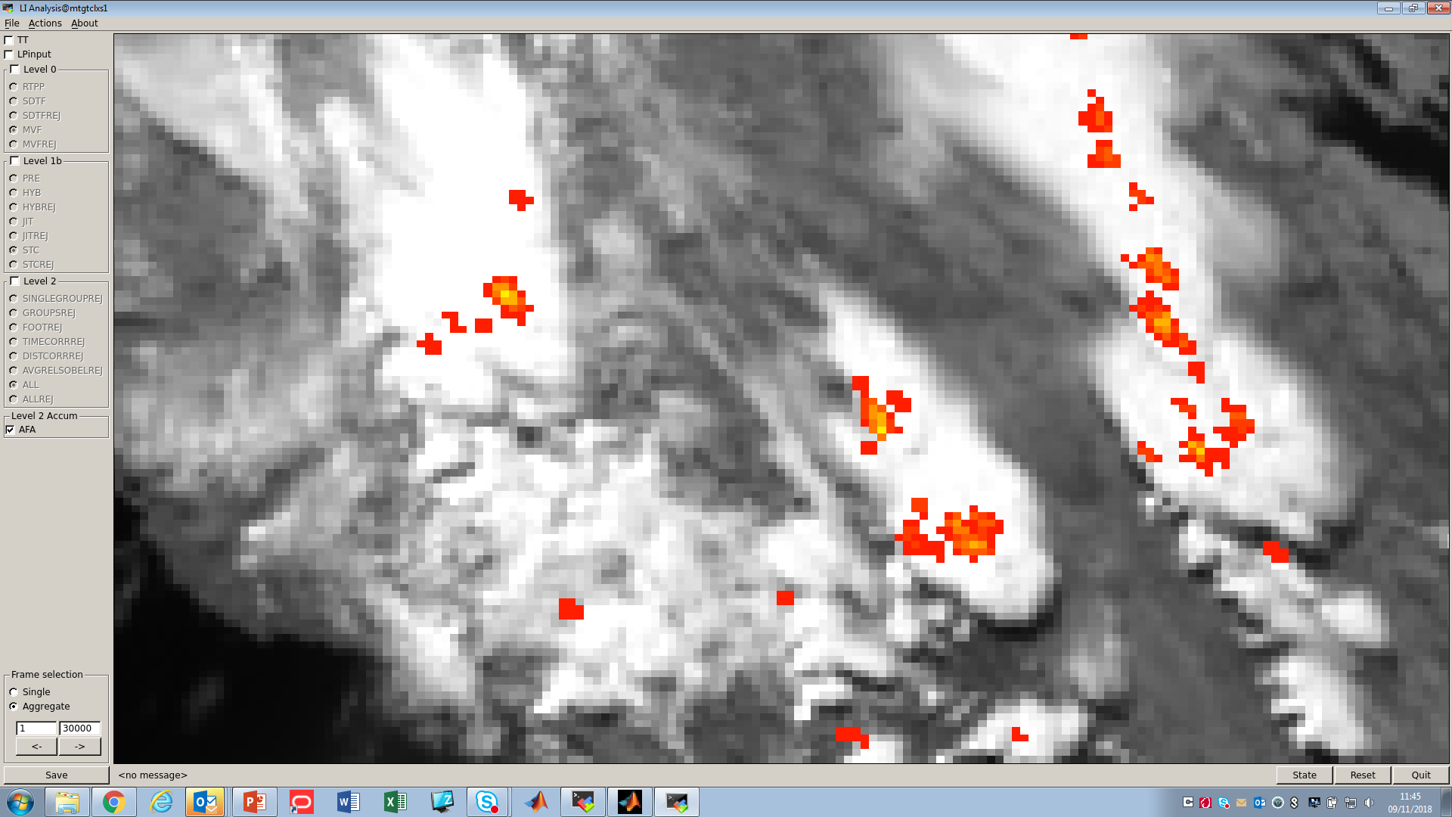
Level 2 Accumulated Product (ZOOM IN)

Slide 42
LI data processing in the end-to-end Reference Processor (RP)
Simulated Level 0 data
Simulated Level 1b data
Simulated scene
Instrument simulator
Level 1b
prototype processor
Level 2
prototype processor
Simulated Level 2 data
Inputs:
Modified SEVIRI VIS0.8 background
Simulated optical pulses
Observation geometry
Micro-Vibration
Radiometric detection including noise
Real Time Pixel Processor (RTPP) detection
Single detection filter (SDT)
Micro-Vibration filter (MVF)
Level 1b background radiometric processing
Level 1b DT radiometric processing
Level 1b DT on-ground filtering:
  pre-processor (sanity checks)
  jitter reconstruction filter
  spatio-temporal coherency filter
  hybrid filter
DT acceptance for Level2 processing
Group computation
Group filtering
Flash computation
Flash filtering
Flash accumulation
Properties of DTs organized in groups and flashes and their background
from this step on DTs are organized in groups and flashes

Slide 43
LI data processing in the end-to-end Reference Processor (RP)
Simulated Level 0 data
Simulated Level 1b data
Simulated scene
Instrument simulator
Level 1b
prototype processor
Level 2
prototype processor
Simulated Level 2 data
Inputs:
Modified SEVIRI VIS0.8 background
Simulated optical pulses
Observation geometry
Micro-Vibration
Radiometric detection including noise
Real Time Pixel Processor (RTPP) detection
Single detection filter (SDT)
Micro-Vibration filter (MVF)
Level 1b background radiometric processing
Level 1b DT radiometric processing
Level 1b DT on-ground filtering:
  pre-processor (sanity checks)
  jitter reconstruction filter
  spatio-temporal coherency filter
  hybrid filter
DT acceptance for Level2 processing
Group computation
Group filtering
Flash computation
Flash filtering
Flash accumulation
Level 2 Groups
Level 2 Flashes
Level 2 Accumulated Products
from this step on DTs are organized in groups and flashes

Slide 44
LI performance assessment
Pre-launch assessment (end-to-end)
  Based on simulations (LI Reference Processor)
  Complementary to the industry assessment
In-orbit assessment, i.e., LI Commissioning and long-term monitoring
  Based on Offline Tools (OFTs)
  Complementary to the industry assessment

Slide 45
LI performance assessment – pre-launch
  Based on simulations
  Complementary to the industry assessment
Industry settings
Background | 3 scenarios representative of: Full illumination Night Day-night terminator
Pulse energy | Minimum required detectable energy (function of the local background)
Pulse radius | 5 km (fixed)
Pulse duration | 0.6 millisecond
Pulse location | Random in space (sub-pixel) and time (wrt the frame central time); the locations are picked within the cloud mask by keeping a uniform angular distribution from the sub-satellite point
Processing level | Level 1b

Slide 46
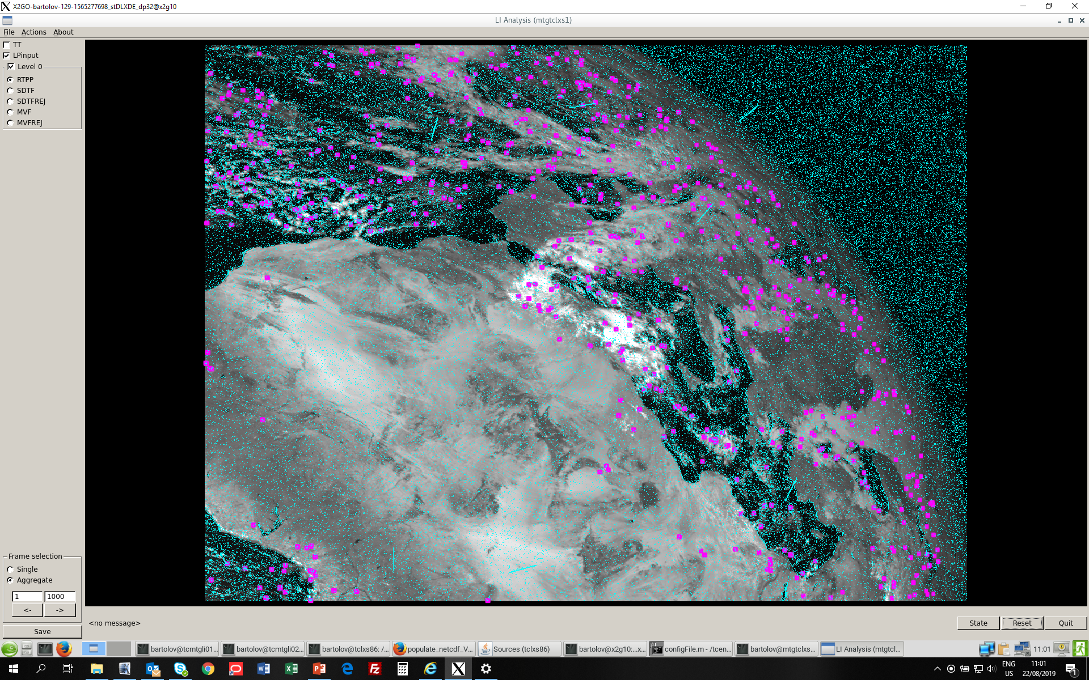
LI performance assessment – pre-launch
  Based on simulations
  Complementary to the industry assessment
Industry settings
Background | 3 scenarios representative of: Full illumination Night Day-night terminator
Pulse energy | Minimum required detectable energy (function of the local background)
Pulse radius | 5 km (fixed)
Pulse duration | 0.6 millisecond
Pulse location | Random in space (sub-pixel) and time (wrt the frame central time); the locations are picked within the cloud mask by keeping a uniform angular distribution from the sub-satellite point
Processing phase | Level 1b

Slide 47
LI performance assessment – pre-launch
EUMETSAT settings
Background | 3 scenarios representative of: Full illumination Night Day-night terminator
Pulse energy | Minimum required detectable energy (function of the local background)
Pulse radius | 5 km (fixed)
Pulse duration | 0.6 millisecond
Pulse location | Within flashes whose barycentre location is random in space and time (same as above for pulses)
Flash properties | Groups in flashes (LIS based) Δt between groups (LIS based) Δd between groups (random within 5 km radius) Random location around the barycentre
Processing level | Level 2

Slide 48
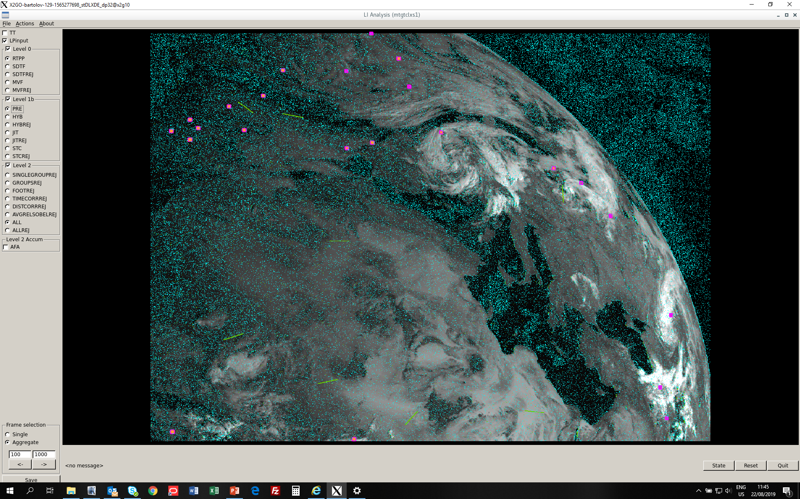
LI performance assessment – pre-launch
EUMETSAT settings
Background | 3 scenarios representative of: Full illumination Night Day-night terminator
Pulse energy | Minimum required detectable energy (function of the local background)
Pulse radius | 5 km (fixed)
Pulse duration | 0.6 millisecond
Pulse location | Within flashes whose barycentre location is random in space and time (same as above for pulses)
Flash properties | Groups in flashes (LIS based) Δt between groups (LIS based) Δd between groups (random within 5 km radius) Random location around the barycentre
Processing phase | Level 2

Slide 49
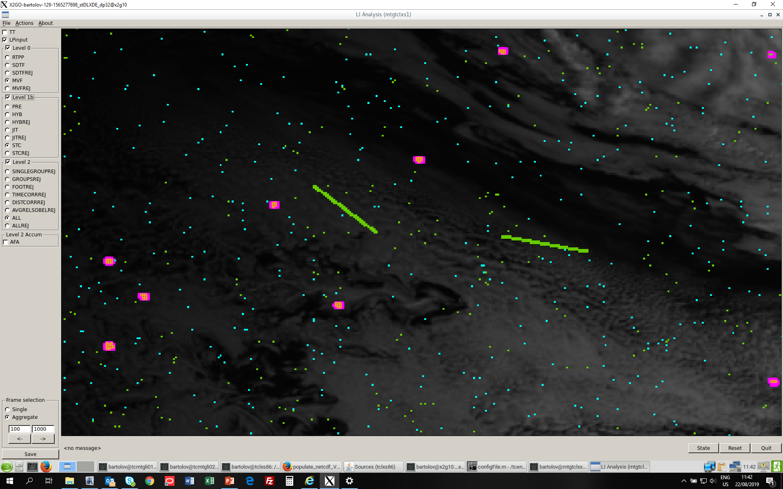
LI performance assessment – pre-launch
EUMETSAT settings
Background | 3 scenarios representative of: Full illumination Night Day-night terminator
Pulse energy | Minimum required detectable energy (function of the local background)
Pulse radius | 5 km (fixed)
Pulse duration | 0.6 millisecond
Pulse location | Within flashes whose barycentre location is random in space and time (same as above for pulses)
Flash properties | Groups in flashes (LIS based) Δt between groups (LIS based) Δd between groups (random within 5 km radius) Random location around the barycentre
Processing phase | Level 2

Slide 50
LI performance assessment – pre-launch
EUMETSAT settings
Background | 3 scenarios representative of: Full illumination Night Day-night terminator
Pulse energy | Minimum required detectable energy (function of the local background)
Pulse radius | 5 km (fixed)
Pulse duration | 0.6 millisecond
Pulse location | Within flashes whose barycentre location is random in space and time (same as above for pulses)
Flash properties | Groups in flashes (LIS based) Δt between groups (LIS based) Δd between groups (random within 5 km radius) Random location around the barycentre
Processing phase | Level 2
PROS:
treat each single flash separately → EASY COMPUTATION OF FLASH DE FROM THE INPUT
simultaneous flashes within the LI FOV → MULTIPLE DETECTION CONDITIONS
duration of simulations comparable to typical flash duration → SHORT SIMULATIONS
CONS:
Not representative of flashes correlated in space and time within storms
Cannot be used to produce long sequences of test data

Slide 51
LI performance assessment – pre-launch
EUMETSAT settings
Background | 3 scenarios representative of: Full illumination Night Day-night terminator
Pulse energy | Minimum required detectable energy (function of the local background)
Pulse radius | 5 km (fixed)
Pulse duration | 0.6 millisecond
Pulse location | Within flashes whose barycentre location is random in space and time (same as above for pulses)
Flash properties | Groups in flashes (LIS based) Δt between groups (LIS based) Δd between groups (random within 5 km radius) Random location around the barycentre
Processing phase | Level 2
PROS:
treat each single flash separately → EASY COMPUTATION OF FLASH DE FROM THE INPUT
simultaneous flashes within the LI FOV → MULTIPLE DETECTION CONDITIONS
duration of simulations comparable to typical flash duration → SHORT SIMULATIONS
CONS:
Not representative of flashes correlated in space and time within storms
Cannot be used to produce long sequences of test data
SPACE OF SETTINGS TO RUN AN ENSEMBLE OF SIMULATIONS AIMED AT ASSESSING:
Level 1b AND Level 2 DETECTION PERFORMANCES IN A ROBUST WAY
THE DEPENDENCY OF THE PERFORMANCES ON THE CHANGE OF INPUT SETTINGS → IN DEPTH KNOWLEDGE OF LI PERFORMANCES

Slide 52
LI performance assessment – in-orbit
  In October 2018 EUMETSAT kicked-off the preparation of the LI System Commissioning
Following the "Satellite" commissioning (satellite + prototype processor) by ESA and industry, EUMETSAT will perform the System Commissioning (satellite + operational processor) to assess the system readiness to deliver validated L2 products to the End Users
EUMETSAT has defined the specifications of the different tests aimed at verifying the system requirements
In parallel, the so called Offline Tools (OFTs) that will be employed for performing the verification (i.e., the software) have been specified

Slide 53
LI performance assessment – in-orbit
LI instrument
detection and filtering
Level 1b
Instrument Data Processing Facility
Level 1b DTs and background
Level 2
L2 Processing Facility
Level 2 products
Level 0 data
IQT = L1PP + PAT
ESA
IQT: Image Quality Tool
L1PP: Level 1 Prototype Processor
PAT: Performance Assessment Tool

Slide 54
LI performance assessment – in-orbit
LI instrument
detection and filtering
Level 1b
Instrument Data Processing Facility
Level 1b DTs and background
Level 2
L2 Processing Facility
Level 2 products
Level 0 data
FCI Level 1c and 2 products
EUMETSAT
LLs external data
LI-STAR
LI PVT
SIFT
PIQMICS
MICMICS
Performance DBs
PIQMICS: Performance Image Quality MonItoring and Characterization System
MICMICS: Mission Integrated Calibration Monitoring Inter-Calibration System
SIFT: Satellite Information Familiarization Tool (https://sift.ssec.wisc.edu/)
LI PVT: LI Processing Visualization Tool
LI-STAR: LI STAtistics and Reporting
LLs: Lightning Location Systems

Slide 55
LI performance assessment – in-orbit
LI-STAR
Requirement | Test Description
Pulse DE | LI L2 group-to-Ref stroke/group matching against external LLs data
Flash DE | LI L2 flash-to-Ref stroke/flash matching against external LLs data
FAR/Flash FAR | Identification of storm regions by means of LI L2 data and external LLs data and identification of outliers, i.e., false detections/flashes
LLs external data
Europe: ATDnet, EUCLID, LMAs in Spain and France
South America and Atlantic Ocean: GLM on GOES-East
LI FOV: GLD360 and ISS-LIS
Coordinated effort
EUMETSAT + LI Mission Advisory Group
KEY ROLE OF US EXPERTS

Slide 56
LI performance assessment – in-orbit
MICMICS
Requirement | Test Description
Radiometric accuracy | Moon calibration
 | Vicarious calibration through desert targets (absolute calibration)
 | Deep Convective Clouds (DCC) calibration
 | Intra-OC analysis on the different overlap areas (histogram and pixel-based)
 | LI vs FCI pixel-based analysis

Slide 57
LI performance assessment – in-orbit
PIQMICS
Requirement | Test Description
Geometric accuracy (ASPKE) | Landmark analysis
 | Star matching
 | Intra-OC analysis (based on tie points and landmark)
 | LI vs FCI pixel-based analysis (co-registration over land regions)
 | Complementary: lightning navigation and timing accuracy against external LLs data
A total of 41 tests are currently planned for the LI Commissioning and long-term monitoring:
Data timeliness and format (from Level 0 to Level 2);
Data quality and processing load
Instrument performance and characterization

Slide 58
Summary and future activities
LI preparation is on-going in view of the launch in late 2021
Focus on the LI performance assessment
  Pre-launch:
    based on simulations through the LI Reference Processor
    Plan to perform a systematic analysis of the LI performance from an wide range of input conditions
    Plan to perform a Level 2 tuning exercise on simulated data
  In-orbit:
    The LI Commissioning Test Specifications have been completed
    The definition of an in-flight tuning strategy will start in September 2019
    The definition of the LI System Commissioning schedule will start in November 2019
    The implementation of the LI Offline Tools for System Commissioning has been kicked-off in August 2019

