Slide 1
Detection Efficiency and False Alarm Rate for GLM-16 and GLM-17
Monte Bateman
and
Douglas Mach

Slide 2
Data Analysis Period
1 Jan 2020 – 31 Aug 2021 (20 mos.)
Maps: DE & FAR
Time Periods shown: 24h & day / night

Slide 3
Virtual Network
Wanted the “best possible” source to compare GLM against
Used several ground-based networks (GLD360, ENGLN, NLDN, CLDN)
Clustered similar to GLM cluster algorithm
Within 330ms and 16.5km

Slide 4
Coincidence Checking: GLM against Virtual
Coincidence: within $±1$s ($±$10 min) and 50km
Detection Efficiency DE = Coincident flashes / all virtual flashes
False Alarm Rate FAR = Non-coincident flashes / All GLM flashes
These are relative to virtual network (the best comparison source we have)

Slide 5
Making the most of Low-DE Ground-Truth Data
Allow the time comparison window to extend to $±10$min
Sparse ground-truth data over far oceans
Mostly WWLLN (10% DE)
Oceanic storms avg flash rate is 1/min
Have to observe such a storm for 10mins to measure a flash
So the comparison is GLM flashes vs. ground-truth storms (lightning in the area)

Slide 6
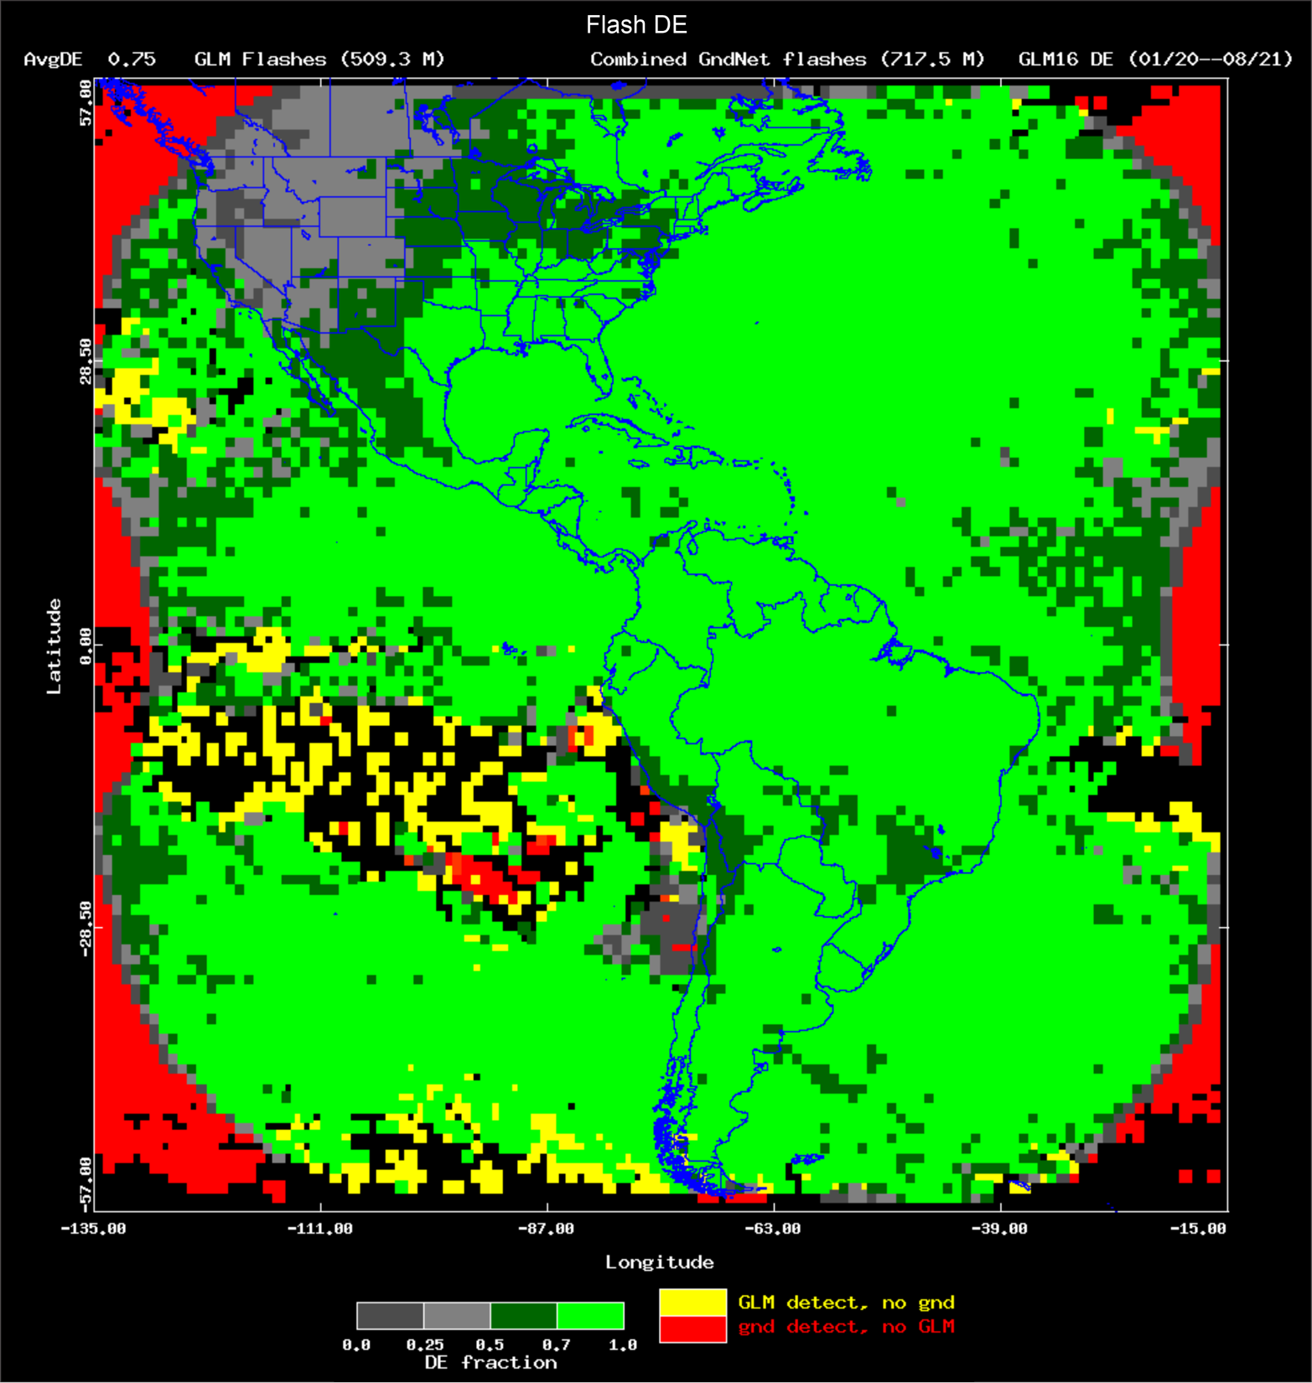
GLM16 DE $$± 1s$$

Slide 7
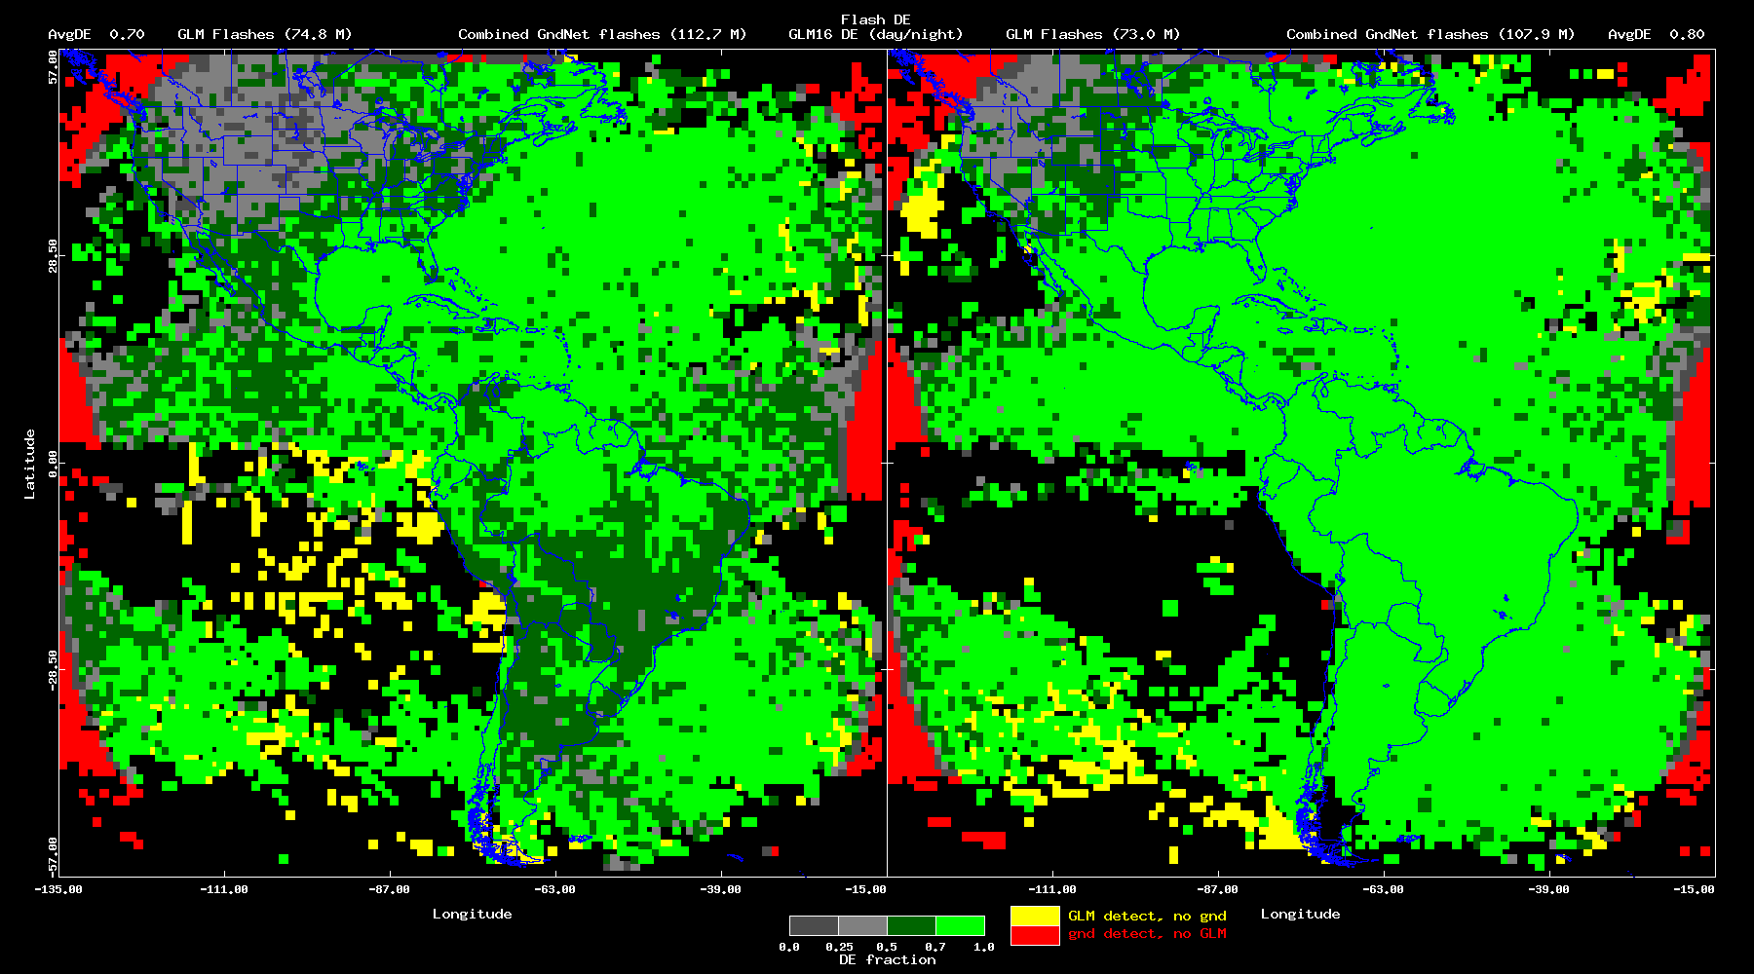
GLM16 DE: Day/Night ($± 1s$)

Slide 8
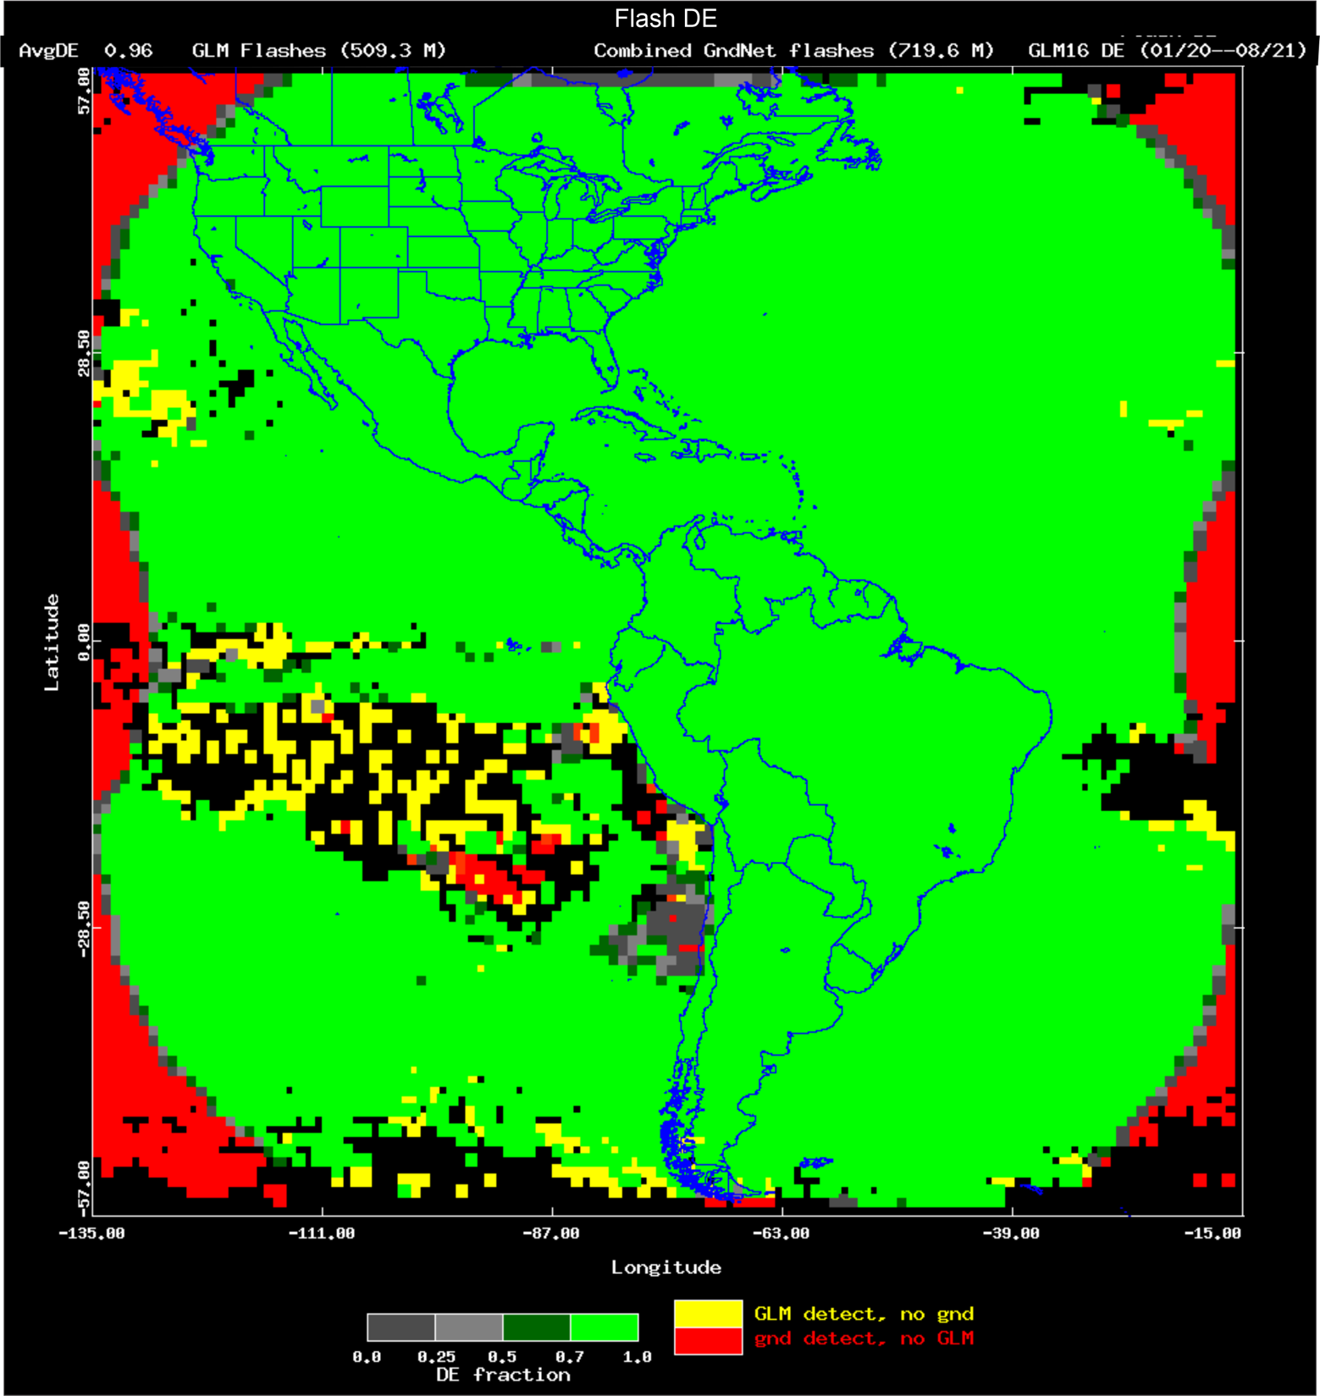
GLM16 DE $± 10$ min

Slide 9
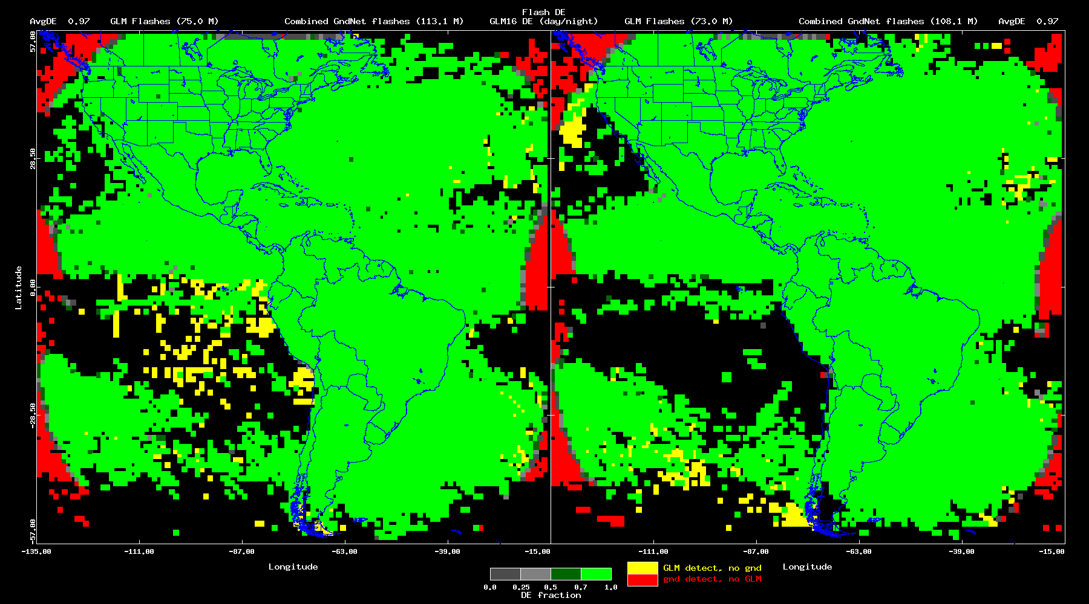
GLM16 DE: Day/Night $(± 10$ min)

Slide 10
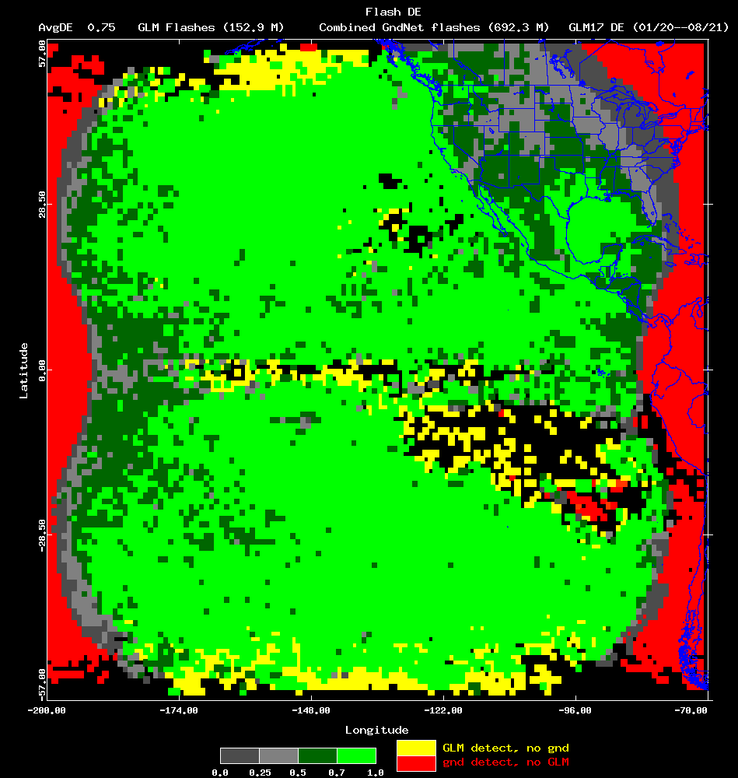
GLM17 DE $$± 1s$$

Slide 11
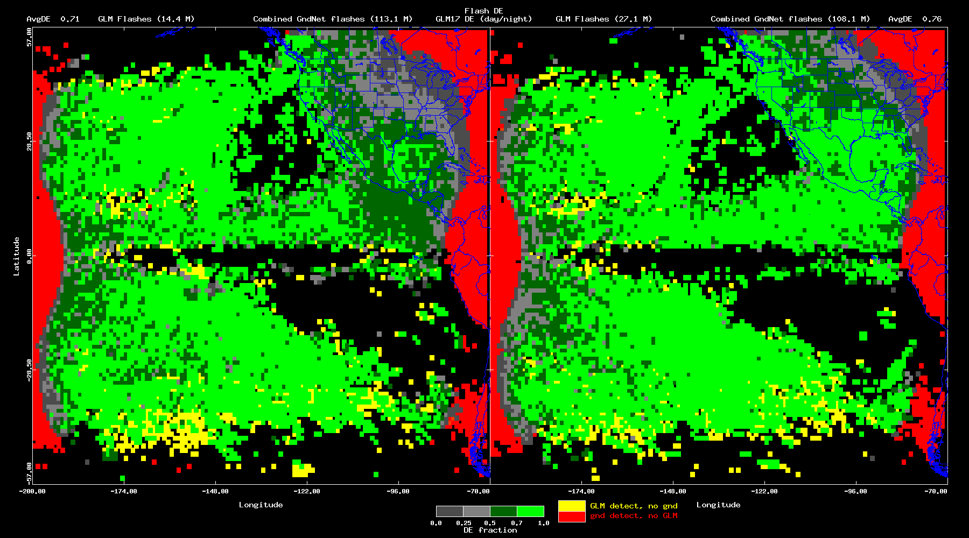
GLM17 DE: Day/Night ($± 1s$)

Slide 12
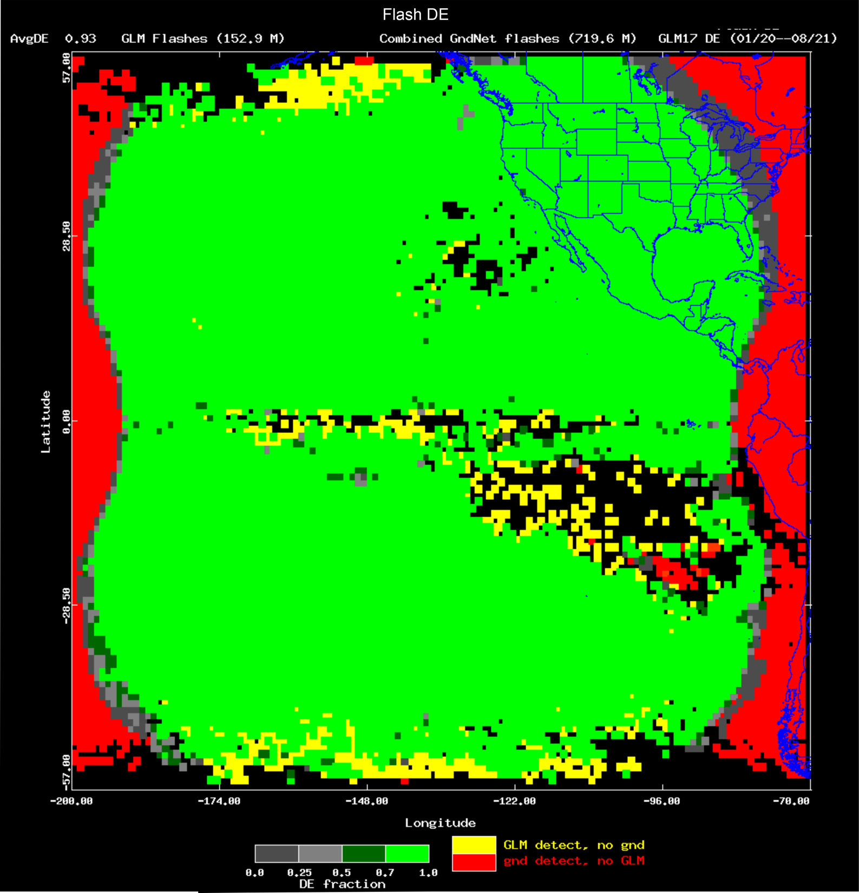
GLM17 DE $± 10$ min

Slide 13
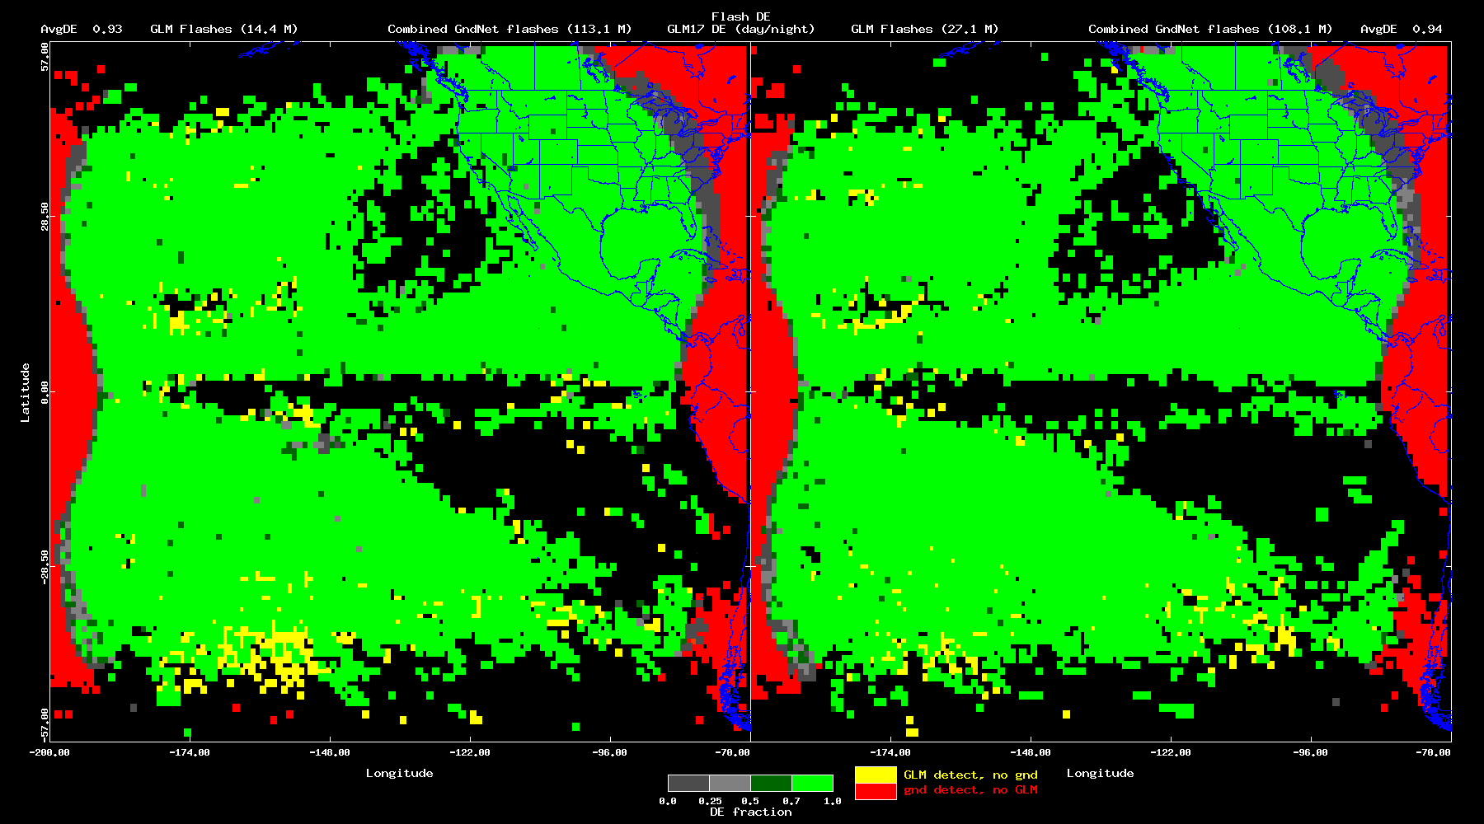
GLM17 DE: Day/Night ($± 10$ min)

Slide 14
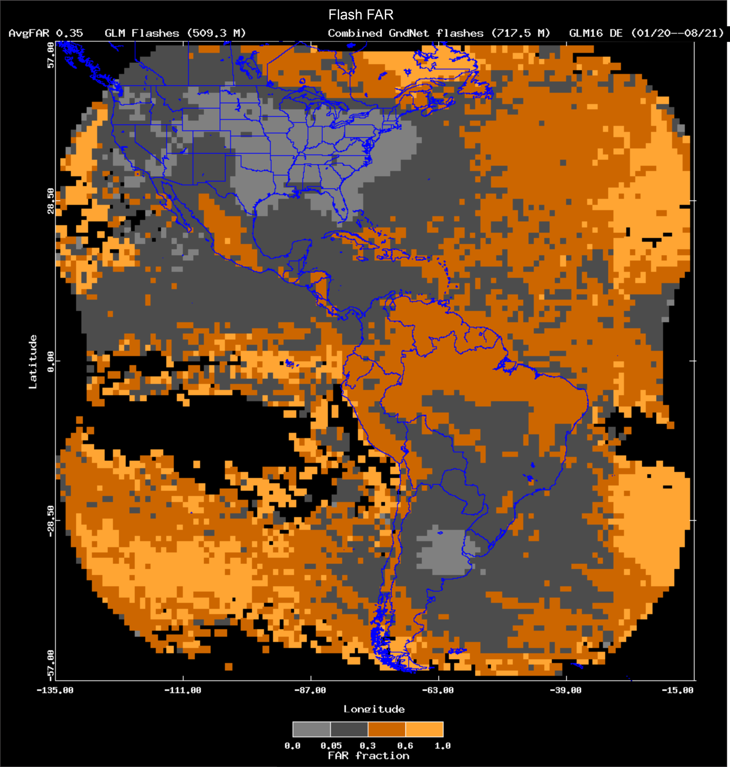
GLM16 FAR $$± 1s$$

Slide 15
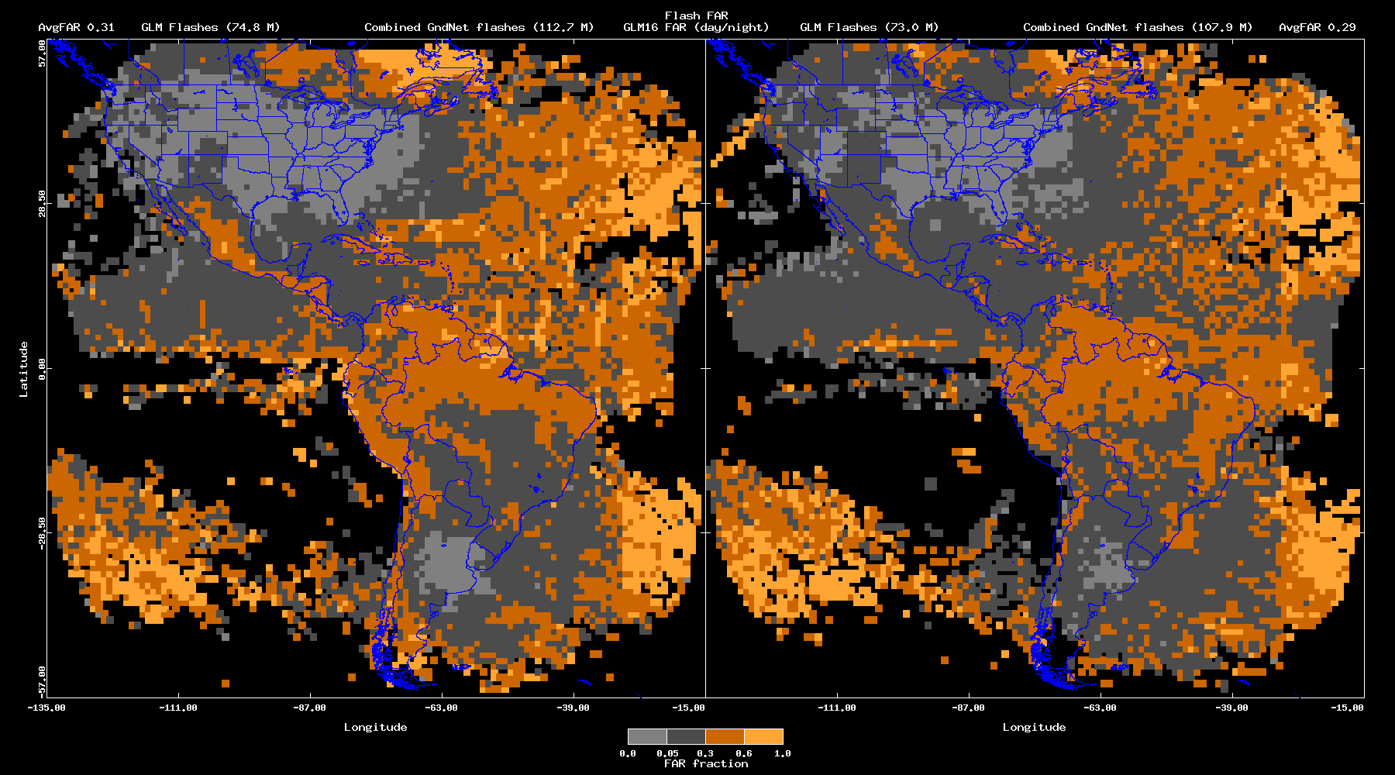
GLM16 FAR: Day/Night ($± 1s$)

Slide 16
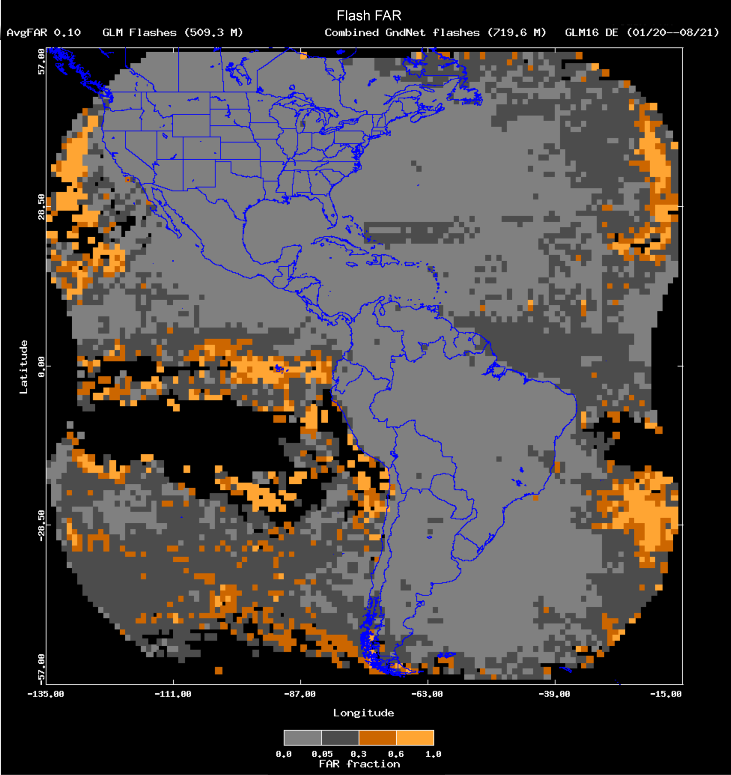
GLM16 FAR $$± 10 \text{min}$$

Slide 17
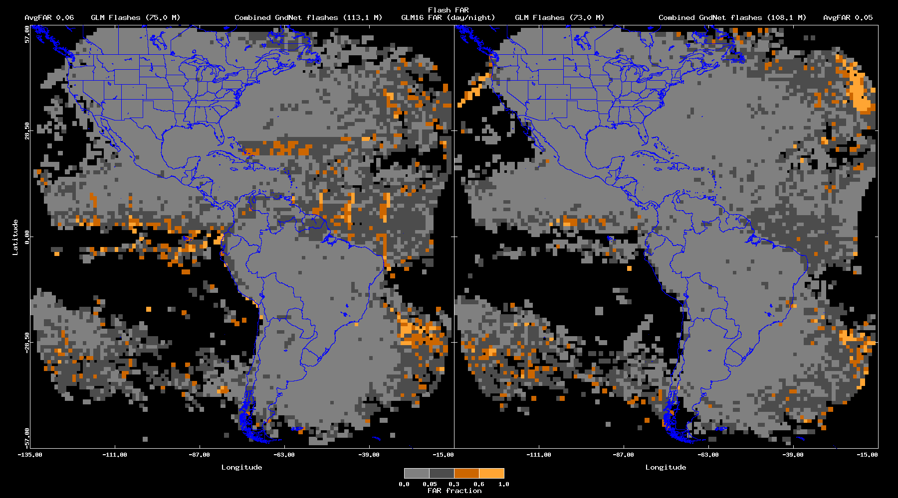
GLM16 FAR: Day/Night $(± 10$ min)

Slide 18
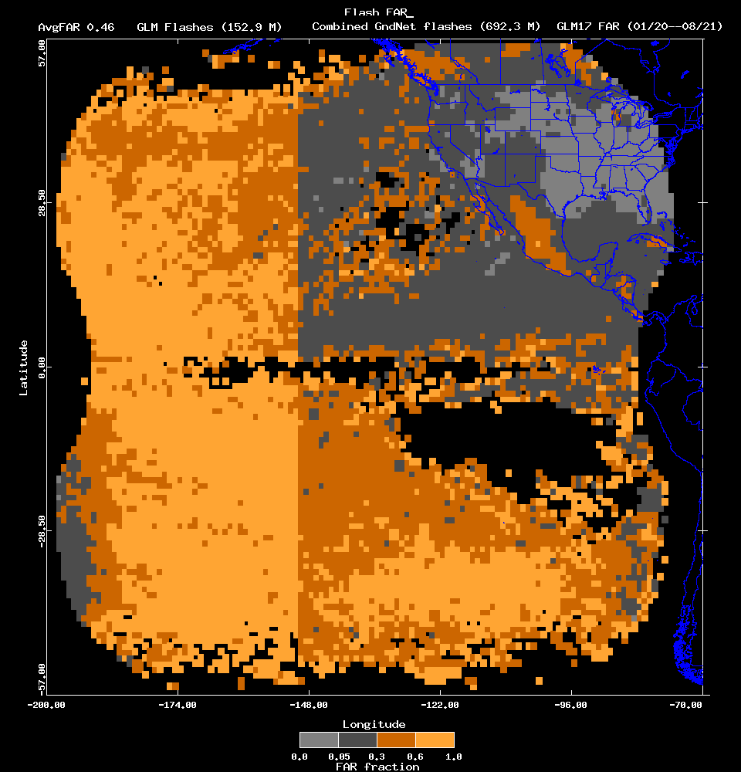
GLM17 FAR $$± 1s$$

Slide 19
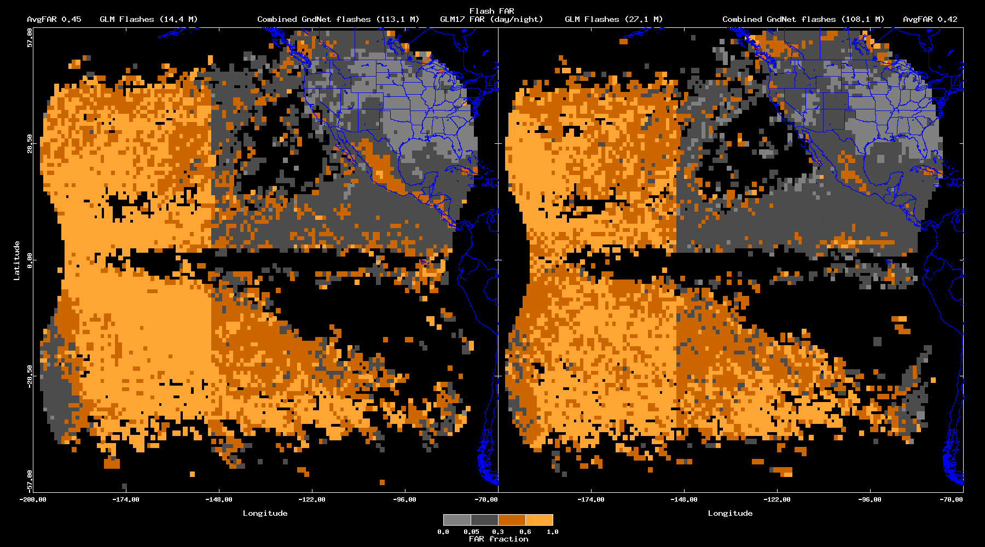
GLM17 FAR: Day/Night ($± 1s$)

Slide 20
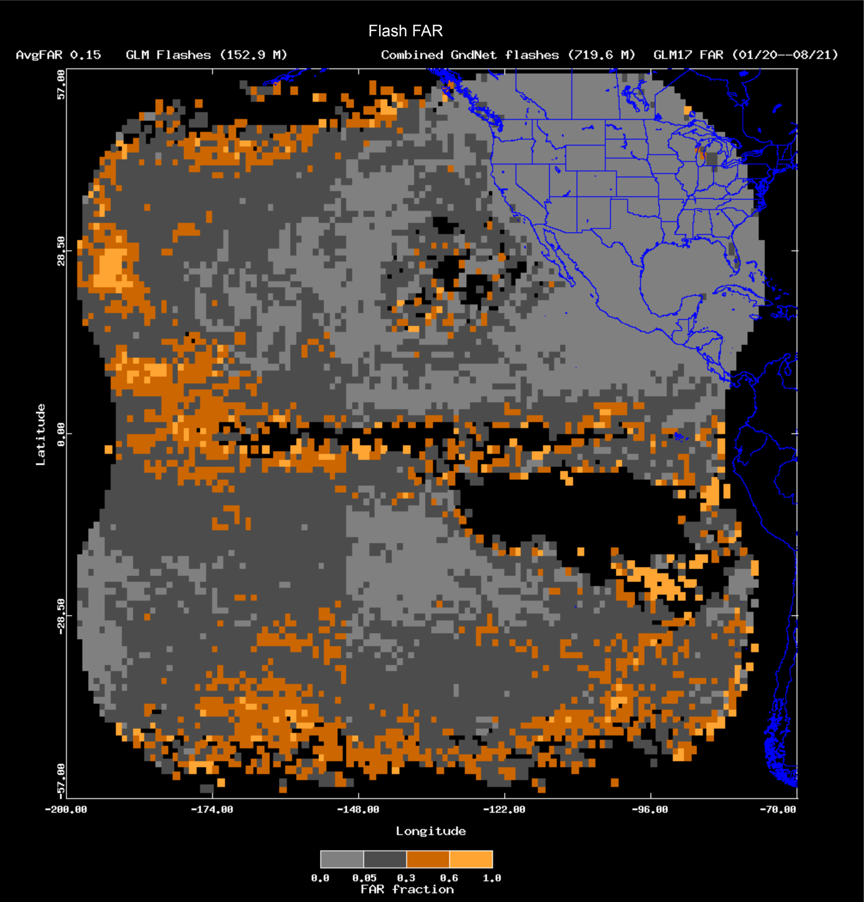
GLM17 FAR $$± 10 \text{min}$$

Slide 21
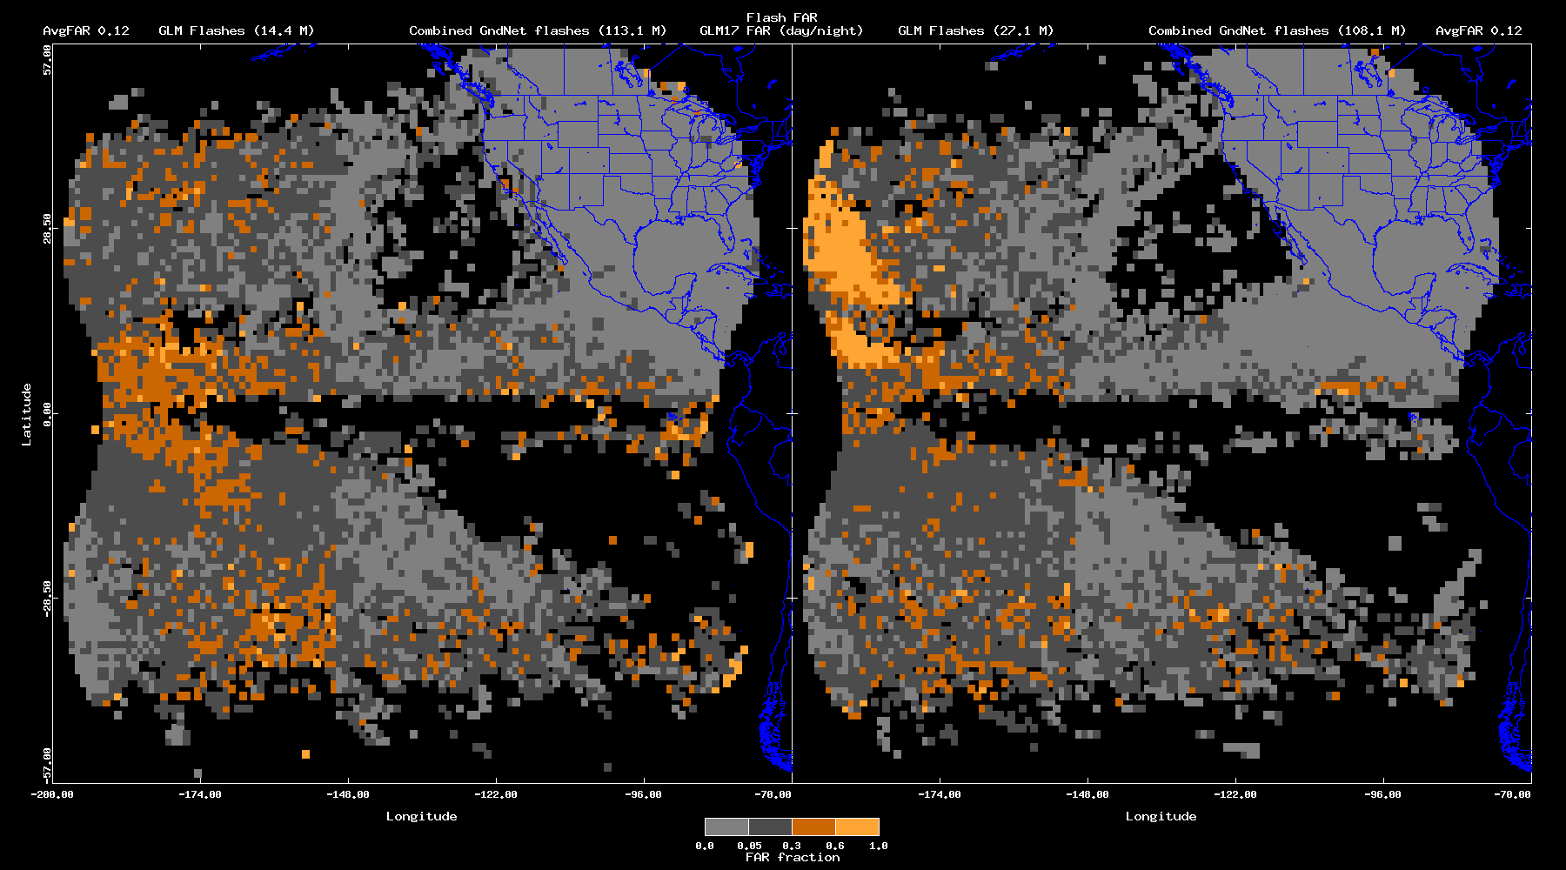
GLM17 FAR: Day/Night $(± 10$ min)

Slide 22
Concluding Remarks
$± 1$s window
GLM16 DE: 0.75 (0.70/0.80), FAR: 0.35 (0.31/0.29)
GLM17 DE: 0.75 (0.71/0.76), FAR: 0.46 (0.45/0.42)
$± 10$ min window
GLM16 DE: 0.96 (0.97/0.97), FAR: 0.10 (0.06/0.05)
GLM17 DE: 0.93 (0.93/0.94), FAR: 0.15 (0.12/0.12)

