Slide 1
Comparison of Modeled and observed glm flash detection
Ken Cummins
GLM Science Meeting 2021
Subset of content in Cummins (2021) AMS Extended Abstract
Notes:
Welcome. This is a brief walk through of the central content of my 2021 AMS Extended Abstract. The Abstract (full paper) provides some additional details.

Slide 2
GLM-16 (Goes East) Flash detection assessment
The fraction of flashes reported by GLM on GOES East has been shown in earlier studies to be much lower in northwest CONUS than in the southeast (see image to the right)
This behavior has also been reported in other studies by Bateman and Mach (2020), Murphy and Said (2020), and Rudlosky & Virts (2021)
(from Blakeslee et al., JGR 2020)
Notes:
The work presented here focuses on GLM detection
(Read first paragraph)
(describe color scale)
Left Panel: ISS LIS Middle Panel: Earth Networks ENTLN Right Panel: Vaisala’s GLD360
(Read second paragraph)

Slide 3
Basis for regional differences in GLM detection - Instrumental variation in detection threshold (first talk) - differences in cloud-top optical energy (second talk)
Notes:
Two factors are responsible for these regional differences

Slide 4
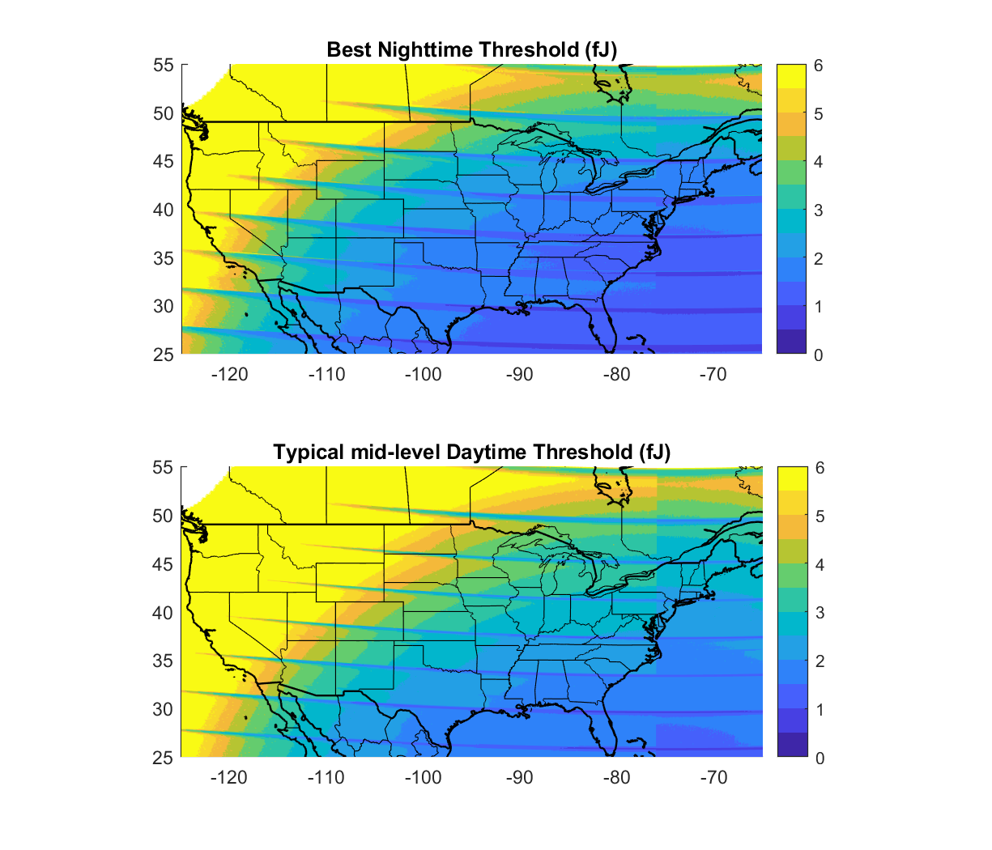
The detection threshold increases towards the edges of the fields-of-view, driven by instrument threshold variations associated with GLM optics and viewing geometry. This is illustrated in the maps to the left showing best-case (upper map) and mid-level thresholds (likely daytime – lower map) throughout CONUS for G16. The lowest threshold (~1 fJ) is in Florida, and it increases to higher than 6 fJ in the northwest. Note: the highest threshold in a region is (roughly) twice the “Best Nightime” values shown in the upper panel
G16 Instrument Thresholds
Thresholds and mean pixel locations provided by Lockheed Martin Staff through NASA – Thanks!
Notes:
Let’s start with instrument threshold
(Read the text on the slide for background and motivation)

Slide 5
Fundamental principle of flash detection: if the brightest event in a flash exceeds the detection threshold in at least one GLM pixel, then the flash is detected (animation showing increasing detection threshold)
Fraction not reported
Notes:
I will be showing an animated sequence meant to help understand the modeling approach
We start with optical energy estimates derived from long-term measurements from the Lightning Imaging Sensors (LIS) on the TRMM satellite and on the International Space Station (ISS). The histogram and related cumulative distribution shows the nature and range of brightest events in LIS flashes in the southeast U.S. The cumulative curve represents the fraction of flashes that are not reported, as a function of increasing detection threshold.
When the threshold id down near zero, the fraction not reported is also zero, reflecting perfect detection
As detection threshold is increased by stepping through the animation, the fraction not reported increases from 0% to over 50%

Slide 6
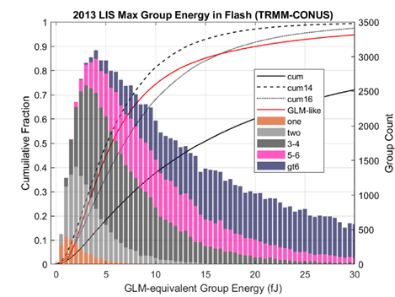
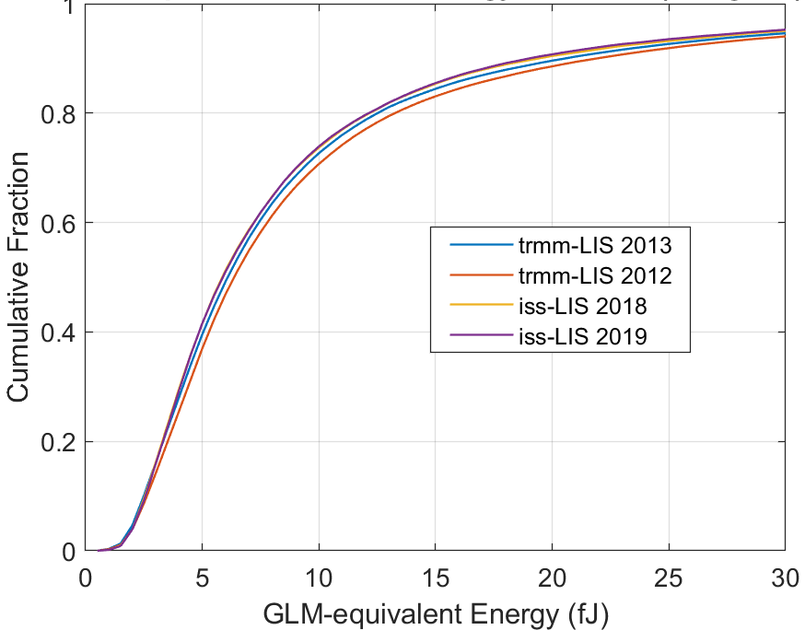
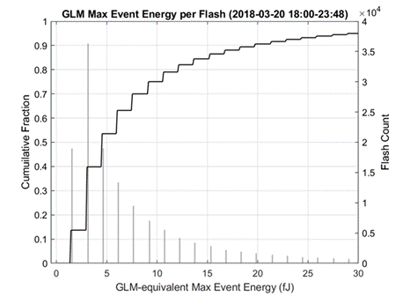
Equivalence for ISS-LIS and TRMM-LIS, and validation of energy calculation
Full-year 2013 LIS CONUS max group energy in flash, stacked by Events-per-group
Cumulative CONUS distributions of GLM-equivalent event energy for two TRMM years and two ISS years
Sample GLM max event-in-flash energy on Florida (low GLM threshold region)

Slide 7
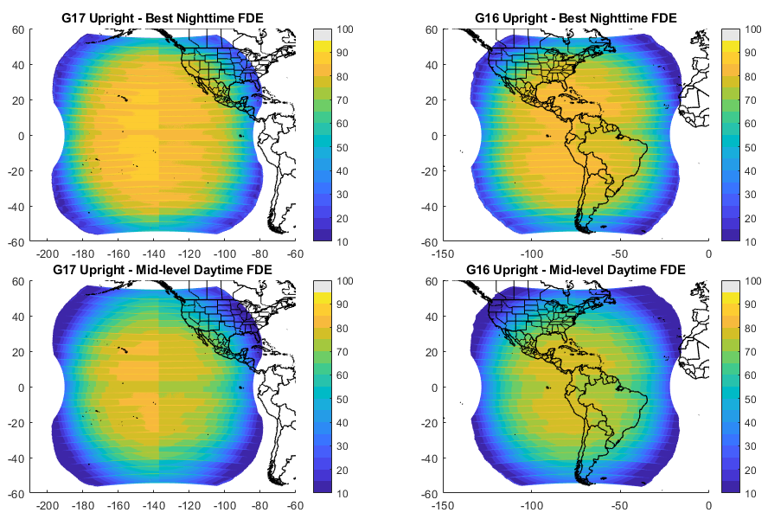
Day and night GLM flash DE Estimates (Threshold-only effects)
Model employed full-CONUS ISS-LIS optical energy distribution, and assumes LIS has 80% flash DE.
Differences in flash size, flash height, or cloud optical depth are not addressed in these estimates. (See Zhang & Cummins, 2020 and Rutledge et al., 2020 for related details)
TRMM-LIS optical source distribution used throughout FOV
Notes:
Using the optical source distribution shown in the previous slide and known GLM threshold values provided by Lockheed Martin, the estimates of daytime and nighttime DE were computed for GOES-West (left column) and GOES-East (right column). These estimates do not address expected variations in optical source energy resulting from differences in flash size, flash height, or cloud optical depth. Colorado is known for anomalously electrified storms with high flash rates, small flash areas, low flash heights, and large optical paths above the flashes. Therefore DE in this region is somewhat over-estimated using this model.

Slide 8
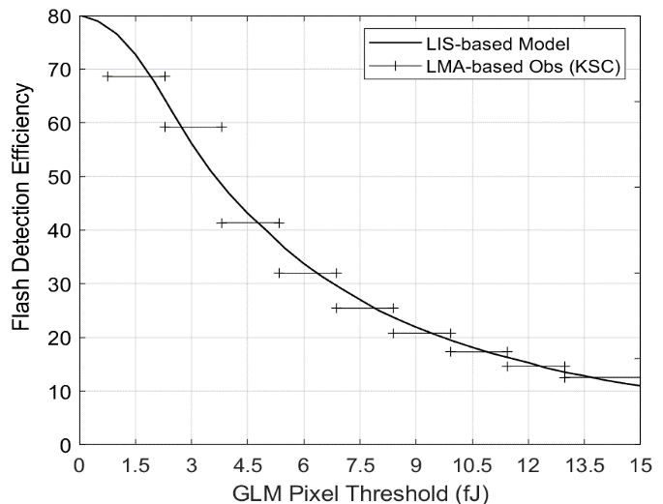
Model Verification @ ksc full year of storms (2018-19) - model curve derived using the ISS-LIS optical source distribution for 2018 for the southeastern U.S land mass bounded by 25 - 35ᵒ N and by 77 - 90ᵒ W - LMA-based observations (bars) obtained by eliminating flashes with group energy below the specified threshold
Flash DE decreases by 10-15% for each 1.5 fJ increase in threshold
Notes:
This figure illustrates the accuracy of this model for storms near Kennedy Space Center in 2018-2019.
The model is the smooth curve reaching 80% at a GLM threshold of zero, and the observations a represented by the horizontal bars. Further details can be found in the extended abstract.
You can see that flash DE decreases by 10-15% for each 1.5 fJ increase in threshold.

Slide 9
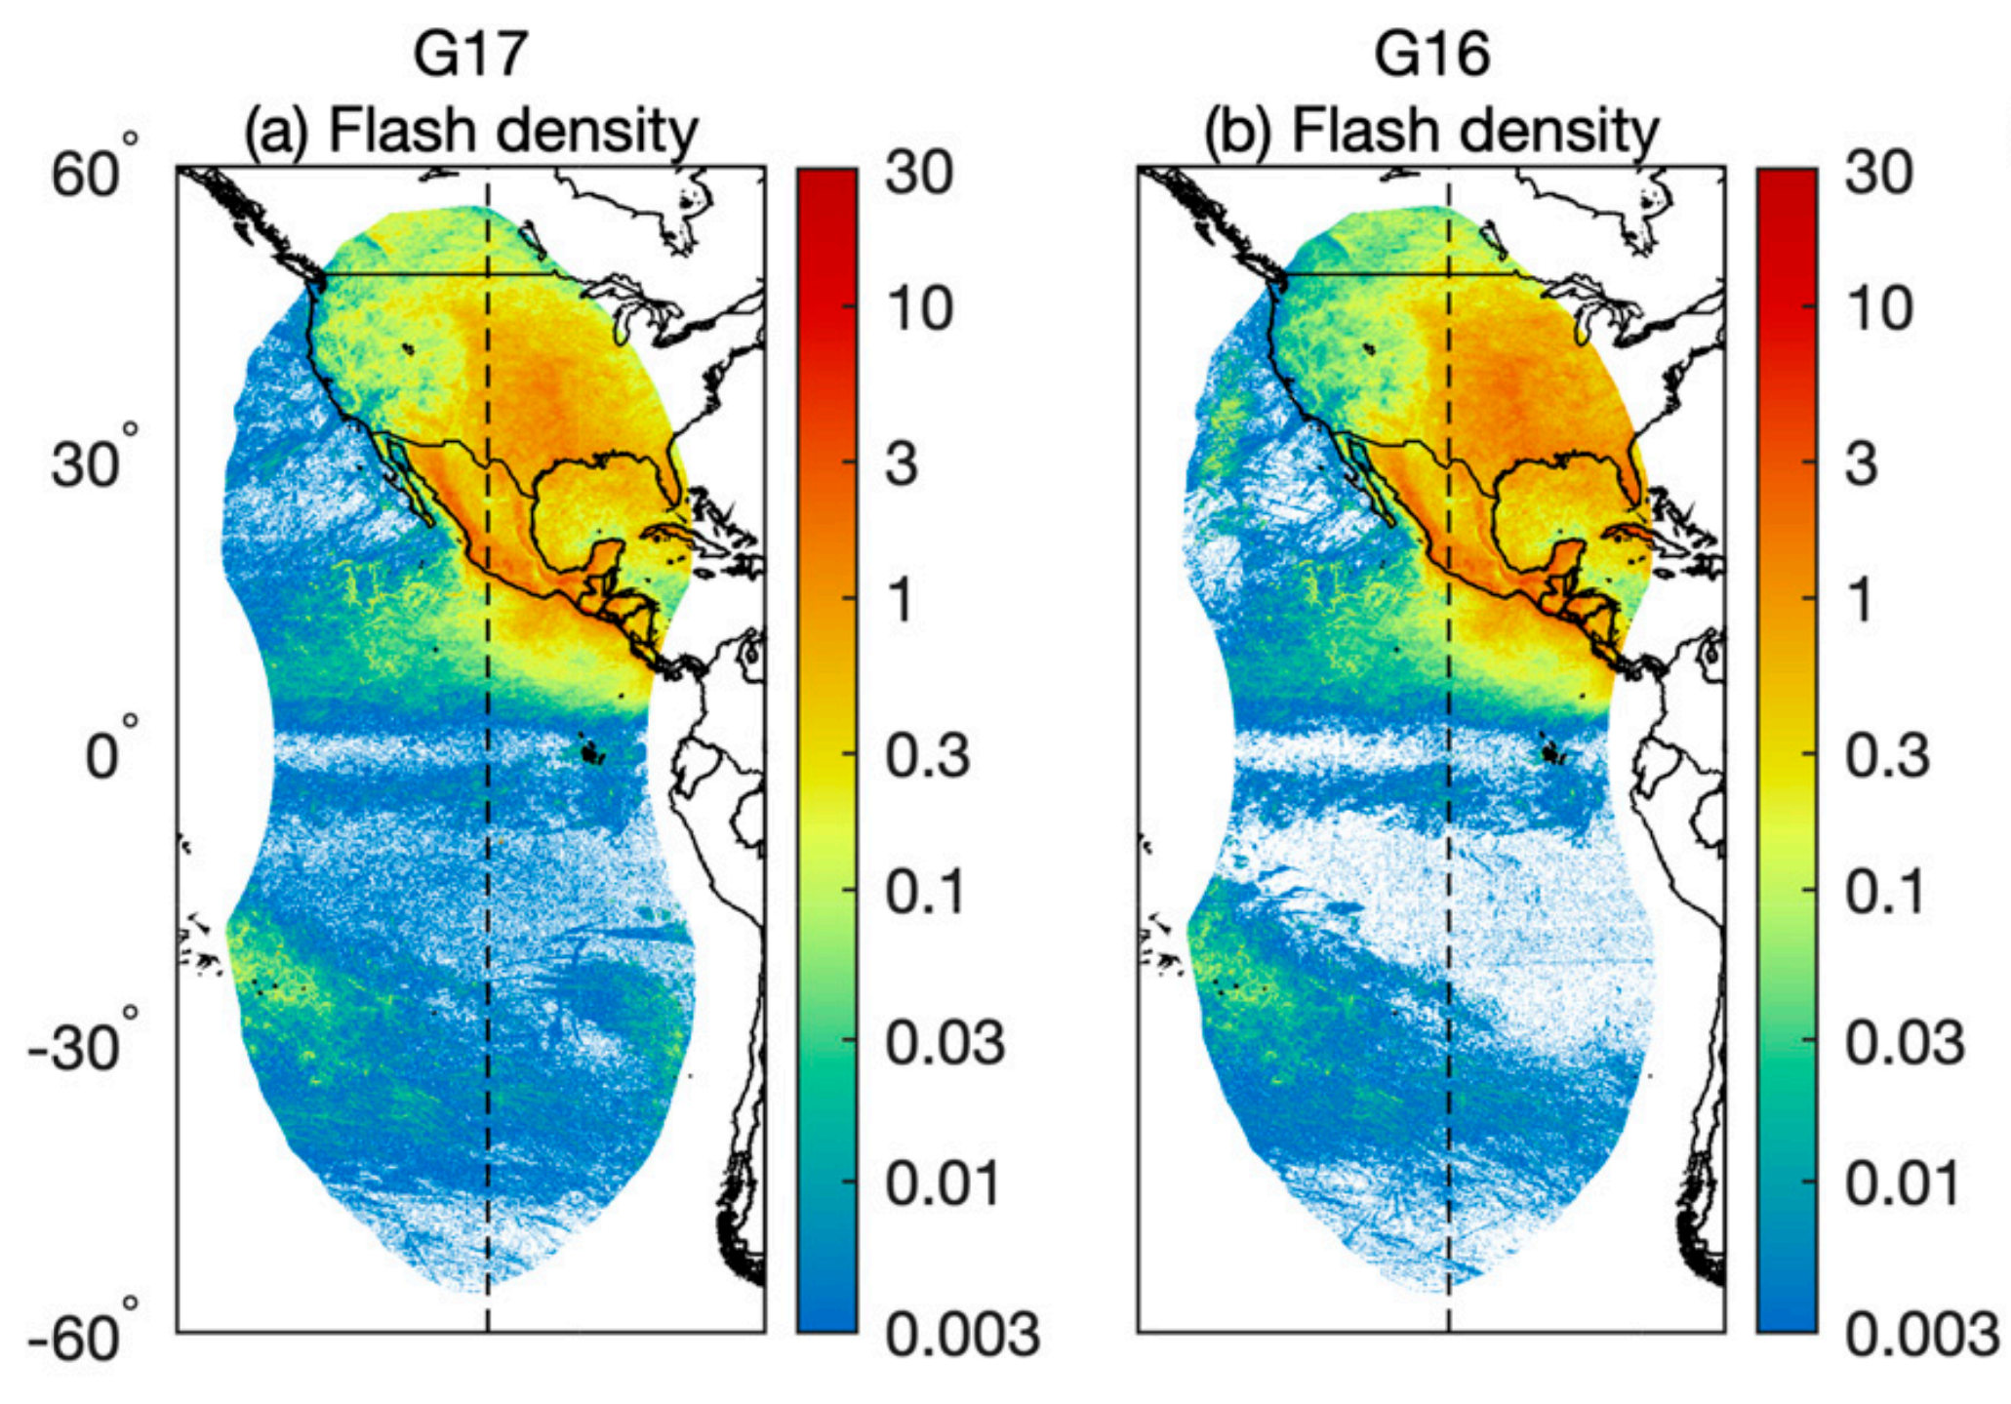
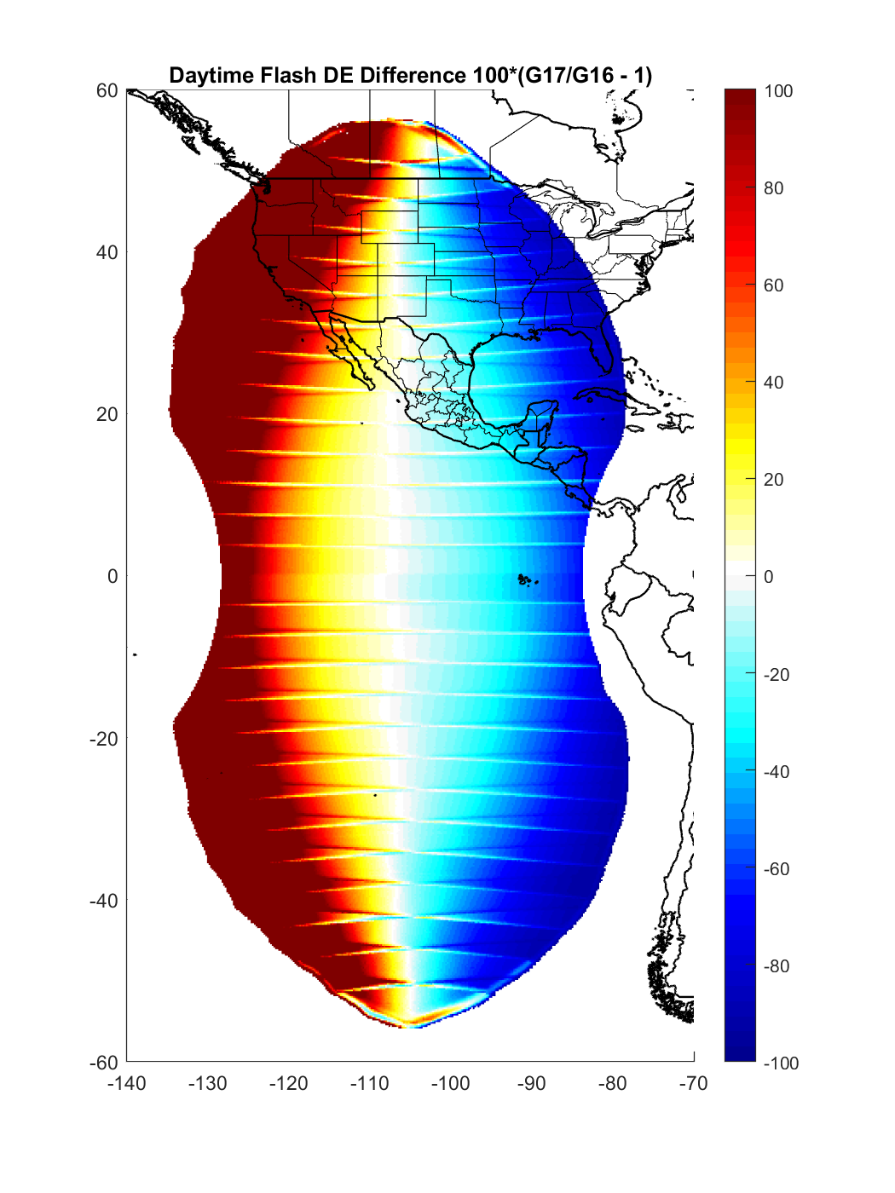
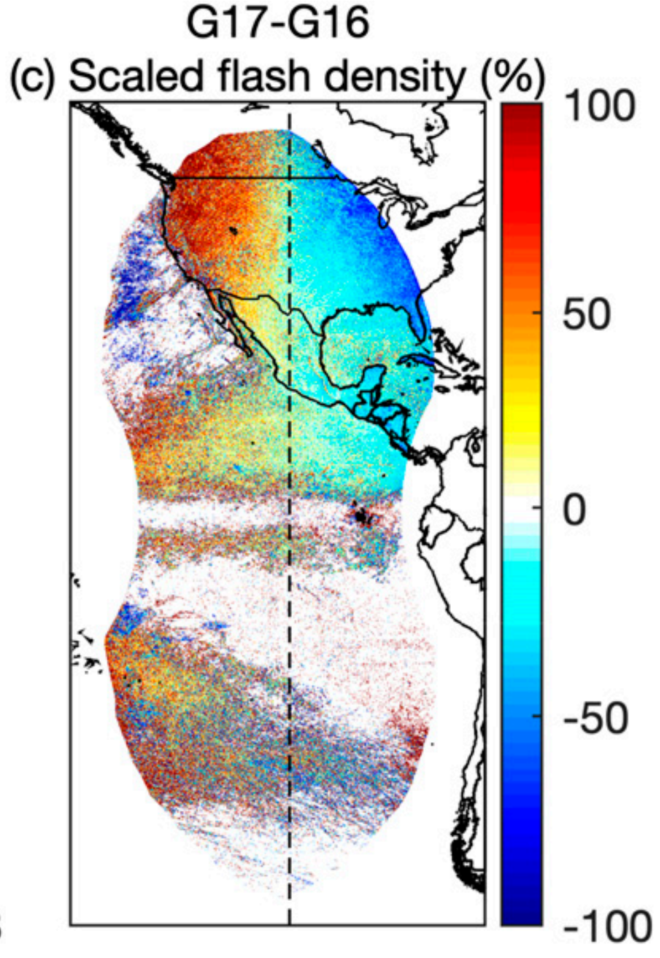
Model Verification in G16:G17 Overlap REgion Model comparison with Rudlosky & Virts (2021) - model curve derived using overall CONUS ISS-LIS (2018-2020) GLM-equivalent largest-in-flash optical sources - Need to employ regional optical source distributions to improve “match”
- GLM observations in low-count regions are contaminated by false reports (see density differences)

Slide 10
Supporting observations
(from Blakeslee et al., JGR 2020)
The transition from 50% to 40% FDE for GLM (gold-to-green) is associated with the daytime threshold transition from about 4-to-5 fJ, consistent with the model findings for Florida

Slide 11
Thank you
Future Work
Refine the DE model include regionally-derived long-term optical energy distributions using ISS-LIS
Refine and further evaluate the technique for estimating GLM event energy from LIS group radiance observations, using existing and refined LIS pixel areas (per Tim Lang)
Explore the best way to get this information into the hands of the operational and research communities

Slide 12
Supporting Slides

Slide 13
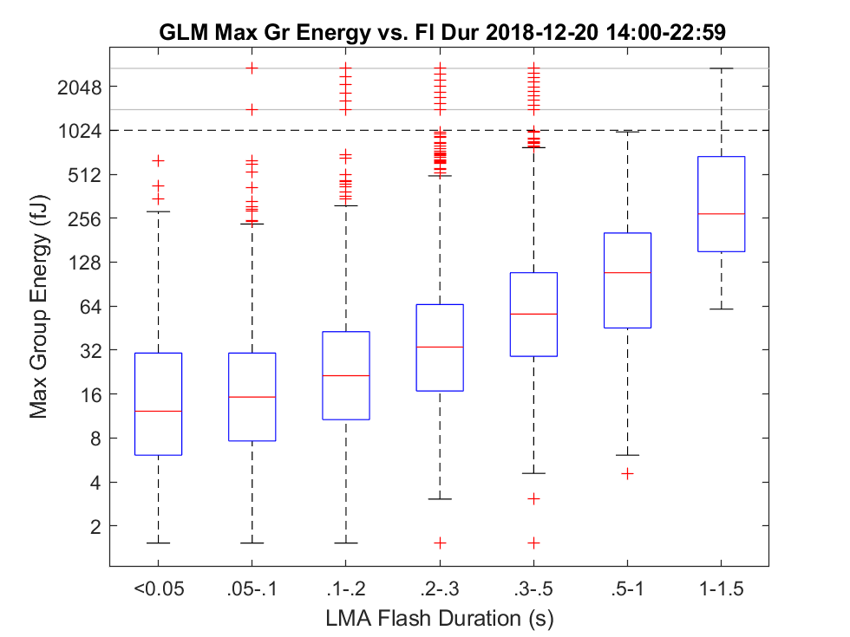
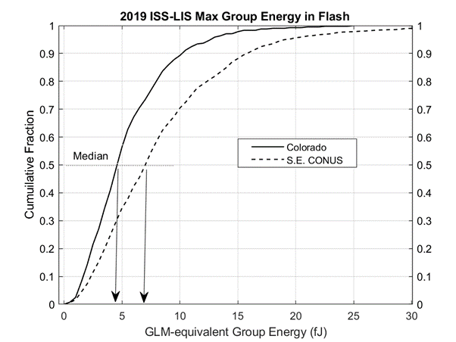
Complication: Optical energy depends on flash duration/Size and region
The Box plot (above) shows that short-duration flashes have the smallest “maximum group energy in the flash” values. Therefore they will be lost first when instrument thresholds increases
Boxes are25th – 75th percentiles. Red +’s are extreme values. Note log scale for energy.
The cumulative curves (above) show that group energy is uniformly lower in Colorado, compared to the southeastern USA
Median value of about 4.5 fJ in Colorado, vs. 6.5 fJ on southeastern USA
Notes:
In this study, the GLM threshold was applied at the EVENT level, so the behavior matches what GLM would do.
The group optical energy Box-plot is, by definition, limited to what GLM sees. Zhang and Cummins show that there are many cloud-top optical sources that have lower energy than GLM’s minimum of about 1.5 fJ.
Maximum Group Energy was used so that we know something about the brightest group. It would be more-informative to use the maximum event energy in each group, so it can be directly related to GLM detection threshold

Slide 14
The specific dependence of flash detection on threshold and flash size depends on the storm (e.g. normal polarity storm in Florida (left) and anomalously electrified storm in Colorado (right)

Slide 15
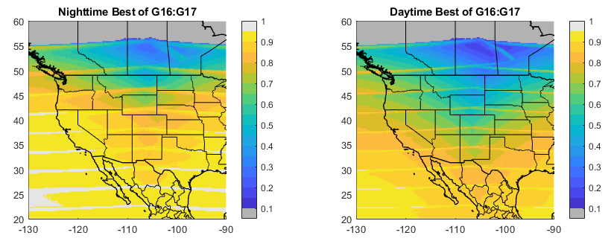
What flash de (relative to LIS) can we get with the best of Goes-East and west?
Notes:
Here we take a closer look at modeled performance over north America.
These DE images were produced by employing the best DE estimate from GOES-East and –West. Note that the estimated flash detection is at or below 50% (0.5) in upper plains and south-central Canada during the daytime.

Slide 16
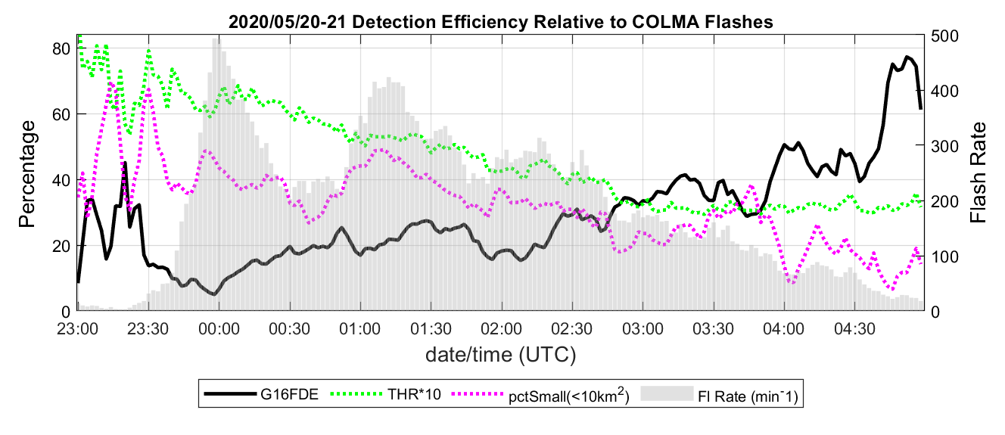
Colorado storm day: May 20, 2020
Threshold Animation (2-min frame rate)
GLM 2-minute event count
Region Median Threshold (fJ) Multiplied by 10
Full-region GLM flash DE
GLM Threshold within the region
% flash area < 10 km²
Note: final image is the per-pixel minimum over whole case
Threshold varies by region, and locally by a factor-of-two -- so we can benefit from Dynamic Tracking of pixel threshold
Notes:
Given that GLM detection threshold varies by region and by time-of-day, it would be helpful to have this information when interpreting GLM data in operational settings.
It is possible to compute the detection threshold for each GLM pixel in real-time with 2–5-minute temporal resolution by accumulating statistics from the event energy values reported in the operational L2 dataset. The left panel shows such a calculation for 2-minute intervals over a 6-hour period that includes full daylight, total darkness, as well as the transition period. The median threshold in the region (green line) starts out at about 7 fJ in full daylight and ends-up at about 3 fJ in full darkness after 03 UTC.
GLM flash DE relative to the local Lightning Mapping Array (thick black line) is quite low during daylight hours in this example, but it exceeded 50% after the median threshold reduced to about 3 fJ and the percentage of small flashes reduced to about 20%. The animation on the right panel shows the per-pixel threshold, color-codes between 1 and 7 fJ, in 2-minute periods. The final image in the panel shows the minimum threshold for each pixel for the duration of the storm.
It should be clear that real-time tracking of GLM threshold is both practical and useful

Slide 17
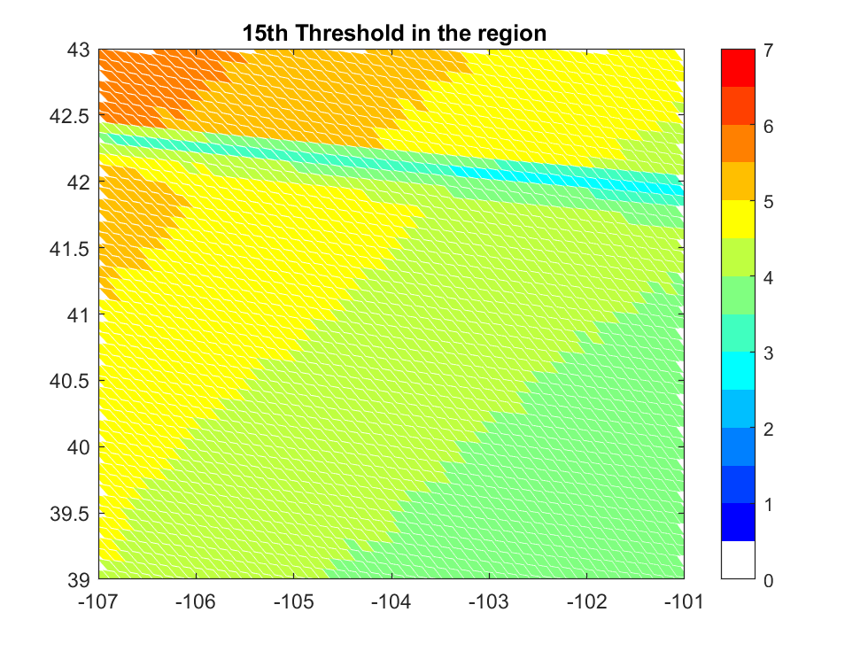
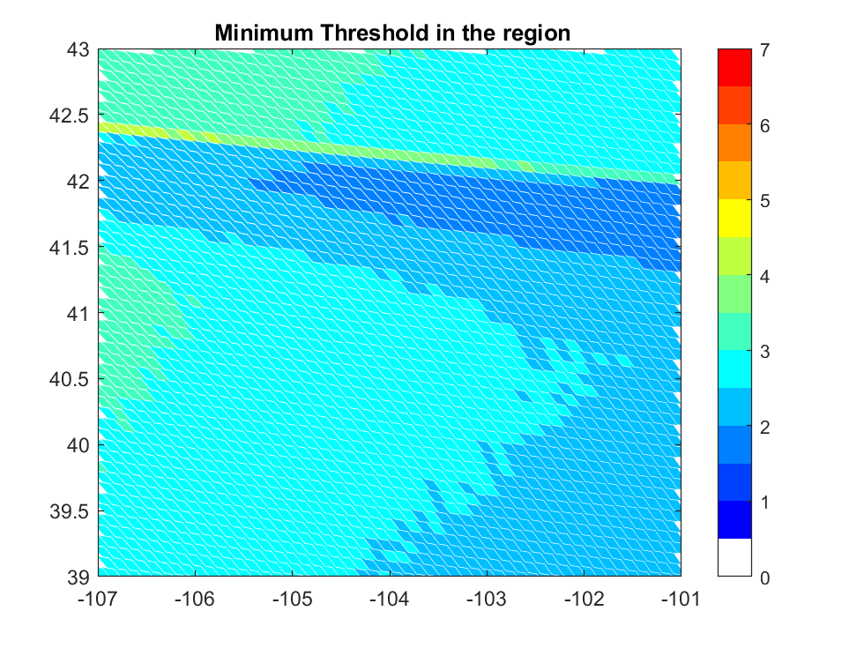
Colorado storm day summary: May 20, 2020

Slide 18
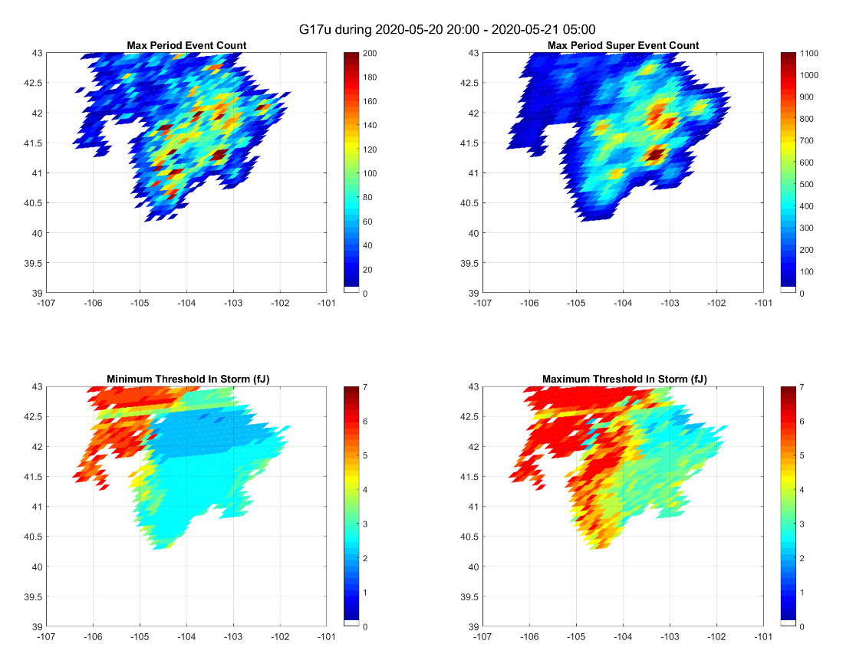
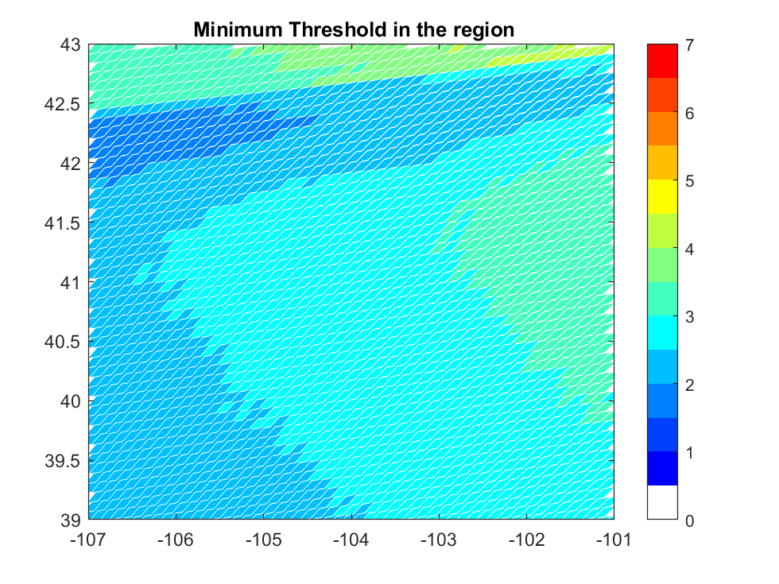
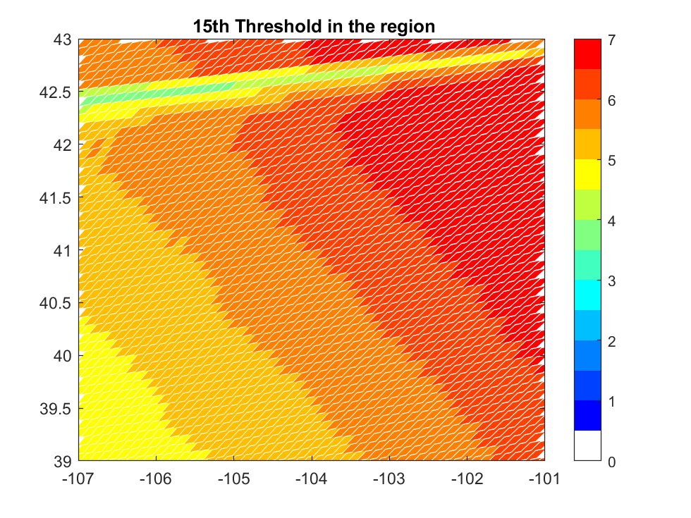
Note that the observed L2 thresholds are similar for G17 and G17, even though their nominal day:night instrument values are quite different. Could this be a “Front Range Effect”?
2-minute Event Count (storm max)
G17
G16
Minimum and maximum 2-minute Observed Thresholds
Instrument Threshold “Range”

Slide 19
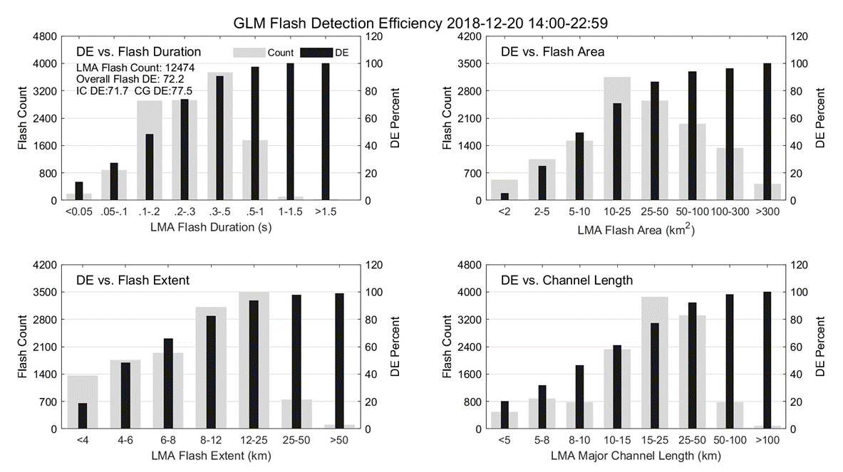
GLM-16 (Goes East): Larger flashes are easier to detect
Based on comparisons with the Kennedy Space Center Lightning Mapping Array (KSCLMA), GLM detection is strongly dependent on all aspects of flash “size” (time duration, area, spatial extent, and overall channel length)
Overall finding for 8 hours of storm activity near KSC on December 20, 2018. ==>
Dark bars indicate flash DE and light wide pars indicate flash counts.
(from Zhang and Cummins, JGR 2020)

