Slide 1
Recent Lightning Developments at the Global Hydrometeorology Resource Center DAAC
Geoffrey Stano – GHRC DAAC Scientist
Sherry Harrison – GHRC Lightning Lead

Slide 2
General Updates for 2021
Name more accurately reflects data archived
Hurricanes
Storm hazards, including lightning
Precipitation studies
Supporting field campaigns
GHRC remains NASA’s lightning DAAC
GHRC in next phase of cloud transition
All datasets in the cloud
Beginning to wind down on-premises processing

Slide 3
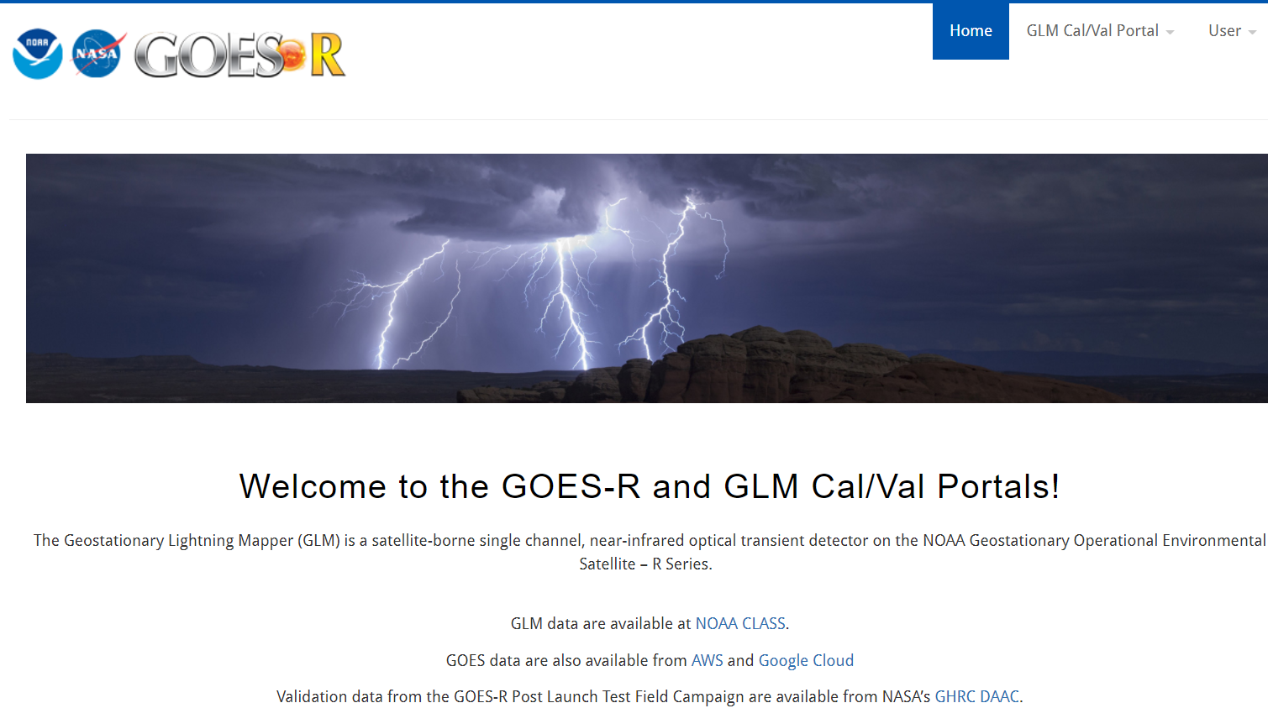
The GLM Portal
GLM Portal remains supported
https://goes-r.nsstc.nasa.gov/home/
Built for GOES-R Post Launch Test (PLT) field campaign
Contains lightning data not available to public
NLDN
ENTLN
Continues to be location of previous GLM Science meeting presentations

Slide 4
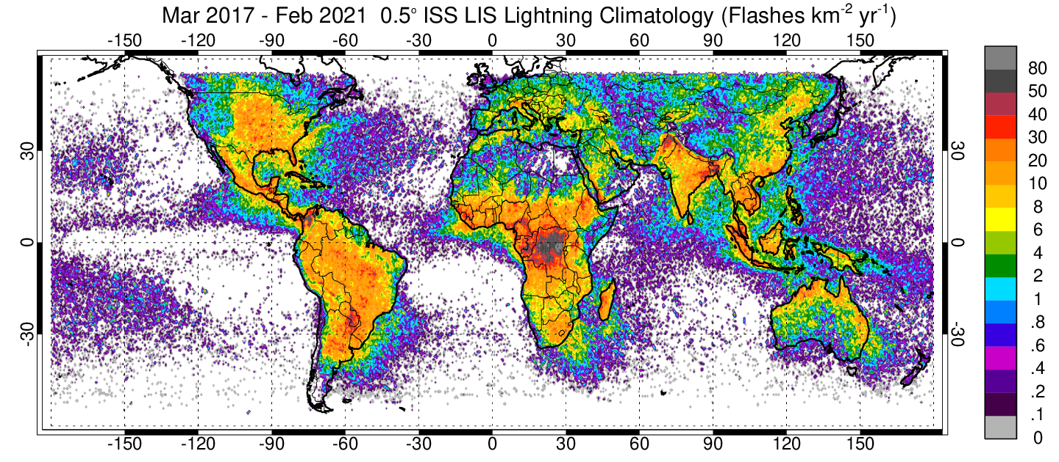
Updates: ISS LIS (part 1)
4 years on orbit – extending long-term TRMM LIS climatology
Middle and higher latitudes of special interest
Have not been sampled (outside of GLM) since the Optical Transient Detector (OTD) from 1995-2000
ISS LIS being incorporated into the 20+ year combined TRMM LIS / OTD climatology
Likely relocated on ISS in early 2022 – Continued operations through at least late 2023
ISS LIS climatology March 2017 – February 2021. Image courtesy of Timothy Lang and Dennis Buechler

Slide 5
Updates: ISS LIS (part 2)
Updates for ISS-LIS Code for Version 2.0
Viewtime correction for solar panels
Viewtime correction for 1 second dropout
Corrected initialized event alert summary variable
Improved the way data at the end of the 24 hour period is handled
Changed the orbit designation from simple increasing index to one based on the day/time of orbit
15 March to 9 May 2021: Timing anomaly that changed offset from reference datasets
Normally < 1 ms with < 1 ms standard error – Increased to ~32 and 10 ms, respectively
V2 data subtracted off a 32 ms offset, but standard error not corrected
Issue resolved May 9 and remains under investigation

Slide 6
North Alabama Lightning Mapping Array (NALMA)
Operations have resumed
Start date: December 17, 2018
Number of stations: 12
Processing transitioned to Huntsville
Local processing is a collaboration between GHRC and the Marshall Space Flight Center Lightning Team
GHRC will host full-rate and raw NALMA data
Full rate:
http://dx.doi.org/10.5067/NALMA/DATA101
Raw:
http://dx.doi.org/10.5067/NALMA/DATA301
Preparing for the near real-time NALMA data
Future plans include publishing the entire period of record back to 2002
NALMA Flash Extent Density example

Slide 7
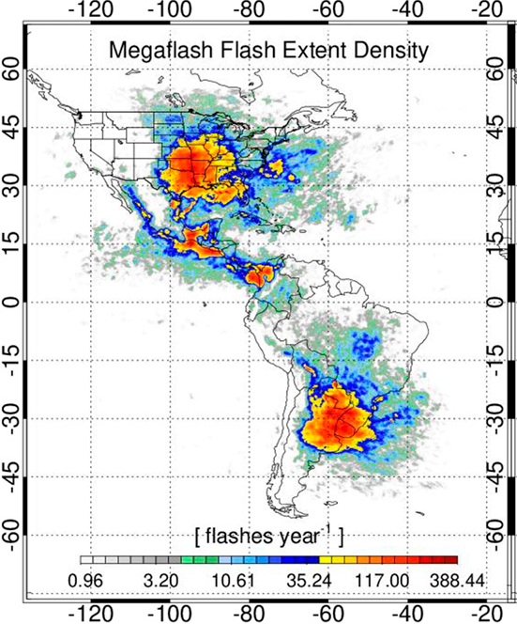
Geostationary Lightning Mapper
Two GLM products in preparation for publication in FY2022
Full disk, gridded GLM products (DOIs when published)
http://dx.doi.org/10.5067/GLM/GOES/DATA101
GLM-CIERRA – Cluster Integrity
http://dx.doi.org/10.5067/GLM/CIERRA/DATA101
Primary delay was with GHRC’s cloud transition
“Ongoing” datasets (i.e., those with regular observations) needed a cloud-based processing solution
GHRC is working with the PIs to begin publishing
GLM CIERRA has provided two years of data to start
Journal Publication
The Hazards Posed by Mesoscale Lightning Megaflashes
https://doi.org/10.1175/EI-D-20-0016.1
From Peterson and Stano 2021 – Using GLM Cierra

Slide 8
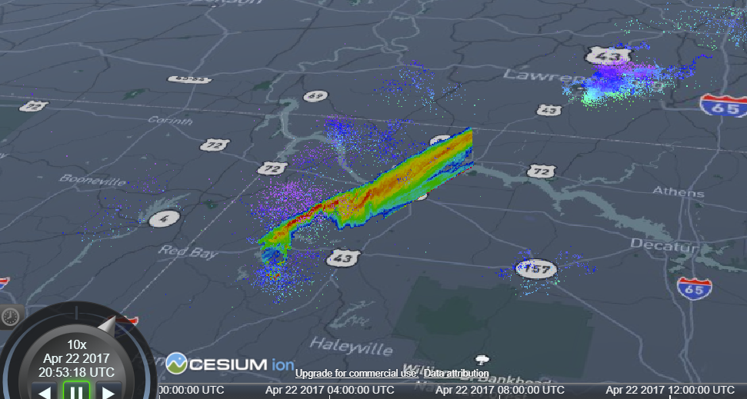
Integrating Lightning Data
Field Campaign Explorer
Software for data discovery, exploration, visualization, and analysis
Cloud-based
Open source
3D viewing of coincident datasets
GHRC lightning holdings being added
Focus on basic displays now (i.e., LMA sources, GLM events)
Update to include more familiar datasets soon
Goal is to use this for dynamic browsing of GHRC holdings as part of the website refresh
https://ghrc.earthdata.nasa.gov/fcx/index.html
NALMA raw source observations along with the Cloud Radar System on the ER-2 during the GOES-R Post Launch Test field campaign. (April 22, 2017 at 2053 UTC)

Slide 9
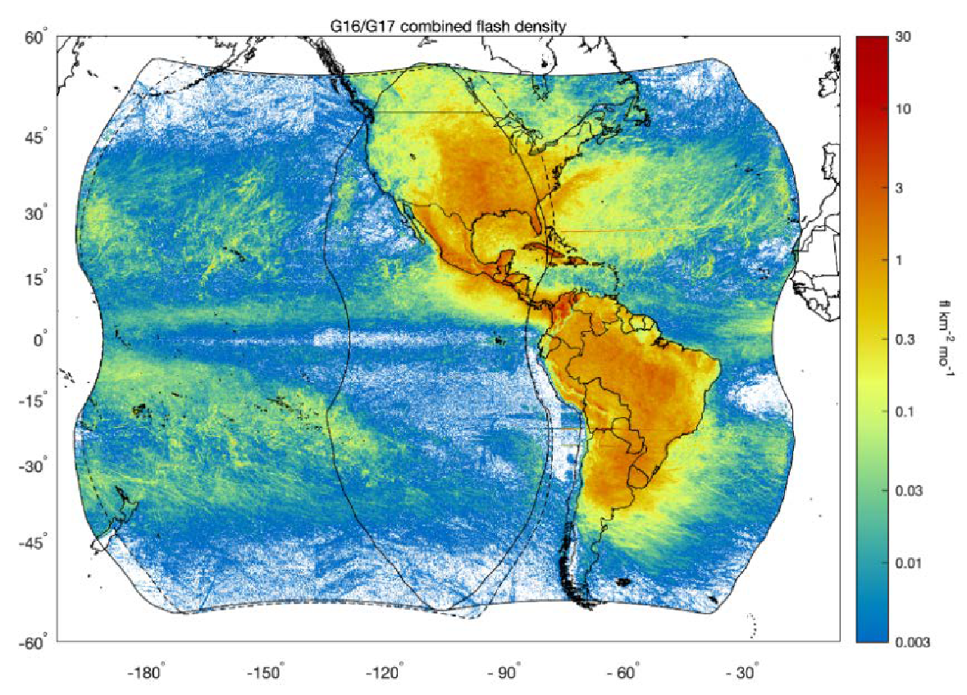
Looking Ahead for FY2022
Primary focus is to complete dataset publications
Version 2 ISS LIS, GLM gridded, GLM CIERRA, and NALMA
Expand Field Campaign Explorer tie-ins
Incorporate other LMA networks
Focus will shift to the DC and Wallops networks
WMO global dataset
More details this fall
Incorporate all available lightning data into a gridded, global dataset
Several potential field campaigns in the next 1-3 years that could come to GHRC
Flash densities of both GOES-16 and GOES-17 from December 1, 2018 – May 31, 2020 (GLM full disk gridded products quick guide)

Slide 10
THANK YOU!
QUESTIONS?

