Slide 1
In-flight assessment of Meteosat Third Generation Lightning Imager Level 2 Performances using the
LI STAtistical and Reporting tool (LI-STAR)
Sven-Erik Enno¹, Bartolomeo Viticchiè¹, Francesco C. Pignatale², Andrea Meraner¹, Colin Duff³, Sauli Joro¹, Jochen Grandell¹, Taylan Oezden⁴, Katja Hungershoefer¹, Gary Fowler¹
¹ EUMETSAT, Darmstadt, Germany
² Telespazio Germany GmbH, Darmstadt, Germany
³ MOLTEK Consultants Ltd, Darmstadt, Germany
⁴ Technical University of Darmstadt, Darmstadt, Germany

Slide 2
MTG LI
The Meteosat Third Generation Lightning Imager (MTG LI) will perform the geostationary detection of lightning optical emissions from space.
In line with other Lightning Location Systems (LLS), LI users will be provided with:
Level 2 groups (every 10 s)
Level 2 flashes (every 10 s)
Level 2 accumulated products (corresponding to GLM gridded products; every 30 s)
The balance between Detection Efficiency (DE) and False Alarm Rate quantifies the ability of the LI system to provide users with real lightning measurement, while allowing for a certain amount of false detections originating from various noise sources.

Slide 3
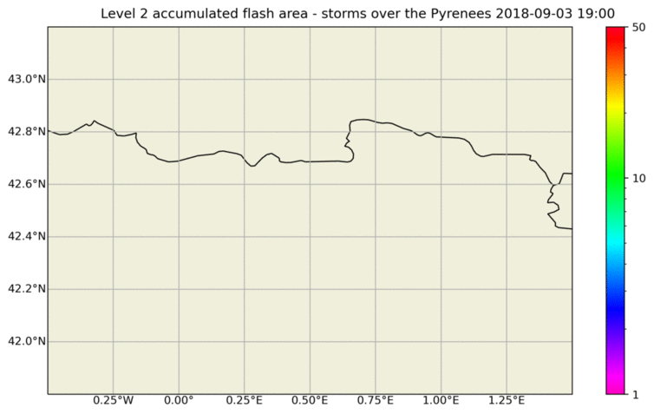
MTG LI
Notes:
Simulated using GLD360 but looking very much like the data provided by the LI will look like.

Slide 4
Why LI-STAR?
LI-STAR is a fast, automated, and centralized (at EUMETSAT) tool for the continuous monitoring of LI performances. This will be employed to:
Support Commissioning and Cal/Val activities (including the tuning of the LI system).
Enable the real-time monitoring of the system during Operations.
Provide users with information about the LI system capabilities and limitations.
The assessment of DE and FAR is performed by comparing LI measurements against well characterized ground/space-based LLS (e.g., this approach is widely used to characterize US space-based optical lightning detectors such as LIS and GLM).
LI-STAR supports the “transparent” handling of data from different LLS with the purpose of monitoring and characterizing the performances of LI. Its functionalities are developed and tested by means of operational systems (such as GLM, GLD360, ATDnet, …) and will be immediately ready to process LI products after launch.

Slide 5
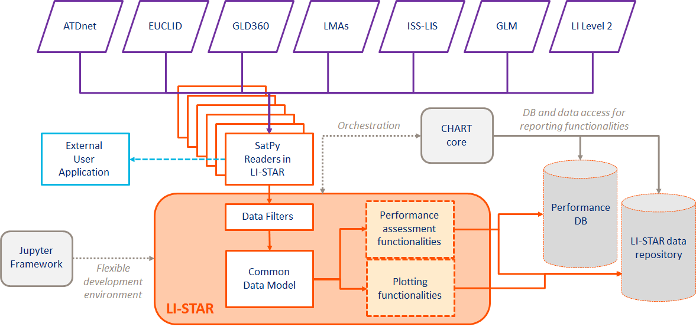
LI-STAR at a glance

Slide 6
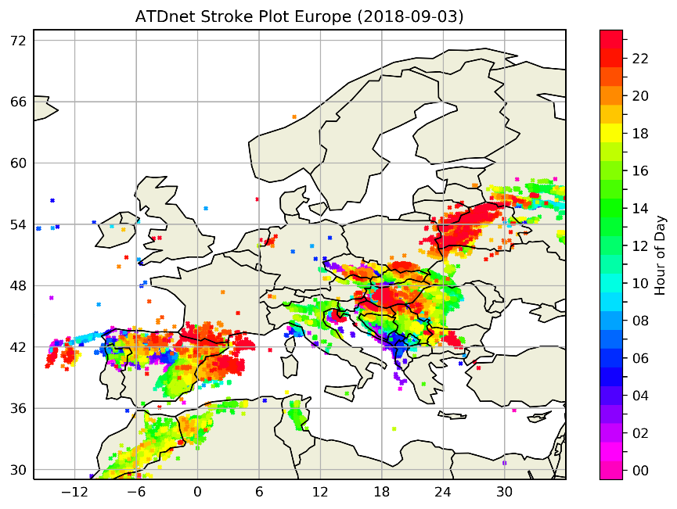
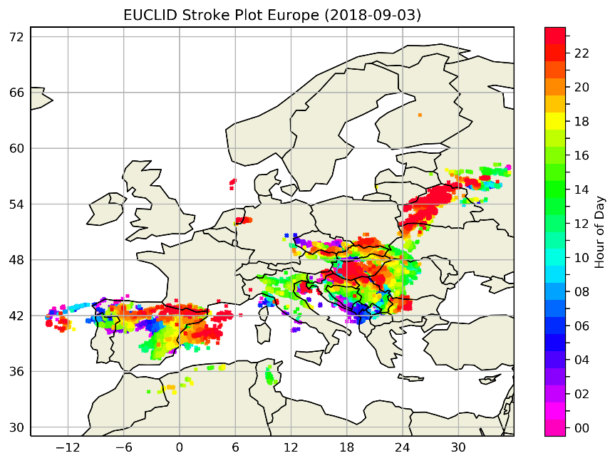
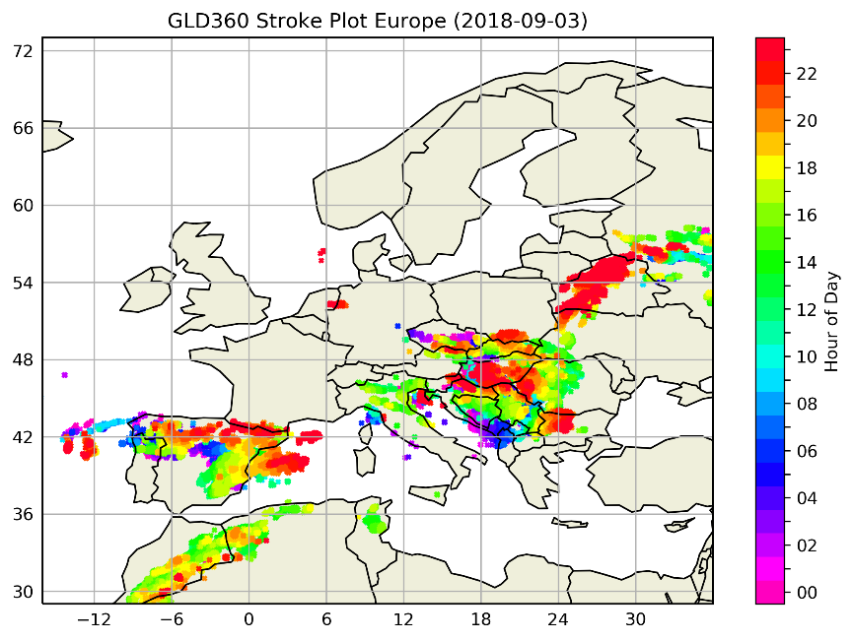
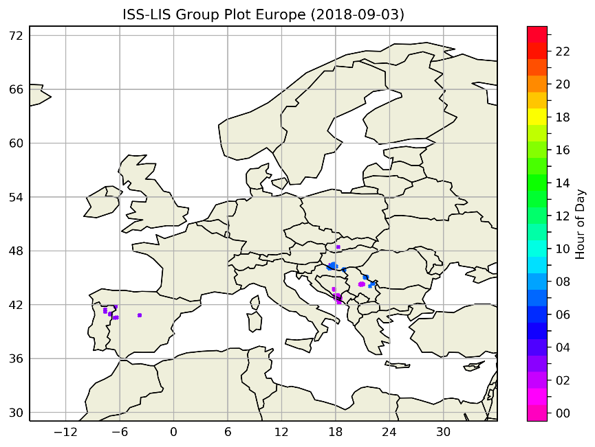
Spatiotemporal group/stroke distribution maps
Notes:
Very first consistency check.

Slide 7
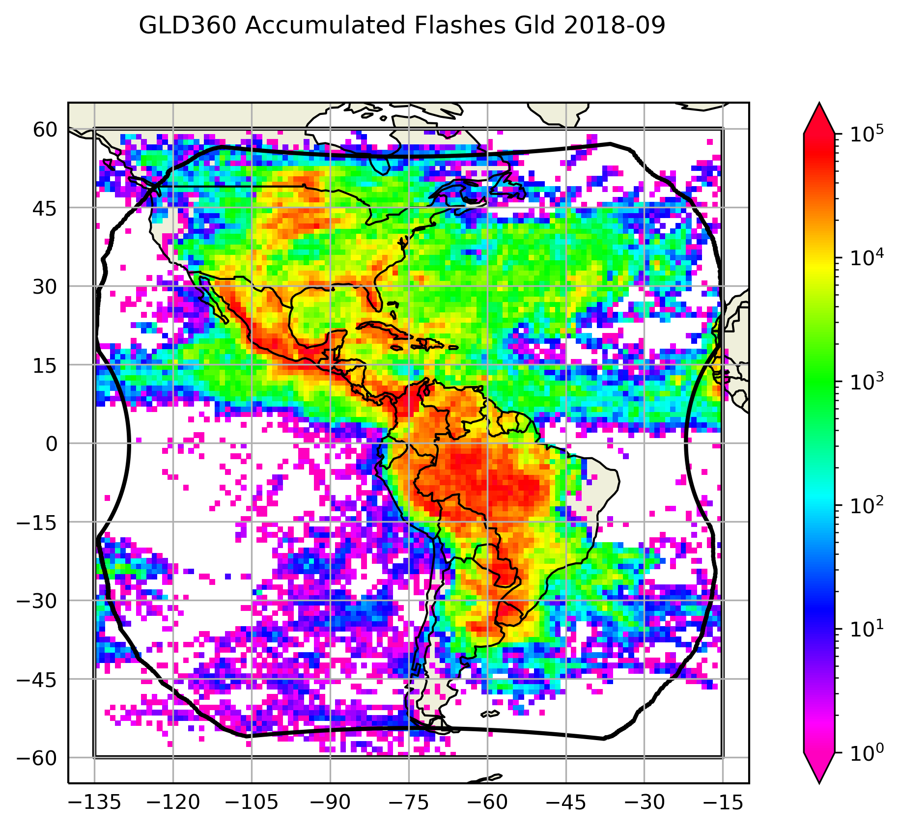
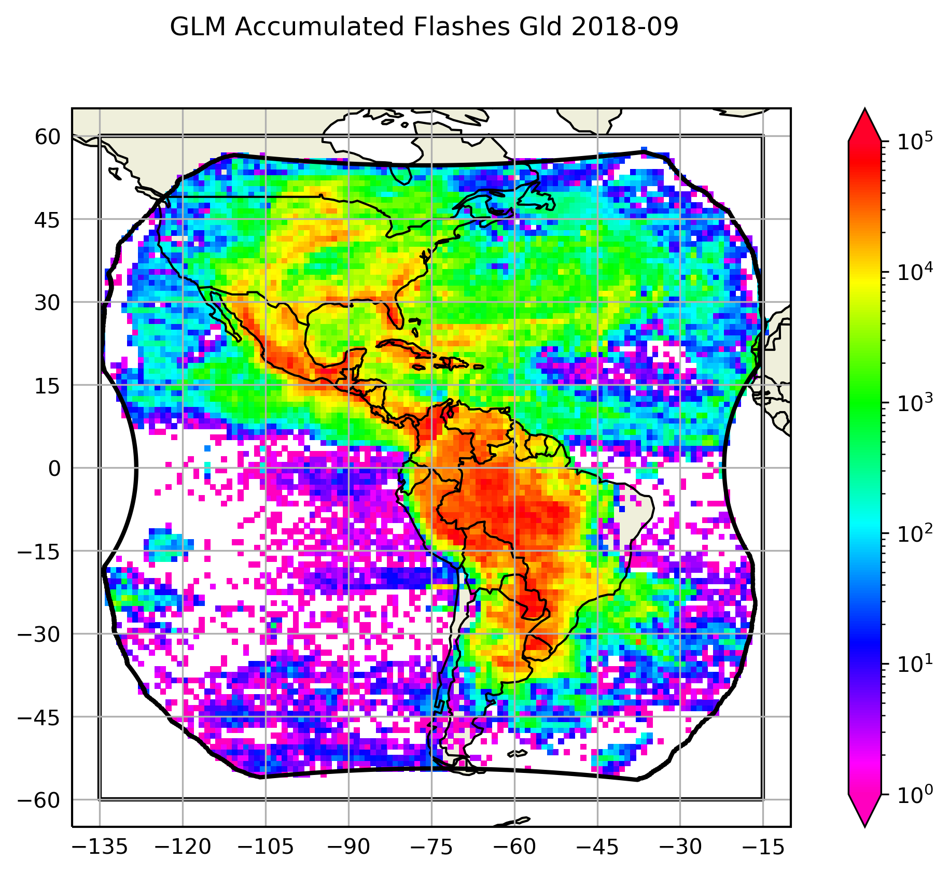
GLD360 and GLM flash accumulation (Sept. 2018)
Notes:
Very nice results given 50M+ observations from both networks.

Slide 8
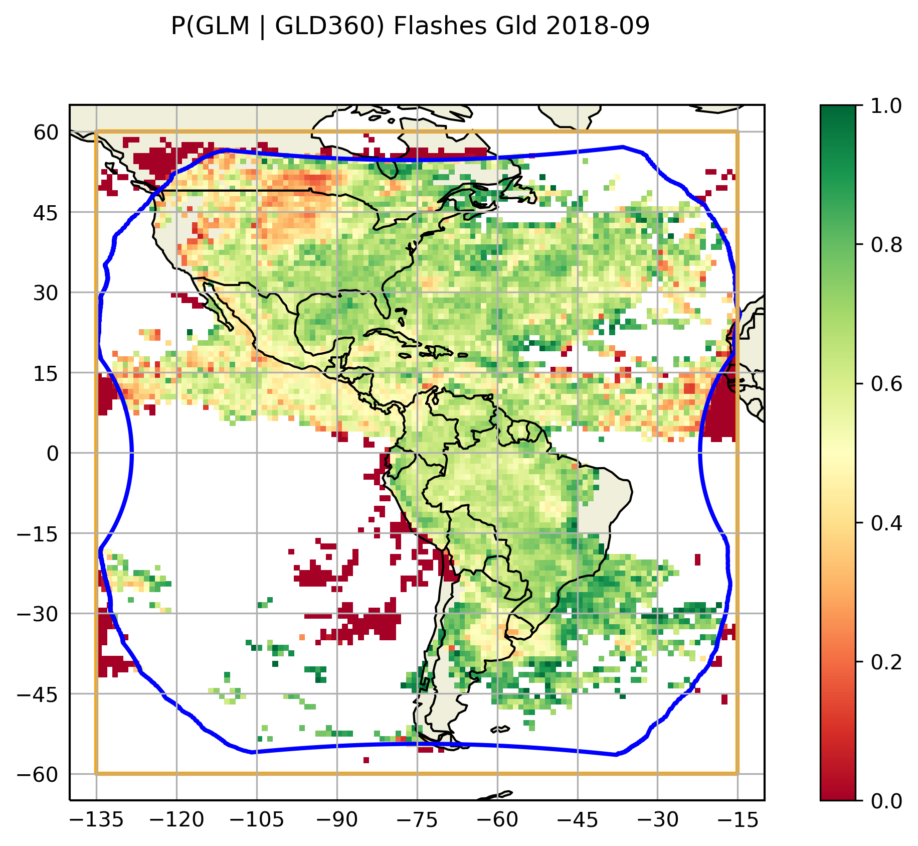
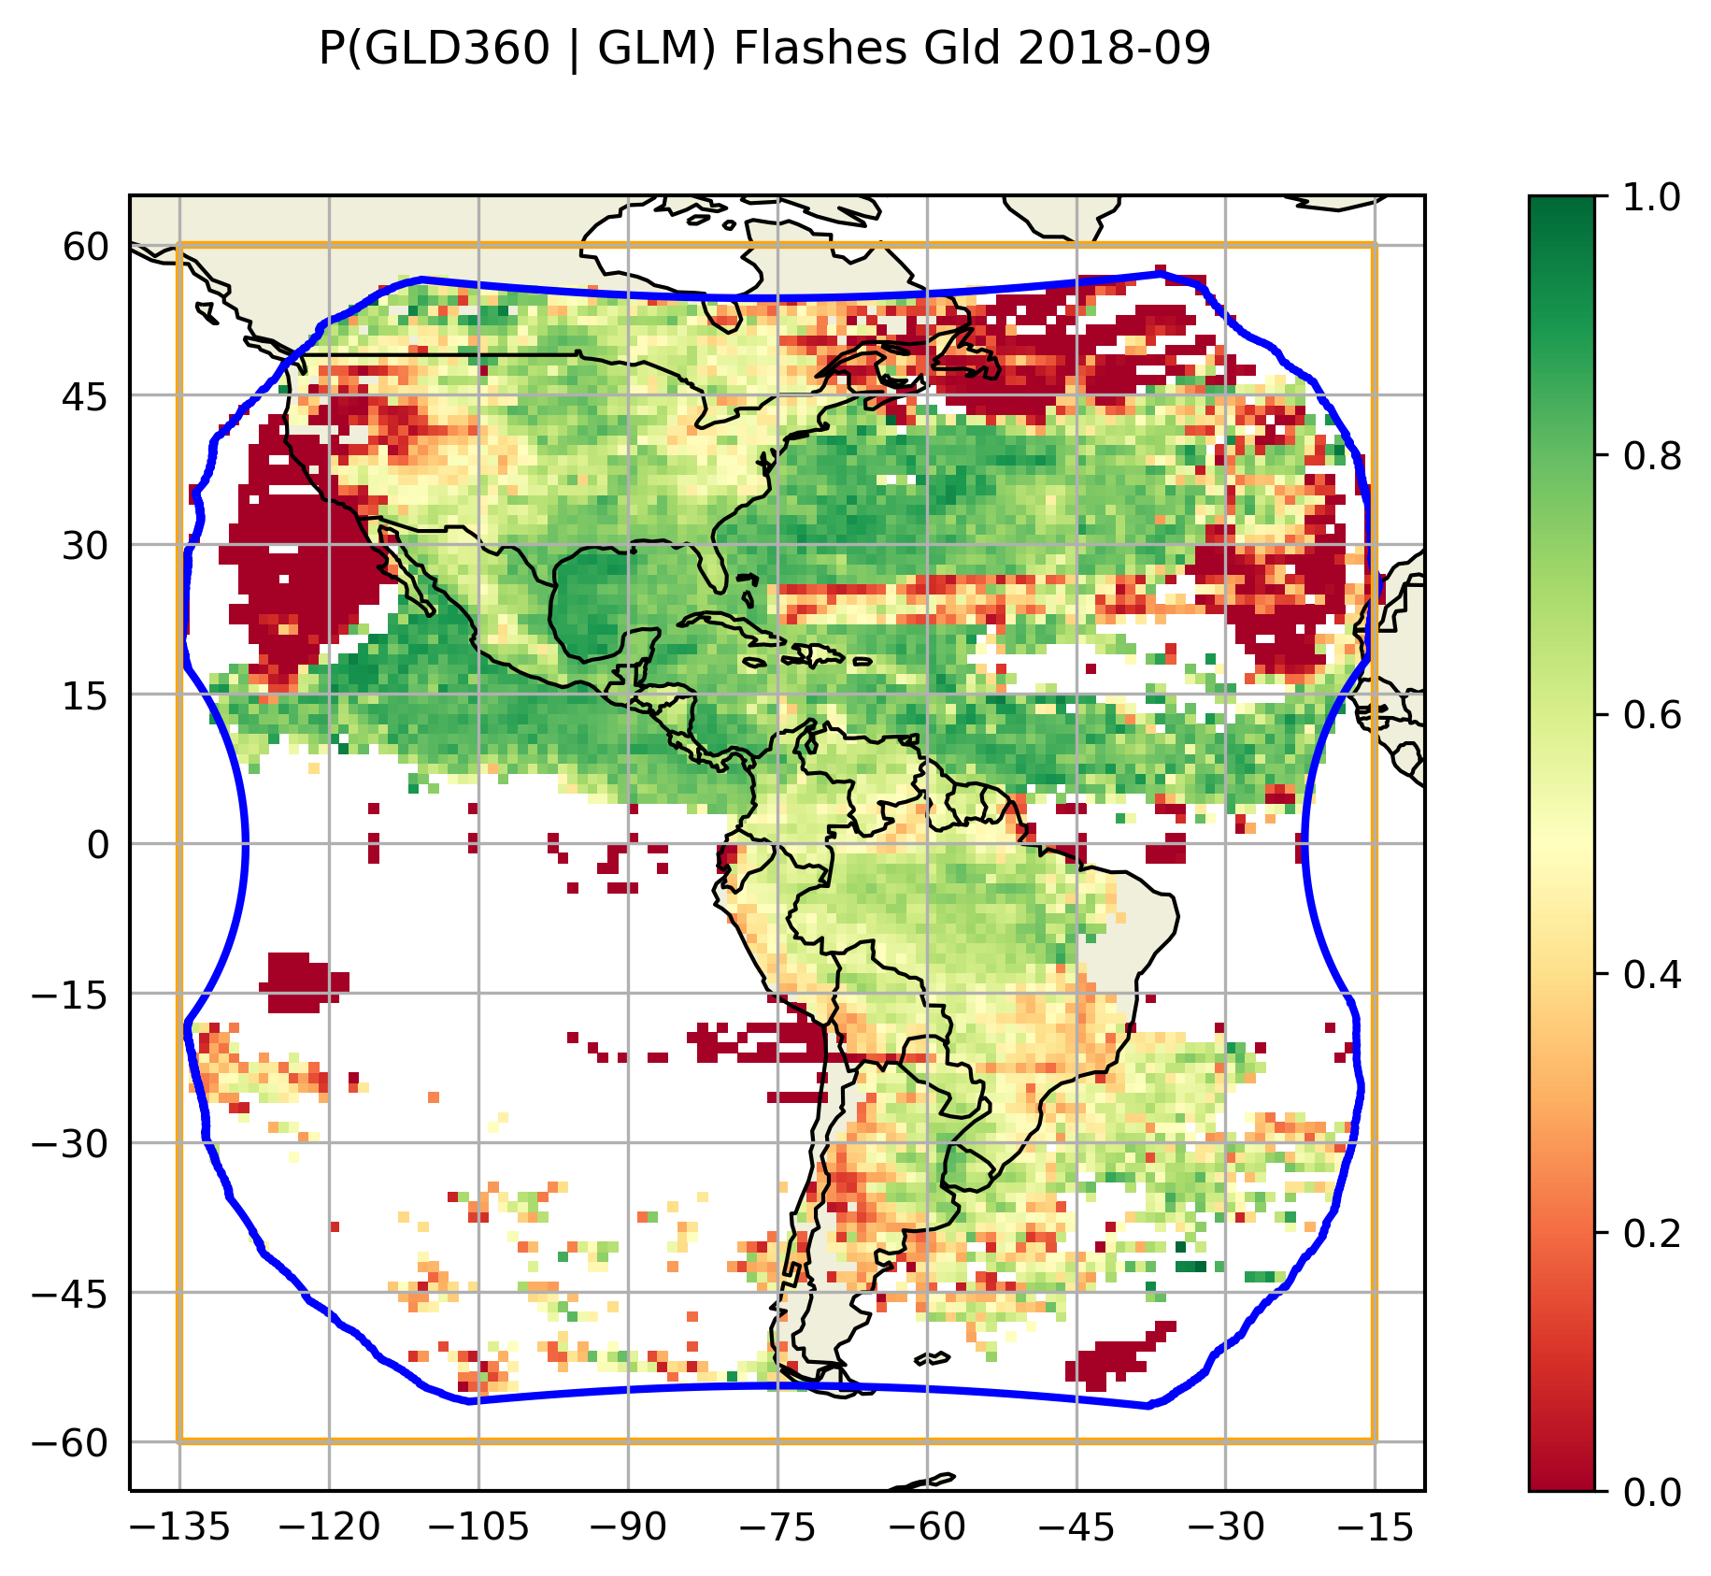
GLD360 and GLM relative flash DE (Sept. 2018)
Notes:
Here we’re using old GLM data. Has many issues that have been resolved by now. Very good for TRAINING!

Slide 9
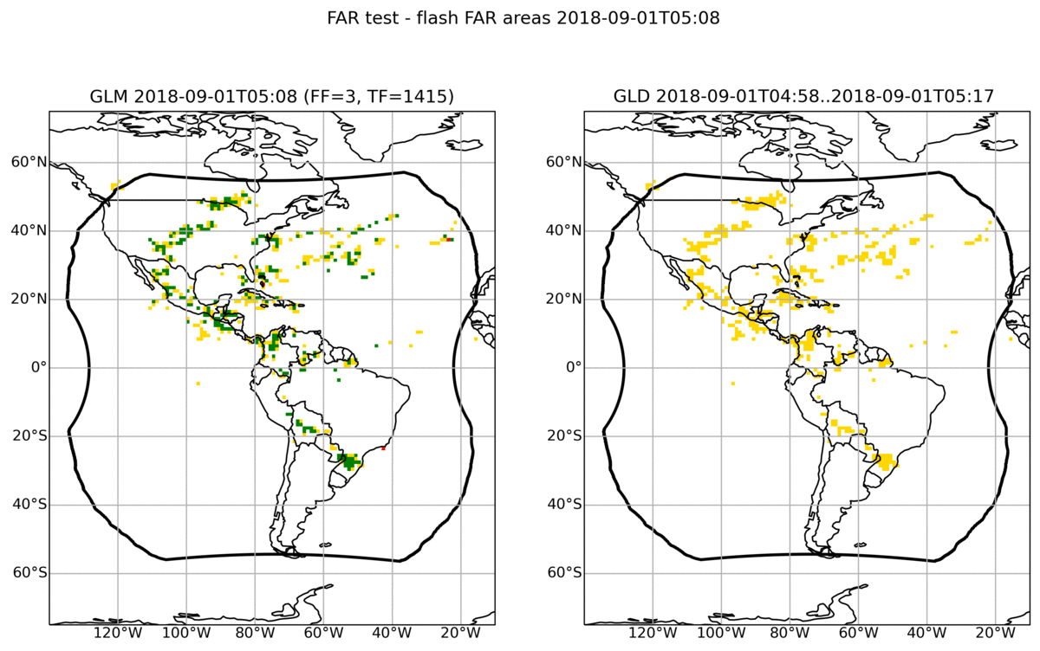
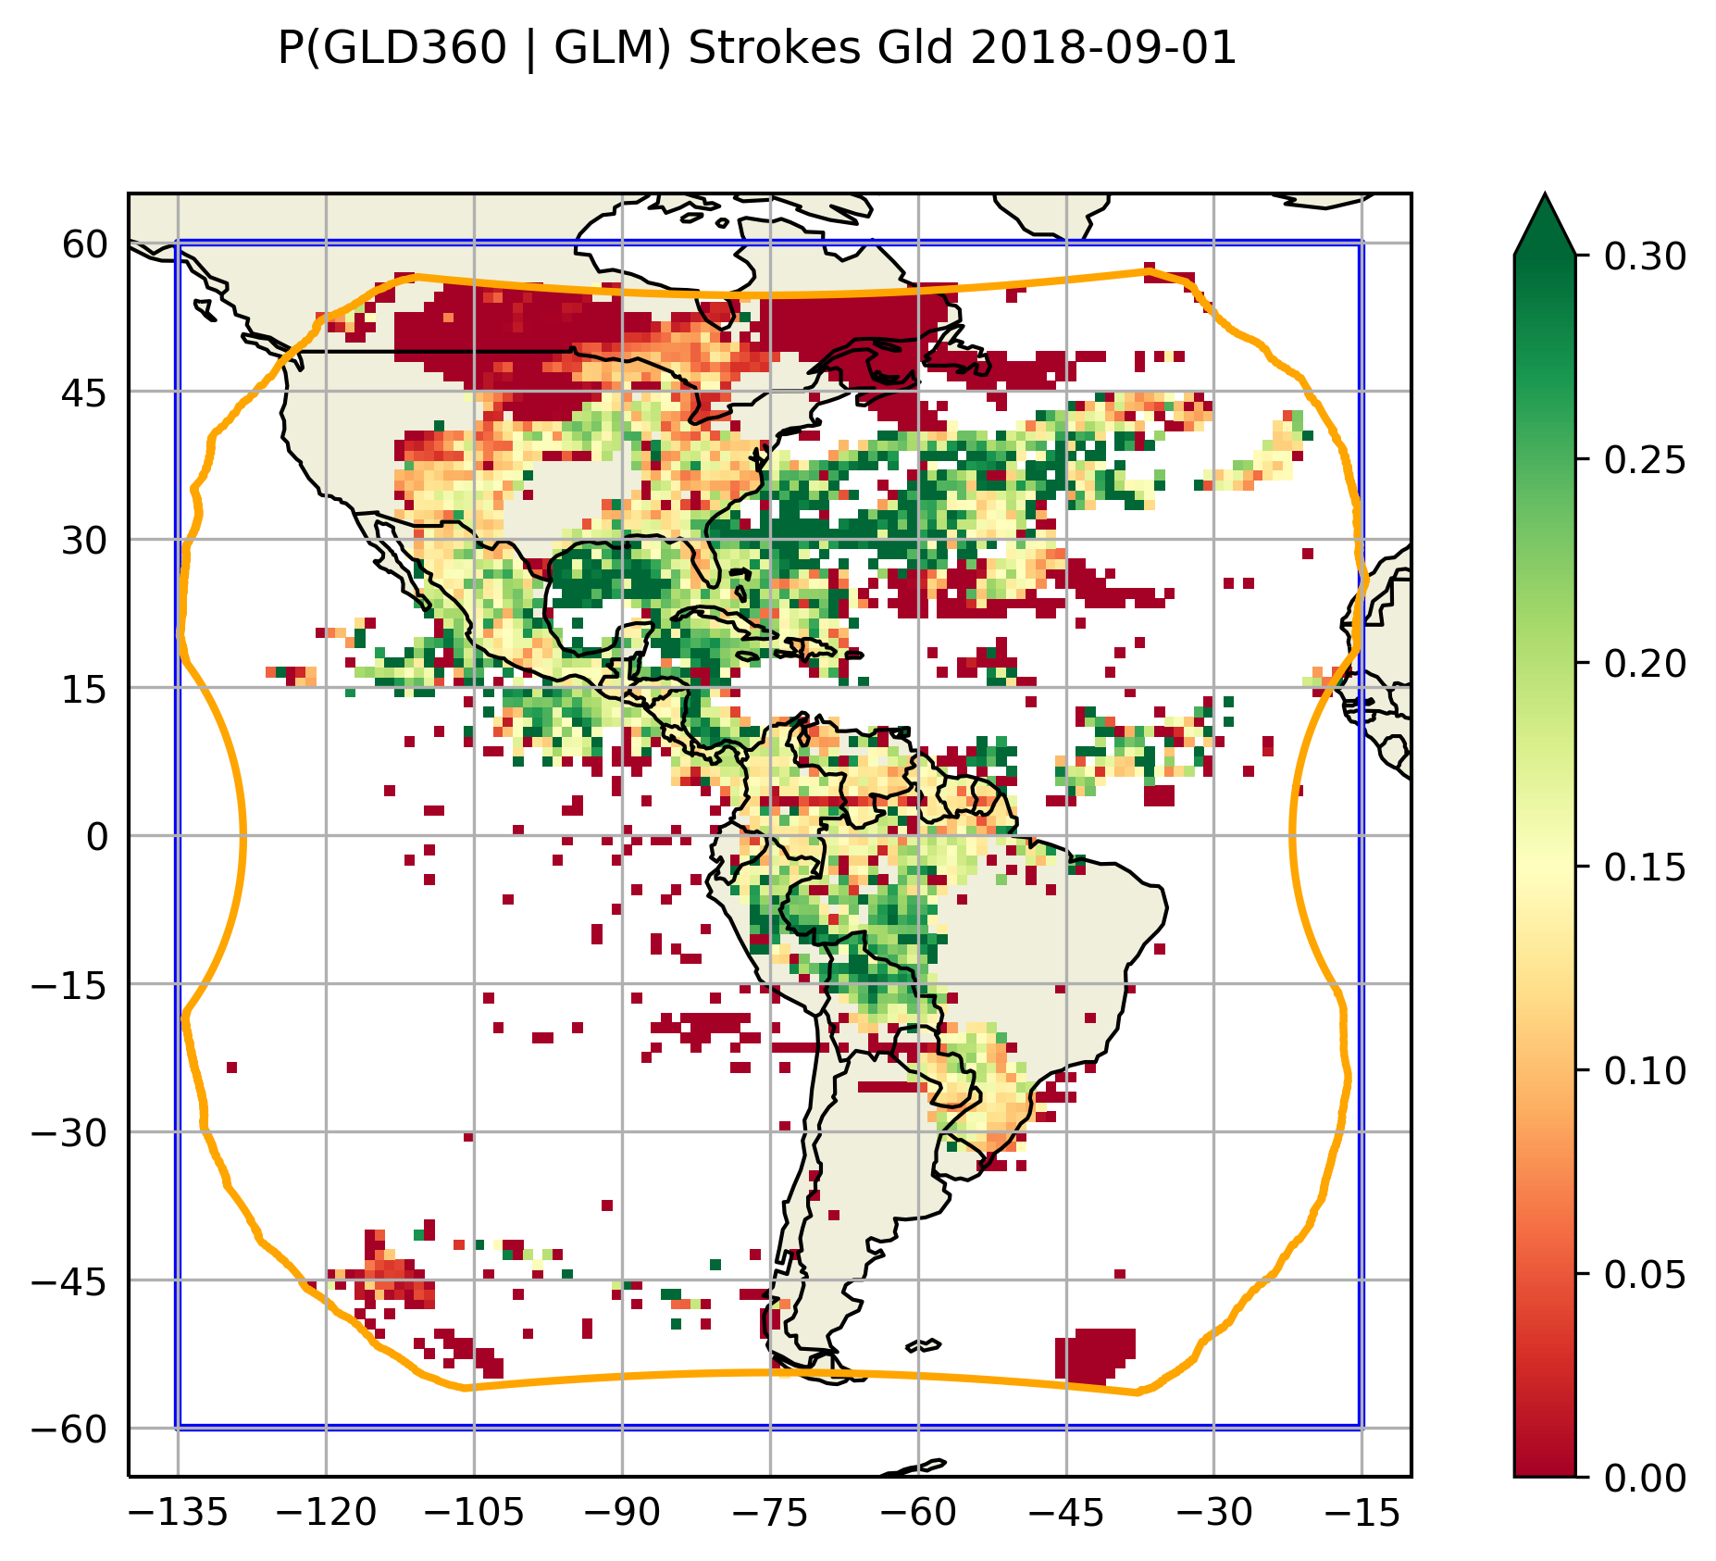
GLM FAR (Sept. 1st, 2018)
Left - GLM flash classification per grid cell relative to GLD360:
Red = GLM false alarm;
Amber = GLM miss;
Green = GLM detection.
Right - GLD360 detection efficiency relative to GLM 01/09/2018.
Notes:
This complements the explanation on the previous slide.

Slide 10
Conclusions
LI-STAR is the key tool for the assessment of the lightning detection performances of LI, i.e., DE and FAR
LI-STAR functionalities devoted to both DE and FAR computation have been already implemented and extensively tested by means operational LLS (e.g., GLM and GLD360)
Other LI-STAR functionalities worth mentioning:
Monitoring of the LI Level 2 group and flash properties
Systematic comparison of the lightning measurements of LI against other LLS (in space and time; e.g., flash rate over areas of interest)
Hourly assessment of LI DE
Assessment of the LI lightning location and timing accuracy (side-product of the matching exercise)
Monitoring of the LI radiometric performances (including a comparison against the Flexible Combined Imager VIS0.8)
Monitoring of the LI navigation performances
For more information about the LI System, LI products and LI-STAR
please check the User Preparation Webinar on MTG LI (with recordings)
https://www.eumetsat.int/mtg-resources
Notes:
List of additional features as we agreed. I don’t think there’s a time to talk in detail about any of these.

Slide 11
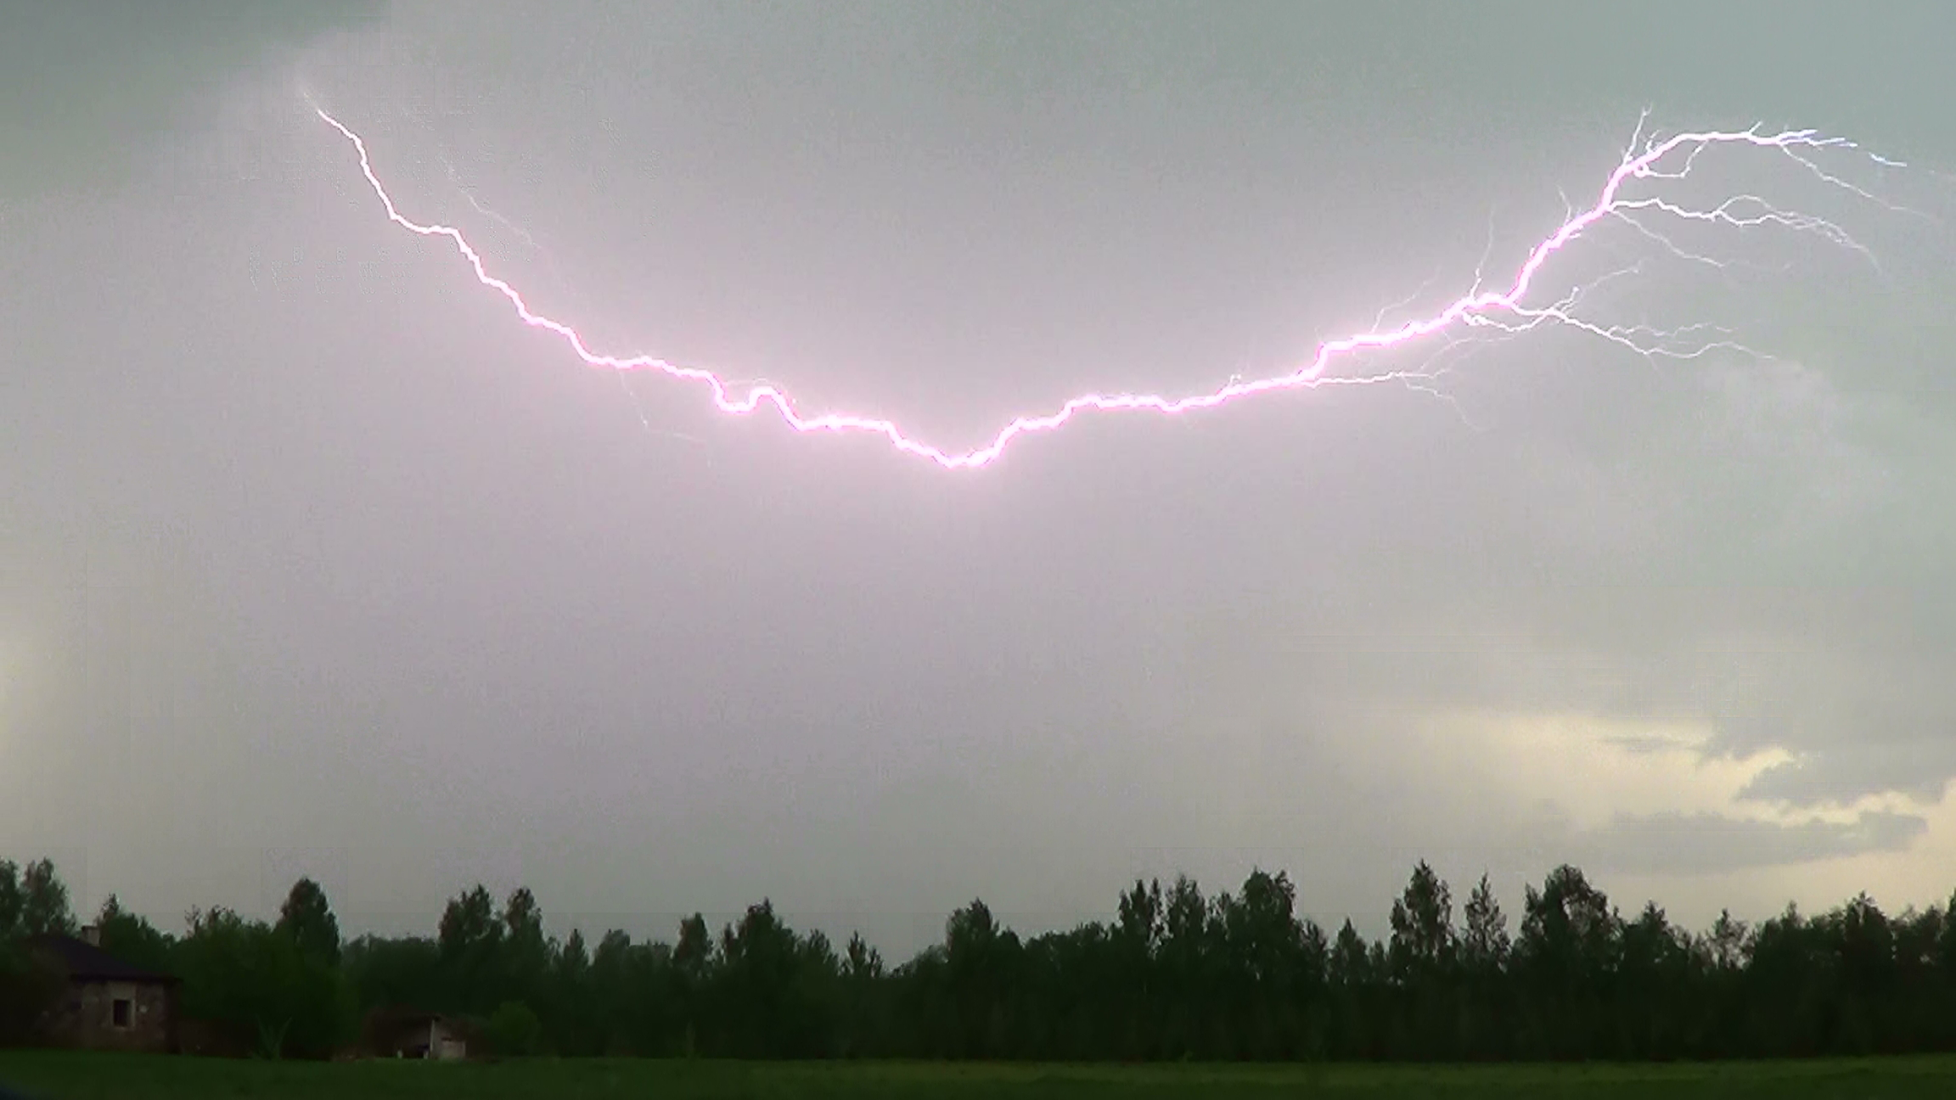
THANK YOUR FOR YOUR ATTENTION!

Slide 12
BACKUP SLIDES

Slide 13
LI-STAR Detection Efficiency (DE) assessment
MATCHING
For each reference network (e.g. GLD360) observation check for test network (e.g. LI) observations within matching time window and matching radius in space
+1
0
MATCH
This reference observation was detected by the test network
MISS
This reference observation was missed by the test network
RELATIVE DETECTION EFFICIENCY (DE): N of matches / N of reference observations * 100
e.g. if GLD360 observed 100000 flashes and LI detected 75000 of them then LI DE relative to GLD360 ( P(LI|GLD360) ) is 75%
Notes:
This is a bit simplified version of what I had in the previous presentations.

Slide 14
LI-STAR False Alarm Rate (FAR) assessment
LI-STAR assesses the FAR of without direct matching between the test data and the reference system. Two techniques are combined:
Gridding. It is much faster to compare two networks if the large datasets are gridded (compared to direct matching).
Time integration. Gridding the reference observations over a longer period of time makes weaker storms more likely to appear on the reference grid.
RNIW
TNIW
Time [min]
Test network observations are accumulated on a spatial grid over the Test Network Integration Window (TNIW, e.g. 1 min)
Reference network observations are accumulated on the same grid over the Reference Network Integration Window (RNIW >> TNIW; e.g. 20 min)
For the assessment over sequences of minutes, both windows are shifted forward by 1 minute.
Notes:
Tried to squeeze the technical side of FAR to one slide. I think it covers all the important bits.

