Slide 1
GLM and STARNET & LINET in Brazil
Carlos Augusto Morales
Universidade de São Paulo
http://www.starnet.iag.usp.br
carlos.morales@iag.usp.br
2021 GLM Science Meeting – Sept 22 2021

Slide 2
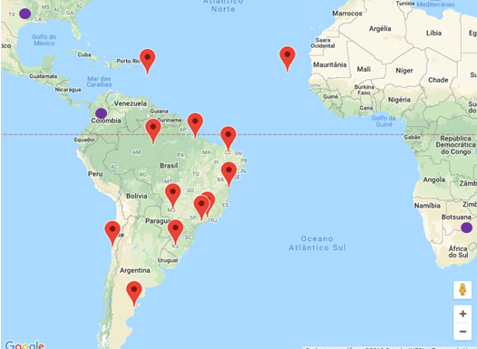
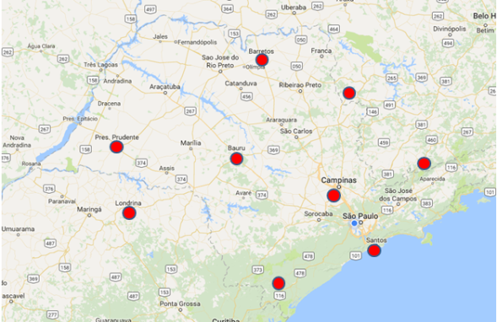
Ground Validation Dataset
STARNET - VLF LONG RANGE LIGHTNING DETECTION NETWORK IN SOUTH AMERICA
13 SENSORS
LOCATION ACCURACY: 2-5 km
DETECTION EFFICIENCY: 30-39% Strokes and 50-70% Flashes.
LINET - VLF/LF Total lightning detection system
9 SENSORS - STATE OF SÃO PAULO
LOCATION ACURRACY: 0.5-2 km
DETECTION EFFICIENCY: Estimated: 80-90% CG - 30% IC strokes
Cooperation with DLR+NOWCAST
Analysis
Time of maximum lightning activity
Diurnal Cycle
Thunderstorms with low IC

Slide 3
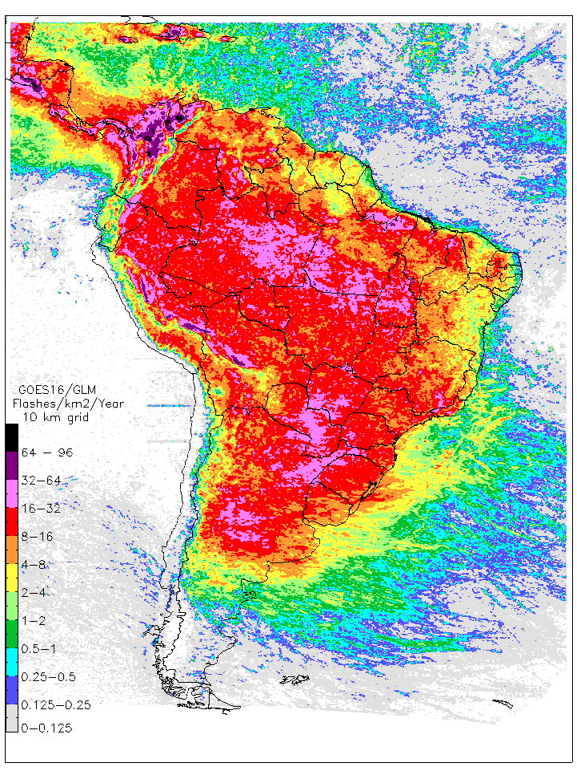
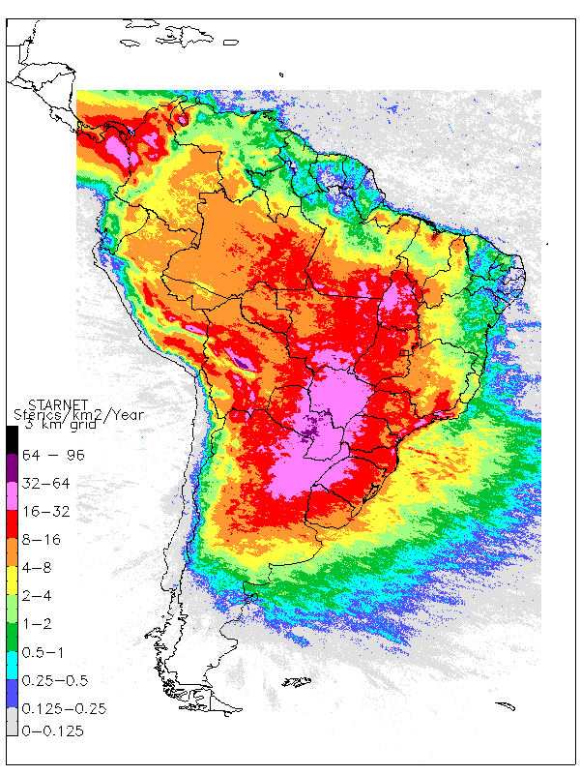
Annual Activity: 0.1ºx0.1º
2020 GLM-GOES16
2012-2018 STARNET

Slide 4
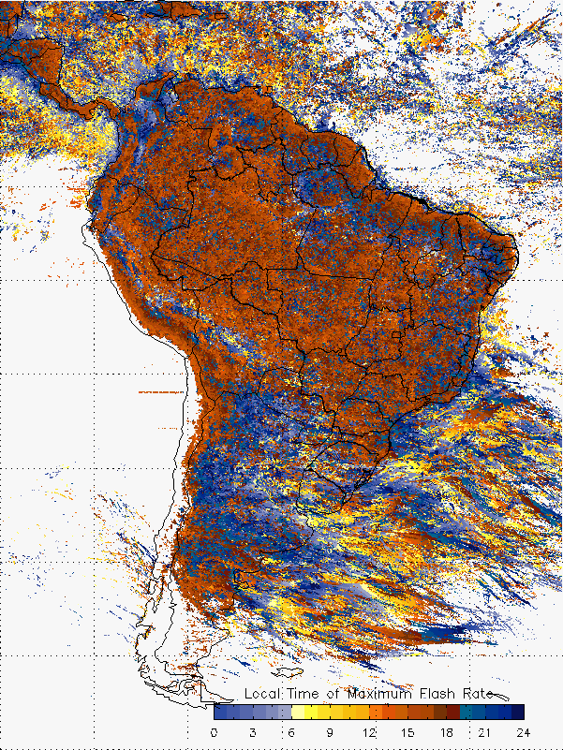
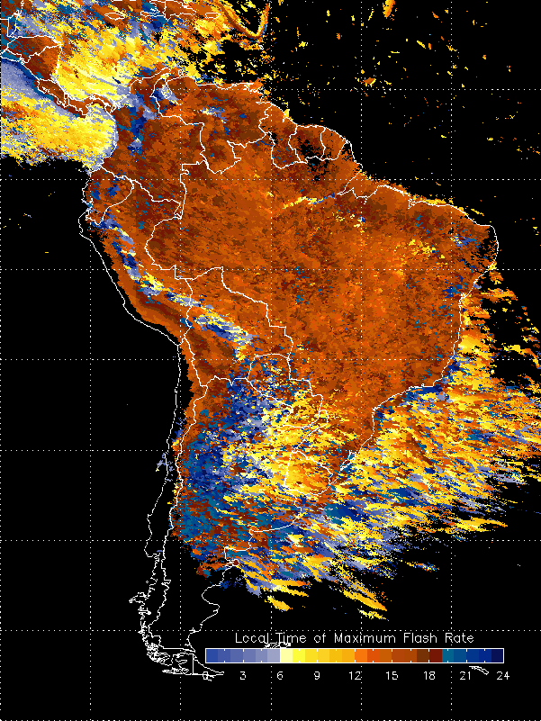
Time of Maximum Activity: 0.1ºx0.1º
2020 - GLM-GOES16 STARNET: 2012-2018

Slide 5
Time of Maximum Activity: 0.1ºx0.1º
2020 - GLM-GOES16 STARNET: 2012-2018
Maracaibo
Manaus

Slide 6
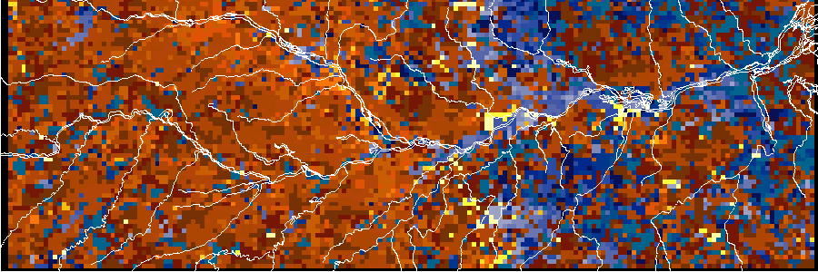
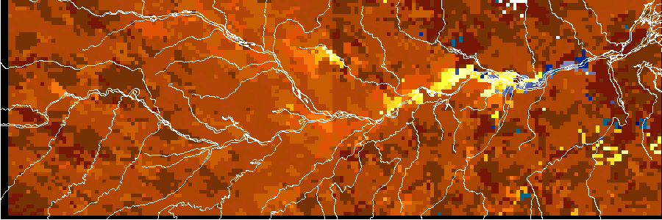
Time of Maximum Activity: Manaus
2020 - GLM-GOES16
STARNET: 2012-2018
Manaus

Slide 7
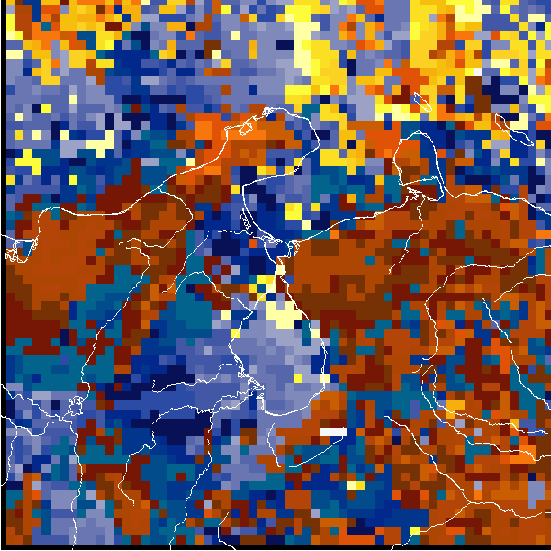
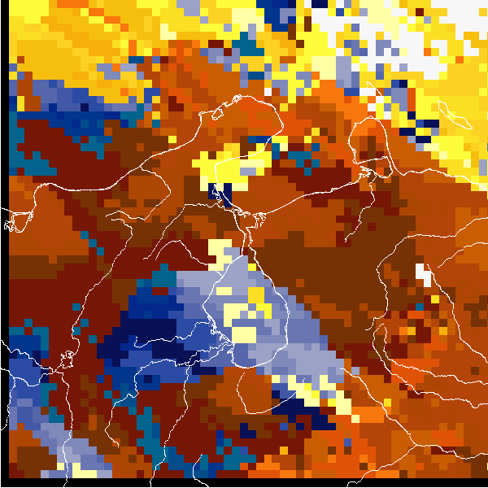
Time of Maximum Activity: Maracaibo
2020 - GLM-GOES16 STARNET: 2012-2018
Manaus

Slide 8
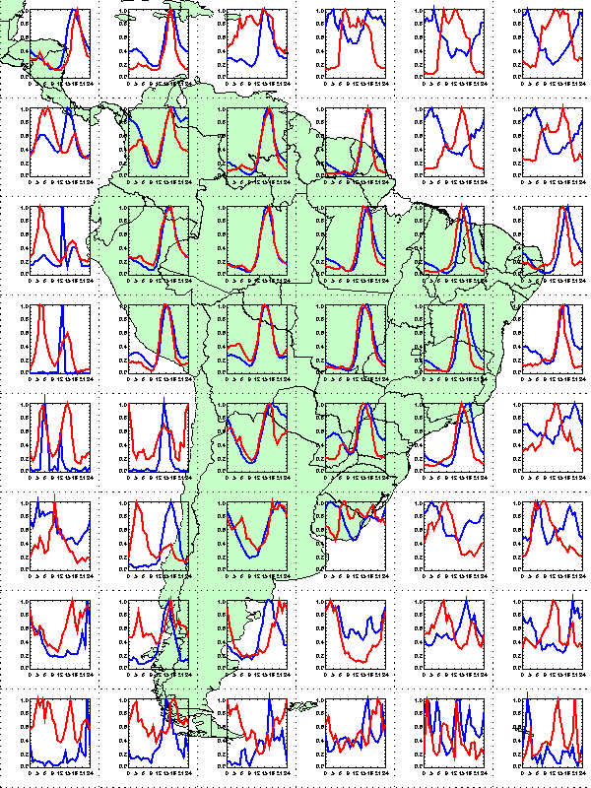
Diurnal Cycle 10ºx10º GLM-2020 STARNET: 2012-2018
Manaus

Slide 9
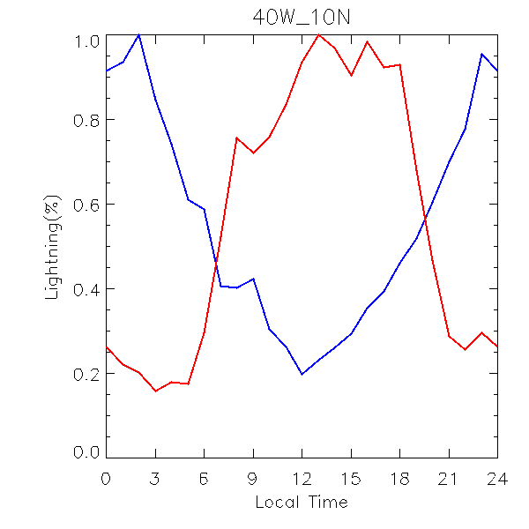
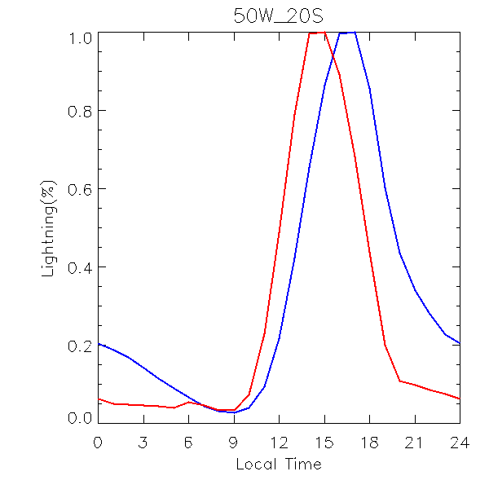
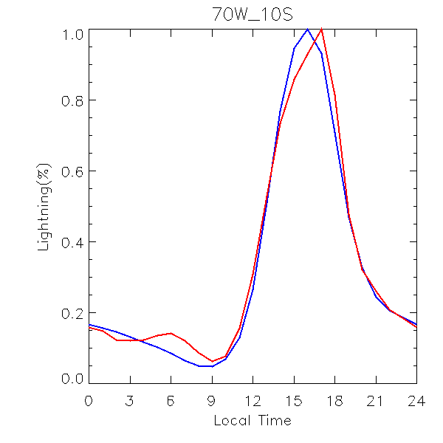
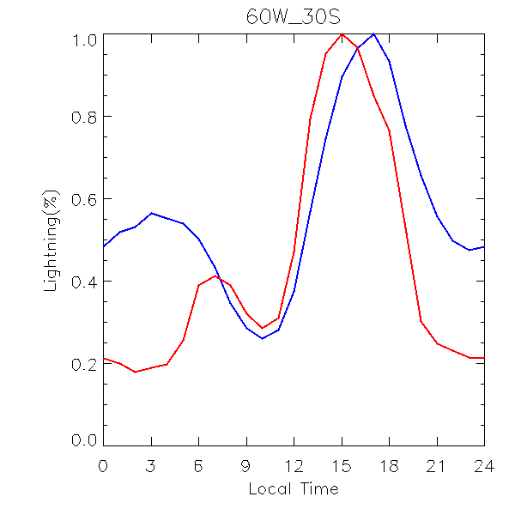
Diurnal Cycle 10ºx10º GLM-2020 STARNET: 2012-2018

Slide 10
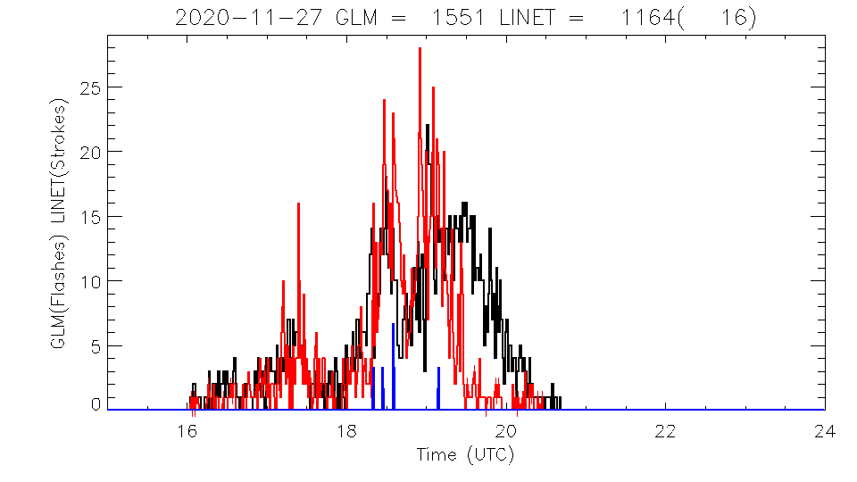
GLM & LINET: São Paulo Area
GLM
LINET-Total
LINET-IC

Slide 11
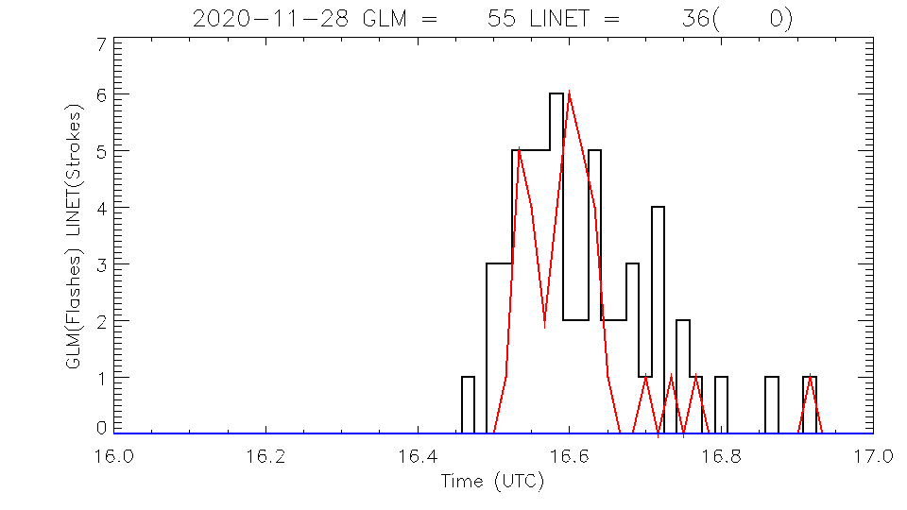
GLM & LINET: São Paulo Area
GLM
LINET-Total
LINET-IC

Slide 12
Thanks
carlos.morales@iag.usp.br

