Slide 1
Comparing FEGS, LIS, and GLM to Advise Future Lightning Imager Design
Mason G. Quick
NASA Marshall Space Flight Center
GLM Science Meeting
September 22, 2021

Slide 2
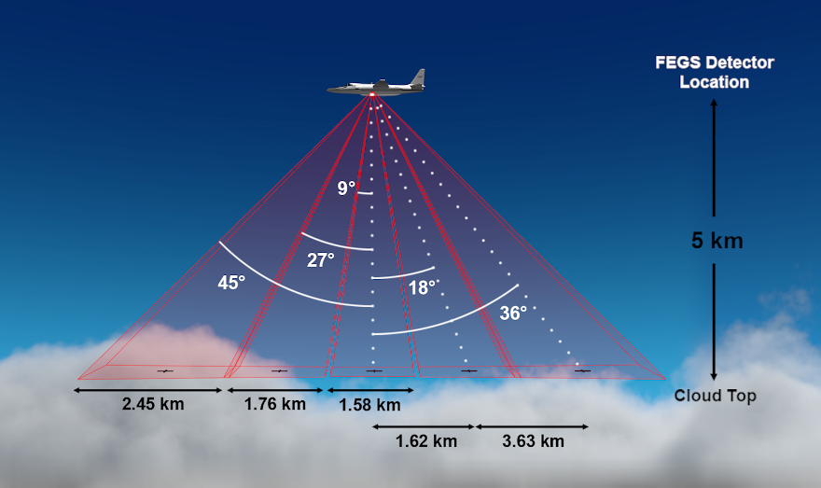
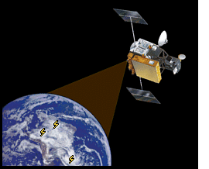
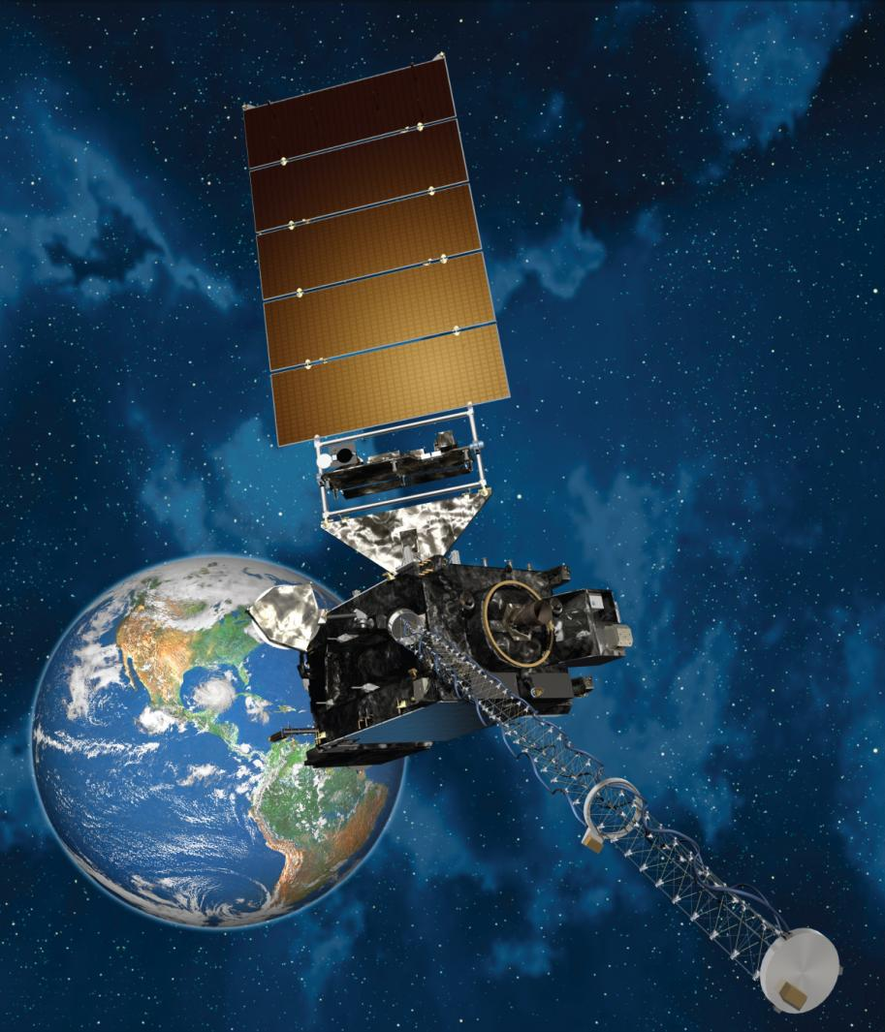
Introduction
Fly’s Eye GLM Simulator (FEGS)
Lightning Imaging Sensor (LIS)
Geostationary Lightning Mapper (GLM)

Slide 3
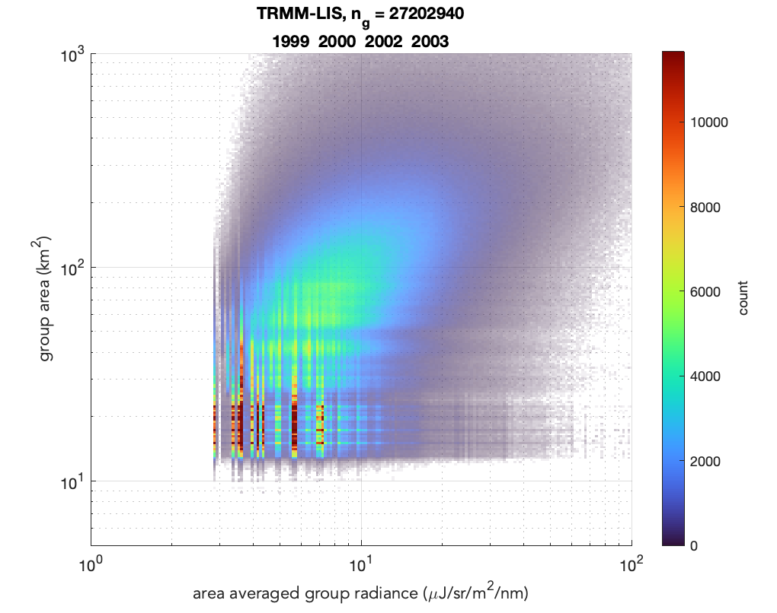
Introduction
Radiance and Area Joint Distributions
4 years of TRMM-LIS data
Quantization artifacts observed in low end
Source size same scale as pixel footprint
Radiance quantization steps are significant
TRMM-LIS data cannot determine low amplitude shape of source distributions
important for estimating the detection efficiency
FEGS provides a more sensitive measurement
combine FEGS + LIS distributions to get precise measure of full range of lightning emission sources.

Slide 4
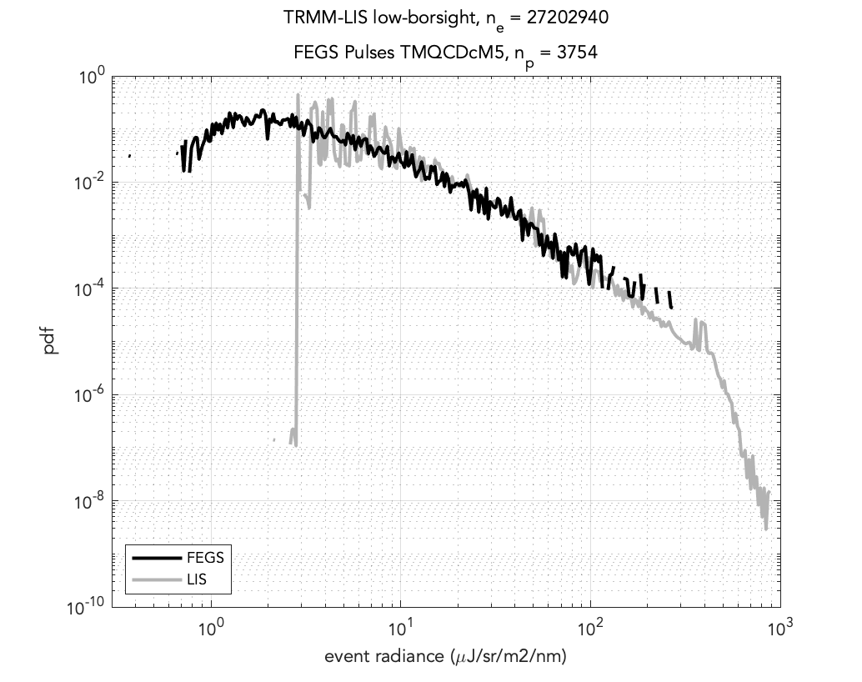
FEGS vs LIS Event Radiance PDF
FEGS pulses <5km offset from a VLF location
Excellent agreement in probability of detecting radiance between 10-100 uJ
This decade includes 34% of LIS events and 29% of FEGS pulses.
Below 10 uJ (65% of LIS events and 70% of FEGS pulses) LIS radiance quantization artifacts
FEGS measurements do not suffer quantization errors
FEGS radiance PDF peak at 1.9 uJ, less than the LIS sensitivity cutoff of 2.6uJ
The two distributions agree remarkably well over the range of values detectable by both instruments.

Slide 5
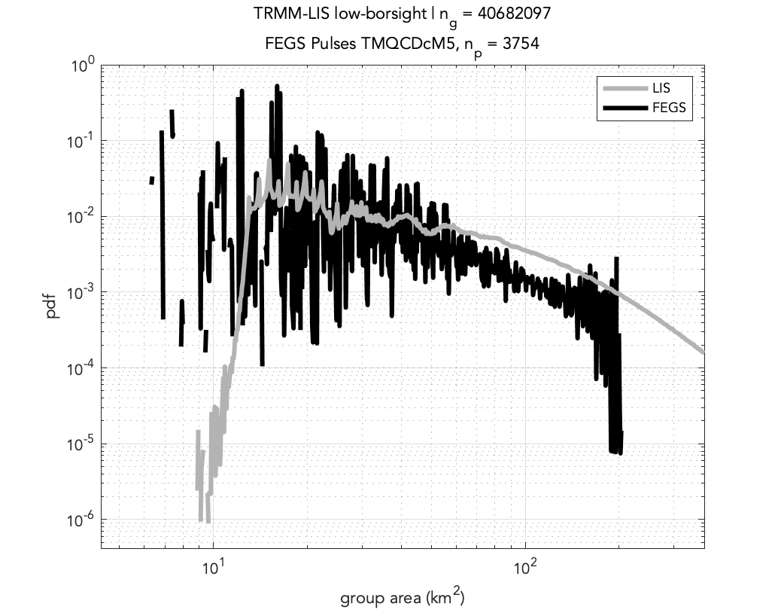
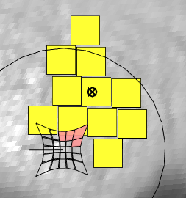
FEGS vs LIS: Group Area
Quantization artifacts when source size similar to pixel size
Peaks in LIS PDF near integer multiples of pixel footprint area
Although FEGS observes sources that are smaller than the LIS resolution limit, the FEGS spatial resolution is not dramatically better.
Variability in the FEGS PDF likely due to low sample population (10 or 100 pulses per bin), but also due to FEGS area quantization. Statistics are weak and we need more flights/observations.
There is a vertical offset between the two PDFs. This may be caused by FEGS systematic bias toward underestimating group area. The entire distribution will be compressed toward small values.

Slide 6
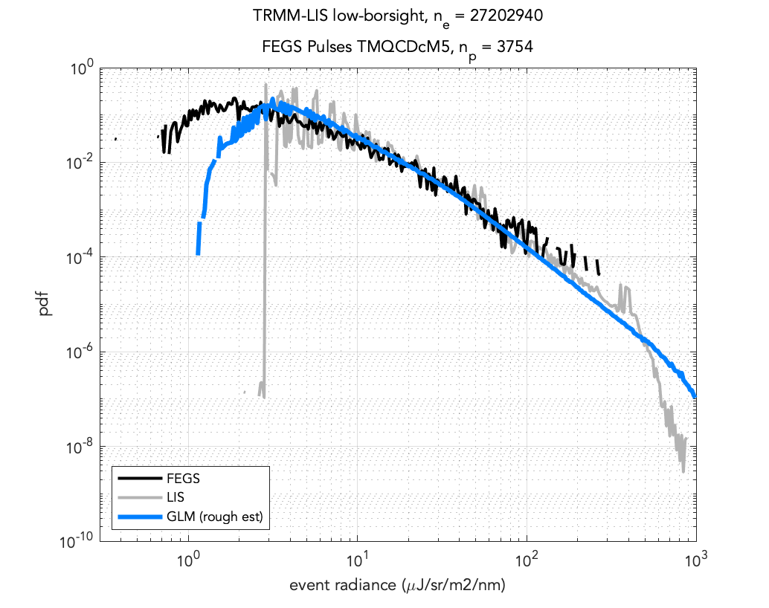
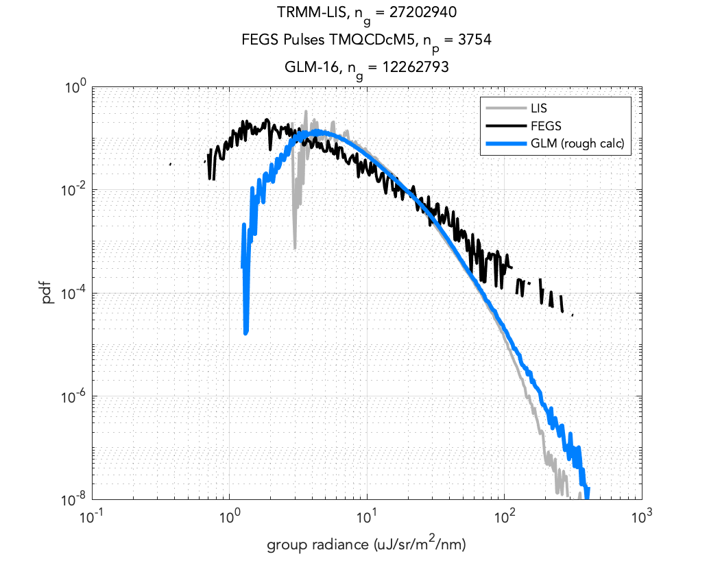
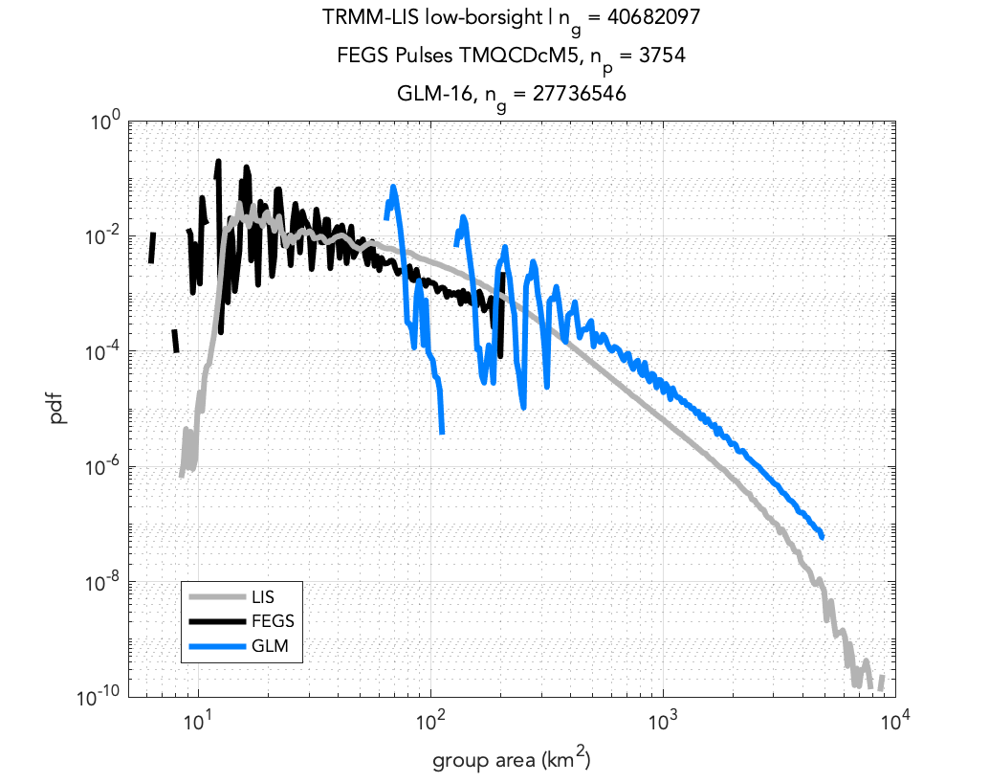
GLM spatial sampling
artifacts
Adding GLM
A rough estimation has been used to convert GLM pixel energy to cloud-top radiance. The estimation assumes:
A constant pixel area
The source lies on the GLM optical axis
Ignores Earth curvature
Radiance Distributions agree remarkably well, except for at the extremities of the observed range.
Group Area distributions problematic

Slide 7
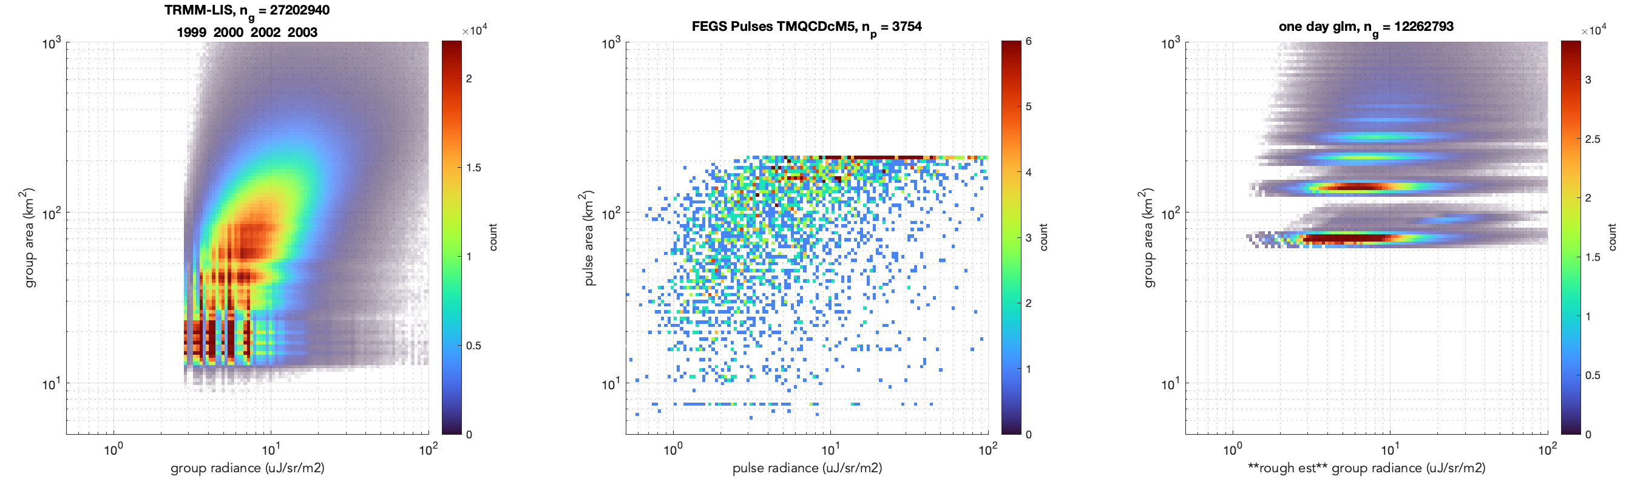
2D Joint Distributions @ 50 bins-per-decade
LIS
close to a complete measurement but limited by resolution
FEGS
helpful for low amplitude end but need more measurements
GLM
coarse resolution

Slide 8
Summary
Both LIS + FEGS observations indicate significant number of small/dim optical sources
FEGS can be used to resolve low end of area/radiance distributions but currently has limited sample set
FEGS FOV limits ability to quantify large area source radiance
Need for space-based imager with high spatial resolution and high sensitivity: CubeSpark

Slide 9
end

Slide 10
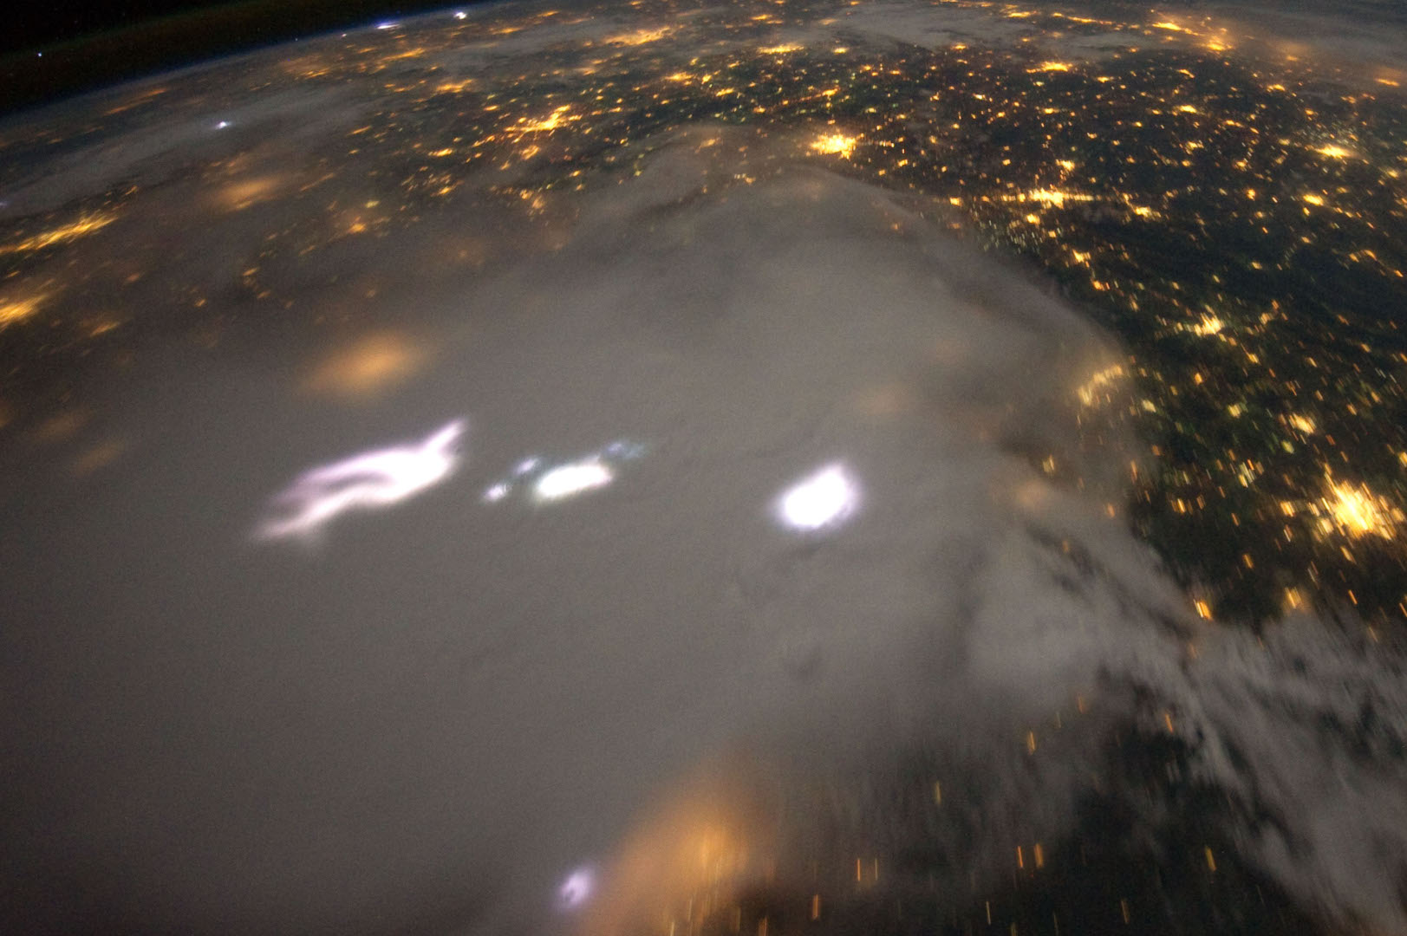
Introduction
Background
Satellite lightning imagers detect the cloud-top optical emission from lightning. The lobes of illumination produced vary in brightness (radiance) and size/shape (area).
The image to the left is a digital camera image from the ISS showing a thunderstorm over north America.
Note the variation in size of the lightning illumination. Area and radiance vary over 2-3 orders of magnitude.

Slide 11
Introduction
Zhang and Cummins [2020] model demonstrates how spatial resolution relative to source size affects distribution of events-per-group in the TRMM-LIS
Groups of 1-2 events are likely smaller than a LIS pixel (point source)
Groups of 3-4 events are likely ~same size as pixel (fuzzy source)
Groups of >4 events are likely bigger than LIS pixel (extended source)
conclude that a large percentage (39% in the first 6ms of a flash and 25% afterward) are smaller than a pixel footprint
A look at the distribution of events-per-group in a test dataset [2002+2003] gives the following percentages
1-event: 24%
2-events: 17%
3-events: 10%
4-events: 12%
>4-events: 36%
51% of groups are smaller than the footprint of a single pixel (1-3 events)
Note that 3- and 4-event groups make up a similar percentage of the population, which has been determined by Zhang and Cummins [2020] to be the signature of sub-pixel area sources

Slide 12
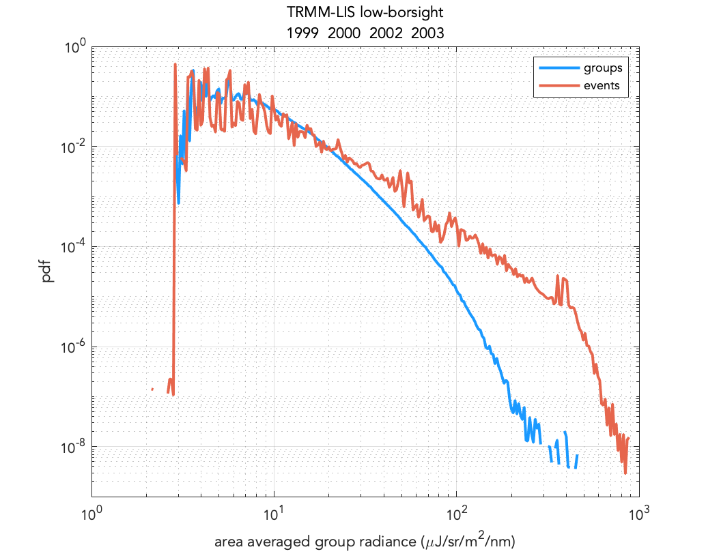
LIS Event vs LIS Group Radiance PDFs
group radiance PDF is weighted toward small values
more common dim events will pull the spatially averaged radiance down from the peak
Result of the spatially variant cloud-top radiance in each group.

