Slide 1
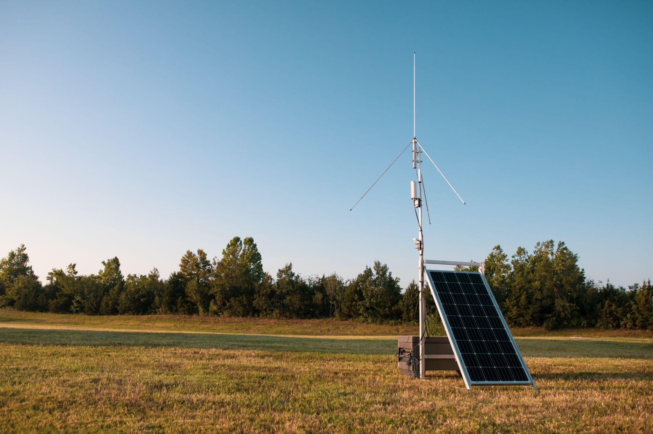
Plans for targeted NSSL Lightning Mapping Array deployments
Vanna Chmielewski^{1,2}, Vicente Salinas^{1,2}, Kristin Calhoun², Doug Kennedy², Zachary Barney², Eric Bruning³, Kelcy Brunner³ Jacquelyn Ringhausen⁴
¹ University of Oklahoma Cooperative Institute for Mesoscale Meteorological Studies
² NOAA / OAR National Severe Storms Laboratory
³ Texas Tech University
⁴ University of Alabama Huntsville

Slide 2
Overview
8 solar-powered LMA sensors + full spare
Automated location checks and logging on boot. Deployment constraints:
Driving time between sites
Number of teams deploying sensors
Standard 1-min LMA solutions in real time in cell coverage

Slide 3
VORTEX-SE & PERiLS
VORTEX-SE: Verification of the Origins of Rotation in Tornadoes Experiment-Southeast (2016-2018 focused on N. Alabama)
PERiLS: Propagation, Evolution and Rotation in Linear Storms
March 1 - April 30 2022
February 8 - May 8 2023
Targeted observations (~8 IOPs) of tornadic quasi-linear convective systems (QLCS) in the southeast U.S.

Slide 4
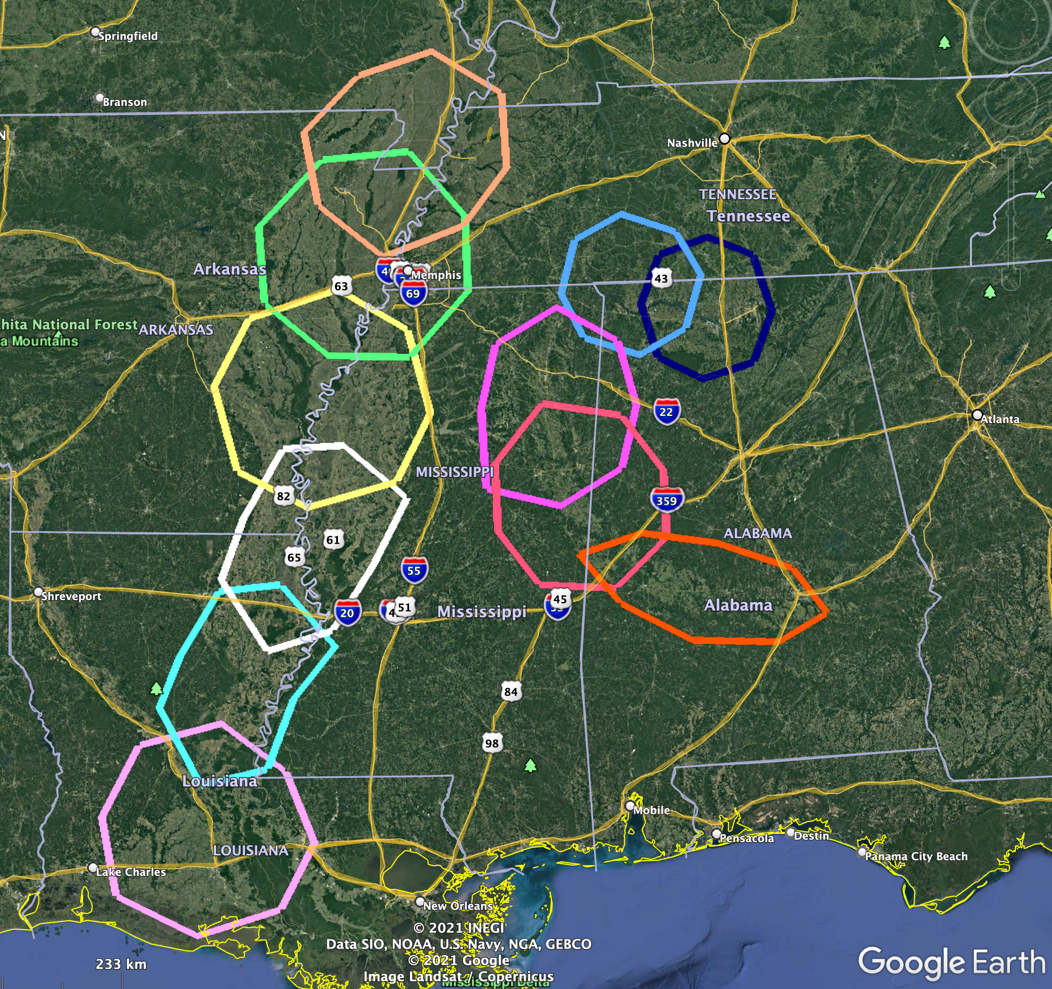
11 pre-determined observation domains
Other observations:
Radars
Surface disdrometers
Surface observations (mobile mesonets, TTU sticknets, UIUC pods)
Soundings
Profilers
UAS
Notes:
Should the domains be labeled? Maybe a small legend or something?

Slide 5
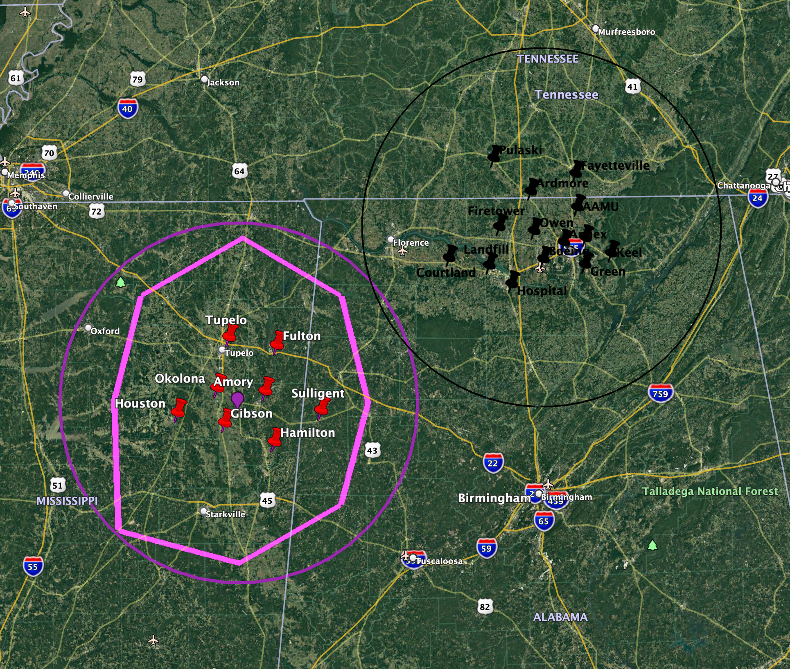
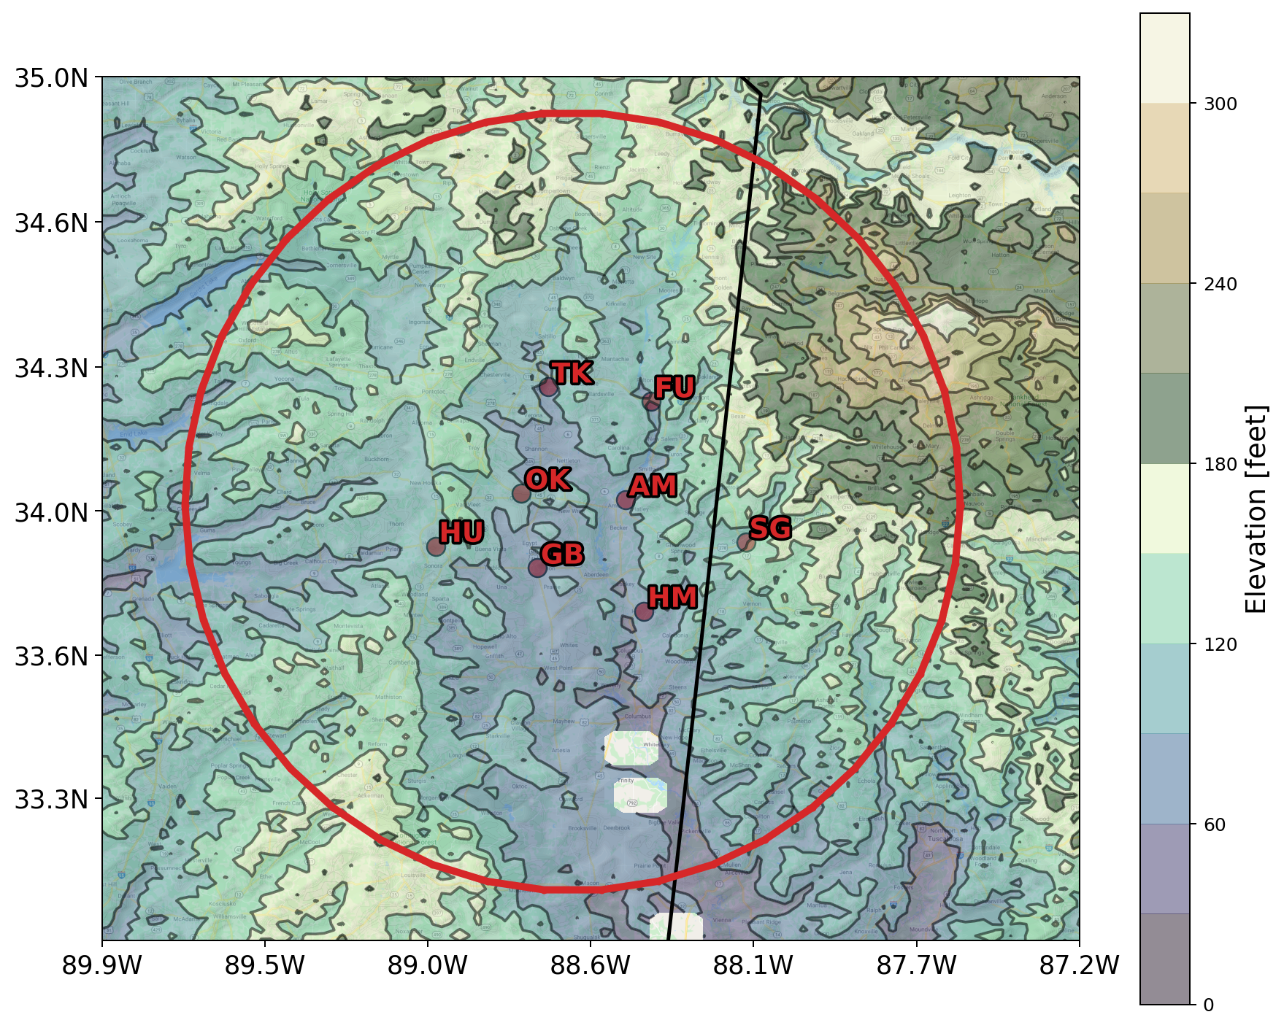
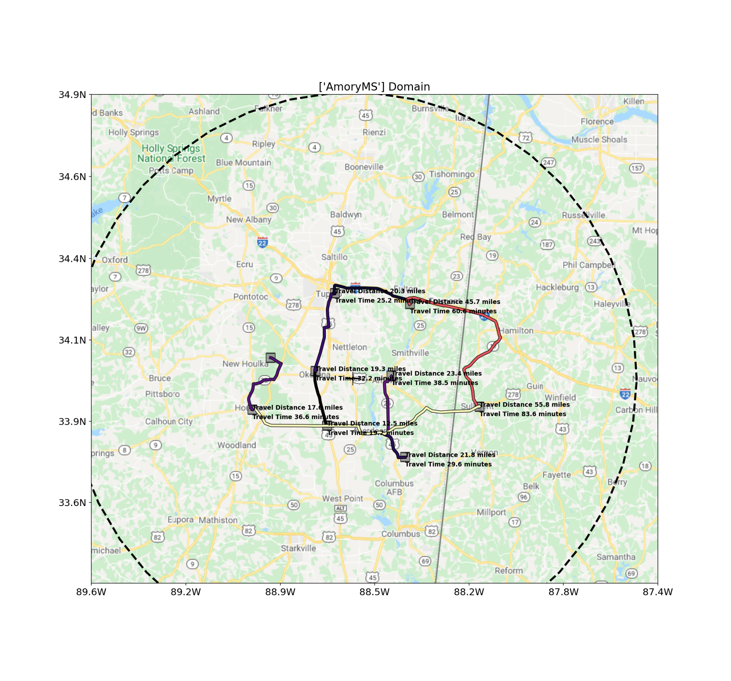
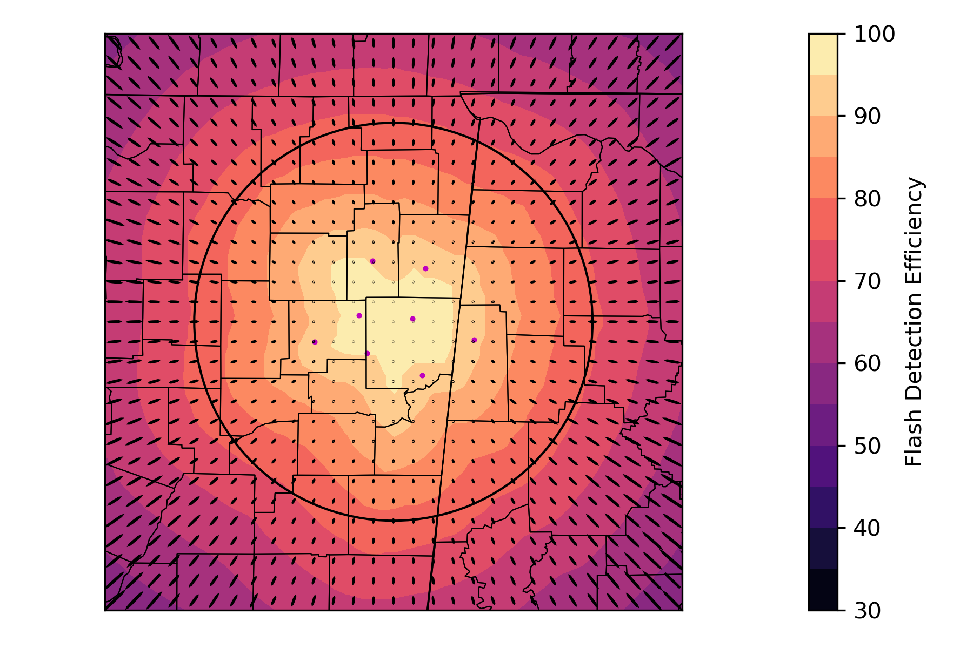
Domain Example
Amory, MS
Pre-determined and surveyed sites to be completed this fall / winter
LMA baselines: 50-75 km, varies per domain
NALMA
Amory domain
Most domains are in river valleys
Driving time: ~ 4 hrs
(lines show shortest route between stations)
Will have expected performance per domain

Slide 6
Deployment logistics
t₀-4 days: IOP declared
t₀-36 hrs: subdomain declared → LMA deployment location known
t₀-24 hrs: other instrument configuration finalized
LMA sensors deployed by 2 teams by t₀-2 hrs, picked up after storms have passed through the domain
Goal: Process and disseminate the real time LMA data for field campaign participants and forecasters.
All post-processed LMA data will be available to others in the community who may benefit from an additional GLM validation set.

Slide 7
Science Goal: Can we use lightning characteristics, by reflecting the variations to precipitation growth aloft, as a proxy for future cold pool heterogeneity of interest to NWS warning operations in QLCS environments?
Spatiotemporal updraft evolution
Mixed-phase precipitation distribution
Build on relationships between lightning and downdrafts, mesocyclogenesis, mixed-phase updraft volume, graupel mass, radar proxies such as Zdr, etc.
Determine the value added by operational lightning datasets (NLDN, ENTLN, GLM) beyond operational radar datasets.
Examine the added benefit of research-quality lightning datasets.
Evaporation rates and mass loading
Lightning rates, energy, sizes
Cold pool baroclinicity and momentum
Tornado risk
(Carey and Rutledge 1996, Goodman et al. 1988, Liu et al. 2012, Mecikalski and Carey 2017, Schultz et al. 2015, Sharma et al. 2021, Stough et al. 2017, Vincent et al. 2003, Williams et al. 1989, 1999)
Notes:
Note collaborations

Slide 8
Future Plans
OKLMA data currently being checked / re-processed and posted here: http://thredds.winstorm.nssl:8080/thredds/catalog/WRDD/OKLMA/catalog.html (DOI acquisition in progress)
Merged LMA grids via Multi-Radar Multi-Sensor (MRMS)
Merge grids from 7 LMA networks
Other potential targets for the mobile array:
Stratiform / Anvil lightning near WTLMA / OKLMA coordinated with TORUS
Hurricane landfall / rain band lightning
Lake effect snow electrification near Lake Ontario
Contact: vanna.chmielewski@noaa.gov

