Slide 1
Maintenance and Development of the Mid-Atlantic lightning mapping array (MALMA)
Guangyang fang
September 22, 2019
University of maryland/CISESS

Slide 2
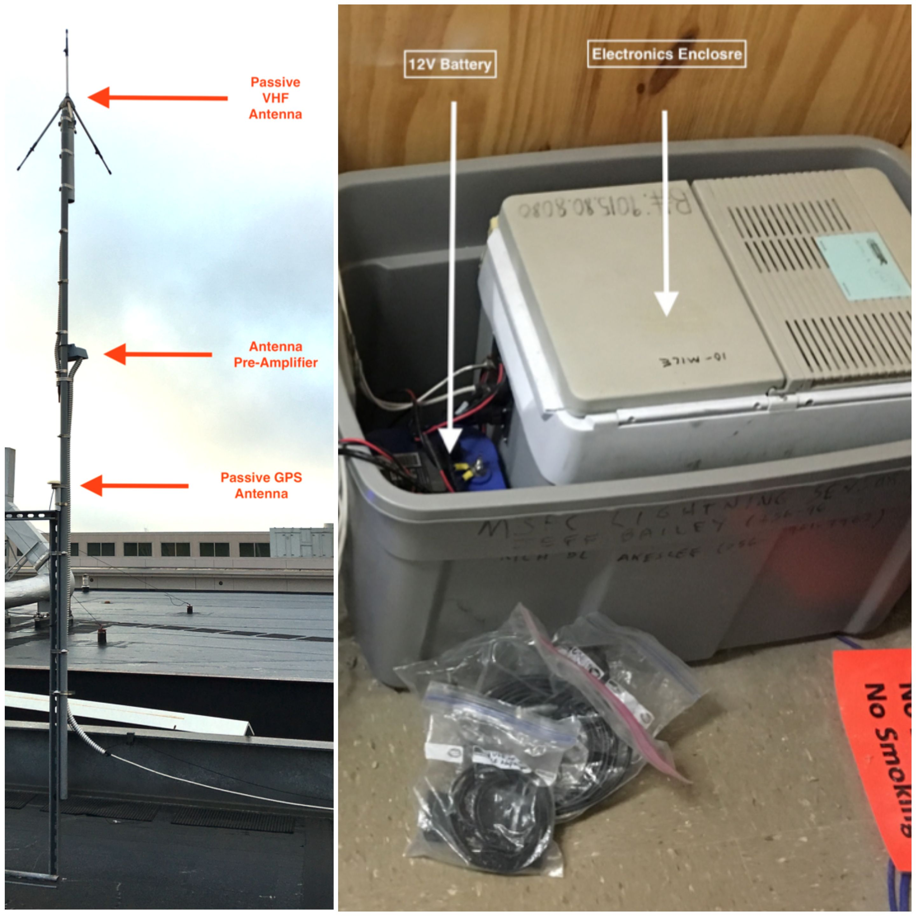
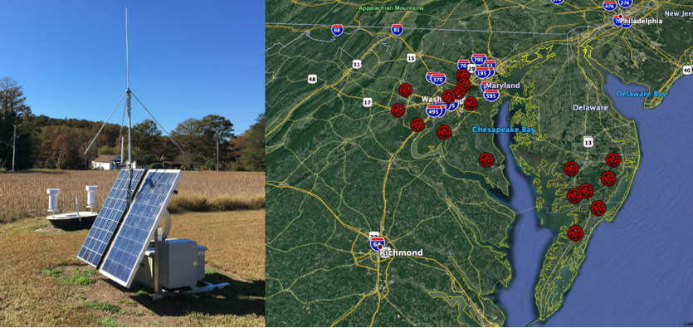
Outline
Background
Maintenance
Case study
Different ways to contribute to GLM validation
Future plan

Slide 3
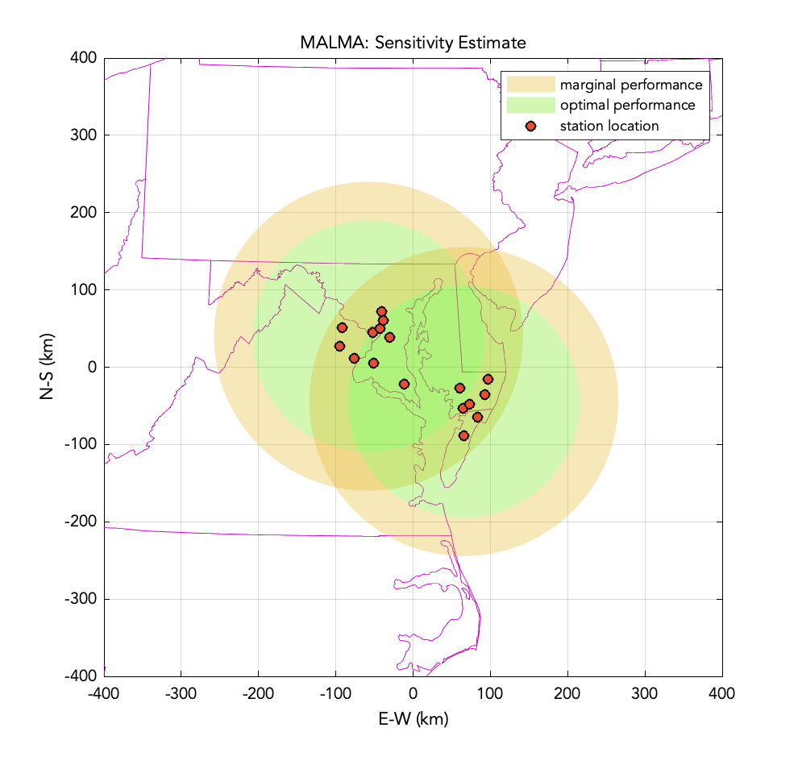
BackgrouNd
DC Lightning Mapping Array (DCLMA) is a 9-station VHF (195 MHz) antenna network that detects and geo-locates lightning in 3 dimension.
All the sensors have been upgraded since the original setup in 2007;
It still has wired connection;
Remains difficult to maintain the DCLMA;
Wallops Flight Facility LMA (WFFLMA) with 8 stations (65 MHz) re-deployed in 2019.
The combined network is named Mid-Atlantic LMA (MALMA) and provides research grade, 3-D geolocation of lightning activity over the mid-Atlantic region.

Slide 4
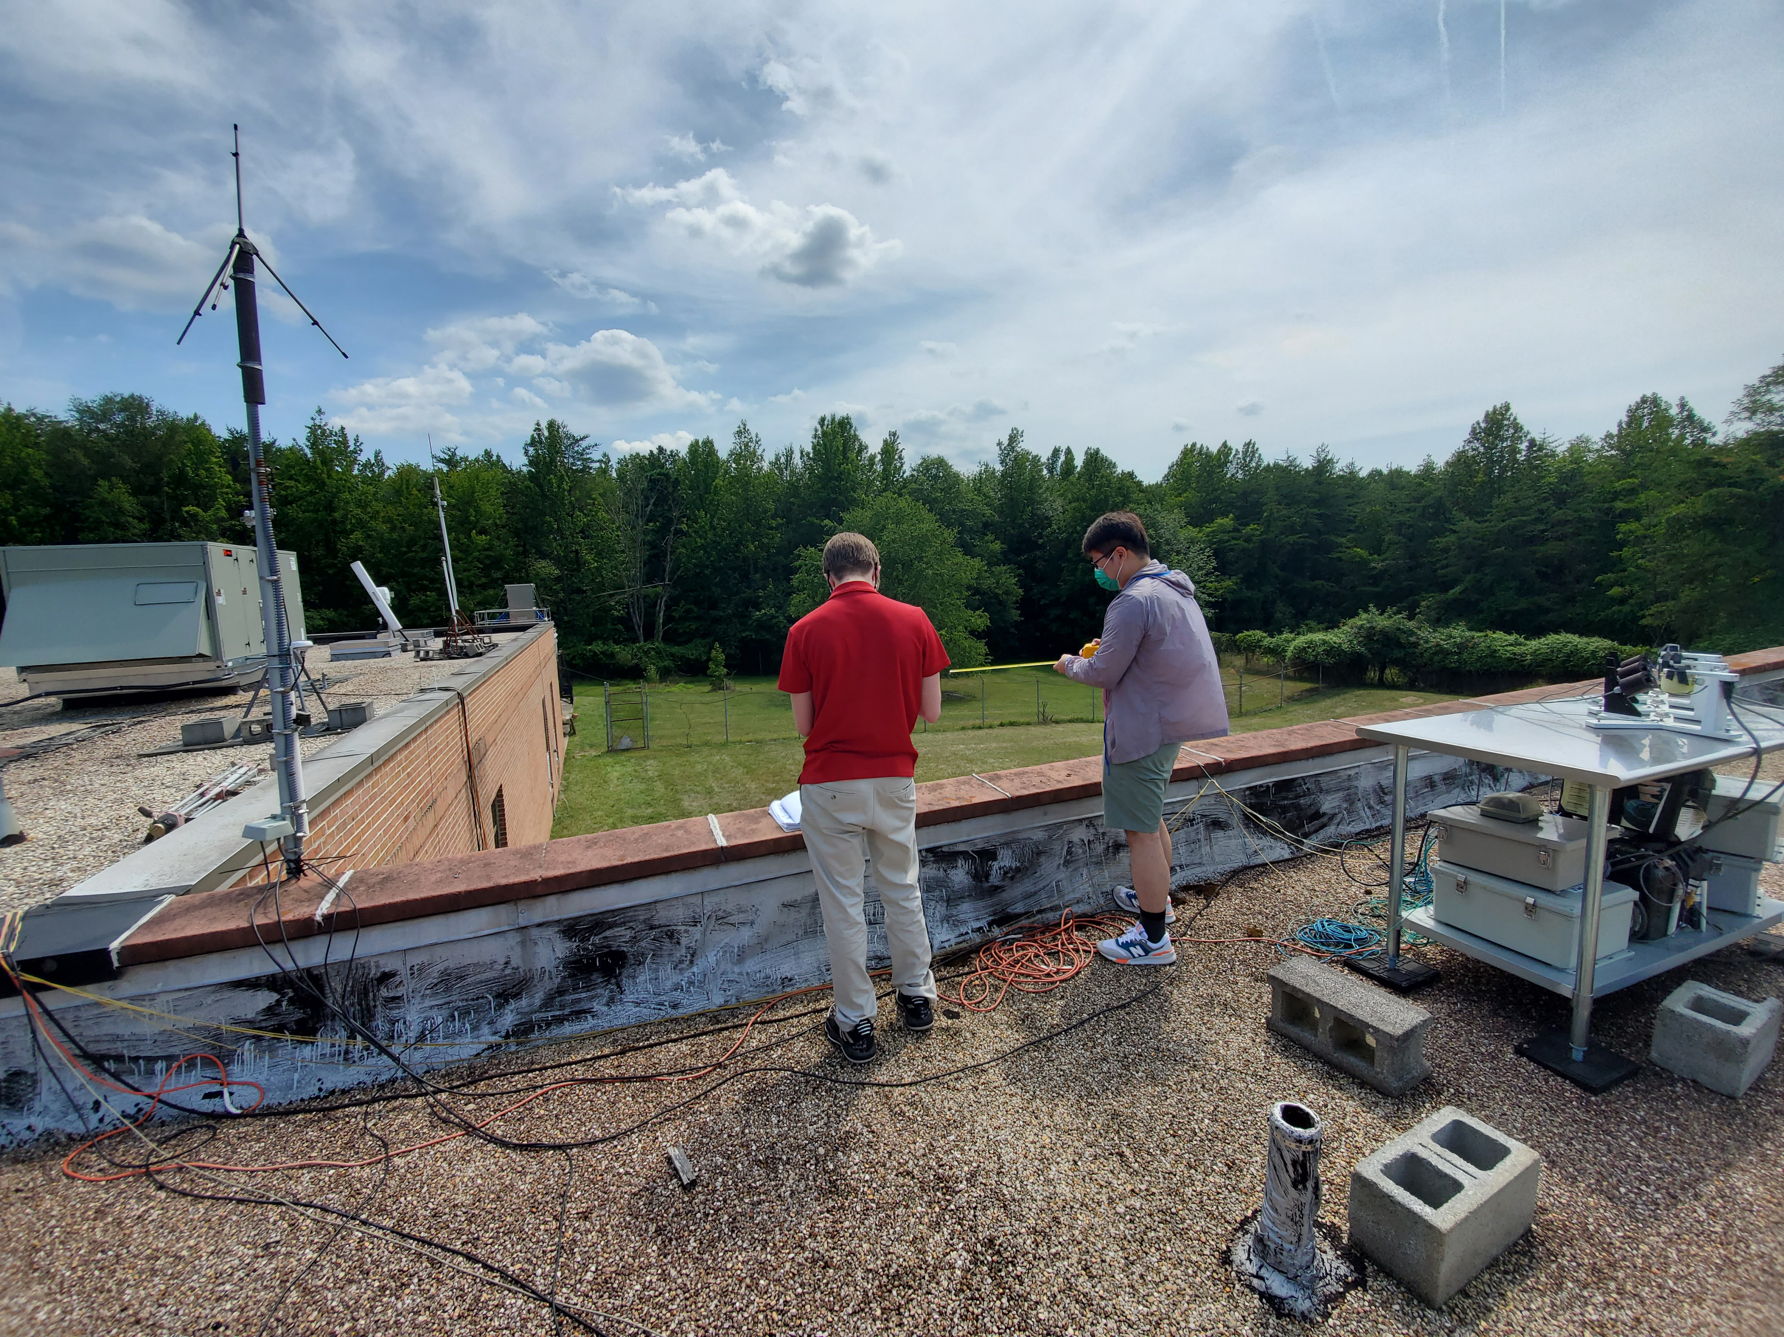
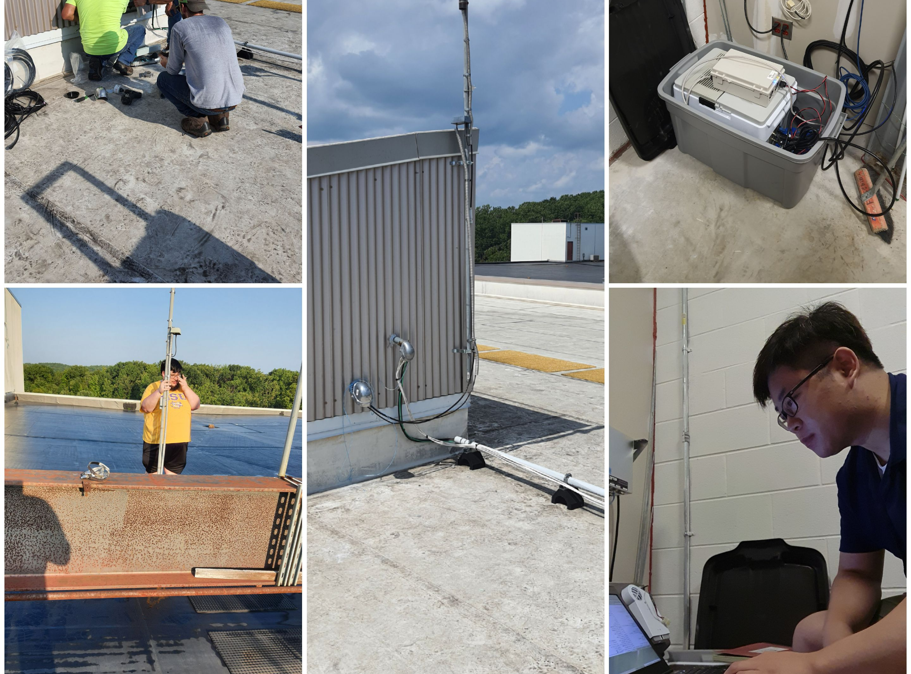
difficult to Maintain!
We are losing sites and getting new sites;
Site on Howard University main campus lost in 2020;
Site in Woodbridge relocated in August 2021.
During the pandemic, DCLMA was hardly maintained due to the limited access to the sites;
Since April, we had 17 site visits to fix all kinds of issues in DCLMA to make it back to work;

Slide 5
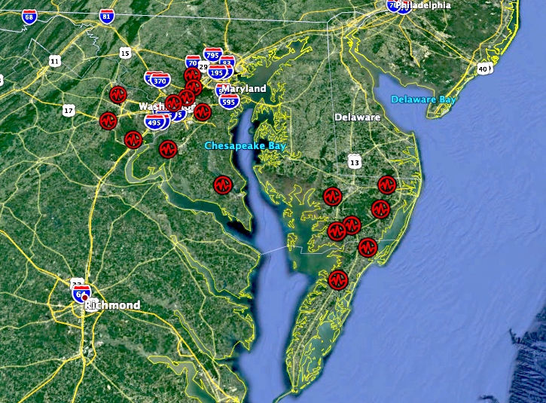
Current status of DCLMA
Station | Status | Details
a Sterling | online
b -> j Woodbridge | online
c CSM | online
d Howard | offline | Not deployed
e UMD | online
f AgSite | online
g GMU | online
h Site8 | online
i Beltsville | online
Spare unit | offline | Spare
Solar powered unit | offline | To be delivered by LMA tech

Slide 6
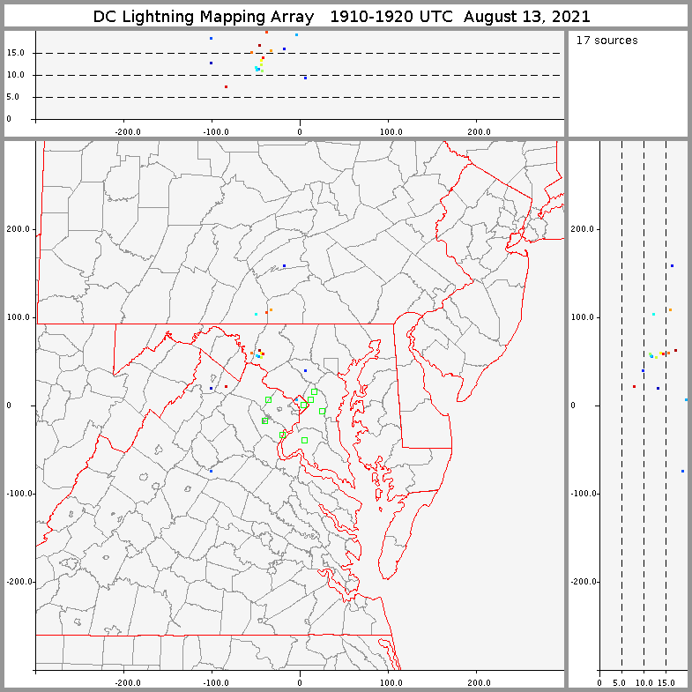
Plans for visualization
Presently, solutions are computed at New Mexico Tech and displayed at http://199.47.207.19/dclma/;
In the future, will we compute the solutions locally or in Huntsville?

Slide 7
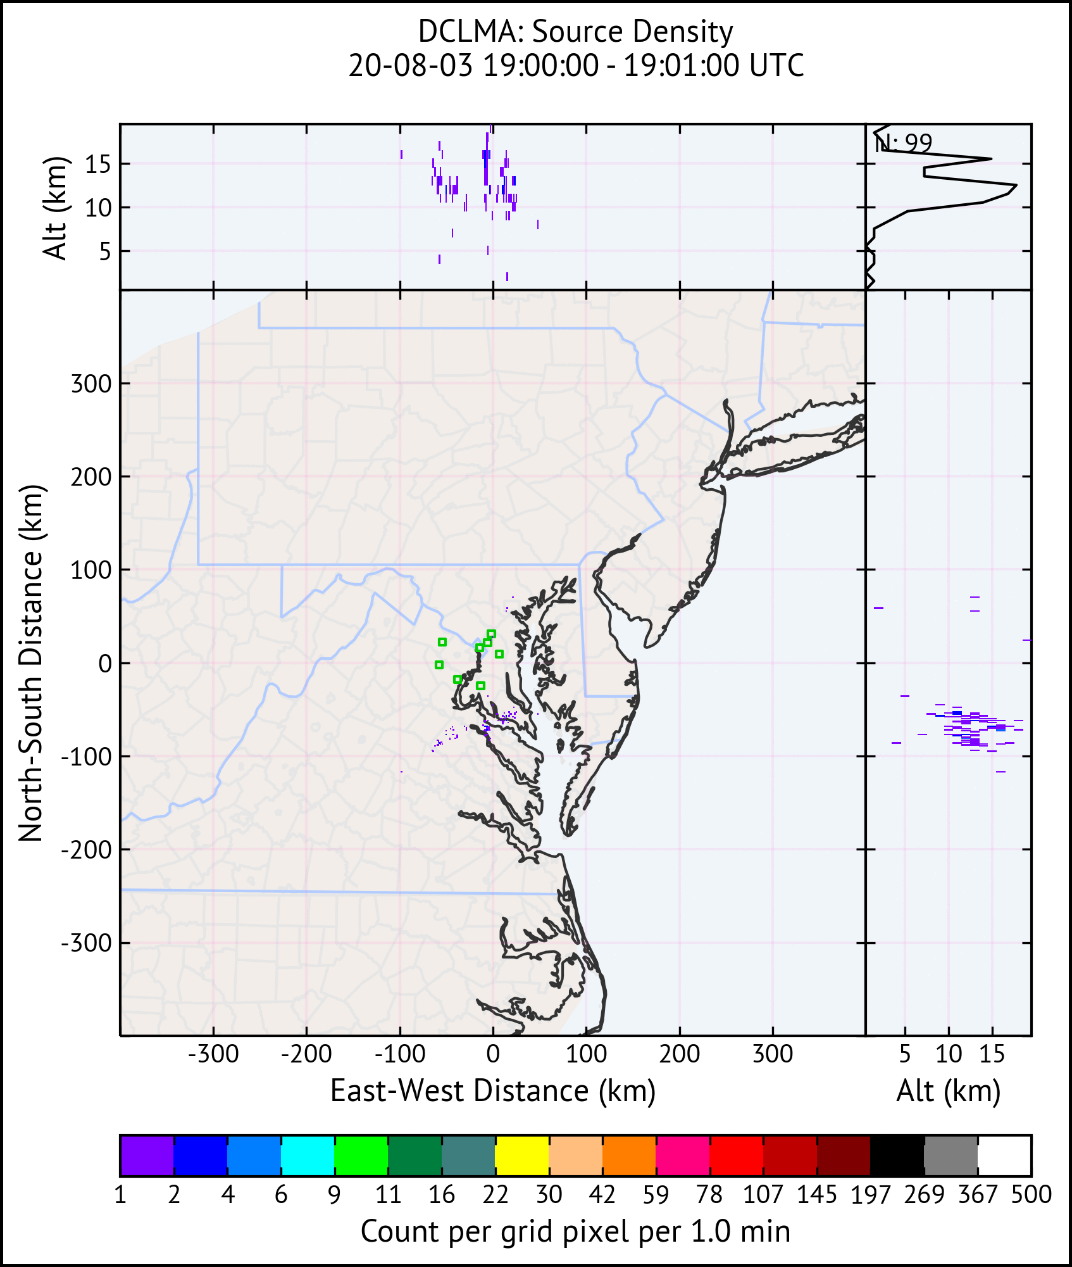
Plans for visualization
This website was built to visualize the DCLMA data;
This case was from 19:00 to 21:00 UTC on August 3rd, 2020. The movie shows the source density, which is the most basic form of gridded data that can be derived from the LMA data. It only counts those sources that contributed to a valid flash.

Slide 8
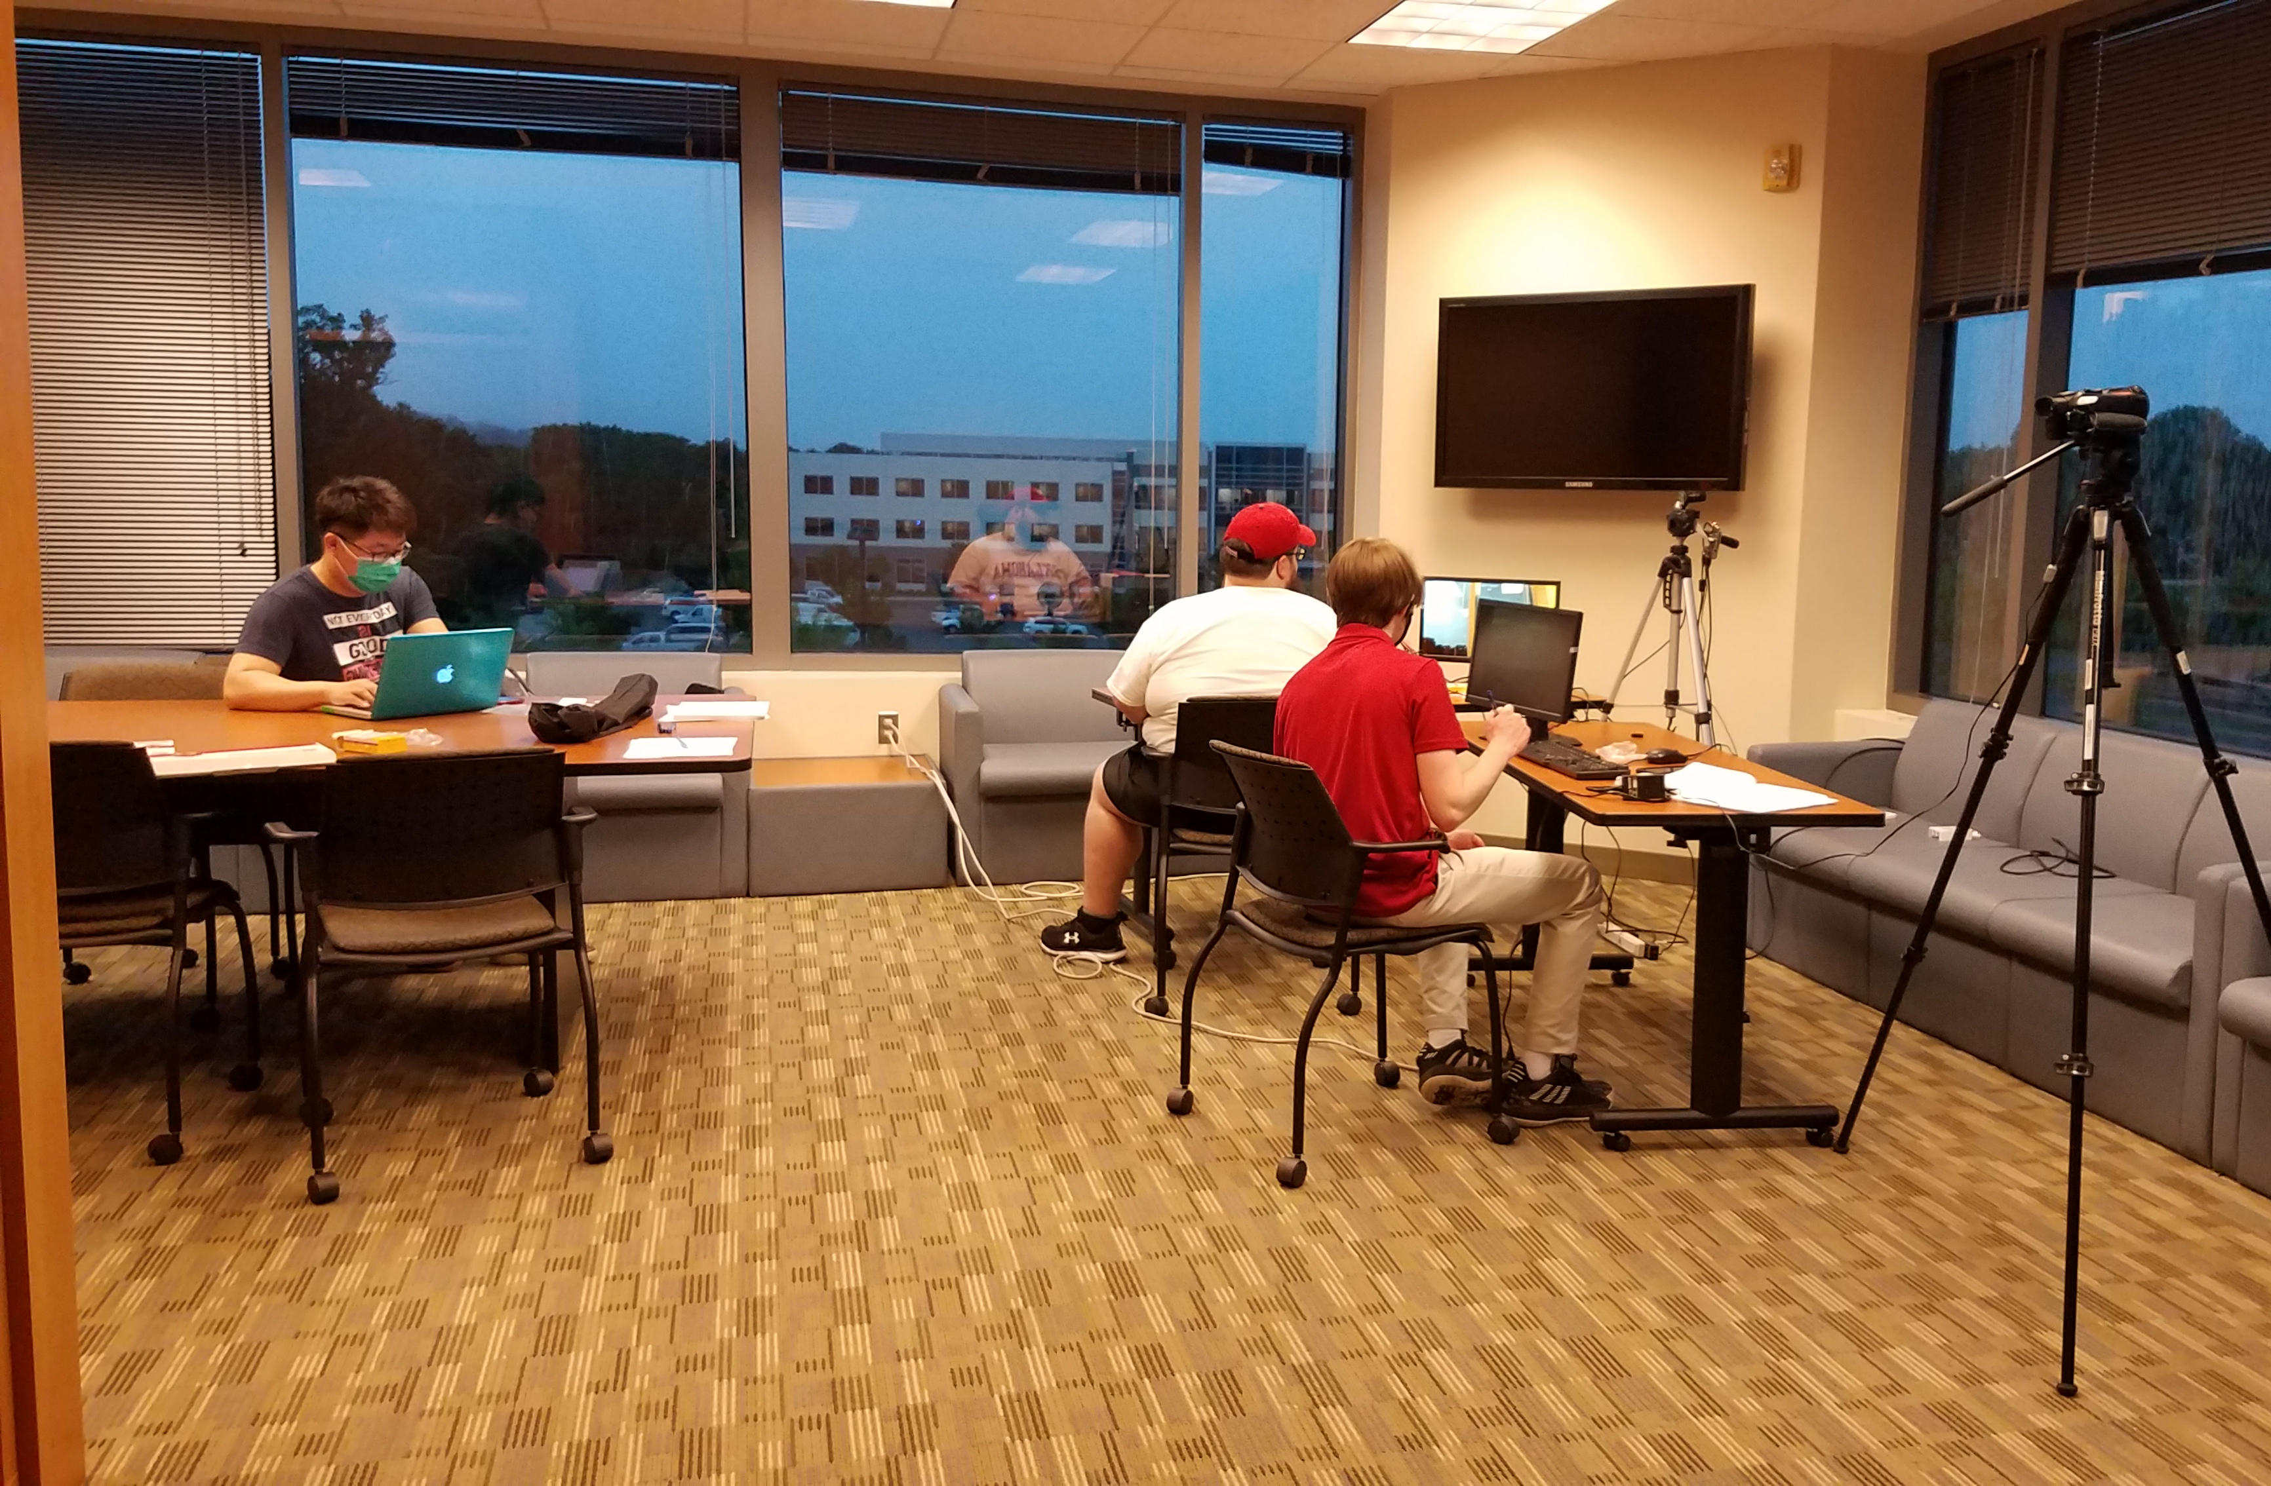
Different ways to contribute to GLM validation
DCLMA;
Wallops island LMA;
Raspberry Pi cameras;
Electric field mills;
Slow and fast antenna;
Drone camera, etc.

Slide 9
Future plans
Do the DCLMA and WFFLMA continue to stand alone?
Do they become a combined network MALMA in the future?
We are open to collaboration regarding the development of DCLMA, data processing and visualization of the solutions.
Anyone, who is interested in DCLMA, is welcome to reach me out at
Guangyang Fang, gfang@umd.edu

Slide 10
Thank you

