Slide 1
Status of Operational GLM Products
Scott Rudlosky, NESDIS/STAR
GLM Science Meeting
September 21, 2021

Slide 2
Geostationary Lightning Mapper
Two GLMs observe spatial and temporal lightning distributions over a vast region
Their broad spatial coverage and rapid temporal updates complement radar observations over CONUS to support severe weather warning decisions
Integrating GLM data into the severe weather warning process promotes earlier and easier warning decisions, better assessment of the areal coverage of hazards, and fewer false alarms, especially during radar outages and in regions of poor radar coverage

Slide 3
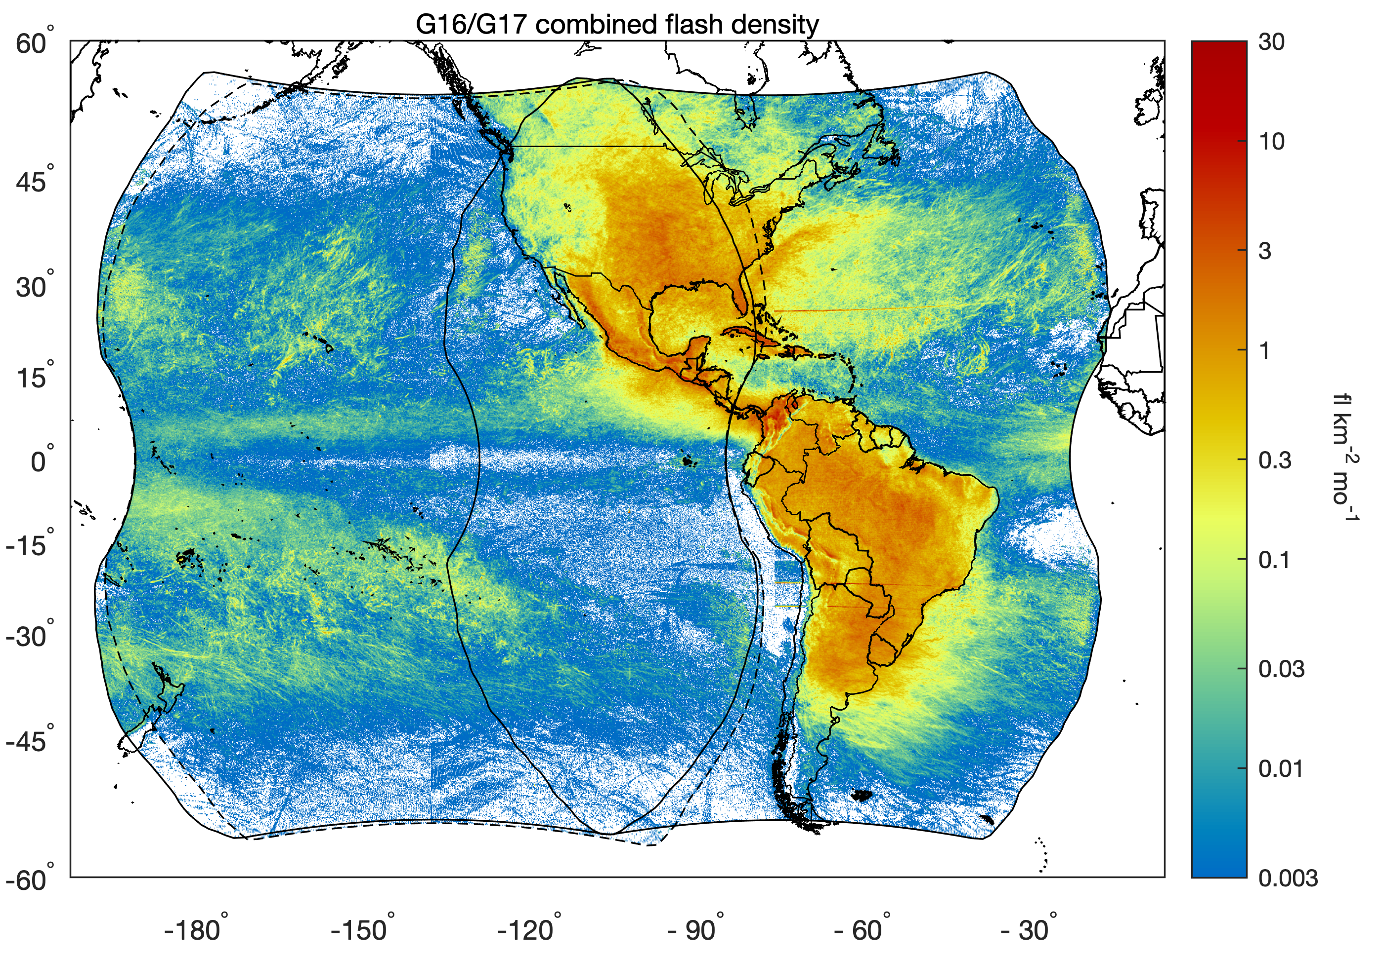
Dual Geostationary Lightning Mapper Observations
Broadening GLM use motivated Rudlosky and Virts to document the GLM distributions (MWR, April 2021)
The GOES-16 GLM covers most land areas in the Western Hemisphere, and detects ~4 times as much lightning as the GOES-17 GLM
Each GLM captured 23,815,641,600 full-disk images during our 548-day study period (1 Dec 2018 – 31 May 2020)
GOES-16 GLM
GOES-17 GLM

Slide 4
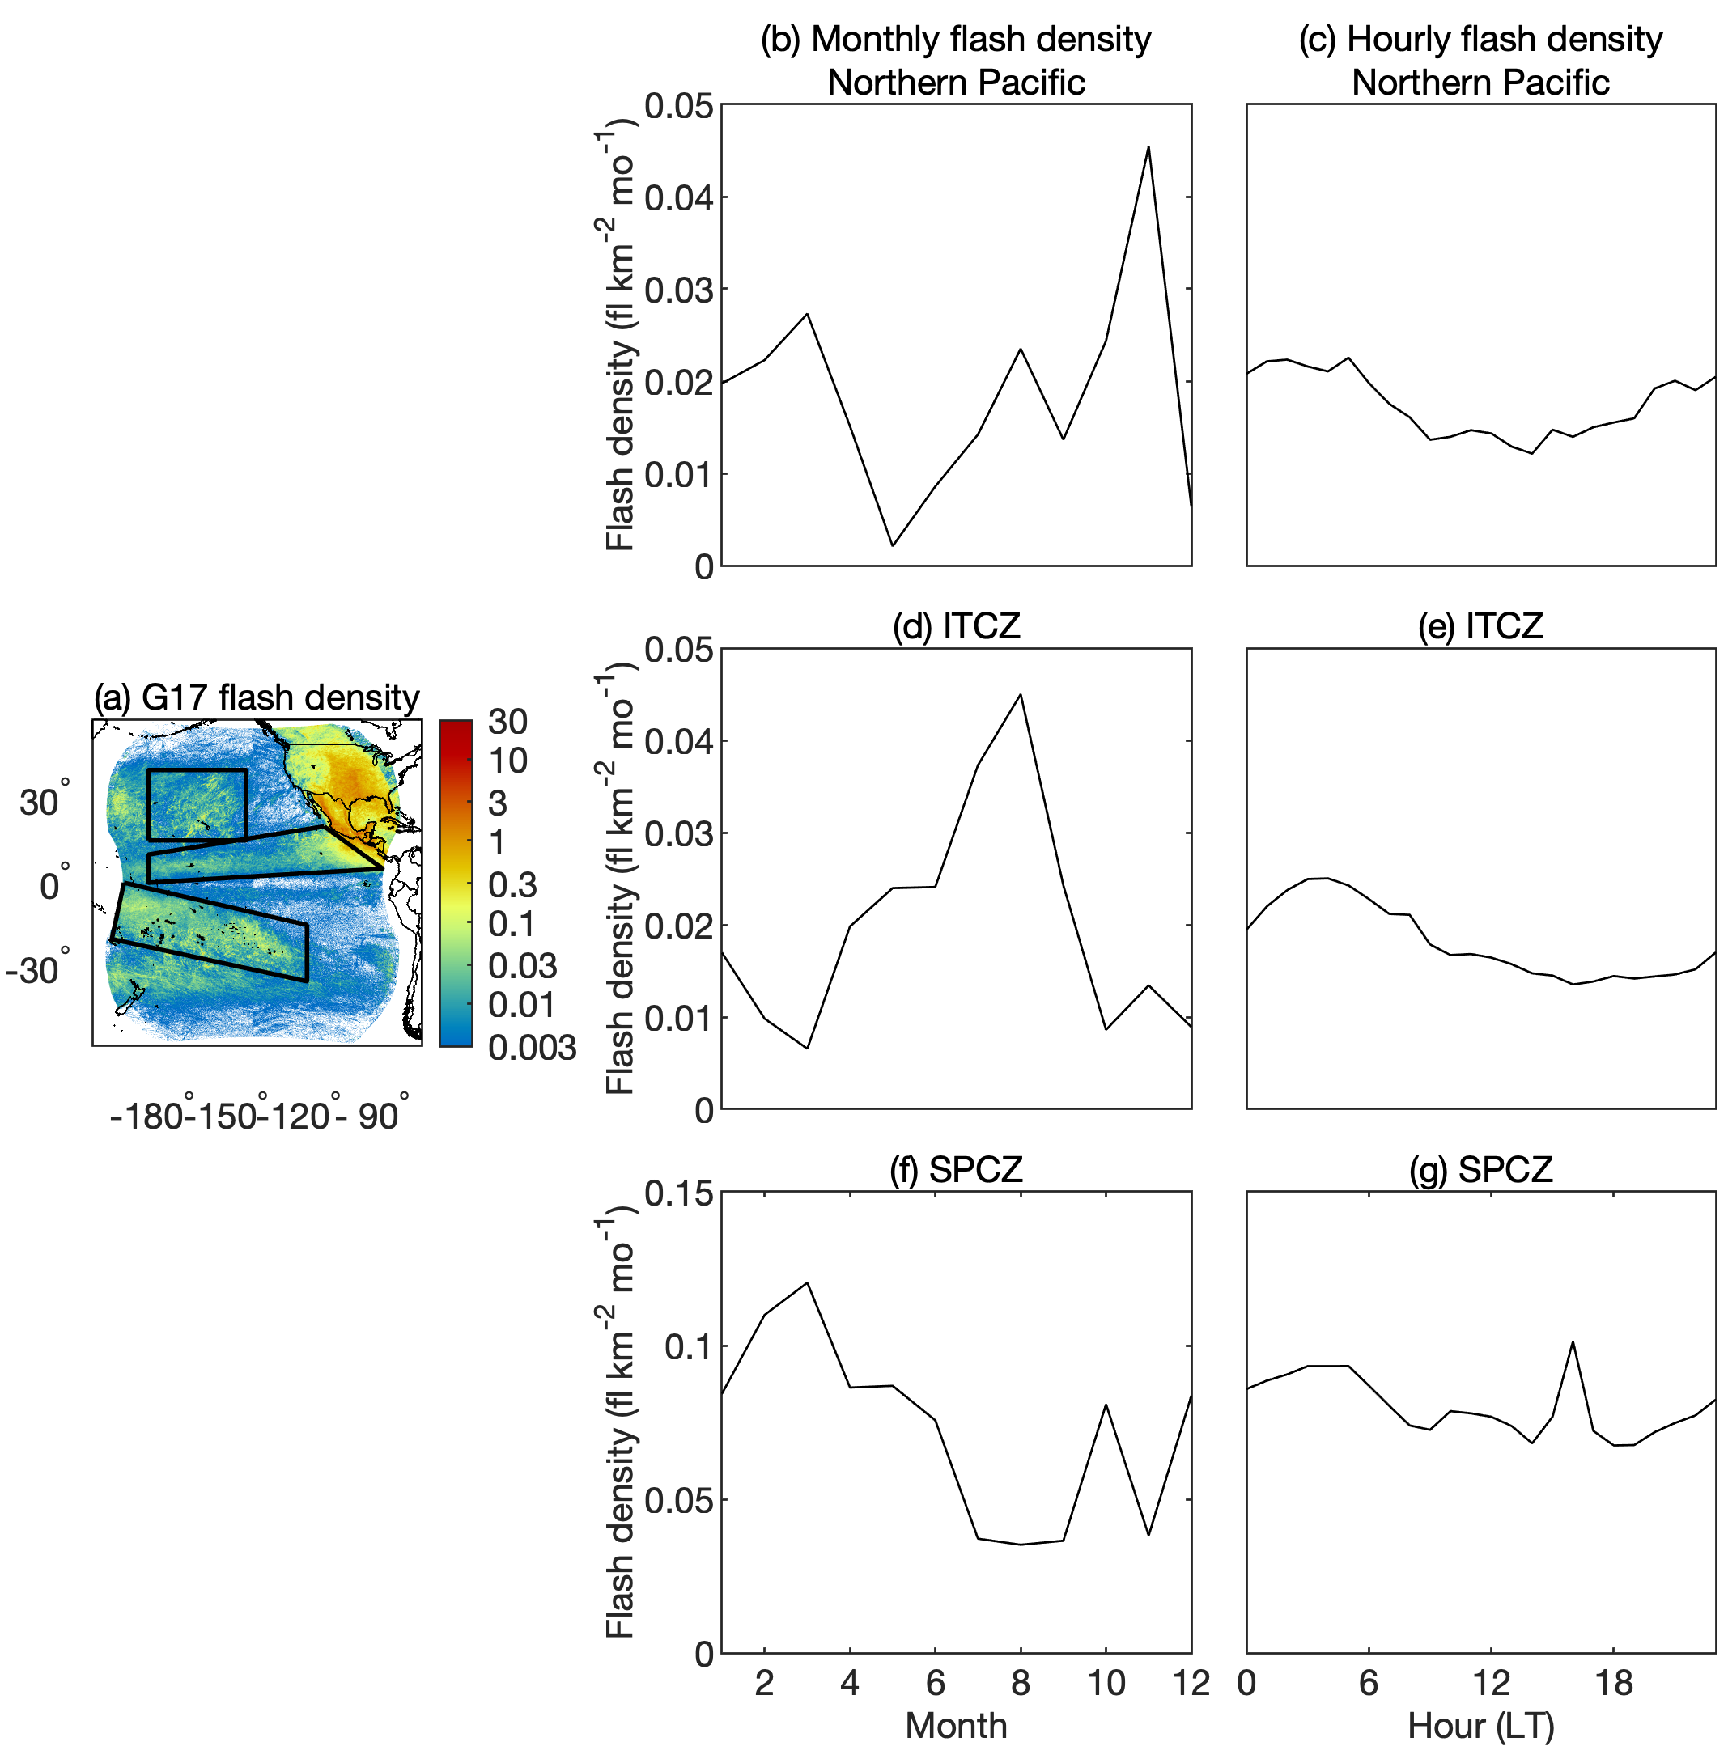
Although continents dominate year round, each season exhibits widespread lightning over the oceans
GOES-16 GLM
These oceanic regions demonstrate the key role convective organization plays in producing larger, longer lasting, and more energetic flashes observed over oceans by both GLMs
G16 GLM | All | Land | Ocean | Difference (%)
Flash count | 4.804e+08 | 4.073e+08 | 7.309e+07 | -69.6
Flash area (km²) | 447.2 | 431.3 | 535.4 | 23.3
Flash duration (ms) | 297.0 | 289.9 | 336.5 | 15.7
Flash energy (fJ) | 249.6 | 220.7 | 410.7 | 76.1
Groups per flash | 15.6 | 14.7 | 20.5 | 37.1
Events per flash | 40.9 | 38.5 | 54.8 | 39.8
Events per group | 2.6 | 2.6 | 2.7 | 5.1
Group area (km²) | 181.1 | 178.5 | 191.7 | 7.3
Group energy (fJ) | 16.0 | 15.0 | 20.1 | 31.7
G17 GLM | All | Land | Ocean | Difference (%)
Flash count | 1.307e+08 | 8.614e+07 | 4.453e+07 | -31.8
Flash area (km²) | 423.9 | 357.8 | 551.7 | 45.7
Flash duration (ms) | 286.1 | 269.2 | 318.7 | 17.3
Flash energy (fJ) | 395.5 | 326.4 | 529.0 | 51.2
Groups per flash | 14.0 | 11.3 | 19.2 | 56.3
Events per flash | 33.6 | 25.4 | 49.5 | 71.8
Events per group | 2.4 | 2.2 | 2.6 | 19.1
Group area (km²) | 185.2 | 170.5 | 201.9 | 17.0
Group energy (fJ) | 28.6 | 29.0 | 28.3 | -2.5
GOES-17 GLM

Slide 5
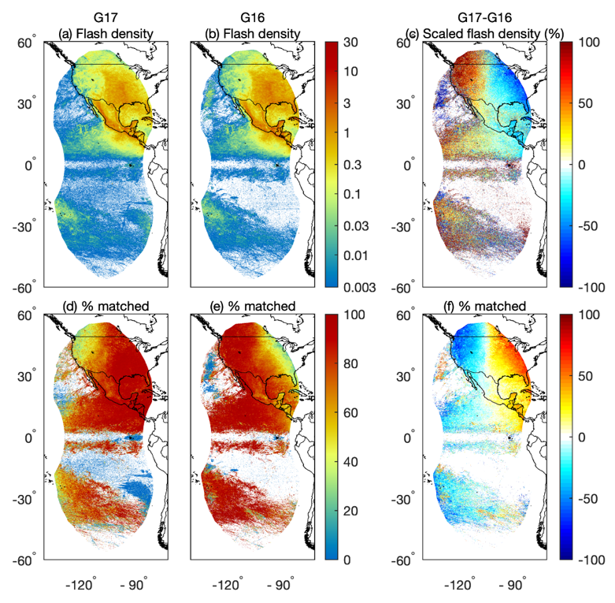
Overlapping region reveals similarities and differences between the G16 and G17 GLM observations
GOES-16 GLM
Analysis of the overlap region reveals a pronounced north-south line near 103° W, with the GOES-East (West) GLM detecting more flashes to the east (west) of this line
Light blue indicates the G17 GLM observes 20- 40% fewer flashes east of this line, and red shades indicate the G16 GLM observes 50-90% fewer flashes over the northwest U.S.
In the northwest U.S., the G16 GLM only observes 25-45% of the G17 GLM observed flashes

Slide 6
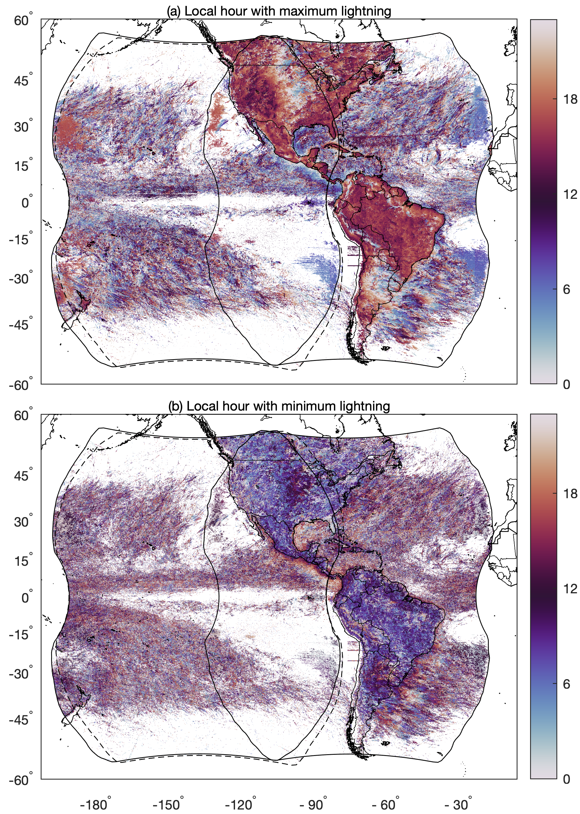
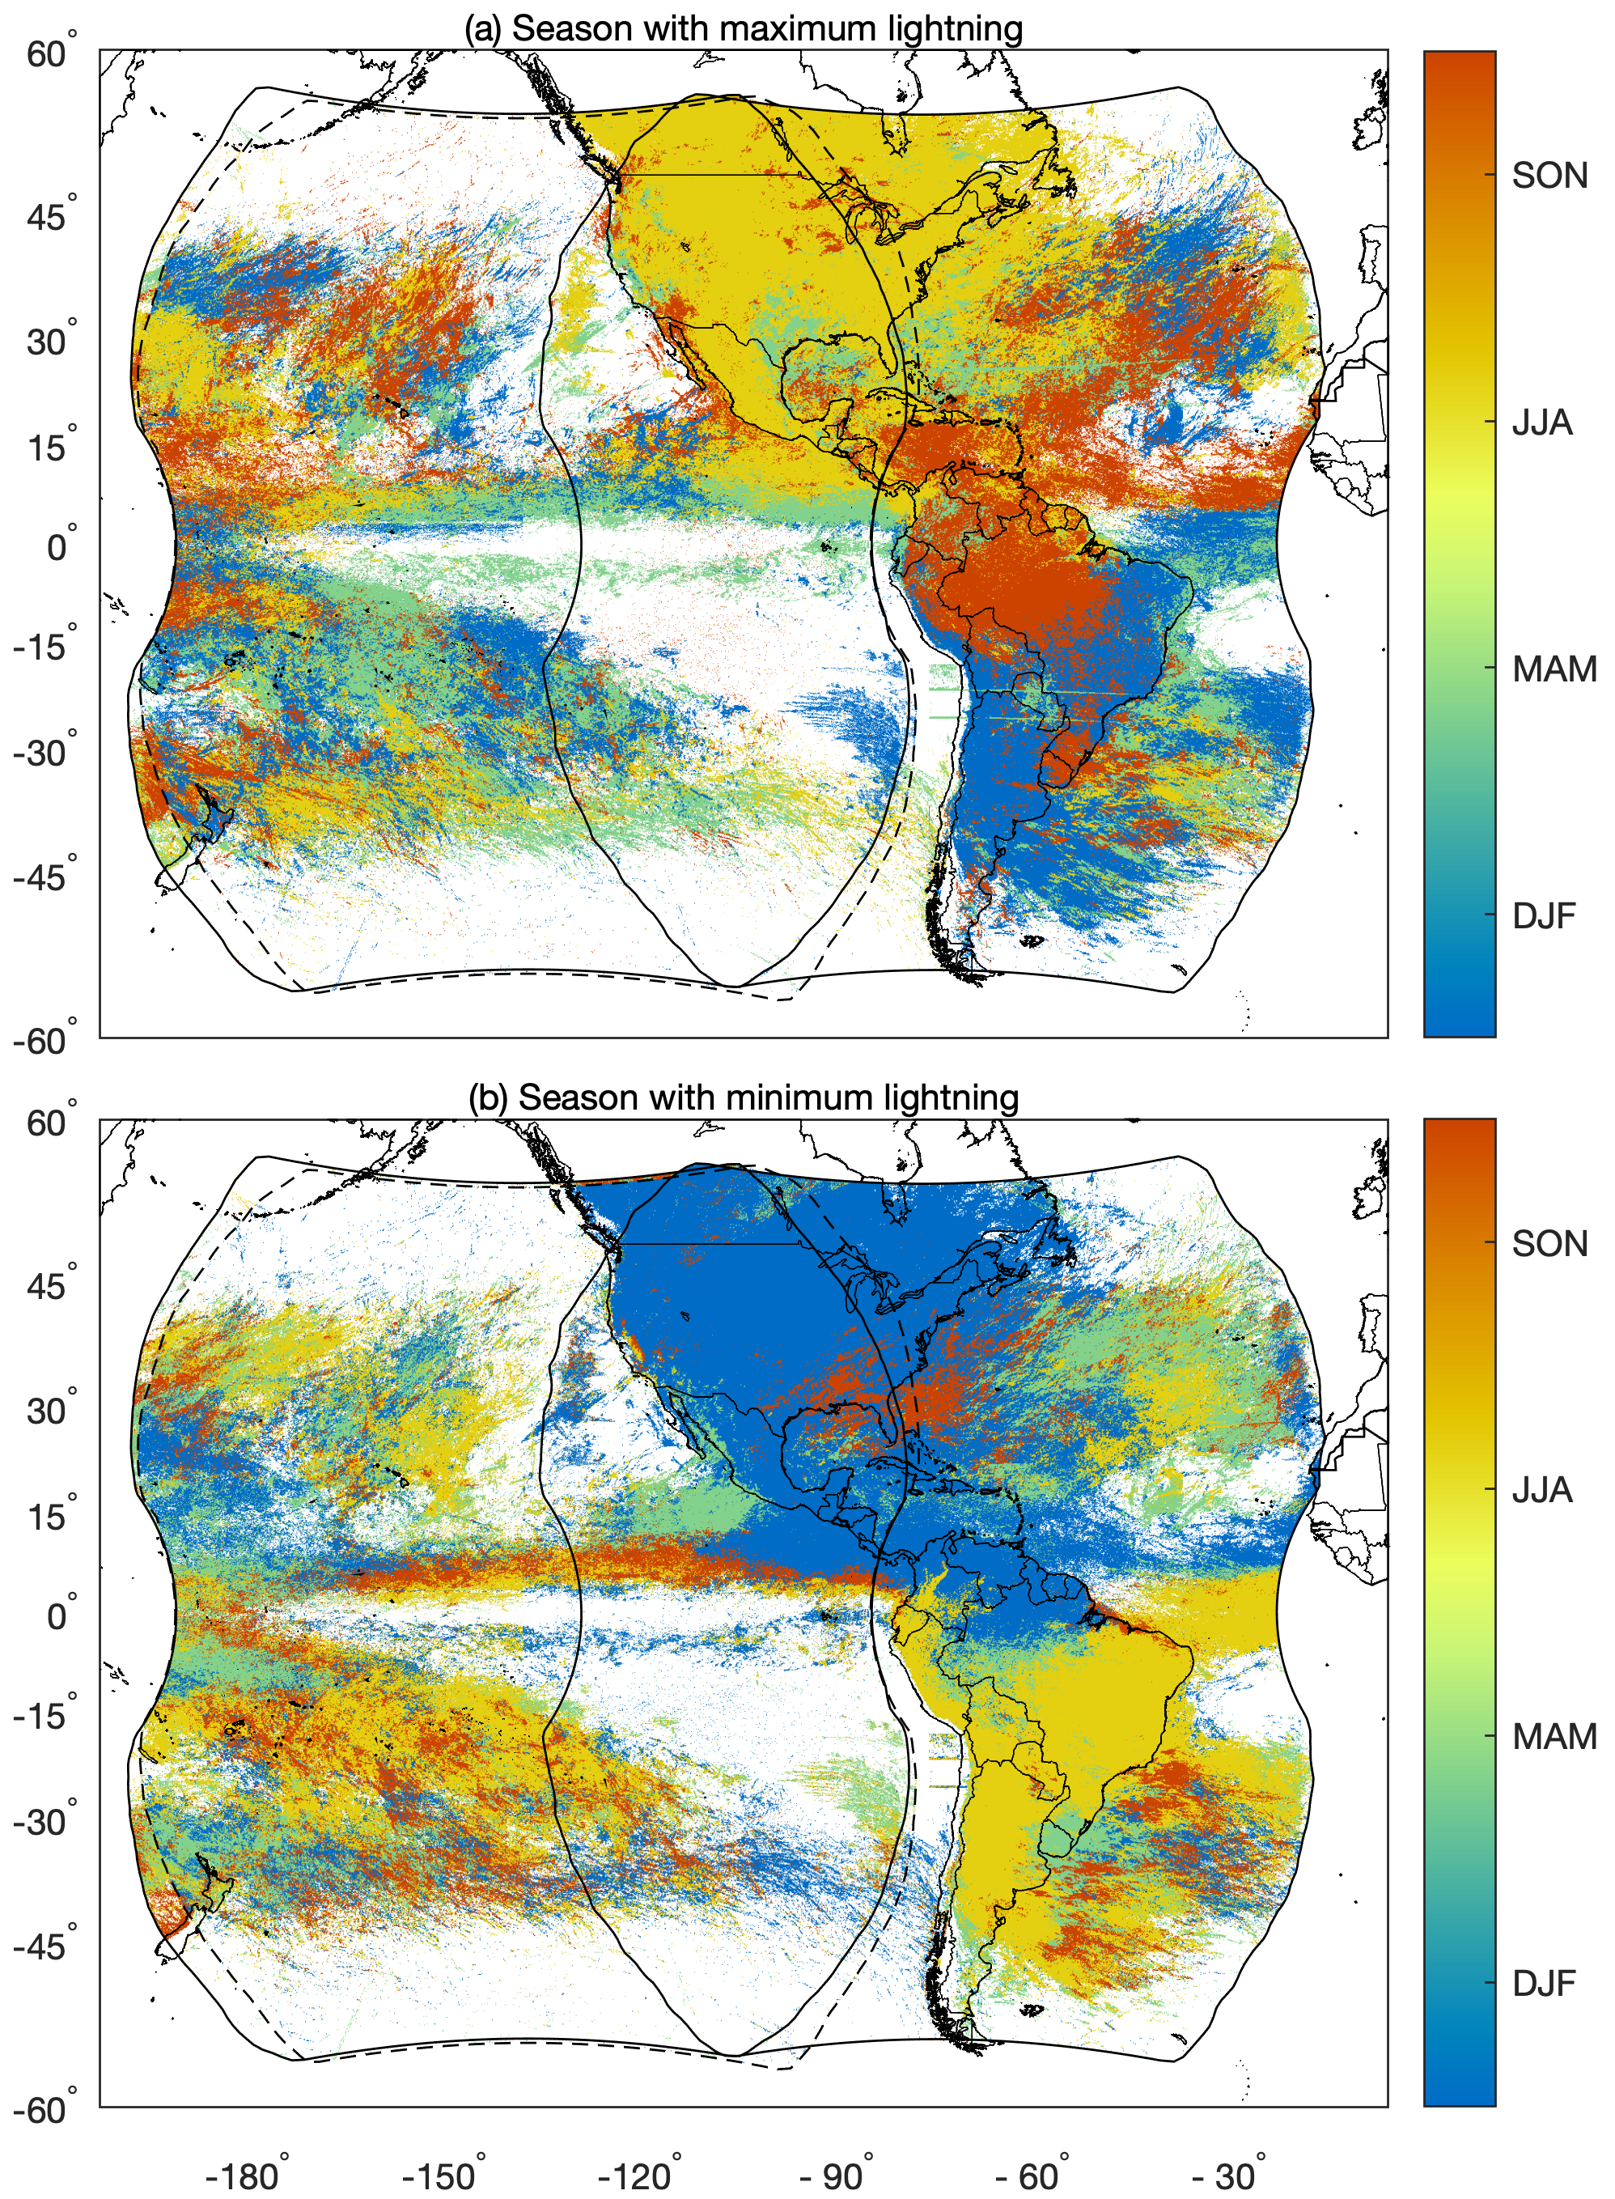
Texture within the flash densities reveals a close relationship with the underlying topography
GOES-16 GLM
Topographical influences are underscored by the complex diurnal cycles observed along coastlines and in mountainous regions
In North America, lightning peaks during JJA, with a few noteworthy exceptions
In South America, lightning activity generally peaks during SON (DJF) to the north (south) of 15° S

Slide 7
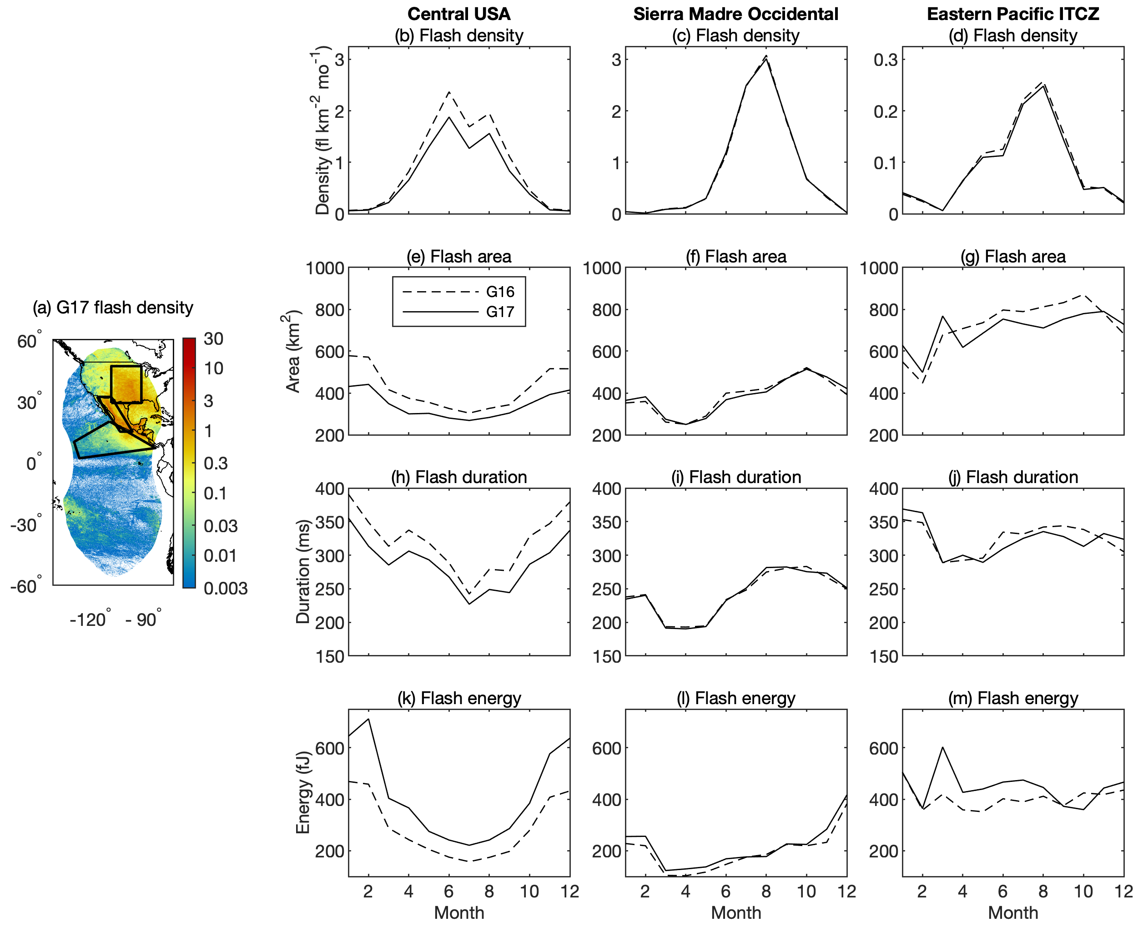
GLM information beyond flash frequency provides additional insights into storm mode and evolution
GOES-16 GLM
For example, over the Sierra Madre Occidental, time series reveal initially small, short-duration GLM flashes growing larger and longer as storms grow upscale
G16 GLM | Mean | 50th | 90th | 99th
Flash area (km²) | 447.2 | 288.8 | 941.0 | 2590
Flash duration (ms) | 297.0 | 236.5 | 620.0 | 1140
Flash energy (fJ) | 249.6 | 84.28 | 632.0 | 2350
Groups per flash | 15.6 | 9.0 | 38.0 | 81
Events per flash | 40.9 | 21.0 | 103.0 | 263
Events per group | 2.6 | 2.0 | 5.0 | 15
Group area (km²) | 181.1 | 135.5 | 352.0 | 1020
Group energy (fJ) | 16.0 | 6.1 | 33.6 | 151
G17 GLM | Mean | 50th | 90th | 99th
Flash area (km²) | 423.9 | 290.1 | 974 | 2610
Flash duration (ms) | 286.1 | 220.9 | 605 | 1140
Flash energy (fJ) | 395.5 | 146.5 | 1080 | 4090
Groups per flash | 14 | 9 | 39 | 82
Events per flash | 33.6 | 17 | 100 | 278
Events per group | 2.4 | 2 | 5 | 13
Group area (km²) | 185.2 | 139.5 | 366 | 1020
Group energy (fJ) | 28.6 | 10.7 | 56.5 | 275

Slide 8
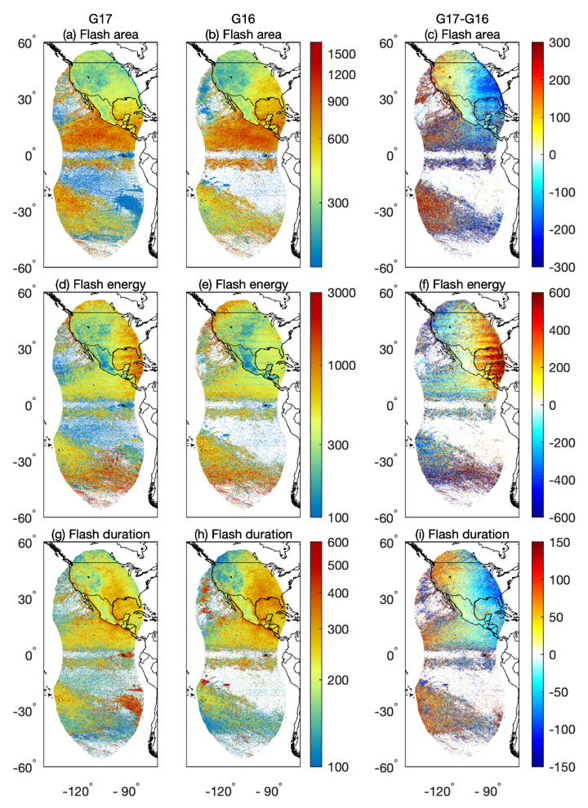
Data quality improves during the study period with tuning of the ground system software
GOES-16 GLM
Sun glint artifacts include anomalously small (blue), long duration (red) flashes
The clearest sun glint examples occur in the southeast portion of the overlap region for G17 and the northwest portion for G16
GLM artifacts due to solar intrusion and Sun glint greatly diminish following the blooming filter installation, and the second-level threshold filter reduces false events along particular subarray boundaries (i.e., bar artifacts)

Slide 9
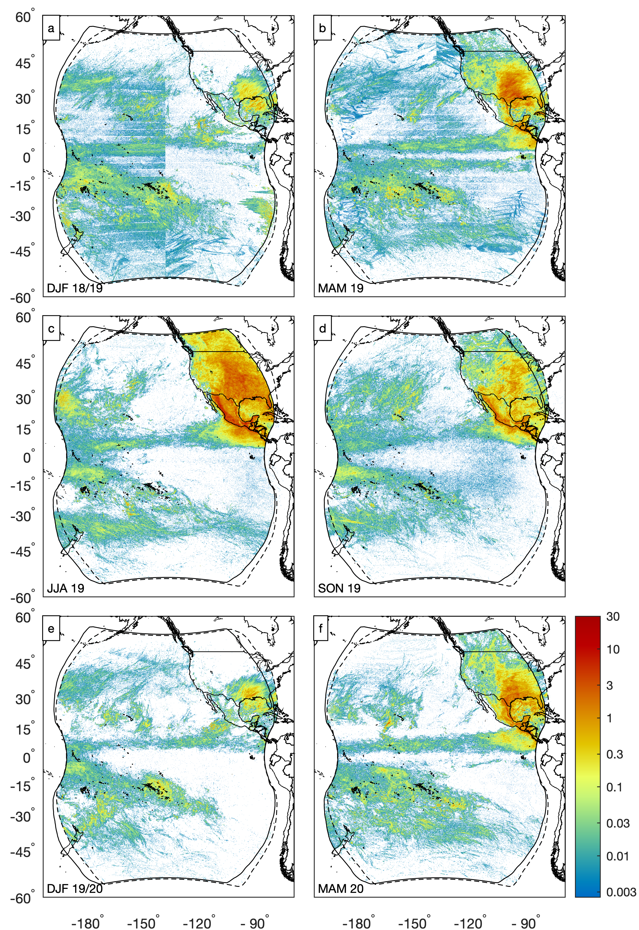
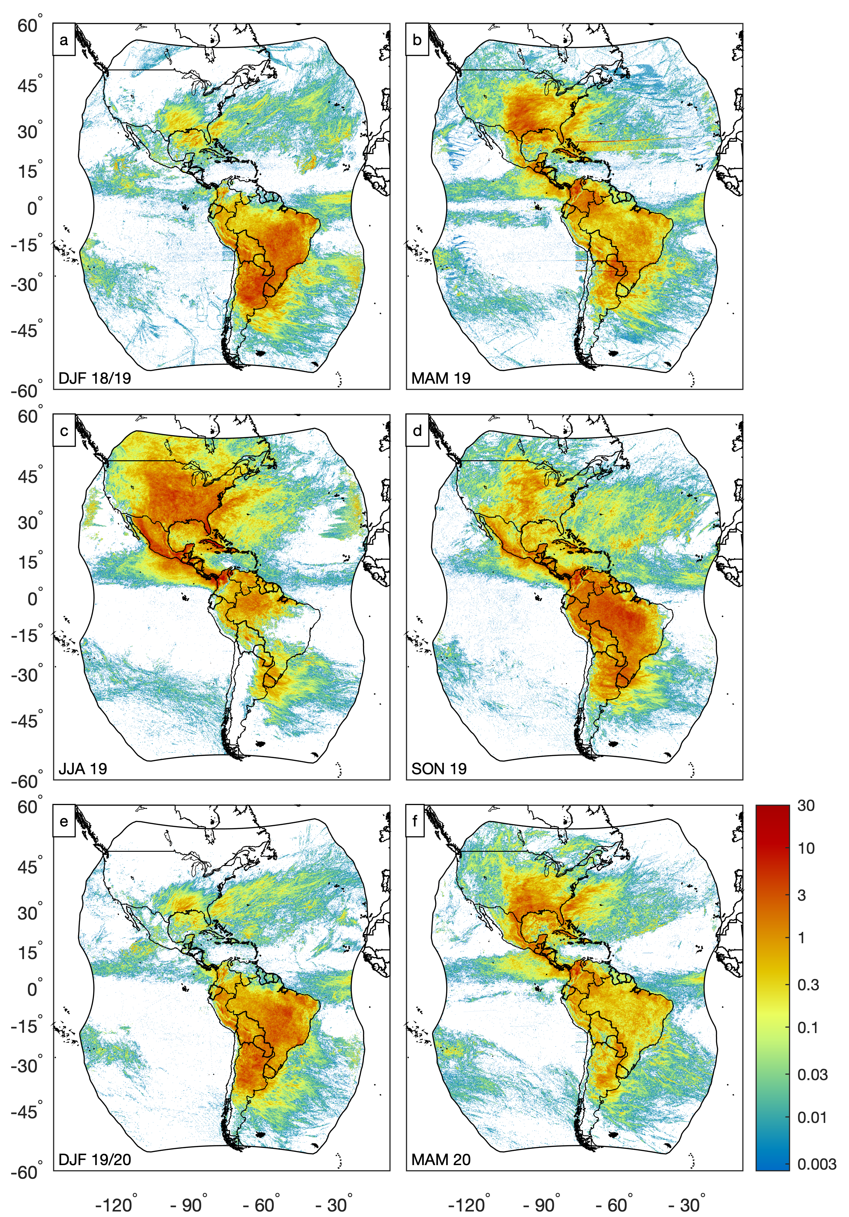
The “Bahamas Bar” artifact during MAM 2019 is almost indistinguishable during MAM 2020
No perfect solution, certain conditions will produce false flashes, coupled with an inverse effect with diminished densities along the same boundaries under the same solar angle and cloud conditions
GOES-16 GLM

Slide 10
Dual Geostationary Lightning Mapper Observations
Take Home Points:
High-resolution seasonal and diurnal lightning distributions reveal many features that merit future study as more GLM data become available
Compositing this information over many years will definitively describe both the seasonal and diurnal variability throughout the broad GLM coverage area
Acknowledgments: Scott and Katrina thank Steve Goodman, Eric Bruning, Rachel Albrecht, and two anonymous reviewers for their contributions to this manuscript
Reference: Rudlosky, S. D., and K. S. Virts, 2021: Dual Geostationary Lightning Mapper Observations. Mon. Wea. Rev., doi: https://doi.org/10.1175/MWR-D-20-0242.1
GOES-16 GLM

Slide 11
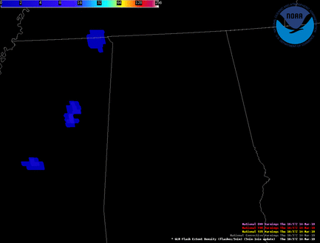
Gridded GLM Products
GLM observations fundamentally differ from the ground-based lightning data most familiar to forecasters
Initial demonstrations revealed that the early GLM tools were not well suited for real GLM data
Motivated an intensive effort to develop a new suite of gridded GLM products tailored to NWS operations (efforts supported by GOES-R and JTTI)
Flash Extent Density
New gridded GLM products restore and disseminate the spatial footprint information while greatly reducing file size
Gridded GLM products re-navigate the GLM event latitude / longitude to the 2×2 km Advanced Baseline Imager (ABI) fixed grid

Slide 12
GLM Gridded Product Timeline
Phase 1
GOES-R Launch
First Real GLM Data Available
NWS Three Things Memo
Gridded Products / ISatSS Selected
Gridded Products Integrated into ISatSS
Gridded Products Available to Select WFOs
April 2016
December 2017
June 2018
November 2016
July 2017
May 2018
Phase 2
Full Disk Grids at NHC via ISatSS
HWT Experiment / Begin Extended Demonstration
Updated glmtools package (FD 2×2 km)
Full Disk Grids Integrated into ISatSS
Full Disk Grids available to all WFOs/NCs
CONUS/PACUS Grids Available to all WFOs
April 2019
November 2019
June 2020
August 2018
May 2019
March 2020

Slide 13
GLM JTTI Project
JTTI project laid the ground work for NESDIS generation and distribution of the recommended GLM gridded product suite by developing four main components…
Standard GLM algorithm software package (glmtools) that produces a baseline set of GLM products sufficiently mature to be transitioned to NOAA operations
Baseline GLM gridded products distributed initially via experimental channels then via more robust generation/distribution channels
Complete set of GLM-related AWIPS modifications committed to baseline software
Gridded product descriptions and guides – training materials are routinely generated and distributed via GLM-specific websites, short courses, and other NWS outreach activities (e.g., field demonstrations)

Slide 14
NWS User Request
“Characteristics of the GLM Level 2 files make them incompatible with the operational NWS software (e.g., file size, format, and frequency).”
“Rather than building and deploying extensive AWIPS software updates, a suite of gridded products were tailored to the sensor characteristics and forecaster needs.”
“At this time, the Flash Extent Density (FED) field proved conclusive for operational implementation. This request is for the 1-minute and 5-minute flash extent density products to flow as tiles through the AWIPS interface, along with more detailed real-time information regarding data quality.”
“The present procedures for generating and distributing the gridded GLM products are unsustainable in the long term.”

Slide 15
GLM Gridded Product Timeline
Phase 1
GOES-R Launch
First Real GLM Data Available
NWS Three Things Memo
Gridded Products / ISatSS Selected
Gridded Products Integrated into ISatSS
Gridded Products Available to Select WFOs
April 2016
December 2017
June 2018
November 2016
July 2017
May 2018
Phase 2
Full Disk Grids at NHC via ISatSS
HWT Experiment / Begin Extended Demonstration
Updated glmtools package (FD 2×2 km)
Full Disk Grids Integrated into ISatSS
Full Disk Grids available to all WFOs/NCs
CONUS/PACUS Grids Available to all WFOs
April 2019
November 2019
June 2020
August 2018
May 2019
March 2020
Phase 3
User Request Received
ROM Cost Estimate Complete
Final L3Harris Implementation Evaluation
Work Request moved to “In Work” Status
L3Harris starts work
L3Harris completes work
Deployed to operations
September 2020
June 2021
Q3 2022
June 2020
March 2021
January 2022
Q4 2022

Slide 16
Other Points of Interest
The glmtools code set also was integrated into CSPP-Geo so that any GRB user can have access to the same products relied upon by NWS forecasters
Still need to consider what a data quality product would look like in AWIPS
Needs to convey both false detections / artifacts and variable detection efficiency (in space and time)
Which forecasters would the DQ product be targeted towards (all, GLM novice, seasoned GLM users)?
Could proper documentation and training be a workable substitute?

Slide 17
STAR GOES Image Viewer

Slide 18
Links
Rudlosky and Virts 2021 – https://doi.org/10.1175/MWR-D-20-0242.1
GLM Value Assessment – https://repository.library.noaa.gov/view/noaa/27429
GLM Vlab – https://vlab.ncep.noaa.gov/web/geostationary-lightning-mapper
UMD GLM Page – https://lightning.umd.edu/glm/
Recent publication – https://doi.org/10.1175/MWR-D-20-0242.1
Links to routinely available imagery (e.g., STAR page)
NESDIS/STAR GOES Viewer – https://www.star.nesdis.noaa.gov/GOES/index.php
Weathernerds Webpage – https://www.weathernerds.org/satellite/
COD Meteorology Webpage – https://weather.cod.edu/satrad/

