Slide 1
Analysis of the 2021 Metro Atlanta Tornadoes
John Trostel, Jessica Losego, Levi Boggs, Gene Greneker
Severe Storms Research Center
Georgia Tech Research Institute
Charlotte Carl
Georgia Tech
Department of Earth and Atmospheric Science

Slide 2
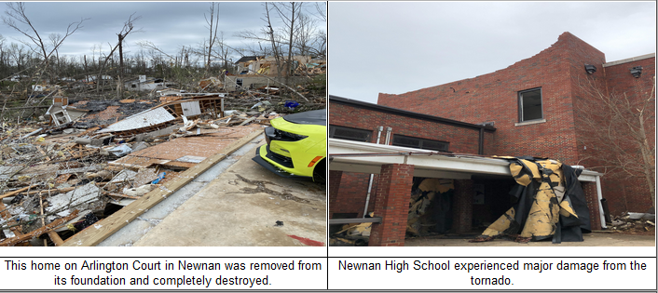
Introduction
Data available from
North Georgia LMA
GLM
Infrasound
Events
March 25-26, 2021 Newnan EF-4
May 3, 2021 southwest Atlanta EF-1
Images: NWS FFC

Slide 3
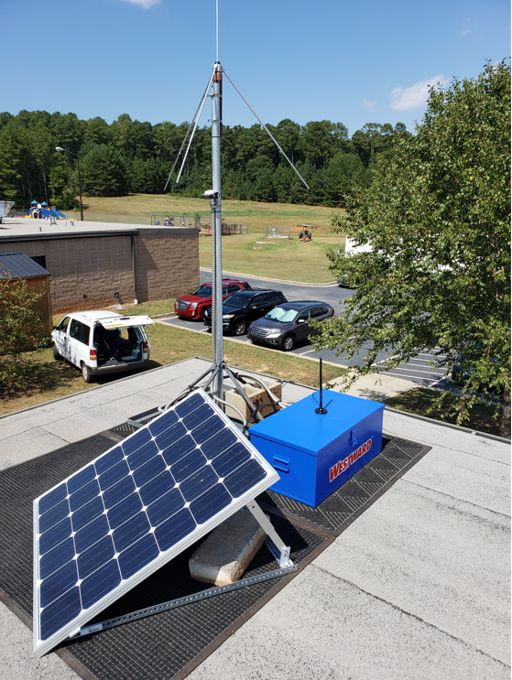
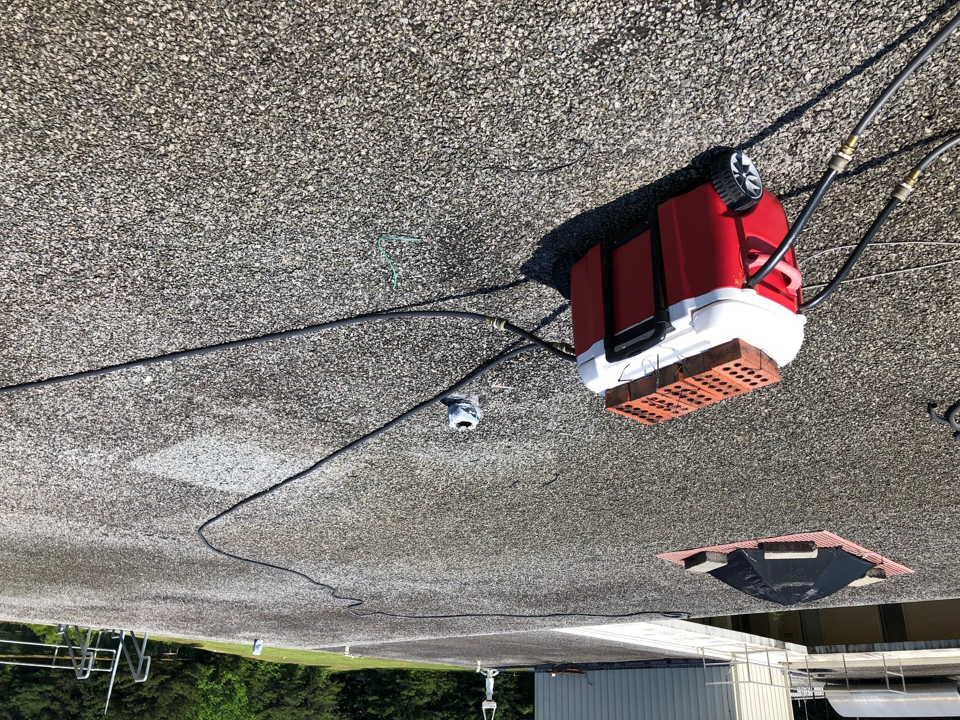
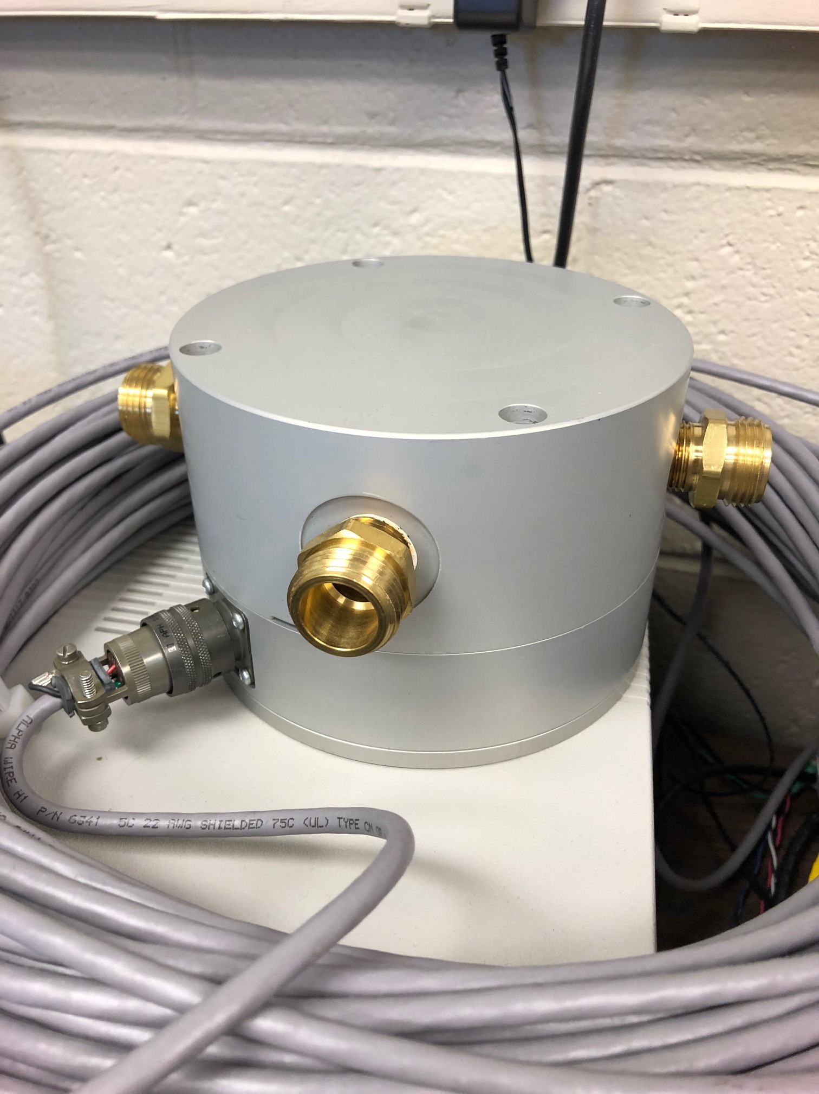
SSRC Instruments
NGLMA
Network of 10 sensors centered on downtown Atlanta
GT Atmospheric Infrasound Array (GAIA)
4 sensors on the roof, operating 24/7 for more than two years
Listening for natural and man-made sounds below 20 Hz, including those made by tornadoes

Slide 4
March 25-26, 2021: Newnan EF-4
Occurred at the end of a day of several rounds of severe weather in AL and GA. Supercell tracked from AL
On the ground for 53 min, 39 miles
1 fatality, 0 injuries
Image: NWS FFC

Slide 5
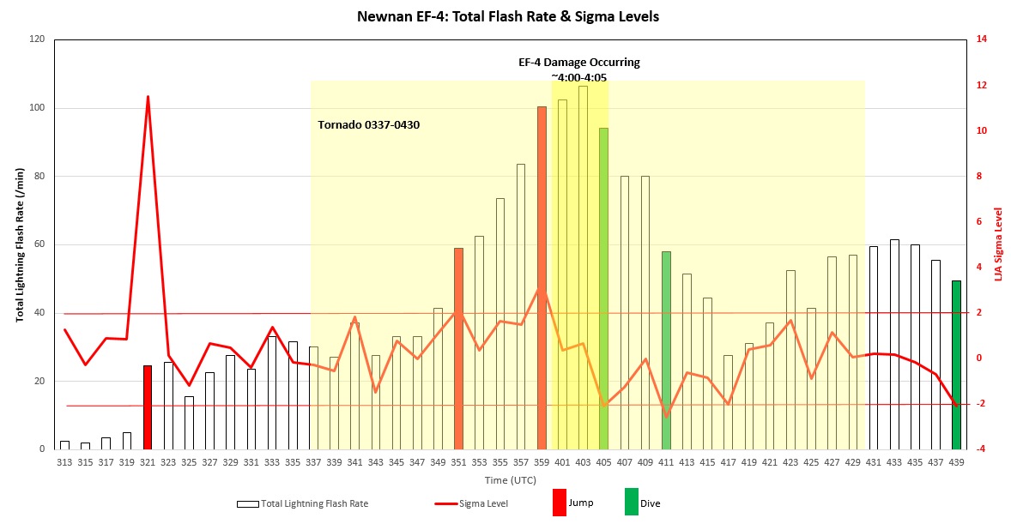
NGLMA Data: Newnan EF-4 Jumps, Dives, Sigma Level
Flash rate totals are medium flashes (11-74 sources) + big flashes (75+ sources)
9 NGLMA sensors online
Used Schultz’s LJA
After Stough et al., 2018

Slide 6
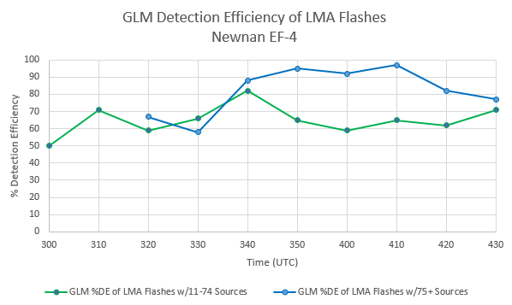
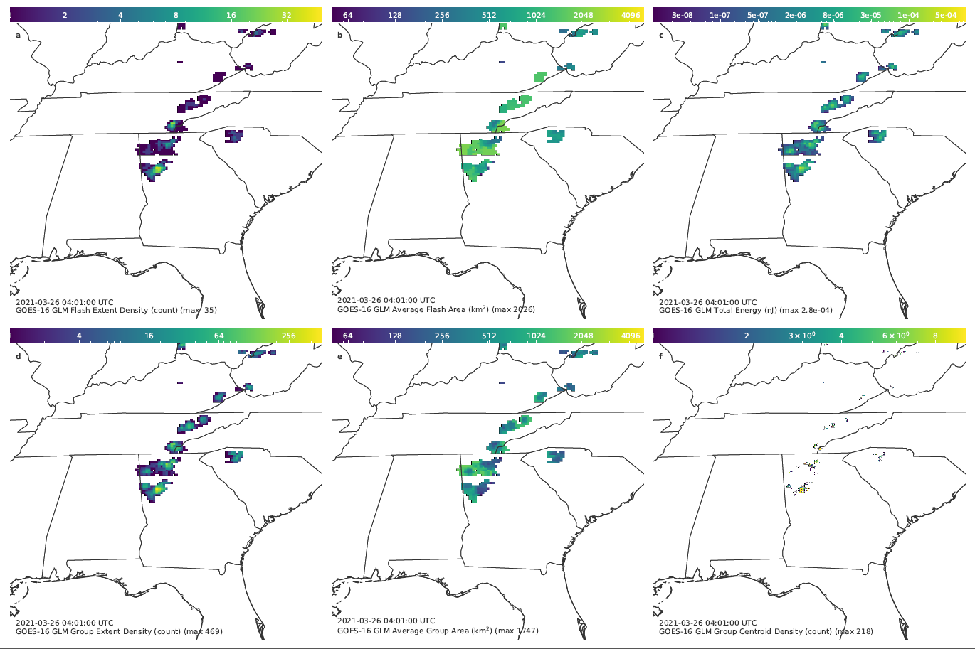
GLM and LMA Comparisons via XLMA
GLM DE is lower for medium flashes
Follows Zhang and Cummins (2020 JGR)
Severe storms often have short duration flashes (Bruning 2010), so IC flashes may not last long enough to produce channels with long/bright enough sources for GLM to detect

Slide 7
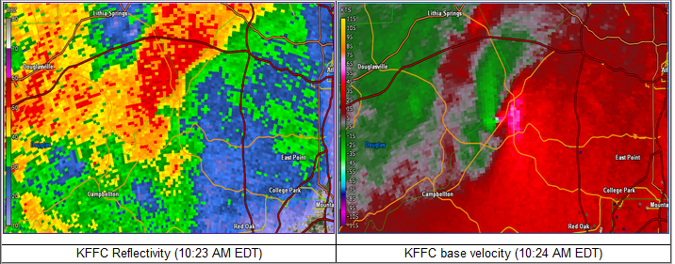
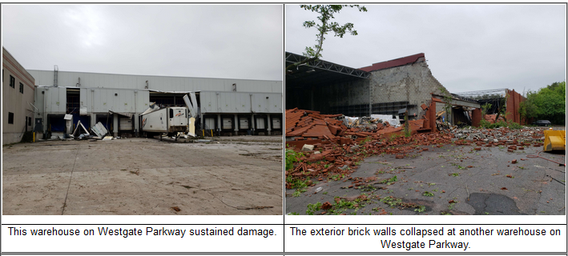
May 3, 2021: SW Atlanta EF-1
Two EF-1s, occurring about 20 min apart
Douglas County: 10:00-10:03 EDT
SW Atlanta: 10:22-10:34 EDT
Spawned from supercell that developed in AL 2 hr prior
Images: NWS FFC

Slide 8
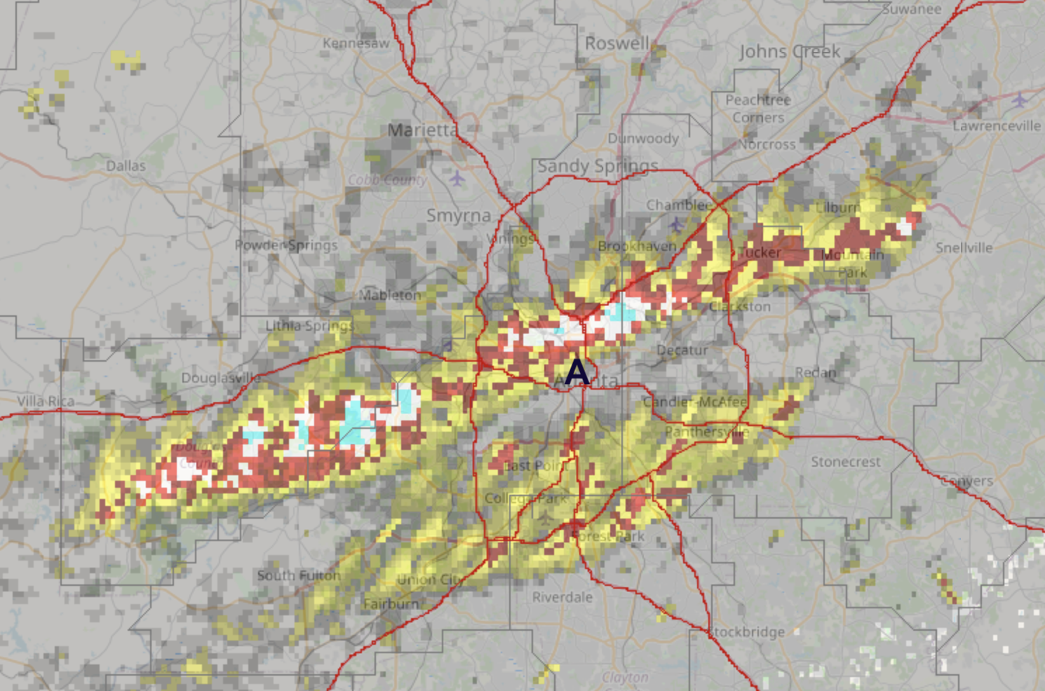
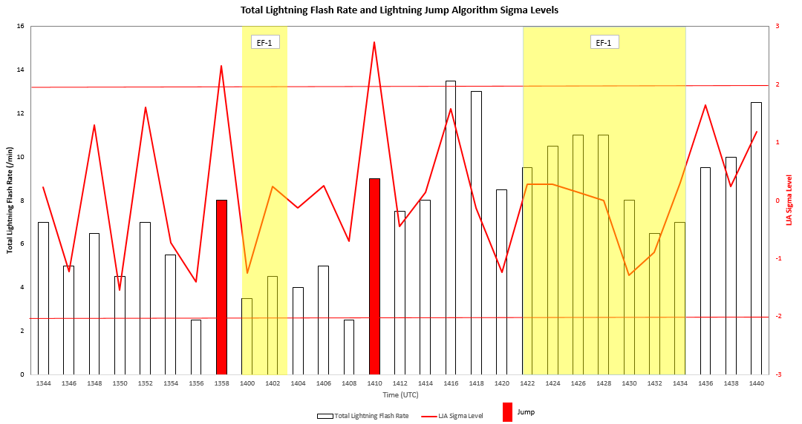
NGLMA Data: SW Atlanta EF-1 Jumps, Dives, Sigma Level
Jump preceded both EF-1s. No dives were observed.
2 min before first EF-1
12 min before second EF-1
After Stough et al., 2018

Slide 9
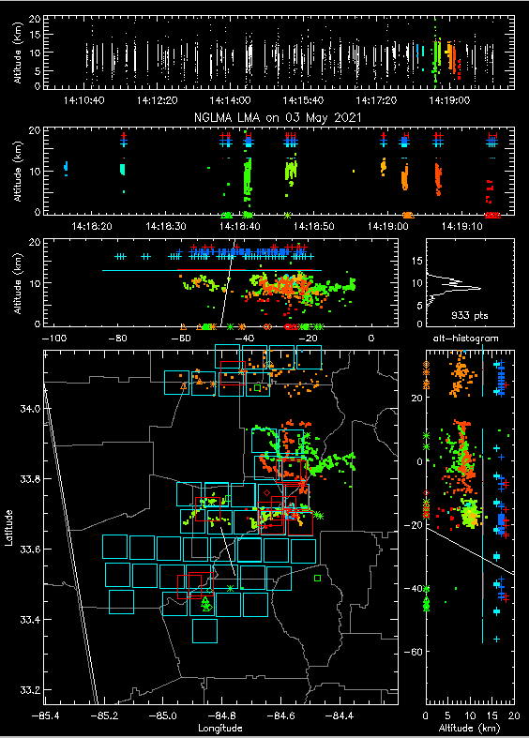
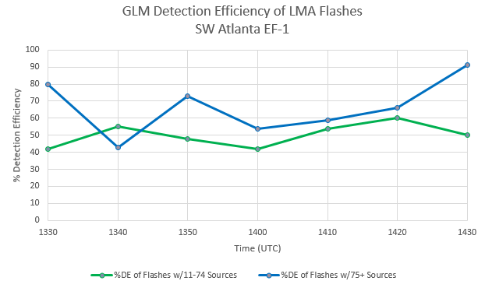
GLM and LMA Comparison via XLMA
GLM has lower DE with medium flashes, big flashes aren’t very high either

Slide 10
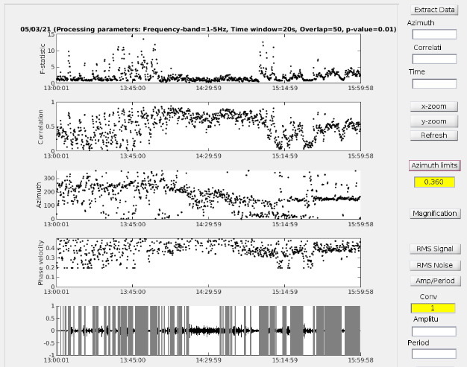
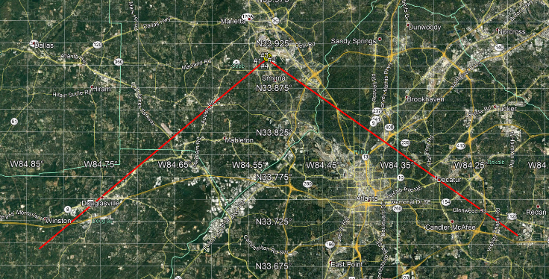
SW Atlanta EF-1: Infrasound
14:02 GMT a possible tornado at
Bearing of 223 degrees
Distance of 35 km from the array
Tracked by NEXRAD 220 degrees and at 23 km by 14:20 GMT
Continued to 118 degrees at 23 km by 15:00 GMT
These bearings and times are consistent with InfraMonitor analysis

Slide 11
Summary
Seeing jumps and some dives before tornadic events
Next: study non-tornadic supercellular storm from same day
Look at more events on March 25, including a significant downburst
GLM DE low compared to LMA
Looking for opportunities to collaborate with others on LMA and GLM topics
Contacts: Jessica Losego, jessica.losego@gtri.gatech.edu
John Trostel, john.trostel@gtri.gatech.edu

