Slide 1
Research to Operation at the NMS of Argentina: GLM Case Study and Applications
GLM Virtual Science Meeting
September 2021
Melissa Patanella
Nowcasting Office
mpatanella@smn.gob.ar

Slide 2
Case study
MCS in central and northern Argentina
November 11th to 12th, 2018
RELAMPAGO project

Slide 3
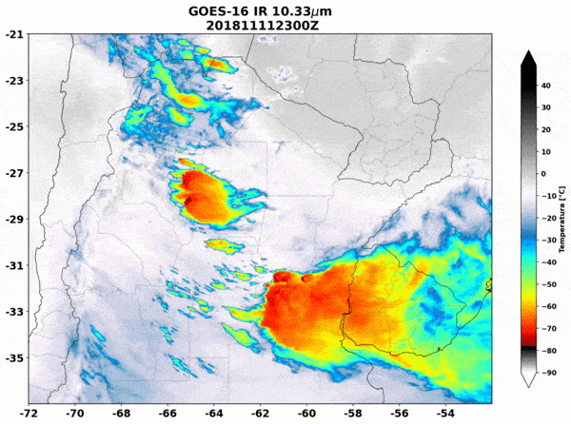
GOES-16 Channel 13
Channel 13
IR - 10.3 μm
What for?
To follow the development of the MCS in time and space.

Slide 4
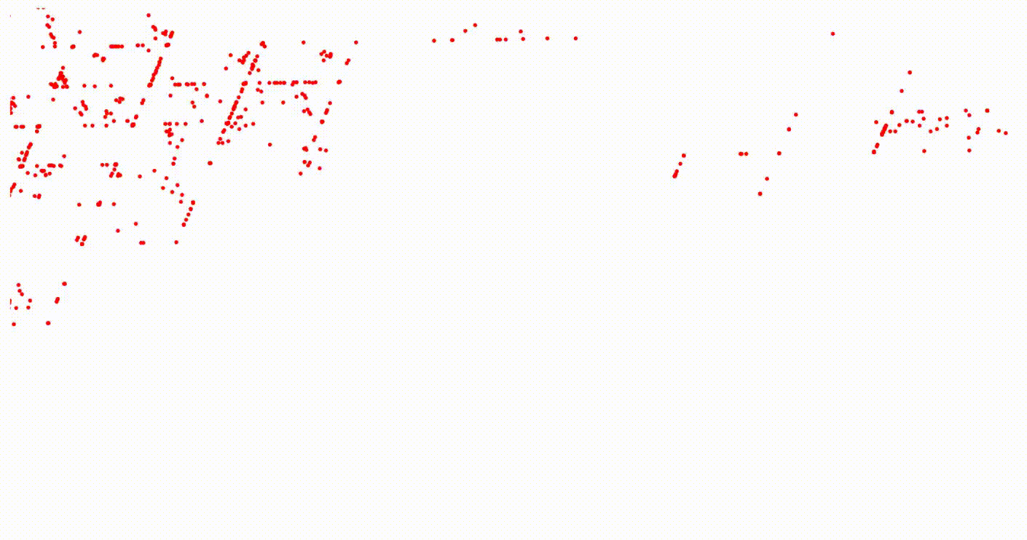
Temporal evolution of lightning flashes
GLM Product (L2)
⬇
Lightning Detection, Events, Groups And Flashes
from the
LCFA (Lightning Cluster Filter Algorithm)
Example of raw lightning flash data for a limited domain in Argentina

Slide 5
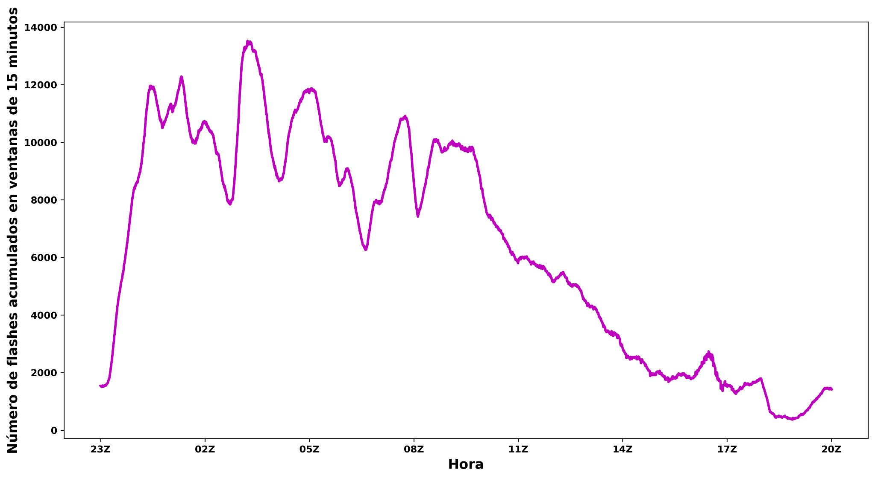
3
2
4
5
Accumulated flashes calculated in 15-minute windows
1
Hour

Slide 6
Developing stage
Mature
stage
Dissipating
stage
3
2
4
5
Accumulated flashes calculated in 15-minute windows
1
Hour

Slide 7
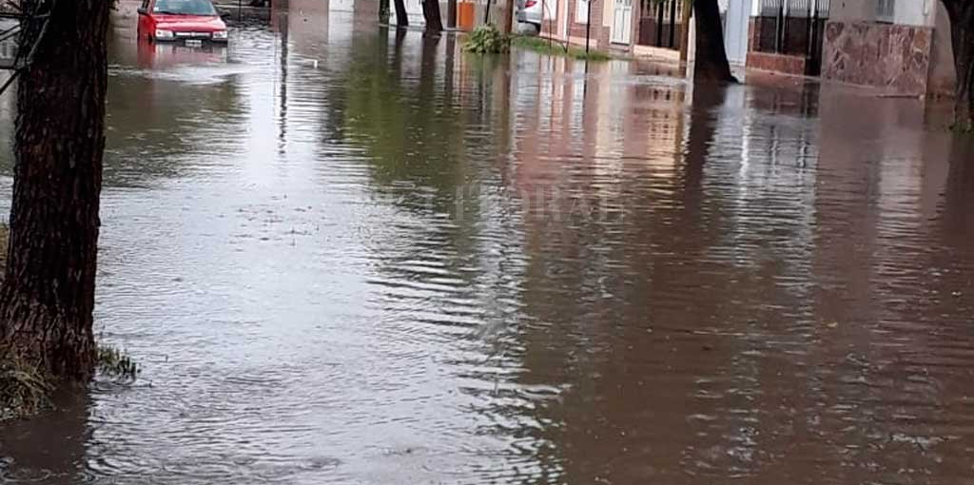
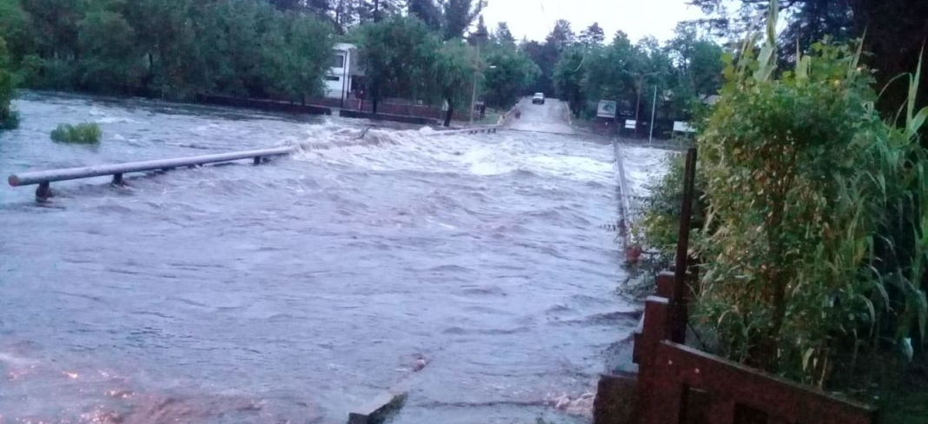
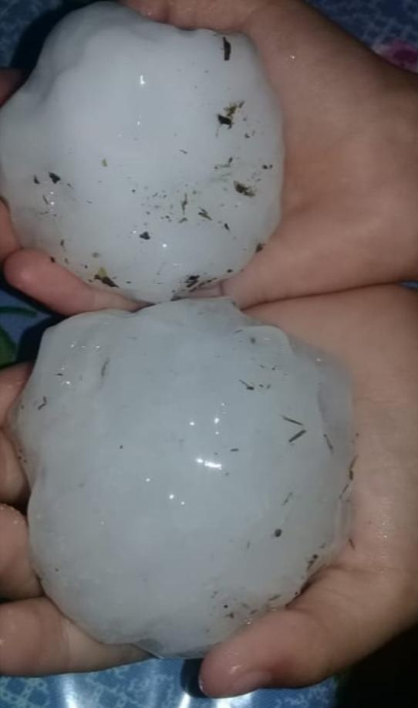
Severe weather reports
Flash floods, wind gusts and hail were reported during the most intense part of the life cycle of the MCS.
2
3
4
5
Accumulated flashes calculated in 15-minute windows
1
Hour

Slide 8
Applications of GLM data
in the NMS of Argentina
Weather Warnings
Future applications

Slide 9
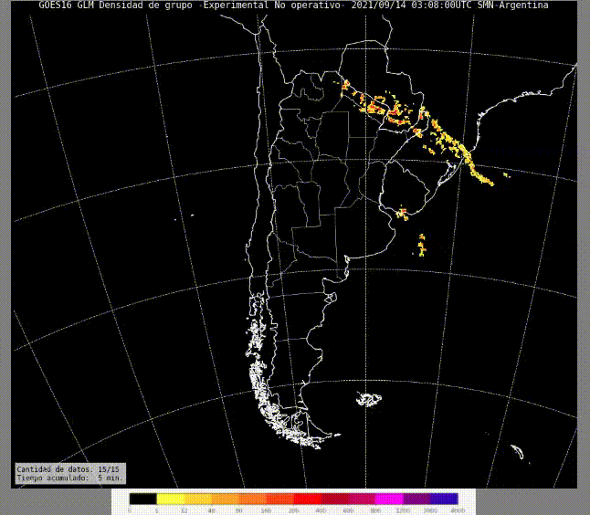
How do we use GLM
data in the NMS?
Group density accumulated in a 5-min moving windows updating every 1 min.
Data is acquired by a satellite receiver located in the NMS.
Example of GLM data used at the NMS

Slide 10
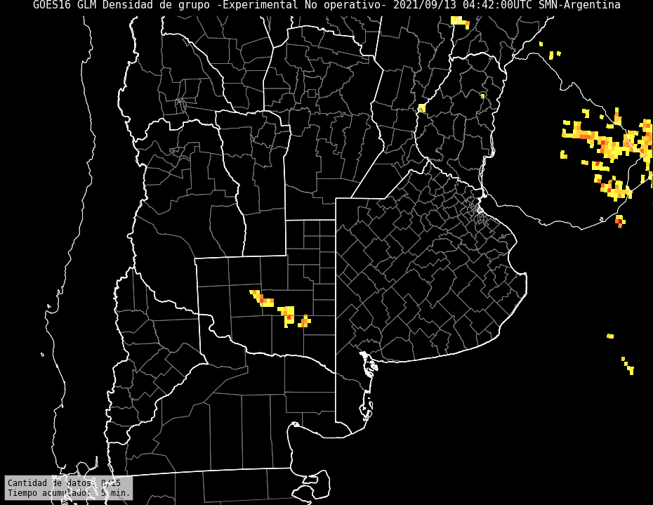
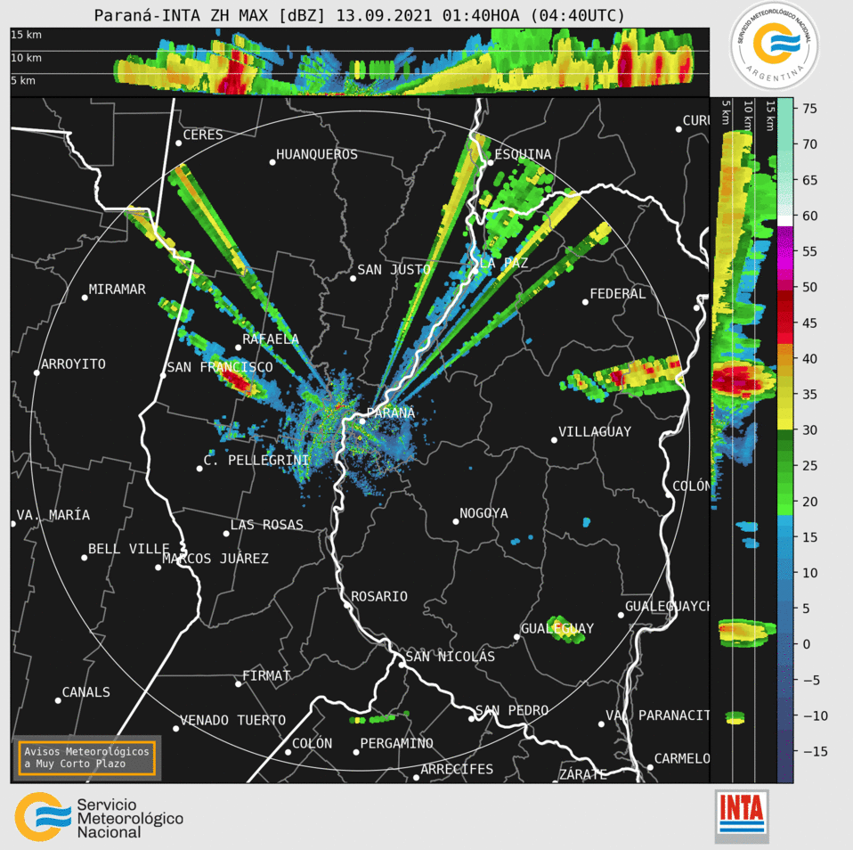
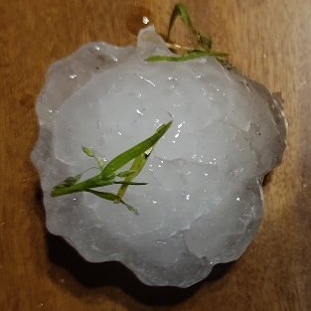
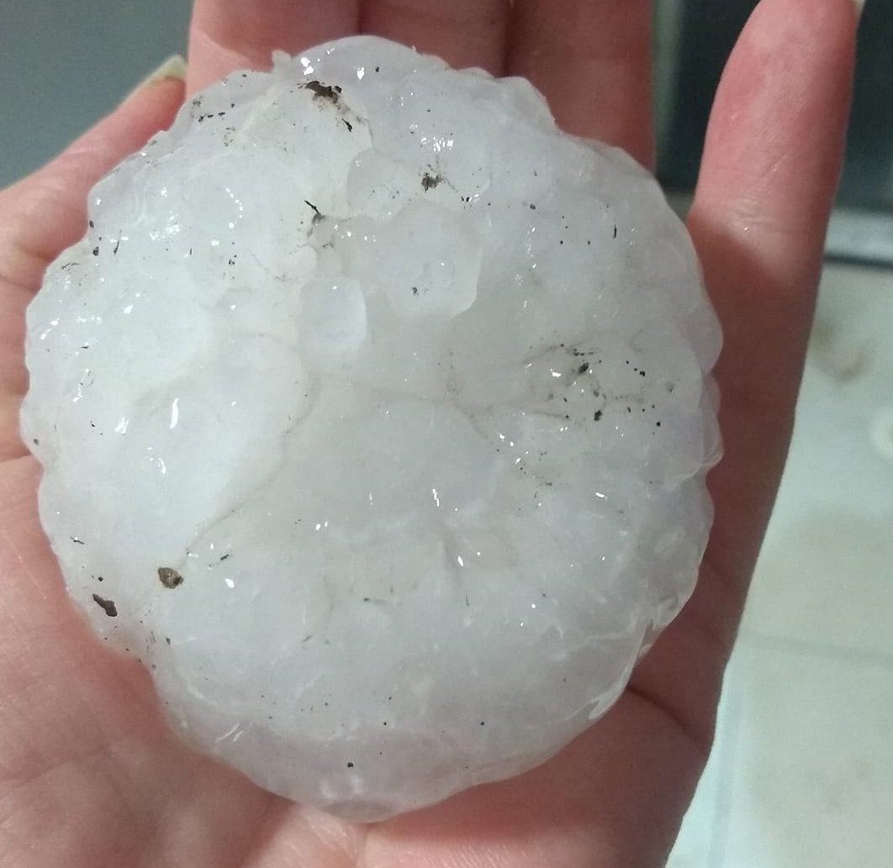
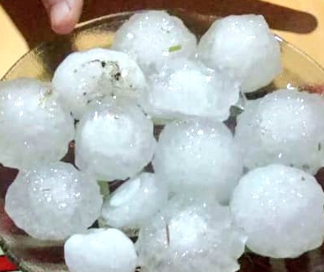
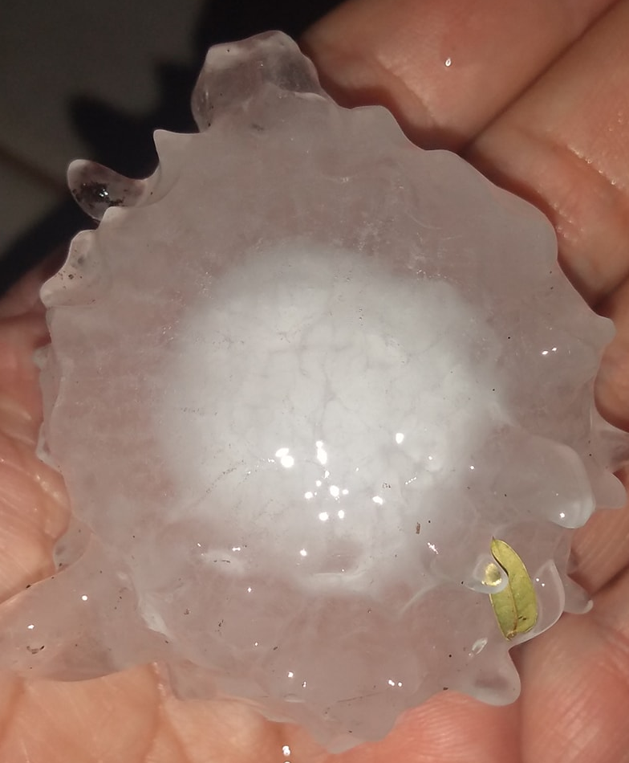
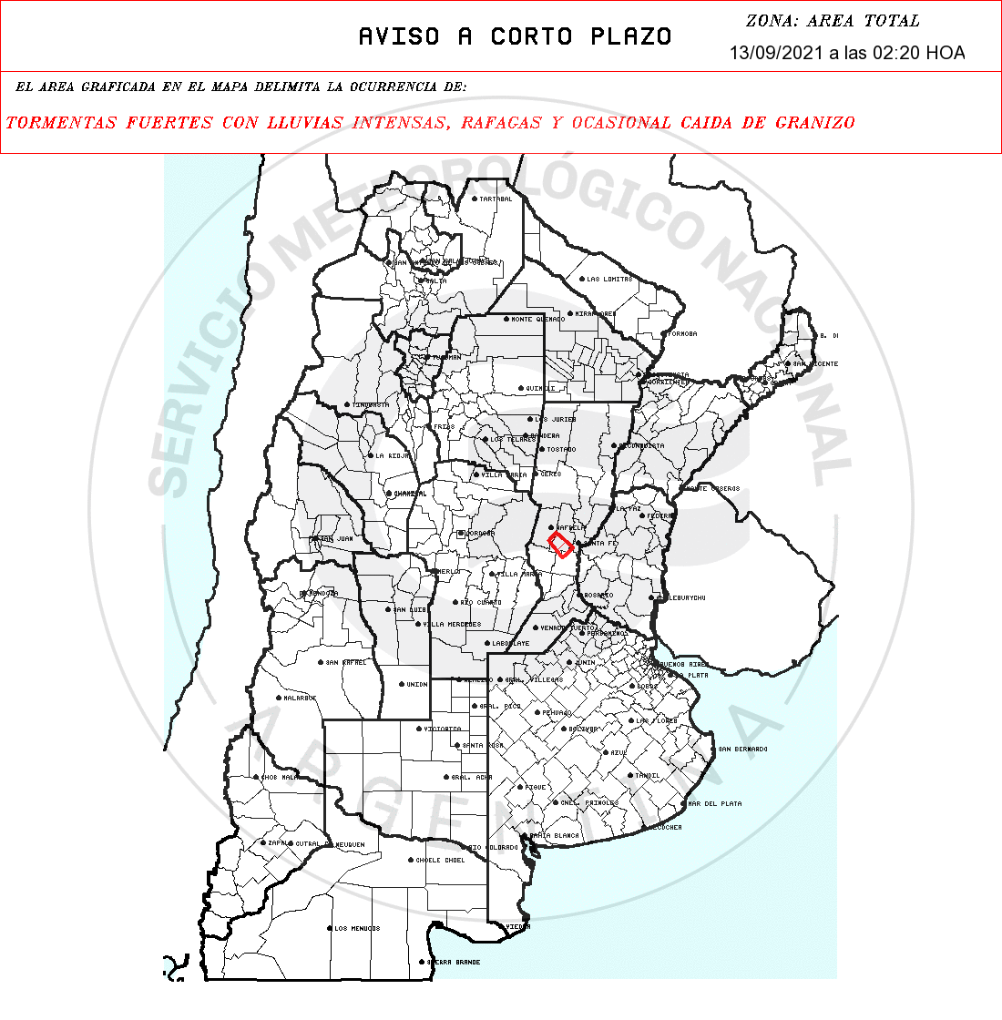
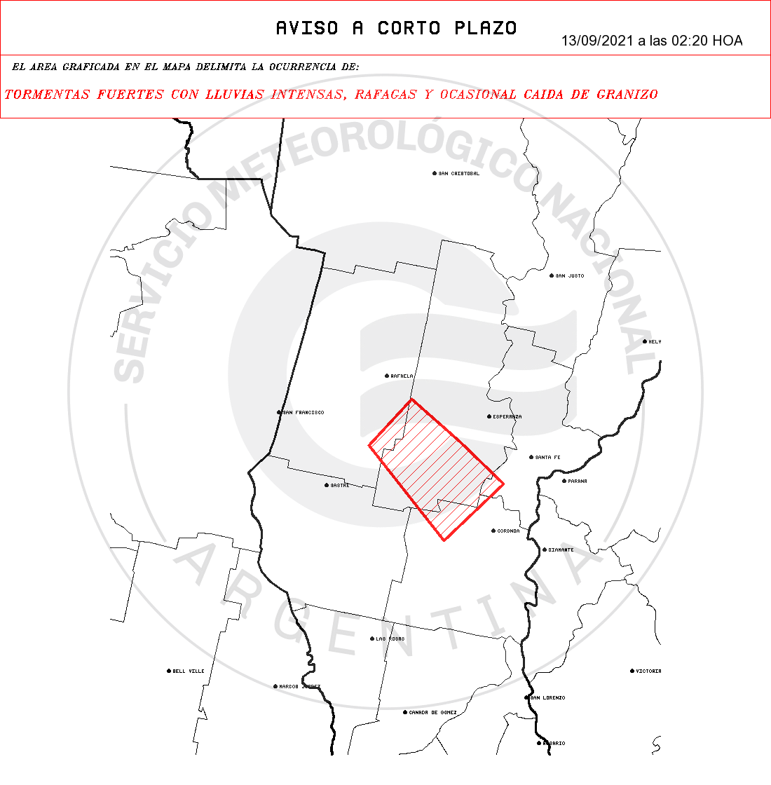
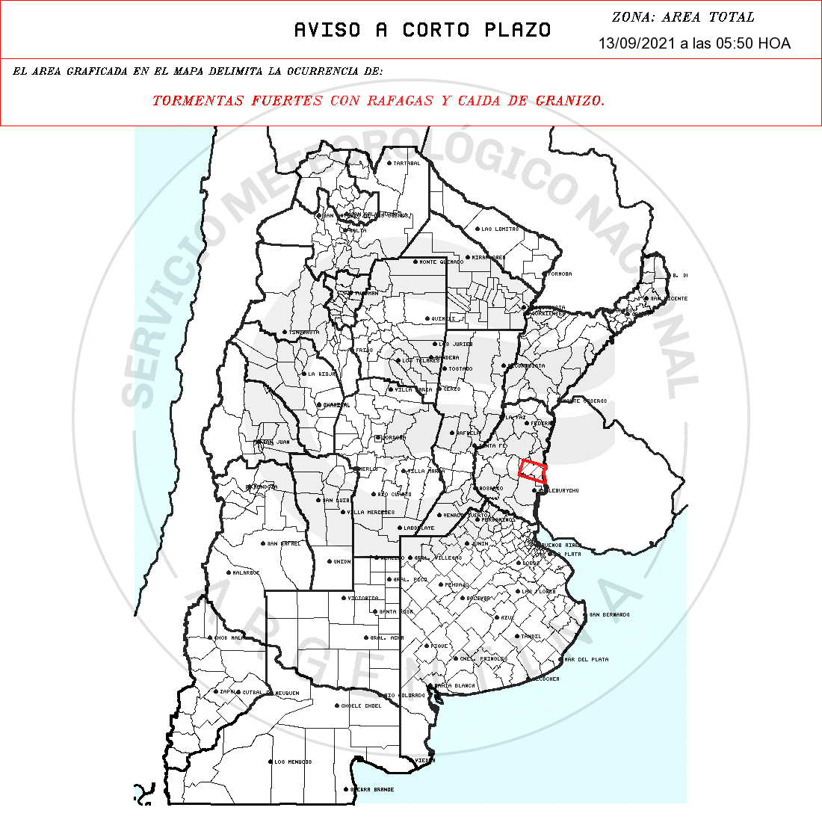
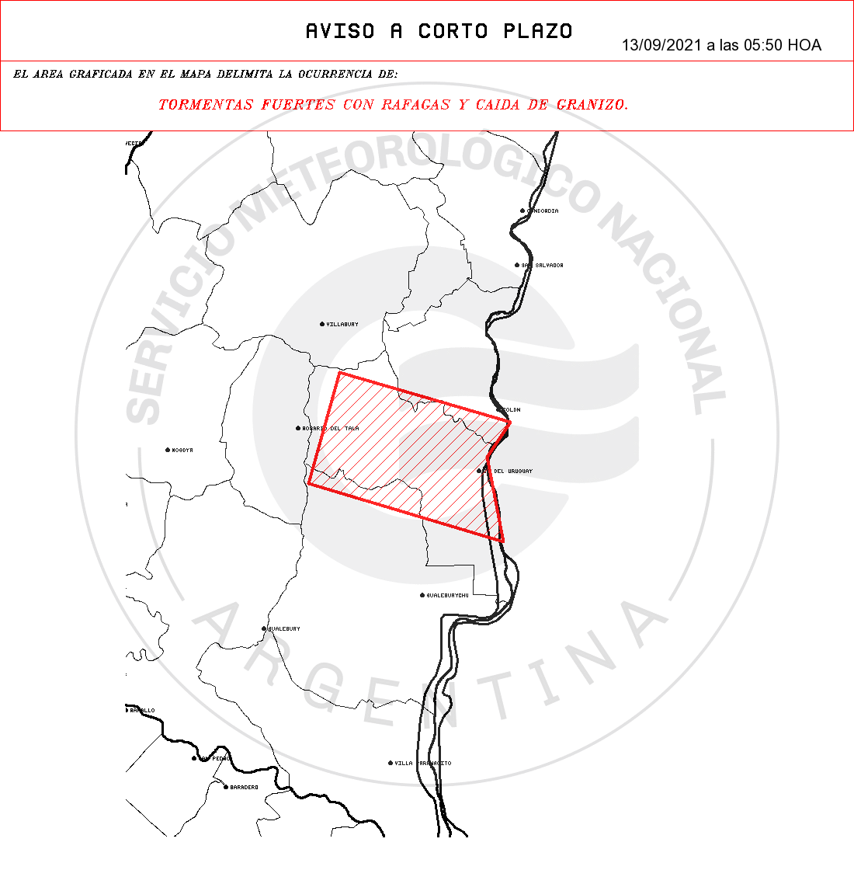
Examples of weather warnings

Slide 11
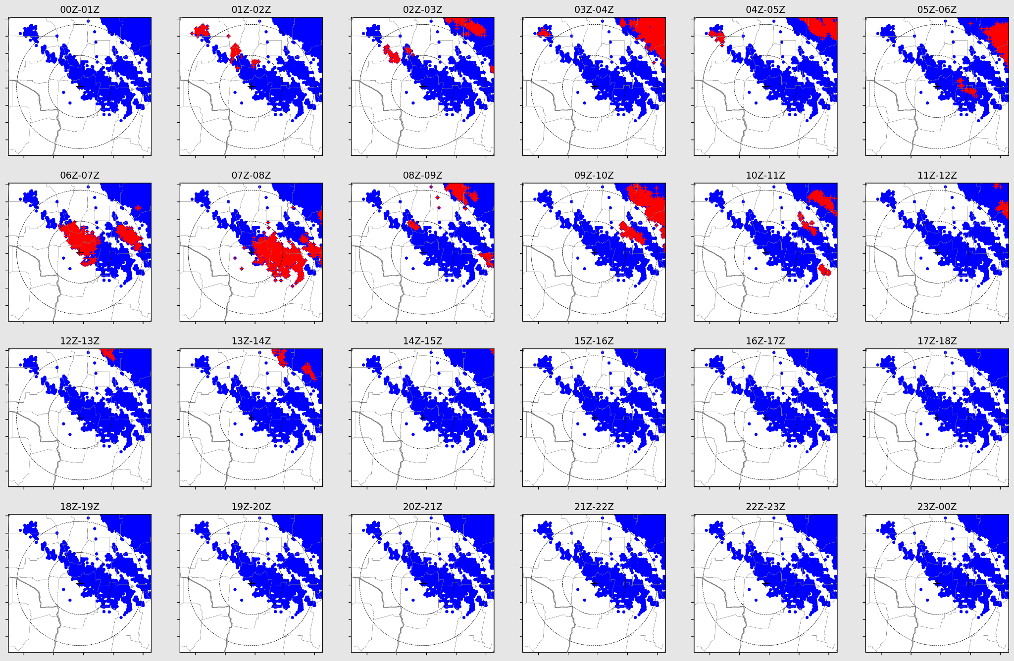
How do we use GLM data in the NMS?
Meteorological Information Center
Reports about the occurrence or not of lightning in a determined area.
Example of a case study

Slide 12
Other projects that are we are working on at the NMS using GLM data
Lightning jump algorithm for nowcasting.
Monitoring fire hazards.
Better detection of convective clusters in ForTraCC (Forecast and Tracking the Evolution of Cloud Clusters) using ABI and GLM data.

