Slide 1
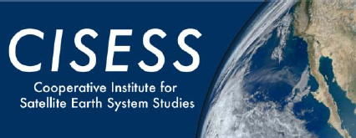
GLM False Returns: Sources and Examples
Hurricane Ida Minimum Flash Area & CH02/Visible Imagery
Joseph Patton (UMD/CISESS)
GLM Science Meeting 2021
September 21st, 2021

Slide 2
Previous Training on GLM False Returns
Data Quality Quick Briefs/Guides produced in 2018 and 2020
Need for more/updated training for GLM false flashes/data quality

Slide 3
Main Sources of GLM False Returns
False Return Source | Mitigation | Characteristics
Radiation Dots | Radiation Dot Filter | Single pixel
Hot Pixels | Second Level Threshold | Temporary or persistent
Sun Glint | Blooming Filter | Known locations and timing
Solar Intrusion | Blooming Filter | Only in eclipse seasons
(Inverse) Bahamas Bar | Second Level Threshold | Certain subarray boundaries
Bolides/Satellites | Training | Can provide confirmation
Spacecraft Stability Disruptions | Notifications | Cloud edge triggers
Rebound Events | Training | Signify energetic flashes

Slide 4
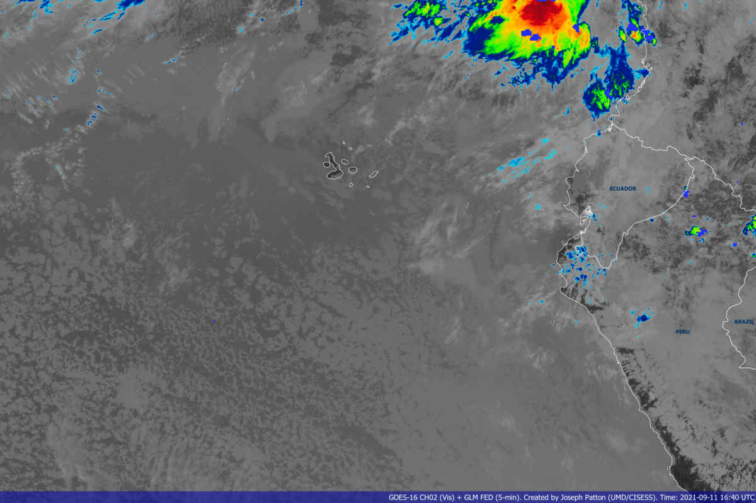
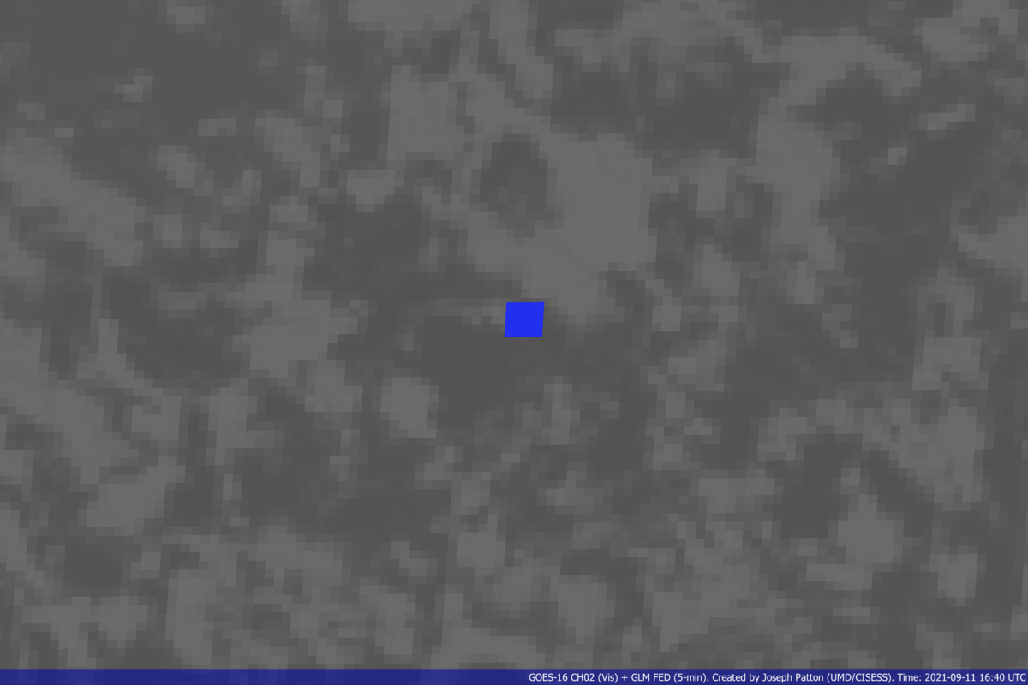
GLM False Returns Example – Radiation Dots
Short-lived, single-pixel false GLM returns which appear randomly in space and time
Caused by high energy particles incident on the GLM focal plane
Single group flashes are removed to help mitigate this artifact (i.e., radiation dot filter)

Slide 5
GLM False Returns Example – Hot Pixels
Inherently underperforming pixels are intrinsic to the GLM CCD (e.g., hot or dead pixels)
Transient hot pixel observed in Indiana, which resolved itself before fixes could be implemented
Second level threshold can “airbrush” out these artifacts
Background radiance and thresholds are higher during the day, disguising some of this noise, making the artifact most prevalent at night

Slide 6
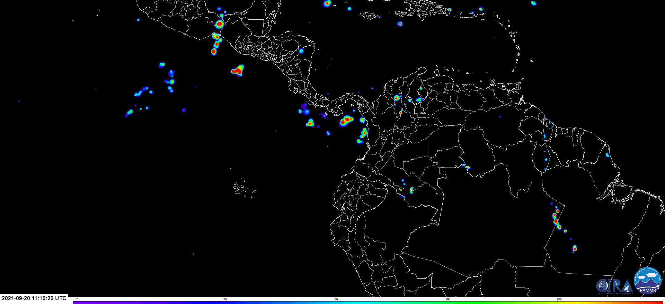
GLM False Returns Example – Hot Pixels
New hot pixel discovered in the South Pacific (around 7°S, 97°W) that has persisted since August 9th, 2021
Hot Pixel

Slide 7
GLM False Returns Example – Sun Glint
Sun light reflecting off calm bodies of water or man-made structures (e.g., solar farms)
Blooming filter prevents cascading events, but some artifacts remain (e.g., G17 over Gulf of Mexico and G16 over Amazon rainforest)
Some sun glint is still triggering lightning events, such as in the Amazon River basin
Sunlight reflecting off solar farms in Southern California, previously detected as lightning by the GLM in 2019, has been removed in identical imagery from 2020 and 2021

Slide 8
GLM False Returns Example – Solar Intrusion
Numerous transient false flashes occur during eclipse season (late February-mid April and late August-mid October)
ABI is mechanically blocked from viewing the Sun during these periods (causing a temporary regional ABI outage) while the GLM stares right at it!

Slide 9
GLM False Returns Example – Bahamas Bar
False flashes detected along certain subarray boundaries when clouds are present around local noon
“Inverse” bar artifact sometimes evident since the second-level threshold was applied
Both occur with similar solar/cloud conditions
Inverse Bahamas Bar Artifact

Slide 10
GLM False Returns Example – Bolides/Objects
GLM detects sudden brightness
Bright objects could include space rocks or other satellites
May show up as a streak or single pixel of false flashes
Straight trajectory, path duration, and
oscillating brightness suggest rotating object such as satellite or space rock

Slide 11
GLM False Returns Example – Bolides/Objects
Source: Automated NASA Bolide Detection Algorithm at https://neo-bolide.ndc.nasa.gov/
Source: Jay O’Brien/CBS-12 West Palm Beach, Florida

Slide 12
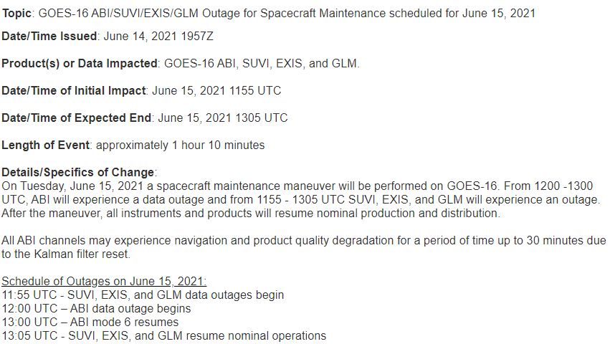
False Returns Example – Spacecraft Instability
Temporary GLM outages/false returns can be created by orbital maneuvers such as yaw flips with GOES-17 or satellite repositioning
Messages about possible outages/spacecraft disruptions are shared by OSPO here: https://www.ospo.noaa.gov/Operations/messages.html
Example of GOES outage message from June 2021

Slide 13
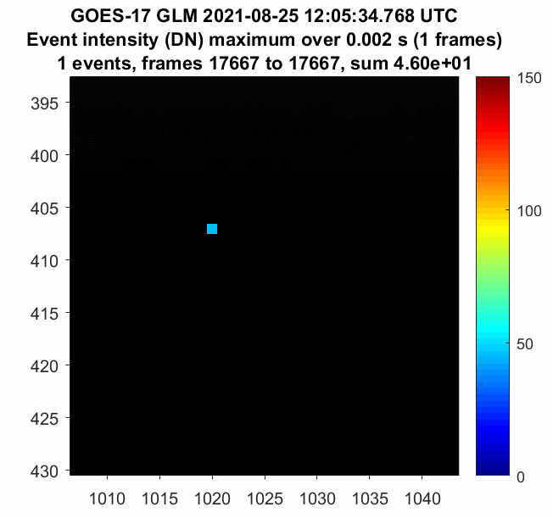
False Returns Example – Rebound Events
Abnormally bright and sustained flashes can cause “undershoot” in pixels aligned radially toward nadir; generates false returns after original flash ends until background average recovers
Animation courtesy of Clem Tillier

Slide 14
False Returns Example – Rebound Events
False GLM returns occur *after* original bright/sustained flash ends
Signify the occurrence of long continuing current
Most common at night, and more common with GOES-West
Same flash as in previous slide

Slide 15
Future Data Quality Training
Imagery/content/feedback from this presentation likely to be basis for future data quality training on the GLM (quick guide/brief)
Developing full disk image which indicates hot spots for certain recurring phenomena (sun glint, Bahamas bar, etc.)
Have any reports of possibly false GLM flashes? Send them our way!

Slide 16
Summary
Filters have greatly reduced the number of false returns observed by the GLM
Knowledge of common artifacts can reduce confusion for users
More “official” training will be developed on this topic
Eclipse season info: https://www.ospo.noaa.gov/Operations/GOES/eclipse.html
GLM VLab webpage for more training/info: https://vlab.noaa.gov/web/geostationary-lightning-mapper/

