Slide 1
River Breeze over the Amazon Seen from GOES-16 GLM and STARNET
2021 GLM Annual Science Meeting – 21-23 September 2021
Rachel Albrecht, Camila Lopes, Stefane Freitas, Carolina Monteiro, Hikari Fukuda, Thiago Biscaro, Alan Calheiros, Michael Cecchini, Luiz Machado, Henrique Barbosa, Paulo Artaxo, Andi Andrea
rachel.albrecht@iag.usp.br

Slide 2
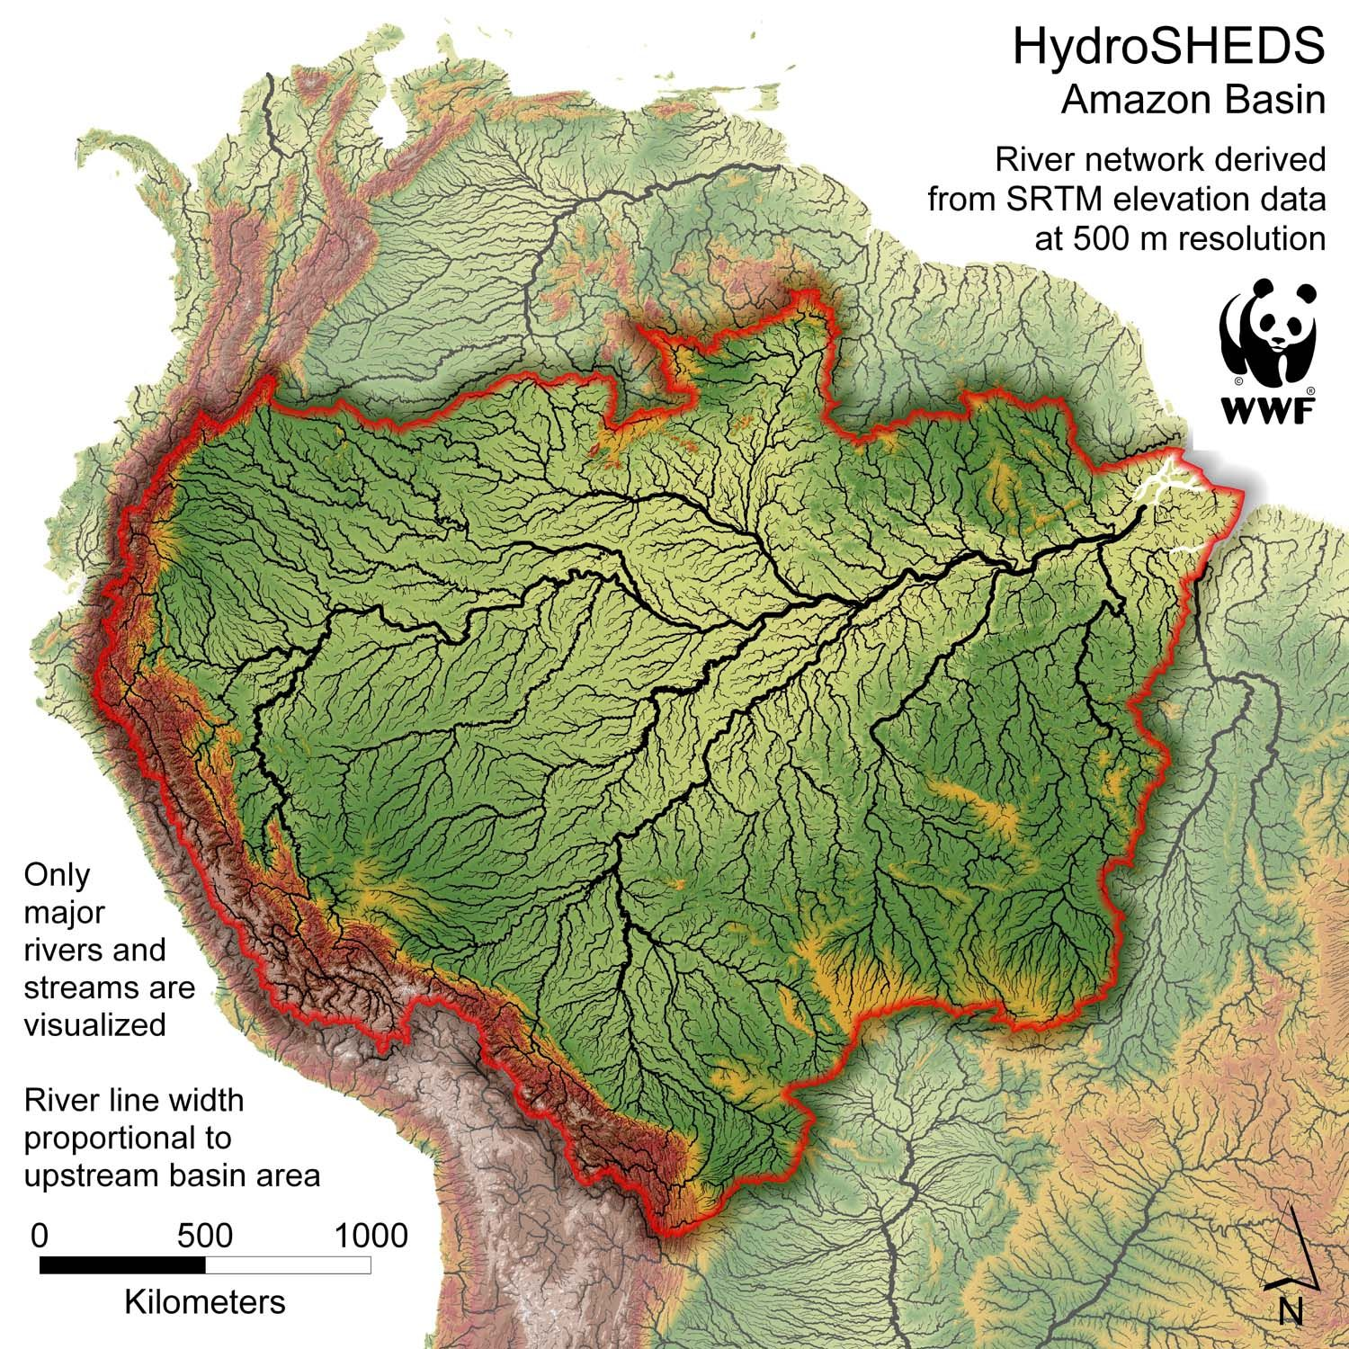
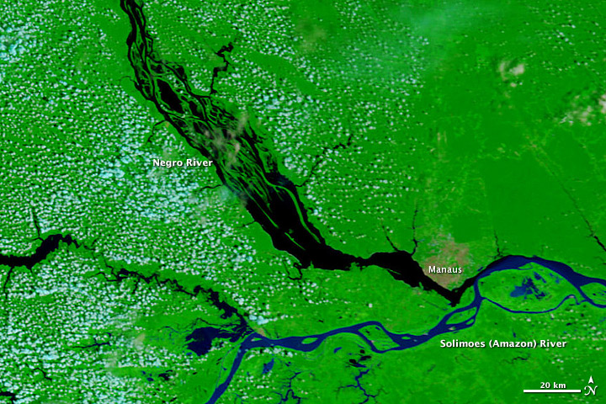
River breezes in the Amazon
The Amazon region comprises huge water bodies such as the Amazon, Negro, Solimões, and Tapajós Rivers.
Notes:
The Amazon region comprises huge water bodies, and has more than a 1,000 tributaries, some of which (Madeira, Rio Negro and the Japurá) are among the 10 largest rivers on the planet.
Of course, these rivers play a fundamental role on Amazonian hydrological cycle.
But they also play a significant role in the deep convection and lightning activity over the basin.
They have enormous dimensions... [ZOOM IN]
Because of their enormous dimensions, they induce large enough thermal differences between the river waters and the surrounding land, inducing circulations that resemble the sea breeze with shallow convection that builds up into deep convection and lightning associated.

Slide 3
River breezes in the Amazon
2020-08-27 0930 to 2230 UTC
[0530 to 1830 LST]
Notes:
GOES-16 ABI CH02 animation of convection over the Amazon on 27 August 2020 from 0930 UTC (0530 AM LST) and 2230 UTC (1830 PM LST)
This is a typical day in the Amazon during the “DRY” season
Starts with fog over the rivers in the early morning
Fog clears out in a few hours
Popcorn convection spreads over the basin as the diurnal heating peaks up
Land is warmer than river waters and the breeze can be seen as suppressed convection over the rivers
The convection builds up and thunderstorms pop up all over the basin and travel westward with the easterly flow

Slide 4
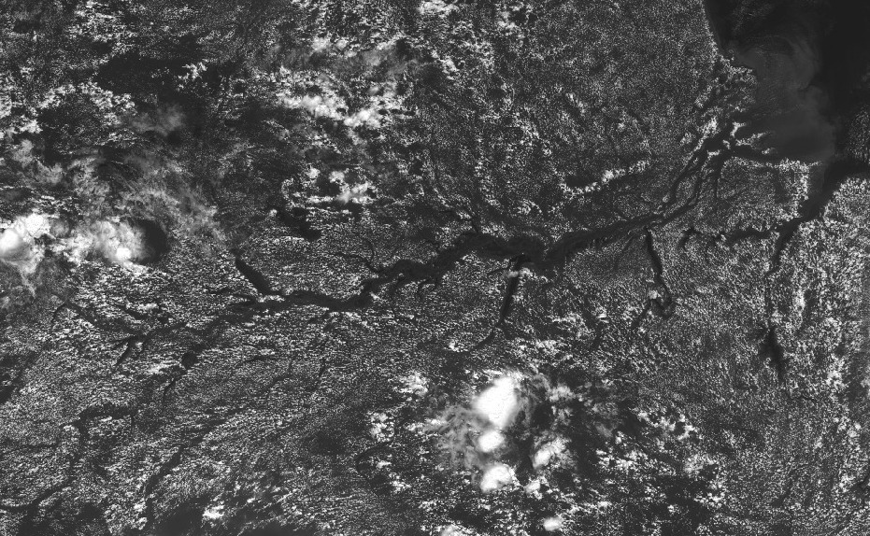
River breezes in the Amazon
2020-08-27 1600 UTC
[1200 LST]
2020-08-27 0930 to 2230 UTC
[0530 to 1830 LST]
COAST
Trombetas River
Uatumã River
Balbina Dam
Negro River
Purus River
MANAUS
Xingu River
Amazon River
Tapajós River
Madeira River
Notes:
GOES-16 ABI CH02 animation of convection over the Amazon on 27 August 2020 from 0930 UTC (0530 AM LST) and 2230 UTC (1830 PM LST)
This is a typical day in the Amazon during the “DRY” season
Starts with fog over the rivers in the early morning
Fog clears out in a few hours
Popcorn convection spreads over the basin as the diurnal heating peaks up
Land is warmer than river waters and the breeze can be seen as suppressed convection over the rivers
The convection builds up and thunderstorms pop up all over the basin and travel westward with the easterly flow

Slide 5
Objective
We use TRMM, STARNET and GOES-16 satellite data to show that specific rivers have an important and determinant role in the development of deep convection and very high flash rate density along the Amazon basin.
Data & Methodology
GOES-16 GLM data
2018, 2019, 2020
Composite maps and cycles by whole year, season, month and local solar time (LST)
whole Amazon Basin, over rivers, and tributaries “basins”

Slide 6
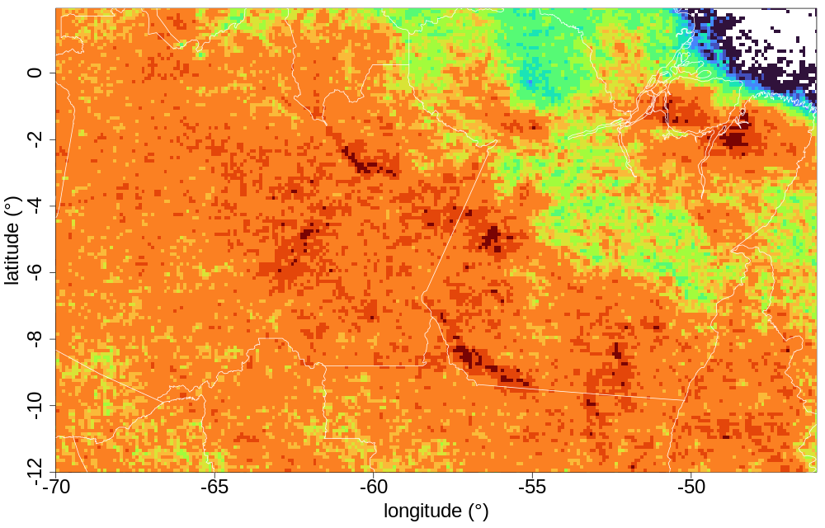
Preliminary RESULTS
Flash Rate Density - entire year, 2020:

Slide 7
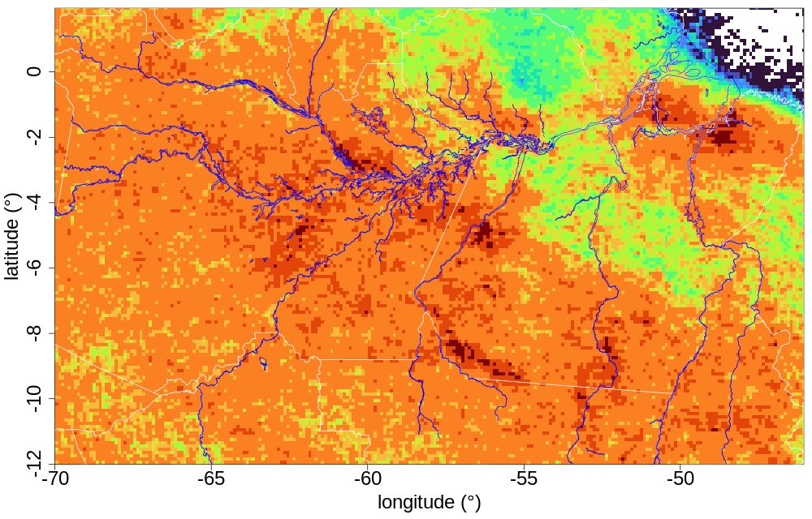
Preliminary RESULTS
Flash Rate Density - entire year, 2020:
Balbina Dam
Trombetas River
Negro River
Uatumã River
MANAUS
Amazon River

Slide 8
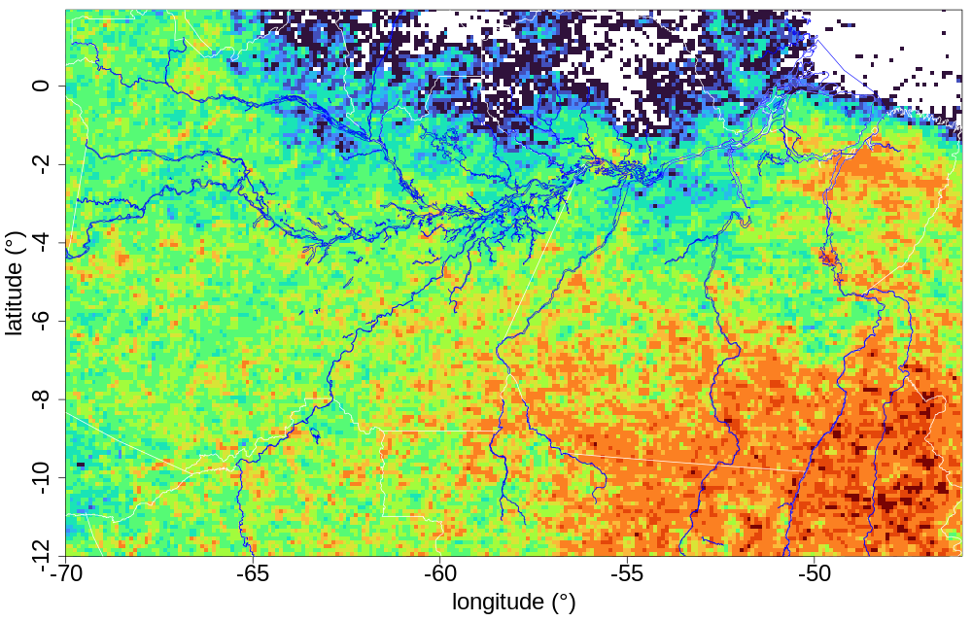
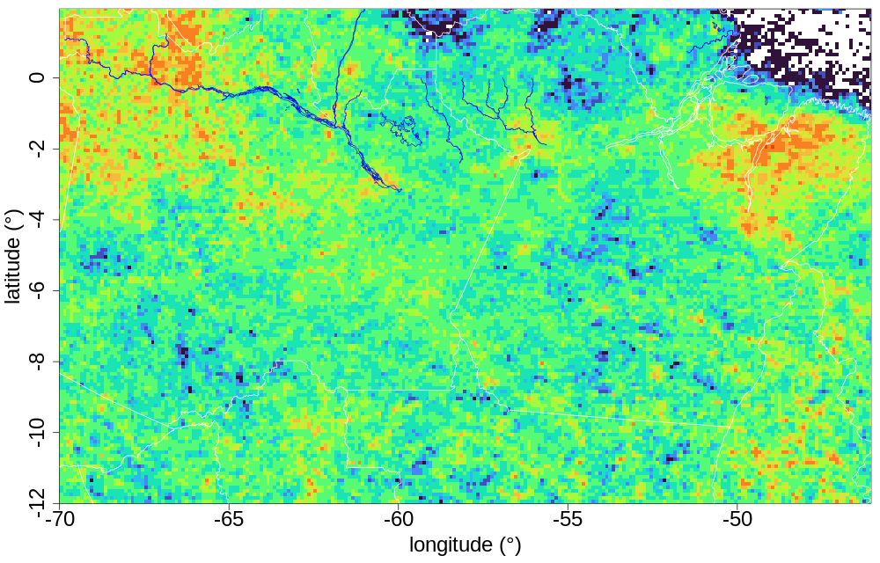
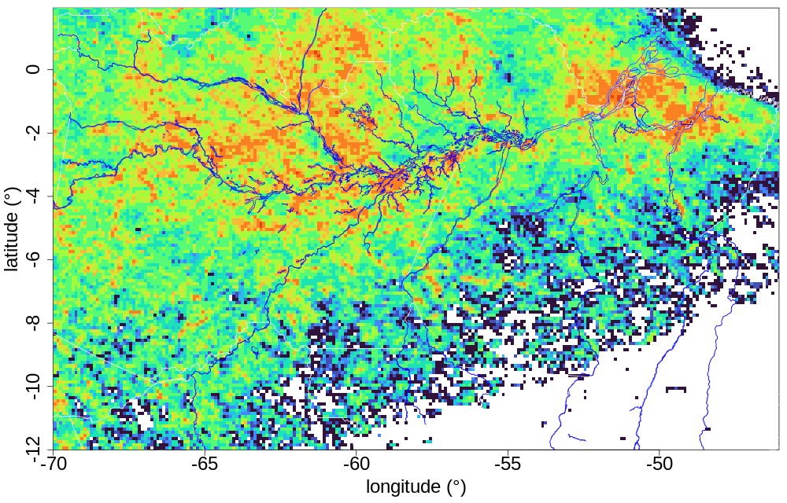
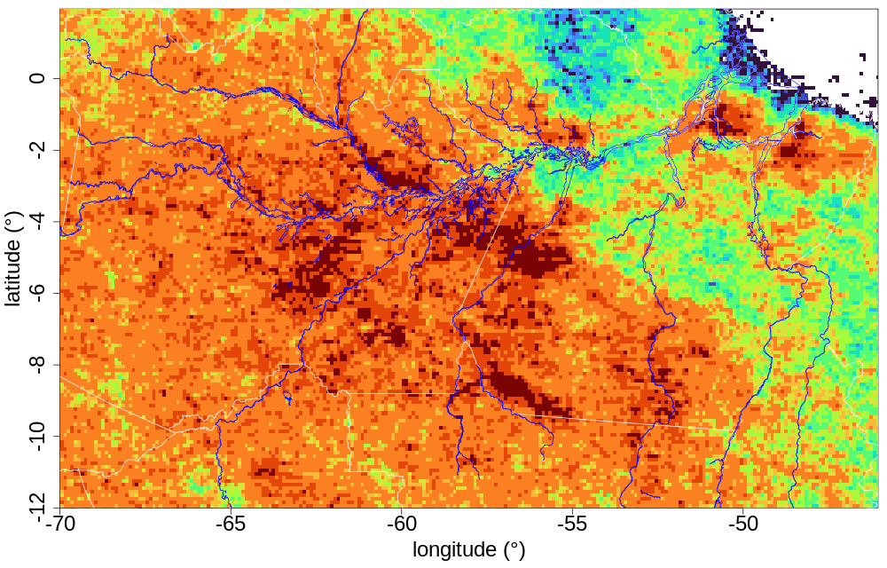
Preliminary RESULTS
Flash Rate Density – by season, 2020:
DJF
MAM
JJA
SON

Slide 9
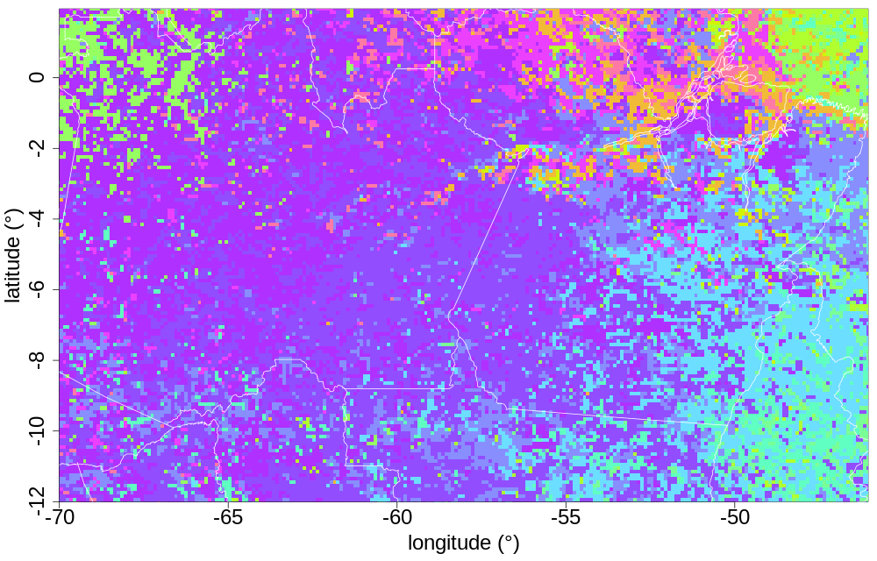
Preliminary RESULTS
Month of maximum Flash Rate Density - entire year, 2020:

Slide 10
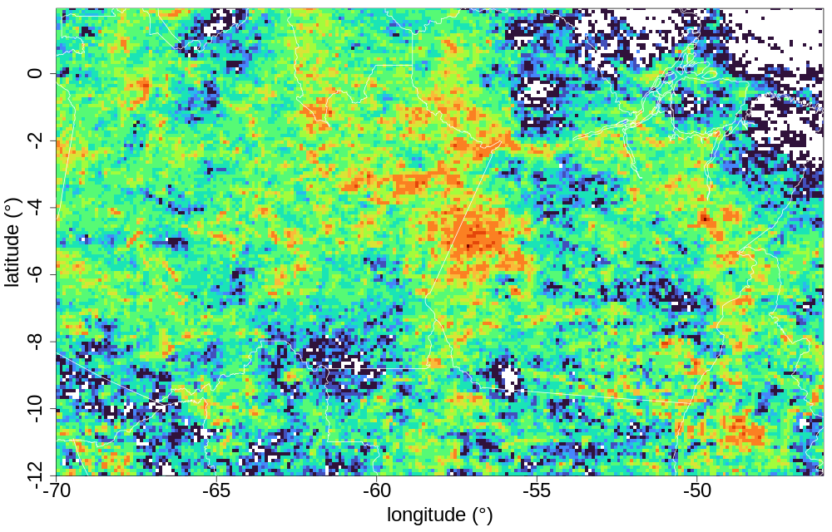
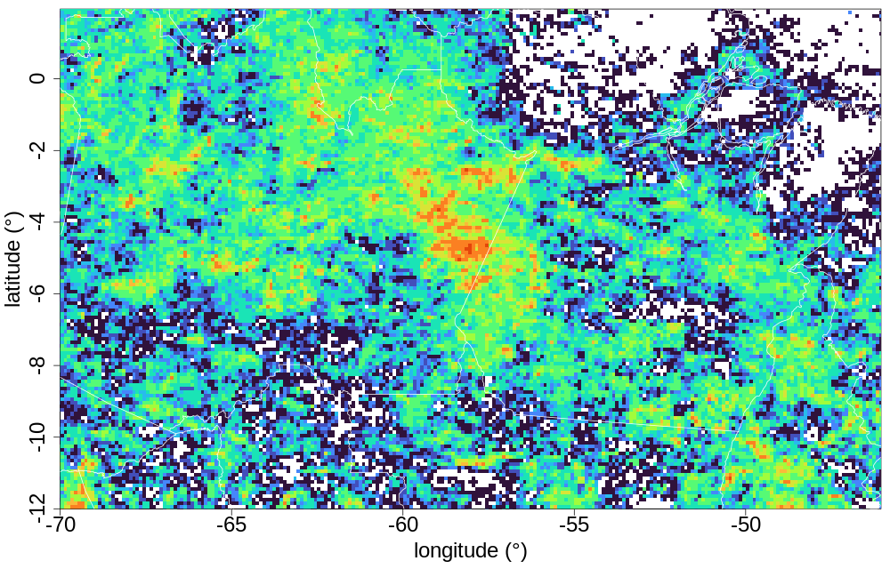
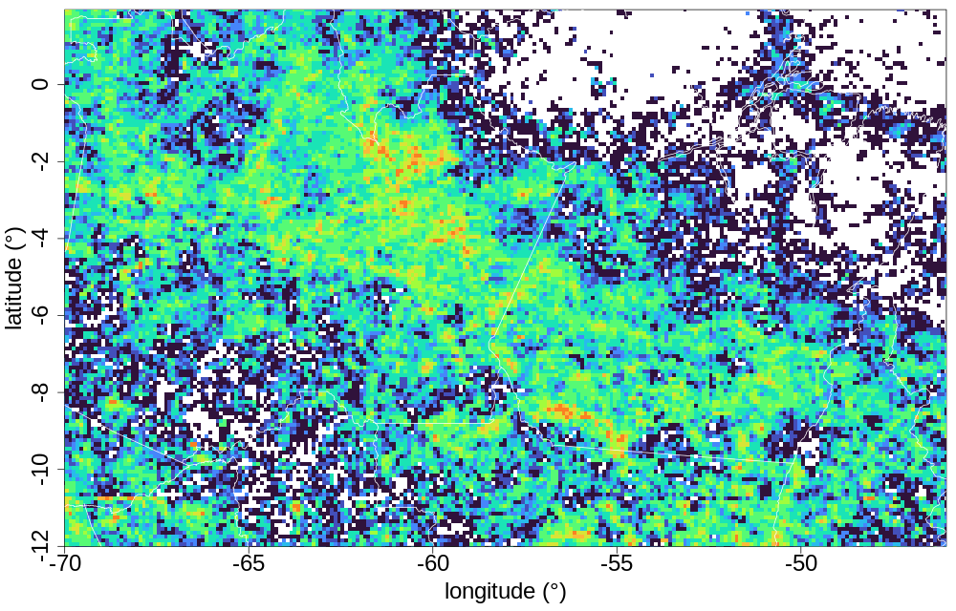
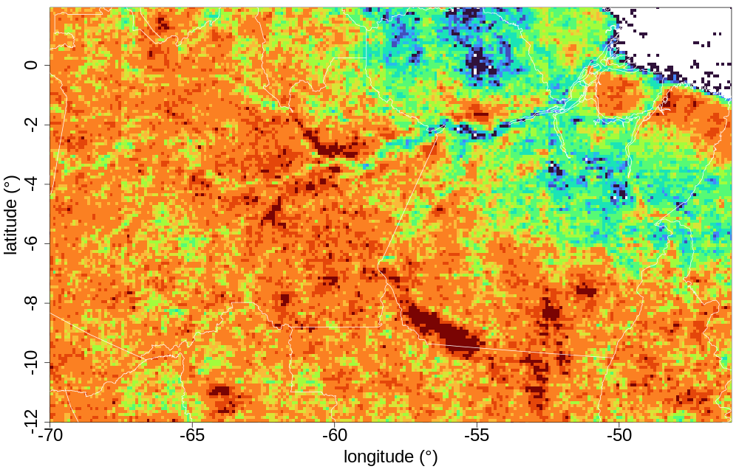
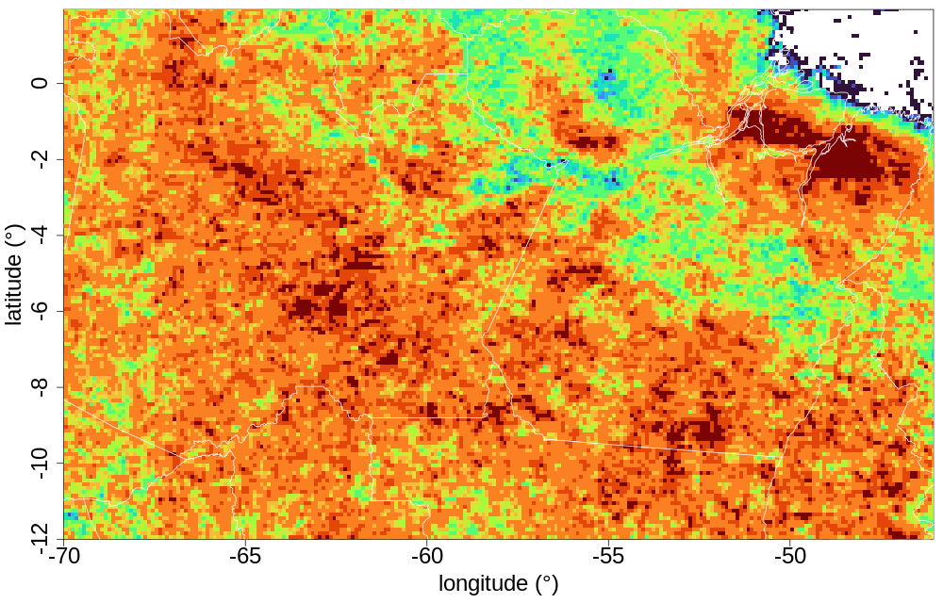
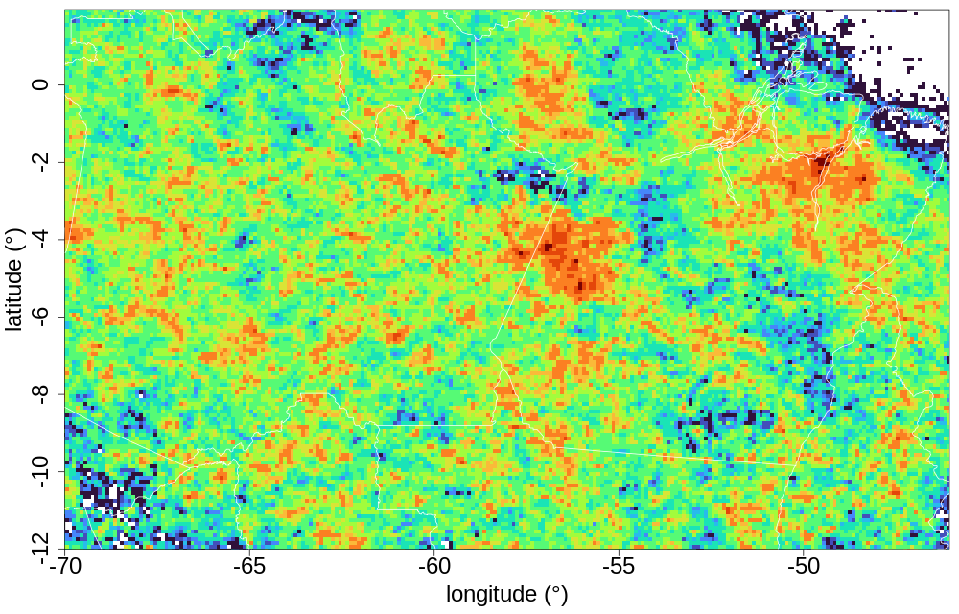
Preliminary RESULTS
Flash Rate Density – by time, 2020:
00–03
04–07
08–11
12–15
16–19
20-23

Slide 11
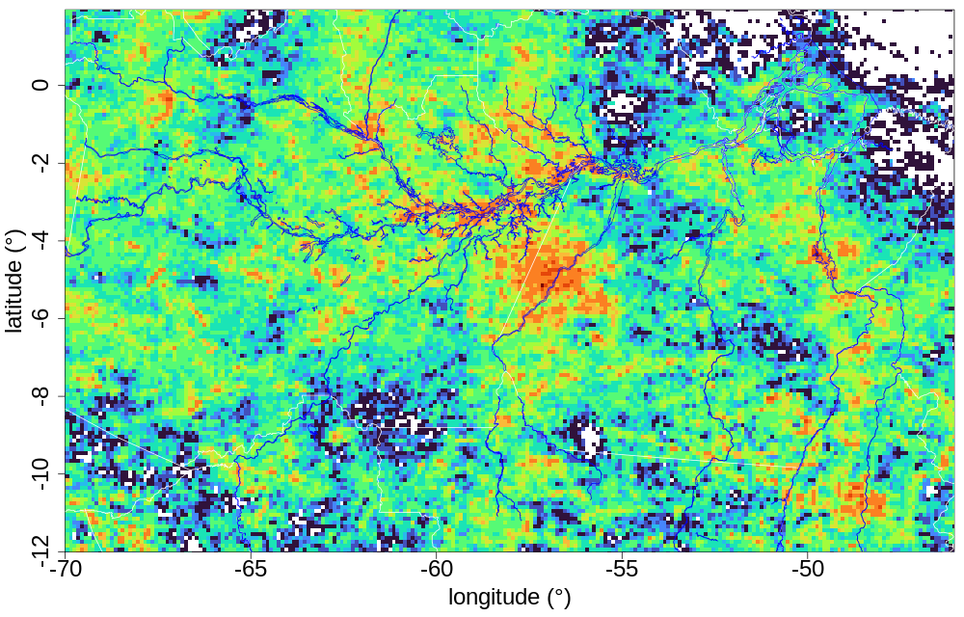
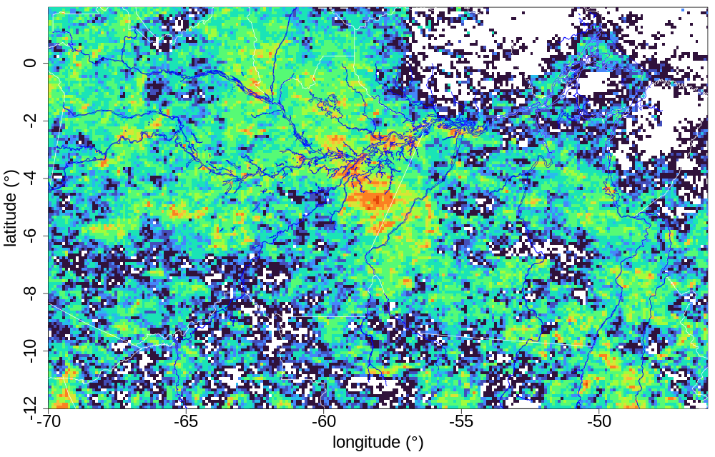
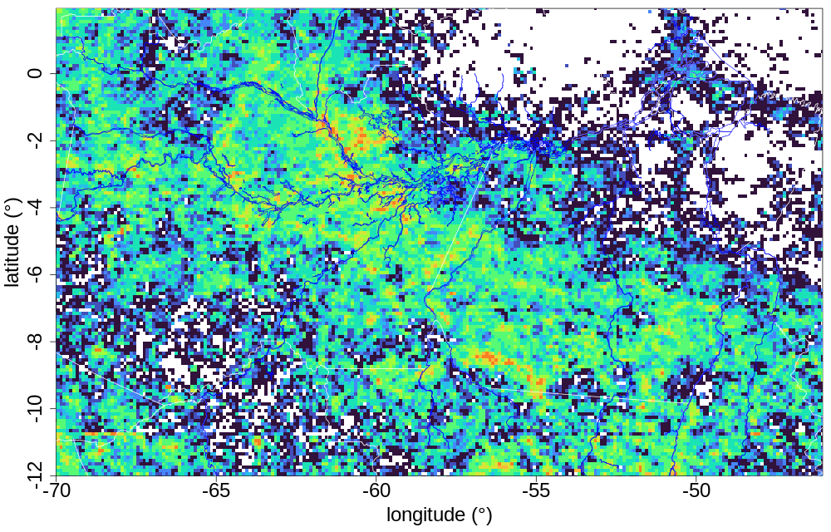
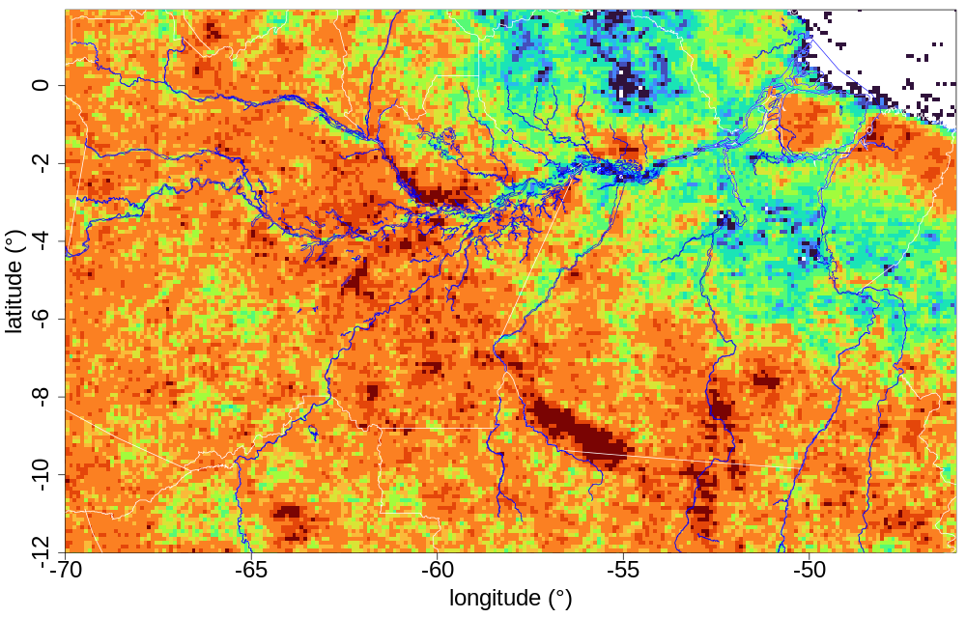
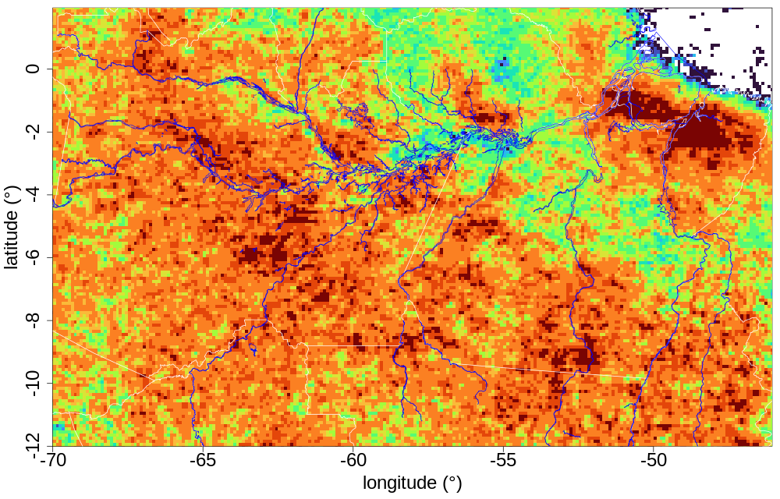
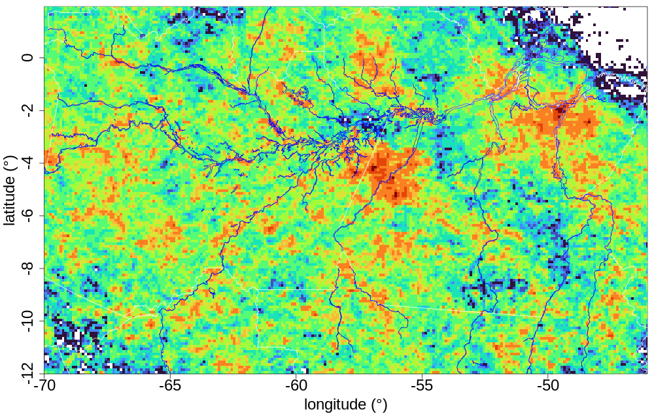
Preliminary RESULTS
Flash Rate Density – by time, 2020:
00–03
04–07
08–11
12–15
16–19
20-23

Slide 12
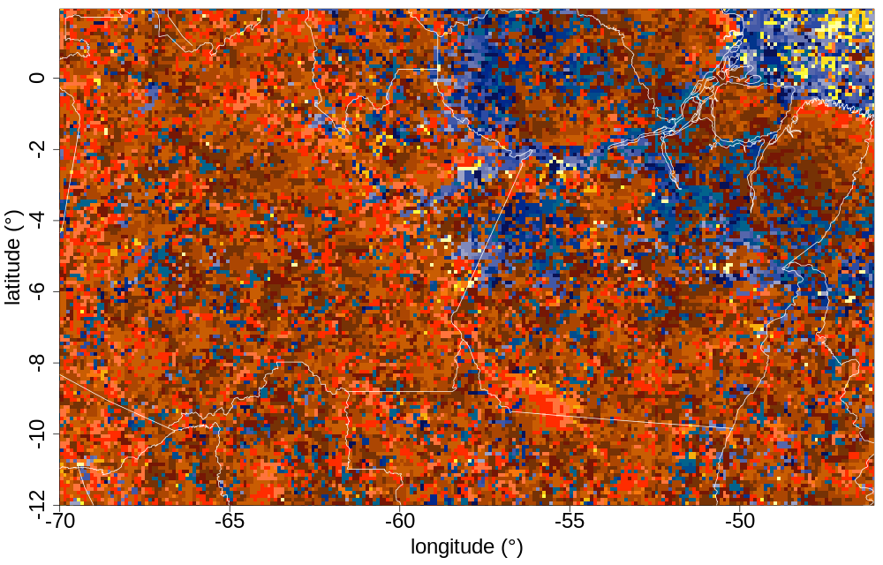
Preliminary RESULTS
Time of maximum Flash Rate Density - entire year, 2020:

Slide 13
Preliminary RESULTS
Looking over rivers, and tributaries “basins” near Manaus:
Manaus

Slide 14
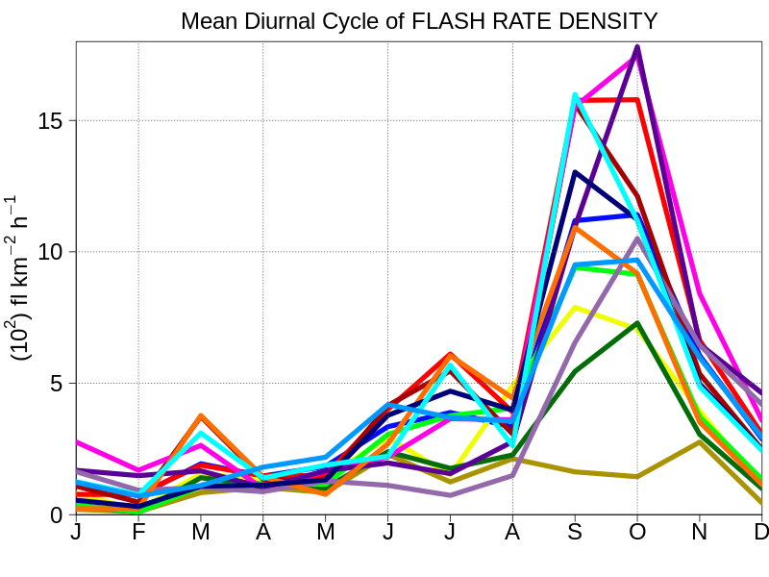
Preliminary RESULTS
whole river or basin and month over all year
$$FRD=\frac{\sum{Flash counts}}{\sum{Area}\sum{∆t}}$$
whole river or basin
month over all year
Looking over rivers, and tributaries “basins” near Manaus:
Negro_River
Amazon_River
Uatumã_River
Notes:
The seasonal cycle clearly show that maximum lightning activity is during the spring
… with a secondary maximum in March
→ maximuns on the transition seasons:
March → WET to DRY
SON → DRY to WET
[large scale regulation of thermodynamics]

Slide 15
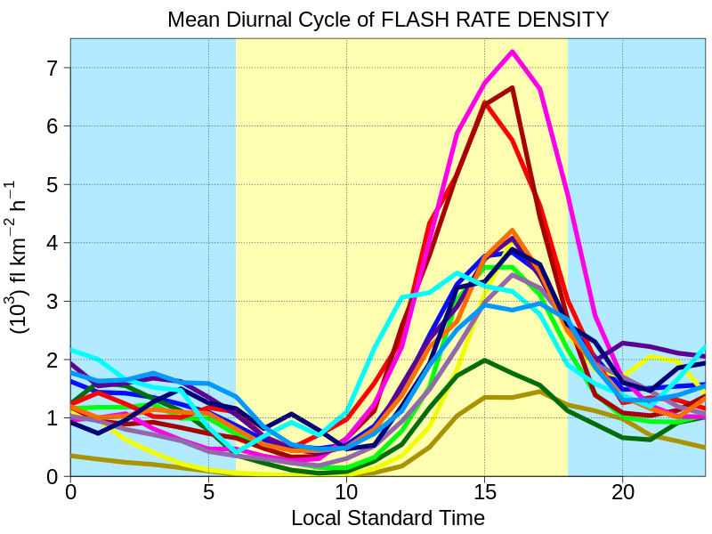
Preliminary RESULTS
whole river or basin and hour over all year
$$FRD=\frac{\sum{Flash counts}}{\sum{Area}\sum{∆t}}$$
whole river or basin
hour over all year
Looking over rivers, and tributaries “basins” near Manaus:
Negro_River
Amazon_River
Uatumã_River
Notes:
The tributaries basins that show higher FRD are:
E and W of Rio Negro River, w/ E peaking up one hour earlier (15LST)
Between Amazon River and Madeira River
Negro River shows :
High nighttime FRD, but higher during daytime which is related to earlier convection and their displacement towards the river by the large-scale easterly flow
Uatumão River + Balbina Dam also show nighttime high FRD

Slide 16
Preliminary CONCLUSIONS
We can see a clear sign of deep convection delineating the rivers.
Flood inundation from Trombetas River show nighttime enhanced lightning activity
FUTURE: We need to access the seasonal impact on the diurnal cycle, including inundation.

Slide 17
Future data collection of interest

Slide 18
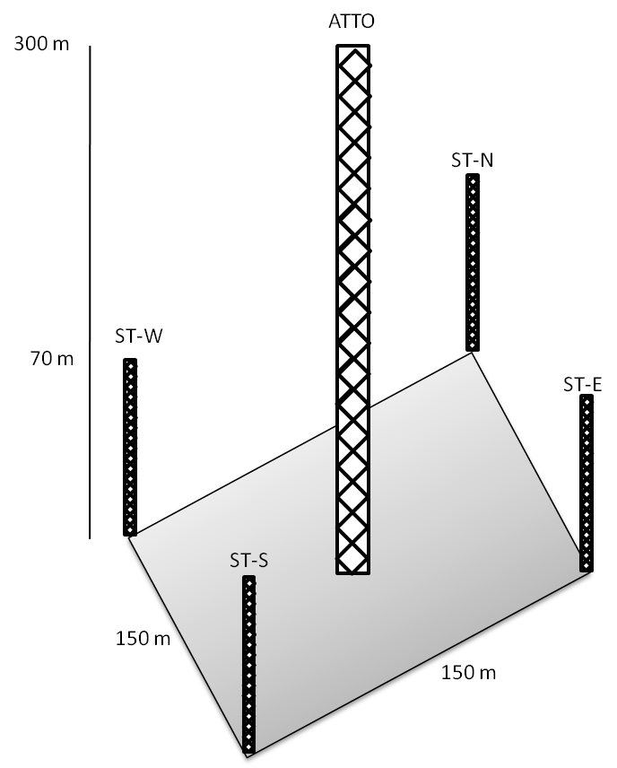
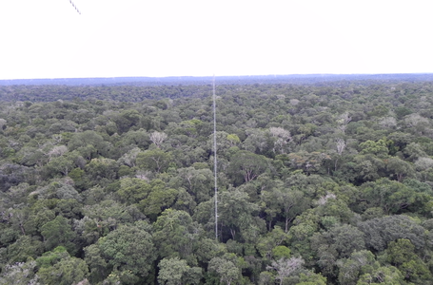
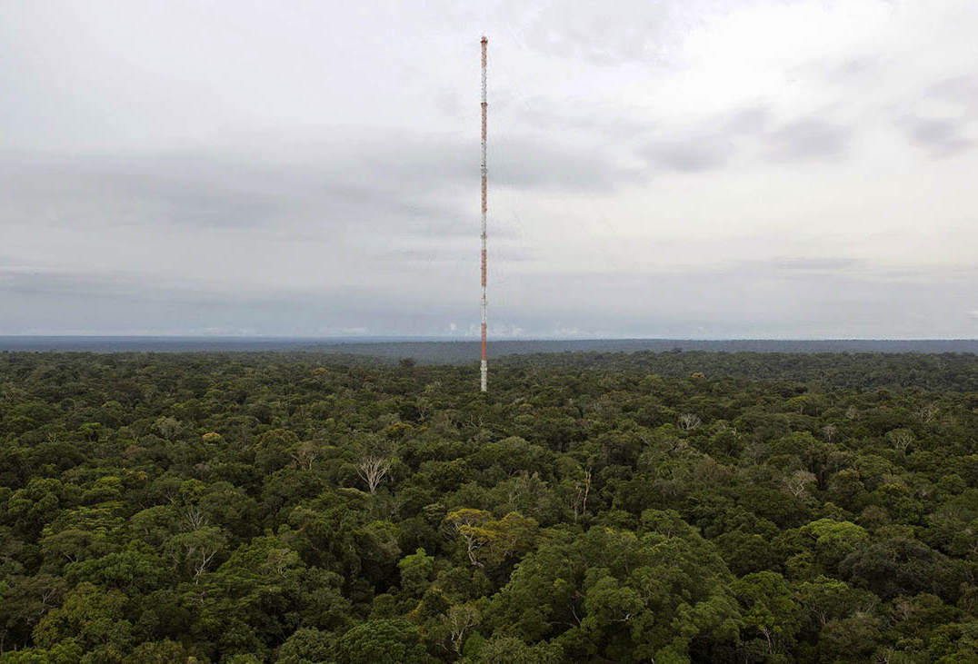
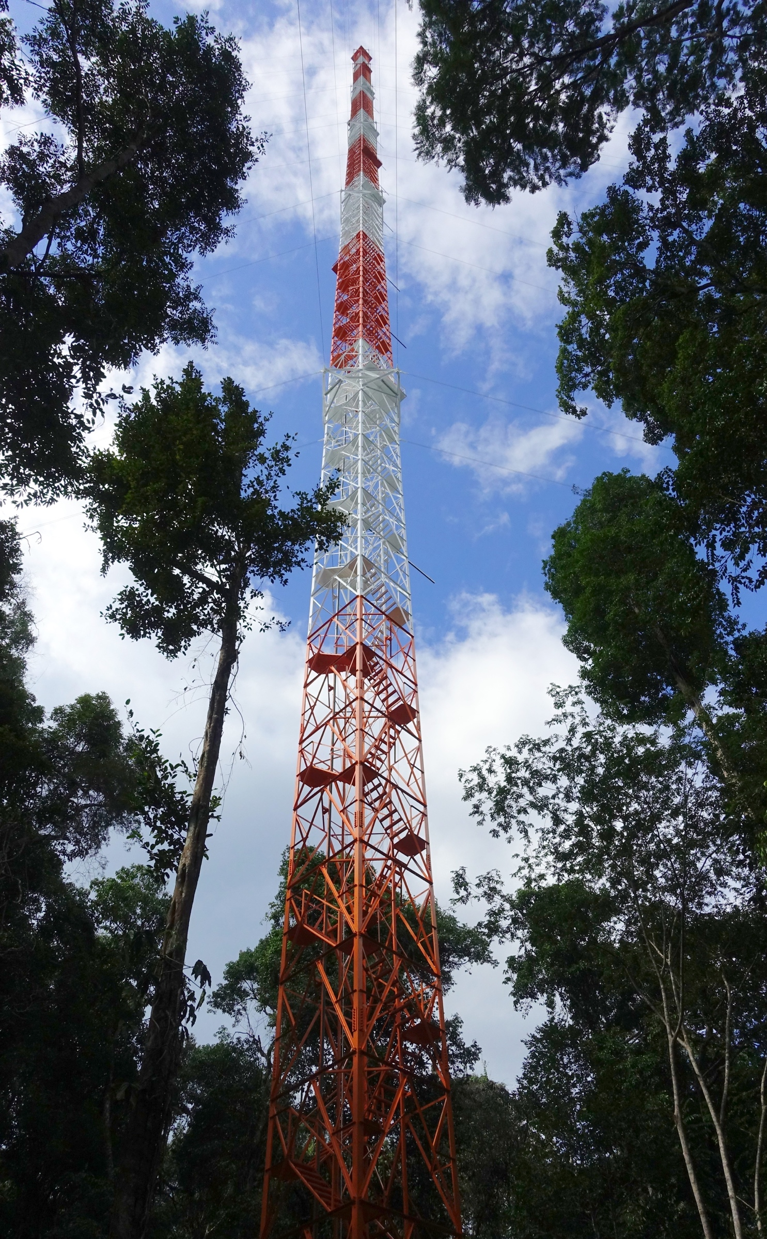
The Amazon Tall Tower Observatory
Pristine remote site in the heart of the Amazon:
One 325 m tall tower
Four 80 m towers
Provide long-term measurements (20+ years) of biogeochemical and atmospheric conditions
80m tower
325 m tower
Notes:
As I mentioned in previous GLM Mtgs, we have one of tallest instrumented towers in world right at the heart of the Amazon
Objective of ATTO:
provide long-term measurements (20+ years) of biogeochemical and atmospheric conditions to monitor changes in the Amazon region as human perturbations increase in the future.

Slide 19
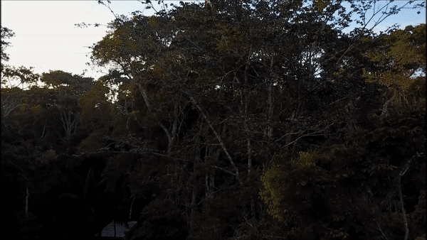
The Amazon Tall Tower Observatory
Tall & 80m Towers – Vertical profiles of trace gases and aerosols:
CO₂, CO, CH₄, O₃ – continuously at 5 to 8 heights
Additional gases species (e.g., VOC, NO, NO₂, OH reactivity) – IOPs
LNOx isotopes (NEW!)
How LNOx contribute to the formation of Secondary Organic Aerosol?
Aerosols (scattering, absorption, number and size distributions, chemical composition, CCNs, hygroscopicity)
Tall Tower (325m)

Slide 20
The Amazon Tall Tower Observatory
Campina site
Notes:
This is an areal view of the Campina site

Slide 21
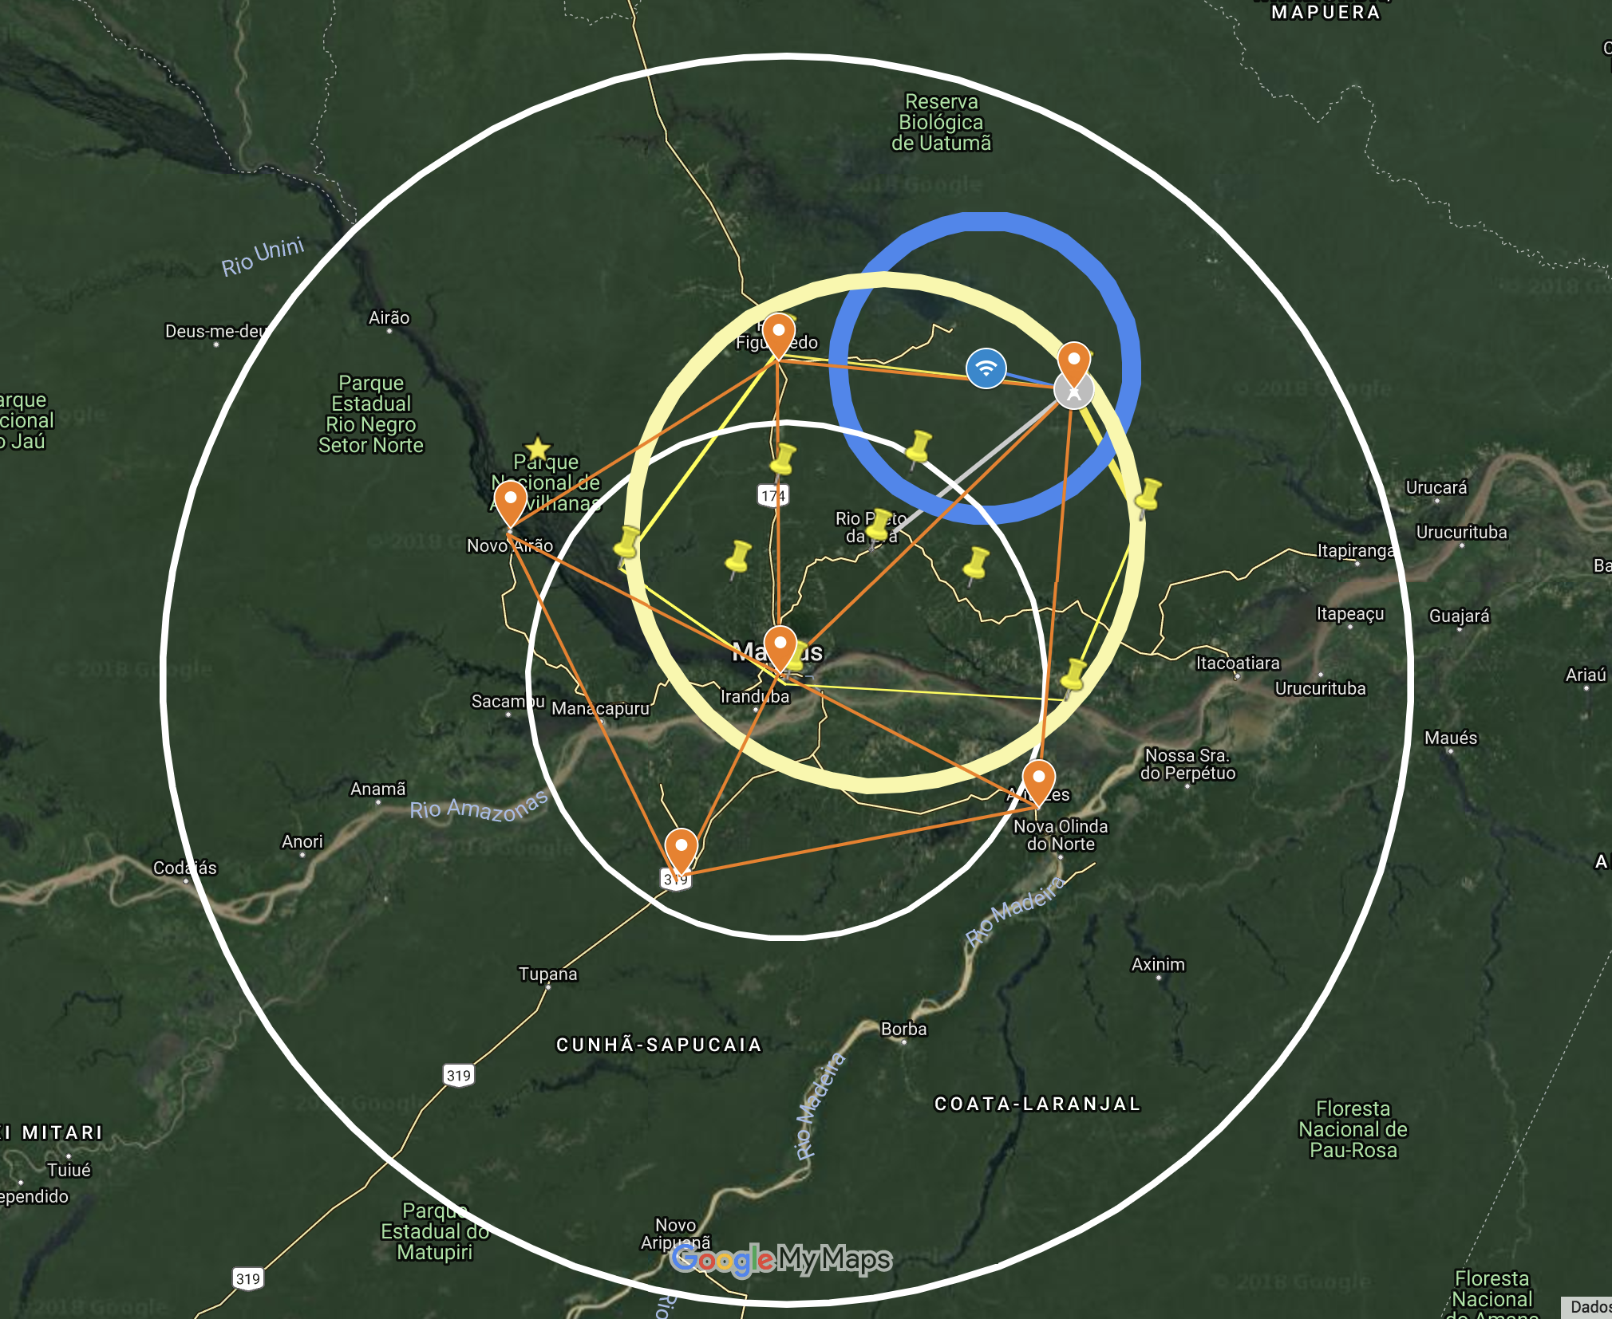
TUPÃ - ThUnderstorm, Precipitation and Aerosol interactions (2022-2027)
ATTO tower (aerosols, chemistry, lidar, RWP, Ka-band, MP3000, etc)
XPOL radar
S-band radar
LMA network
LLS short-baseline LF network
Notes:
We are working right now to get the funding to place out mobile XPOL radar near ATTO
And as soon as our funding and pollical situation in Brazil gets better, we will work on the funding for the LMA network

Slide 22
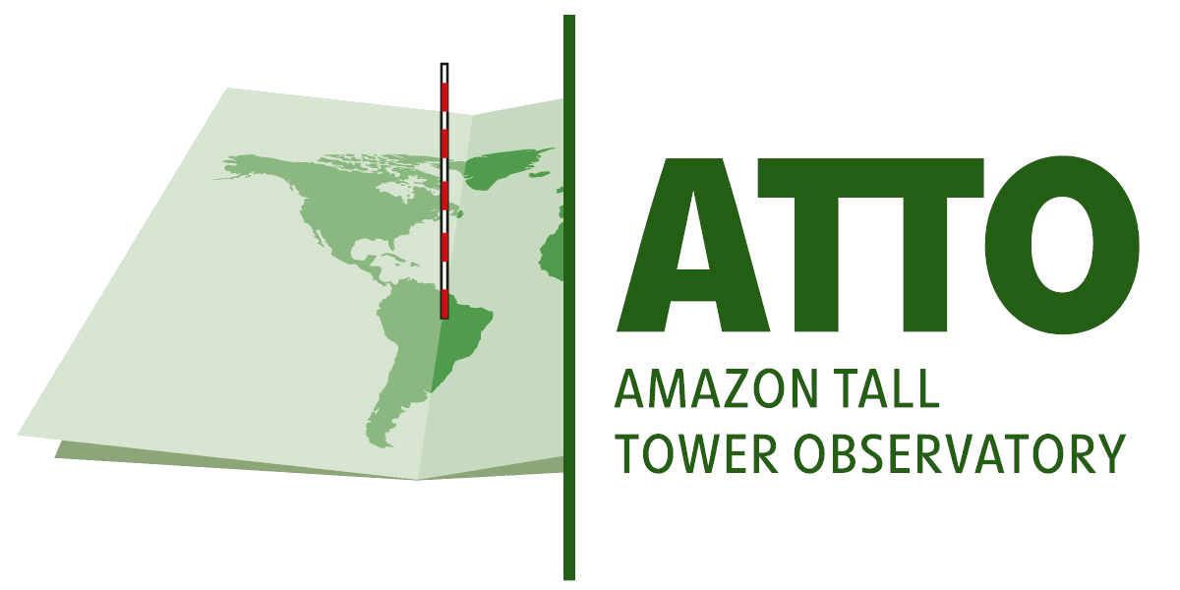
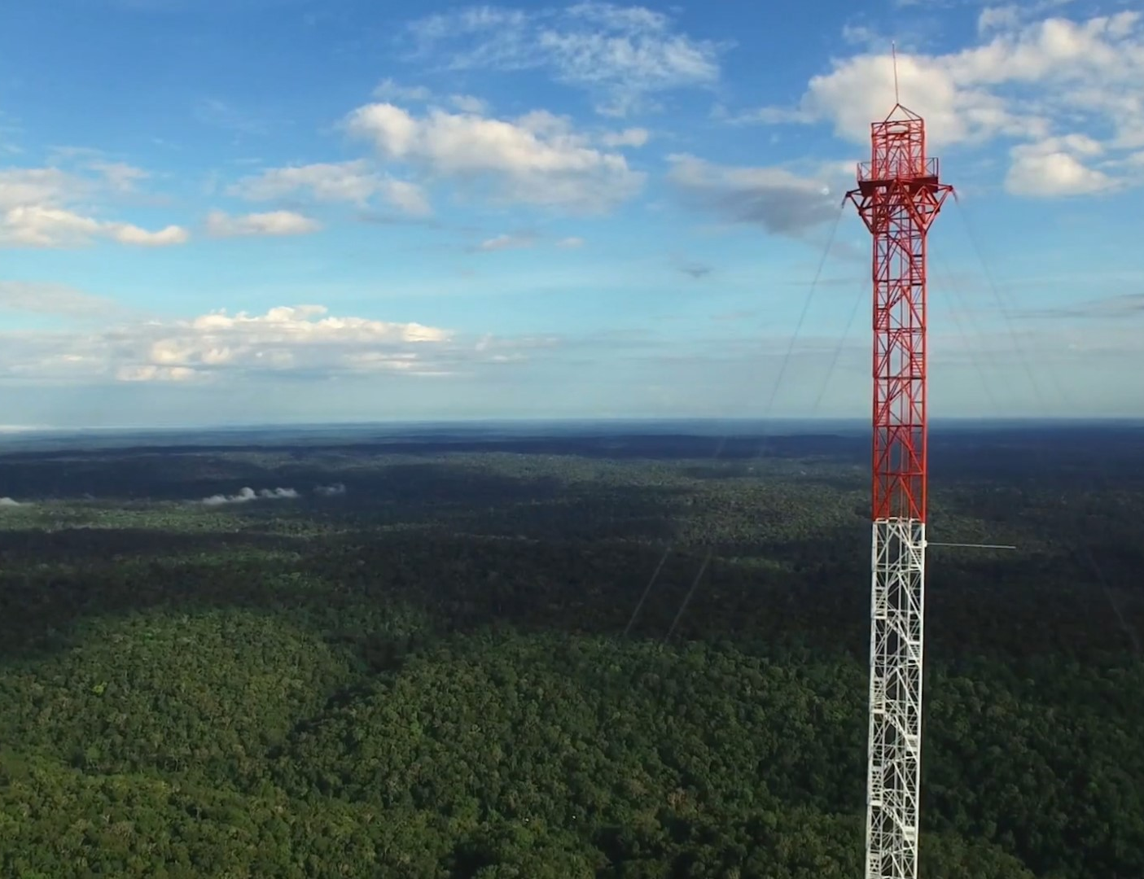
Thank you!
https://www.attoproject.org/
https://youtu.be/ZIV2K4JRtOA

