Slide 1
GLM Assimilation in the HRRR-DAS ensemble framework
Amanda Back David Dowell
CIRA/NOAA GSL NOAA GSL
Eric Bruning Ashley Sebok
Texas Tech Texas A&M
Ming Xue Rong Kong
OU/CAPS

Slide 2
Background & methods
Demonstrate ensemble development by Kong & Xue in the High Resolution Rapid Refresh Ensemble D.A. System
as in HRRRv4, operational Dec. 2020
CONUS-encompassing domain at 3 km resolution
Hourly ensemble D.A. as in operational HRRR-DAS
Relate GLM Flash Extent Density (GOES-16) to graupel mass
Average observations over 5 minutes
Thin observations to group centroids; ignore 0-flash data
Compare to and combine with ensemble radar DA
Evaluate reflectivity and lightning forecast skill

Slide 3
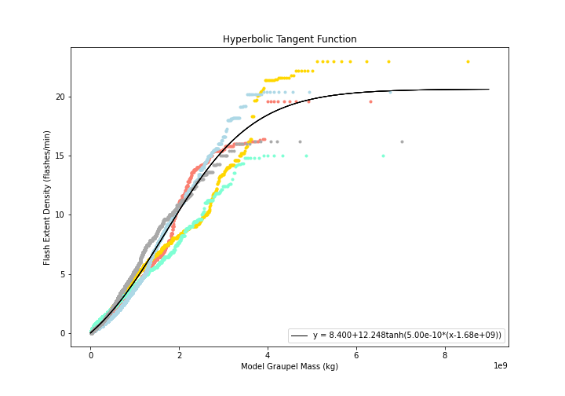
Forward operator calibration
Kong et al. (2020) linear forward operator
FED = C_{M} x 2.088 x 10⁻⁸ x GM = 0.5 x 2.088 x 10⁻⁸ x GM
Graupel mass (GM; kg) summed over 15 km x 15 km column
Sebok and Back
FED = a + b * tanh(c *(GM-d))
a = 8.4 flashes minute⁻¹
b = 12.248 flashes minute⁻¹
c = 5.0 x 10⁻¹⁰ kg⁻¹
d = 1.68 x 10⁹ kg
Maximum parameterized FED: 18 flashes minute⁻¹
Maximum observed FED: 18 flashes minute⁻¹

Slide 4
Other fields impacted through covariances
GLM assimilated 6Z 6/22/2020
Rain water mixing ratio (g/kg), L11 increment
Water vapor mixing ratio (g/kg), L1 increment
Graupel mixing ratio (g/kg), L21
increment
Cloud water mixing ratio (g/kg), L21 increment
Potential temperature (K), L1 increment

Slide 5
Experiment configurations
Observations assimilated (varies across experiments):
Other configuration aspects held constant:
Conventional observations
Conventional + GLM-K
Conventional + GLM-S
Conventional + radar
Conventional + radar + GLM-S
36 ensemble members cycled hourly
Also tested 15-minute cadence
12-hour forecasts launched from 3 members every 3 hours
Test period 6/22-6/24 2020 (17 forecast inits, cycling between)

Slide 6
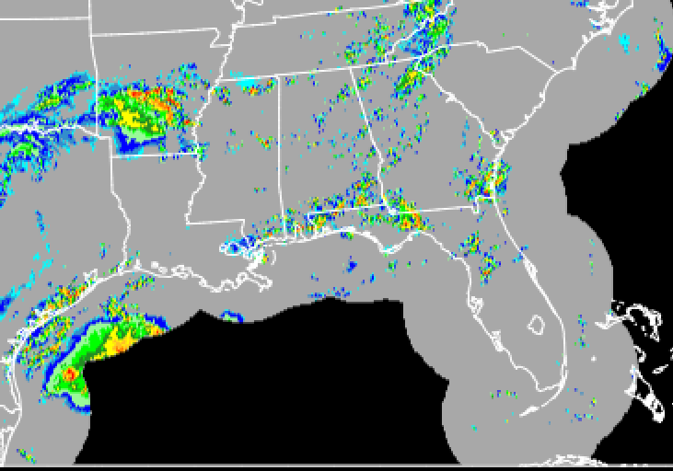
GLM impacts in the Gulf of Mexico (17Z, 6/23)
CONVENTIONAL DA
CONV + RADAR DA
CONV + GLM-S DA
MRMS OBSERVATIONS
2-HOUR CREF FORECASTS VALID 17Z, 6/23
17Z 6/23/2020
dBZ
Reflectivity forecasts from 3 ensemble members per experiment, at one valid time

Slide 7
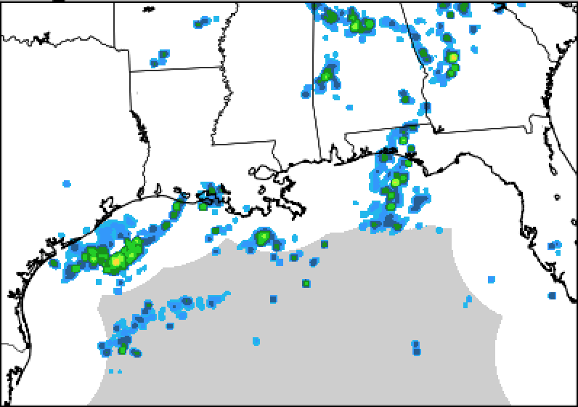
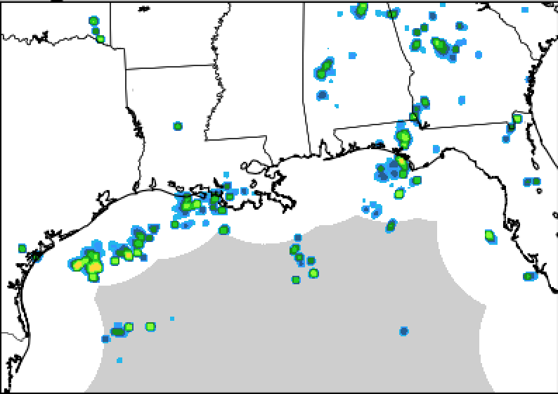
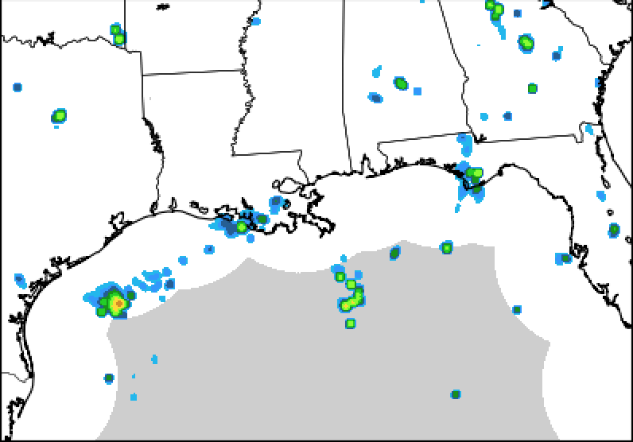
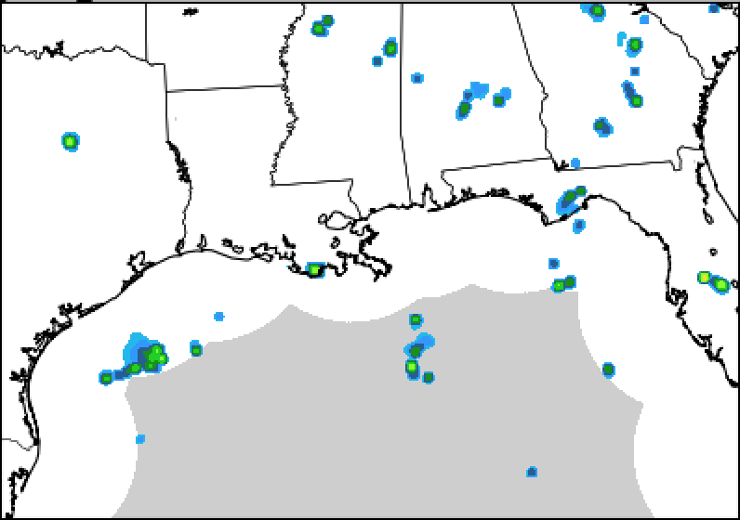
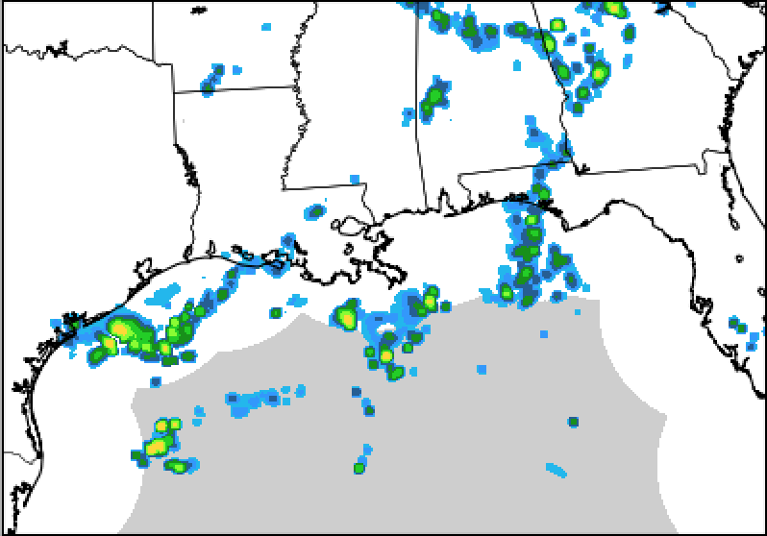
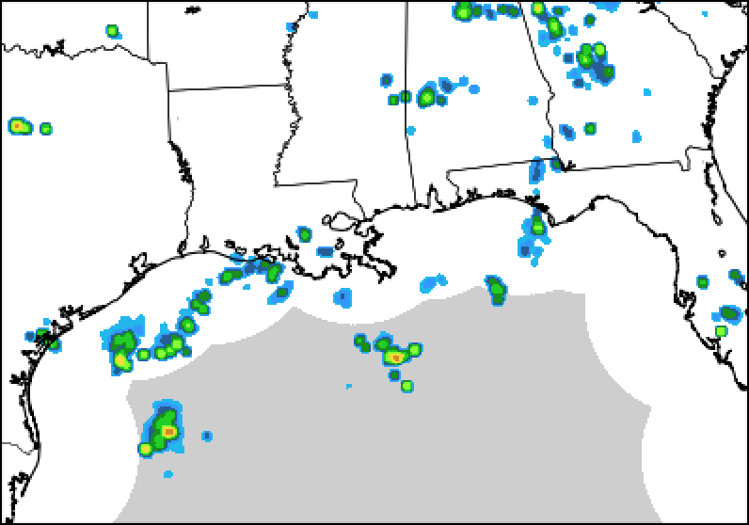
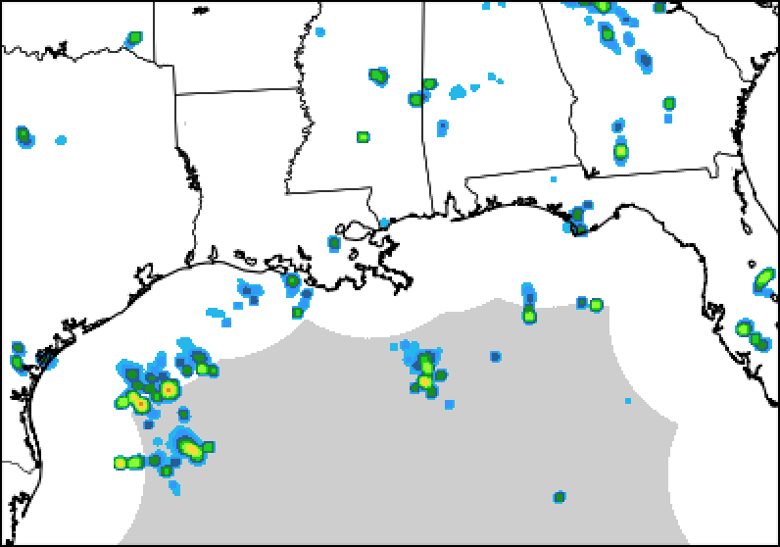
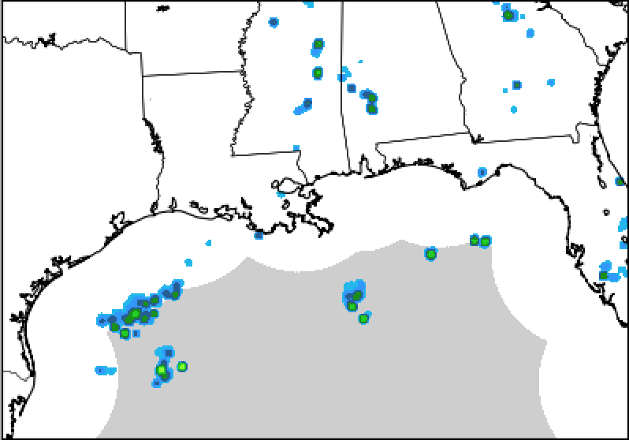
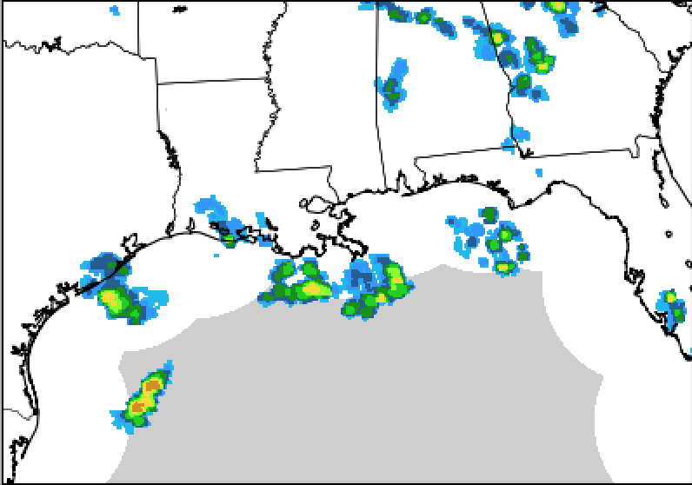
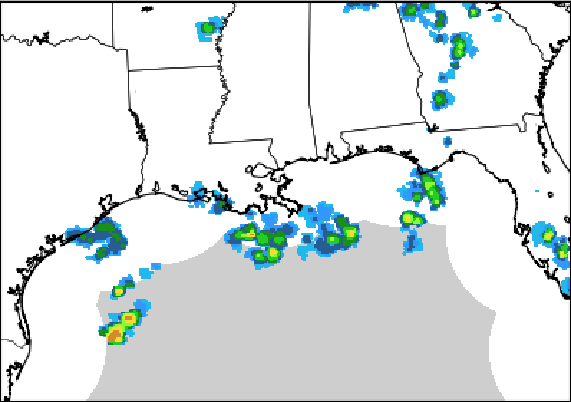
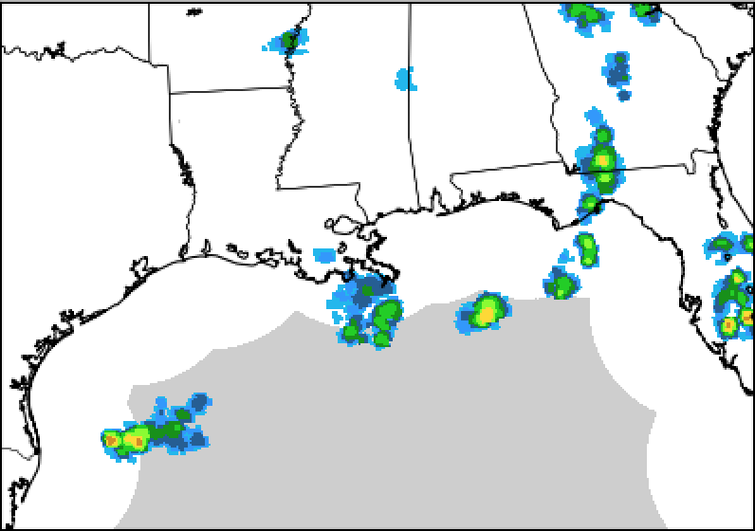
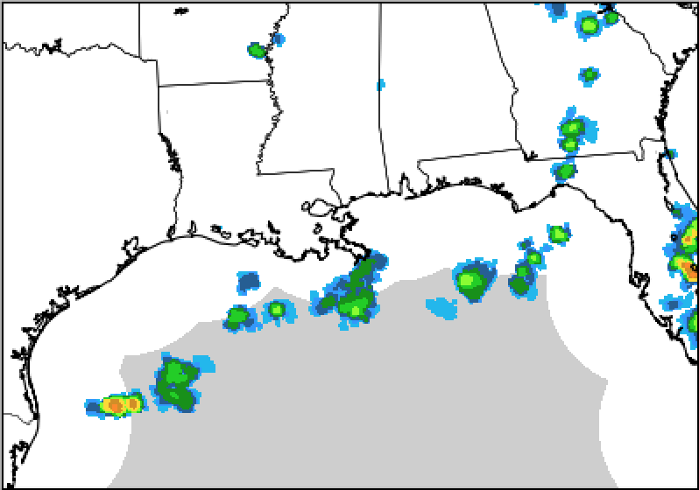
GLM impacts in the Gulf of Mexico (21Z, 6/22)
21Z + 0
21Z + 1
21Z + 2
21Z + 3
CONV+RADAR
Forecast hours 0-3, 1 member per experiment
CONV+RADAR+GLM
flashes/ minute
GOES-16 FED OBS
21 Z
22 Z
23 Z
0 Z

Slide 8
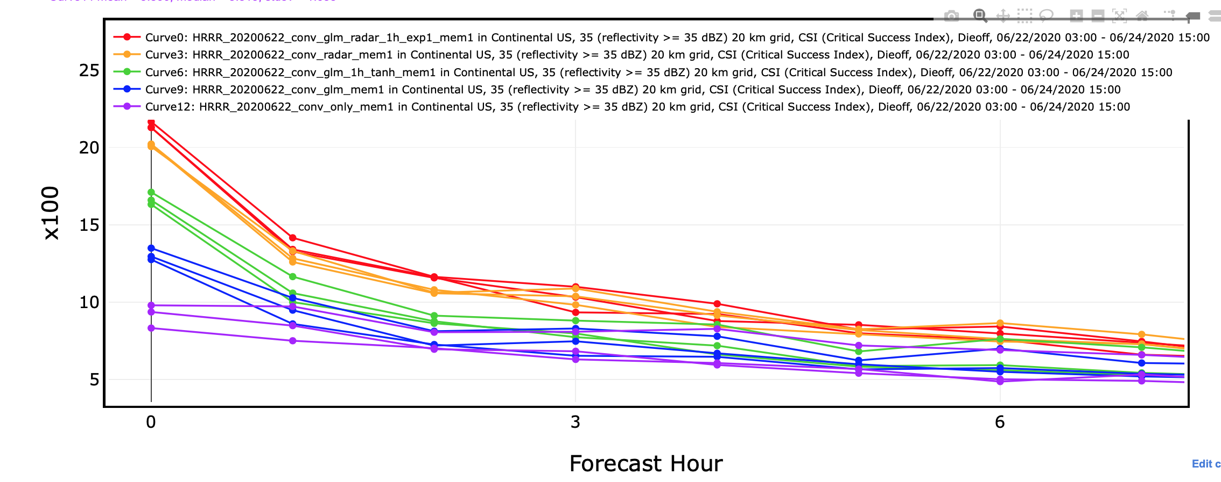
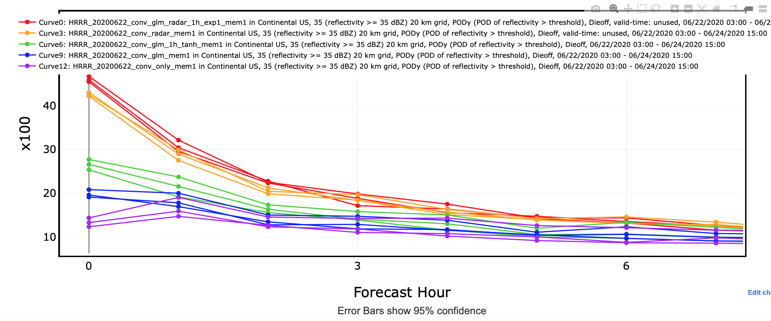
Forecasts assessed against radar observations
Critical Success Index at 35 dBZ
grids coarsened to 20 km
Probability of Detection at 35 dBZ
Conventional + radar + GLM-S
Conventional + radar
Conventional + GLM-S
Conventional + GLM-K
Conventional only

Slide 9
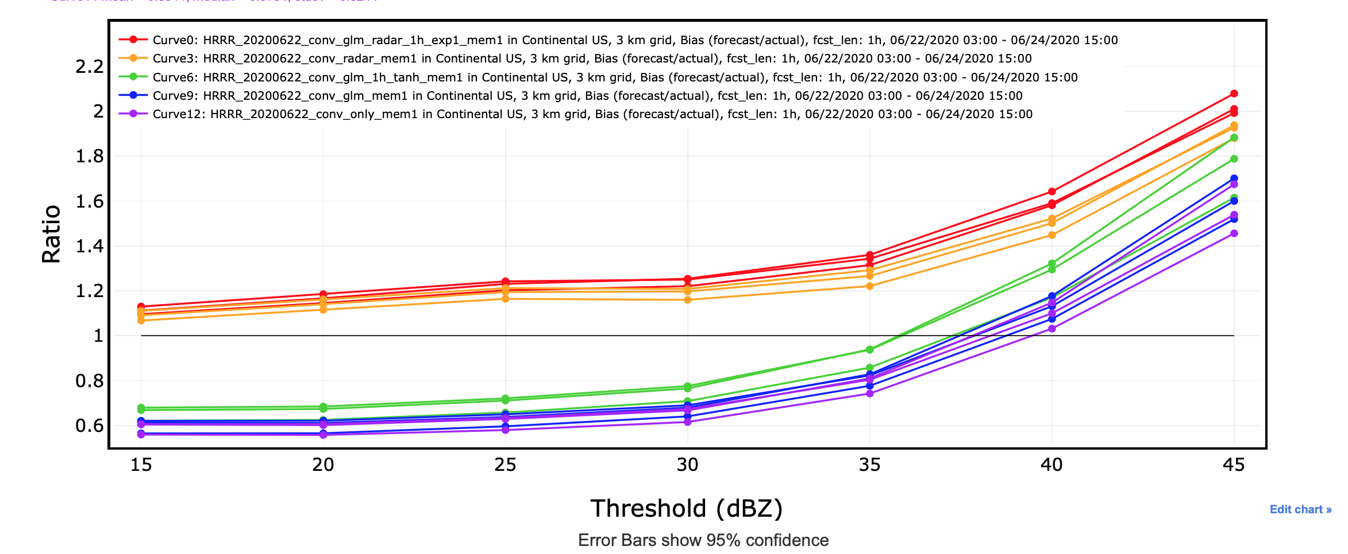
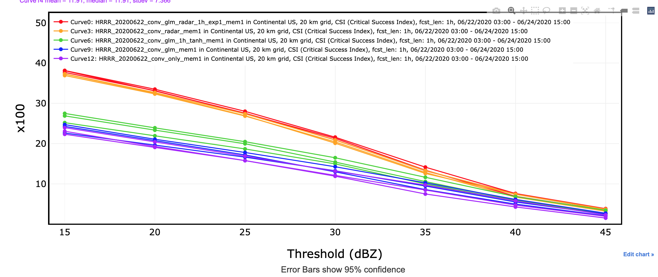
Forecasts assessed against radar observations
1-hour forecasts’ frequency bias on native grid
average skill over 17 forecasts
1-hour forecasts’ CSI on 20 km grid
Conventional + radar + GLM-S
Conventional + radar
Conventional + GLM-S
Conventional + GLM-K
Conventional only

Slide 10
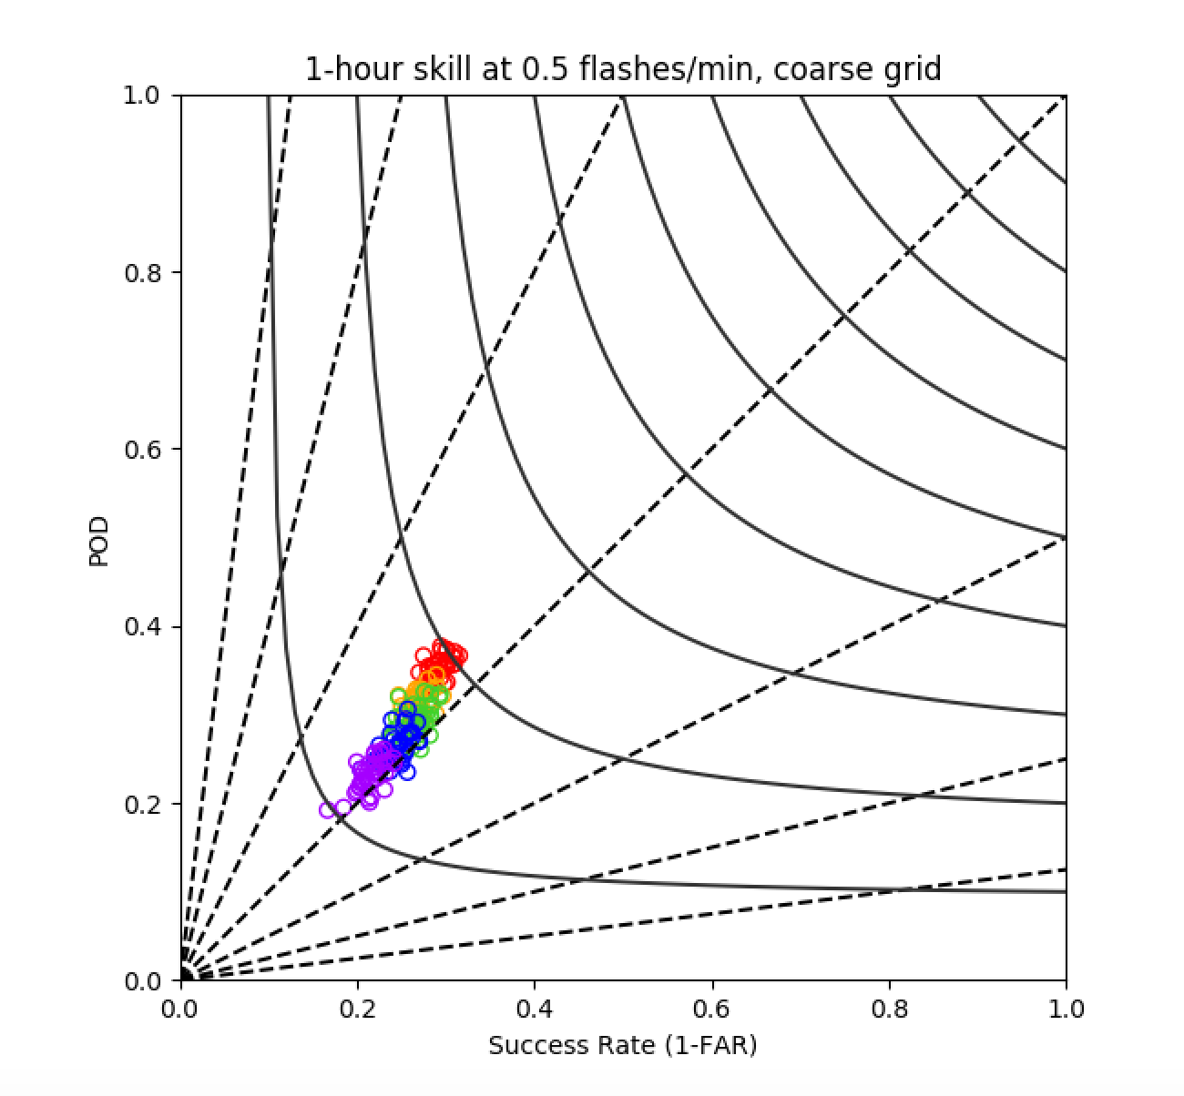
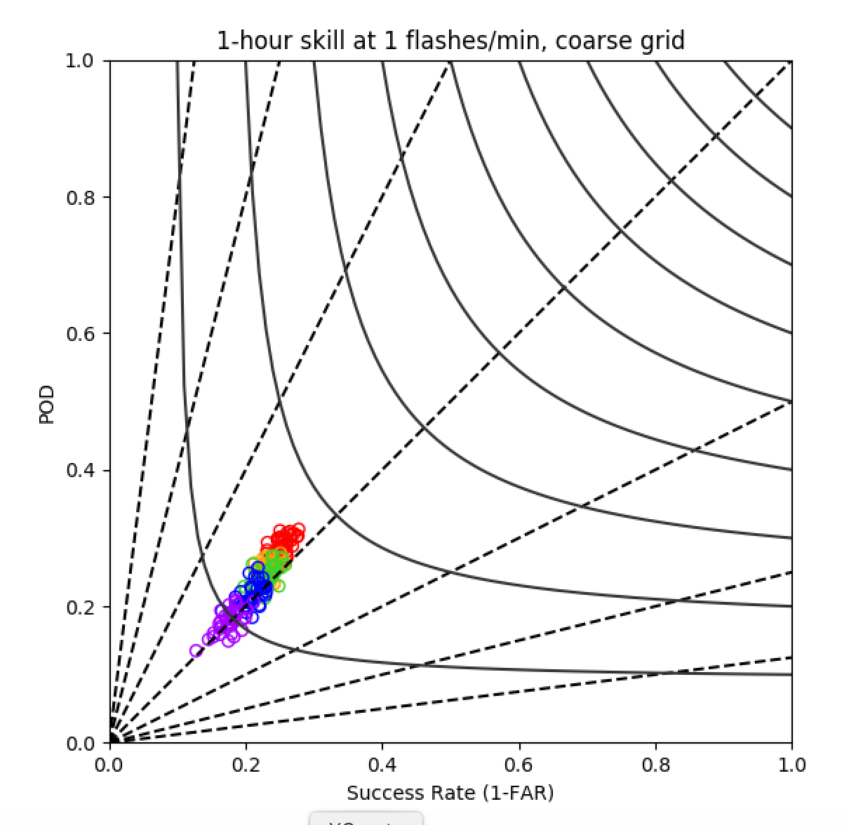
Forecasts assessed against GOES-East GLM
Conventional + radar + GLM-S
Conventional + radar
Conventional + GLM-S
Conventional + GLM-K
Conventional only
bias = 2
bias = 1
CSI = 0.5
bias = 0.5
bias = 0.5
CSI = 0.4
CSI = 0.3
bias = 0.25
bias = 0.25
CSI = 0.2
CSI = 0.1
(CONUS domain—members’ skill avg. over 17 forecasts)

Slide 11
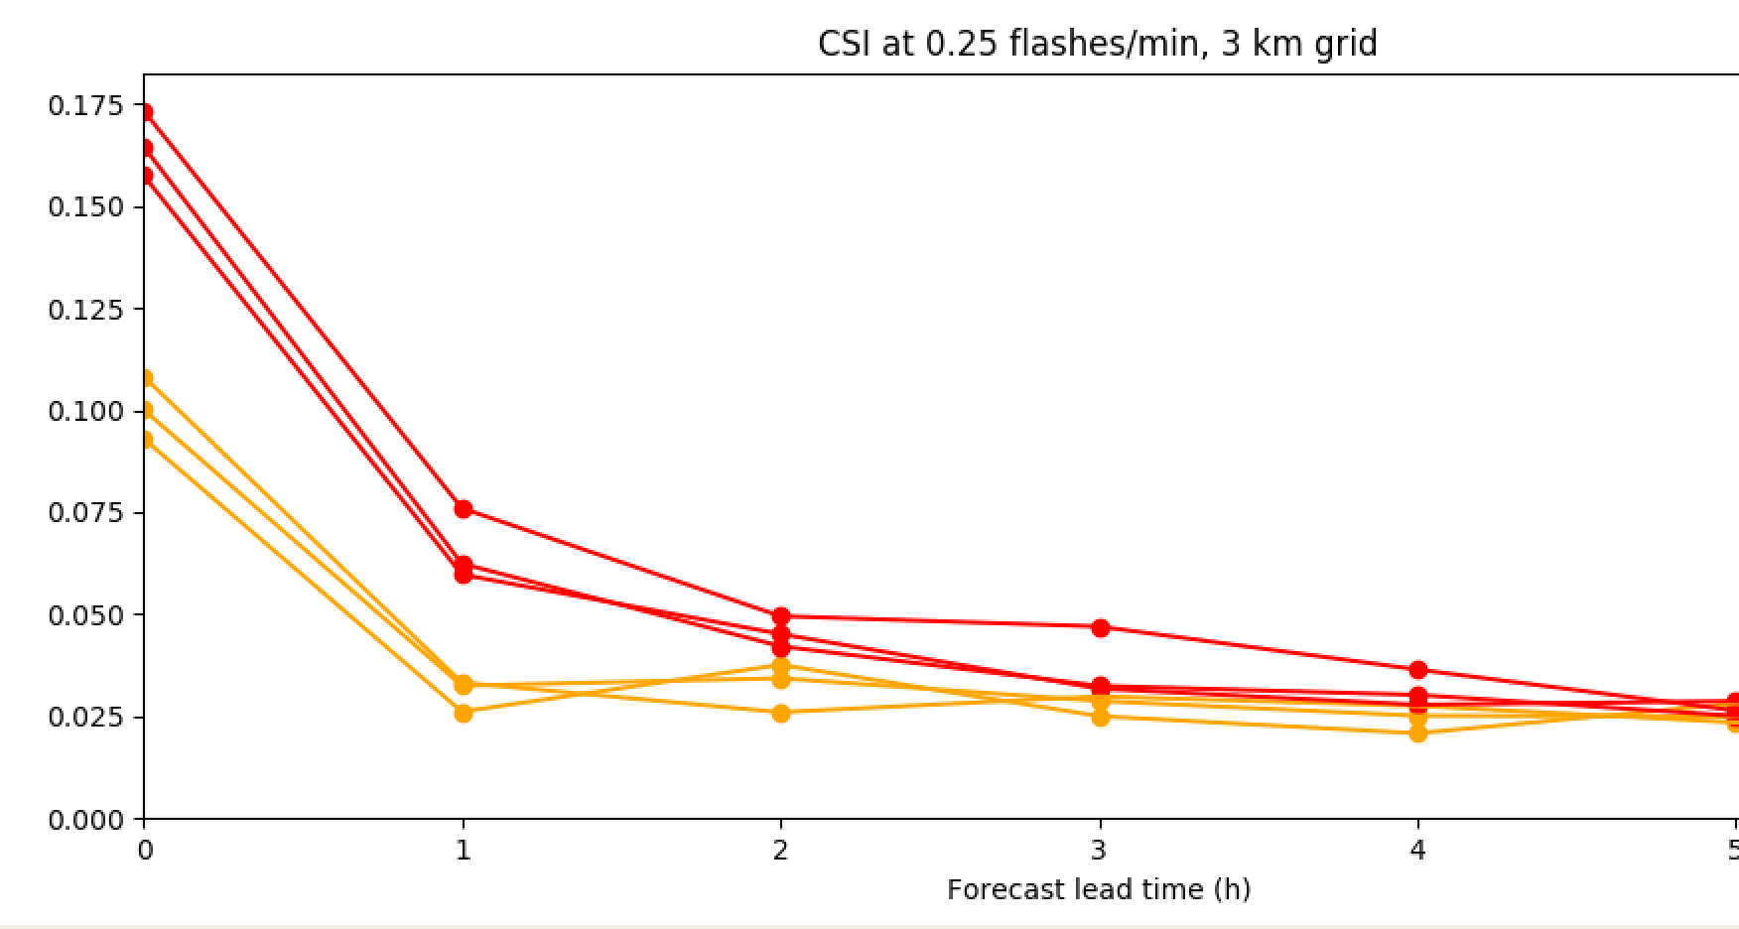
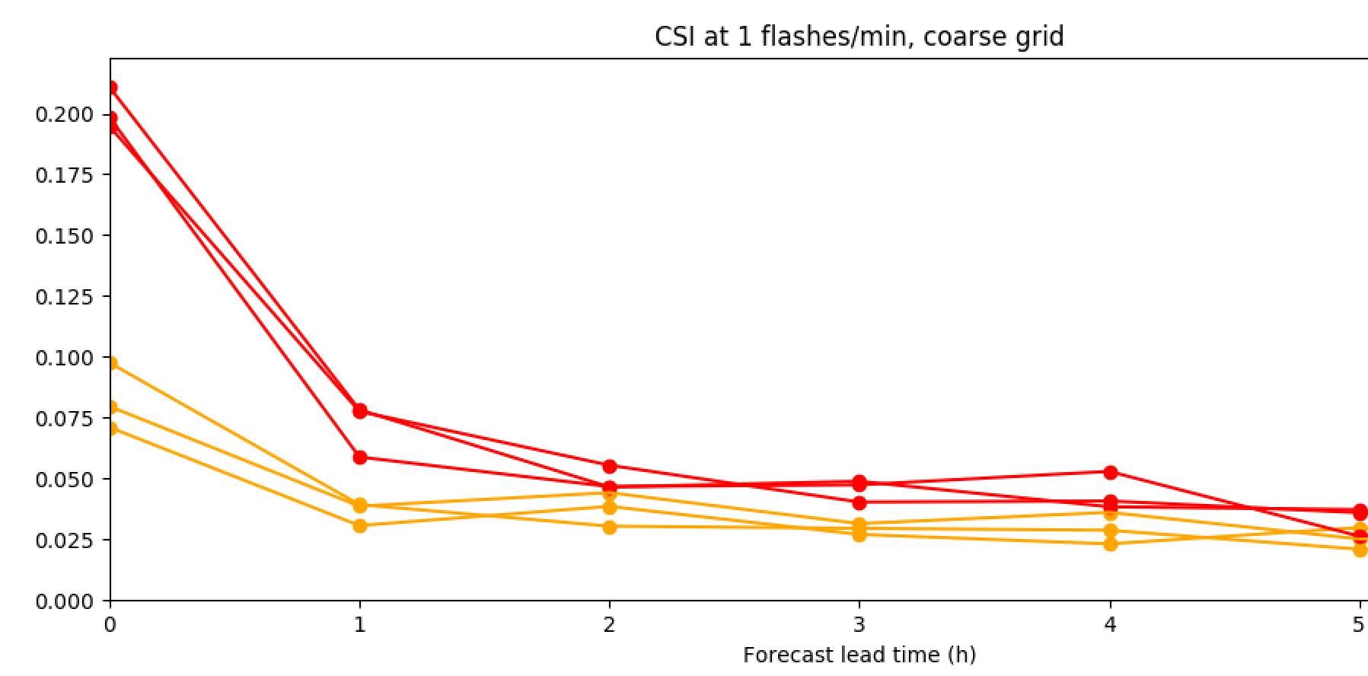
Forecasts assessed against GOES-East GLM
0.25 flashes/min, native grid
1 flash/min, coarse grid
members’ CSI vs forecast hour, averaged over 17 forecasts on a radar-excluding domain
(verification domain excluding most radar obs)

Slide 12
Future work
Continue testing ensemble assimilation on other time periods, contrasting and possibly recalibrating operators
Install OU hybrid D.A. capability in HRRRX for further testing
Transition to Rapid Refresh Forecast System (regional UFS component) for implementation

Slide 13
Thank you!

