Slide 1
Global patterns of flash optical properties based on long-term iss-lis observations
Ken Cummins
GLM Science Meeting 2021

Slide 2
Estimating GLM-Equivalent event Optical energy using LIS groups
Most optical sources are smaller than a GLM pixel (< 2-3 LIS pixels) in which case:
GLM Event Energy = LIS Group Energy
When a LIS group is larger than a GLM pixel, the assigned GLM pixel energy is the larger of
- highest energy LIS event-in-group energy
- group energy scaled by 64 km²/(Group Area)
$$Converting LIS Group Radiance \left(\hat{ξ}\right) to$$
$Optical Energy \left(E\right)$in Joules
$$E=\frac{πΔλ\hat{ξ}A}{n}$$
GLM Pixel
Where
Δλ = Optical Bandwidth (m)
A = Group Area (m²)
n = # of Events in a Group
see Koshak (2017) and
Zhang & Cummins (2020)
LIS Pixel

Slide 3
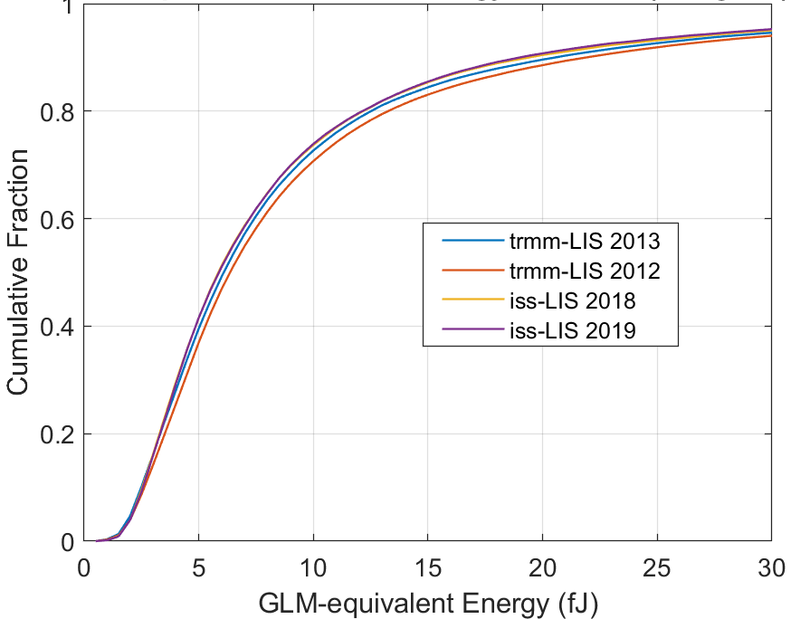
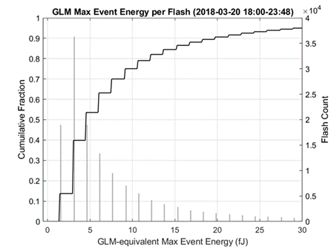
Equivalence for ISS-LIS and TRMM-LIS, and validation of energy calculation
Derived from LIS
As measured by GLM
Cumulative CONUS distributions of GLM-equivalent event energy for two TRMM years and two ISS years
Sample GLM max event-in-flash energy on Florida (low GLM threshold region)

Slide 4
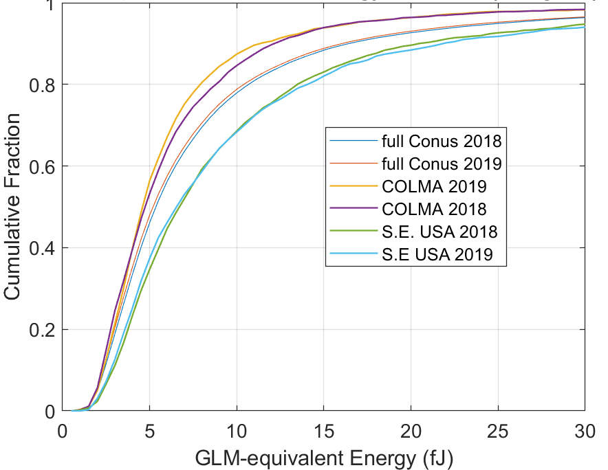
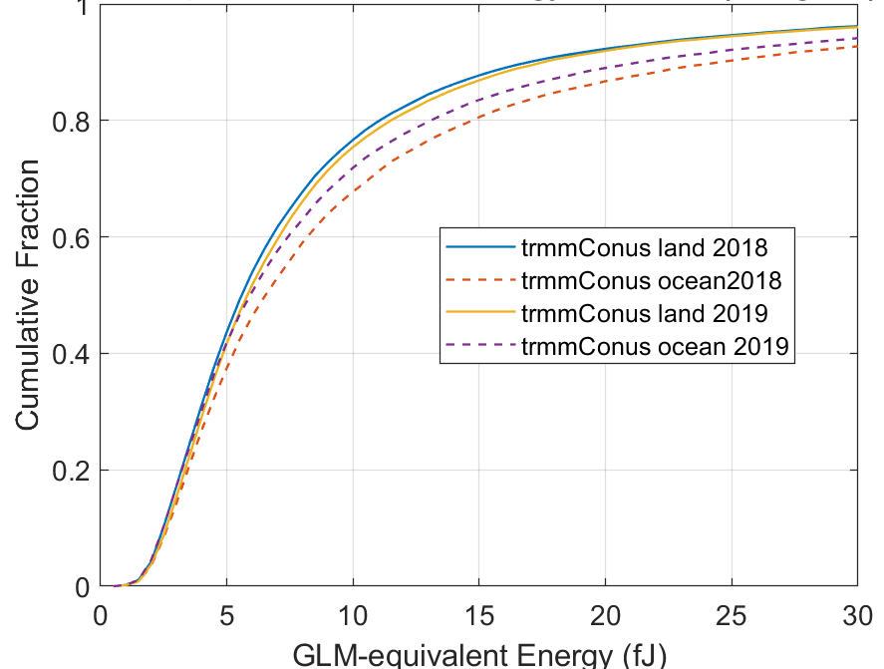
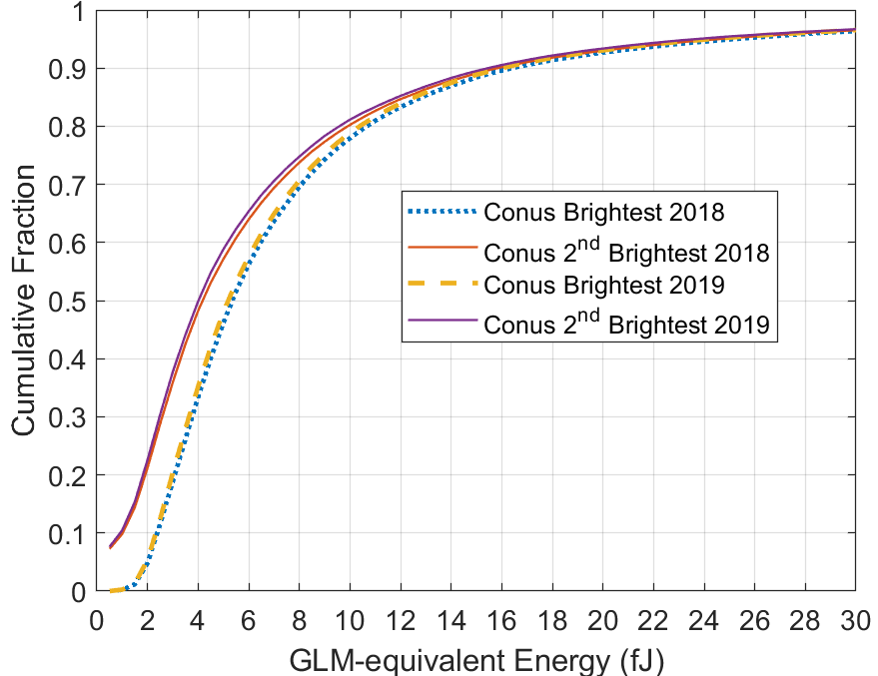
Plots of ISS-LIS derived cumulative “brightest event” energy under various conditions
COLMA
CONUS
LAND
2nd Largest
OCEAN
S.E. USA
Largest
NOTE: FDE = 80*(1-Fraction)
Various regions in CONUS, showing consistency between years
Land and ocean regions in/near CONUS, showing land/ocean differences and consistency between years
Impact of requiring two groups in a flash by quantifying the 2nd “brightest” group in a flash

Slide 5
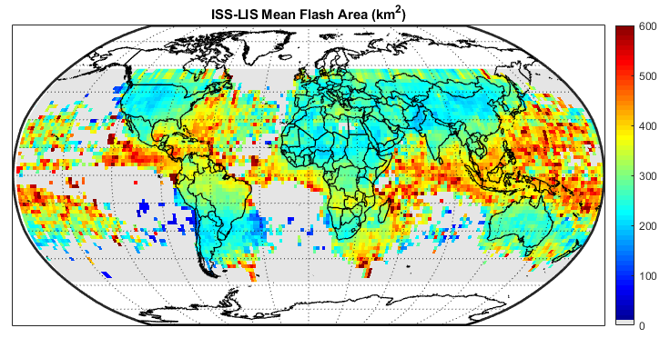
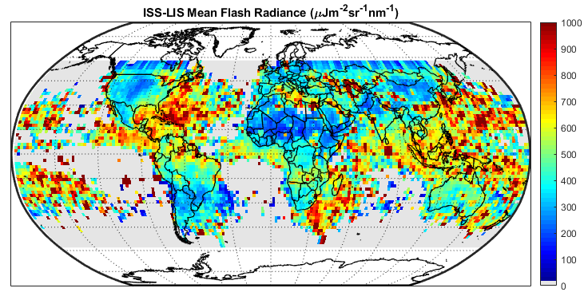
Global view of ISS-LIS parameters: Maps of flash Area & Radiance
- Much larger and “brighter” flashes over most ocean regions
- More land:ocean variation for flash radiance than flash area
- Very low flash radiance over some land regions, including Central Great Plains

Slide 6
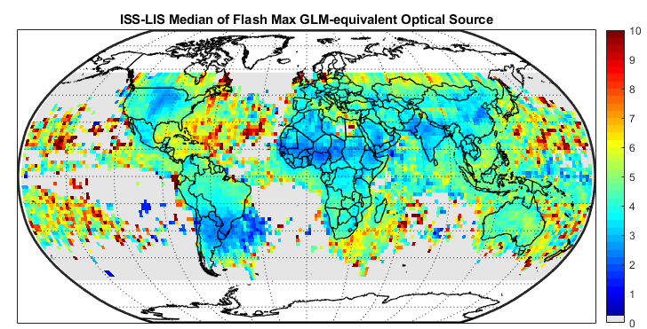
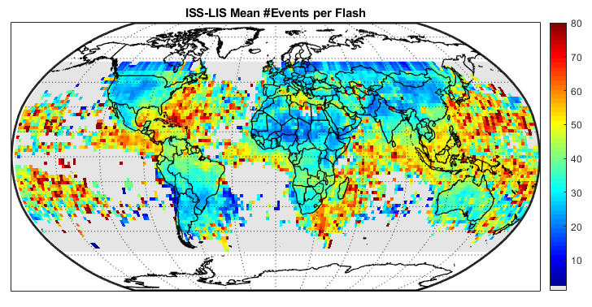
Global view of ISS-LIS parameters: Maps of highest energy GLM-equiv. event in flash & # of events in flash
Median highest-energy GLM-equivalent optical source shows
Moderate land-ocean differences
Very low values in some regions
- Variation in #events per flash is very similar to flash area (as expected)
- Very low flash radiance over some land regions, including Central Great Plains

Slide 7
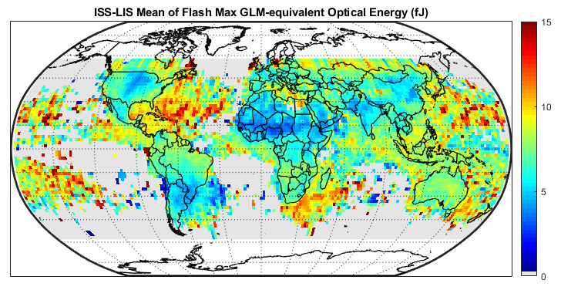
Global view of ISS-LIS parameters: Maps of highest energy GLM-equiv. event in flash & # of events in flash
- Variation in mean of highest-energy GLM-equiv. event energy is spatially similar to mean flash energy, but with smaller fractional variation
- Take-home message: GLM event threshold of 4-5 fJ will result is very low flash DE in some regions, but will have have much less impact in most oceanic regions

Slide 8
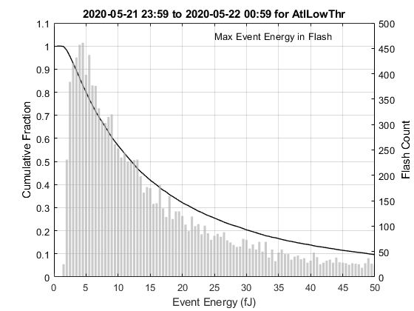
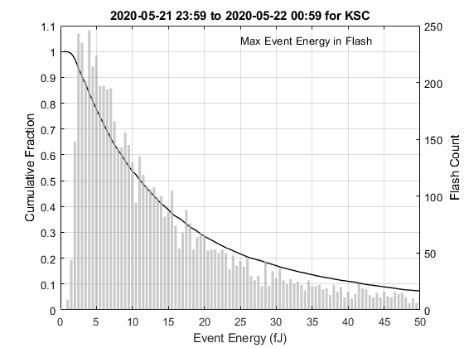
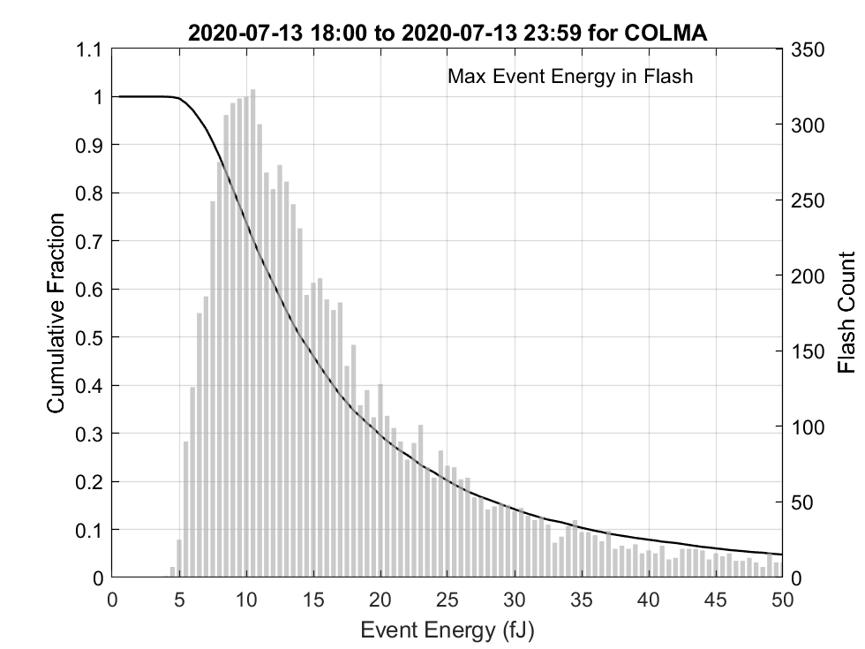
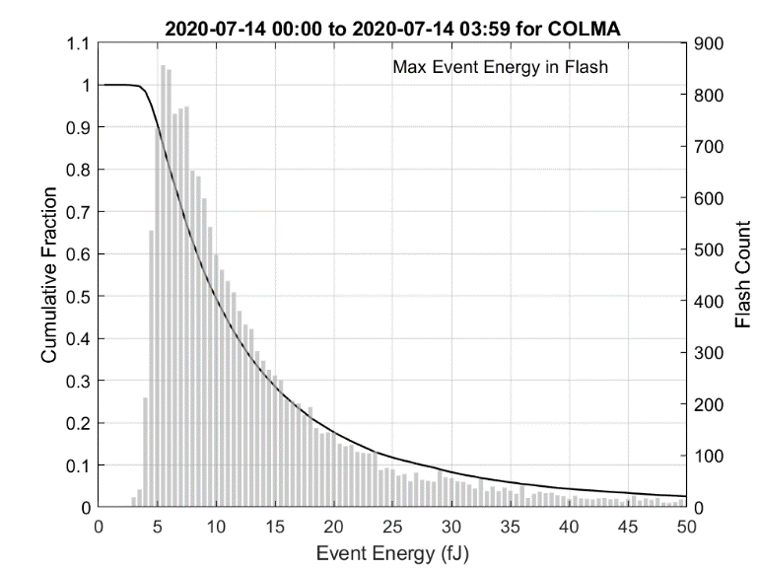
KSC and the high-sensitivity Caribbean regions are similar, but with a larger fraction of “brighter” events (higher energy) over the water The impact of GLM threshold is clear in the Colorado area. There are also fewer high-energy events in this region, compared to KSC and the Caribbean
Quick look at GLM Max Event Energy by Region
Caribbean and Gulf of Mexico
Denver Area Daytime
East-central Florida (KSC)
Denver Area at Night

Slide 9
Thank you
Future Work
Refine the DE model include regionally-derived long-term optical energy distributions using ISS-LIS
Refine and further evaluate the technique for estimating GLM event energy from LIS group radiance observations, using existing and refined LIS pixel areas (per Tim Lang)
Explore the best way to get this information into the hands of the operational and research communities

Slide 10
Supporting Slides

Slide 11
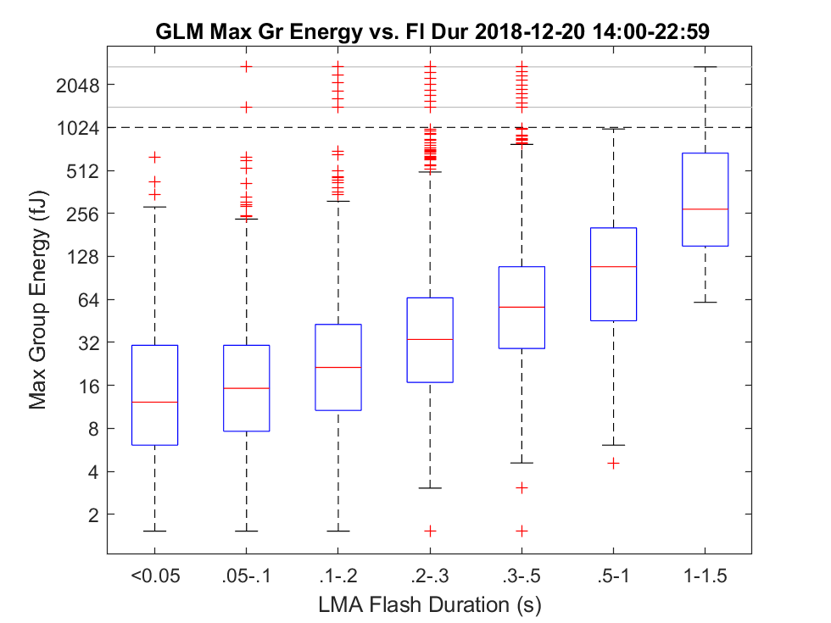
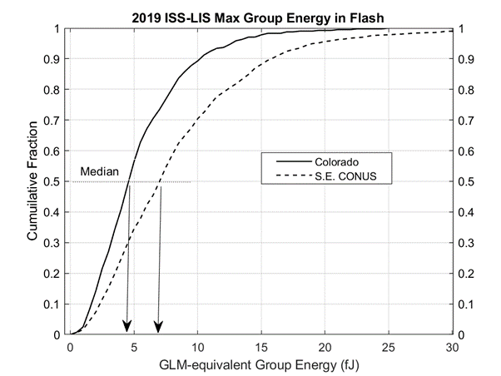
Complication: Optical energy depends on flash duration/Size and region
The Box plot (above) shows that short-duration flashes have the smallest “maximum group energy in the flash” values. Therefore they will be lost first when instrument thresholds increases
Boxes are25th – 75th percentiles. Red +’s are extreme values. Note log scale for energy.
The cumulative curves (above) show that group energy is uniformly lower in Colorado, compared to the southeastern USA
Median value of about 4.5 fJ in Colorado, vs. 6.5 fJ on southeastern USA
Notes:
In this study, the GLM threshold was applied at the EVENT level, so the behavior matches what GLM would do.
The group optical energy Box-plot is, by definition, limited to what GLM sees. Zhang and Cummins show that there are many cloud-top optical sources that have lower energy than GLM’s minimum of about 1.5 fJ.
Maximum Group Energy was used so that we know something about the brightest group. It would be more-informative to use the maximum event energy in each group, so it can be directly related to GLM detection threshold

Slide 12
The specific dependence of flash detection on threshold and flash size depends on the storm (e.g. normal polarity storm in Florida (left) and anomalously electrified storm in Colorado (right)
Add plot using local LIS source distribution and flash rate

Slide 13
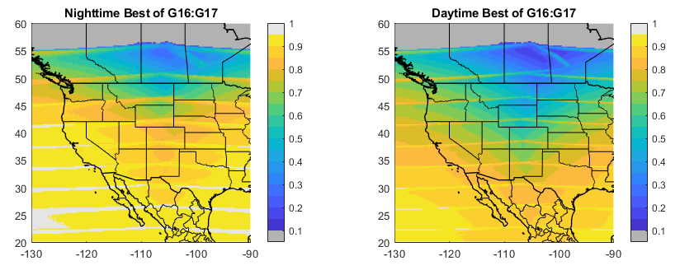
What flash de (relative to LIS) can we get with the best of Goes-East and west?
Notes:
Here we take a closer look at modeled performance over north America.
These DE images were produced by employing the best DE estimate from GOES-East and –West. Note that the estimated flash detection is at or below 50% (0.5) in upper plains and south-central Canada during the daytime.

Slide 14
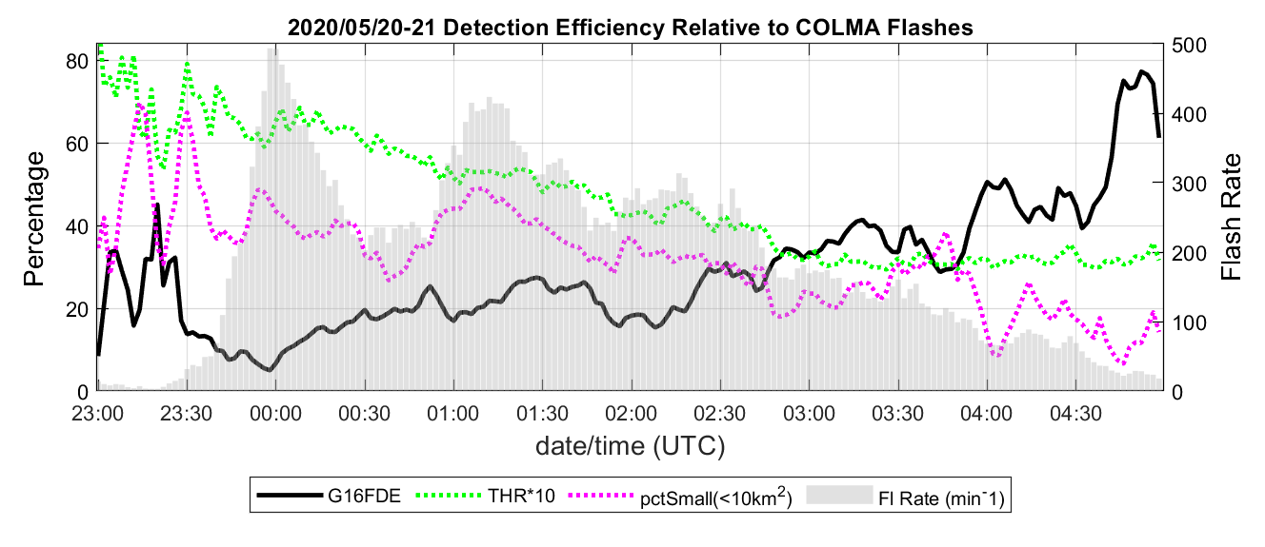
Colorado storm day: May 20, 2020
Threshold Animation (2-min frame rate)
GLM 2-minute event count
Region Median Threshold (fJ) Multiplied by 10
Full-region GLM flash DE
GLM Threshold within the region
% flash area < 10 km²
Note: final image is the per-pixel minimum over whole case
Threshold varies by region, and locally by a factor-of-two -- so we can benefit from Dynamic Tracking of pixel threshold
Notes:
Given that GLM detection threshold varies by region and by time-of-day, it would be helpful to have this information when interpreting GLM data in operational settings.
It is possible to compute the detection threshold for each GLM pixel in real-time with 2–5-minute temporal resolution by accumulating statistics from the event energy values reported in the operational L2 dataset. The left panel shows such a calculation for 2-minute intervals over a 6-hour period that includes full daylight, total darkness, as well as the transition period. The median threshold in the region (green line) starts out at about 7 fJ in full daylight and ends-up at about 3 fJ in full darkness after 03 UTC.
GLM flash DE relative to the local Lightning Mapping Array (thick black line) is quite low during daylight hours in this example, but it exceeded 50% after the median threshold reduced to about 3 fJ and the percentage of small flashes reduced to about 20%. The animation on the right panel shows the per-pixel threshold, color-codes between 1 and 7 fJ, in 2-minute periods. The final image in the panel shows the minimum threshold for each pixel for the duration of the storm.
It should be clear that real-time tracking of GLM threshold is both practical and useful

Slide 15
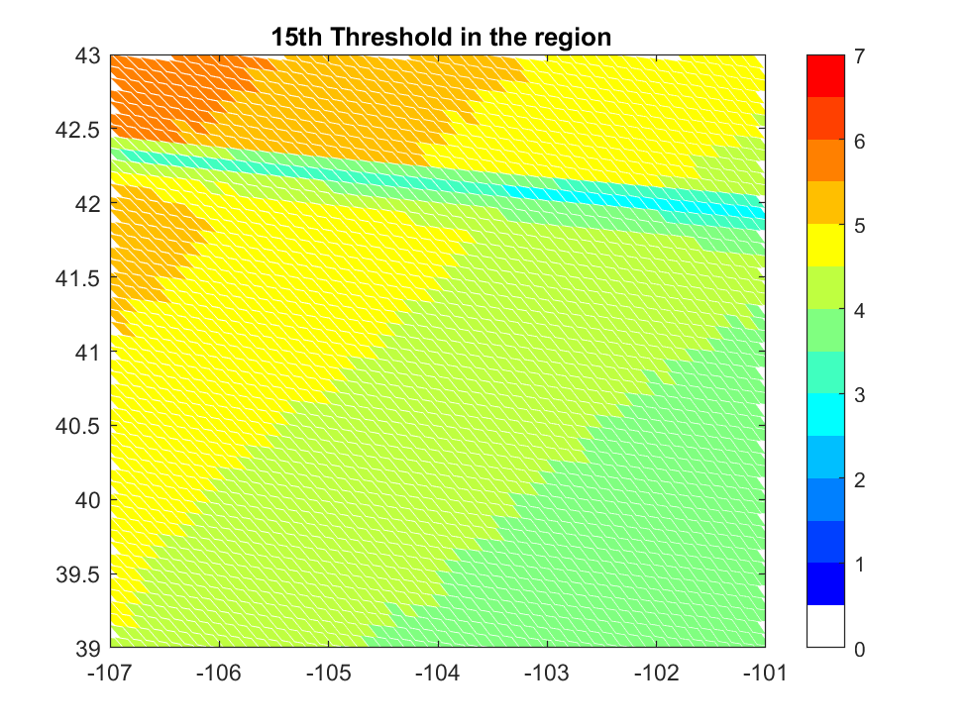
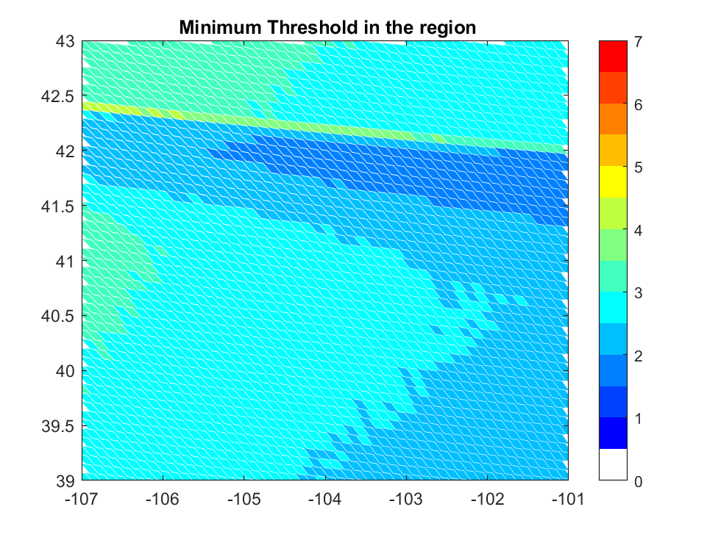
Colorado storm day summary: May 20, 2020

Slide 16
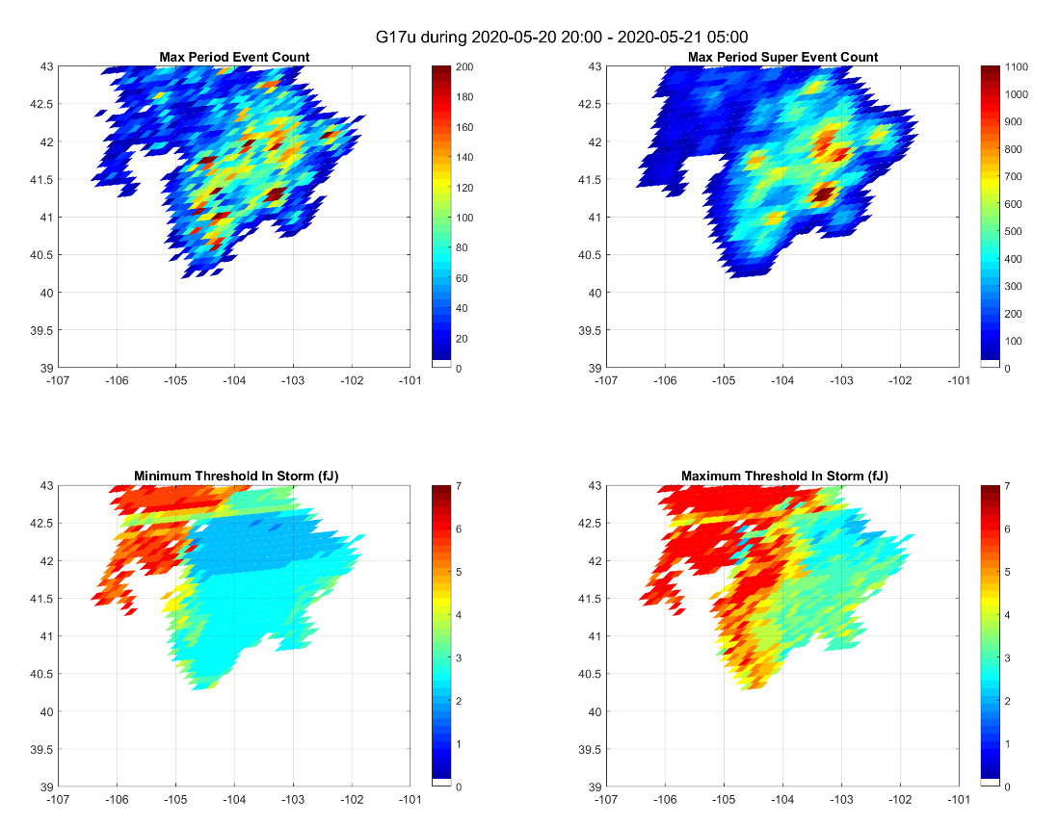
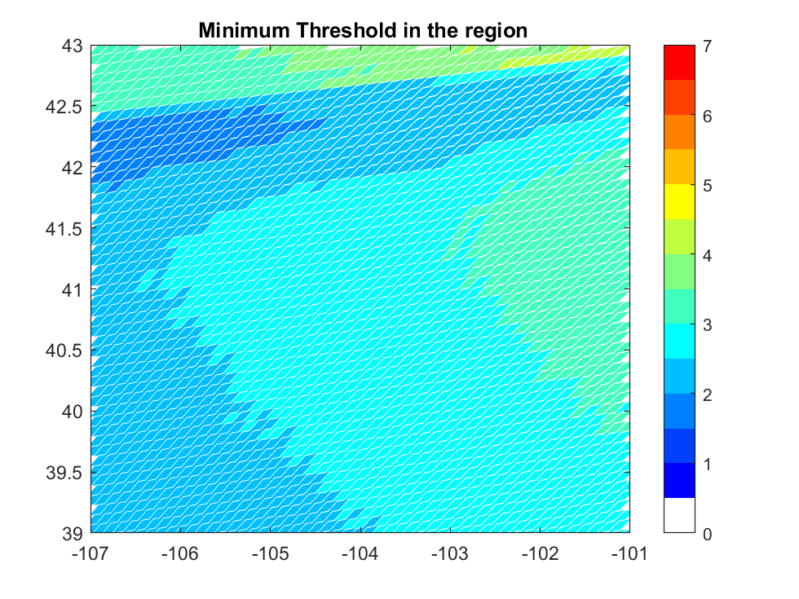
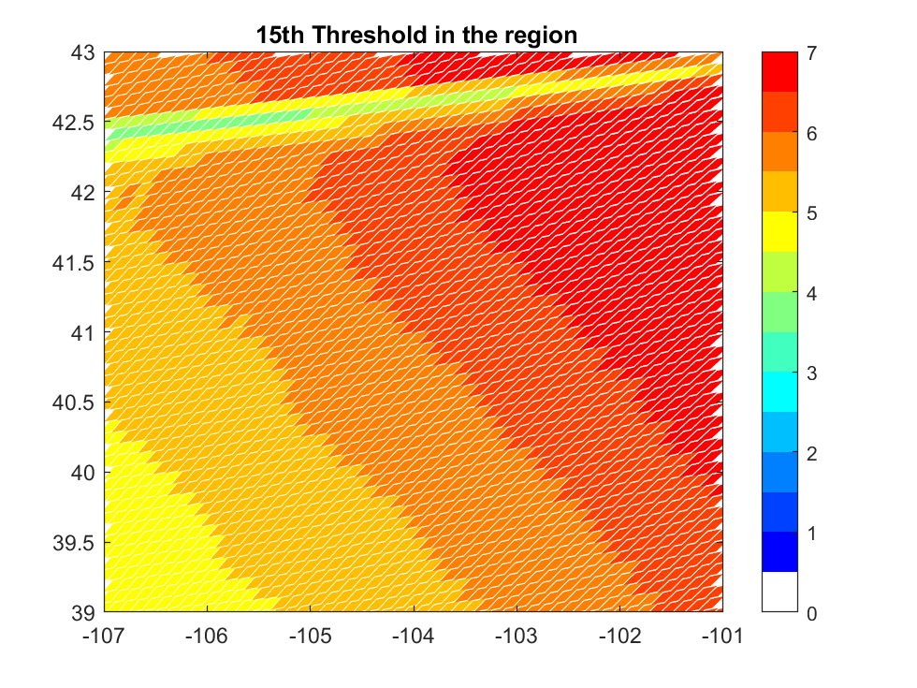
Note that the observed L2 thresholds are similar for G17 and G17, even though their nominal day:night instrument values are quite different. Could this be a “Front Range Effect”?
2-minute Event Count (storm max)
G17
G16
Minimum and maximum 2-minute Observed Thresholds
Instrument Threshold “Range”

Slide 17
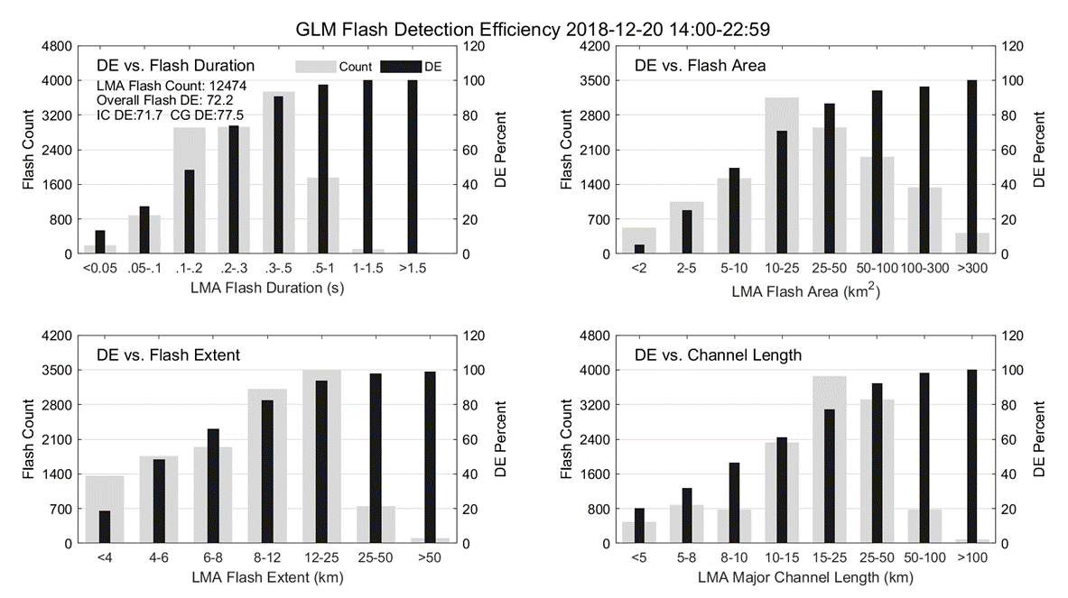
GLM-16 (Goes East): Larger flashes are easier to detect
Based on comparisons with the Kennedy Space Center Lightning Mapping Array (KSCLMA), GLM detection is strongly dependent on all aspects of flash “size” (time duration, area, spatial extent, and overall channel length)
Overall finding for 8 hours of storm activity near KSC on December 20, 2018. ==>
Dark bars indicate flash DE and light wide pars indicate flash counts.
(from Zhang and Cummins, JGR 2020)

