Slide 1
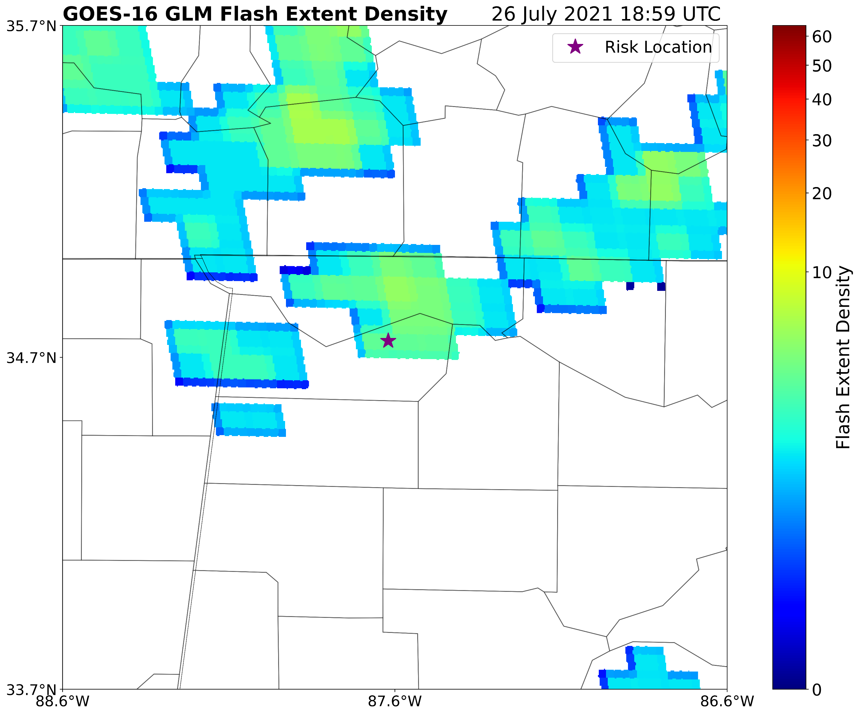
Applications and Performance of a Lightning Risk Assessment Using GLM Data
Kelley M. Murphy¹, Roger E. Allen², Christopher J. Schultz³, Eric C. Bruning⁴
1 – Earth System Science Center (ESSC), UAH, Huntsville, AL 2 – NASA SPoRT/Jacobs Engineering, Huntsville, AL
3 – NASA SPoRT, Marshall Space Flight Center, Huntsville, AL 4 – Department of Geosciences, TTU, Lubbock, TX

Slide 2
Motivation & Background
Why lightning?
Prevent fatality & injury prevention
US has made great progress, but lightning is a much larger danger in other countries (especially underdeveloped)
Why lightning safety?
Fatality & injury prevention
US has made great progress, but lightning is a much larger danger in other countries (especially lesser-developed)

Slide 3
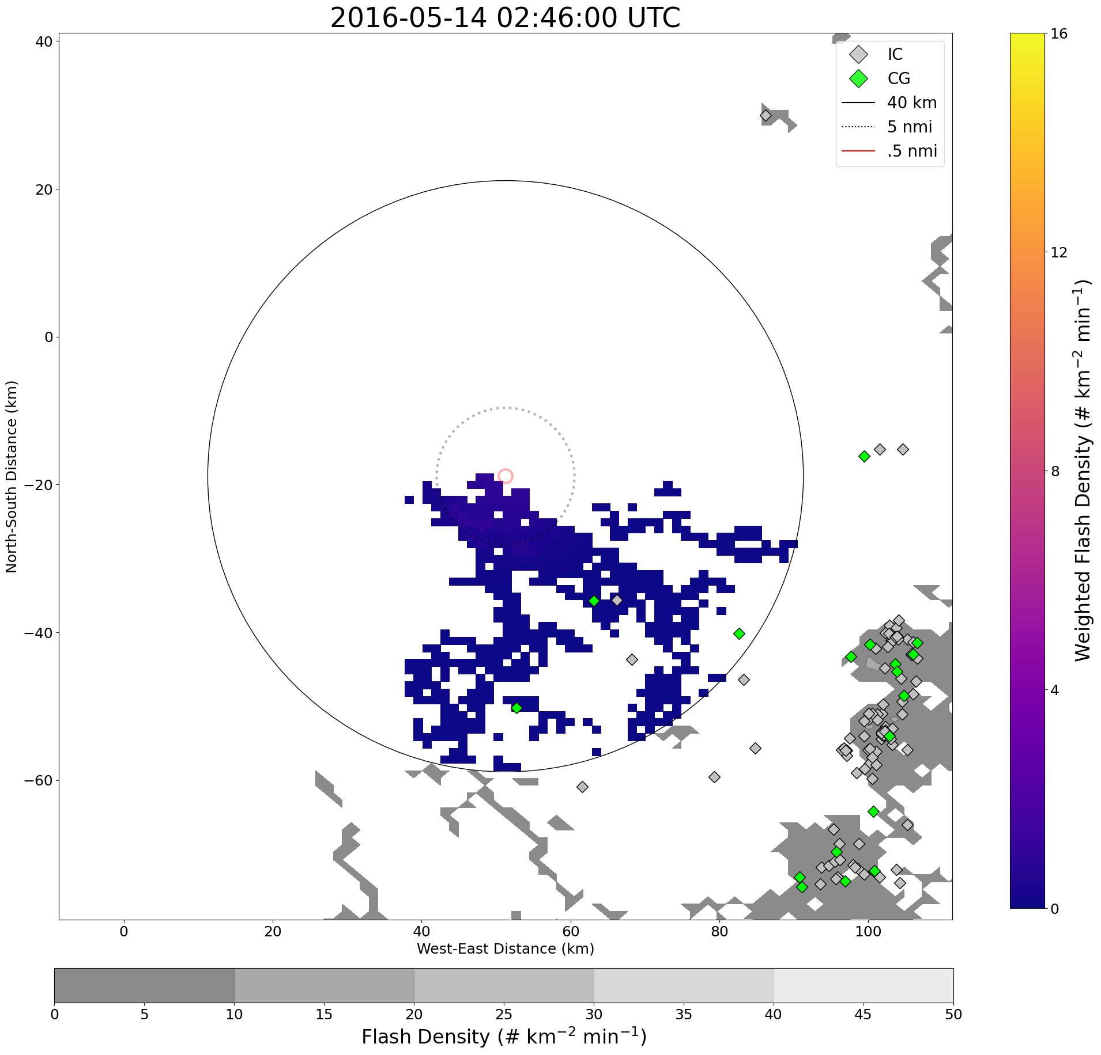
Motivation & Background
Why GLM?
Spatially mapped data provides insight to lightning location in the cloud/overhead in contrast to point data
Risk method originally used LMA data, but a switch to GLM allows for expanded application in areas outside of LMA domains

Slide 4
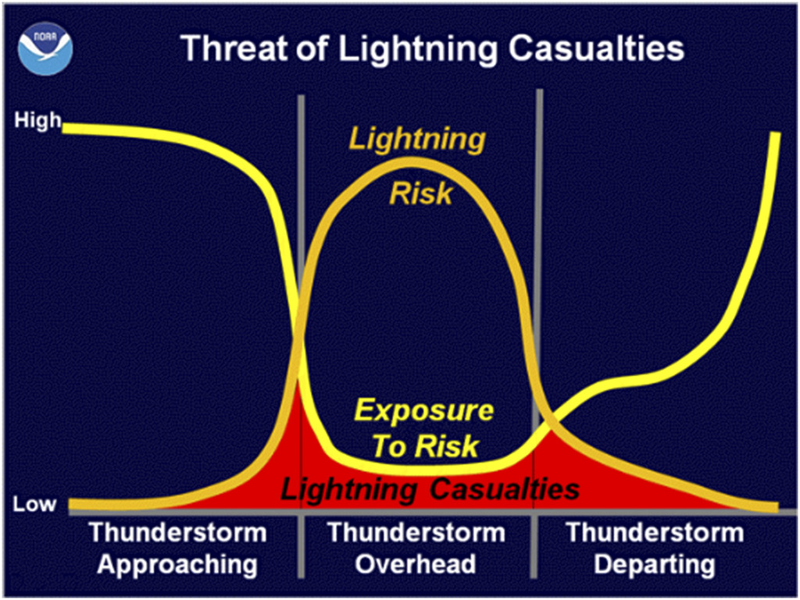
Motivation & Background
Why GLM?
Spatially mapped data provides insight to lightning location in the cloud/overhead in contrast to point data
Risk method originally used LMA data, but a switch to GLM allows for expanded application in areas outside of LMA domains
Why spatiotemporal risk?
Considers the situation from all angles – both subjective & objective
Yields a risk magnitude from multiple factors/considerations - room for further expansion/additions in the future

Slide 5
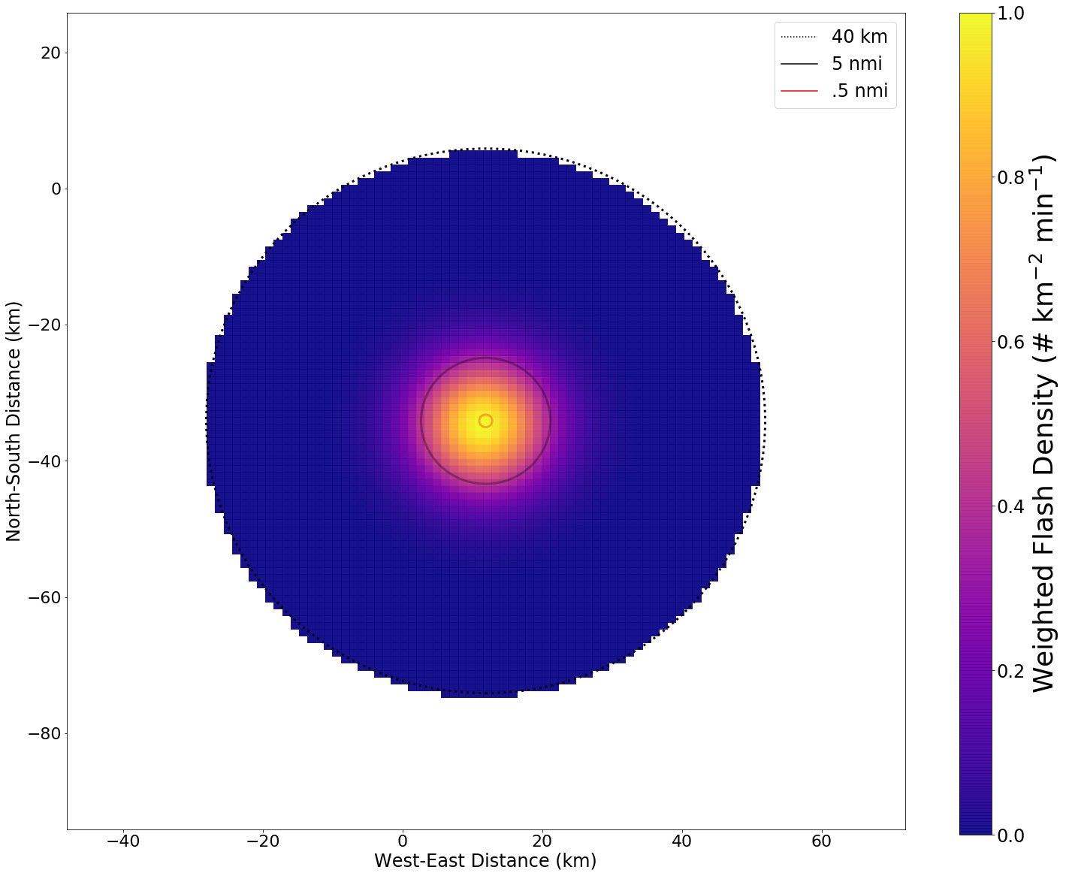
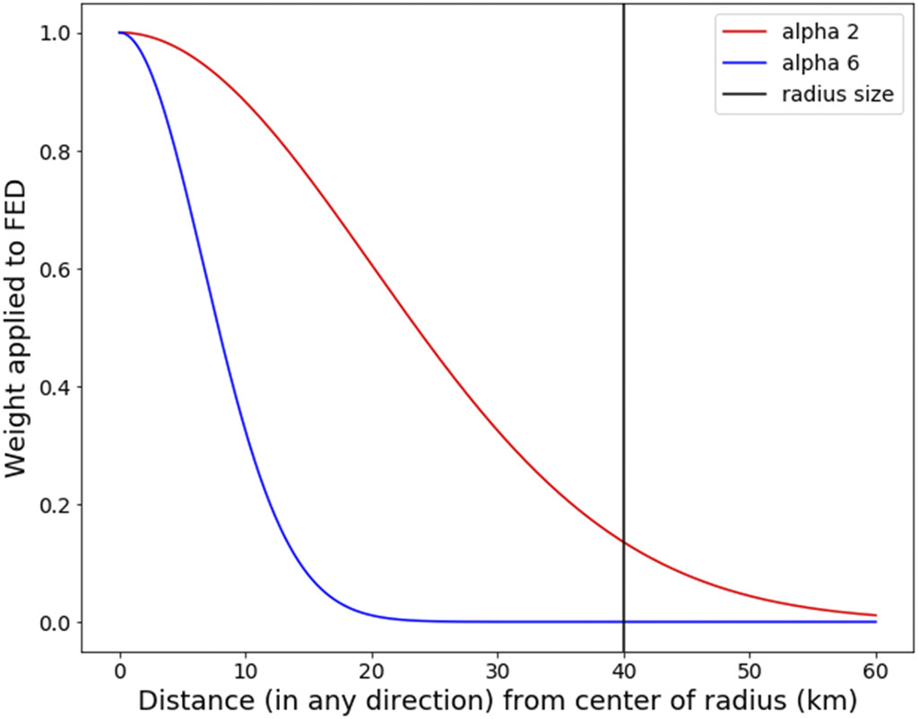
Methods
Calculation is based on International Electrotechnical Commission Standard 62305-2 (IEC 62305-2).
Adapted for human safety scenarios
Area used: radius of 100ft surrounding human
Breaks down into three parts: number of dangerous events, probability of damage, and consequent loss.
Resulting risk magnitude compared to tolerability thresholds to evaluate safety
A Spatiotemporal Lightning Risk Assessment Using Lightning Mapping Data
Murphy, K. M., E. C. Bruning, C. J. Schultz, J. K. Vanos
https://journals.ametsoc.org/view/journals/wcas/aop/WCAS-D-20-0021.1/WCAS-D-20-0021.1.xml

Slide 6
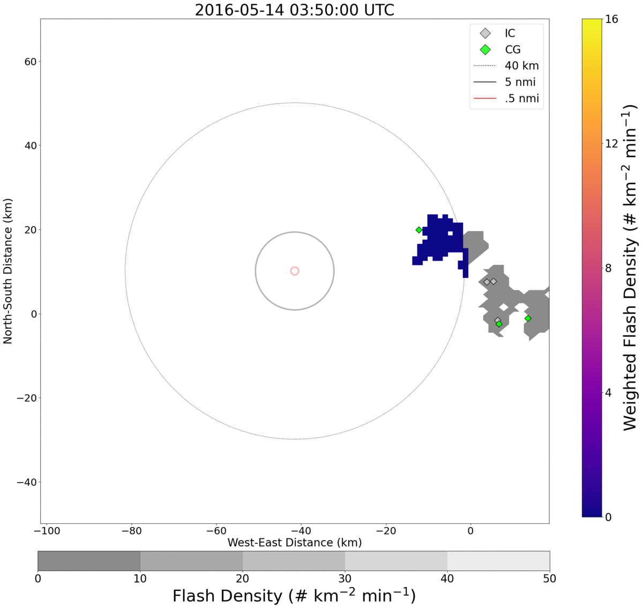
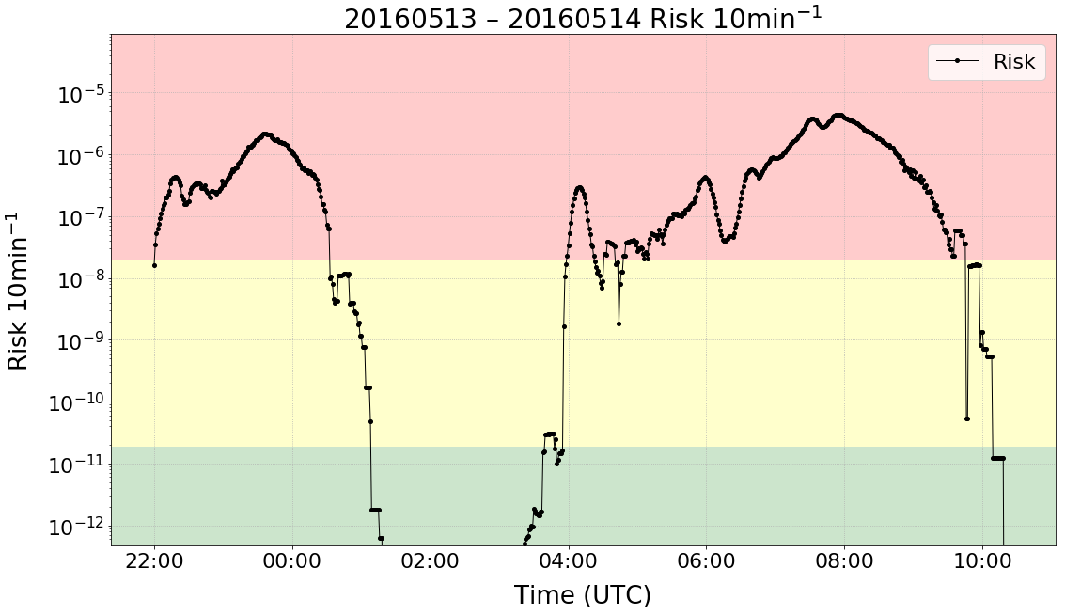
Methods
Calculation is based on International Electrotechnical Commission Standard 62305-2 (IEC 62305-2).
Adapted for human safety scenarios
Area used: radius of 100ft surrounding human
Breaks down into three parts: number of dangerous events, probability of damage, and consequent loss.
Resulting risk magnitude compared to tolerability thresholds to evaluate safety
A Spatiotemporal Lightning Risk Assessment Using Lightning Mapping Data
Murphy, K. M., E. C. Bruning, C. J. Schultz, J. K. Vanos
https://journals.ametsoc.org/view/journals/wcas/aop/WCAS-D-20-0021.1/WCAS-D-20-0021.1.xml

Slide 7
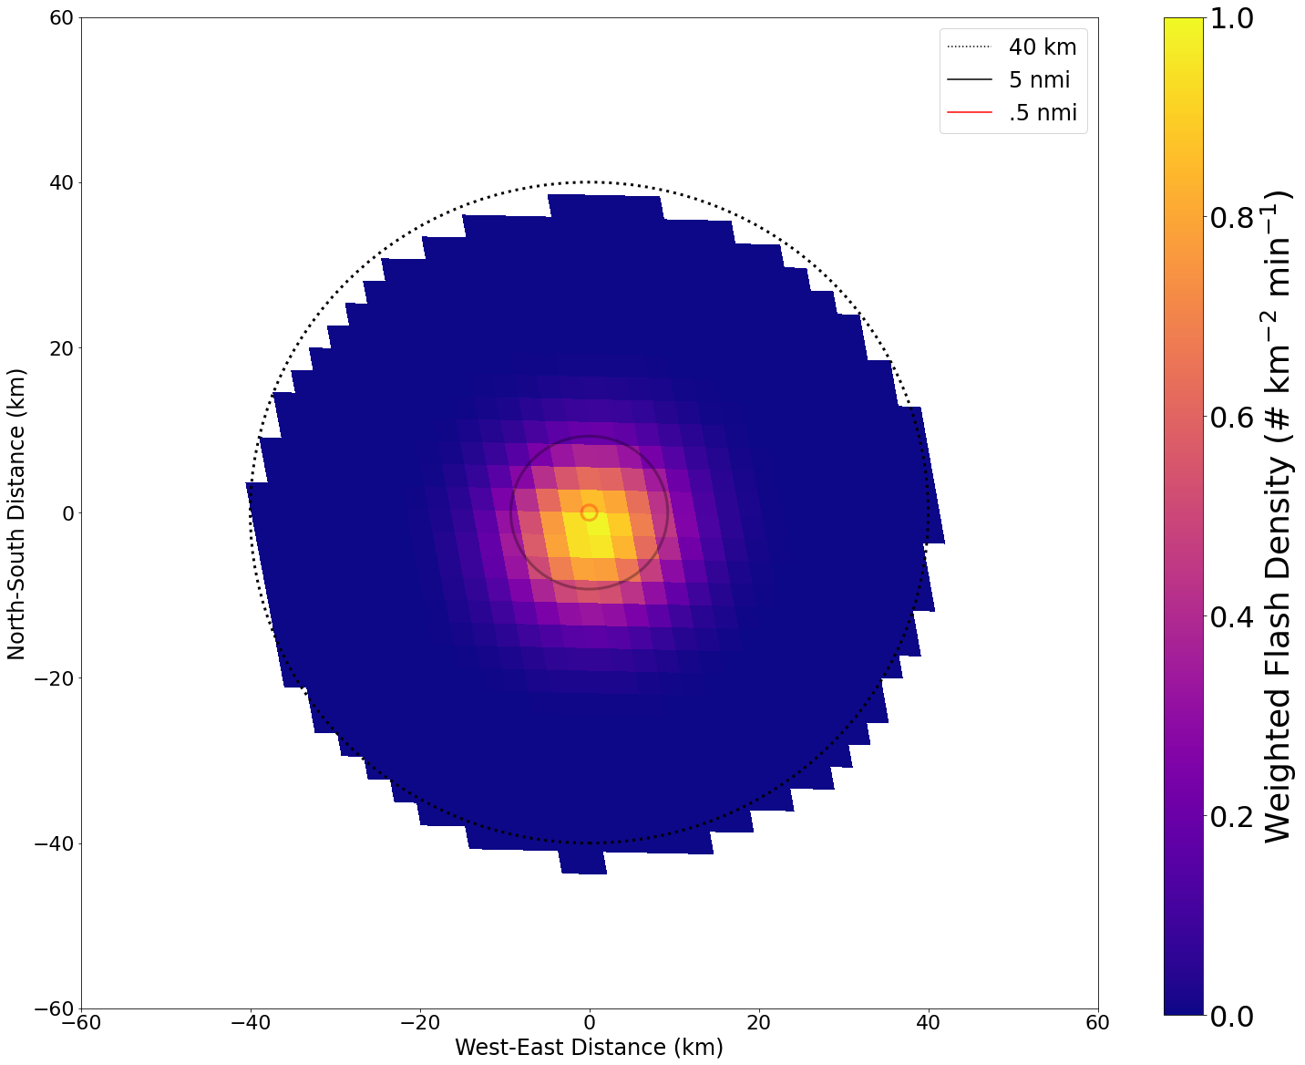
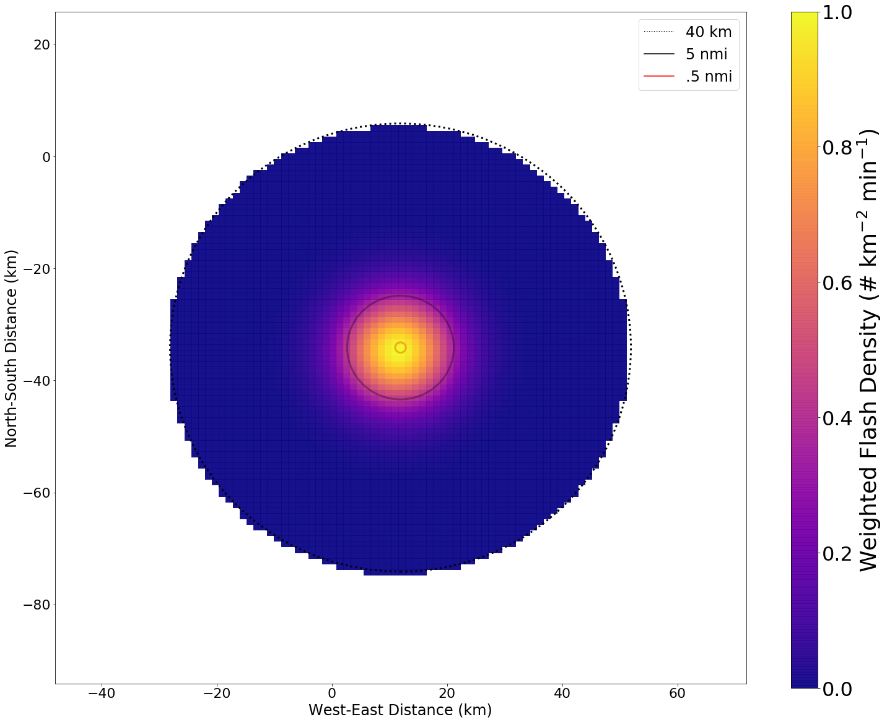
Switch to GLM data
Process GLM L2 files data using glmtools (Bruning et al. 2019)
Use gridded flash extent density (FED)
Follow same methodology to calculate a risk magnitude that changes with time
Have to consider parallax
GLM
LMA

Slide 8
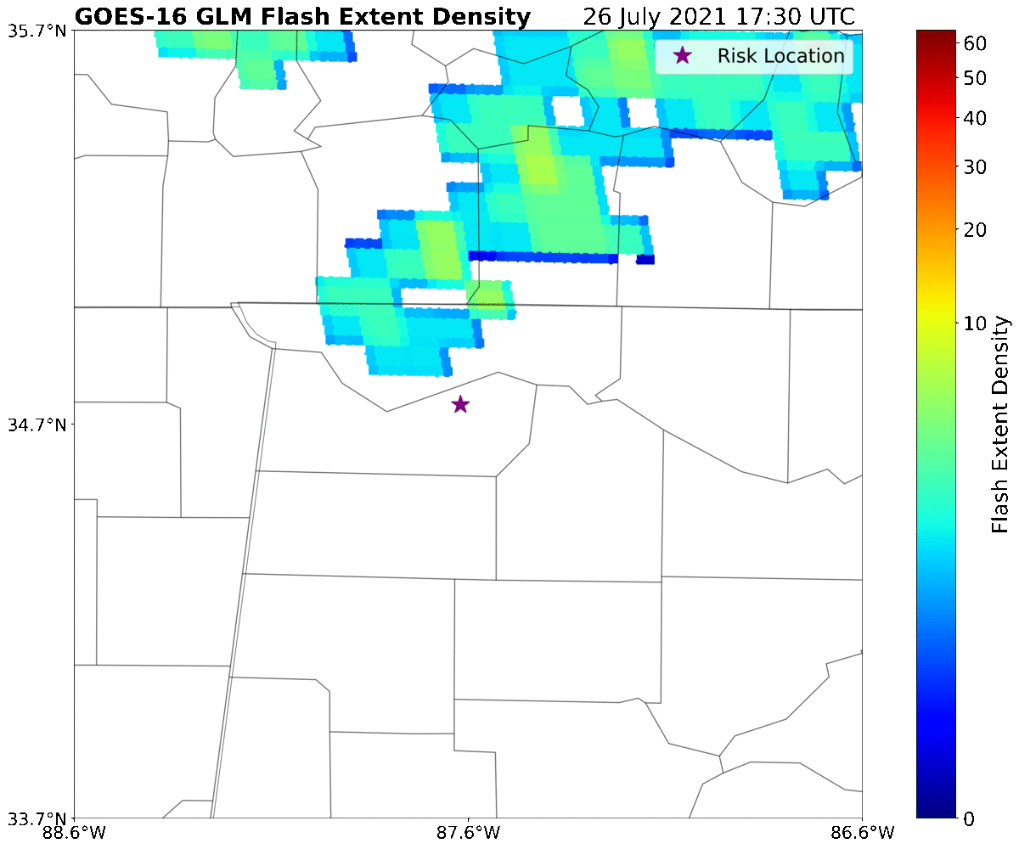
Compare GLM vs. LMA
Looked at 20210726 from ~17 UTC to 22 UTC in Muscle Shoals, Alabama

Slide 9
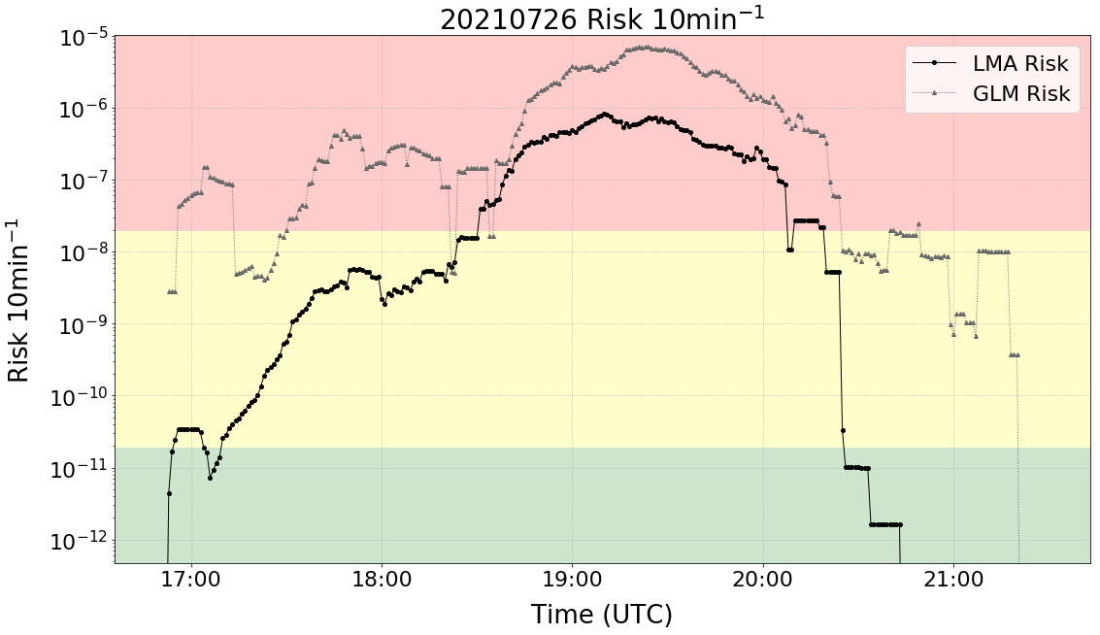
Compare GLM vs. LMA
Risk for GLM is greater than LMA almost the entire duration
Difference in risk magnitude across time is less with GLM

Slide 10
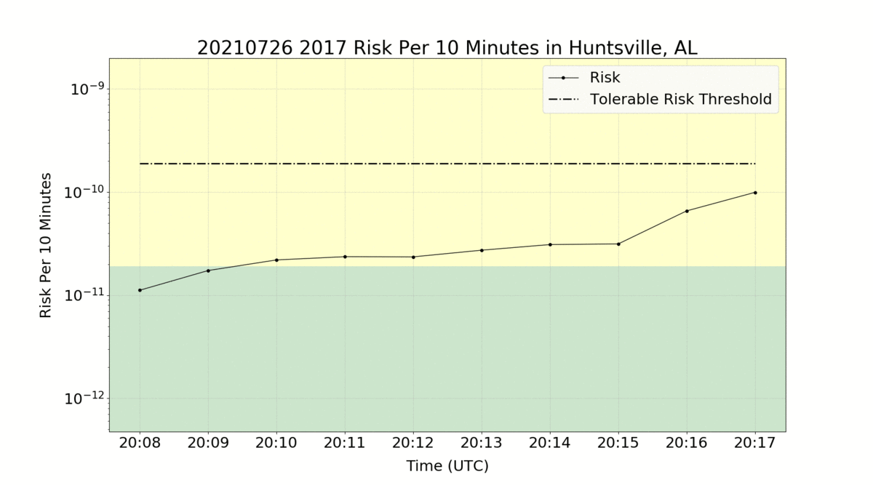
Next & Future Steps
Create a database of case days to compare GLM vs. LMA risk
Compare both evolution and magnitude of risk for both methods
Compare GLM results to NLDN methodology (as was done for LMA)
Apply the risk method to cases outside of the US
Work with local NWS office to analyze performance in real time
Have the risk method run in real time with GLM in various locations in North Alabama
Long term, implement additional variables into the risk calculation

