Slide 1
2021 GLM Science Meeting
GLM Detections of Lightning Flashes to Instrumented Towers
Joan Montanyà , Carlos Morales , Silverio Visacro and Marcelo Saba
(Spain)
(Brazil)
(Brazil)
(Brazil)
23 September 2021
1

Slide 2
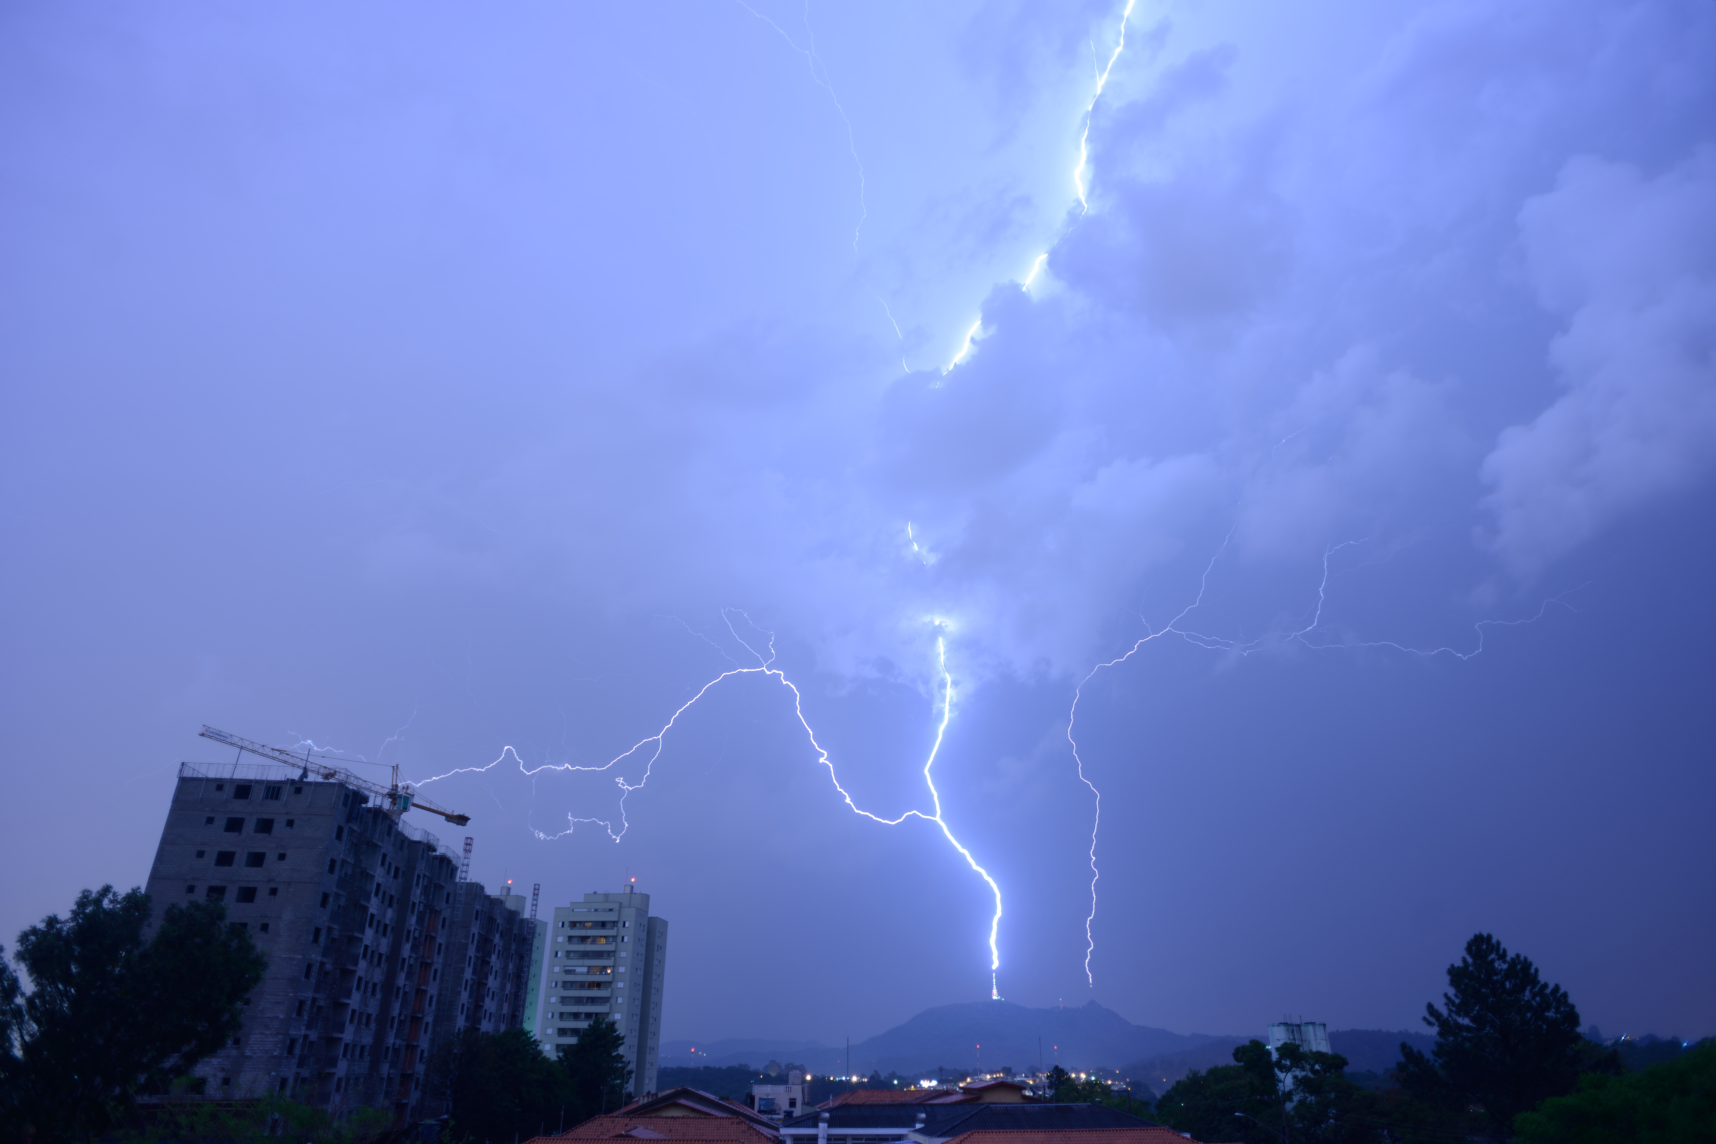
2021 GLM Science Meeting
Introduction
We present the GLM detections to the Morro do Cachimbo instrumented tower (Belo Horizonte, Brazil) and the towers at Pico do Jaraguá (São Paulo, Brazil).
For each flash, optical energy of all the GLM events is integrated in each frame. The resulted integrated energy is compared with the measurements/observations at the towers.
More information e.g. Visacro et al. (2004, 2012, 2017)
Marcelo Saba (INPE)
2

Slide 3
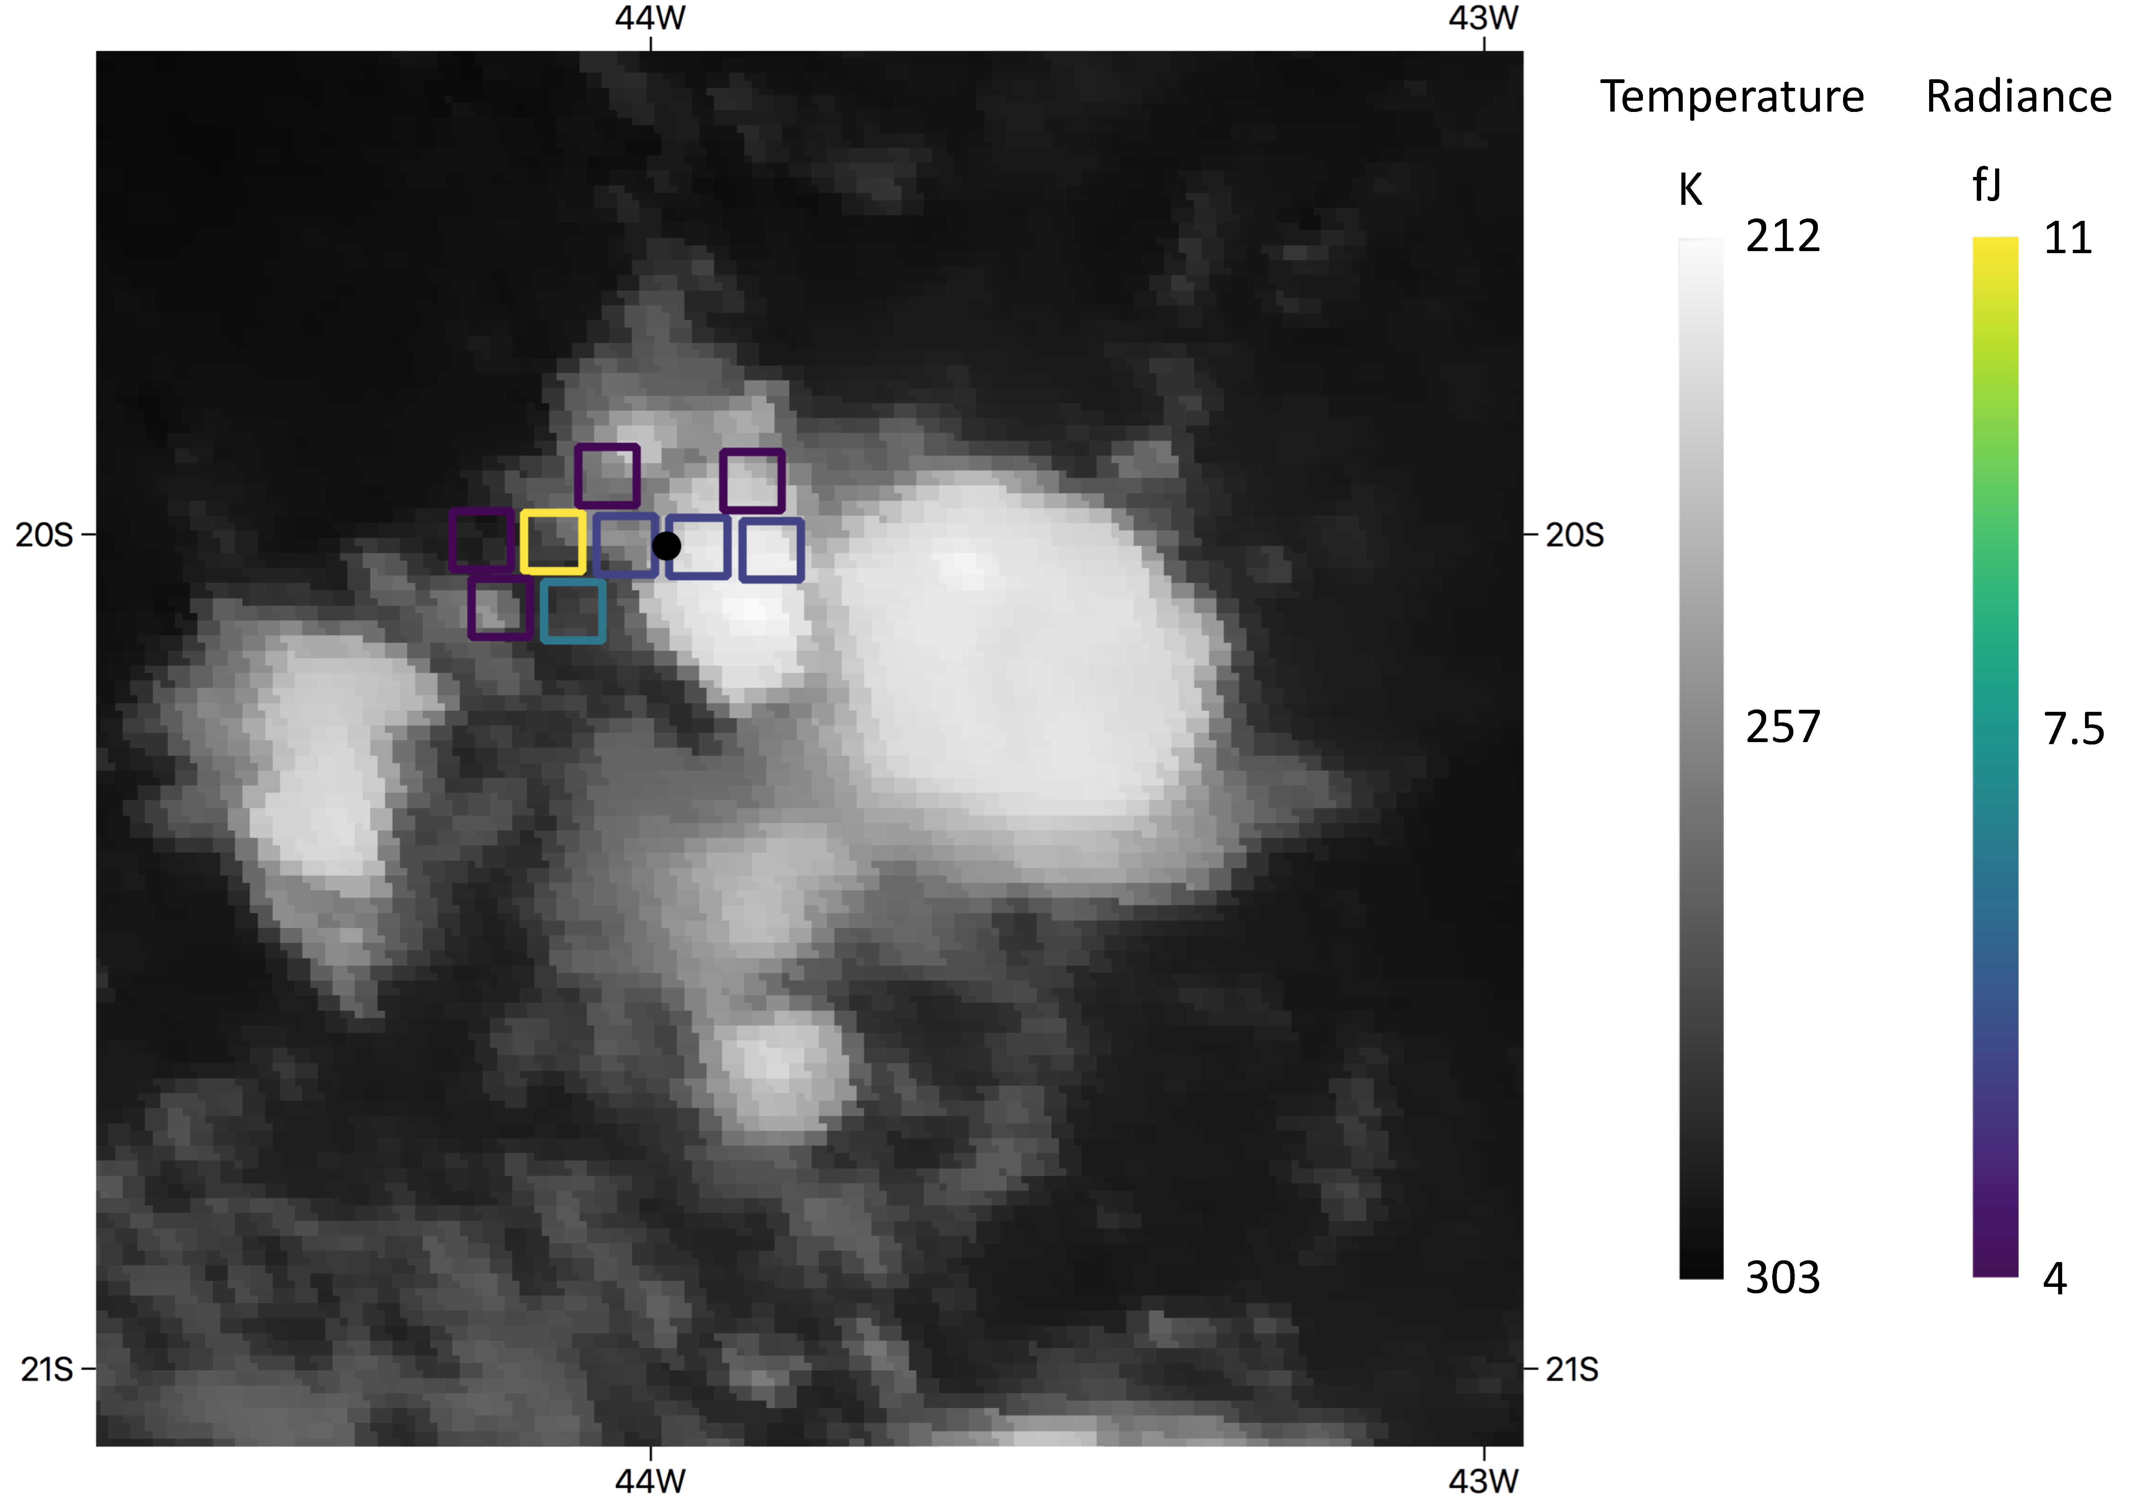
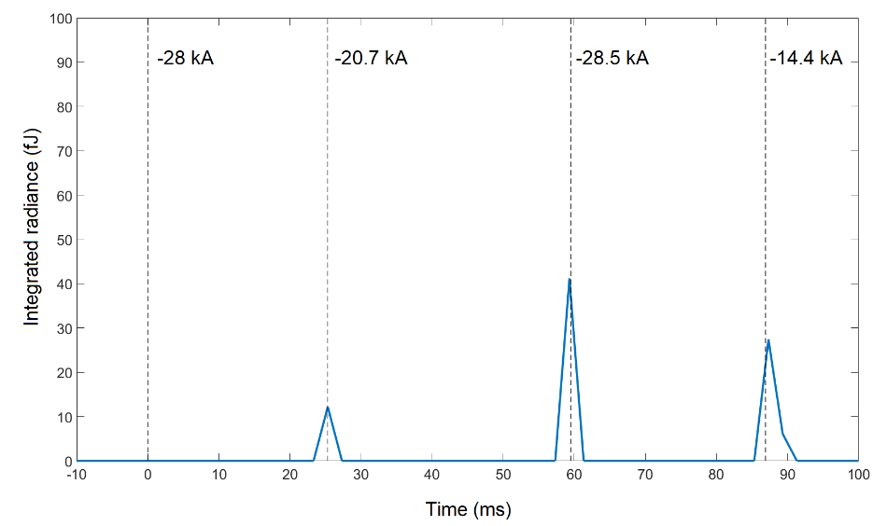
Morro do Cachimbo: Multi-stroke –CG flash
20190120 20:15:27
GLM
 | Measured Peak current | ms from trigger
1st RS | -28.3 kA | 0
2nd RS | -20.7 kA | 25.2982
3rd RS | -28.5 kA | 59.5482
4th RS | -14.4 kA | 86.8982
The first stroke was not detected despite of the high peak current (-28.3 kA).
Optical energy is not proportional to the measured peak current I, charge Q or specific energy i²t.
3

Slide 4
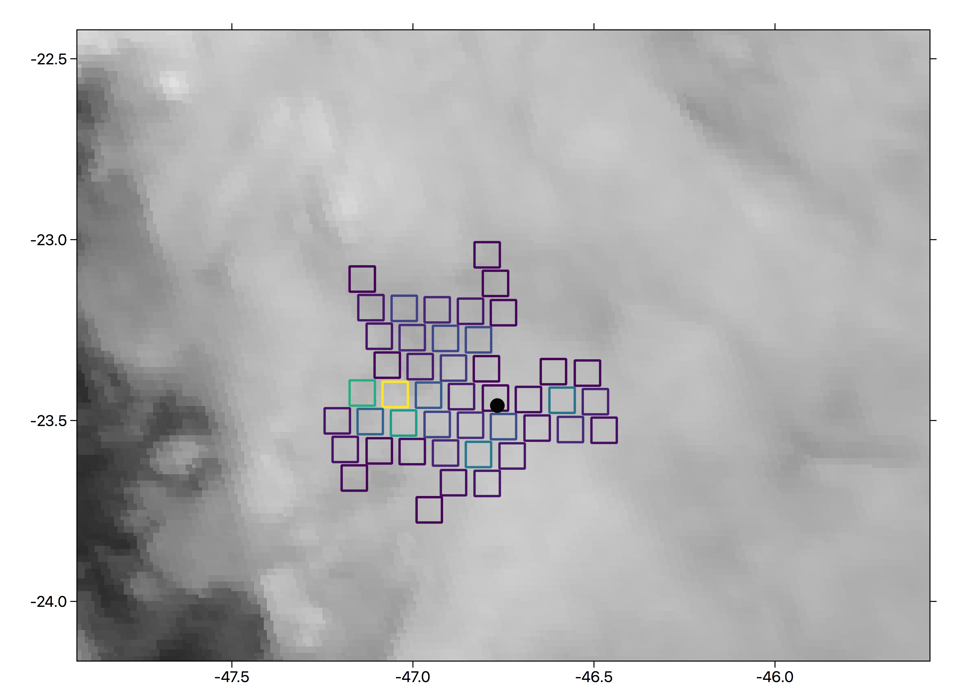
Upward flash initiated by a +CG with continuing current (I- Pico do Jaraguá )
Flash ID169 20190125
end of upward leader
Upward leader
Initiation of upward leader (t=0 ms)
GLM
Marcelo Saba (INPE)
+CG
Upward leader
+60 kA
Upward leader starts after 75 ms
4

Slide 5
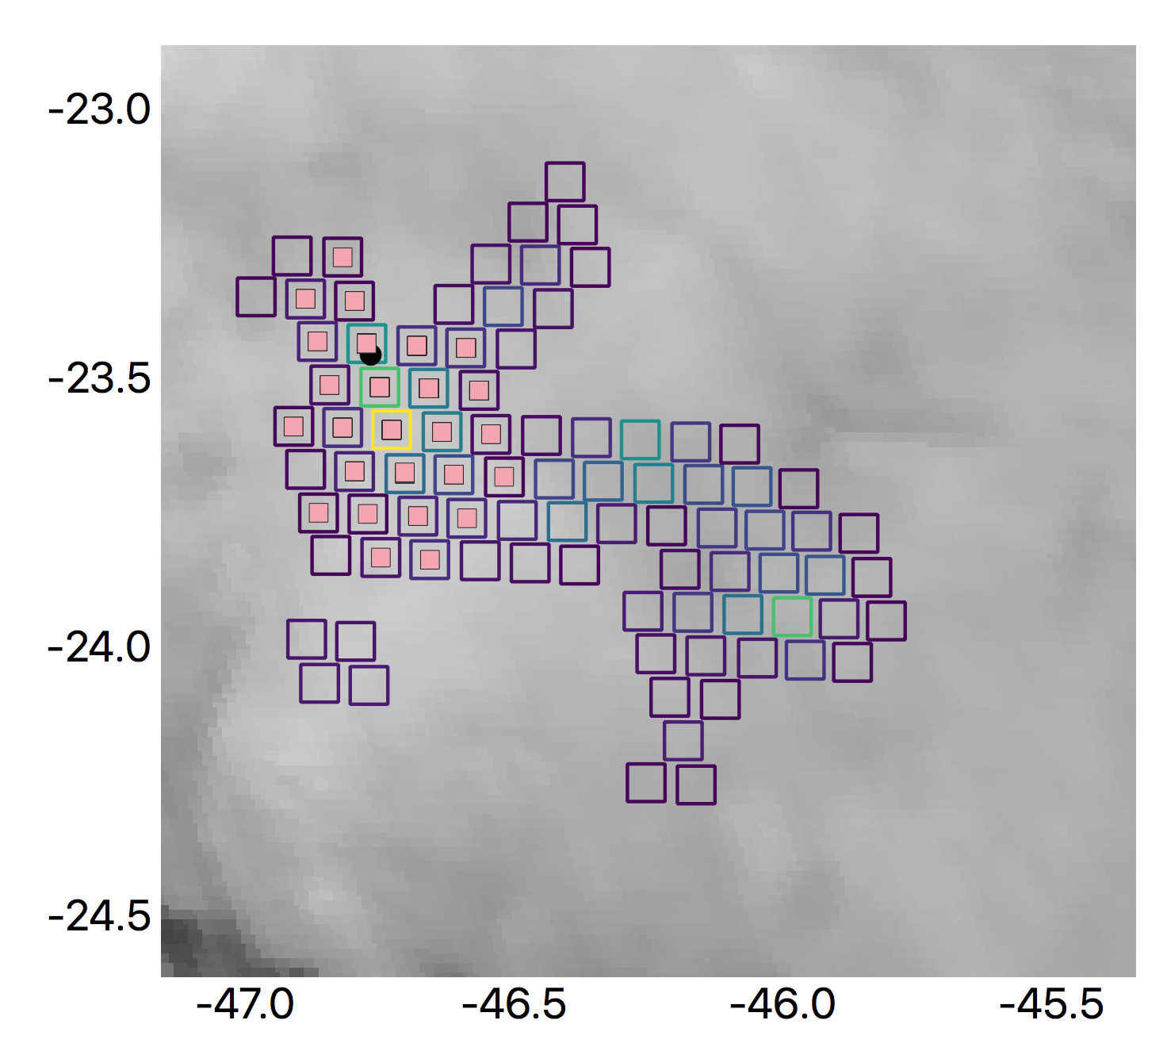
Upward flash initiated by a +CG with continuing current (II- Pico do Jaraguá )
Flash ID 166 20190125
Upward leaders with strokes
+CG
Marcelo Saba (INPE)
5

Slide 6
Upward flash initiated by a +CG with continuing current (II- Pico do Jaraguá )
Upward leaders and
cloud recoil leader acivity
strokes
+28 kA
GLM
Initiation of upward leaders (t=0 ms)
6

Slide 7
2021 GLM Science Meeting
Conclusions
The three available flashes at Morro do Cachimbo are detected by GLM despite if they are donward –CG o upward –CG initiated by nearby flash.
Direct comparison with measured peak currents and GLM detections has been possible for the –CG downward cases but not for the upward flash that involved low peak currents (< 9 kA).
The 6 analysed flashes upward flashes at Pico do Jaraguá show a previous +CG that initiates upward leaders at the towers.
In these flashes GLM shows the presence of continuing currents after the +CG strokes.
Upward leaders from the towers can start just after the +CG stroke or during the continuing currents.
GLM can help to identify cases of upward flashes from tall towers that can be a threat in some particular situations such as wind turbines.
7

