Slide 1
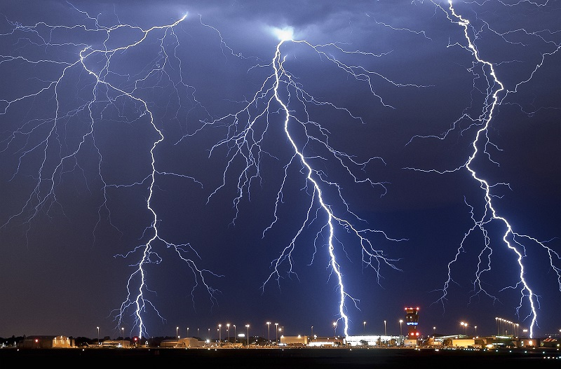
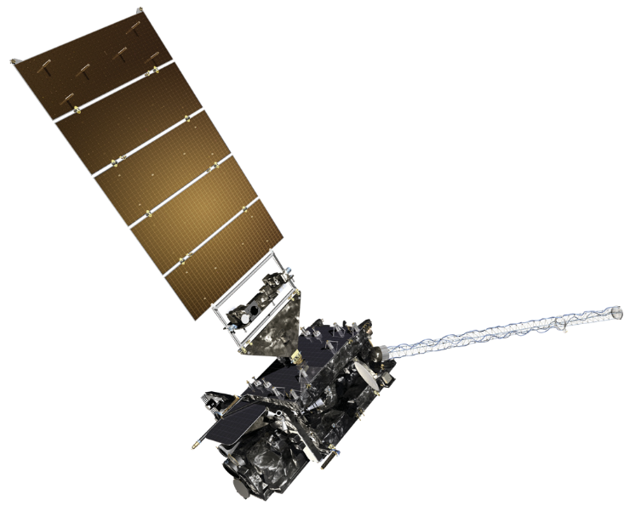






Assimilation of GOES-R Global Lightning Mapper Total Flash Rate Data for the Analysis and Short-Term Forecast of Convective Storms using EnKF and Hybrid En3DVar Methods
Ming Xue^{1,2} , Rong Kong¹, Alexandre O. Fierro^{3,4}
Chengsi Liu¹ , Youngsun Jung¹
Edward R. Mansell⁴ and Donald R. MacGorman⁴
¹Center for Analysis and Prediction of Storms
²School of Meteorology,
³Cooperative Institute for Mesoscale Meteorological Studies
University of Oklahoma, Norman Oklahoma 73072
⁴NOAA/National Severe Storms Laboratory, Norman, Oklahoma
GLM Virtual Science Meeting
9/21-23, 2021
Credit: Rowland Beardsell

Slide 2
Assimilation of Lightning Data into NWP Models
Assimilation into convection-parameterizing models:
  Converted to rainrates to adjust latent heating in cumulus parameterization scheme (CPS)
  Using CG lightning data to adjust humidity profiles to indirectly trigger a CPS or directly activate a CPS
Assimilation of lightning data into CAM models:
  Assimilate pseudo-moisture derived from lightning data
  Adjust low-level temperature based on lightning data
  Converting lightning data into reflectivity then assimilate
Positive impacts of lightning data were generally obtained.
These indirect methods generally do not consistently update all model state variables.

Slide 3
Direct Assimilation of Lightning Data
Ensemble Kalman filter (EnKF) nad hybrid ensemble variational (En3DVar) methods can directly assimilate lightning data with the help of an observation operator.
Flow-dependent ensemble background error covariance (across variables) allows for the updating of all model state variables, not just those directly linked to observed quantities (e.g. graupel).
Mansell et al. (2014) and Allen et al (2016) were first to assimilate simulated or pseudo-GLM FED observations using EnKF.

Slide 4
EnKF and Hybrid En3DVar for FED DA in GSI
(recent work done at OU under support of a GOES-R Risk Reduction Grant)
Developed flash extent density (FED) data assimilation (DA) capabilities within GSI EnKF and tested with an MCS case (Kong et al. 2020a, MWR). Included FED data preprocessor, FED obs operators.
Developed FED DA capabilities based on GSI hybrid En3DVar, including adjoint of operator. Compared FED DA using GSI EnKF, 3DVar and hybrid En3DVar for two convective storm cases, pure En3DVar performed similarly to EnKF and are the best, 3DVar worst (manuscript to be resubmitted).
Develop new observation operators based on statical relations for GOES-R GLM FED data: tests with two convective events over the US.
Assimilate FED data with and without radar observations (rerun using the new operator).

Slide 5
1-min FED Observations on 10 km Grid
Black dots: Original flash events
Shading: Number of flashes going through a 10 x 10 km grid box in 1 minute interval (processed FED data to be assimilated)
One-minute FED (units: min⁻¹ pixel⁻¹, shading)
Notes:
A 10-km (instead of 8-km) grid pixel is used here to suppress data holes exit in the obtained FED field.

Slide 6
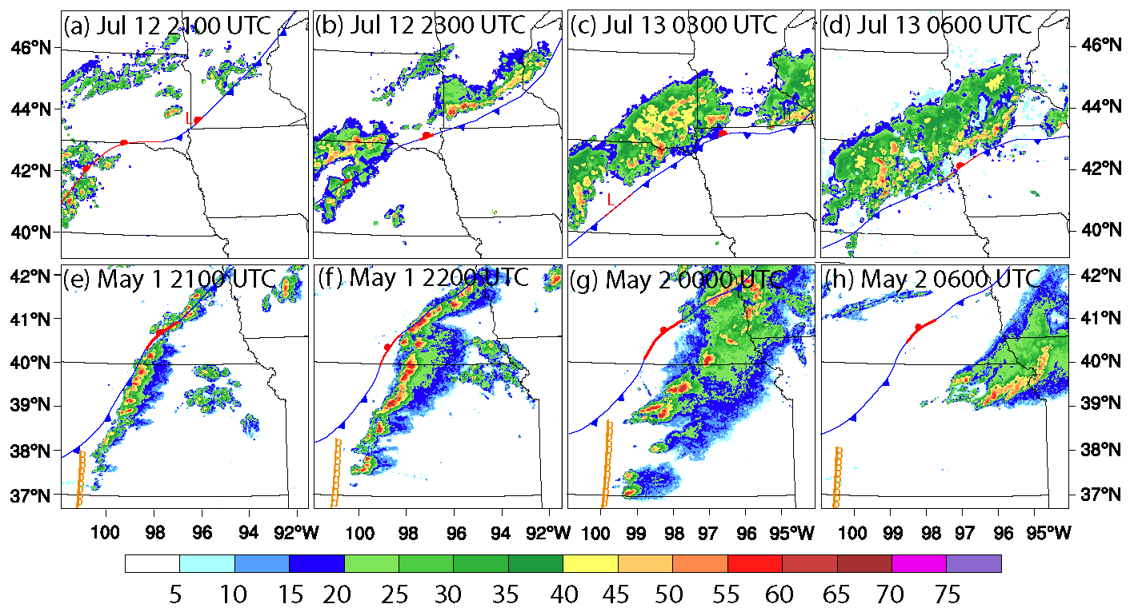
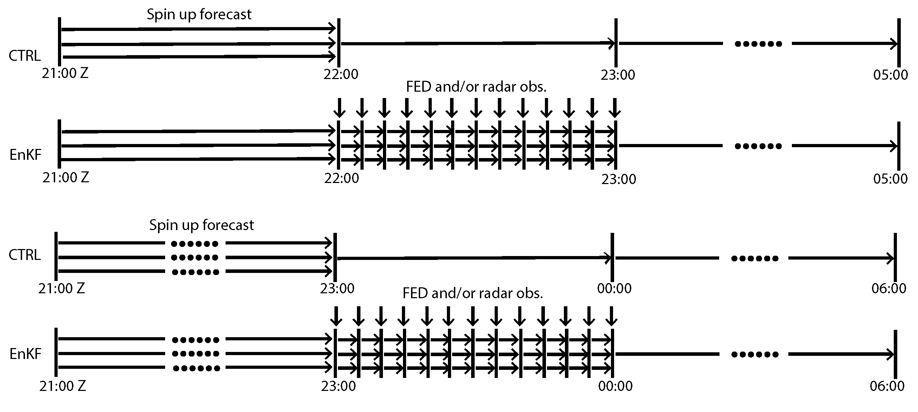
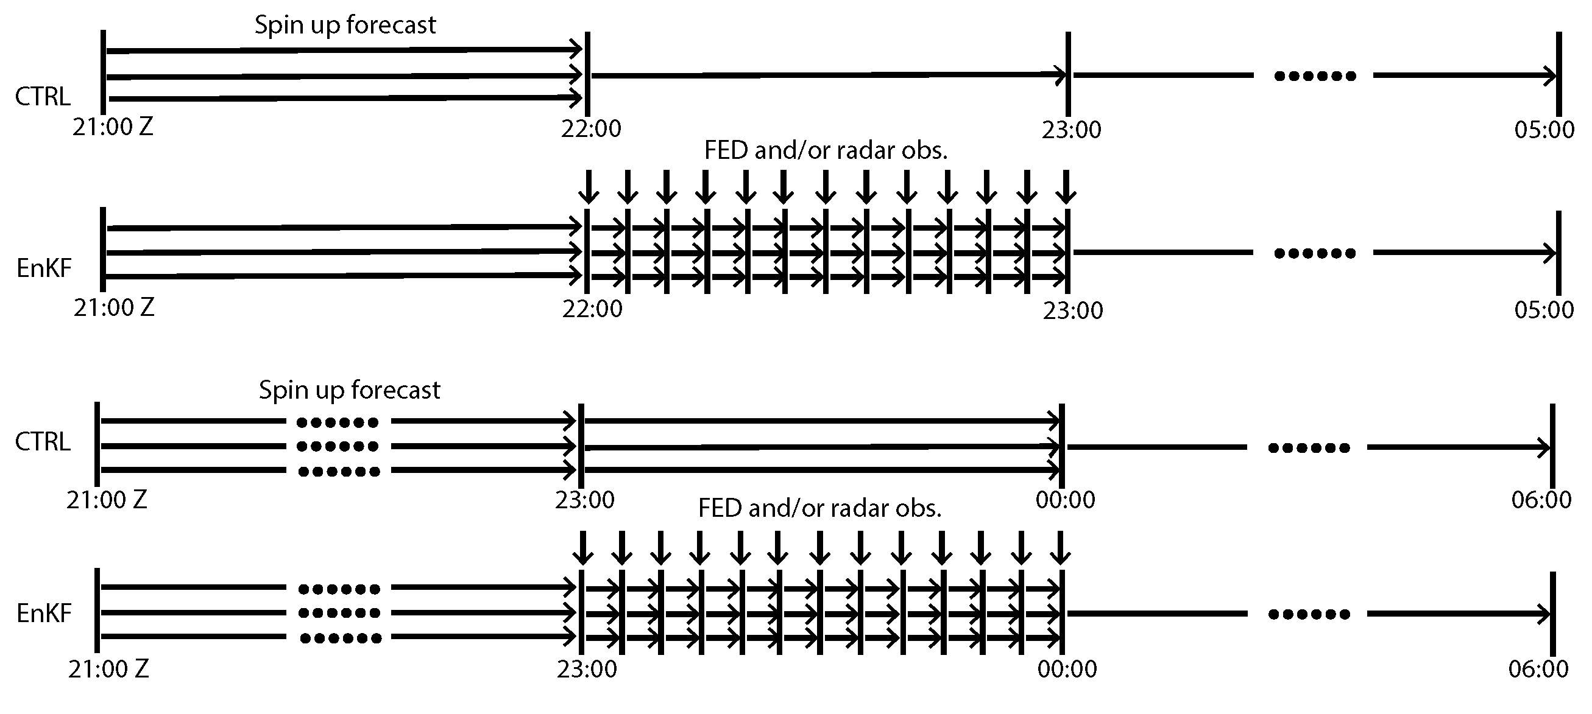
Storm cases, model, and DA setup
1. MCS case (20180712 2100 ~ 20180713 0600 UTC)
DA systems: GSI-EnKF
2-h (1-h) spinup ensemble forecasts for the MCS (supercell) case from 40 ensembles derived from 3 h NCEP NAM forecast + SREF ensemble forecasts.
Assimilate FED and/or radar obs. using EnKF every 5 min for 1 hour followed by 6-h forecast from ensemble mean analysis.
WRF model, dx=3 km (1km) for MCS (supercell), 40-member ensemble, 2 surface, 3 PBL and Thompson MP.
2. Supercell case (20180501 2100 ~ 20180502 0500 UTC)
Notes:
Developing and testing the new operators based on the relatively weak convection in the MCS case and the strong supercecullar convection enable the operators to include information spanning both ends of the convective spectrum and, hence, to be more general/universal.

Slide 7
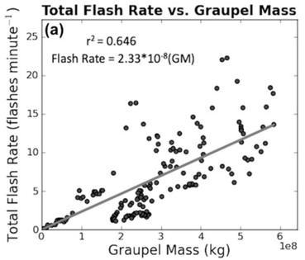


Develop new observation operators for GOES-R Geostationary Lightning Mapper flash extent density data: tests with two convective events over the US.
Allen et al. (2016): the FED observation operators were developed based on model simulations of the FED and graupel fields and were applied to simulation of pseudo-GLM FED data.
From Fig. 5a in Allen et al. (2016)
Kong et al. (2020) tuned above operator by multiplying a factor C_{M}
The tuned operator had been tested with the WoF system by Yaping Wang of NSSL (Wang et al. 2021) and HRRR system by Amanda Back (see next talk).
Notes:
sensitivity tuning correction is insufficient to address the high variability in the observation minus first guess statistics due to the high degree of situational weather dependence associated with an empirically based lightning observation operator, the strong nonlinearities caused by the link between lightning and cloud microphysics, and the positive-definite nature of the lightning observations.

Slide 8
New FED observational operators and tests
We developed new observation operators by curve-fitting FED observations and model predicted graupel mass;
They are compared with results using the tuned Allen et al. operator (as used in Kong et al. 2020) for two storm cases.
Notes:
The aggregated one-dimensional FED observations and the simulated graupel mass field are then sorted in ascending order before being fitted, under the assumption that the probability distribution function of the less accurate data (the simulated FED in our case) equal to that of the more accurate data (the observed FED, Anagnostou et al. 1999; Ebert 2001; Rosenfeld et al. 1993).
New observation operators are then developed based on the third-order nonlinear fits of the sorted one-dimensional FED observations and model simulations of the graupel mass field.
Since the FED observations are dominated by zero FED values (about 95% in both cases), with the zero FED observations and the corresponding graupel-mass simulations (after sorting) are discarded to facilitate the regression process.

Slide 9
Experimental Design
Exp. name | Description
NoDA | Do not assimilate any data.
Hx_K2020 | FED DA using tuned observation operator as in (Kong et al. 2020).
Hx_MCSFit | FED DA using operator with 3rd order polynomial fit between FED observations and 0-6 h forecasts of experiment Hx_K2020 for the MCS case.
Hx_SupercellFit | FED DA using operator with 3rd order polynomial fit between FED observations and 0-6 h forecasts of experiment Hx_K2020 for the supercell case.
Hx_CombinedFit | FED DA using operator with 3rd order polynomial fit between FED observations and 0-6 h forecasts of experiment Hx_K2020 for both MCS and supercell cases.

Slide 10
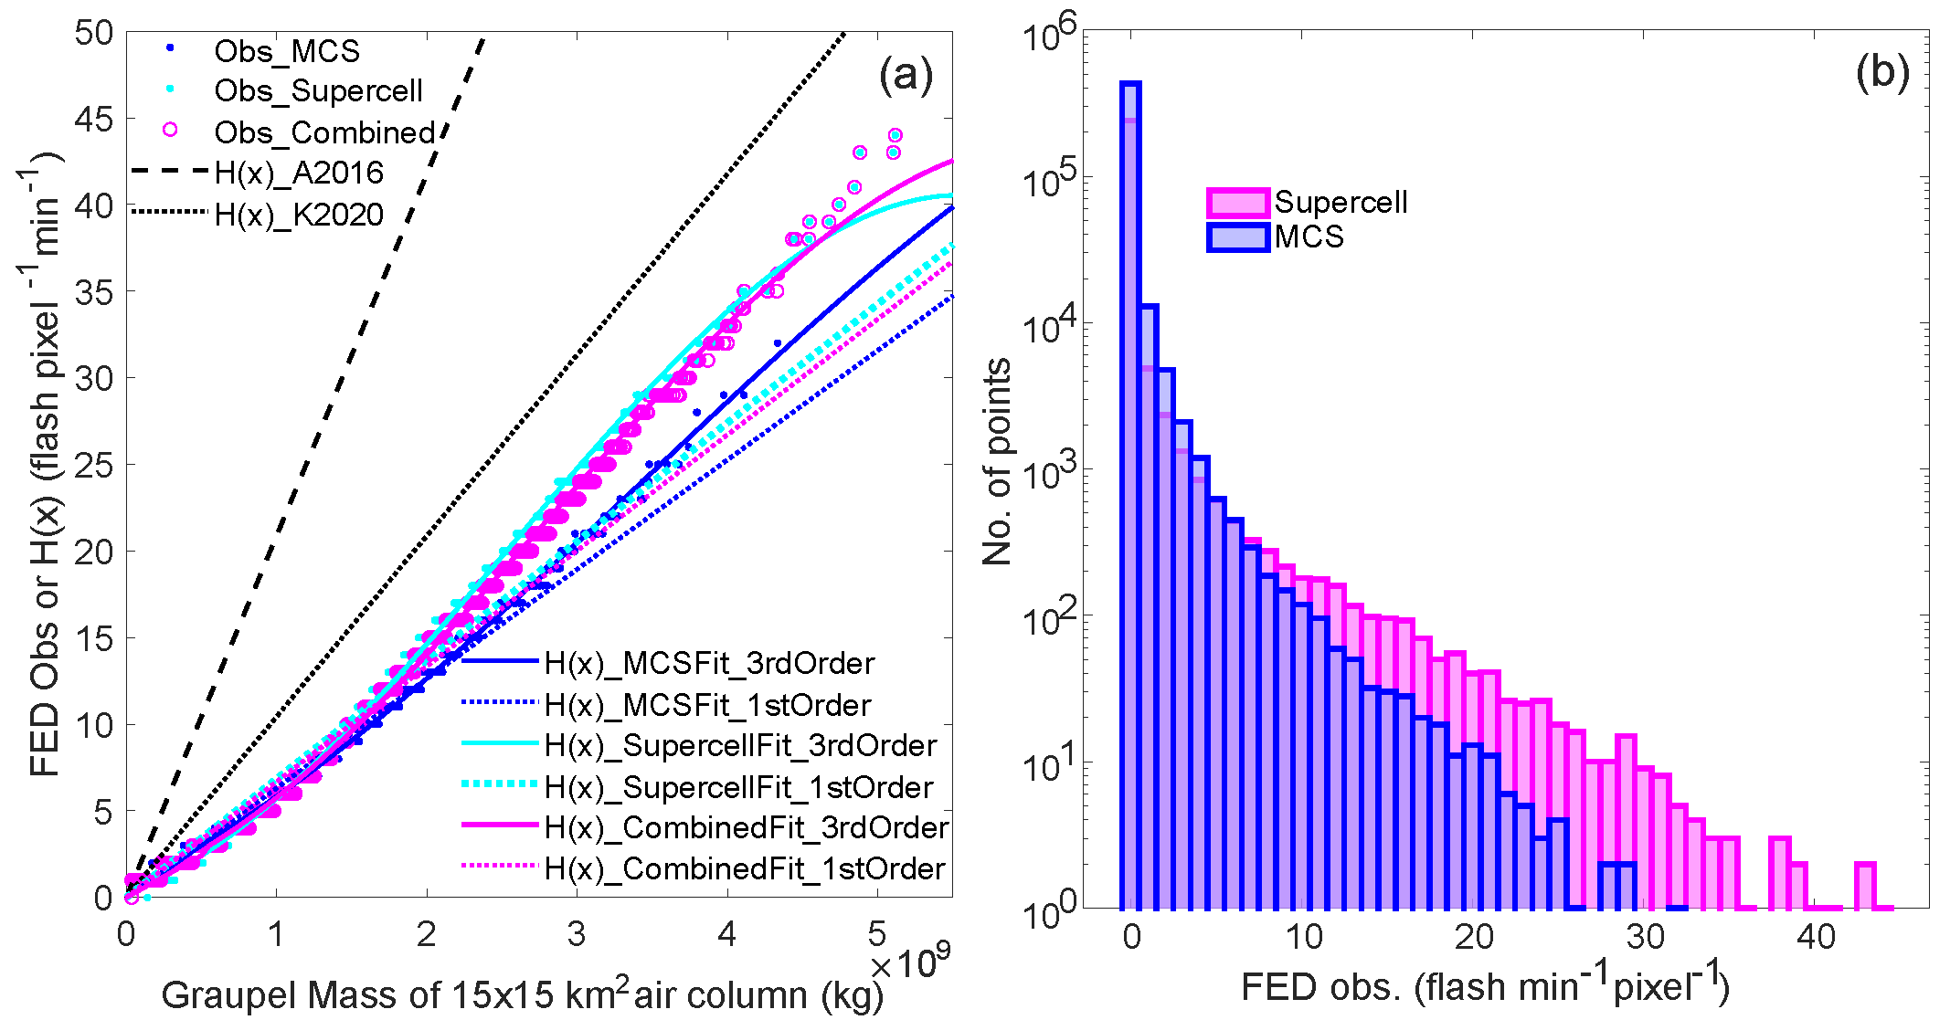
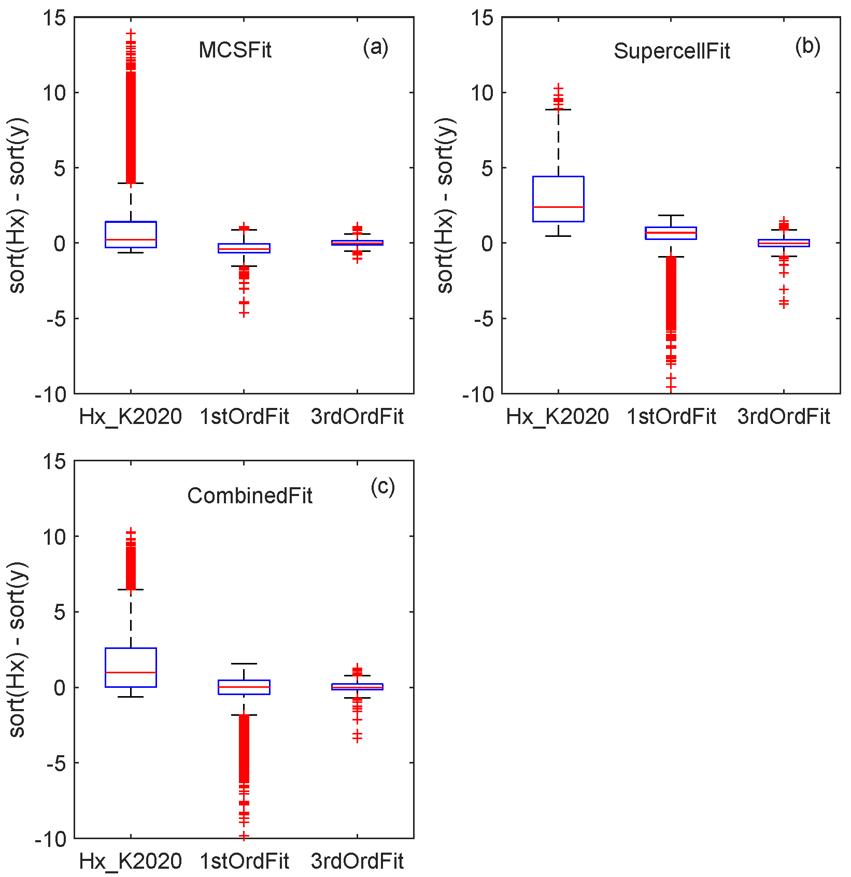
(sorted) FED observations versus graupel mass
Error distributions
Histogram of FED observations
The FED observations and simulated graupel mass field are sorted in ascending order before being fitted to alleviate the location/distribution errors in FED simulations.
1st and 3rd order fit between FED observations and graupel mass are obtained for both MCS and supercell cases, as well as combination of two cases.
The 3rd-order fit is much closer to observations especially for high FED values.
Supercell has more high FEDs than MCS, thus the superiority of the 3rd order fit should be more obvious than the 1st-order fit.
Notes:
The aggregated one-dimensional FED observations and the simulated graupel mass field are then sorted in ascending order before being fitted, under the assumption that the probability distribution function of the less accurate data (the simulated FED in our case) equal to that of the more accurate data (the observed FED, Anagnostou et al. 1999; Ebert 2001; Rosenfeld et al. 1993).

Slide 11
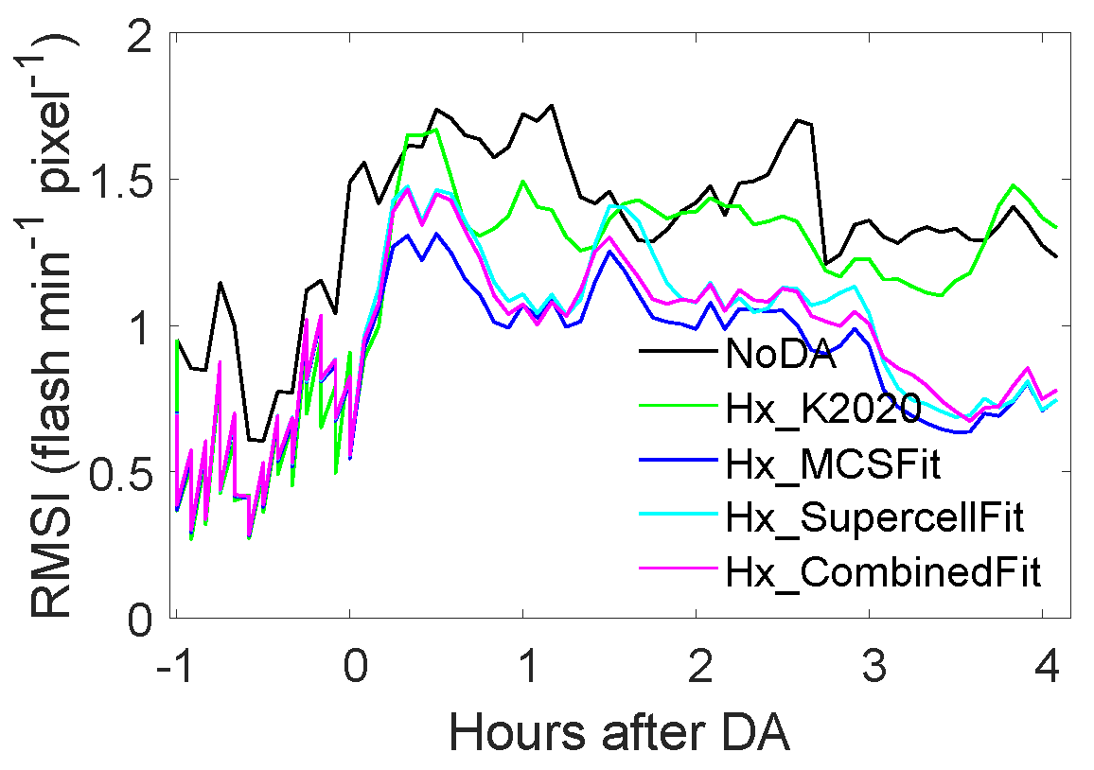
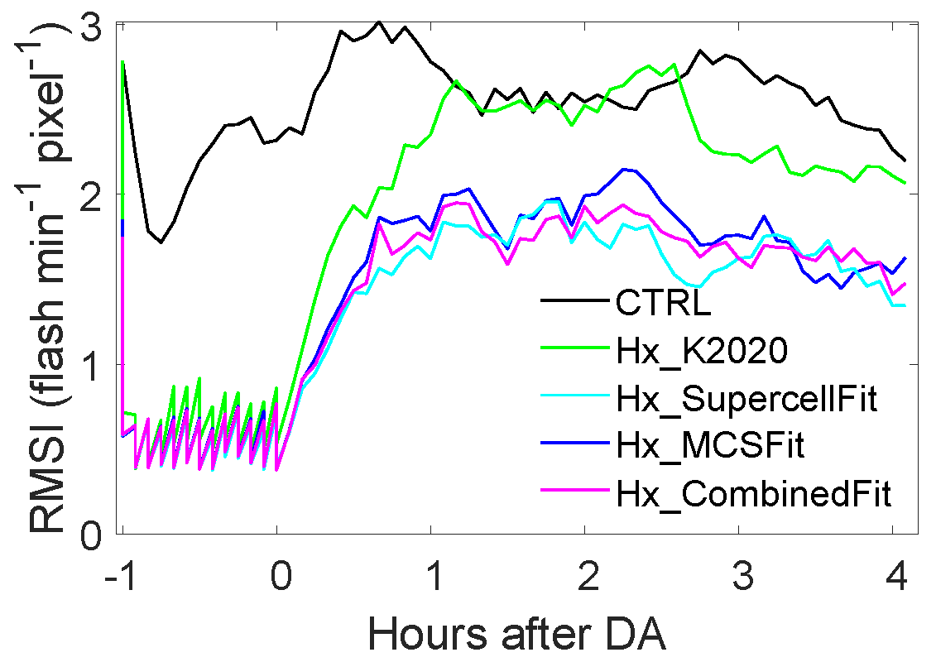
RMS Innovations of FED analyses & 0-4h forecasts
MCS Supercell
NoDA
Employing the new 3rd order operator reduces RMSIs in 0-4 h forecasts of FED relative to Hx_K2020 for both cases.
Operators developed based on a single case and a combination of two are small, suggesting weak case dependency of the operators.

Slide 12
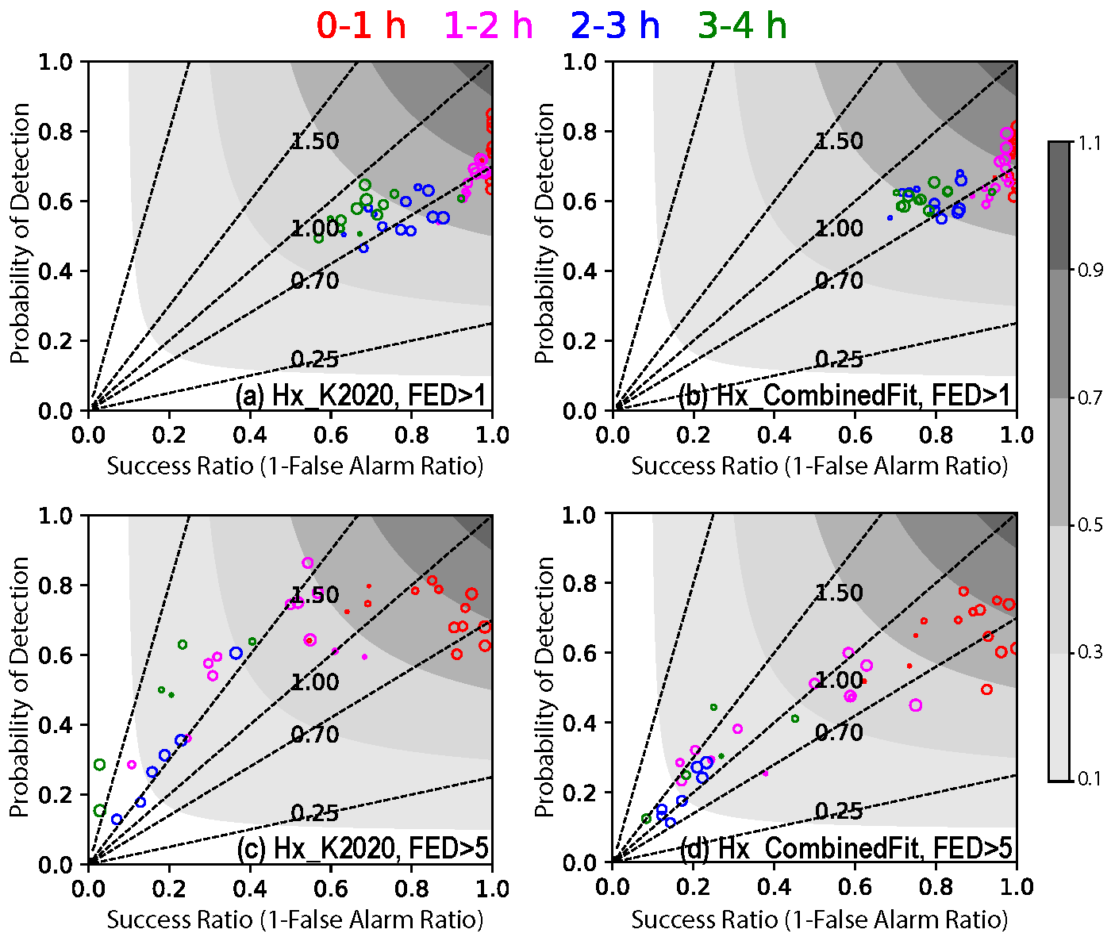
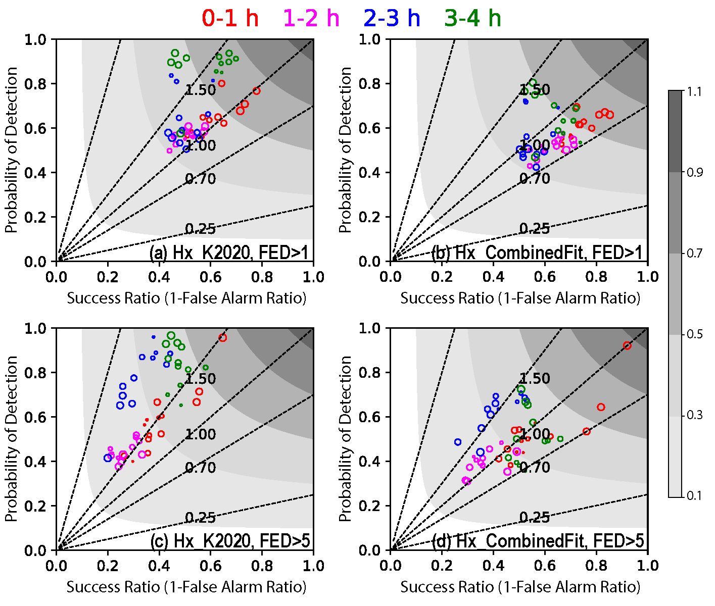
Performance diagrams of 0-4 h FED forecasts
MCS Supercell
The new 3rd-order operator reduces frequency biases in 0-4 h forecasts of FED relative to Hx_K2020 for both cases.

Slide 13
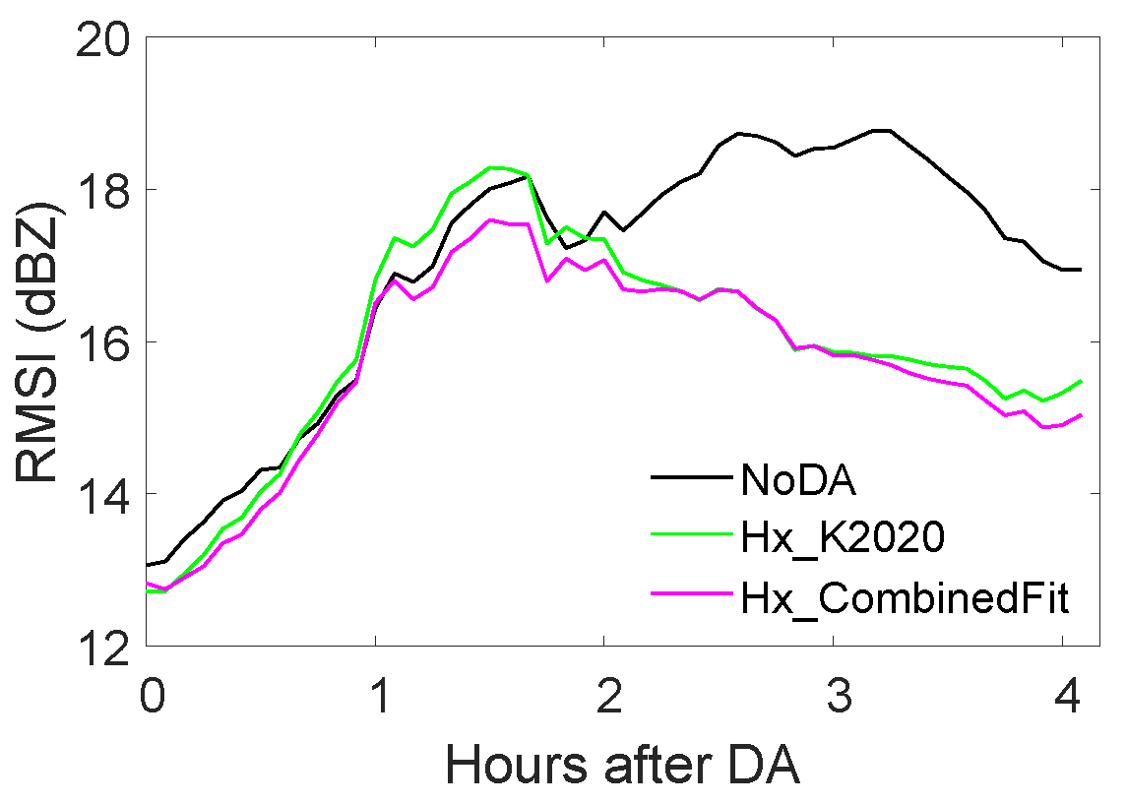
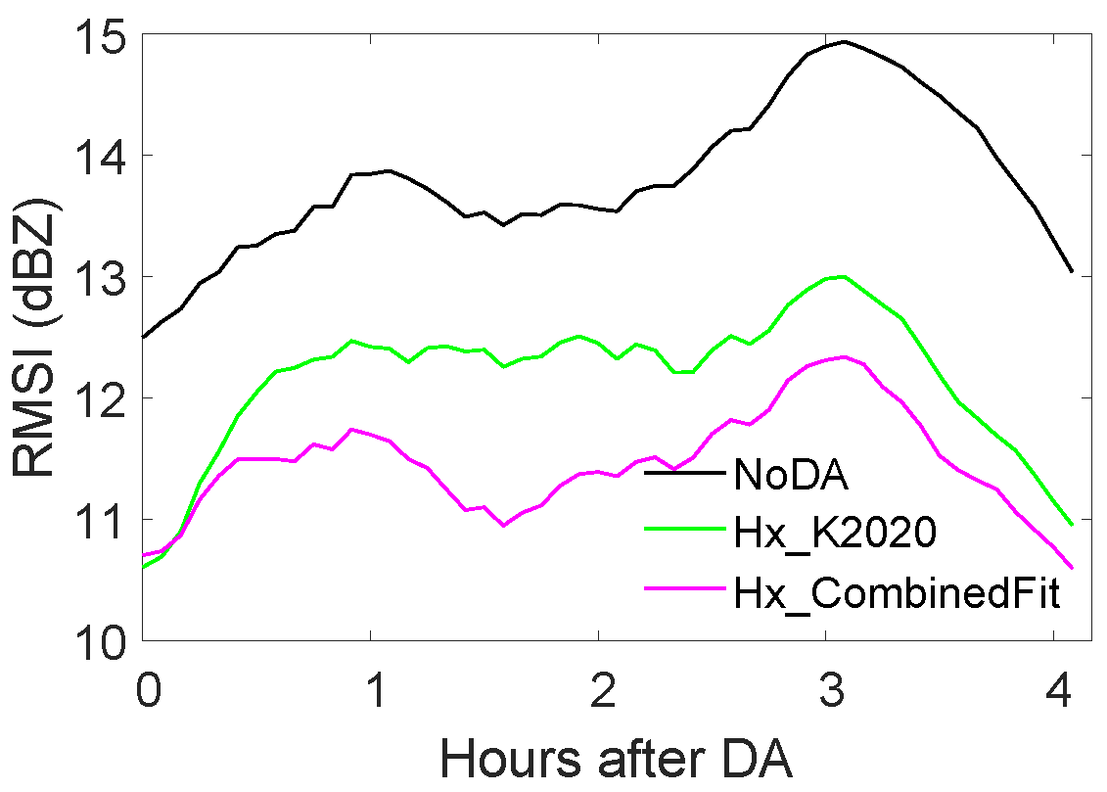
RMSIs of Forecast Composite Reflectivity
(assimilating FED data)
MCS Supercell
Employing the new 3rd-order operator reduces RMSIs in 0-4 h forecasts of reflectivity relative to Hx_K2020 for both (especially for the supercell) storm cases.

Slide 14
Summary on New Operator Experiments
Overall, Hx_K2020 improves storm forecasts relative to NoDA.
Employing the new 3rd-order nonlinear operator further reduces frequency biases (RMSIs) in 0-4 h forecasts of FED (reflectivity) relative to Hx_K2020 for both storm cases.
The differences using the new operators developed based on a single case and a combination of two are negligible, suggesting a small case-dependency of the operator; it is recommended that the combined fit be used for general forecast applications.

Slide 15
Experimental design
Assimilating FED data with and without radar data and effect of assimilating zero FEDs
Exp. | Data being assimilated
CTRL (no DA) | Does not assimilate any data.
OnlyFED0 | Only assimilate FED data >= 0 flash min⁻¹ pixel⁻¹.
ZVrFED0 | Assimilate both radar observations (reflectivity [including clear-air reflectivity] and radial velocity) and FED data >= 0 flash min⁻¹ pixel⁻¹.
OnlyFED1 | Only assimilate FED data >= 1 flash min⁻¹ pixel⁻¹.

Slide 16
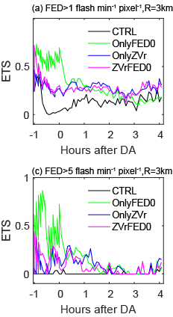
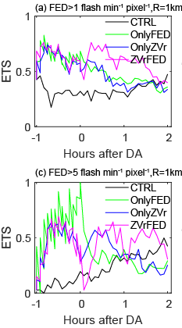
ETS of FED analyses/forecasts
MCS Supercell
Assimilating FED data alone (OnlyFED0) can produce comparable FED forecasts as assimilating radar data alone (OnlyZVr), both are much better than CNTL (NoDA).
When FED data is assimilated together with radar data, the additional benefits of FED data is tiny for the MCS but more clear for the supercell case in terms of forecast FED.

Slide 17
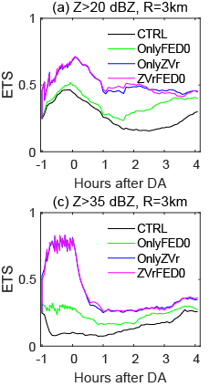
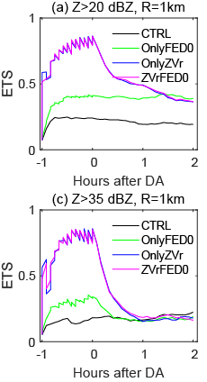
ETS of composite reflectivity analyses/forecasts
MCS Supercell
Assimilating FED data alone (OnlyFED0) can improve reflectivity forecasts relative to CTRL, but not as much as assimilating radar data alone (OnlyZVr).
When FED data is assimilated together with radar data, the additional impacts of FED data is tiny in terms of forecast reflectivity.

Slide 18
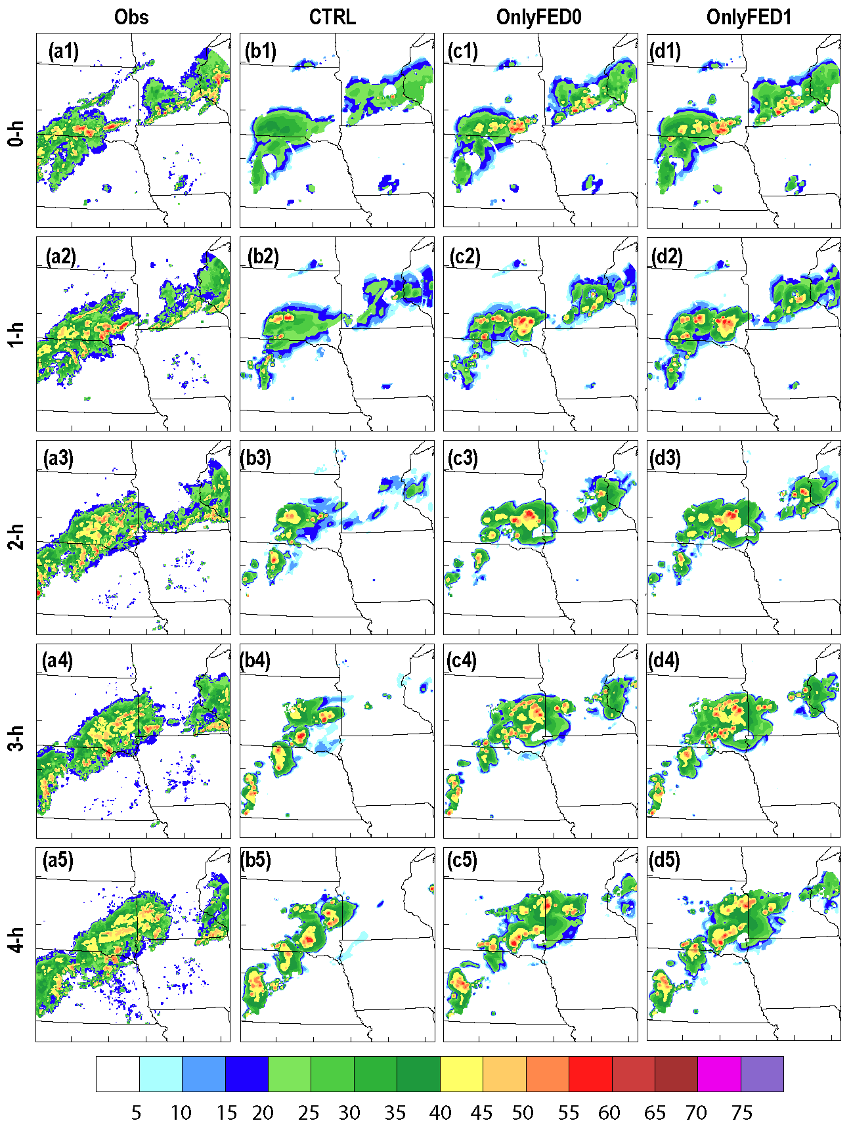
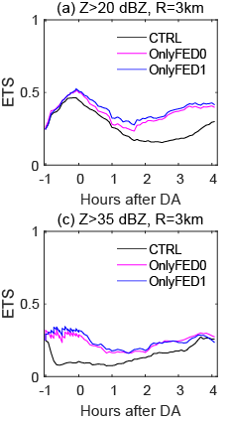
Impacts of assimilating zero FEDs (MCS case)
Assimilating zero FEDs slightly degrades reflectivity forecasts for the MCS case that does not have obvious spurious storms.

Slide 19
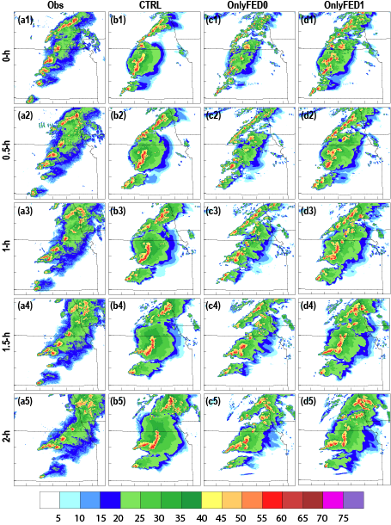
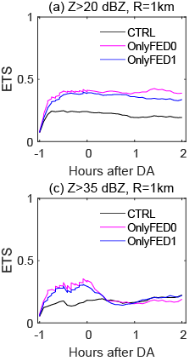
Impacts of assimilating zero FEDs (supercell case)
Assimilating zero FEDs improve the forecasts for the supercell case that has obvious spurious storms in the background fields.

Slide 20
Summary on FED+Radar and Zero FED Experiments
Assimilating FED data alone (OnlyFED0) can produce comparable FED forecasts as assimilating radar data alone (OnlyZVr), both are much better than the CTRL.
When FED data is assimilated together with radar data, the additional impacts of FED data is tiny in terms of forecast reflectivity but more clear for supercell FED forecast.
Assimilating zero FEDs slightly degrades reflectivity forecasts of the MCS case but improves the forecasts of supercell case (that has more spurious storms in the background fields)

Slide 21
Future plans
The capabilities are being tested at GSL (Amanda Back’s talk) for HRRR configurations, together with all other data types.
Under the support of the new JTTI program (started in August this year), the new FED DA capabilities will be implemented into JEDI EnVar and LETKF and tested with the target Rapid Refresh Forecast System (RRFS) configurations.

Slide 22
Questions?

