Slide 1
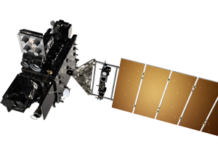
FM3/FM4 Status GLM Science Team Meeting
Never thought it would last this long
Marc Rafal
GLM Instrument Manager
21 September 2021
Drawing Not To Scale

Slide 2
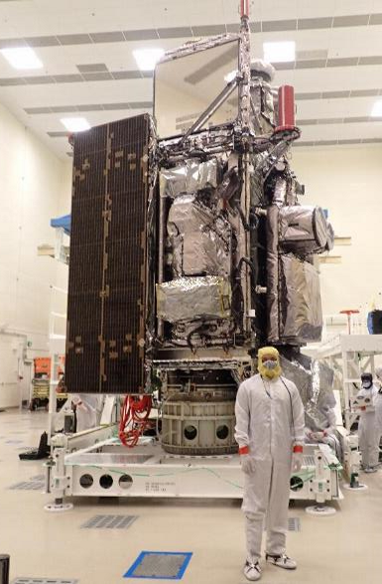
GOES-T/U Update
GOES-T
All environmental tests completed
Storage in Waterton until shipment
Ship to Cape November 2021
Launch now February 16, 2022
Delayed due to Starliner launch delay
GOES-U
GLM FM4 in storage at Waterton
Environmental testing Starts early 2023
Ship to Cape December 2023
Launch April 2024 (tentative)
SpaceX Falcon Heavy selected for GOES-U launch vehicle
GOES-T Configured for Storage

Slide 3
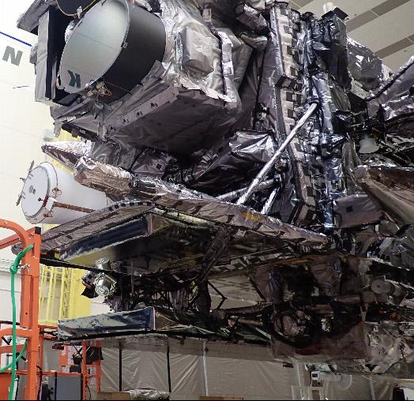
FM3
Performance improvements compared to FM1/2
Design changes to mitigate
Stray light from solar intrusion
Overshoot/undershoot at high contrast boundaries
Improved camera timing settings
Longer “Triple Wide DC Restore” pulse results in lower noise
Allows lower RTEP Thresholds yielding higher DE
Evaluating use on FM1 and FM2 on-orbit
Tewa Kaplun will cover predicted performance

Slide 4
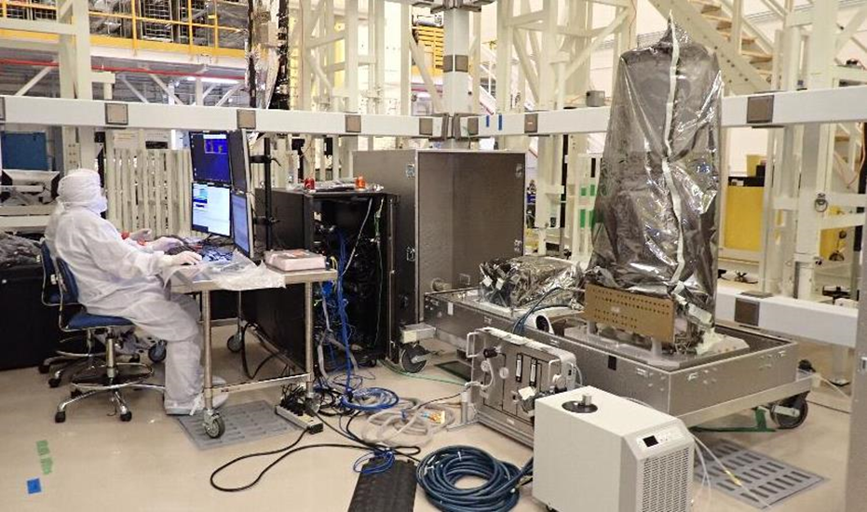
FM4
FM4 completed all instrument level environmental tests
Delivered to Waterton
Bench acceptance test completed
In storage in High Bay until installation on GOES-U
EU Installation scheduled October 2021
SU Installation scheduled early 2022
Tewa Kaplun will cover predicted performance

Slide 5
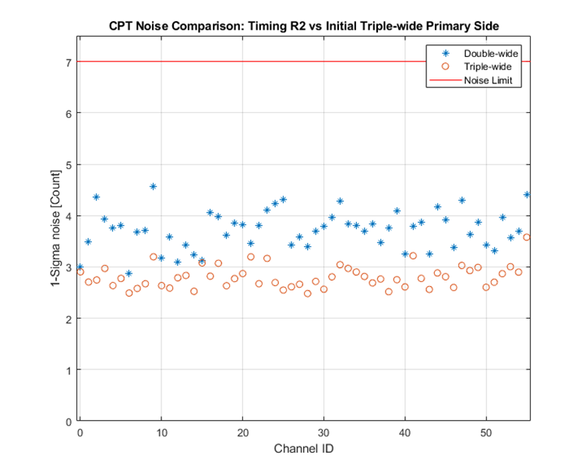
On-Orbit Status
FM1 (GOES-E) and FM2 (GOES-W) continue to operate nominally
GOES-W entered safe hold July 22, 2021 and returned to operation July 23
Double bit memory error in spacecraft computer
GLM returned to Normal Mode after spacecraft restart
Tested new Loop Heat Pipe Startup Macro
Collected on-orbit data on FM2 (GOES-W) with Triple Wide DC Restore
Confirmed lower noise
Executed first iteration on RTEP threshold setting
Once iterations complete will evaluate DE improvement and make a recommendation on operational change for FM1 and FM2

