Slide 1
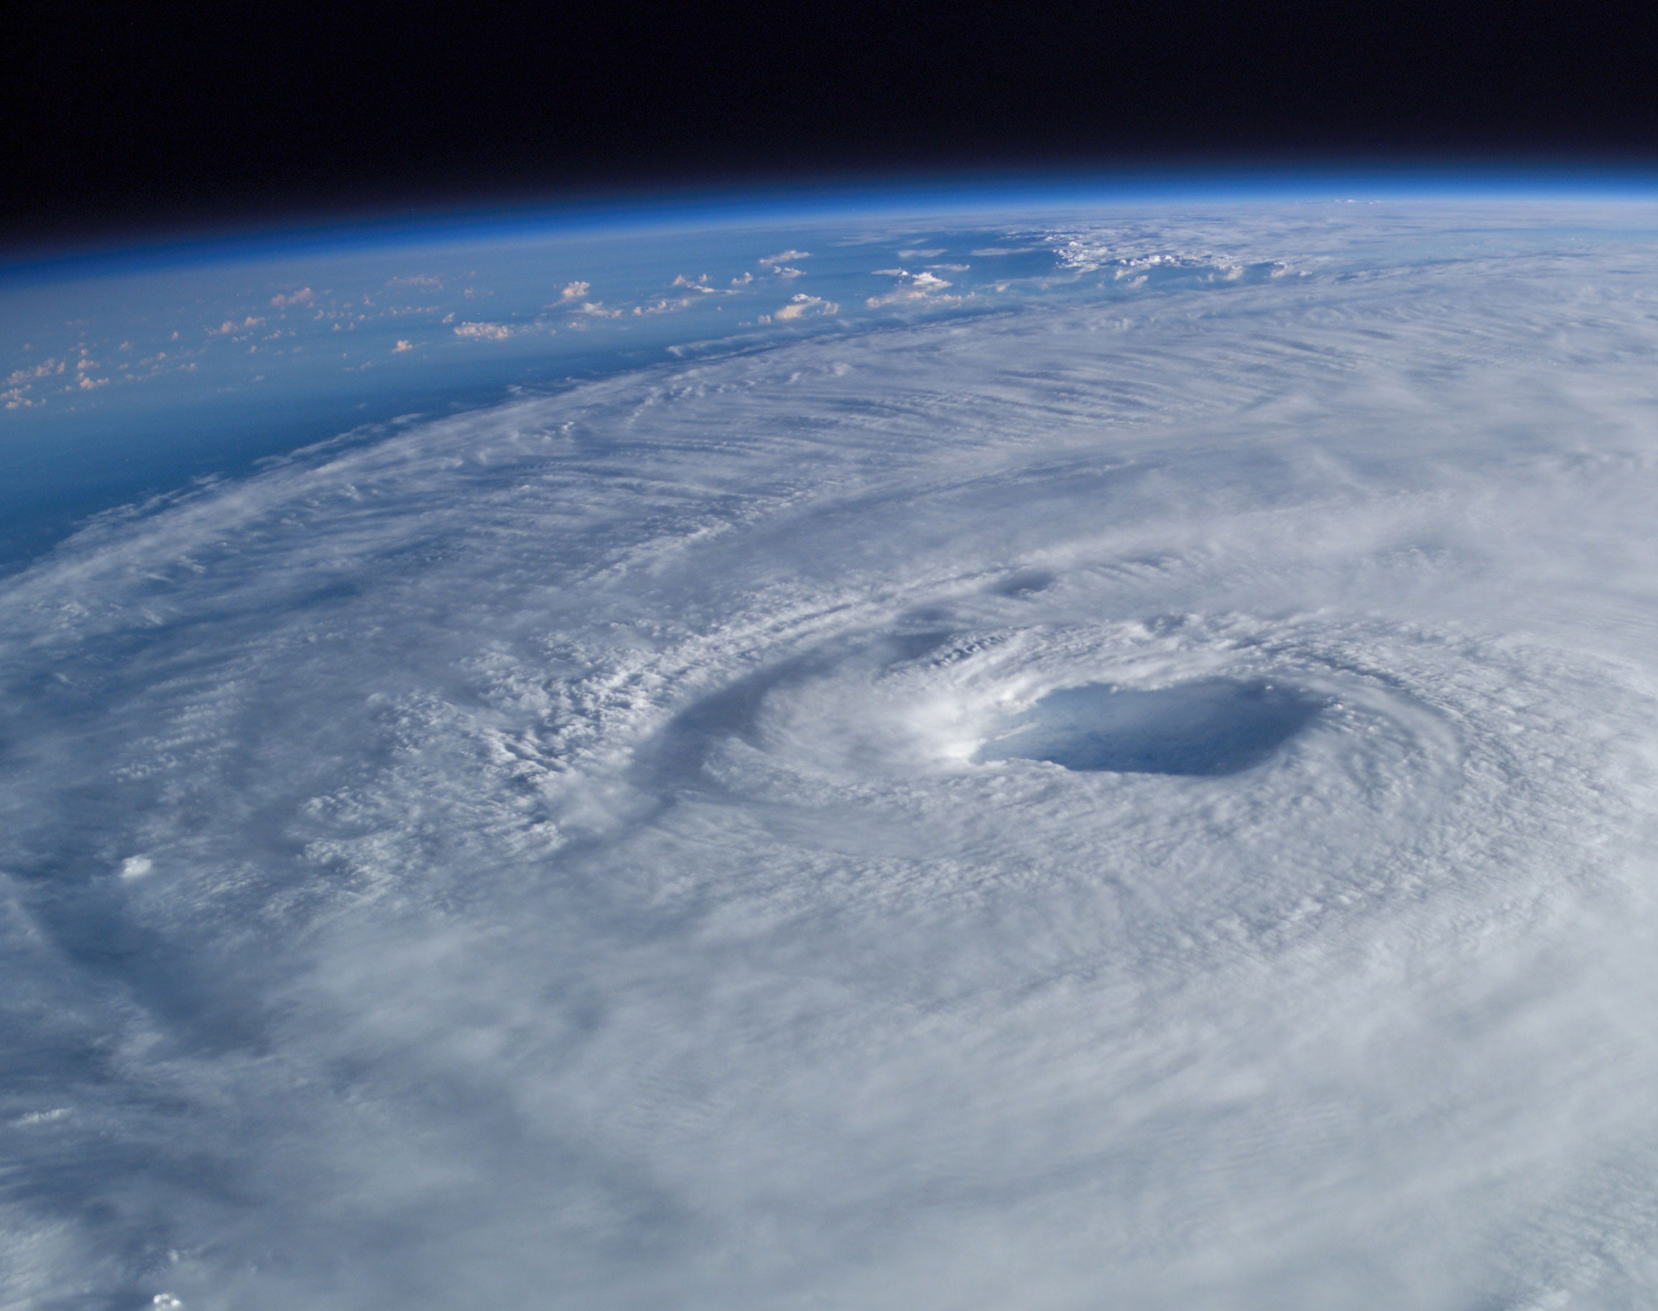
GLM Flash Data Trends in Tropical Cyclone Intensification Changes
Photo Credit: Mike Trenchard, Earth Sciences & Image Analysis Laboratory, NASA Johnson Space Center.
Hurricane Isabel in September 2003, as seen from the International Space Station.
David J. PeQueen
Eric C. Bruning
23 September 2021
GLM Science Team Meeting

Slide 2
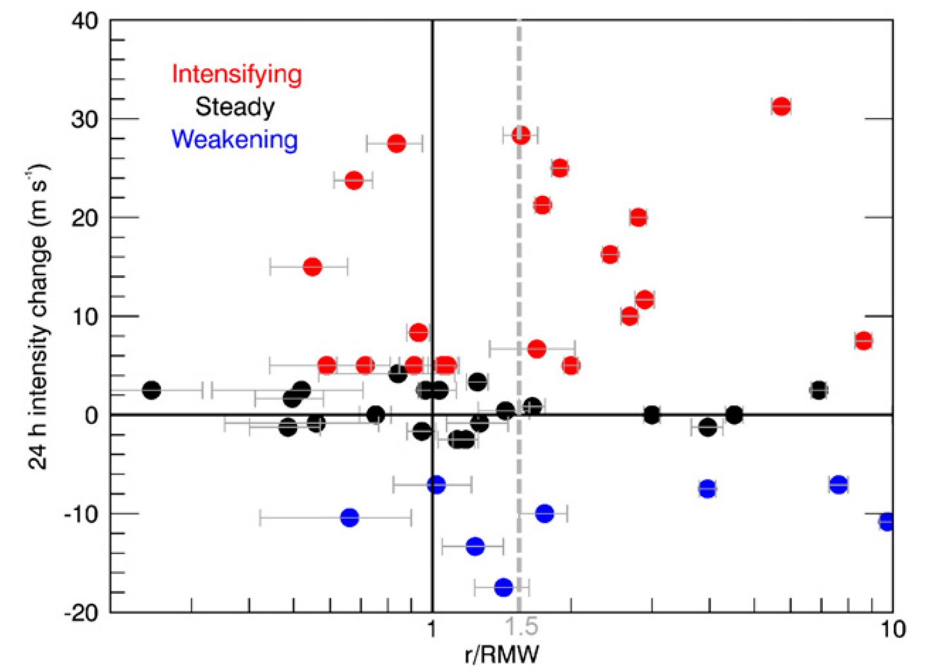
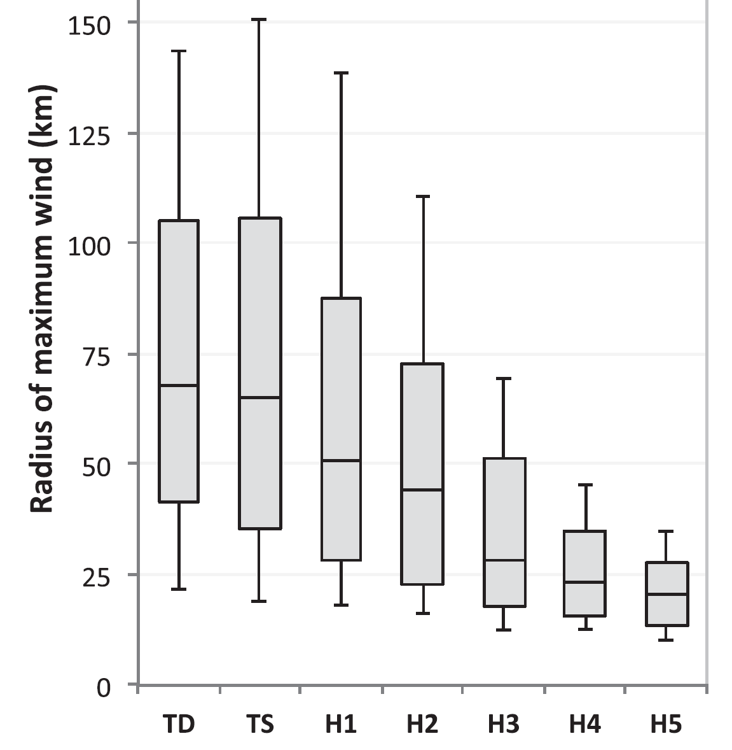
Tropical Cyclone Intensity
Saffir-Simpson Hurricane Wind Scale
Category | Winds [kt]
1 | 64-82
2 | 83-95
3 | 96-112
4 | 113-136
5 | 137+
Inner Core: radial region within 100 km of the TC center
Rapid Intensification: ≥ 30 kt increase in max sustained wind in 24-hr
Rapid Weakening: ≥ 30 kt decrease in max sustained wind in 24-hr
Radius of Maximum Wind (RMW)
2005-2014 TCs in FLIGHT+ data set.
(Stevenson et al. 2018, Fig. 1).
ICLB radial position relative to the RMW
Stevenson et al. (2018) finds 24-hr average intensity change:
r < 1 RMW and r > 1.5 RMW, +10.3 kts
1 < r < 1.5 RMW, -5.1 kts
Possible basin dependence?
ENP TCs remain near constant intensity
NA TCs experienced intensification
NA TCs 24-hr intensity change (Stevenson et al. 2018, Fig. 5).

Slide 3
Continuous vs. Non-Continuous Flash Storms
Dorian (2019 NA)
Humberto (2019 NA)

Slide 4
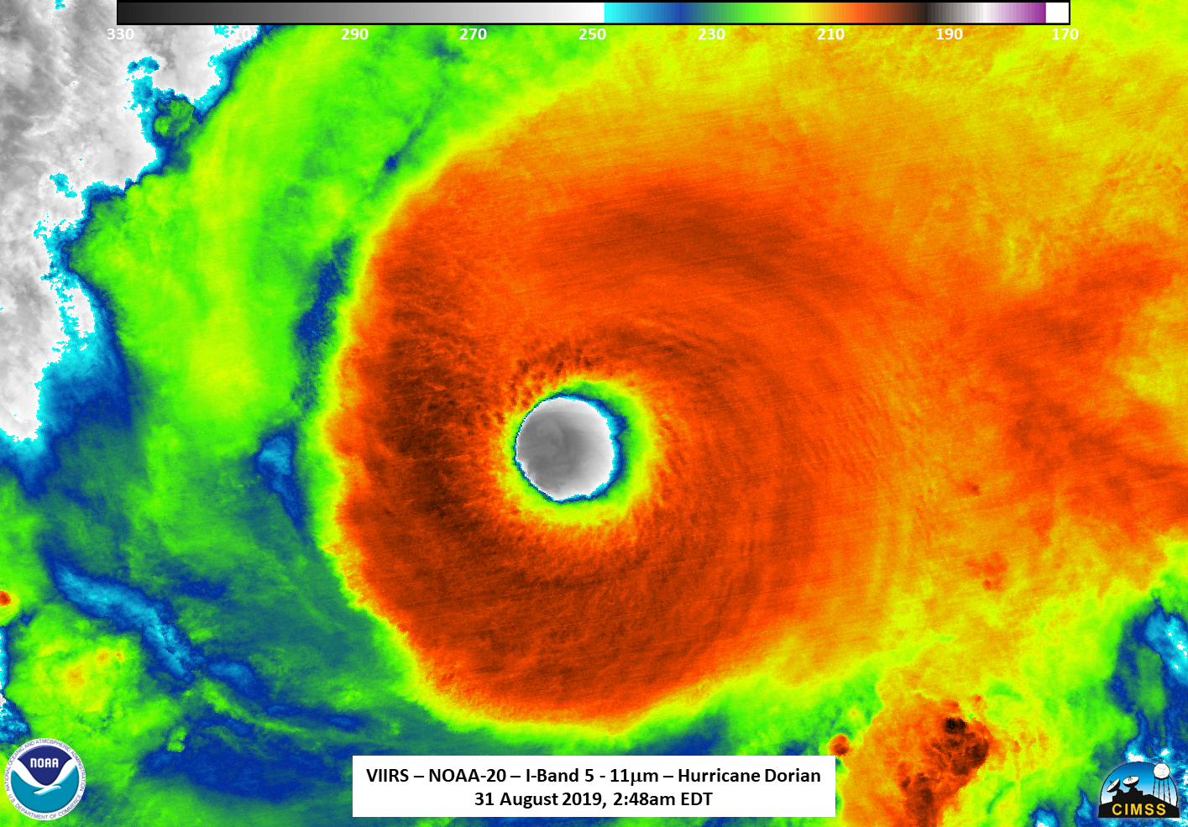
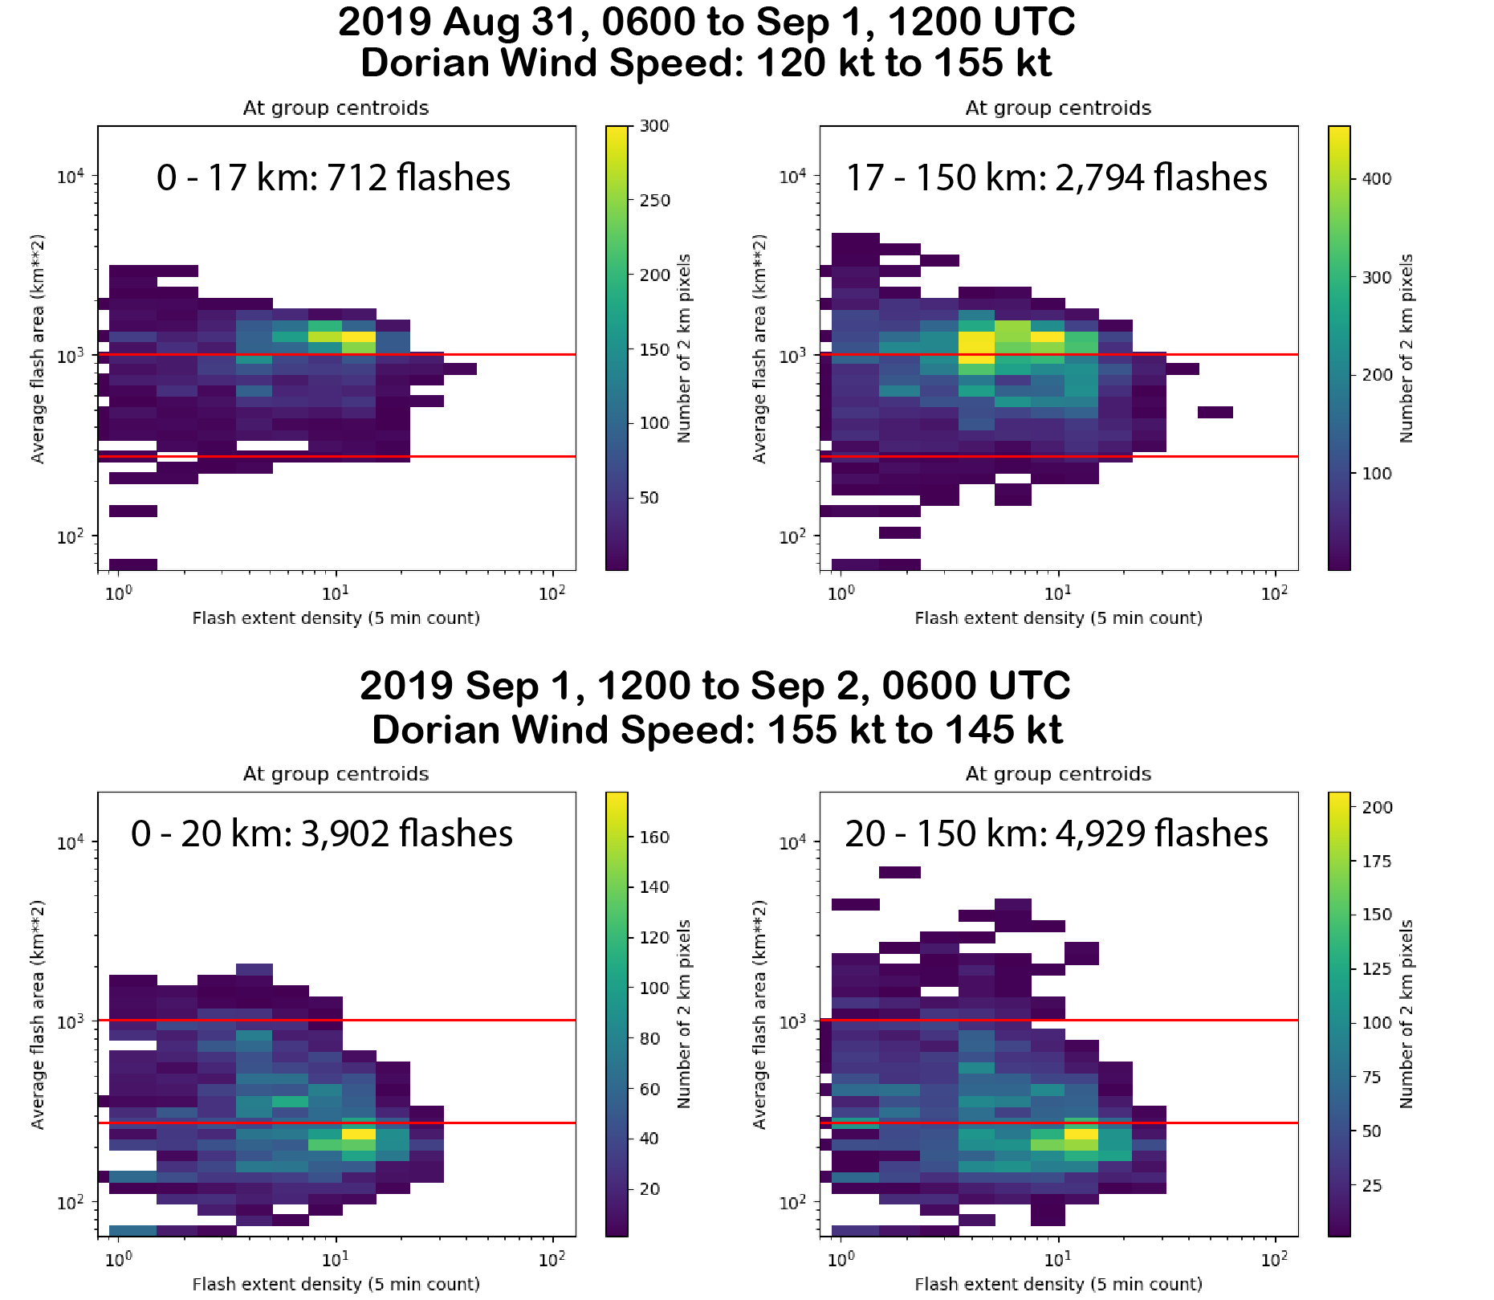
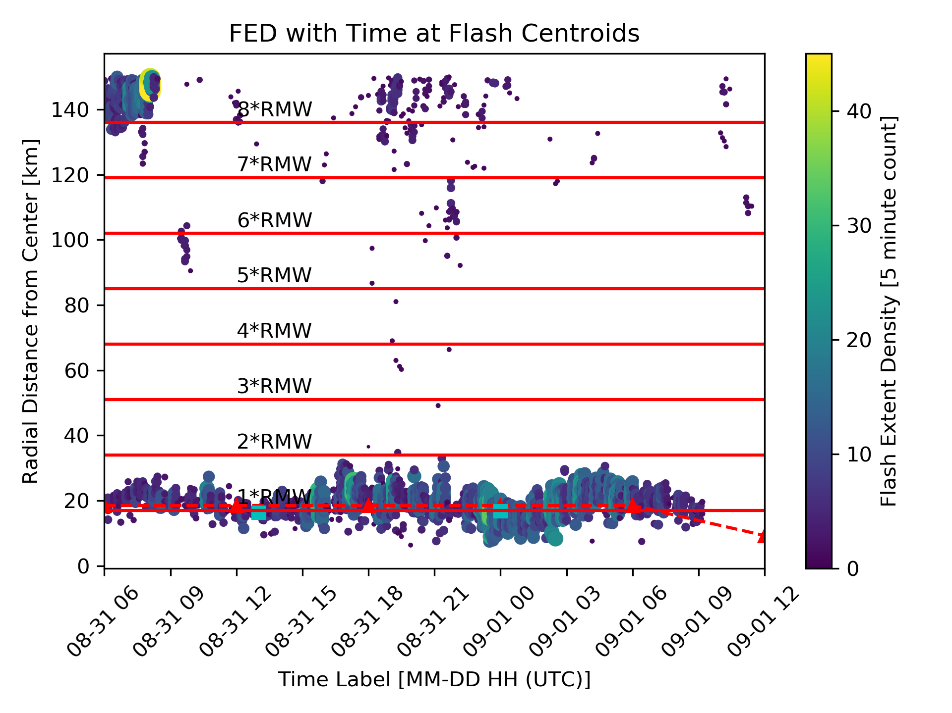
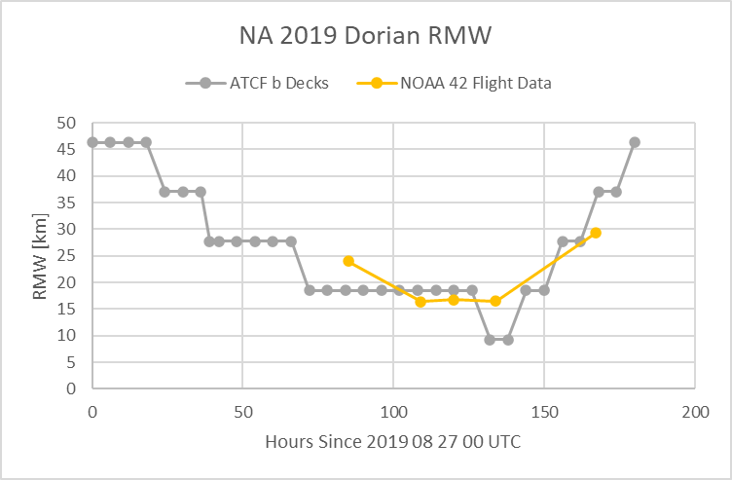
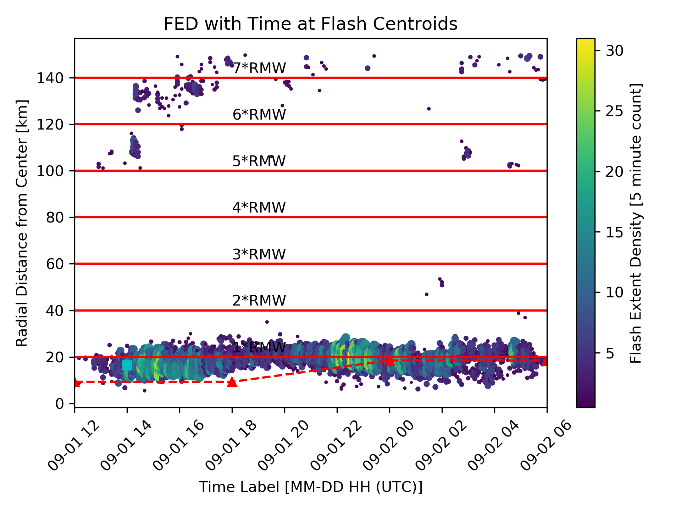
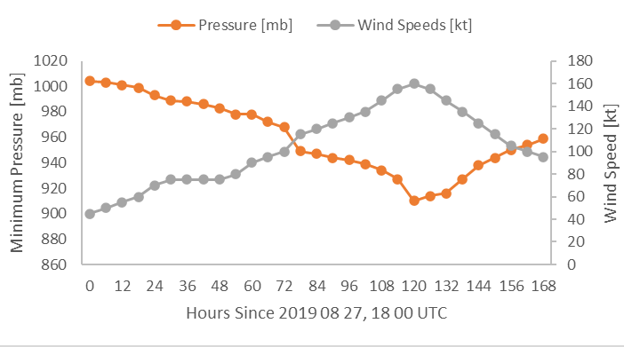
Hurricane Dorian (2019 NA)
Photo Credit: nesdis.noaa.gov/content/hurricane-dorian-2019
Peak intensity: 910 mb; 160 kt (Category 5) on Sept. 1
Dramatic shift in core lightning characteristics
Decrease in AFA interior to RMW
Strengthening
Weakening

Slide 5
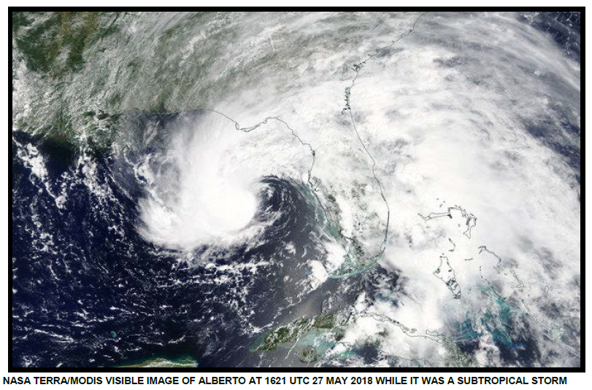
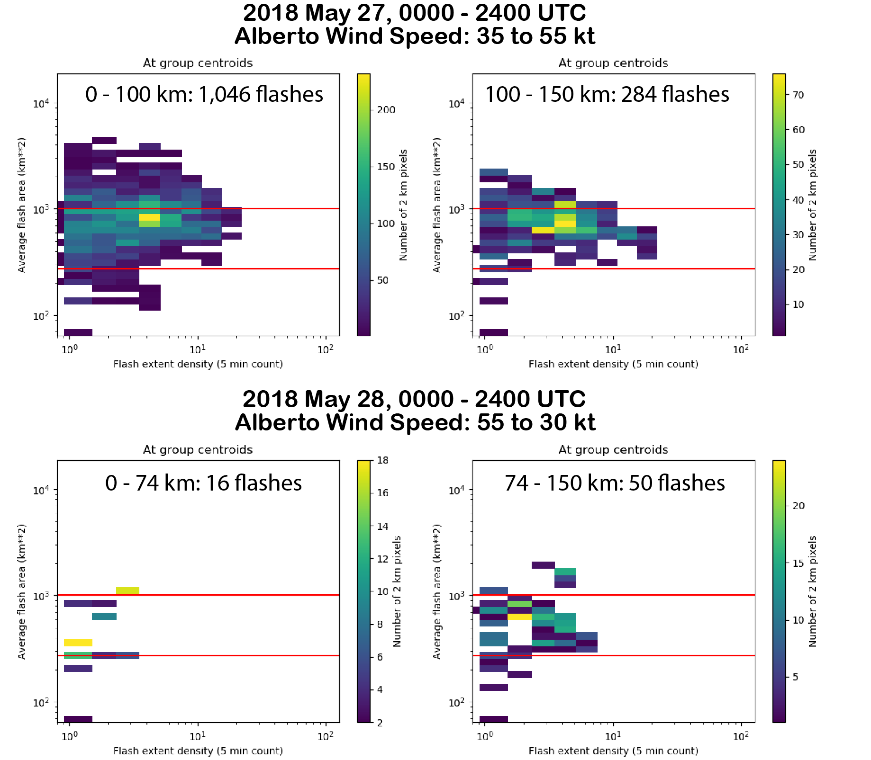
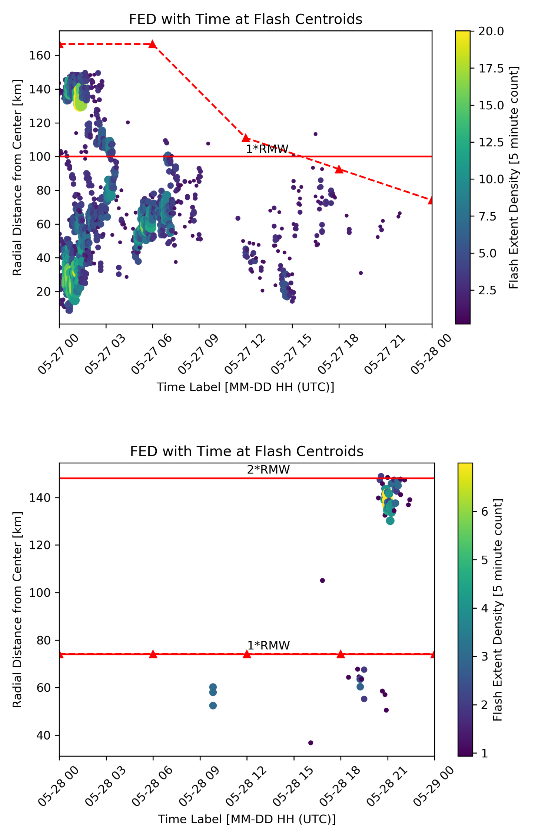
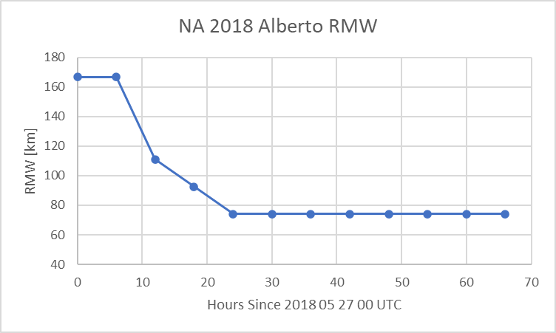
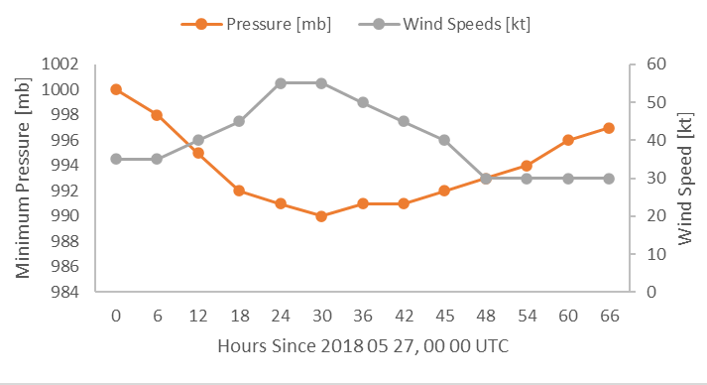
Tropical Storm Alberto (2018 NA)
Peak intensity: 990 mb; 55 kt (TS) at 06 UTC 28 May
Larger FED, AFA, and TOE preceding intensification all decrease in magnitude as RMW contracts
Flash activity ceases with onset of weakening
Strengthening
Weakening

Slide 6
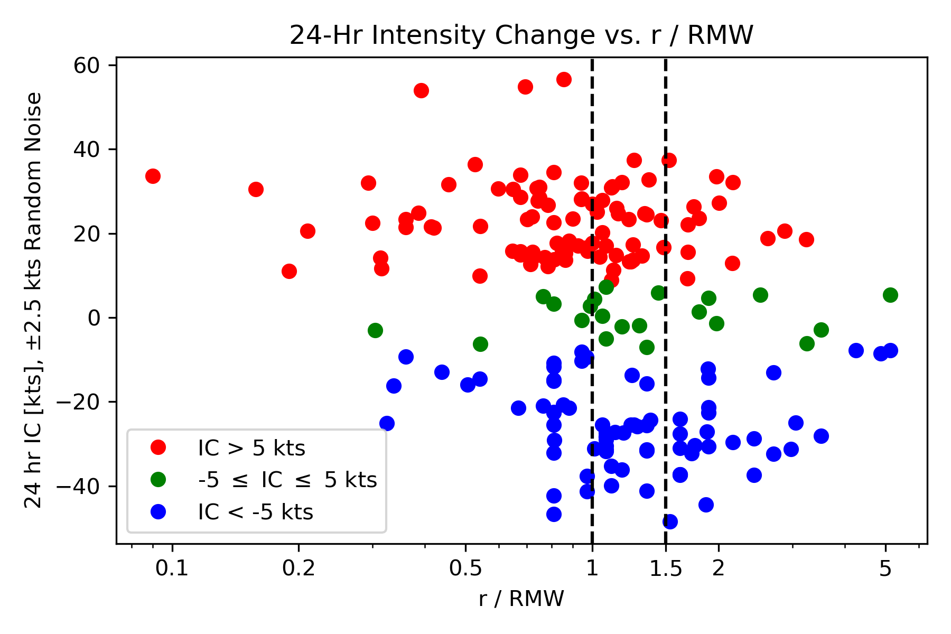
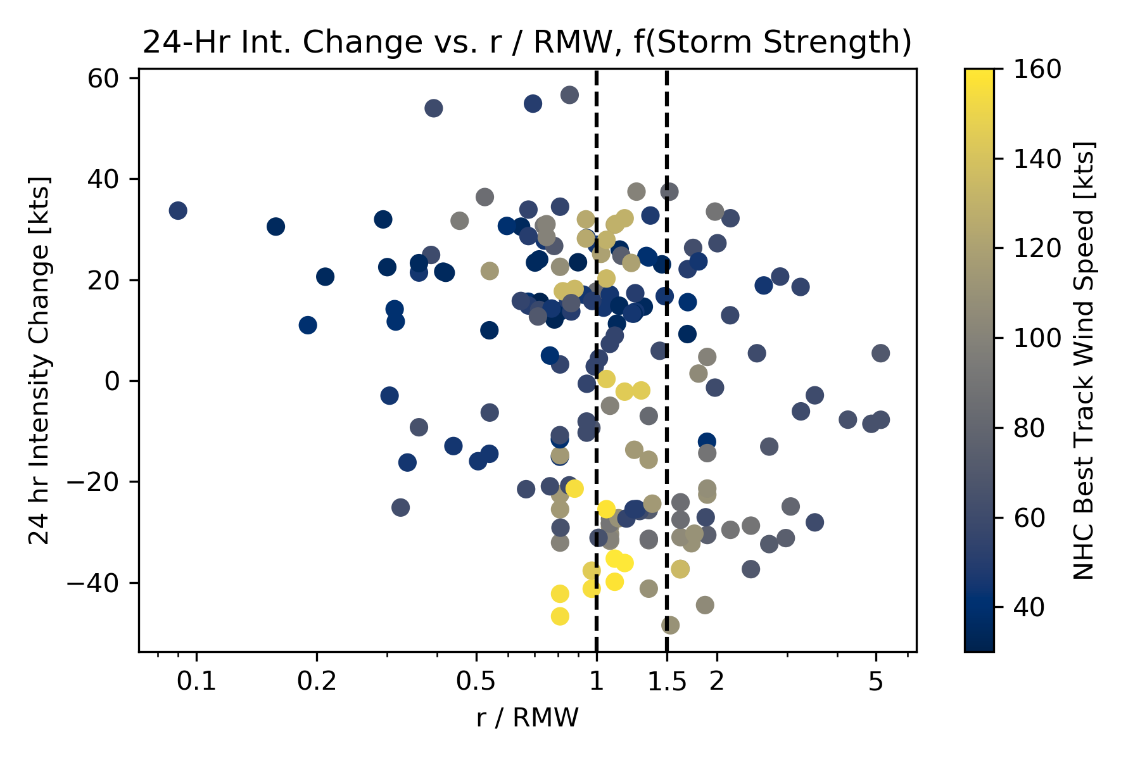
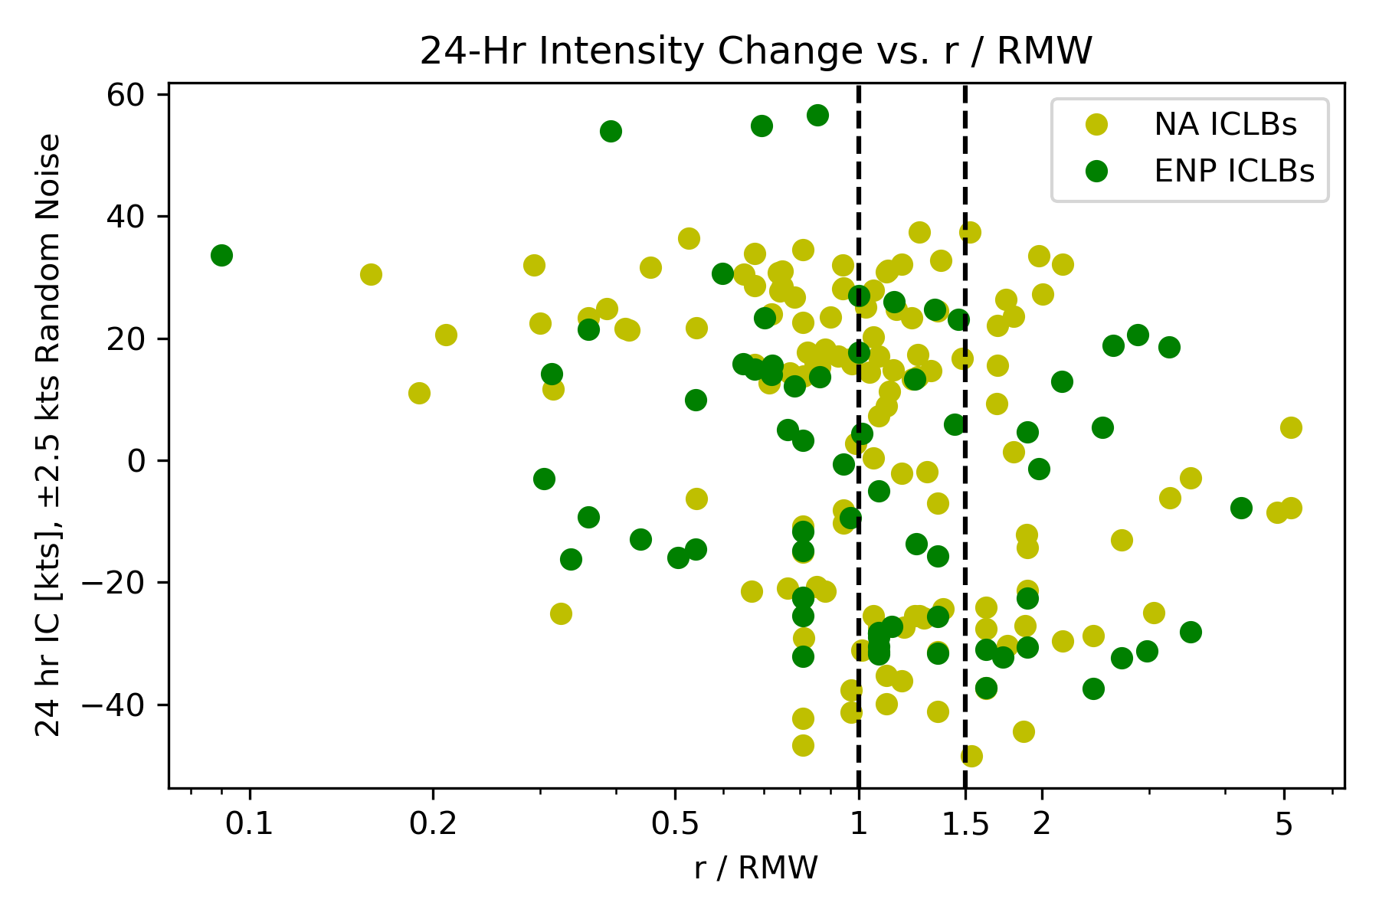
(Stevenson et al. 2018, Fig. 5).
Two-hour ICLB radial positions relative to RMW
Comparison to S18
Gap in intensifying storms 1 < r/RMW < 1.5 not present
Preference for
intensification r/RMW < 1
weakening r/RMW > 1.5
ENP to NA basin dependence not present
Stronger TCs have greater preference for ICLB to occur near 1 RMW
TC Intensity
ENP vs. NA

Slide 7
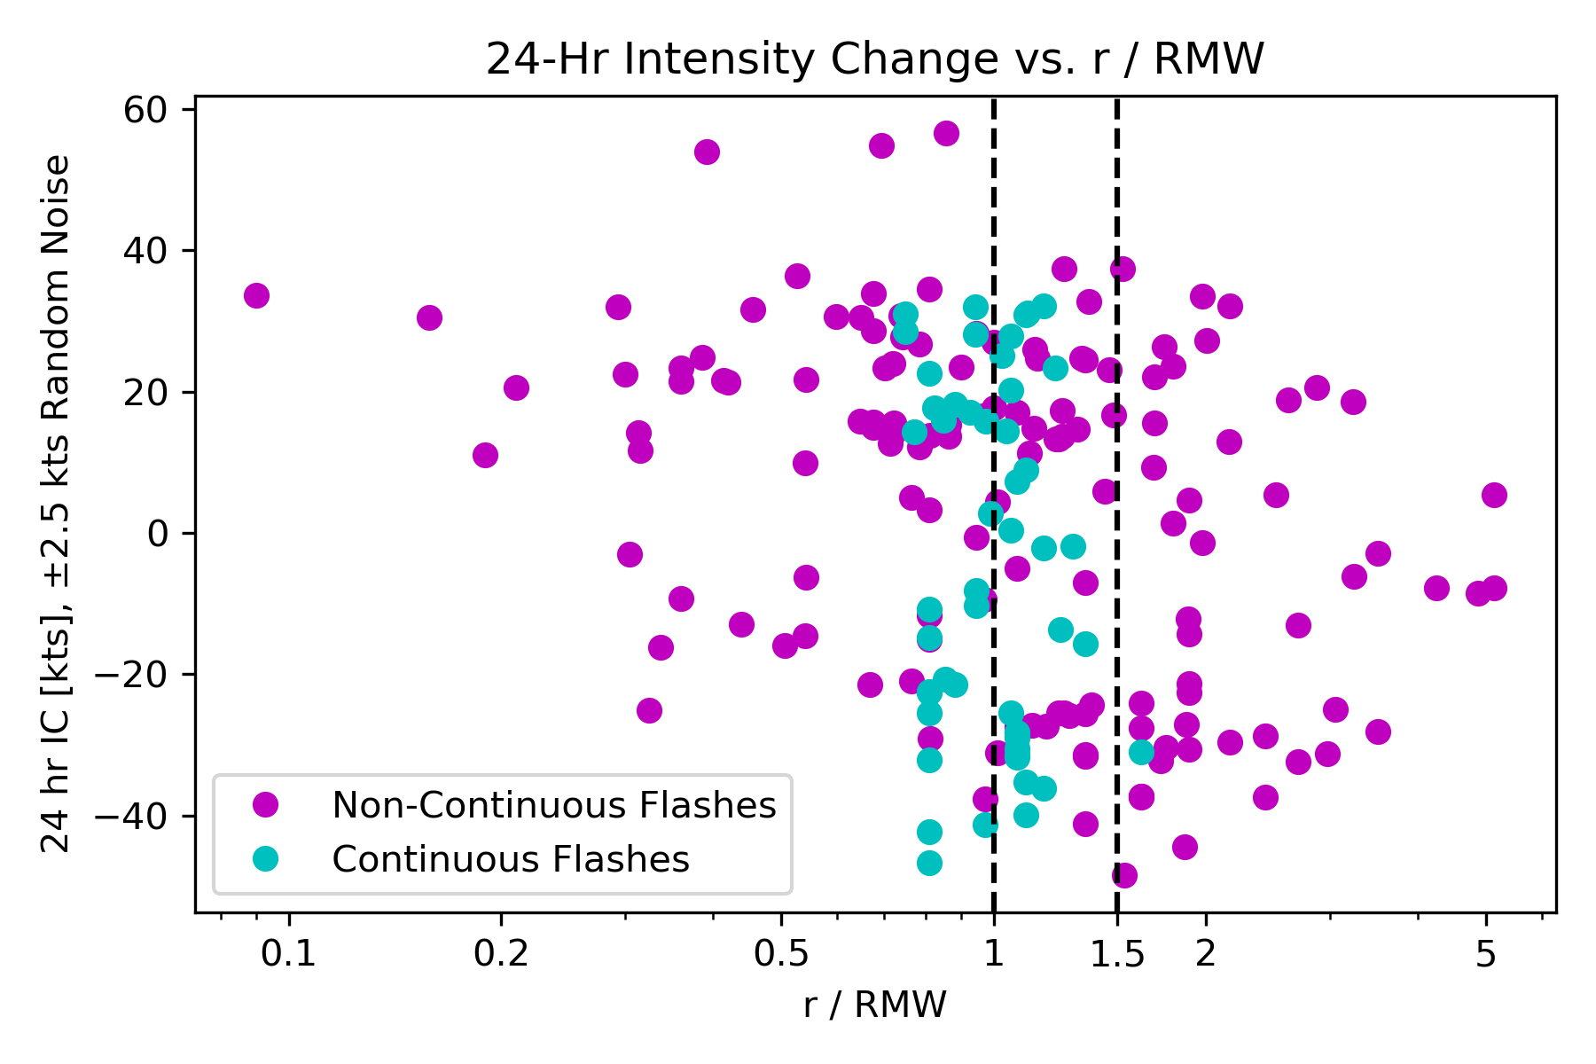
Continuous vs. Non-Continuous ICLBs
24-hr TC Intensity Change Means
Continuous flash cases have greater preference for ICLB to occur near 1 RMW
All categorizations interior to 1 RMW suggest upcoming strengthening except continuous bursts
All categorizations exterior to 1.5 RMW suggest upcoming weakening
Between 1 and 1.5 RMW, ENP vs. NA difference may be attributed to small ENP sample size
Including bursts between 100 and 150 km for storms with RMW > 50 km and r/RMW < 2.5 does not appreciably change means
Categorization | r/RMW ≤ 1 | 1 < r/RMW ≤ 1.5 | r/RMW > 1.5
All 2-Hr Periods [kt] | 9.07 | -2.84 | -9.04
All 2-Hr Count | 89 | 58 | 47
Non-Continuous Only [kt] | 13.63 | -1.21 | -8.59
Non-Continuous Count | 64 | 33 | 46
Continuous Only [kt] | -2.60 | -5.00 | -30.00
Continuous Count | 25 | 25 | 1
ENP Only [kt] | 6.89 | -11.97 | -11.91
ENP Count | 33 | 19 | 17
NA Only [kt] | 10.36 | 1.60 | -7.42
NA Count | 56 | 39 | 30
Rigid 100 km Cutoff [kt] | 8.75 | -6.08 | -11.28
100 km Count | 78 | 44 | 39

Slide 8
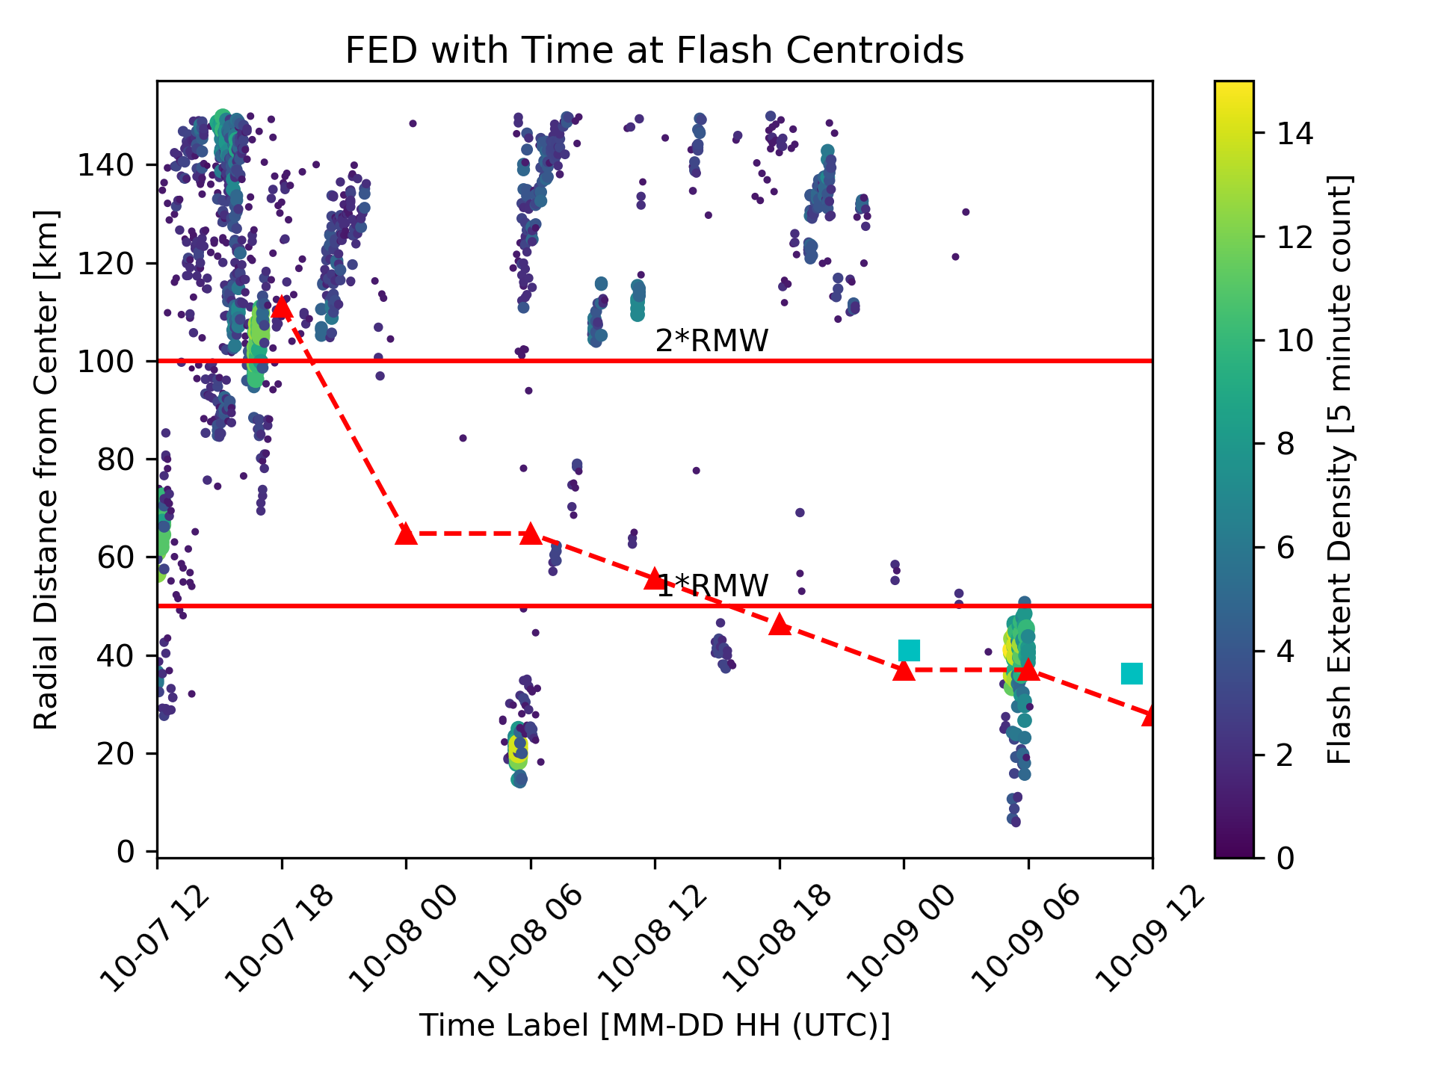
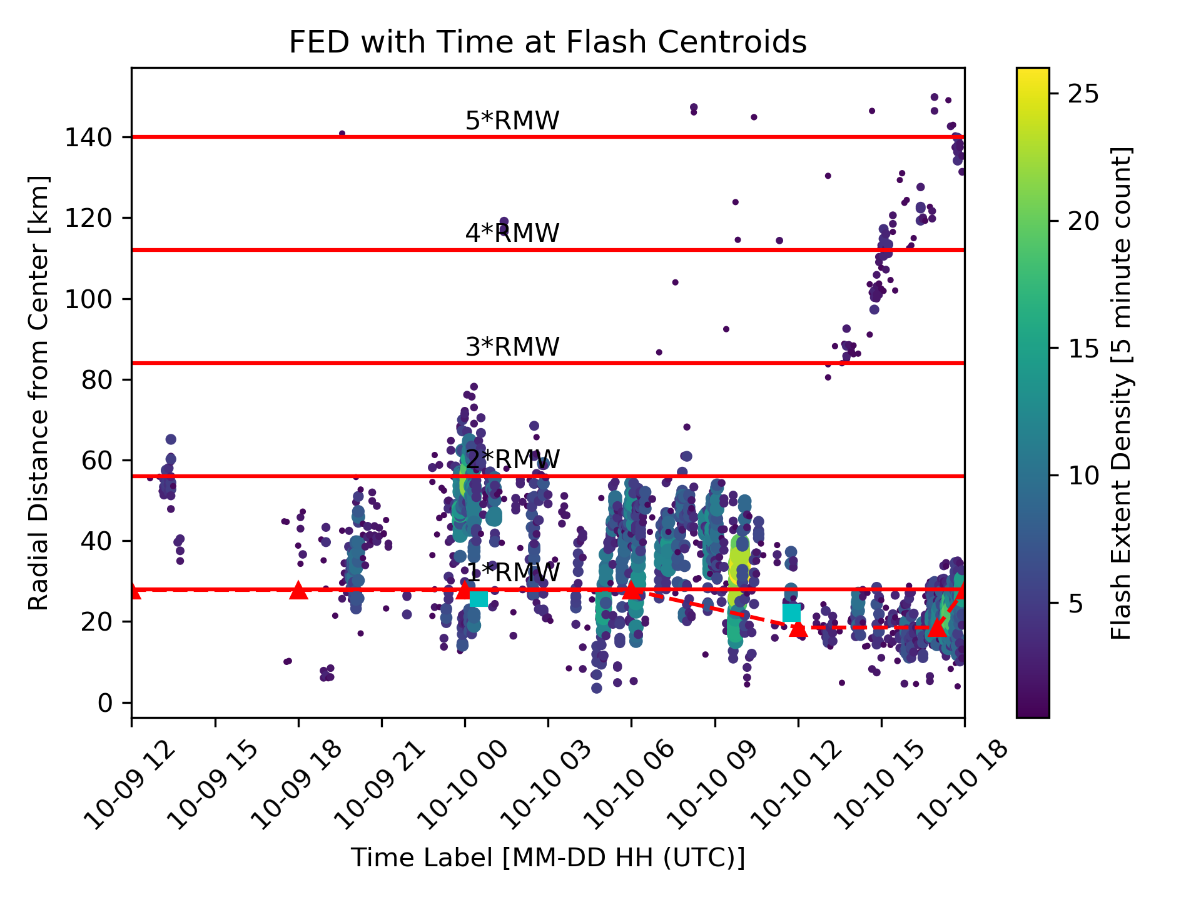
RI cases match S18 relationship
S18 RMW hypothesis supported interior to 1 RMW, in opposition beyond 1.5 RMW
RW poorly modeled by RMW hypothesis
Only two RI-preceding ICLB cases that disagree with S18, both from Michael (2018 NA), one of which is >100 km from TC center
Periods | 2-Hr ICLB Activity | RI | RW
Total Count | 194 | 26 | 36
Agree w/ S18 Count [%] | 106 [55%] | 23 [79%] | 14 [39%]
Ambiguous Count [%] | 27 [14%] | 4 [14%] | 10 [28%]
Disagree w/ S18 Count [%] | 61 [31%] | 2 [7%] | 12 [33%]
Michael (2018 NA)

Slide 9
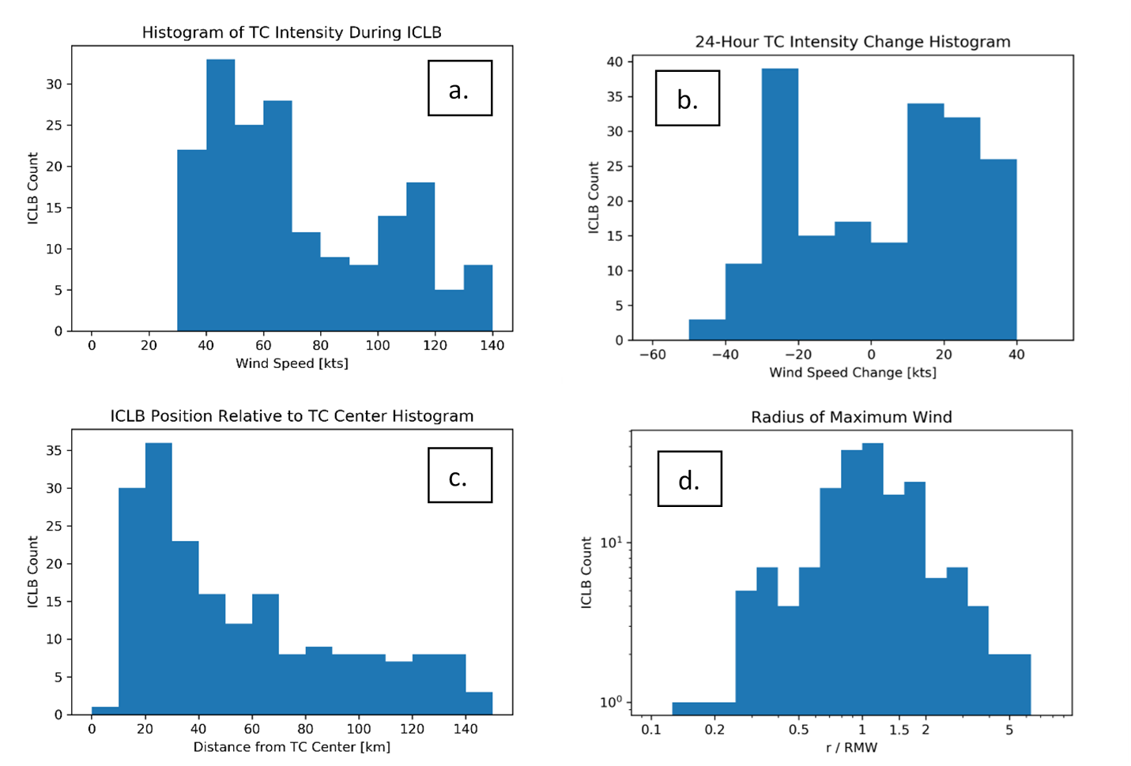
Conclusions
The majority of TCs observed by GLM in the 2018 and 2019 seasons support overall trends stated by DeMaria et al. (2012) and others
three common radial flash regions (weak inner maximum, distinct minimum, strong rainband maximum)
NA TCs generally exhibit greater flash density than ENP TCs
weaker TCs tend to have more lightning than stronger TCs (plot a)
the presence of an ICLB alone is not sufficient to inform intensity change forecasts (plot b)
average lightning density decreases with increasing distance from the storm center (plot c)
Stevenson et al. (2018) RMW relationship supported interior to 1 RMW, but contradicted by ICLBs beyond 1.5 RMW
RI is well-modeled, but RW poorly predicted
Basin dependence appears less influential
Large uncertainty in ATCF b-deck RMWs

