Slide 1
Quantifying the Value of Using GLM to Fill Radar Coverage Gaps
Scott Rudlosky, NESDIS/STAR
Version 1, First presented 7/22/21

Slide 2
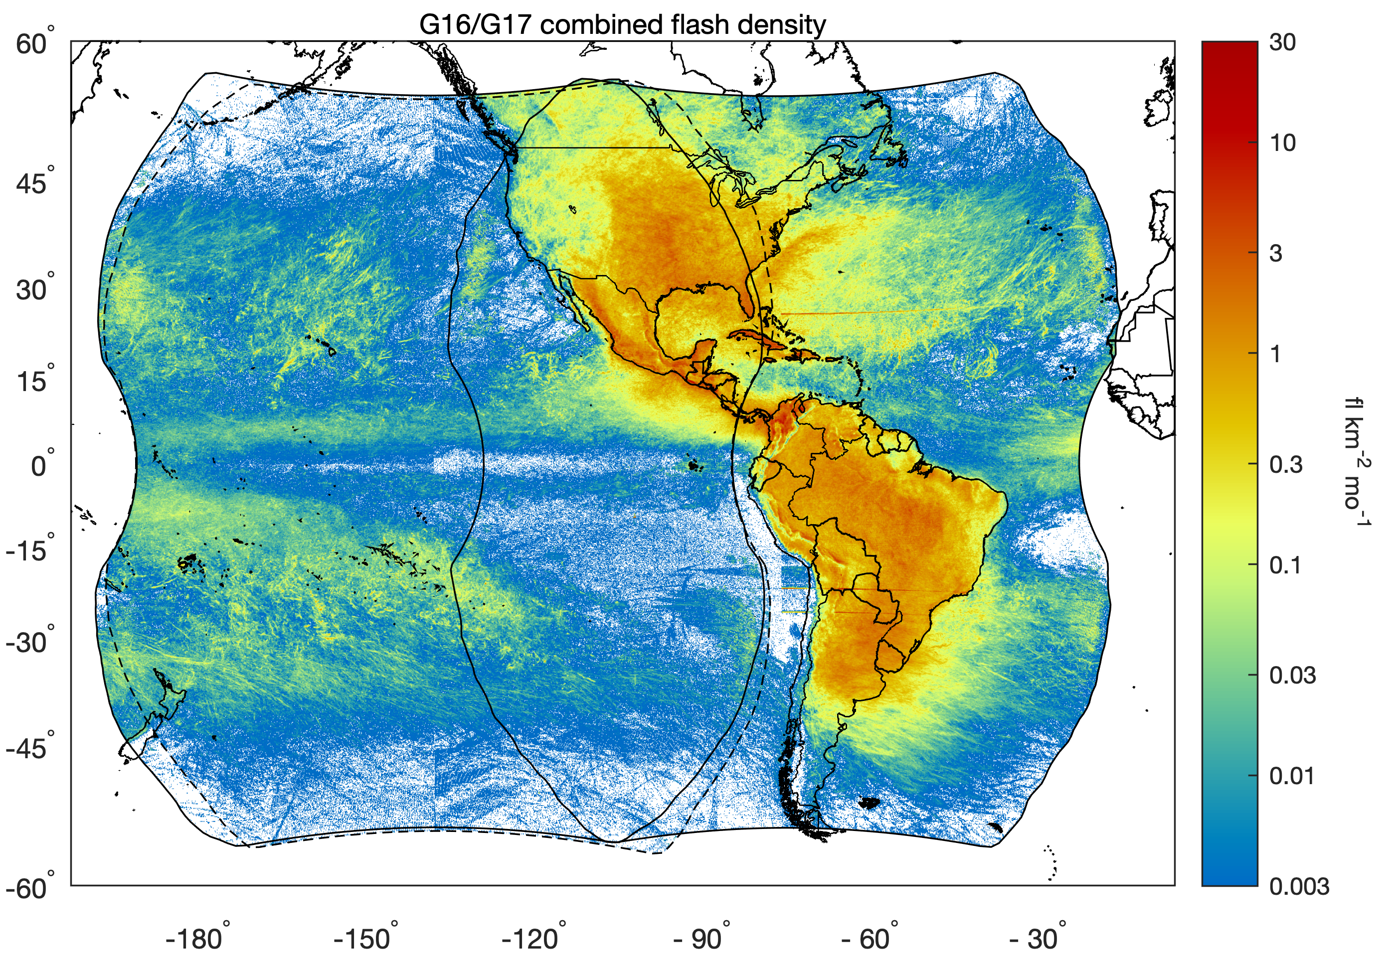
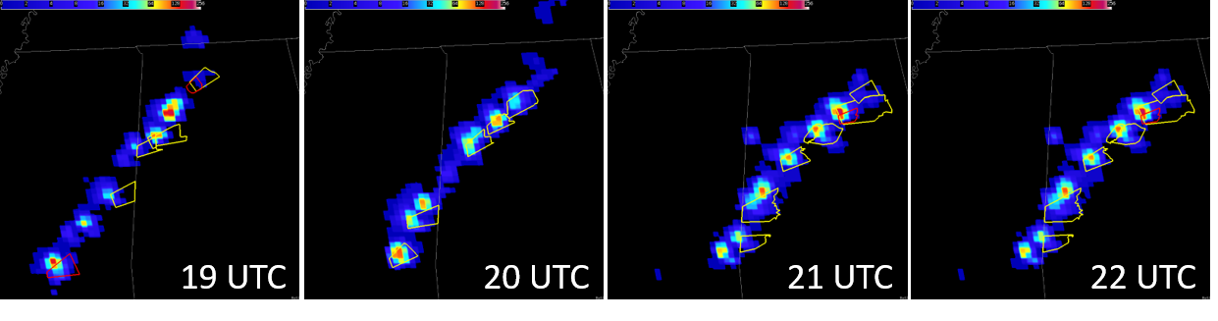
Geostationary Lightning Mapper
Two GLMs observe spatial and temporal lightning distributions over a vast region
Their broad spatial coverage and rapid temporal updates complement radar observations over CONUS to support severe weather warning decisions
Integrating GLM data into the severe weather warning process promotes earlier and easier warning decisions, better assessment of the areal coverage of hazards, and fewer false alarms, especially during radar outages and in regions of poor radar coverage

Slide 3
Value of Filling Radar Coverage Gaps
As part of the ongoing GeoXO economic analysis, this study digs deeper into quantifying the value of using GLM to fill radar coverage gaps (see sections 2.2 and 3.1 of GLM Value Assessment – https://repository.library.noaa.gov/view/noaa/27429)
Two main aspects:
  Characterizing the frequency of radar outages and the coincidence of lightning and severe weather, computing costs associated with radar outages, attributing value to datasets that provide coverage during outages
  Exploring the verification of NWS Severe Thunderstorm, Tornado, and Flash Flood warnings in the context of varying radar coverage, in an attempt to capture temporal variability in the accuracy of warnings during the GOES-R era (i.e., 2018-2020)

Slide 4
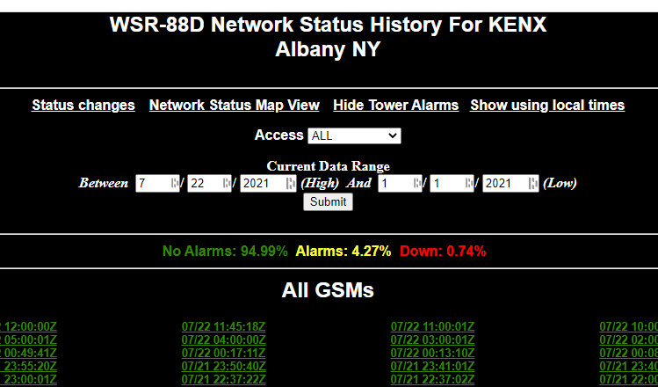
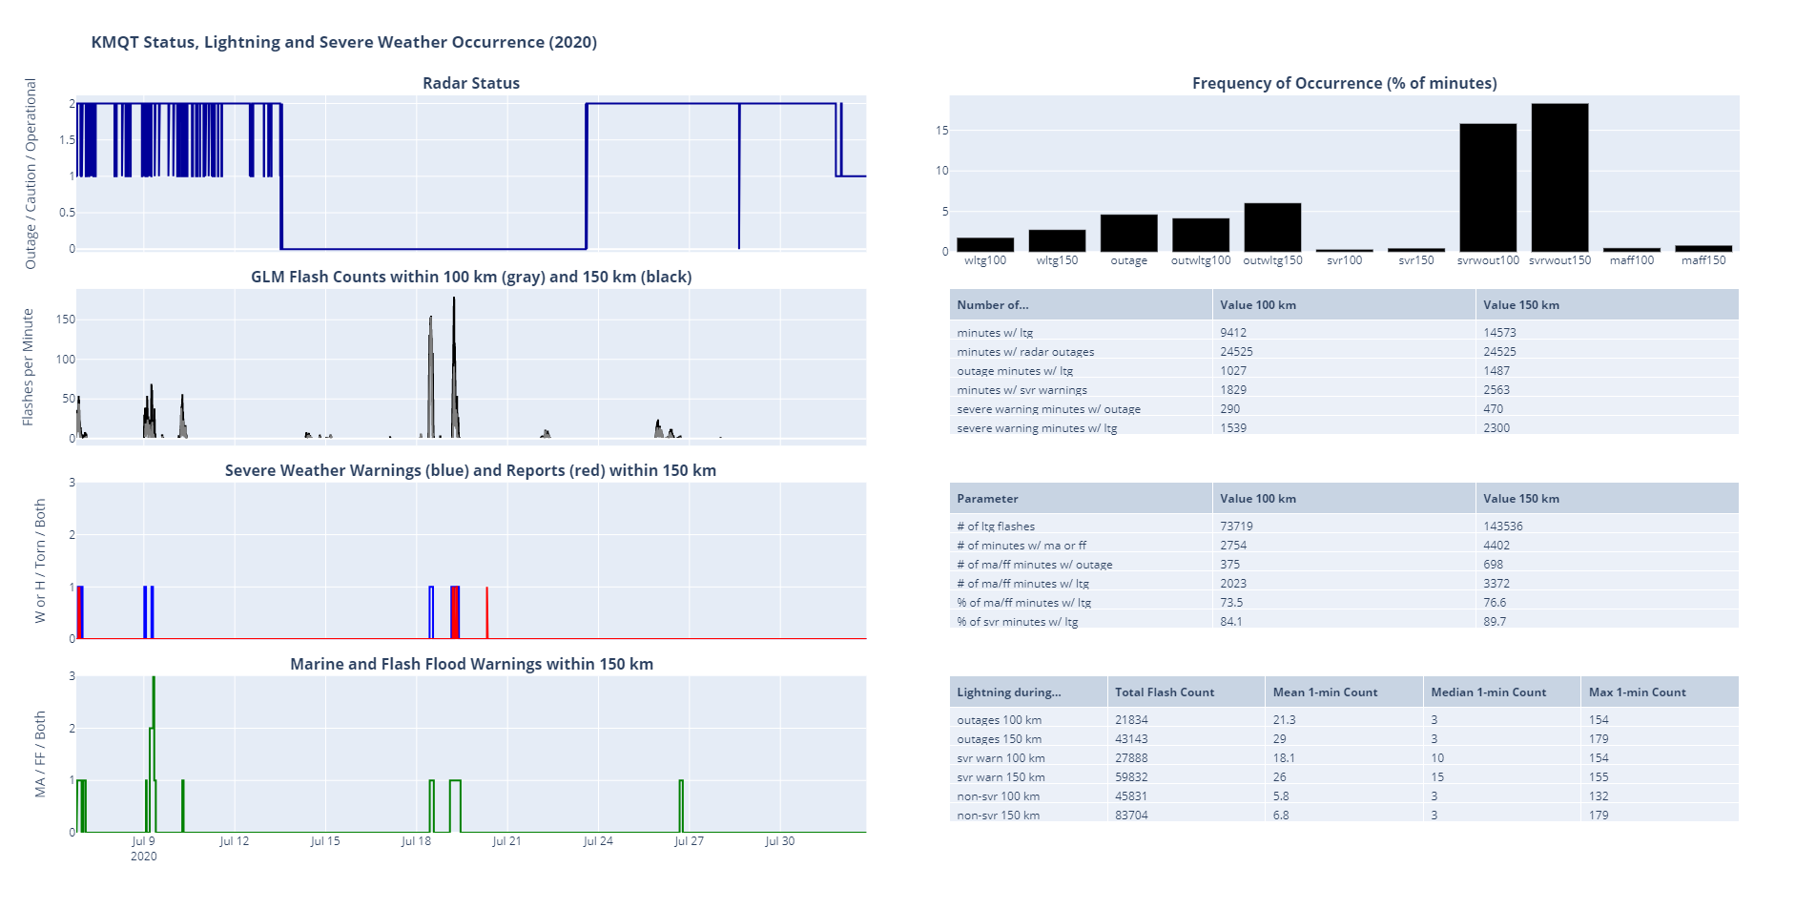
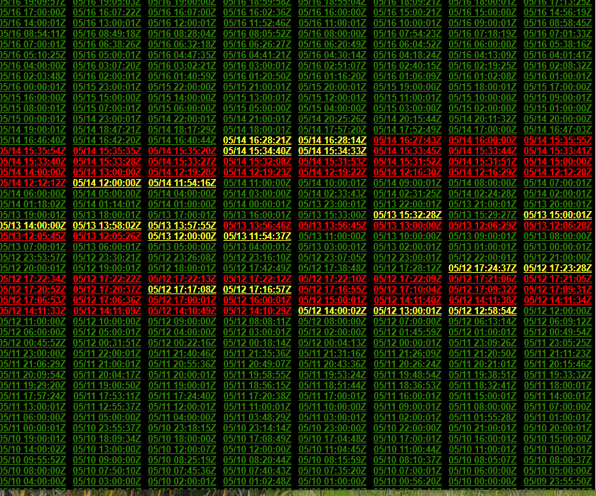
WSR-88D Status, Lightning, and Severe Weather Summaries
An interactive status page is provided for each radar to illustrate the relative occurrence of lightning and severe weather in the context of varying radar status (https://lightning.umd.edu/glm/docs/radarstatus/2020/)

Slide 5
WSR-88D Status, Lightning, and Severe Weather Summaries
Seasonal top 10 lists of the most lightning prone radars (i.e., most frequent lightning within 1.5°) and those with the most frequent outages during 2020
Radar | wltg150 | minwltg150 | ltg150sum |  | Radar | outageper | outagemin
KAMX | 17.13 | 90293 | 951513 |  | KLCH | 16.78 | 88430
KTBW | 14.37 | 75760 | 1012604 |  | KDFX | 8.46 | 44584
KMLB | 14 | 73784 | 1049256 |  | KBBX | 8.4 | 44287
KBYX | 12.89 | 67913 | 474668 |  | KTBW | 7.91 | 41673
KLIX | 10.94 | 57679 | 804728 |  | KMBX | 7.73 | 40763
KMOB | 10.64 | 56083 | 736670 |  | KVAX | 7.67 | 40431
KHGX | 10.35 | 54557 | 729221 |  | KRGX | 7.39 | 38969
KJAX | 9.9 | 52167 | 661768 |  | KEOX | 6.69 | 35235
KLCH | 9.58 | 50514 | 618451 |  | KBGM | 6.53 | 34414
KDGX | 9.56 | 50381 | 806666 |  | KTLH | 6.5 | 34262
Radar | # of outage min w/ ltg | % of outage min w/ ltg | Flash count during outages | Mean count | Median count | Max count
KLCH | 6739 | 7.62 | 67661 | 10 | 3 | 123
KAMX | 6281 | 24.84 | 87837 | 14 | 5 | 143
KMBX | 5538 | 13.59 | 57346 | 10.4 | 5 | 63
KGWX | 3465 | 20.11 | 38094 | 11 | 5 | 81
KDDC | 3309 | 21.5 | 107784 | 32.6 | 18 | 273
KMRX | 3185 | 30.46 | 39749 | 12.5 | 6 | 81
KPAH | 3183 | 16.34 | 64058 | 20.1 | 9 | 154
KVAX | 3065 | 7.58 | 35828 | 11.7 | 4 | 169
KCLX | 2826 | 9.27 | 21737 | 7.7 | 4 | 223
KTLH | 2214 | 6.46 | 12779 | 5.8 | 2 | 53
Radar | # of outage min w/ ltg | % of outage min w/ ltg | Flash count during outages | Mean count | Median count | Max count
KSHV | 327 | 31.53 | 789 | 2.4 | 2 | 9
KMRX | 3185 | 30.46 | 39749 | 12.5 | 6 | 81
KAMX | 6281 | 24.84 | 87837 | 14 | 5 | 143
KLZK | 209 | 22.14 | 7096 | 34 | 43 | 70
KHGX | 251 | 21.64 | 2517 | 10 | 10 | 39
KDDC | 3309 | 21.5 | 107784 | 32.6 | 18 | 273
KGWX | 3465 | 20.11 | 38094 | 11 | 5 | 81
KOHX | 1897 | 16.62 | 19510 | 10.3 | 4 | 78
KPAH | 3183 | 16.34 | 64058 | 20.1 | 9 | 154
KMBX | 5538 | 13.59 | 57346 | 10.4 | 5 | 63
Radar | # of outage min w/ ltg | % of outage min w/ ltg | Flash count during outages | Mean count | Median count | Max count
KDDC | 3309 | 21.5 | 107784 | 32.6 | 18 | 273
KAMX | 6281 | 24.84 | 87837 | 14 | 5 | 143
KLCH | 6739 | 7.62 | 67661 | 10 | 3 | 123
KPAH | 3183 | 16.34 | 64058 | 20.1 | 9 | 154
KMBX | 5538 | 13.59 | 57346 | 10.4 | 5 | 63
KMQT | 1487 | 6.06 | 43143 | 29 | 3 | 179
KMRX | 3185 | 30.46 | 39749 | 12.5 | 6 | 81
KGWX | 3465 | 20.11 | 38094 | 11 | 5 | 81
KVAX | 3065 | 7.58 | 35828 | 11.7 | 4 | 169
KARX | 1779 | 8.09 | 28328 | 15.9 | 6 | 109

Slide 6
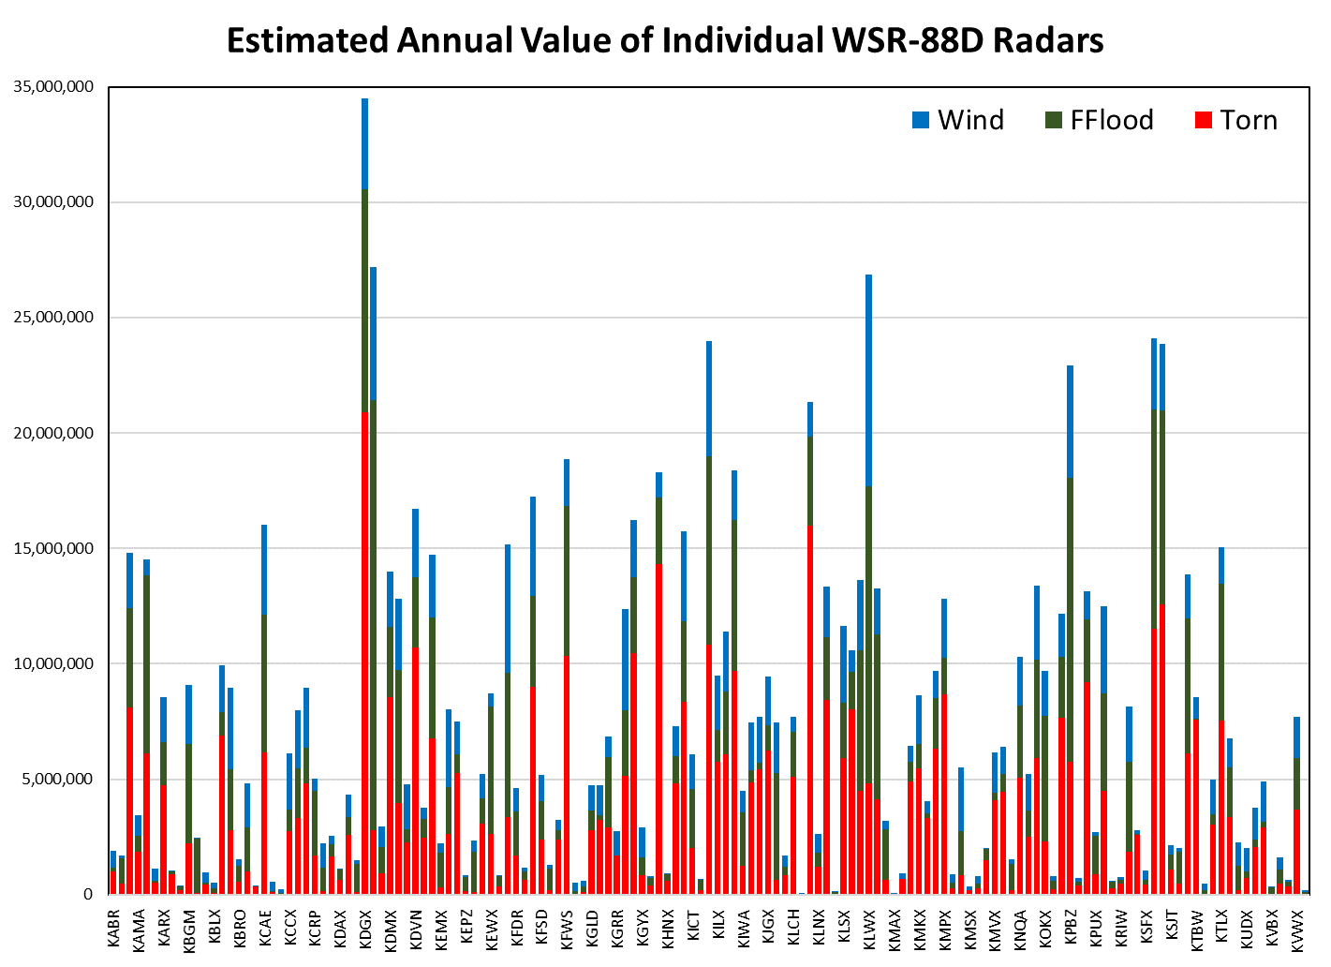
Estimating the Value of Individual WSR-88D Radars
Computed radar value estimates that represent the portion of 2015-2020 tornado, wind, and flash flood reports nearest to each radar (scaled by the log of the population density), multiplied by the annual value of the existing radar network
Annual radar value/benefit shown by Cho and Kurdzo
  Tornado - $490 million/year
  Flash Flood - $316 million/year
  Wind - $207 million/year
KDGX
(Brandon, MS)
($3,958,292)
($9,649,581)
($20,899,614)
KDIX (Mt. Holly)
($5,770,851 - Wind)
($18,630,992 - FFlood)
($2,798,256 -Tornado)
KLWX (Sterling, VA)
($9,185,645)
($12,852,746)
($4,828,877)

Slide 7
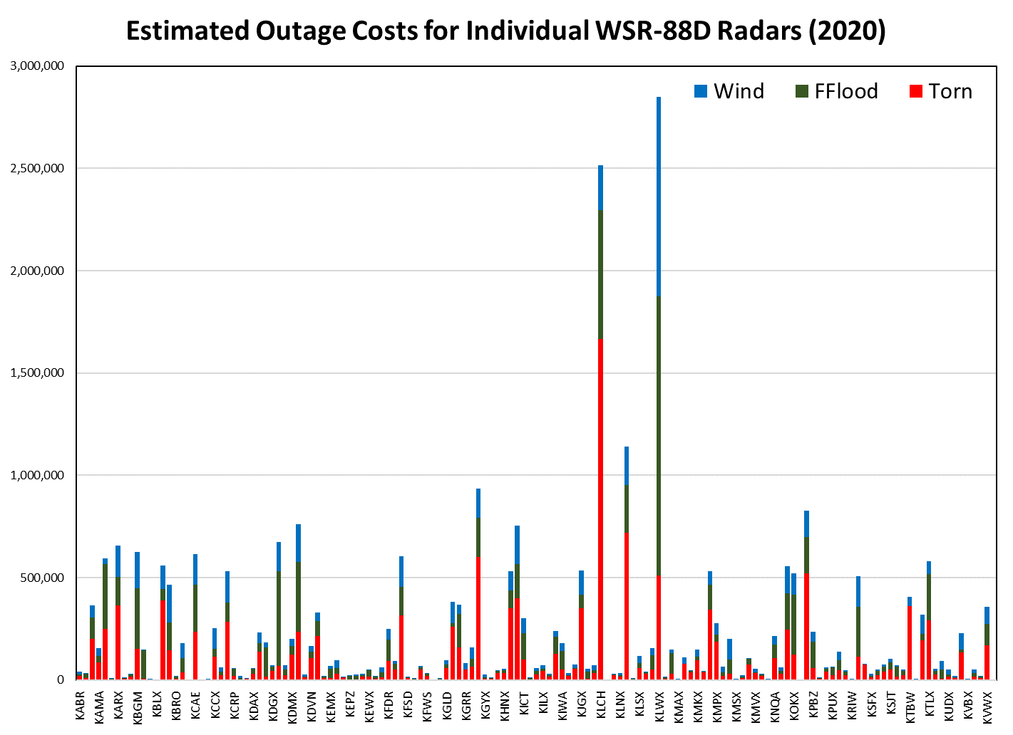
Estimating the Value of Covering Radar Outages
Value estimates for each radar are multiplied by the fraction of minutes each radar was offline during 2020 to estimate the costs associated with outages
If this ~$30 million is reclaimed through use of gap filling datasets, which portion of this value can be attributed to the GOES-R GLM and ABI?
Hazard | Outage Costs
Tornado | $13,871,447
Flash Flood | $9,277,445
Wind | $6,337,370
Total | $29,486,262
KLCH (16.8%)
($218,654)
($630,863)
($1,665,198)
KLWX(5.6%)
($973,678)
($1,362,391)
($511,861)
KLOT (5.2%)
($189,526)
($232,482)
($720,033)

Slide 8
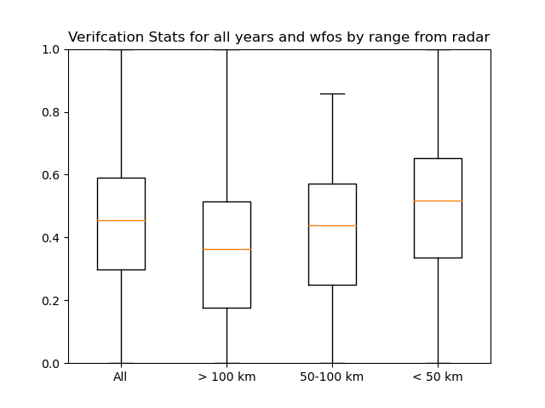
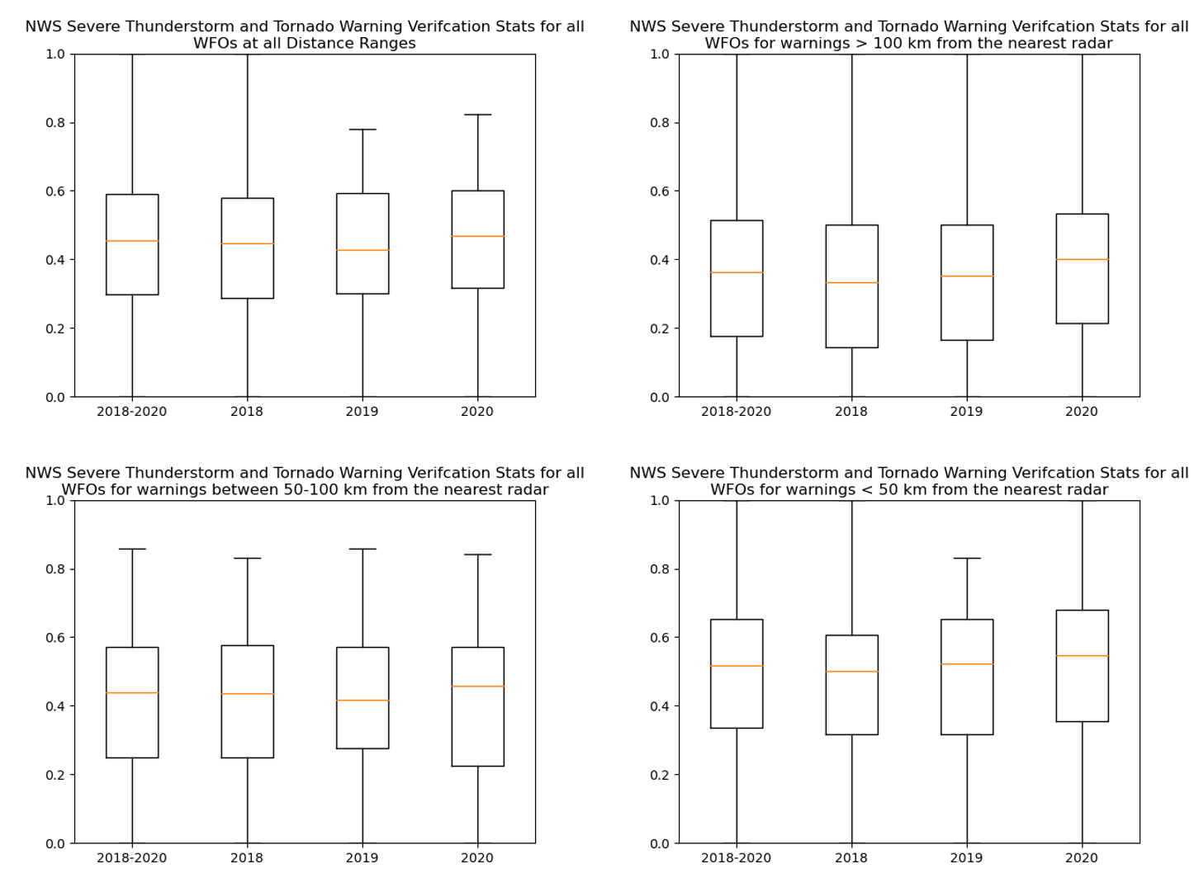
NWS Warning Verification Analysis
Study next explores the verification of NWS Severe Thunderstorm, Tornado, and Flash Flood warnings in the context of varying radar coverage
Analysis attempts to capture temporal variability in the accuracy of warnings during the GOES-R era (i.e., 2018-2020)
Initial work considered only the distance from the radar, more recent work better characterizes radar coverage

Slide 9
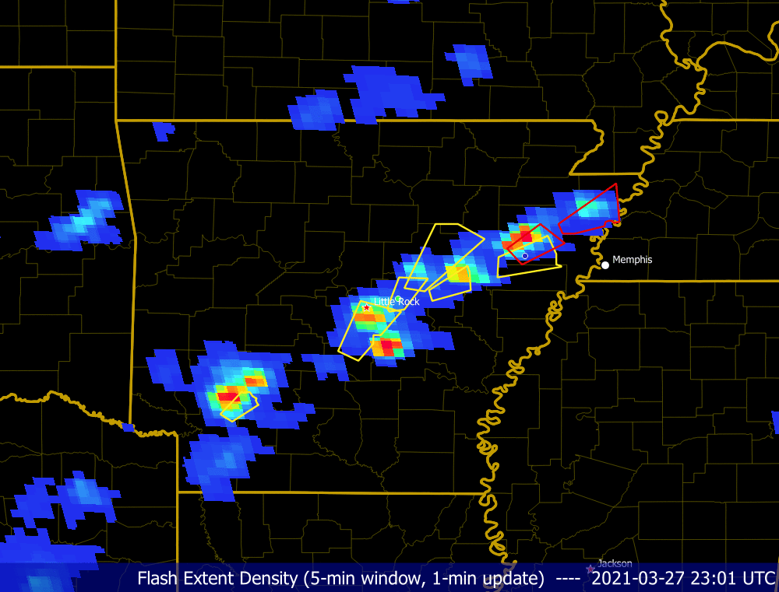
Verifying Severe Weather Warnings
Warnings last an average of 40 min
Severe wind, hail, tornado, or flash flood reports occurring within the warning polygon during the valid time verify the warning
Lead time is the difference between the warning issuance and the first subsequent severe weather report within the polygon
GLM Flash Extent Density, yellow (red) severe thunderstorm (tornado) warning polygons, and severe wind, hail, and tornados indicated by triangles, squares, and circles, respectively (Courtesy of Joseph Patton, UMD/CICESS)

Slide 10
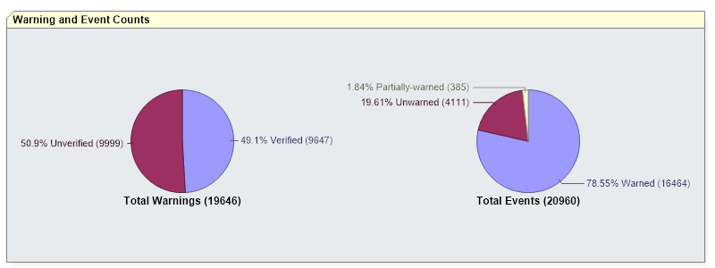
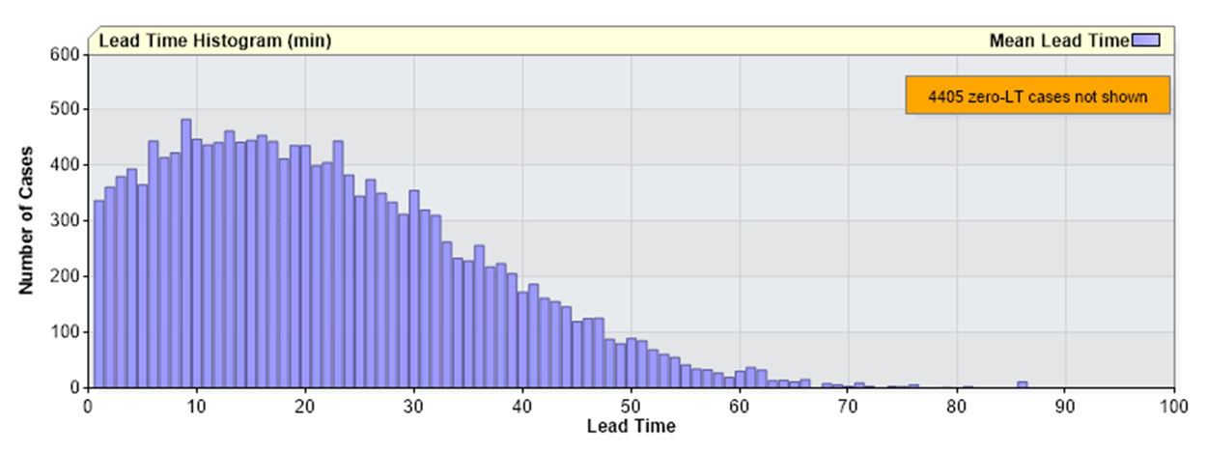
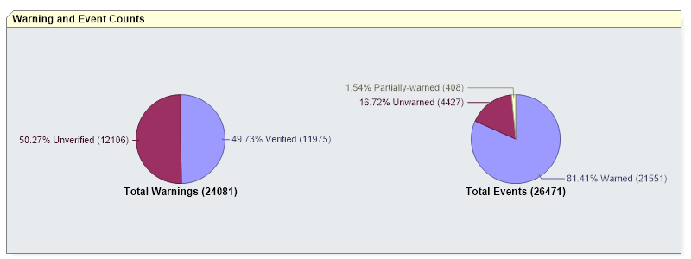
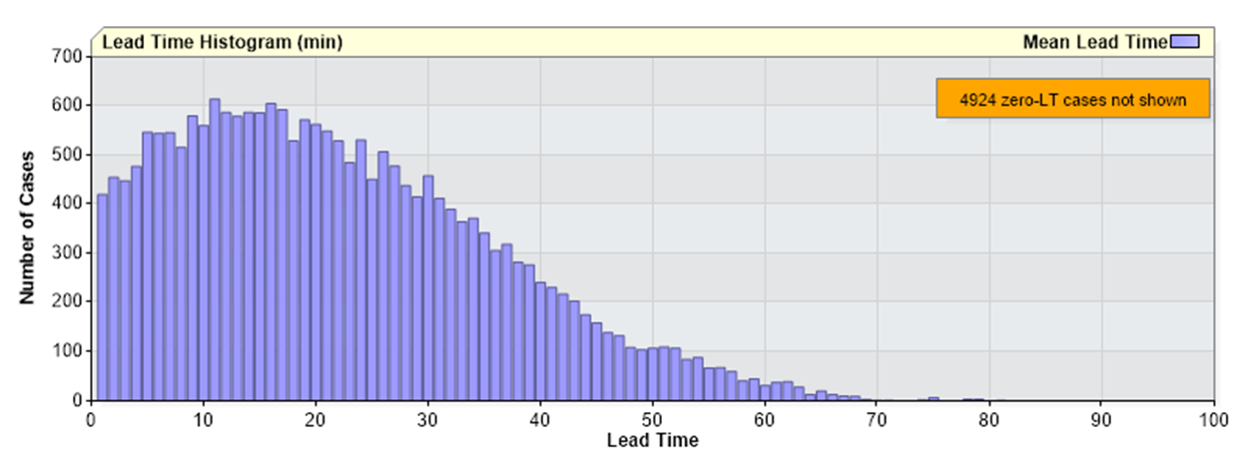
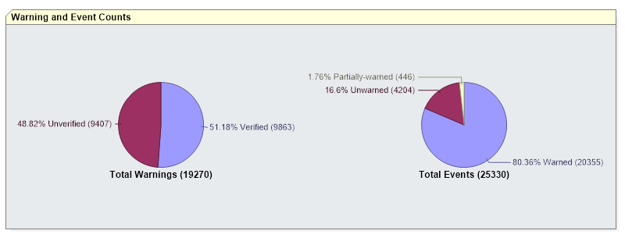
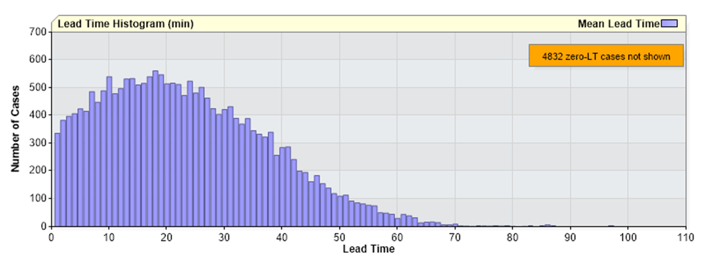
Official NWS Verification Results
Year | Total Warning Count | Verified Warnings | Unverified Warnings | Total Event Count | Warned Events | Partially Warned Events | Unwarned Events | POD | FAR | CSI | Mean Leadtime | Initial Leadtime | Total Warned Area | Average Warning Size | County Area Reduction
2015 | 20237 | 10262 | 9975 | 22185 | 17536 | 443 | 4206 | 0.802 | 0.493 | 0.451 | 17.13 | 16.81 | 12301991 | 608.05 | 0.85
2016 | 19846 | 10332 | 9514 | 23127 | 18014 | 427 | 4686 | 0.789 | 0.479 | 0.457 | 17.32 | 16.99 | 12402123 | 624.92 | 0.85
2017 | 21385 | 10907 | 10478 | 25193 | 20282 | 465 | 4446 | 0.816 | 0.49 | 0.457 | 17.84 | 17.52 | 13330018 | 623.33 | 0.84
2018 | 19646 | 9647 | 9999 | 20960 | 16464 | 385 | 4111 | 0.796 | 0.509 | 0.436 | 17.54 | 17.23 | 12072425 | 614.5 | 0.85
2019 | 24081 | 11975 | 12106 | 26471 | 21551 | 408 | 4427 | 0.826 | 0.503 | 0.45 | 18.21 | 17.91 | 15142233 | 628.8 | 0.85
2020 | 19270 | 9863 | 9407 | 25330 | 20355 | 446 | 4204 | 0.825 | 0.488 | 0.462 | 19.18 | 18.89 | 13636508 | 707.65 | 0.84
2018
Year | verf | > 1° | 0.5°-1° | < 0.5°
2018 | 0.48 | 0.43 | 0.47 | 0.52
2019 | 0.49 | 0.42 | 0.46 | 0.55
2020 | 0.51 | 0.46 | 0.49 | 0.56
48.1%
2019
49.73%
Summary of initial verification results stratified by distance from radar (matches NWS verification stats)
2020
51.18%

Slide 11
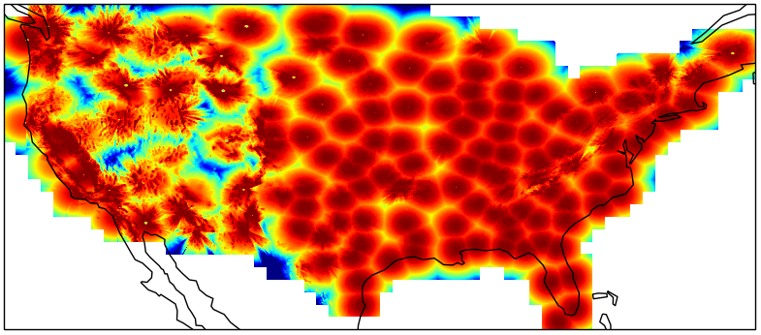
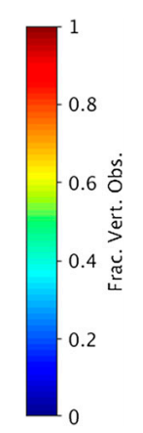
Characterizing Radar Coverage
Cho and Kurdzo (2019, 2020a,b) developed a new radar coverage metric, the fraction of vertical volume observed (FVO) between Earth’s surface and 20 kft AGL
Considers beam geometry and terrain effects, including surface elevation data (both natural and man made) to account for beam blockage and height above ground level variations
Fraction of vertical volume observed between 0 and 20 kft AGL by current CONUS WSR-88Ds. (Courtesy of Cho and Kurdzo)

Slide 12
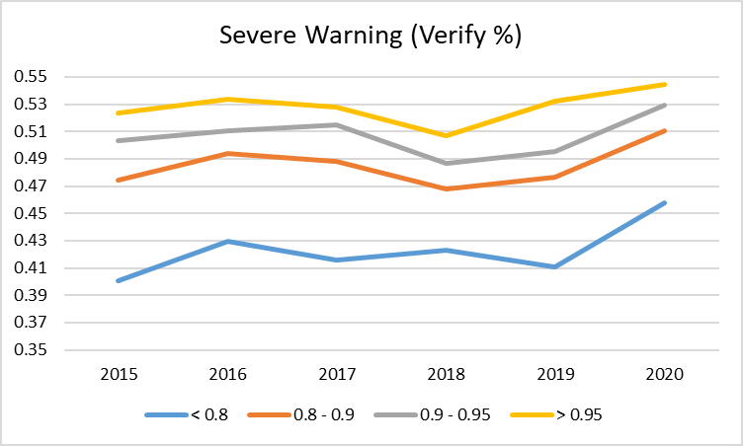
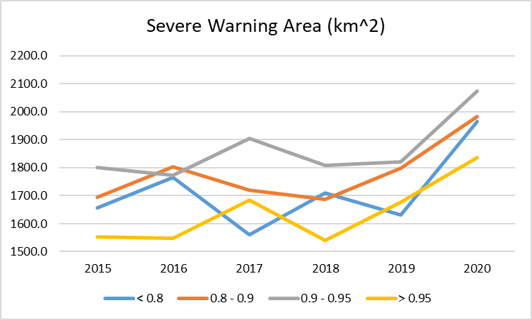
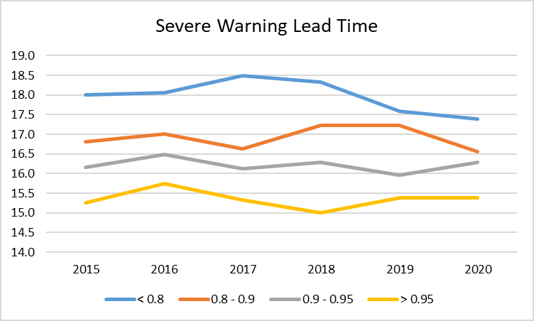
Severe Thunderstorm Warning Verification
Notable increase in the severe thunderstorm warning verification percentage between 2018-2020 (most evident where radar coverage is poorest)
Coupled with a prominent increase in the severe thunderstorm warning size
Shortest warning lead time observed where radar coverage is best (spread narrowing)
Suggests that more robust data might not necessarily improve warning lead time

Slide 13
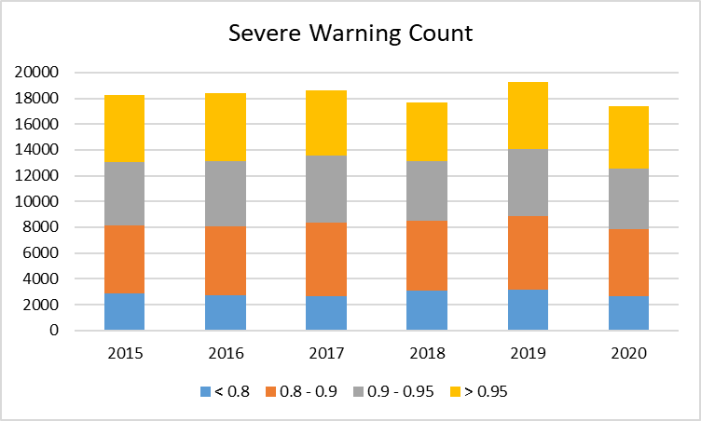
Severe Thunderstorm Warning Verification
Hypothesis: Improved satellite observations provide forecasters with increased confidence when issuing warnings, especially where radar coverage is poor, these larger warnings now better indicate the area at risk, as shown by an increased severe thunderstorm warning verification percentage
0.28
0.27
0.29
0.16
0.28
0.28
0.29
0.15
0.27
0.28
0.31
0.14
0.25
0.26
0.31
0.18
0.27
0.27
0.30
0.16
0.28
0.27
0.30
0.16

Slide 14
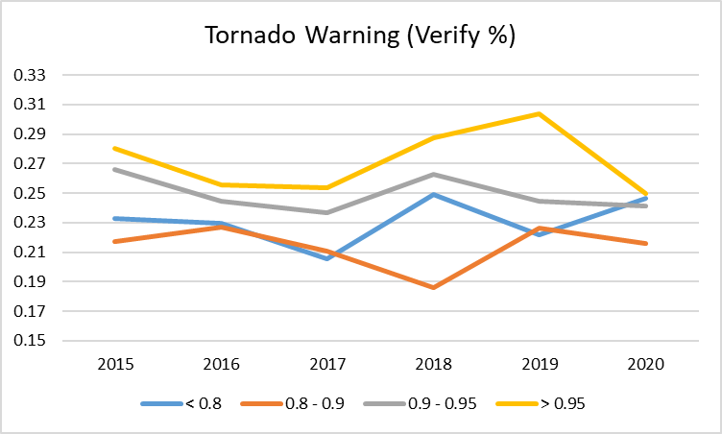
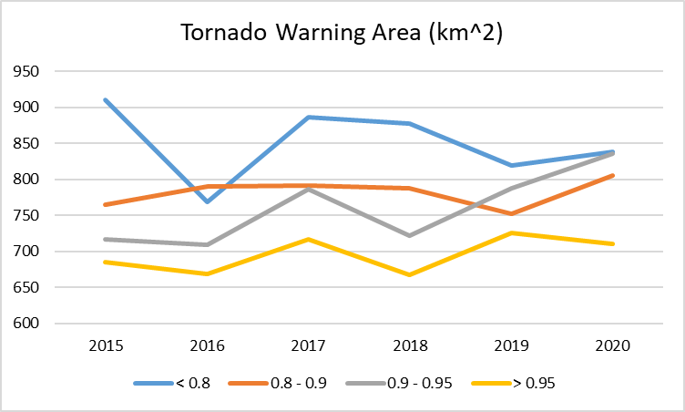
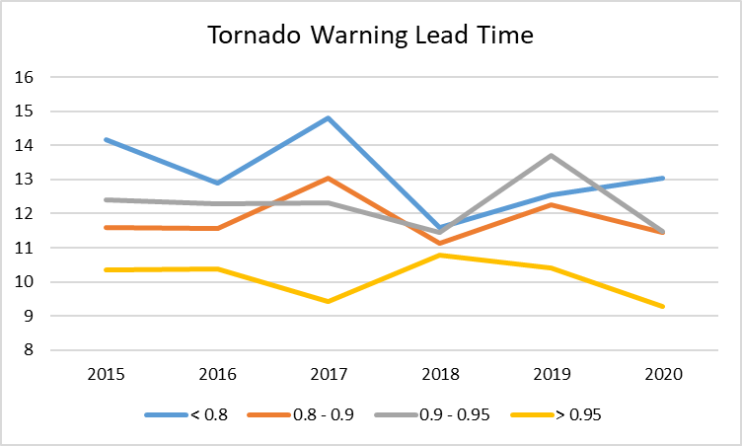
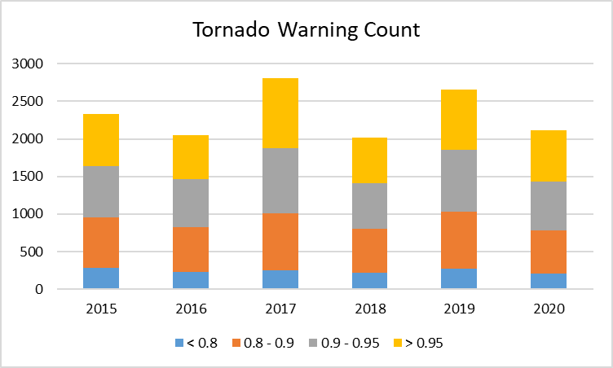
Tornado Warning Verification
Patterns are less clear for tornado warnings, mainly because lower counts make this analysis more sensitive to natural variability in the annual number and location of tornados

Slide 15
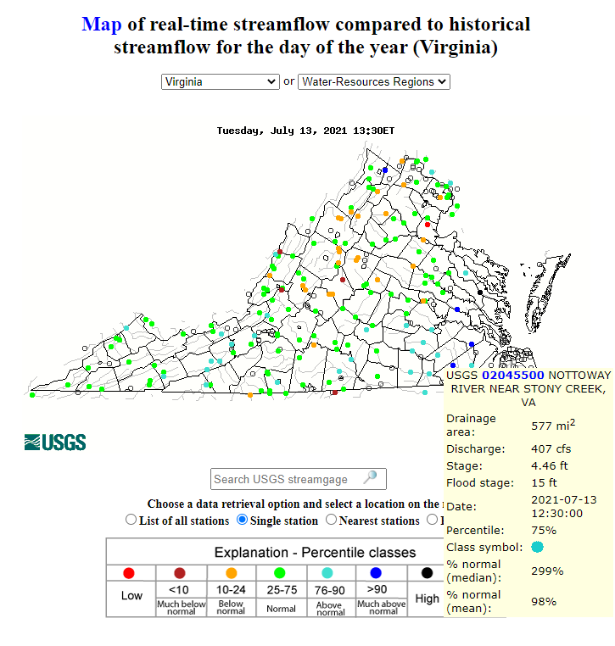
Flash Flood Warning Verification Analysis
Searched Storm Events Database for “Flash Flood” reports associated with “Heavy Rain”
Located nearest rain gauge, found drainage basin boundary, then characterized the radar coverage (FVO) for each basin
Used the FF reports to verify FF warnings and compute verification statistics by radar coverage

Slide 16
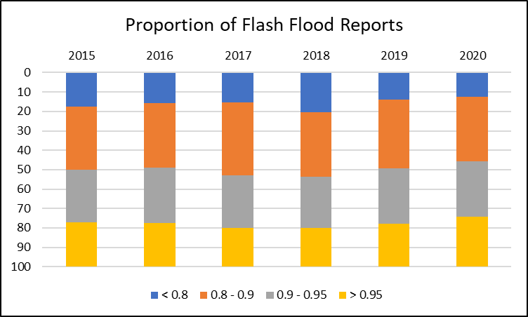
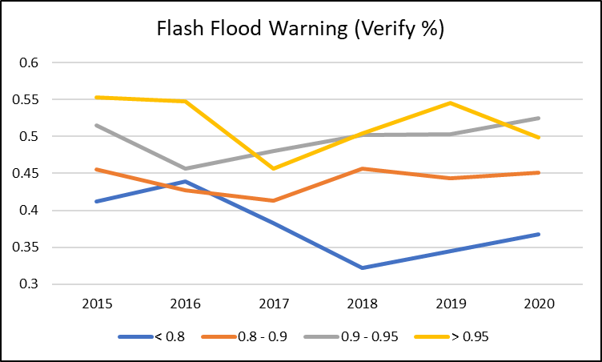
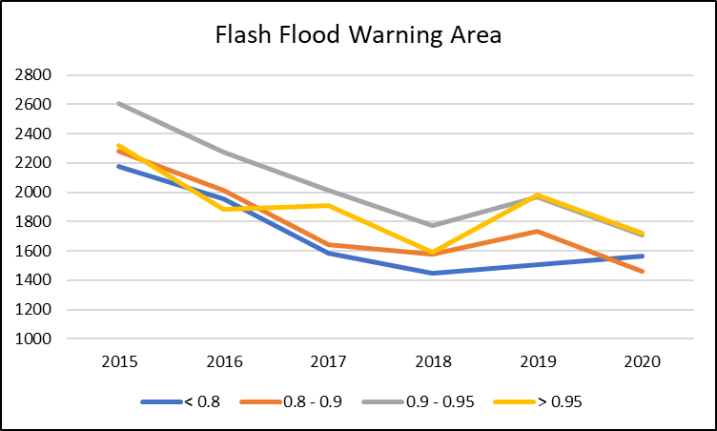
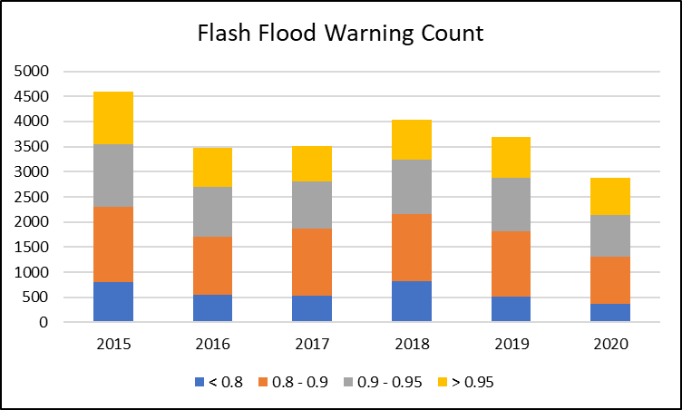
Flash Flood Warning Verification Analysis
No clear patterns in the Flash Flood Warning verification percentage, as with tornados, this likely relates to smaller counts and the natural variability in the annual number and location of flash flood warnings
Flash flood warning areas have decreased over the past several years (opposite of severe thunderstorm warnings)

Slide 17
Ongoing/Future Work
How best to determine which portion of the ~$30 million can be attributed to the ABI and GLM?
  Survey offices to determine which datasets are used most when radar outages occur during severe weather warning operations
  Assess which radars have terminal doppler backups and the proximity of nearby radars to determine a weight for the role that GOES products likely play during outages
Potentially further subdivide by severe hazard type, intensity (e.g., number of reports, amount of lightning), etc. – although this may raise new sample size issues
Can the increasing severe weather warning size be linked to the GOES data? If so, characterize any additional value this might provide

Slide 18
Backup Slides

Slide 19
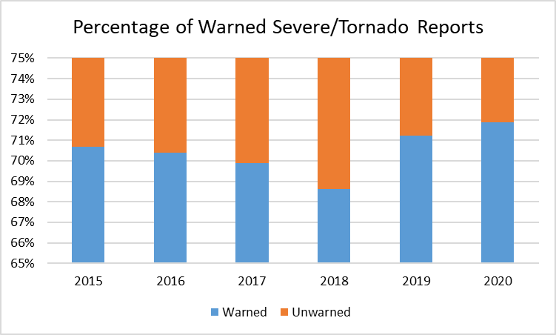
Severe Weather Warning Statistics
Add more on the distribution of reports?
Hold
Year | Warned Reports | Unwarned Reports | All Reports | Percentage Warned
2015 | 13543 | 5615 | 19158 | 70.69
2016 | 14264 | 5996 | 20260 | 70.40
2017 | 15193 | 6552 | 21745 | 69.87
2018 | 13035 | 5957 | 18992 | 68.63
2019 | 16523 | 6679 | 23202 | 71.21
2020 | 15796 | 6182 | 21978 | 71.87

Slide 20
WSR-88D Status, Lightning, and Severe Weather Summaries
Statistics are produced for each radar describing the relative frequency and coincidence of radar outages, lightning, and severe weather warnings / reports
Abbreviation | Metric Description | Avg. Radar | Maximum | Radar
wltg100 | Percentage of minutes w/ ltg within 1° | 3.6 | 12.5 | KAMX
wltg150 | Percentage of minutes w/ ltg within 1.5° | 5.0 | 17.1 | KAMX
outage | Percentage of minutes w/ radar outage | 2.8 | 16.8 | KLCH
outwltg100 | Percentage of outage minutes w/ ltg | 2.6 | 24.4 | KMRX
outwltg150 | Percentage of outage minutes w/ ltg | 3.7 | 31.5 | KSHV
svr100 | Percentage of minutes w/ svr warnings within 1° | 0.7 | 1.7 | KFDR
Svr150 | Percentage of minutes w/ svr warnings within 1.5° | 1.1 | 2.7 | KFDR
svrwout100 | Percentage of severe warning minutes w/ outage | 2.0 | 47.3 | KMBX
svrwout150 | Percentage of severe warning minutes w/ outage | 2.3 | 43.2 | KMBX
maff100 | Percentage of ma/ff warning minutes within 1° | 0.9 | 7.0 | KAMX
maff150 | Percentage of ma/ff warning minutes within 1.5° | 1.5 | 9.2 | KAMX
For those interested in more closely exploring these distributions, the intermediate files are available here (https://lightning.umd.edu/glm/docs/radarstatus/datafiles/)
These simple text files contain 527040 rows (minutes during 2020) by 143 columns (radars, order indicated in newradarcoords.csv)
These files should be self-explanatory with the html images as context

Slide 21
Initial Warning Verification Analysis
Severe weather warning polygons (only NEW/CON and SV/TO) were modified to include some new columns, and the warning shapefiles have been recreated for 2018, 2019, and 2020 (all files are available here https://lightning.umd.edu/glm/docs/warn/)
New Warning Columns:
radar = nearest radar (between radar location and nearest point in polygon)
mindist = distance to nearest radar
verified = 1 if svr/tor report occurred during warning, 0 otherwise
rpttimes = times and type of coincident reports
ltgsum = GLM flash count throughout entire warning
ltgcounts = 1-min flash count time series during entire warning
New Report Columns:
radar = nearest radar
mindist = distance to nearest radar
windex = index of coincident warnings
Year | verf | farverf | midverf | nearverf
2018 | 0.48 | 0.43 | 0.47 | 0.52
2019 | 0.49 | 0.42 | 0.46 | 0.55
2020 | 0.51 | 0.46 | 0.49 | 0.56
Year | torf | svrf | wfff | farf | midf | nearf
2018 | 0.10 | 0.90 | 0.96 | 0.26 | 0.39 | 0.35
2019 | 0.13 | 0.87 | 0.97 | 0.24 | 0.39 | 0.37
2020 | 0.11 | 0.89 | 0.93 | 0.23 | 0.38 | 0.39

Slide 22
Initial Warning Verification Analysis
Most Lightning per Warning
Mean Area (km2)
ALL | all | tor | svr | ver | non | wff | wfo | far | mid | near
2018 | 1588.2 | 741.6 | 1684.9 | 1934.9 | 1272.5 | 1602.2 | 1244.4 | 1356 | 1471.5 | 1890.1
2019 | 1626.1 | 761 | 1751.6 | 1942.7 | 1327.7 | 1640.6 | 1200.1 | 1330.6 | 1510.5 | 1944.6
2020 | 1834.8 | 786.4 | 1962.3 | 2243 | 1410.6 | 1849.3 | 1632.8 | 1467.4 | 1651.2 | 2234.4
WFOYYYY | Flashes |  | WFOYYYY | Density
SHV2019 | 1043 |  | MLB2020 | 0.01996
FWD2019 | 1014 |  | MLB2018 | 0.01794
FWD2020 | 1014 |  | MLB2019 | 0.01777
EWX2019 | 948 |  | LCH2019 | 0.01753
CRP2020 | 941 |  | JAX2018 | 0.01687
BRO2020 | 929 |  | HGX2019 | 0.01591
CRP2018 | 849 |  | MFL2019 | 0.01572
CHS2020 | 816 |  | BMX2018 | 0.01554
EWX2020 | 811 |  | CHS2020 | 0.01539
ICT2019 | 774 |  | RLX2018 | 0.01521
EWX2018 | 764 |  | LIX2019 | 0.01513
HGX2019 | 752 |  | HGX2020 | 0.01492
FGF2018 | 741 |  | BRO2020 | 0.0149
HGX2020 | 737 |  | LCH2018 | 0.01471
SHV2020 | 713 |  | JAX2019 | 0.01431
TSA2019 | 712 |  | EWX2018 | 0.01396
GRB2019 | 703 |  | FFC2018 | 0.0138
OUN2018 | 699 |  | TBW2019 | 0.01371
SJT2018 | 678 |  | LMK2018 | 0.01334
ICT2020 | 676 |  | JAX2020 | 0.01284
Mean GLM Flash Count (flashes)
ALL | all | tor | svr | ver | non | wff | wfo | far | mid | near
2018 | 412 | 198 | 437 | 531 | 304 | 429 | 0 | 361 | 404 | 461
2019 | 414 | 216 | 443 | 508 | 326 | 428 | 0 | 332 | 403 | 480
2020 | 398 | 152 | 427 | 494 | 298 | 426 | 0 | 332 | 377 | 457
Mean GLM Flash Density (flashes km-2 min-1)
ALL | all | tor | Svr | ver | non | wff | wfo | far | mid | near
2018 | 0.0081 | 0.0093 | 0.0080 | 0.0083 | 0.0079 | 0.0084 | 0.0000 | 0.0083 | 0.0084 | 0.0076
2019 | 0.0075 | 0.0091 | 0.0072 | 0.0076 | 0.0074 | 0.0077 | 0.0000 | 0.0075 | 0.0078 | 0.0072
2020 | 0.0068 | 0.0071 | 0.0068 | 0.0069 | 0.0068 | 0.0073 | 0.0000 | 0.0070 | 0.0072 | 0.0063
Mean Minimum Distance to Radar (degrees)
ALL | all | tor | svr | ver | non | wff | wfo | far | mid | near
2018 | 0.75 | 0.732 | 0.752 | 0.689 | 0.806 | 0.73 | 1.246 | 1.434 | 0.743 | 0.252
2019 | 0.715 | 0.707 | 0.717 | 0.649 | 0.778 | 0.705 | 1.03 | 1.388 | 0.739 | 0.245
2020 | 0.759 | 0.719 | 0.764 | 0.643 | 0.88 | 0.687 | 1.759 | 1.66 | 0.744 | 0.242

Slide 23
Severe Weather Warning Statistics
Both | Verified Fraction
Year/FVO | < 0.8 | 0.8 - 0.9 | 0.9 - 0.95 | > 0.95
2015 | 0.386 | 0.445 | 0.474 | 0.495
2016 | 0.414 | 0.467 | 0.481 | 0.506
2017 | 0.398 | 0.456 | 0.475 | 0.485
2018 | 0.412 | 0.441 | 0.461 | 0.481
2019 | 0.397 | 0.447 | 0.461 | 0.502
2020 | 0.443 | 0.481 | 0.495 | 0.508
 | Leadtime
Year/FVO | < 0.8 | 0.8 - 0.9 | 0.9 - 0.95 | > 0.95
2015 | 17.8 | 16.5 | 15.9 | 15.0
2016 | 17.8 | 16.8 | 16.2 | 15.5
2017 | 18.3 | 16.4 | 15.9 | 14.9
2018 | 18.1 | 17.0 | 16.0 | 14.7
2019 | 17.3 | 16.9 | 15.8 | 15.0
2020 | 17.2 | 16.3 | 16.0 | 15.0
 | Count
Year/FVO | < 0.8 | 0.8 - 0.9 | 0.9 - 0.95 | > 0.95
2015 | 3156 | 5953 | 5586 | 5881
2016 | 2953 | 5938 | 5702 | 5835
2017 | 2917 | 6487 | 6054 | 5946
2018 | 3319 | 5982 | 5248 | 5131
2019 | 3476 | 6490 | 6031 | 6006
2020 | 2890 | 5708 | 5367 | 5573
 | Area
Year/FVO | < 0.8 | 0.8 - 0.9 | 0.9 - 0.95 | > 0.95
2015 | 1588.3 | 1591.5 | 1668.5 | 1449.6
2016 | 1687.0 | 1702.1 | 1655.3 | 1458.3
2017 | 1502.4 | 1611.5 | 1743.4 | 1532.8
2018 | 1653.3 | 1598.6 | 1684.0 | 1437.0
2019 | 1562.9 | 1673.3 | 1680.4 | 1547.1
2020 | 1884.8 | 1865.1 | 1922.7 | 1697.7
SV | Verified Fraction
Year/FVO | < 0.8 | 0.8 - 0.9 | 0.9 - 0.95 | > 0.95
2015 | 0.401 | 0.474 | 0.503 | 0.524
2016 | 0.430 | 0.494 | 0.511 | 0.534
2017 | 0.416 | 0.488 | 0.515 | 0.528
2018 | 0.423 | 0.468 | 0.486 | 0.507
2019 | 0.411 | 0.476 | 0.495 | 0.532
2020 | 0.458 | 0.510 | 0.530 | 0.544
 | Leadtime
Year/FVO | < 0.8 | 0.8 - 0.9 | 0.9 - 0.95 | > 0.95
2015 | 18.0 | 16.8 | 16.2 | 15.3
2016 | 18.1 | 17.0 | 16.5 | 15.7
2017 | 18.5 | 16.6 | 16.1 | 15.3
2018 | 18.3 | 17.2 | 16.3 | 15.0
2019 | 17.6 | 17.2 | 16.0 | 15.4
2020 | 17.4 | 16.6 | 16.3 | 15.4
 | Count
Year/FVO | < 0.8 | 0.8 - 0.9 | 0.9 - 0.95 | > 0.95
2015 | 2868 | 5285 | 4909 | 5186
2016 | 2722 | 5344 | 5068 | 5244
2017 | 2669 | 5724 | 5184 | 5016
2018 | 3098 | 5397 | 4647 | 4519
2019 | 3181 | 5707 | 5207 | 5192
2020 | 2683 | 5138 | 4713 | 4885
 | Area
Year/FVO | < 0.8 | 0.8 - 0.9 | 0.9 - 0.95 | > 0.95
2015 | 1656.4 | 1696.0 | 1799.7 | 1552.1
2016 | 1765.0 | 1803.5 | 1773.7 | 1547.4
2017 | 1559.6 | 1721.0 | 1903.9 | 1684.0
2018 | 1708.7 | 1686.4 | 1808.4 | 1541.2
2019 | 1630.3 | 1797.9 | 1821.6 | 1676.5
2020 | 1965.6 | 1982.7 | 2073.5 | 1836.7
TO | Verified Fraction
Year/FVO | < 0.8 | 0.8 - 0.9 | 0.9 - 0.95 | > 0.95
2015 | 0.233 | 0.217 | 0.266 | 0.281
2016 | 0.229 | 0.227 | 0.244 | 0.255
2017 | 0.206 | 0.211 | 0.237 | 0.254
2018 | 0.249 | 0.186 | 0.263 | 0.288
2019 | 0.222 | 0.226 | 0.244 | 0.303
2020 | 0.246 | 0.216 | 0.242 | 0.250
 | Leadtime
Year/FVO | < 0.8 | 0.8 - 0.9 | 0.9 - 0.95 | > 0.95
2015 | 14.2 | 11.6 | 12.4 | 10.3
2016 | 12.9 | 11.6 | 12.3 | 10.4
2017 | 14.8 | 13.0 | 12.3 | 9.4
2018 | 11.6 | 11.1 | 11.5 | 10.8
2019 | 12.5 | 12.3 | 13.7 | 10.4
2020 | 13.0 | 11.4 | 11.5 | 9.3
 | Count
Year/FVO | < 0.8 | 0.8 - 0.9 | 0.9 - 0.95 | > 0.95
2015 | 288 | 668 | 677 | 695
2016 | 231 | 594 | 634 | 591
2017 | 248 | 763 | 870 | 930
2018 | 221 | 585 | 601 | 612
2019 | 275 | 760 | 818 | 804
2020 | 207 | 570 | 654 | 688
 | Area
Year/FVO | < 0.8 | 0.8 - 0.9 | 0.9 - 0.95 | > 0.95
2015 | 910.2 | 765.3 | 717.2 | 685.1
2016 | 768.4 | 790.3 | 709.0 | 668.3
2017 | 886.6 | 790.7 | 786.6 | 717.0
2018 | 876.9 | 788.1 | 722.1 | 667.5
2019 | 819.6 | 751.6 | 786.9 | 725.9
2020 | 838.0 | 804.7 | 835.6 | 710.1
Backup Tables

