Slide 1
Surface Reflections from Bolides
GLM Science Meeting, September 23rd, 2021
Randy Longenbaugh
Chris Henze (NASA Ames)
Nina McCurdy (NASA Ames)

Slide 2
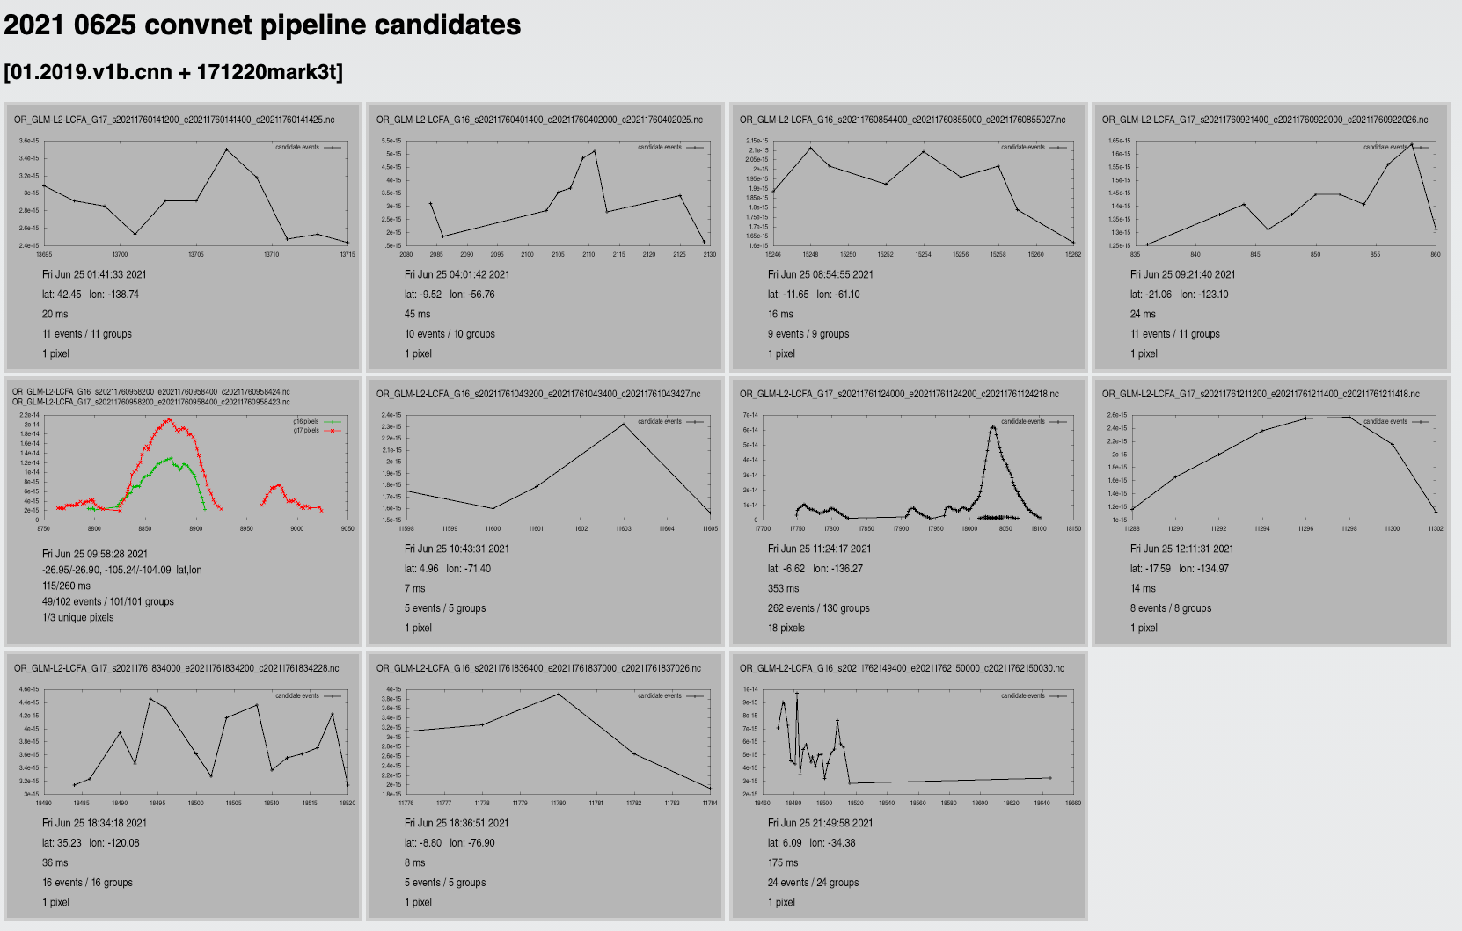
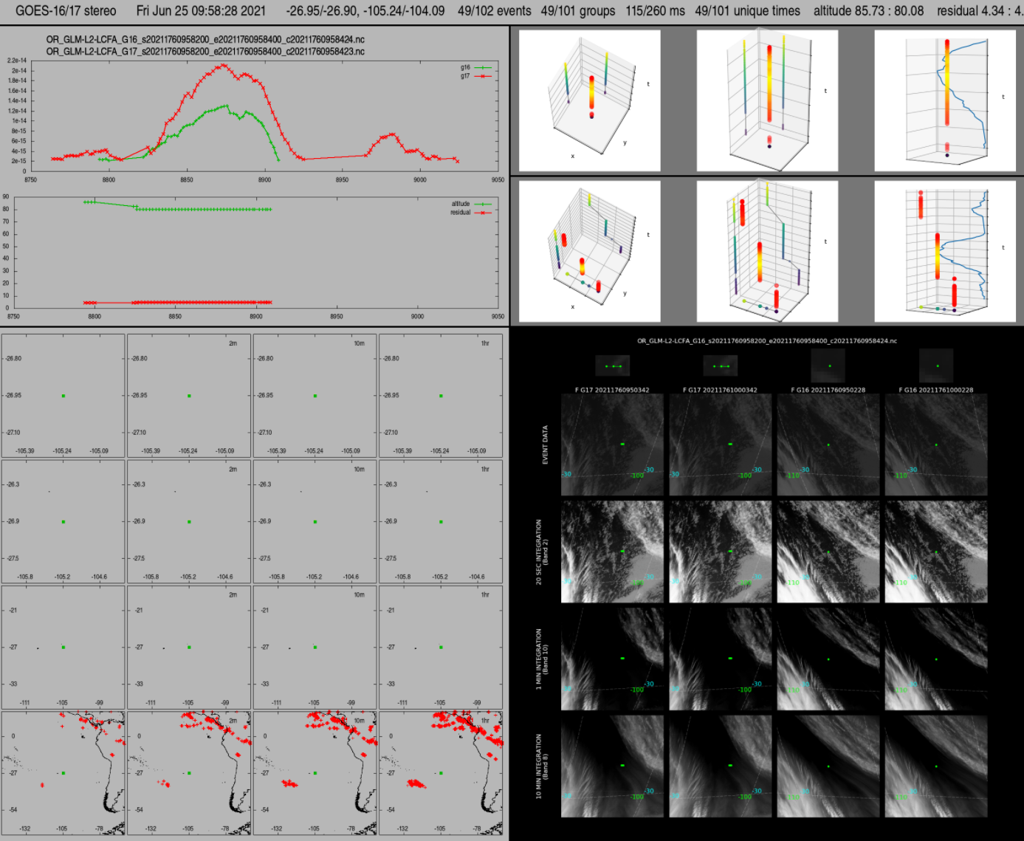
GLM Detection of Surface Reflections from Bolides
Evidence of ground reflections have been observed in bolide detections for some time but not interpreted correctly until recently
Now utilizing GLM L2 event data in the vetting process
NASA Ames does daily processing of GLM L2 group data using machine learning algorithms to find bolide candidates
In a parallel effort NASA Ames has developed bolide vetting tools that consist of static images of GLM L2 group data, GLM L2 event data, and ABI
Notes:
Add launch date – Nov 23?
Add to yellow box “collaborate with the lightning science community”
then delete Slide 2 and begin with Slide 3

Slide 3
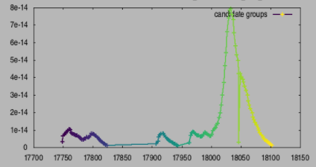
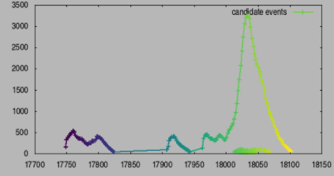
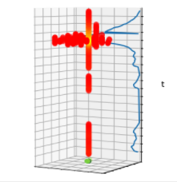
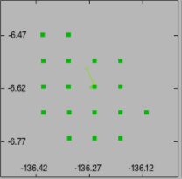
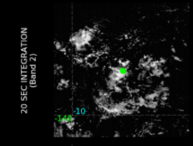
GLM Detection of Surface Reflections from Bolides
On June 25th, 2021 at 11:24:17 a GLM-17 detection occurred at 6.6N, 136.3W
Very close to GLM-17 nadir location
Local night time – dark earth
The bolide disintegration is isolated to a single pixel
At peak brightness an additional 17 pixels are illuminated by light reflecting off of a mixture of ocean and clouds (mostly clouds)
In order to trigger so many pixels the peak brightness had to occur at very high altitude
Group Light Curve
Event Light Curves
Volume plot showing ground track and light curve
Pixel Map
ABI band 2 and GLM
Notes:
Add launch date – Nov 23?
Add to yellow box “collaborate with the lightning science community”
then delete Slide 2 and begin with Slide 3

Slide 4
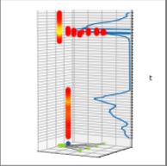
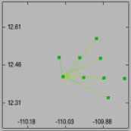
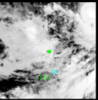
GLM Detection of Surface Reflections from Bolides
On June 26th, 2021 at 02:22:14 both GLM-16 and GLM-17 detected a bolide at 12.5N, 110.1W
Very close to the center of the stereo region
Local night time – dark earth
The bolide disintegration propagates across two pixels
At peak brightness an additional 8 pixels are illuminated by light reflecting off of a cloud top
Re-navigation of the bolide track picks up the ground reflection but there are L2 group centroiding artifacts that cause the convergence residuals to increase
reflection altitude ~10km
Group Light Curve
Pixel Map
ABI band 2 and GLM
Volume plot showing ground track and light curve
Altitude profile with convergence residual

