Slide 1
Lightning Data Assimilation Overview
Amanda Back
Alex Fierro
Scott Rudlosky
GLM Science Meeting
22 September 2021
Notes:
title?
names/affiliations (credit GLM DA working group?)

Slide 2
Background
Why assimilate lightning data?
Locate convective cores and provide information about storm evolution/intensity
Benefits of GLM: Imagery-like output enhances info about spatial structure; satellite data covers hard-to-reach places
Notes:
Please make any changes to the background section. Text on slide is just some notes for ideas
Images are a case my summer intern, Ashley Sebok, selected. Left is MRMS composite reflectivity (dBZ) and right is GOES-16 flash extent density (flashes per minute, averaged over 5 minutes); the grey stuff indicates areas where WSR-88D either doesn’t reach, or has lowest scan angle too high to be reliable indicator of column max reflectivity. Note the log scale on the GLM plot makes its structure appear more similar to CREF that is plotted with a linear scale. Ashley wondered about some areas with no lightning but nonzero CREF (Along the coast and other spots), so we also plotted Vaisala cloud-to-ground stroke and flash density at this time (not pictured) and found it agrees closely with GLM--GLM didn’t miss areas of CG lightning activity for these 5 minutes.
“Continuous lightning observations are one way to provide extra information about the growth, location, life cycle, and ice microphysics of convection in a variety of regimes.” - Papadopoulos et al., 2005

Slide 3
Background
Need to specify a relationship between lightning observations and model variables (assume thunderstorm electrification is not prognostic in the model)
Indirect methods first map lightning detections to another observation type before assimilating
Direct methods convert model variables to predicted lightning detections
For convection-allowing models, relationship usually involves hydrometeors and other variables
For convection-parameterizing models, relationship may include lower level convergence, moisture, temperature tendency
In variational/hybrid/ensemble frameworks, assimilation projects onto additional variables through covariances
Notes:
Please suggest changes on this slide and next--maybe too much material, some can be introduced in the examples that follow

Slide 4
Background
Earlier lightning assimilation studies targeted lightning detections from ground-based sensors, often only cloud-to-ground
GLM total lightning imagery is a growing area of research focus
Experience with data from ground-based networks led GLM centroid densities to be assimilated first, quickly followed by studies exploring additional GLM information that is unavailable from large-scale ground-based lightning detection networks (e.g., Flash Extent Density)
Lightning DA impacts the first few hours of forecasts, most relevant to nowcasting and short-range forecasting. Impacts may be assessed on any model output; the most frequently assessed forecasts are for rainfall rate, accumulated precip, radar reflectivity, and lightning itself

Slide 5
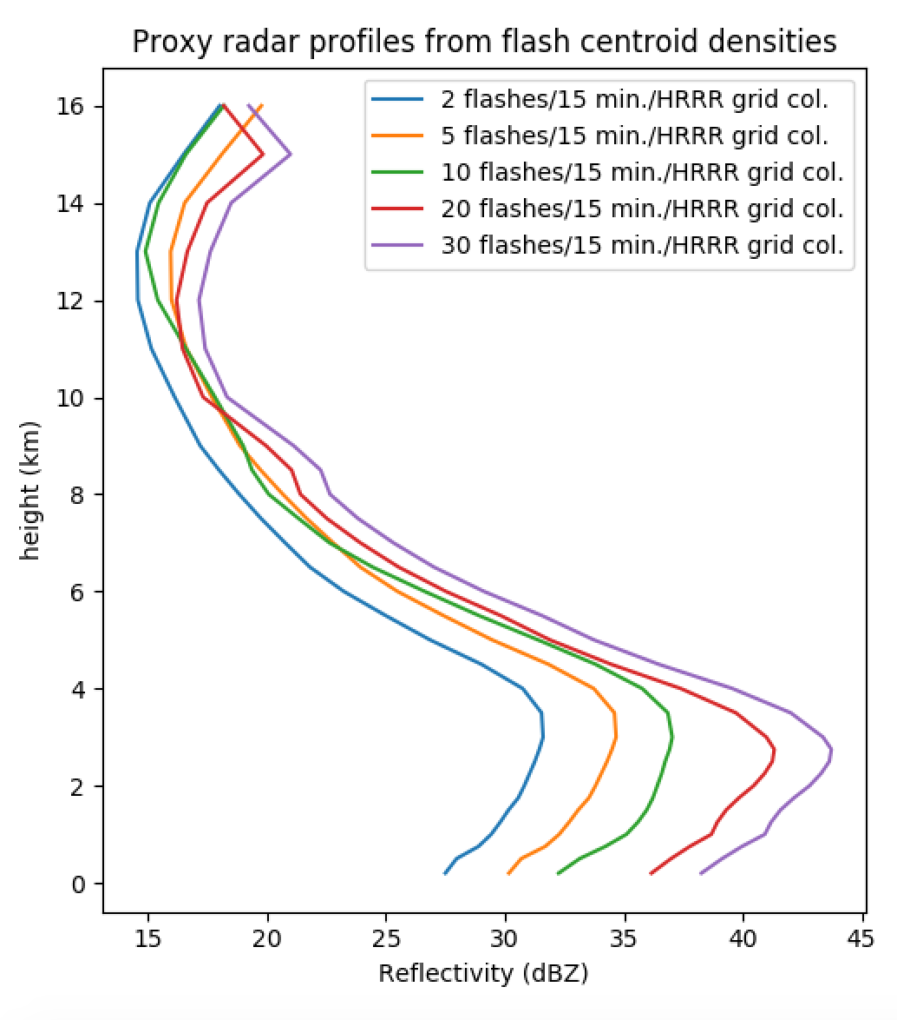
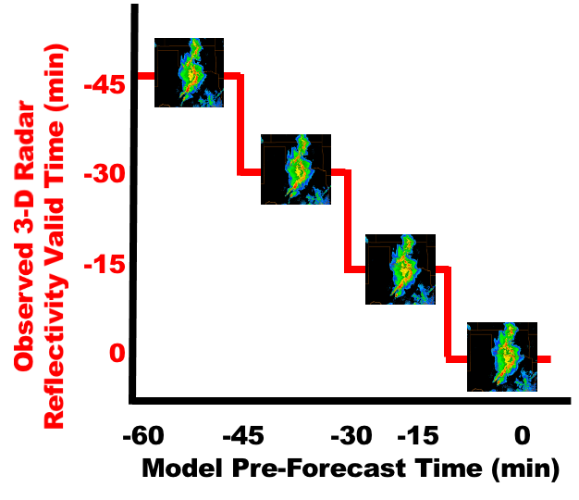
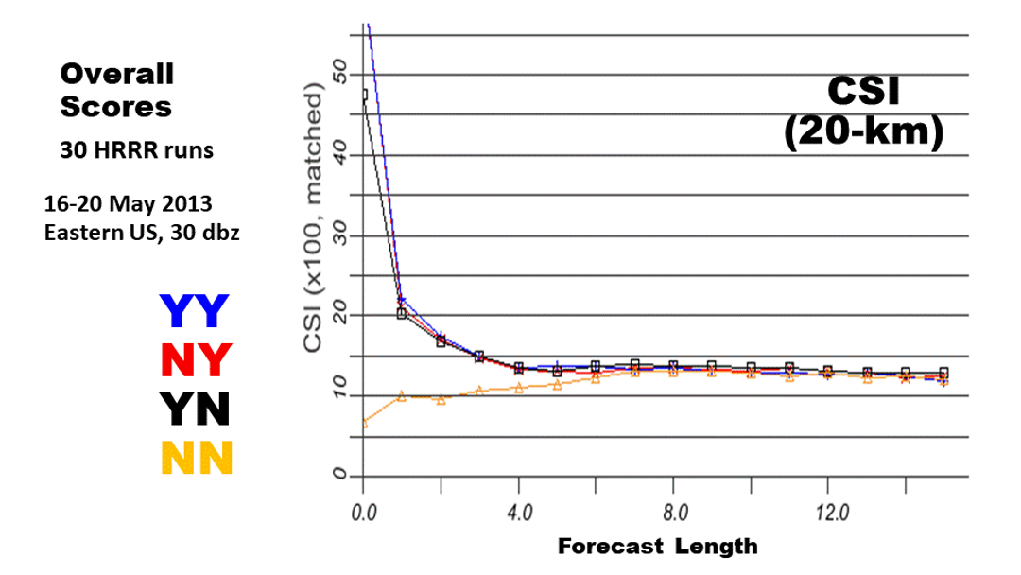
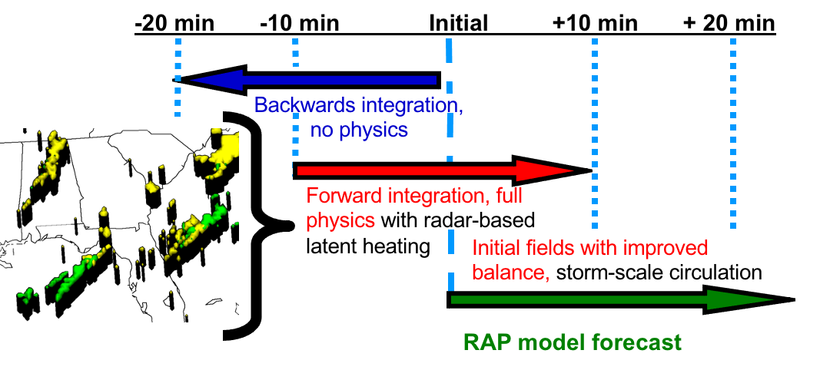
Indirect assimilation in Rapid Refresh
RAP (13 km North America domain) and HRRR (3 km CONUS, Alaska)
CG flash centroid densities converted to radar reflectivity profiles
Together specify temperature tendency profile applied at model initialization
radar-LH-DFI
forward- radar-LH
Weygandt et al., 2022: "Radar Reflectivity-based Model Initialization using Specified Latent Heating (Radar-LHI) within a Diabatic Digital Filter or Pre-forecast Integration." Submitted.
Notes:
Pertinent ground to cover for rapid refresh:
RAP/HRRR domains
lightning flash centroid density converted to radar
radar converted to tten profile goes in two ways
impacts of overall tten adjustment (radar, CG lightning)
HRRRv1-3 vs HRRRv4 initialization from RAP/from HRRR-DAS cycled with ensemble radar assim. but not lightning
GLM experiments

Slide 6
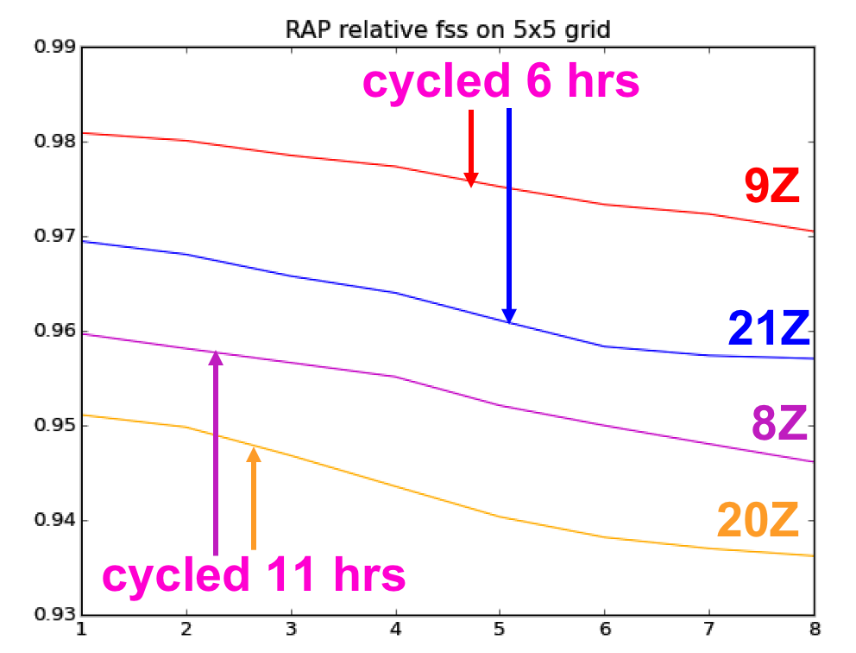
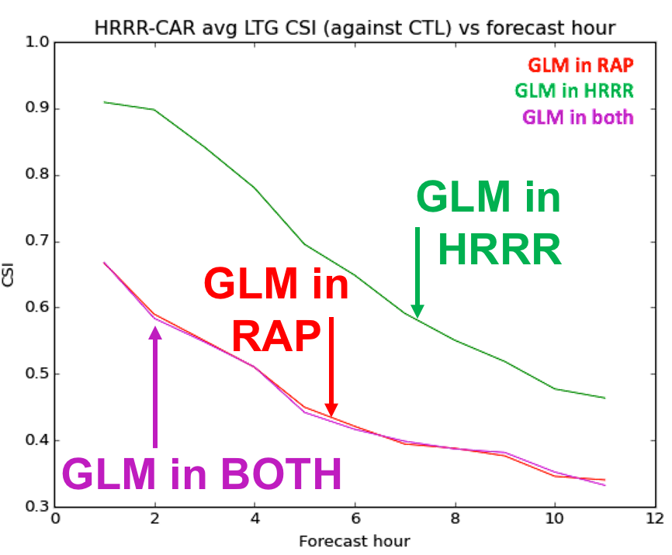
Indirect assimilation in Rapid Refresh - including GLM
RAP forecasts of Cloud Physics Thunder Parameter (Bright et al. 2005)
HRRR forecasts of Lightning Threat index (McCaul et al. 2009)
RAP cycling length enhances impact
greatest HRRR impacts from RAP-GLM initialization
17 hrs
Forecast Hour
11 runs averaged per curve
12 runs (0/12 Z inits) avged per curve
Full results of summer 2020 RAP and HRRR-Caribbean initializations with and without GLM: Back et al., 2021: “Toward a continental-scale convection-allowing UFS model initialized with GOES-R lightning data.” Ninth AMS Symposium on the Joint Center for Satellite Data Assimilation, 15 Jan. 2021. Recording available.
Notes:
Reflectivity and CG lightning from ground-based detecting networks assimilated in all configurations
Left plot measures difference in McCaul lightning threat index forecast as a function of forecast hour for configs with/without GLM launched at different hours. 8/9Z and 20/21Z had similar convective environments, while 9/21Z RAP runs cycle for 17 hours; 8/20 only for 6 -> longer cycling leads to larger GLM impacts
Right plot: Caribbean: assimilated NLDN; MRMS only available in a corner of the domain. Again comparing McCaul diagnostic per forecast hour, difference from control with no GLM assimilated--assimilation in RAP results in more impact. Conjecture that this is due to cycling conflicts with study on prev slide with radar; another possibility is RAP grid coarseness leads to longer-lasting impact
Recent published studies with satellite lightning to radar proxy (see citations in GLM Valuation chapter): Chen et al. for FY-4A satellite; Vendrasco et al. using pseudo-GLM in Brazil

Slide 7
Evaluation of the impact of assimilating spaceborne (GLM) total lightning data and radar data on short-term forecasts of convective events in the 3DVAR framework
Alexandre O. Fierro
Collaborators: Junjun Hu, Yunheng Wang, Jidong Gao, Ted Mansell, Israel Jirak, Adam Clark, Ming Hu, Eric James, Don MacGorman
Notes:
Please make any changes to the background section. Text on slide is just some notes for ideas
Images are a case my summer intern, Ashley Sebok, selected. Left is MRMS composite reflectivity (dBZ) and right is GOES-16 flash extent density (flashes per minute, averaged over 5 minutes); the grey stuff indicates areas where WSR-88D either doesn’t reach, or has lowest scan angle too high to be reliable indicator of column max reflectivity. Note the log scale on the GLM plot makes its structure appear more similar to CREF that is plotted with a linear scale. Ashley wondered about some areas with no lightning but nonzero CREF (Along the coast and other spots), so we also plotted Vaisala cloud-to-ground stroke and flash density at this time (not pictured) and found it agrees closely with GLM--GLM didn’t miss areas of CG lightning activity for these 5 minutes.
“Continuous lightning observations are one way to provide extra information about the growth, location, life cycle, and ice microphysics of convection in a variety of regimes.” - Papadopoulos et al., 2005

Slide 8
Four main methods of lightning data assimilation were investigated by CIMMS-NSSL thus far:
1. Using lightning to force convection initiation by nudging qv where lightning is observed but convection is absent in the model. Forcing is maintained for 10s of minutes to achieve a model response to sustain storms.
2. Variational (3DVAR) assimilation with high frequency (<= 15 min) successive cycling also using Qv as pseudo observations (proxy) for lightning. [used real-time SFE during HWT]
3. Ensemble Kalman Filter to modulate convection (e.g., strengthen or weaken) in the ensemble members. Ensemble covariances provide adjustments to all state variables (e.g., temperature, water vapor, winds, liquid water and ice particles). Data introduced on 1-5 minutes intervals.
4. Hybrids: EnKF-VAR or ensemble of 3DEnVARs with high frequency (<= 15 min) successive cycling.
Notes:
Please make any changes to the background section. Text on slide is just some notes for ideas
Images are a case my summer intern, Ashley Sebok, selected. Left is MRMS composite reflectivity (dBZ) and right is GOES-16 flash extent density (flashes per minute, averaged over 5 minutes); the grey stuff indicates areas where WSR-88D either doesn’t reach, or has lowest scan angle too high to be reliable indicator of column max reflectivity. Note the log scale on the GLM plot makes its structure appear more similar to CREF that is plotted with a linear scale. Ashley wondered about some areas with no lightning but nonzero CREF (Along the coast and other spots), so we also plotted Vaisala cloud-to-ground stroke and flash density at this time (not pictured) and found it agrees closely with GLM--GLM didn’t miss areas of CG lightning activity for these 5 minutes.
“Continuous lightning observations are one way to provide extra information about the growth, location, life cycle, and ice microphysics of convection in a variety of regimes.” - Papadopoulos et al., 2005

Slide 9
Types of lightning data assimilated:
(1) Ground based networks divided in 3 categories
VLF (global/intl: WWLLN, GLD360, ZEUS). 3–30 kHz
Broadband (intl: ENTLN). 1 Hz–12 MHz
VHF (regional: LMA). 30–300 MHz
(2) Spaceborne optical instruments
Low Earth Orbit (TRMM-LIS)
Near Polar Orbit (OTD-Microlab-1)
Geostationary (GOES-R GLM / FenYun4 LMI/ MTG)
Each of these technologies sees or detects different physical aspects of lightning flashes (photon emission versus dE/dt pulses or sferics), which must be accounted for during DA exercises.
Notes:
Please make any changes to the background section. Text on slide is just some notes for ideas
Images are a case my summer intern, Ashley Sebok, selected. Left is MRMS composite reflectivity (dBZ) and right is GOES-16 flash extent density (flashes per minute, averaged over 5 minutes); the grey stuff indicates areas where WSR-88D either doesn’t reach, or has lowest scan angle too high to be reliable indicator of column max reflectivity. Note the log scale on the GLM plot makes its structure appear more similar to CREF that is plotted with a linear scale. Ashley wondered about some areas with no lightning but nonzero CREF (Along the coast and other spots), so we also plotted Vaisala cloud-to-ground stroke and flash density at this time (not pictured) and found it agrees closely with GLM--GLM didn’t miss areas of CG lightning activity for these 5 minutes.
“Continuous lightning observations are one way to provide extra information about the growth, location, life cycle, and ice microphysics of convection in a variety of regimes.” - Papadopoulos et al., 2005

Slide 10
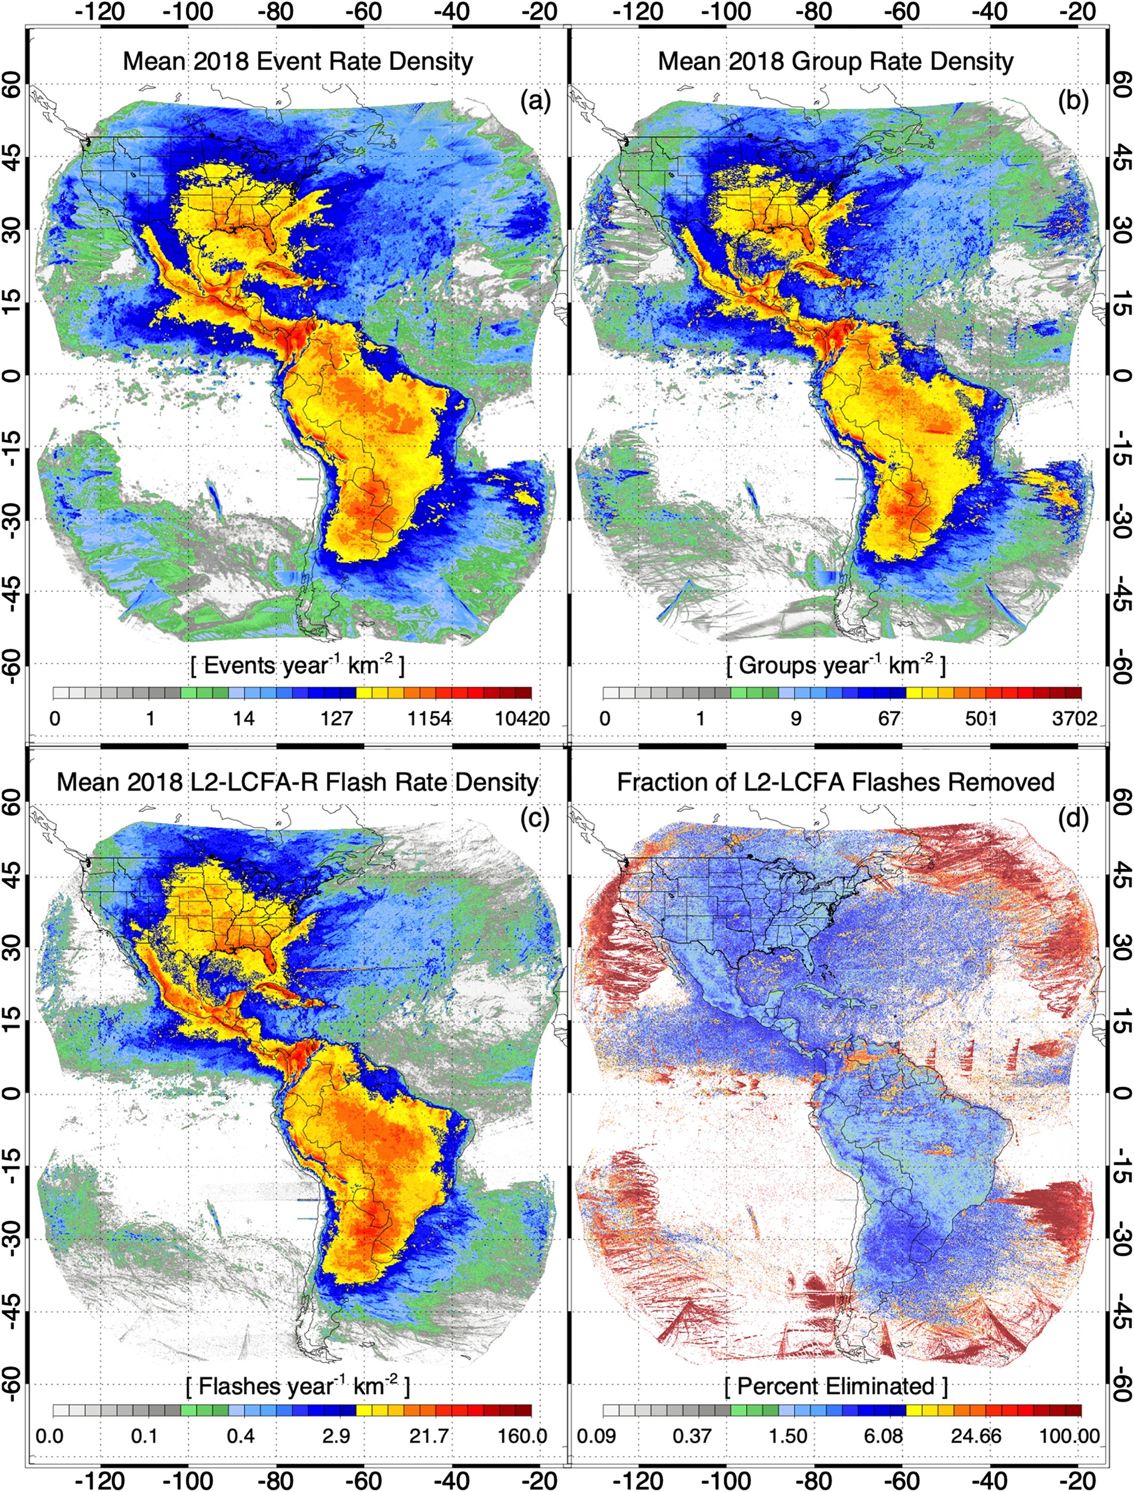
Spaceborne optical instruments: GLM
2018 GLM Data:
Characteristics
Staring CCD imager (optical)
(1372x1300 pixels)
Near uniform spatial resolution
8 km nadir, 12 km edge fov
Coverage up to 52 deg lat
70-90% flash detection day and night
2 ms frame rate
< 20 sec product latency
Different instruments observe same phenomenon differently --> challenge for DA applications!
Petersen, (2019), JGR
Notes:
Please make any changes to the background section. Text on slide is just some notes for ideas
Images are a case my summer intern, Ashley Sebok, selected. Left is MRMS composite reflectivity (dBZ) and right is GOES-16 flash extent density (flashes per minute, averaged over 5 minutes); the grey stuff indicates areas where WSR-88D either doesn’t reach, or has lowest scan angle too high to be reliable indicator of column max reflectivity. Note the log scale on the GLM plot makes its structure appear more similar to CREF that is plotted with a linear scale. Ashley wondered about some areas with no lightning but nonzero CREF (Along the coast and other spots), so we also plotted Vaisala cloud-to-ground stroke and flash density at this time (not pictured) and found it agrees closely with GLM--GLM didn’t miss areas of CG lightning activity for these 5 minutes.
“Continuous lightning observations are one way to provide extra information about the growth, location, life cycle, and ice microphysics of convection in a variety of regimes.” - Papadopoulos et al., 2005

Slide 11
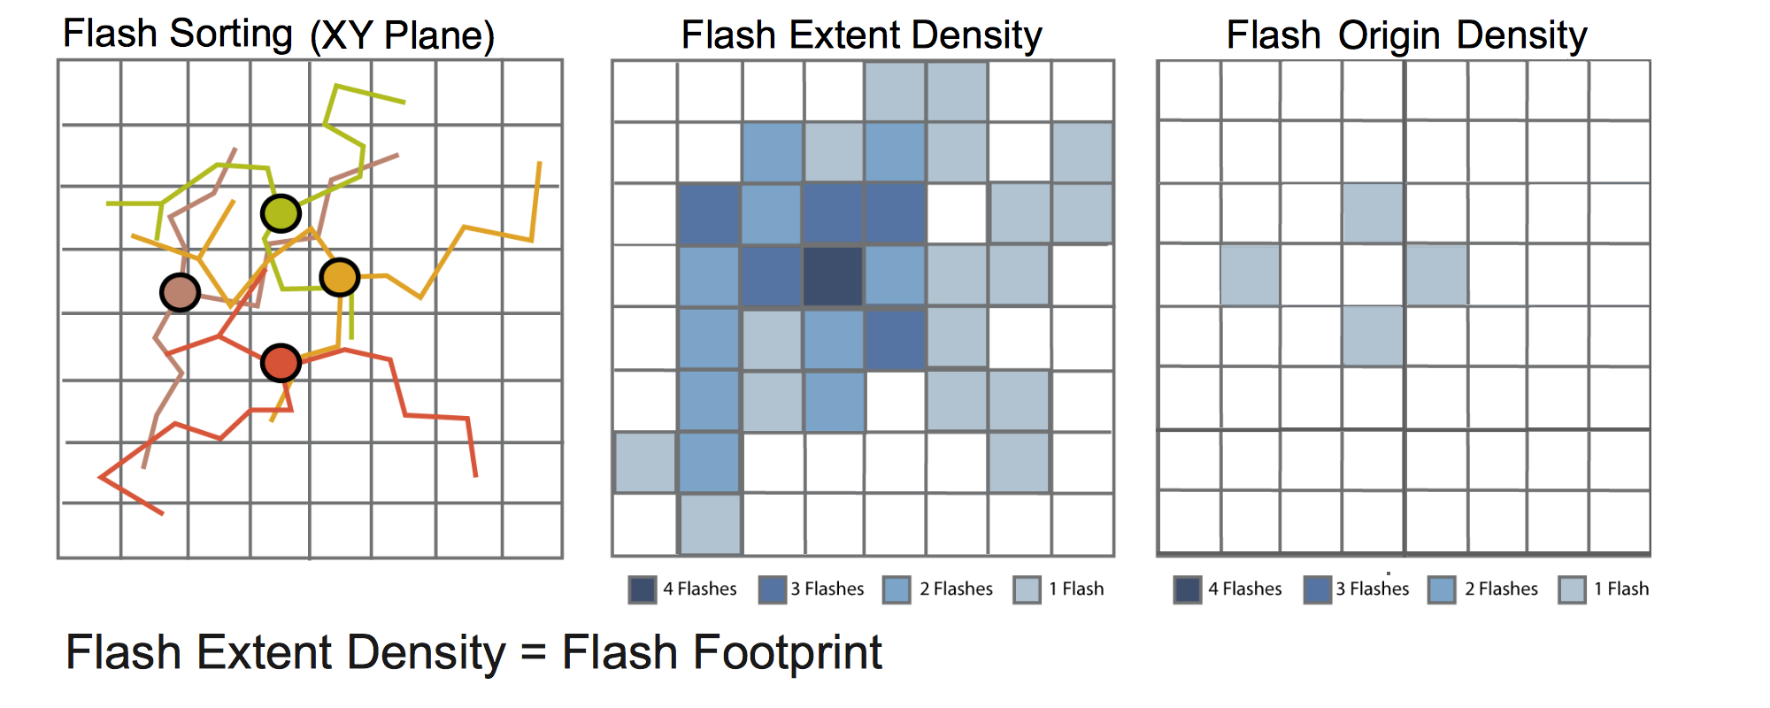
Flash metrics options for DA:
3D channel volume
Notes:
Please make any changes to the background section. Text on slide is just some notes for ideas
Images are a case my summer intern, Ashley Sebok, selected. Left is MRMS composite reflectivity (dBZ) and right is GOES-16 flash extent density (flashes per minute, averaged over 5 minutes); the grey stuff indicates areas where WSR-88D either doesn’t reach, or has lowest scan angle too high to be reliable indicator of column max reflectivity. Note the log scale on the GLM plot makes its structure appear more similar to CREF that is plotted with a linear scale. Ashley wondered about some areas with no lightning but nonzero CREF (Along the coast and other spots), so we also plotted Vaisala cloud-to-ground stroke and flash density at this time (not pictured) and found it agrees closely with GLM--GLM didn’t miss areas of CG lightning activity for these 5 minutes.
“Continuous lightning observations are one way to provide extra information about the growth, location, life cycle, and ice microphysics of convection in a variety of regimes.” - Papadopoulos et al., 2005

Slide 12
Lightning DA: create pseudo-observations
- Lightning not explicitly predicted in typical operational NWP -> Find a proxy for lightning
- Lightning → presence of moist mixed phase convection → saturated (buoyant) ascent (wrt to water)
- Boost water vapor mass Qv within a fixed layer above cloud base (LCL) towards Qsat_water. Concomitantly, increasing Qv at constant T boosts thermal buoyancy (via θv) and, ultimately, promotes updraft development
- CAPE within 2-3 km layer above LCL most efficiently converted into KE + updrafts will be more systematically rooted in BL
- Only applied whenever simulated RH= Qv / Qsat_water < fixed thresholds: i.e., if the model already is in the right direction don’t adjust Qv
- Project L2 GLM “flash” centroids onto CAM (dx= 3-km) grid
- Account for ~9x9 km2 pixel resolution of the GLM by spreading footprint on 3-km grid as shown here →
- Create 3D pseudo Qv observations that are minimized in cost function
Notes:
Please make any changes to the background section. Text on slide is just some notes for ideas
Images are a case my summer intern, Ashley Sebok, selected. Left is MRMS composite reflectivity (dBZ) and right is GOES-16 flash extent density (flashes per minute, averaged over 5 minutes); the grey stuff indicates areas where WSR-88D either doesn’t reach, or has lowest scan angle too high to be reliable indicator of column max reflectivity. Note the log scale on the GLM plot makes its structure appear more similar to CREF that is plotted with a linear scale. Ashley wondered about some areas with no lightning but nonzero CREF (Along the coast and other spots), so we also plotted Vaisala cloud-to-ground stroke and flash density at this time (not pictured) and found it agrees closely with GLM--GLM didn’t miss areas of CG lightning activity for these 5 minutes.
“Continuous lightning observations are one way to provide extra information about the growth, location, life cycle, and ice microphysics of convection in a variety of regimes.” - Papadopoulos et al., 2005

Slide 13
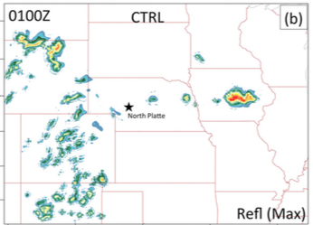
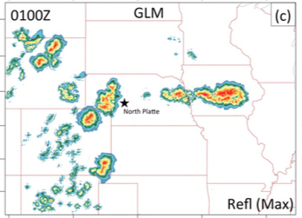
Lightning DA used in real time during the SFE in a nutshell:
Similar idea to nudging: Boosts thermal buoyancy via Qv adjustments toward water saturation (RH=95%) between LCL and LCL+3km.
No DA
1-h forecast
GLM DA
+
forecast
Background Qv
Adjusted Qv
3DVAR analysis
Fierro et al. (2019, MWR)
Notes:
Please make any changes to the background section. Text on slide is just some notes for ideas
Images are a case my summer intern, Ashley Sebok, selected. Left is MRMS composite reflectivity (dBZ) and right is GOES-16 flash extent density (flashes per minute, averaged over 5 minutes); the grey stuff indicates areas where WSR-88D either doesn’t reach, or has lowest scan angle too high to be reliable indicator of column max reflectivity. Note the log scale on the GLM plot makes its structure appear more similar to CREF that is plotted with a linear scale. Ashley wondered about some areas with no lightning but nonzero CREF (Along the coast and other spots), so we also plotted Vaisala cloud-to-ground stroke and flash density at this time (not pictured) and found it agrees closely with GLM--GLM didn’t miss areas of CG lightning activity for these 5 minutes.
“Continuous lightning observations are one way to provide extra information about the growth, location, life cycle, and ice microphysics of convection in a variety of regimes.” - Papadopoulos et al., 2005

Slide 14
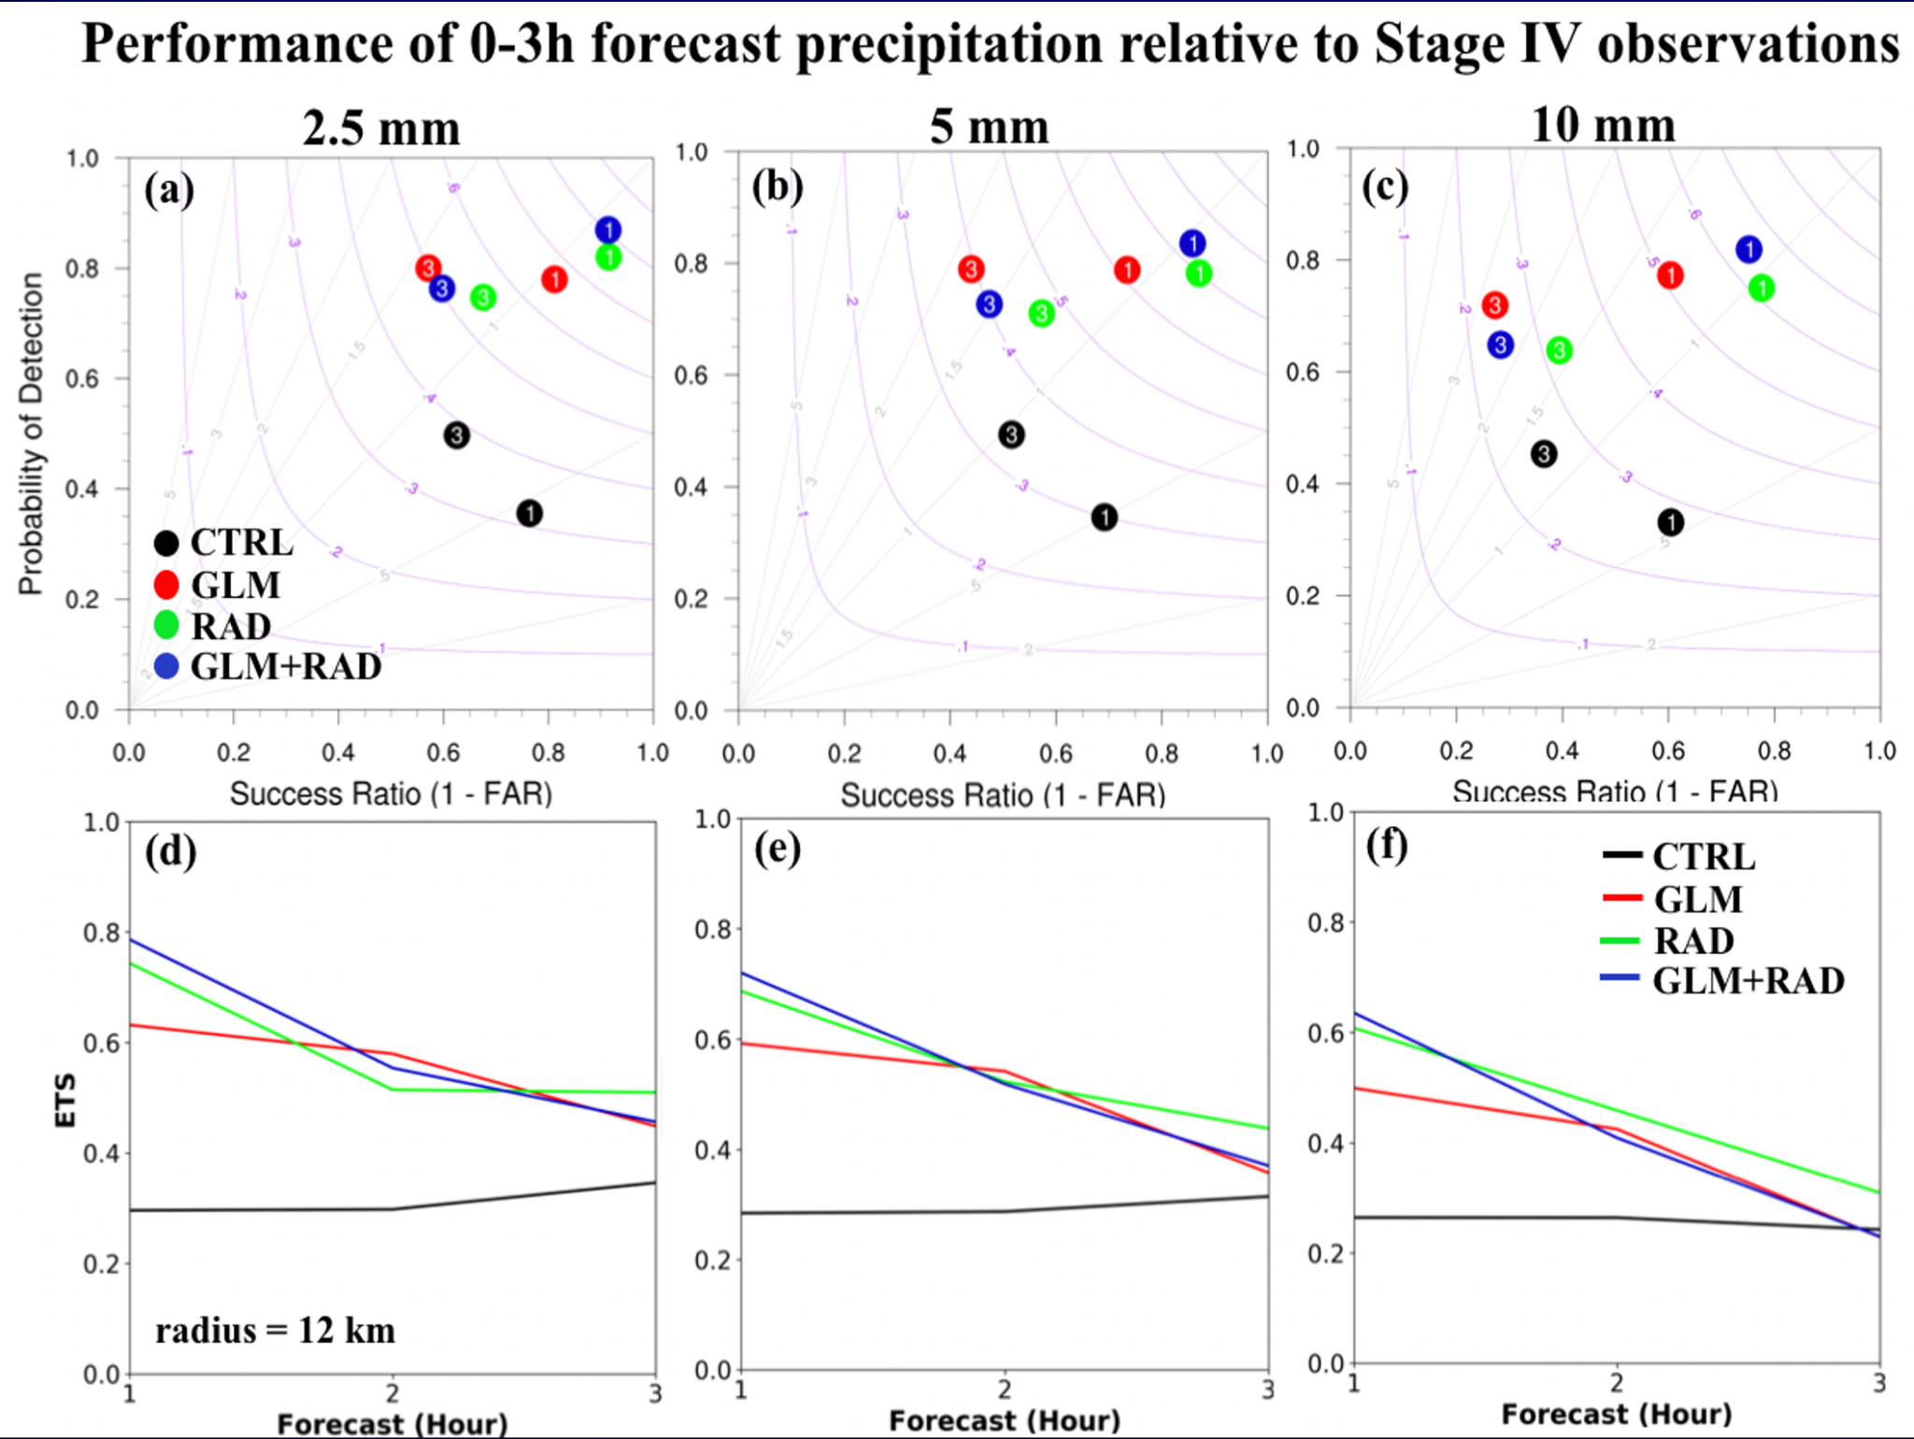
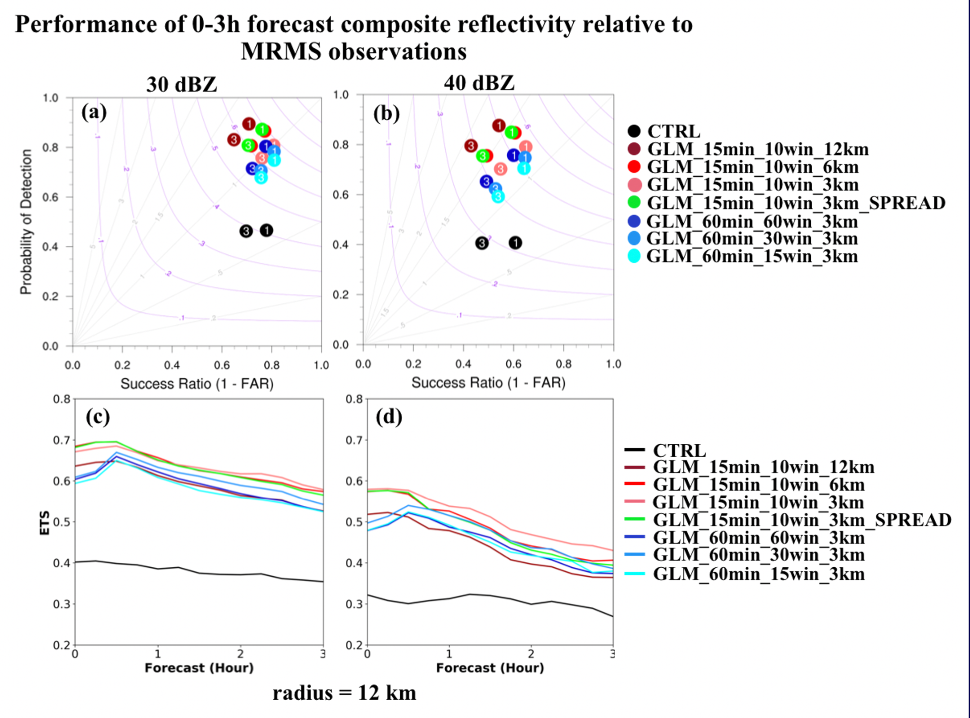
Testing more cases with 3DVAR cycling:
1st step: Optimize the 3DVAR LDA for convective scales: 3DVAR sensitivity tests on decorrelation length scale and GLM lightning frequency
- Seeking an “optimal” configuration of GLM DA:
- Aggregate performance (precip):
- Best results: L2=3km, DA cycle freq=15 min and Δt=10 min (Same for CREF)
-Test optimal GLM DA settings against/with DA of level II radar. Aggregate performance over all 45 forecasts (precip):
-1 and 3-h forecasts of rainfall notably improved by radar and/or GLM DA without increasing frequency bias significantly (<2)
Experiment | DA cycle freq (min) | GLM rates Δt (min) | Horizontal decorrelation length (km)
GLM_15min_10win_12km | 15 | 10 | 12
GLM_15min_10win_6km | 15 | 10 | 6
GLM_15min_10win_3km | 15 | 10 | 3
GLM_15min_10win_3km_Spread | 15 | 10 | 3
GLM_60min_60win_3km | 60 | 60 | 3
GLM_60min_30win_3km | 60 | 30 | 3
GLM_60min_15win_3km | 60 | 15 | 3
Notes:
Please make any changes to the background section. Text on slide is just some notes for ideas
Images are a case my summer intern, Ashley Sebok, selected. Left is MRMS composite reflectivity (dBZ) and right is GOES-16 flash extent density (flashes per minute, averaged over 5 minutes); the grey stuff indicates areas where WSR-88D either doesn’t reach, or has lowest scan angle too high to be reliable indicator of column max reflectivity. Note the log scale on the GLM plot makes its structure appear more similar to CREF that is plotted with a linear scale. Ashley wondered about some areas with no lightning but nonzero CREF (Along the coast and other spots), so we also plotted Vaisala cloud-to-ground stroke and flash density at this time (not pictured) and found it agrees closely with GLM--GLM didn’t miss areas of CG lightning activity for these 5 minutes.
“Continuous lightning observations are one way to provide extra information about the growth, location, life cycle, and ice microphysics of convection in a variety of regimes.” - Papadopoulos et al., 2005

Slide 15
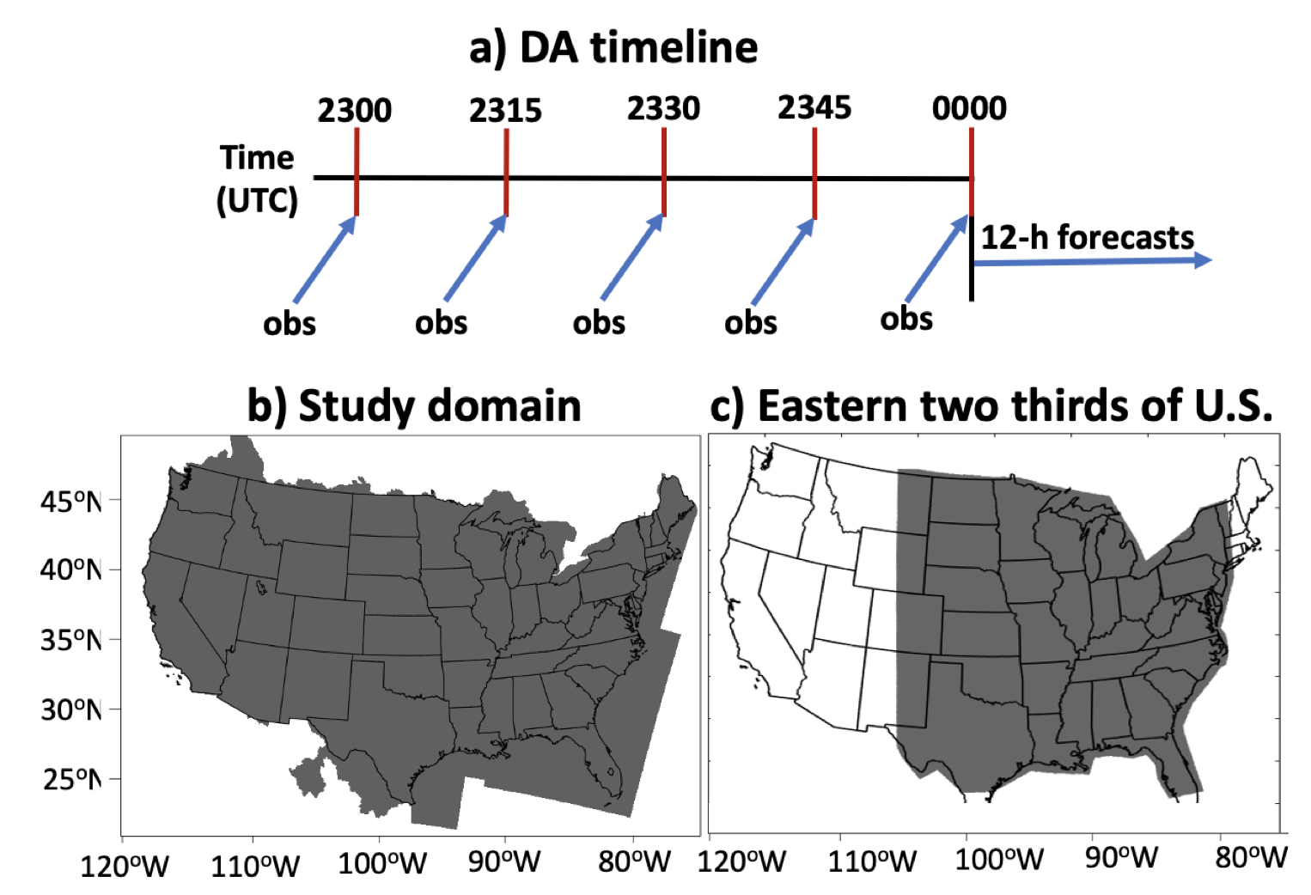
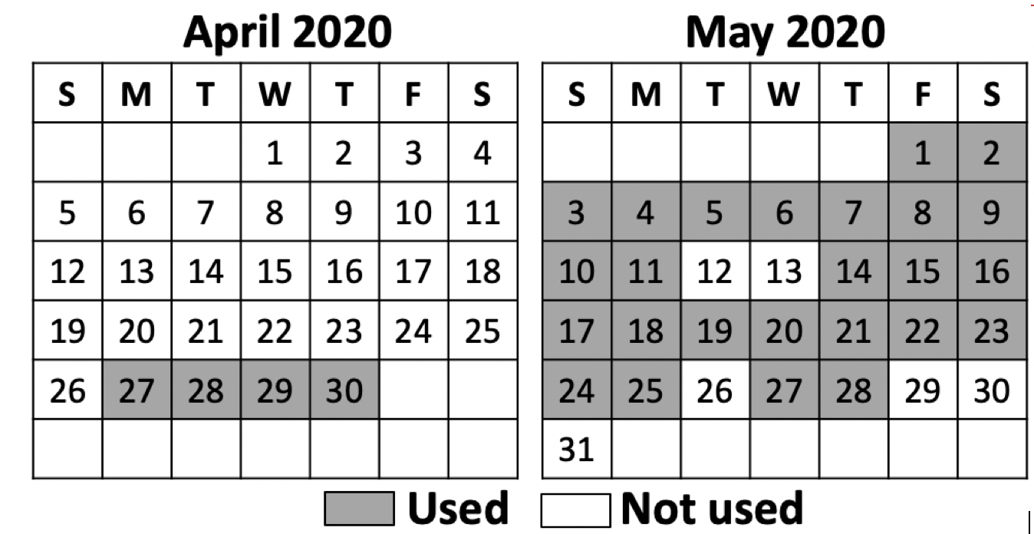
Real time DA during the SFE:
- Use CLUE domain (3-km, 4860 km x 3360 km) and HRRRv4 model with RAPv5 input data.
-DA performed daily between 23-00UTC.
- Use 15 min 3DVAR cycles with 10-min acc GLM data.
- At 00UTC, a 12 h deterministic fcst is launched.
- A sample of 29 fcst days was obtained.
- Analysis focus on precip; contrasts eastern 2/3 vs western 1/3 CONUS (good vs poor radar coverage areas).
Notes:
Please make any changes to the background section. Text on slide is just some notes for ideas
Images are a case my summer intern, Ashley Sebok, selected. Left is MRMS composite reflectivity (dBZ) and right is GOES-16 flash extent density (flashes per minute, averaged over 5 minutes); the grey stuff indicates areas where WSR-88D either doesn’t reach, or has lowest scan angle too high to be reliable indicator of column max reflectivity. Note the log scale on the GLM plot makes its structure appear more similar to CREF that is plotted with a linear scale. Ashley wondered about some areas with no lightning but nonzero CREF (Along the coast and other spots), so we also plotted Vaisala cloud-to-ground stroke and flash density at this time (not pictured) and found it agrees closely with GLM--GLM didn’t miss areas of CG lightning activity for these 5 minutes.
“Continuous lightning observations are one way to provide extra information about the growth, location, life cycle, and ice microphysics of convection in a variety of regimes.” - Papadopoulos et al., 2005

Slide 16
SFE Experiments
Experiments | Description | Data assimilated variationally | Model variables adjusted
CTRL | Control run | None | None
GLM | Lightning DA run. | GLM flash density rates. | q_{v} (LCL-3 km)
RAD | Radar DA run | Vr and dBZ | q_{r}, q_{g}, q_{s}, q_{h}, u, v, w, θ
RAD+GLM | Lightning + Radar DA run | GLM flash density rates, Vr and dBZ | q_{v} (LCL-3 km), q_{r}, q_{g}, q_{s}, q_{h}, u, v, w, θ
- Level II (Vr+ dBZ factor) data from 140+ radars were assimilated.
- SFE eval during HWT solely focused on RAD-based experiments over the western 1/3 CONUS to gauge added value of GLM in radar-data sparse areas.
- CTRL and GLM DA run performed and analyzed offline during SFE.
(Same nomenclature used in predecessor work presented here)
Notes:
Please make any changes to the background section. Text on slide is just some notes for ideas
Images are a case my summer intern, Ashley Sebok, selected. Left is MRMS composite reflectivity (dBZ) and right is GOES-16 flash extent density (flashes per minute, averaged over 5 minutes); the grey stuff indicates areas where WSR-88D either doesn’t reach, or has lowest scan angle too high to be reliable indicator of column max reflectivity. Note the log scale on the GLM plot makes its structure appear more similar to CREF that is plotted with a linear scale. Ashley wondered about some areas with no lightning but nonzero CREF (Along the coast and other spots), so we also plotted Vaisala cloud-to-ground stroke and flash density at this time (not pictured) and found it agrees closely with GLM--GLM didn’t miss areas of CG lightning activity for these 5 minutes.
“Continuous lightning observations are one way to provide extra information about the growth, location, life cycle, and ice microphysics of convection in a variety of regimes.” - Papadopoulos et al., 2005

Slide 17
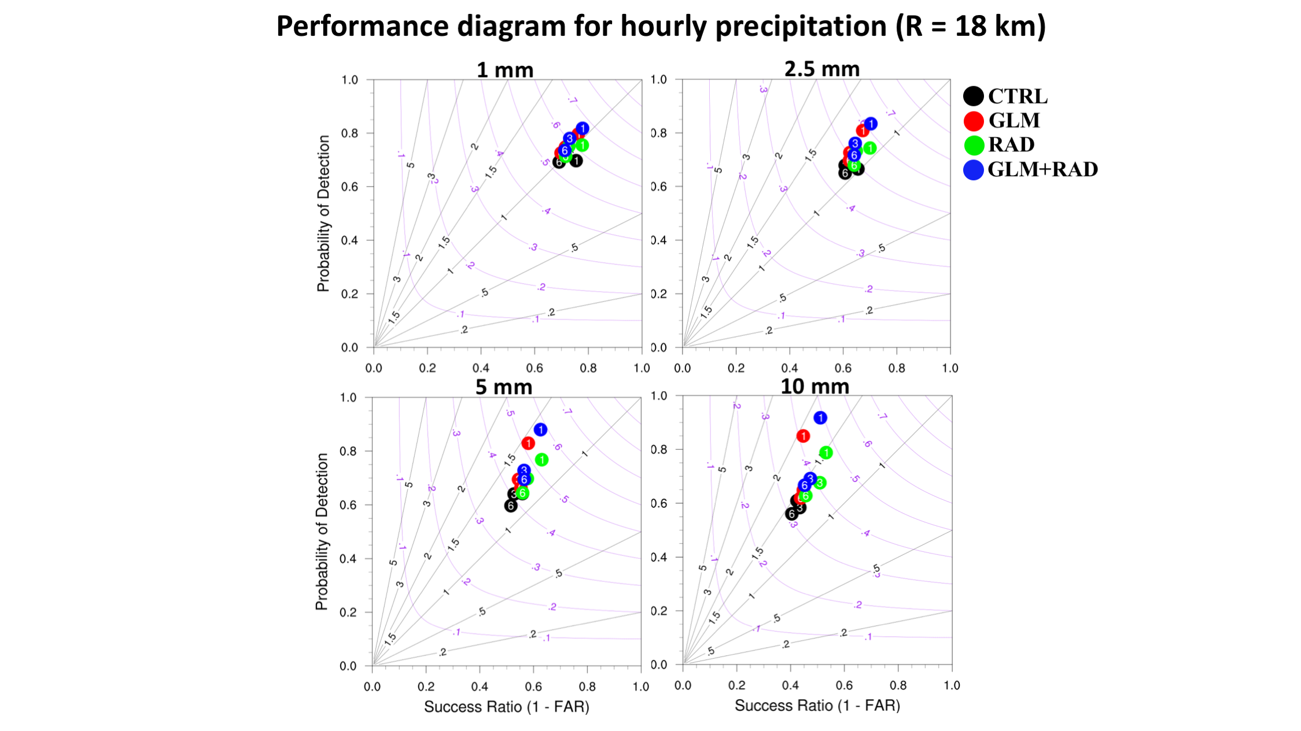
SFE/HWT real-time experiment over CLUE domain; preliminary results
- Performance diagrams aggregated over all 29 forecast days over CONUS for 1, 3 and 6-h forecast show a general improvement in forecast skill over CTRL for all DA runs; with the best results obtained for GLM+RAD.
- Individual cases reveal that assimilating GLM data showed benefit in radar-sparse areas such as the mountainous west, the Gulf of Mexico, East coast and the Sierra Madre in Mexico.
- Excellent performance of CTRL is explained by RAPv5 data already blending info from a large arrays of obs, including lightning and radar.
Notes:
Please make any changes to the background section. Text on slide is just some notes for ideas
Images are a case my summer intern, Ashley Sebok, selected. Left is MRMS composite reflectivity (dBZ) and right is GOES-16 flash extent density (flashes per minute, averaged over 5 minutes); the grey stuff indicates areas where WSR-88D either doesn’t reach, or has lowest scan angle too high to be reliable indicator of column max reflectivity. Note the log scale on the GLM plot makes its structure appear more similar to CREF that is plotted with a linear scale. Ashley wondered about some areas with no lightning but nonzero CREF (Along the coast and other spots), so we also plotted Vaisala cloud-to-ground stroke and flash density at this time (not pictured) and found it agrees closely with GLM--GLM didn’t miss areas of CG lightning activity for these 5 minutes.
“Continuous lightning observations are one way to provide extra information about the growth, location, life cycle, and ice microphysics of convection in a variety of regimes.” - Papadopoulos et al., 2005

Slide 18
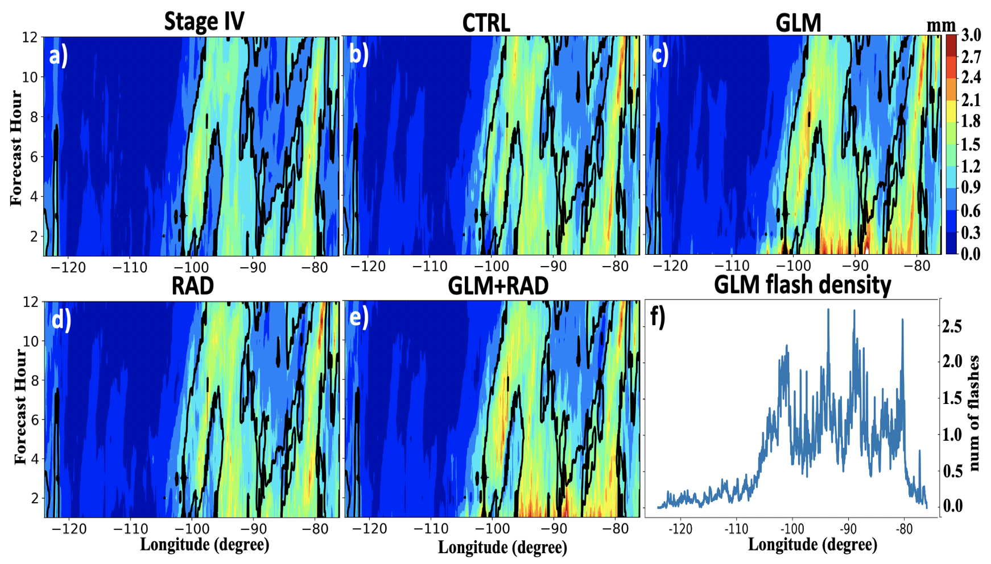
SFE/HWT real-time experiment
1. Using
0-6h rainfall aggregated over 29 fcst days
GLM DA adds in more precipitation during the first 2-3h of forecast, especially over the eastern 2/3rd of CONUS where bulk of lightning occurs.
Notes:
Please make any changes to the background section. Text on slide is just some notes for ideas
Images are a case my summer intern, Ashley Sebok, selected. Left is MRMS composite reflectivity (dBZ) and right is GOES-16 flash extent density (flashes per minute, averaged over 5 minutes); the grey stuff indicates areas where WSR-88D either doesn’t reach, or has lowest scan angle too high to be reliable indicator of column max reflectivity. Note the log scale on the GLM plot makes its structure appear more similar to CREF that is plotted with a linear scale. Ashley wondered about some areas with no lightning but nonzero CREF (Along the coast and other spots), so we also plotted Vaisala cloud-to-ground stroke and flash density at this time (not pictured) and found it agrees closely with GLM--GLM didn’t miss areas of CG lightning activity for these 5 minutes.
“Continuous lightning observations are one way to provide extra information about the growth, location, life cycle, and ice microphysics of convection in a variety of regimes.” - Papadopoulos et al., 2005

Slide 19
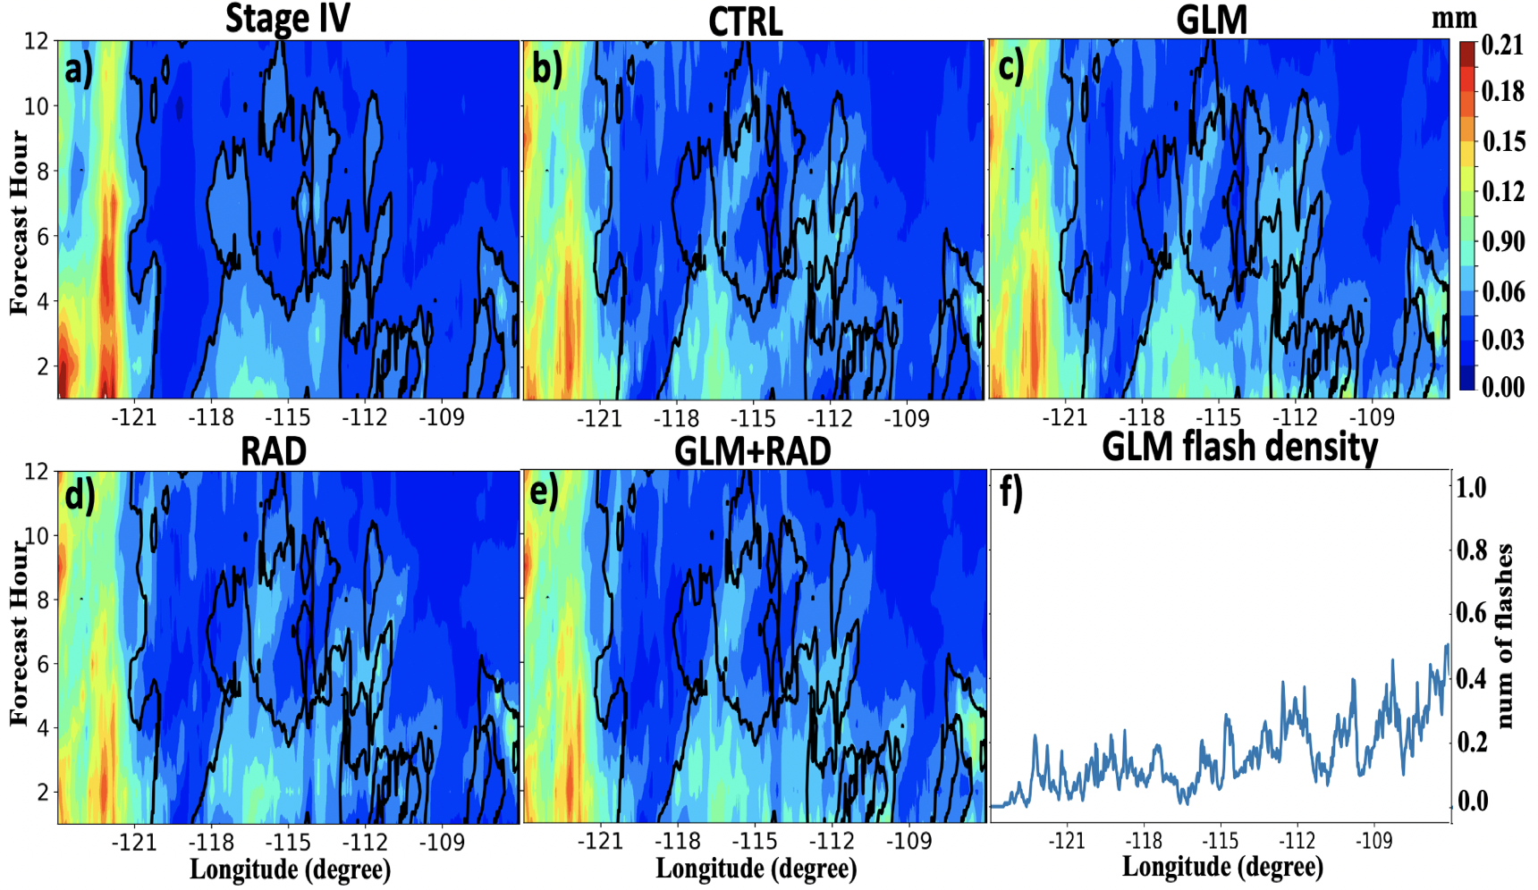
SFE/HWT real-time experiment;
Western US: Relatively less rainfall is added overall by RAD or GLM DA owing to the weaker convective nature of the storms over the western CONUS (e.g., monsoon storms).
Notes:
Please make any changes to the background section. Text on slide is just some notes for ideas
Images are a case my summer intern, Ashley Sebok, selected. Left is MRMS composite reflectivity (dBZ) and right is GOES-16 flash extent density (flashes per minute, averaged over 5 minutes); the grey stuff indicates areas where WSR-88D either doesn’t reach, or has lowest scan angle too high to be reliable indicator of column max reflectivity. Note the log scale on the GLM plot makes its structure appear more similar to CREF that is plotted with a linear scale. Ashley wondered about some areas with no lightning but nonzero CREF (Along the coast and other spots), so we also plotted Vaisala cloud-to-ground stroke and flash density at this time (not pictured) and found it agrees closely with GLM--GLM didn’t miss areas of CG lightning activity for these 5 minutes.
“Continuous lightning observations are one way to provide extra information about the growth, location, life cycle, and ice microphysics of convection in a variety of regimes.” - Papadopoulos et al., 2005

Slide 20
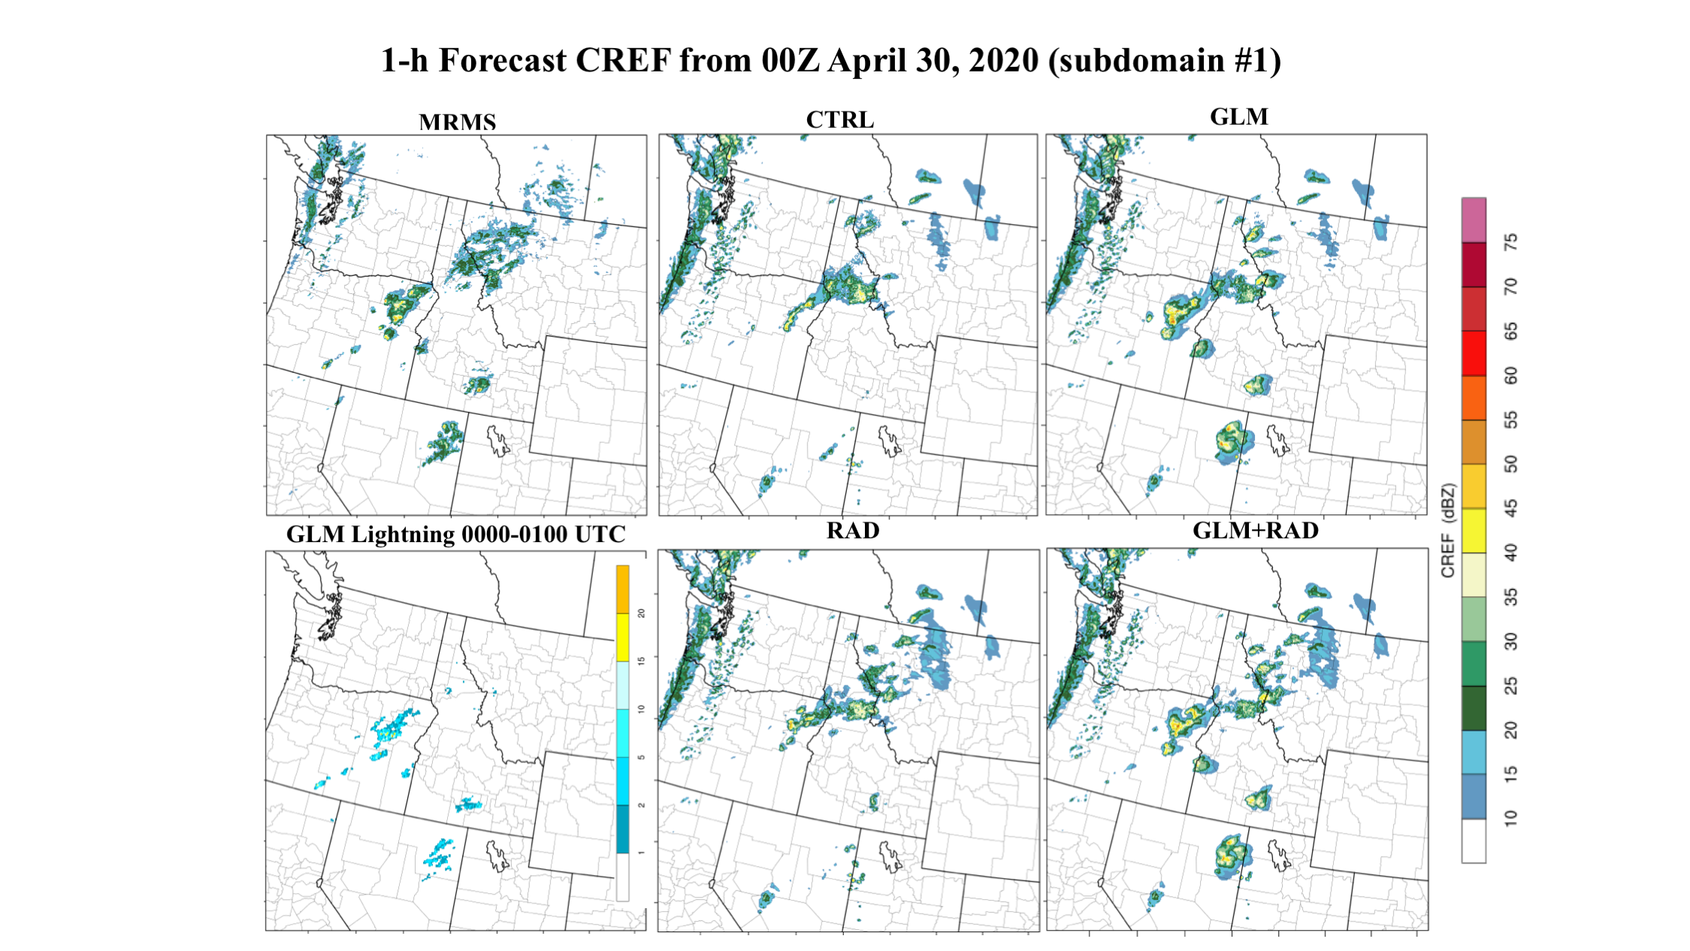
Western US: example of GLM DA improvements over areas characterized by poor radar coverage
Notes:
Please make any changes to the background section. Text on slide is just some notes for ideas
Images are a case my summer intern, Ashley Sebok, selected. Left is MRMS composite reflectivity (dBZ) and right is GOES-16 flash extent density (flashes per minute, averaged over 5 minutes); the grey stuff indicates areas where WSR-88D either doesn’t reach, or has lowest scan angle too high to be reliable indicator of column max reflectivity. Note the log scale on the GLM plot makes its structure appear more similar to CREF that is plotted with a linear scale. Ashley wondered about some areas with no lightning but nonzero CREF (Along the coast and other spots), so we also plotted Vaisala cloud-to-ground stroke and flash density at this time (not pictured) and found it agrees closely with GLM--GLM didn’t miss areas of CG lightning activity for these 5 minutes.
“Continuous lightning observations are one way to provide extra information about the growth, location, life cycle, and ice microphysics of convection in a variety of regimes.” - Papadopoulos et al., 2005

Slide 21
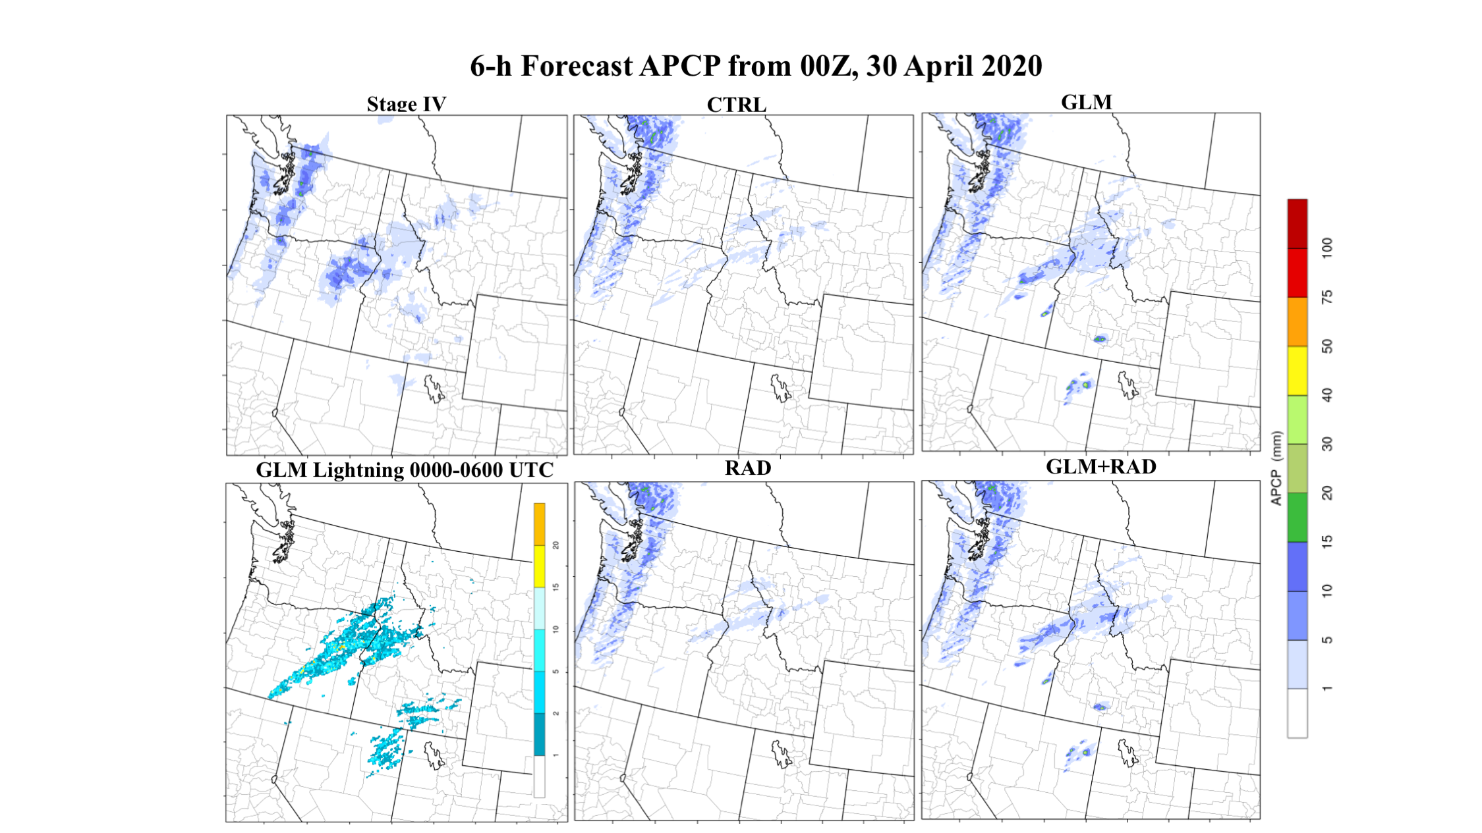
Western US: example of GLM DA improvements over areas characterized by poor radar coverage (rainfall)
Notes:
Please make any changes to the background section. Text on slide is just some notes for ideas
Images are a case my summer intern, Ashley Sebok, selected. Left is MRMS composite reflectivity (dBZ) and right is GOES-16 flash extent density (flashes per minute, averaged over 5 minutes); the grey stuff indicates areas where WSR-88D either doesn’t reach, or has lowest scan angle too high to be reliable indicator of column max reflectivity. Note the log scale on the GLM plot makes its structure appear more similar to CREF that is plotted with a linear scale. Ashley wondered about some areas with no lightning but nonzero CREF (Along the coast and other spots), so we also plotted Vaisala cloud-to-ground stroke and flash density at this time (not pictured) and found it agrees closely with GLM--GLM didn’t miss areas of CG lightning activity for these 5 minutes.
“Continuous lightning observations are one way to provide extra information about the growth, location, life cycle, and ice microphysics of convection in a variety of regimes.” - Papadopoulos et al., 2005

Slide 22
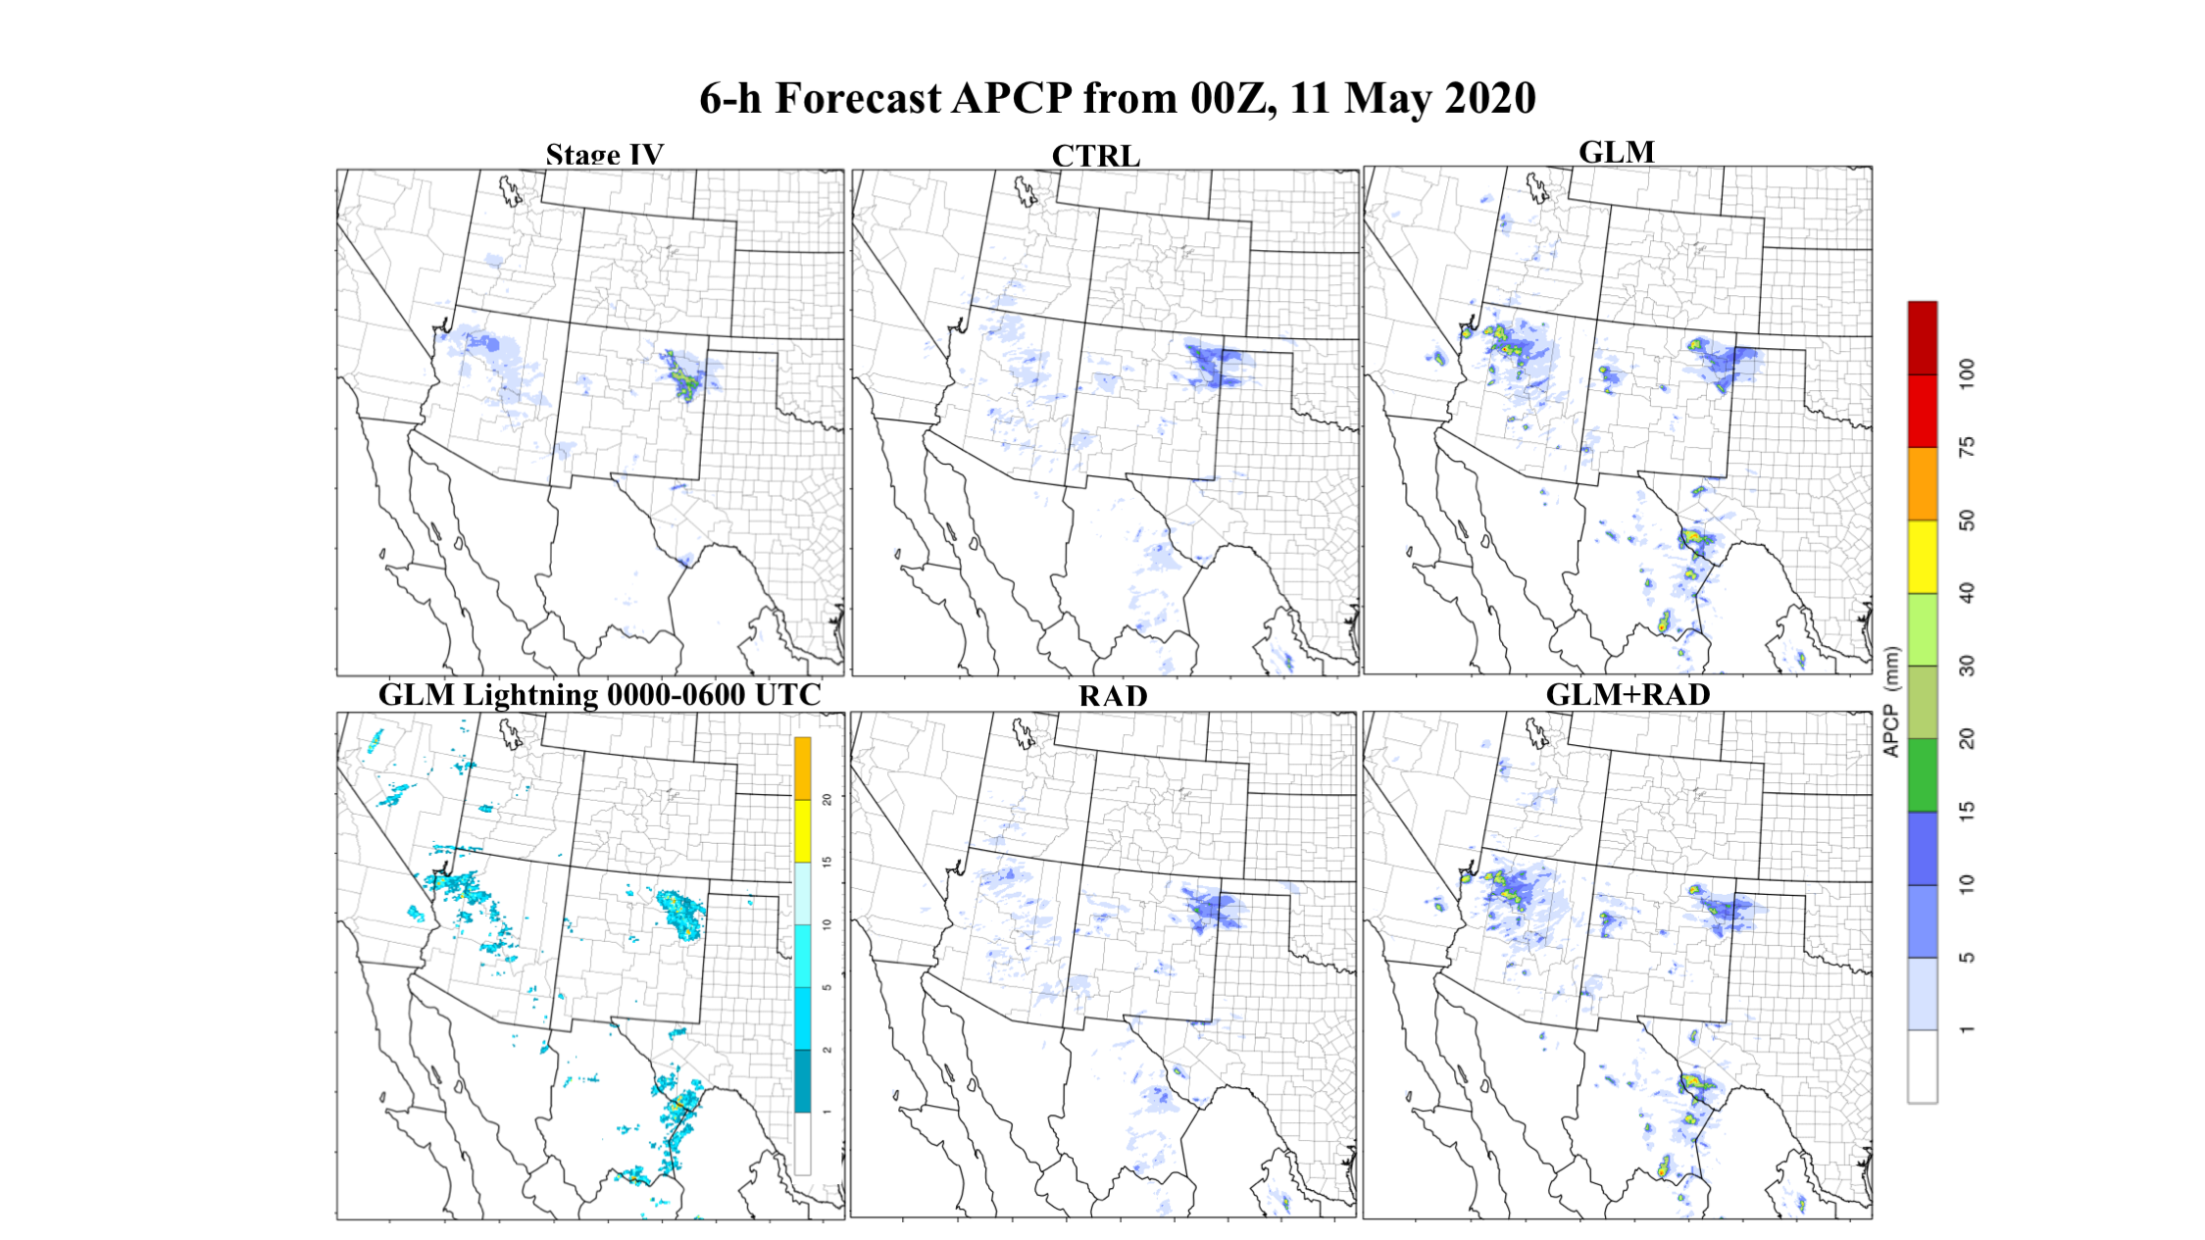
Western US: Other example of GLM DA improvements over areas characterized by poor radar coverage (rainfall)
Notes:
Please make any changes to the background section. Text on slide is just some notes for ideas
Images are a case my summer intern, Ashley Sebok, selected. Left is MRMS composite reflectivity (dBZ) and right is GOES-16 flash extent density (flashes per minute, averaged over 5 minutes); the grey stuff indicates areas where WSR-88D either doesn’t reach, or has lowest scan angle too high to be reliable indicator of column max reflectivity. Note the log scale on the GLM plot makes its structure appear more similar to CREF that is plotted with a linear scale. Ashley wondered about some areas with no lightning but nonzero CREF (Along the coast and other spots), so we also plotted Vaisala cloud-to-ground stroke and flash density at this time (not pictured) and found it agrees closely with GLM--GLM didn’t miss areas of CG lightning activity for these 5 minutes.
“Continuous lightning observations are one way to provide extra information about the growth, location, life cycle, and ice microphysics of convection in a variety of regimes.” - Papadopoulos et al., 2005

Slide 23
Apodaca and Zupanski: direct assimilation for convection-parameterizing and convection-allowing models
using pseudo-GLM from WWLLN, two lightning diagnostic relationships demonstrated:
McCaul et al., 2008:
“Forecasting Lightning Threat Using Cloud-Resolving Model Simulations”
flash rates <---> column-integrated ice &
vert. flux of precip ice at -15C)
u, v, T, hydrometeor mixing ratios included as control variables
Barthe et al., 2010:
“Estimation of total lightning from various storm parameters: A cloud-resolving model study”
flash rates <---> updrafts
(updrafts <--- u,v,q,T)
See JCSDA Quarterly, Winter 2018: “Variational and Hybrid (EnVar) Methodologies to Add the Capability to Assimilate GOES-16/GLM Observations into GDAS”
and Nonlinear Processes in Geophysics, 2014: “Development of a hybrid variational-ensemble data assimilation technique for observed lightning tested in a mesoscale model”
Notes:
Maybe see also Xiao et al 2021 (Accepted to MWR) using 4DVar and vertical updraft relationship with explicit updrafts, GLD360

Slide 24
Direct assimilation of Flash Extent Density for CAM
Studies described so far assimilate centroid densities
Continuous FED on CONUS- or hemispheric-scale is unique to GOES-R GLM
Mansell, 2014 “Storm-Scale Ensemble Kalman Filter Assimilation of Total Lightning Flash-Extent Data” pioneered GLM FED assimilation onto graupel volume in an OSSE
Allen et al., 2016 “Assimilation of Pseudo-GLM Data Using the Ensemble Kalman Filter” assimilated pseudo-GLM onto graupel volume and graupel mass
Recent work at OU builds on these ensemble techniques and adds hybrid capability (see upcoming talks)
Notes:
Brief overview of Mansell, Blake graupel relationship to FED that Xue/Kong build on

Slide 25
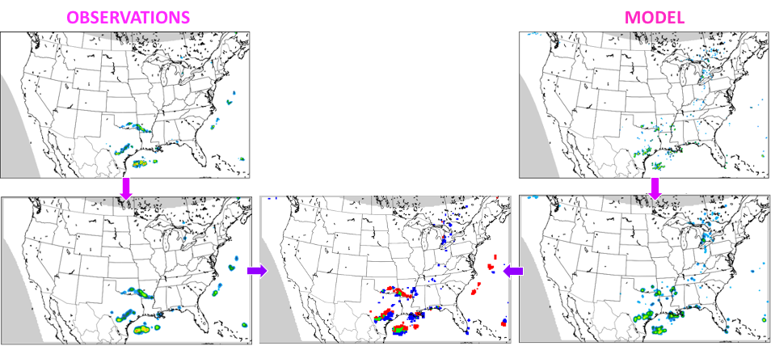
GLM used to verify model forecast skill
Quality convective observations are needed for both assimilation and model performance assessment
As CAM domains grow over data-deprived areas, the importance of satellite observations increases
FED-based contingency table verification in development at GSL
CREF SKILL FED SKILL
see Blaylock & Horel, 2020: “Comparison of Lightning Forecasts from the High-Resolution Rapid Refresh Model to Geostationary Lightning Mapper Observations” published in Weather Analysis and Forecasting, assessing HRRR Lightning Threat Index against GLM centroid densities
Sebok et al., 2022: “Formulation of a GOES-R Lightning nonlinear forward operator for ensemble assimilation and verification in the HRRR” poster presentation at AMS, demonstrating FED forecasts from HRRR-like experiments
Notes:
Optional - skip if short on time
Lightning is often used as truth data set for lightning assimilation studies
Has broad appeal for other types of experiments, replacing radar as truth outside NEXRAD
Blaylock & Horel assessed HRRR’s McCaul diagnostic against GLM centroids
GSL developing FED verification for Rapid Refresh using contingency tables
Left image shows process of grid coarsening followed by counting hits, misses and false alarms at some threshold
Right compares Critical Success Index of a set of experiments, using MRMS CREF as truth (left) and GOES-16 FED as truth (right). Top row is time series of 1-hour forecasts CSI using thresholds of 30 dBZ and 0.5 flash/min. Bottom row is averaged CSI as a function of threshold for 1-hour forecasts (these details are irrelevant, figures are included to show that FED can be used comparably to CREF for forecast verification)

Slide 26
Thanks!

