Slide 1
A Technique for Determining Three-Dimensional Storm Cloud Locations From Stereo GLM Look Vectors
Douglas Mach
Universities Space Research Association (USRA)
Science and Technology Institute (STI)
Huntsville, AL
Presented at
The GLM Science Meeting
September 21-23, 2021

Slide 2
Introduction: GLM Event/Group/Flash Geolocation
To determine GLM lightning locations, we require:
Look vector
Cloud top height
Cloud top height from model ellipsoid
6 km above sea-level at the pole
14 km above sea-level at the equator
Often not correct
Creates errors in lightning locations
Various efforts underway to increase cloud top estimation accuracy
Often using external (to GLM) data sources
Will describe an alternative method that only uses GLM data

Slide 3
Utilizing The Overlap Regions Between GLM16 & GLM17
GLM FOVs
GLM17 – cyan
GLM16 – magenta
Overlap region – blue
Significant fraction of the 2 GLM FOVs overlap
Provides an opportunity to use the stereo look vectors from the two GLMs to calculate the three-dimensional cloud top locations
Will describe the stereo GLM technique

Slide 4
Stereo GLM Technique
Use GLM groups
Procedure to determine “best location”
Initial group 3D locations determined by the two GLM sensors
X, Y provided by the L2 files
Z provided by the cloud top ellipsoid model
Determine a set of GLM16 and GLM17 group pairs from the two instruments
Using set Δt and Δx,y
For this analysis, used 3 ms and 20 km
Determine the initial two look vectors from the individual GLMs to the initial locations of the lightning groups

Slide 5
Stereo GLM Technique
Create a grid in the vicinity of the two nominal group locations
Used nested grid, coarse & fine to speed processing
Determine the look vectors from each GLM to all grid points in coarse grid
2 km horizontal, 1 km vertical
Find the 3D location in the grid that minimizes the sum of squares differences between the final look vectors and the initial nominal look vectors (black dot)
Create a fine grid around the minimum location in the coarse grid
200 m horizontal, 100 m vertical
Determine the look vectors from each GLM to all grid points in fine grid
Determine the 3D location of the group based on the minimum α_{t} & β_{t} in the fine grid (red dot)
Now on to the data…
Find α_{t}, β_{t} that minimizes
((α_{t}-α₀)² + (β_{t}-β₀)²)

Slide 6
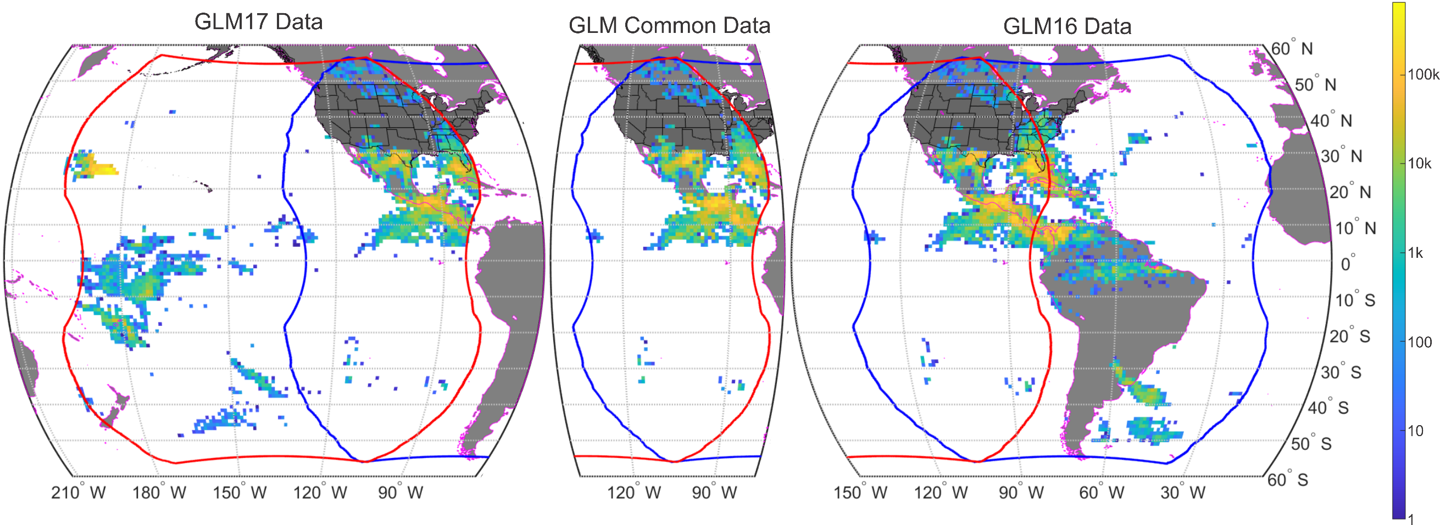
Example Dataset
10 June 2019
GLM16: 13.6 Mgroups in overlap region
GLM17: 13.3 Mgroups in overlap region
GLM16: 7.5 Mgroups common with GLM17 groups
GLM17: 6.1 Mgroups common with GLM16 groups
11.9 Mpairs

Slide 7
More Pairs of Groups Than Groups in Either Dataset?
A group from one GLM can pair with more than one group from the other GLM
Creates several possible pairs (and 3D locations)

Slide 8
Single Storm Results
Left panel: group centroid footprints of the storm from GLM17 (cyan), GLM16 (magenta), and overlaps (blue)
Center panel: gridded mean locations and altitudes
Right panel: ABI AWG Cloud Height Algorithm (ACHA) altitudes
5 km grid
Black ‘x’s are GLD360 strokes
Both altitude scales are to the far right

Slide 9
Overall Results
Plot of Altitude vs. Latitude
Magenta line is the model ellipsoid
Lowest angle error data (50%) shown in color
Outline is all results
Peak values compare well to ABI and cloud top ellipsoid model
Variation higher in SGLM results

Slide 10
Overall Results, Part 2
Sub-Group | Plot Color | Full Group Count | Subset Group Location |  | SGLM Derived Altitude |  |  | Mean Ellipsoid Model* Altitude (km) | ACHA Derived Cloud Top Altitude
 |  |  | Mean Latitude | Mean Longitude | Median (km) | Mean (km) | Std (km) |  | Mean (km) | Std (km)
CAN | red | 26k | 49.7° | -101.6° | 7.0 | 6.8 | 1.9 | 9.4 | 5.3 | 2.4
EUSA | black | 2,571k | 26.2° | -83.1° | 11.2 | 11.1 | 2.8 | 12.5 | 10.3 | 3.0
MEX | yellow | 2,823k | 28.7° | -101.8° | 14.0 | 13.6 | 3.0 | 12.2 | 13.9 | 3.3
CENAL | cyan | 5,566k | 15.1° | -91.4° | 13.4 | 12.9 | 3.2 | 13.4 | 13.5 | 3.0
CENAO | gold | 964k | 10.0° | -96.9° | 12.4 | 12.1 | 2.9 | 13.7 | 11.7 | 2.7
CPAC | maroon | 1.2k | 6.5° | -126.7° | 10.9 | 10.5 | 2.4 | 13.9 | 11.7 | 1.0
SWPAC | green | 8.4k | -29.5° | -114.7° | 9.6 | 9.5 | 1.8 | 12.1 | 10.1 | 0.6
SEPAC | blue | 6.5k | -34.3° | -85.3° | 5.2 | 5.1 | 1.7 | 11.5 | 6.0 | 2.8

Slide 11
Conclusions
Developed a technique to estimate the 3D location of lightning components based on the stereo view of common lightning elements from two different orbital instruments
Example results from common lightning Groups in the GLM16 and GLM17 datasets
The technique is not limited to GLM16 & GLM17
GLM16 & LI
GLM & ISS-LIS
ISS-LIS & LI
LI & LI
Technique can also be used to determine the altitudes of phenomena detected by GLM other than typical lightning
Gigantic jets, bolides, or other above cloud illuminations

Slide 12
Questions?

