Slide 1
RROE Lightning Collection Campaign
GLM Science Meeting, September 23rd, 2021
Randy Longenbaugh
Steve Goodman
Grant Soehnel

Slide 2
Rationale for RROE Lightning Collection Campaign
RROE’s main objective in this campaign is to gather terrestrial lightning data throughout the 9 month mission
What is it about the occurrence and properties of lightning that triggers USNDS sensors?
Frequency and distribution
Characteristics of lightning (flash type, polarity, energy, power, size and duration)
Use RROE as a collaboration opportunity to provide better clarity and understanding of the lightning background
Collaboration with the lightning science community offers a unique opportunity to help Sandia obtain a better understanding of background signals recorded by USNDS sensors
Unique opportunity with 3 GLMs on orbit (75.2W, 89.5W, 137.2W) and having an overlapping view of the same storms over CONUS. GOES-18 launch in January 2022?
The higher sub-millisecond temporal resolution (40 kHz) and the highly pixelated FPA of RROE will add new insight into the observed optical emissions as a function of time and space never before available
RROE data is the mechanism that allows SNL to collaborate with the lightning science community (13 government, university, commercial partners)

Slide 3
RROE Collection Campaign Correlative Reference Data Sets
Reference data sets will be collected using well-calibrated instruments and networks to validate post-launch instrument performance and more fully characterize the lightning properties
This collection campaign will focus on geographic regions known to have high-resolution ground-based lightning supersites and reference data sets for energetic lightning storms that will trigger RROE
The following instruments and ground networks are being targeted for this lightning campaign
SENSER
RROE
RFS
GLM 16, 17, and 18
ISS
LIS
Atmosphere‑Space Interactions Monitor (ASIM)
NASA, NOAA, and university high resolution (LMA VHF) and RF (Duke, GaTech) lightning detection networks
Commercial national-global RF lightning networks
ENGLN
NLDN
GLD360
Space-based and ground-based measurements are complementary
Can be integrated into a more complete picture of the lightning properties and characteristics observed from space

Slide 4
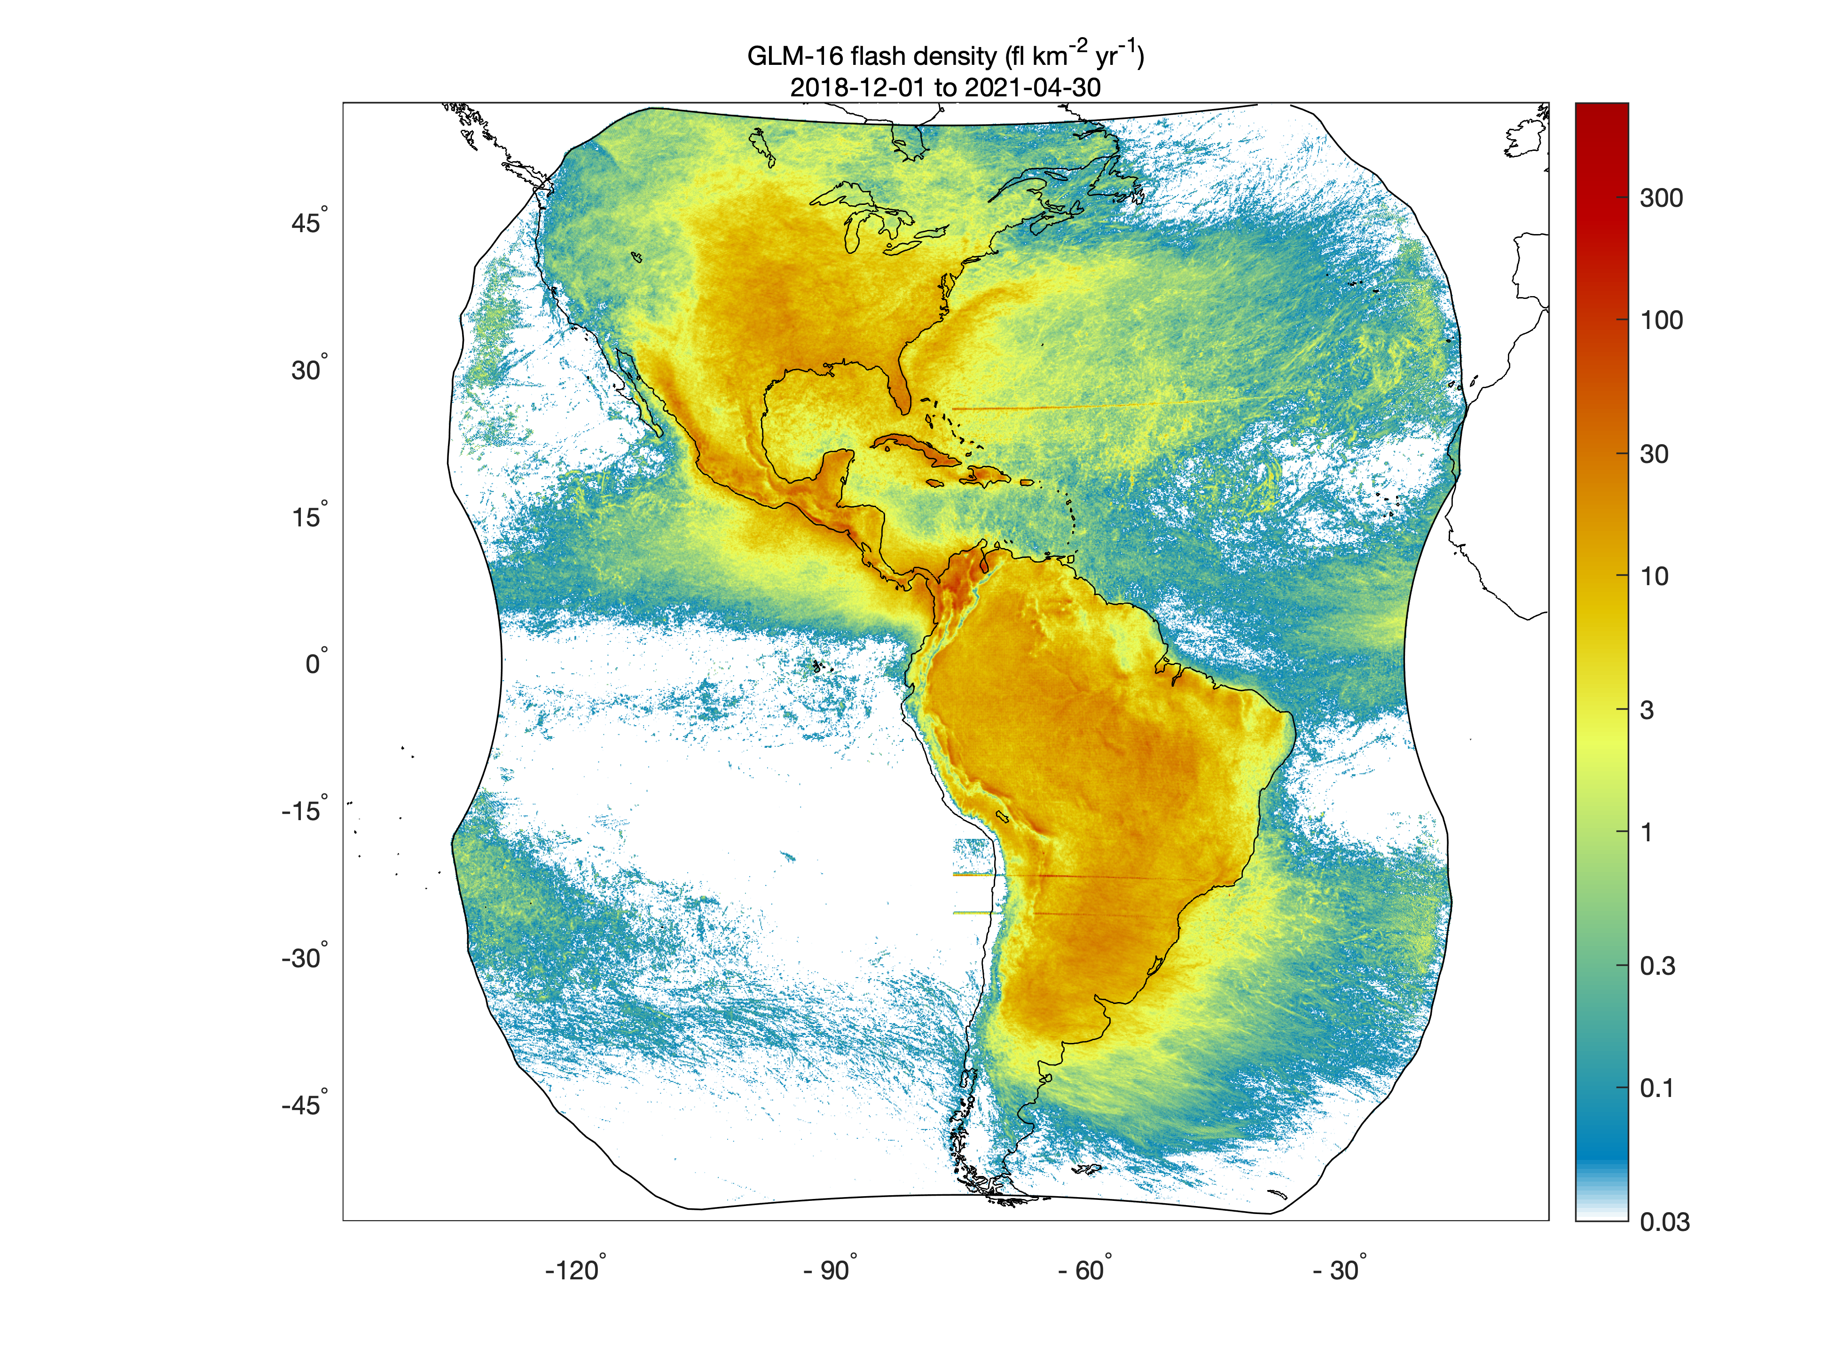
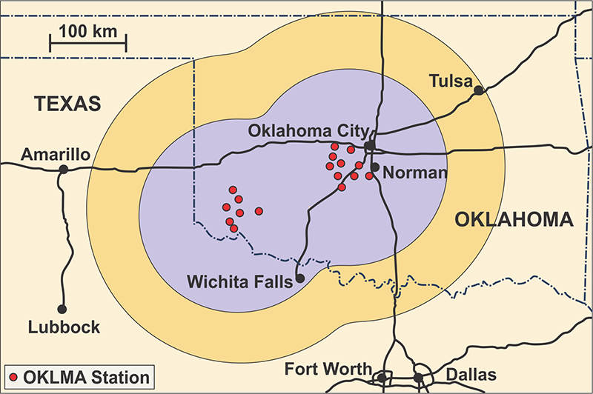
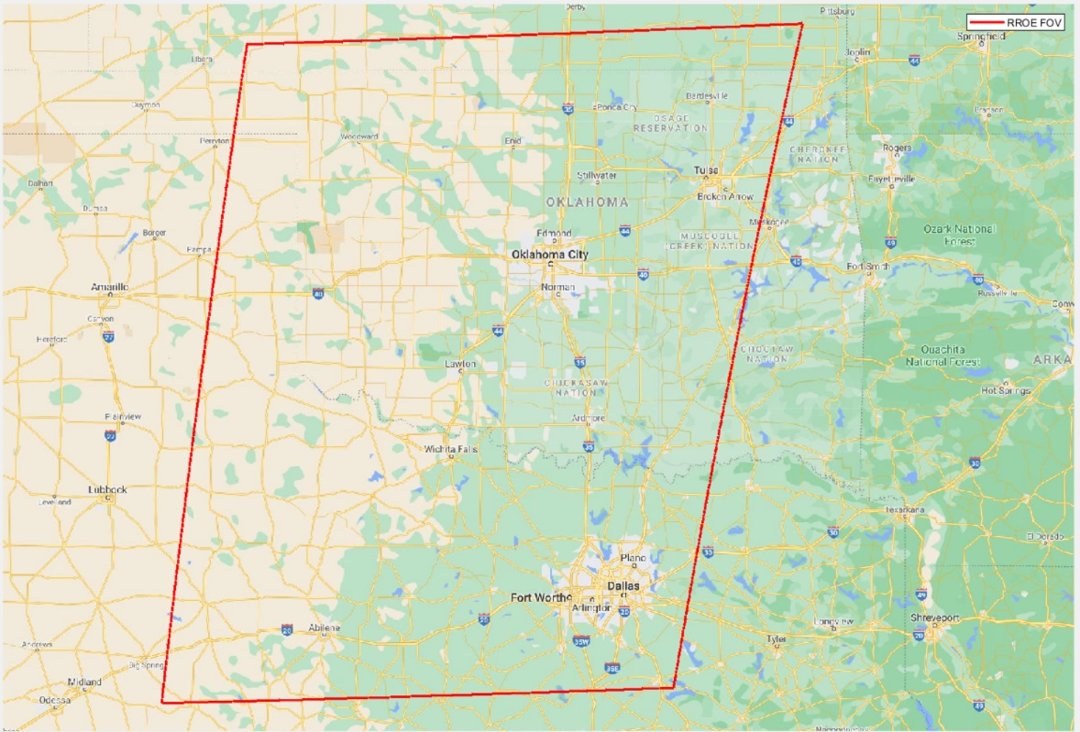
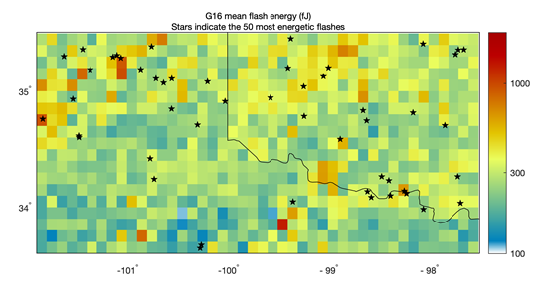
GLM Climatology of Energetic Flashes Used for Target Site Selection
This Example Identifies a Prime RROE Target Area in Southwest Oklahoma (one of our 9 target sites)
GLM
Climatology
G16 GLM Flash Density 12/01/2018 – 04/30/2021
GLM Most
Energetic Flashes
Climatology
RROE
Coverage

Slide 5
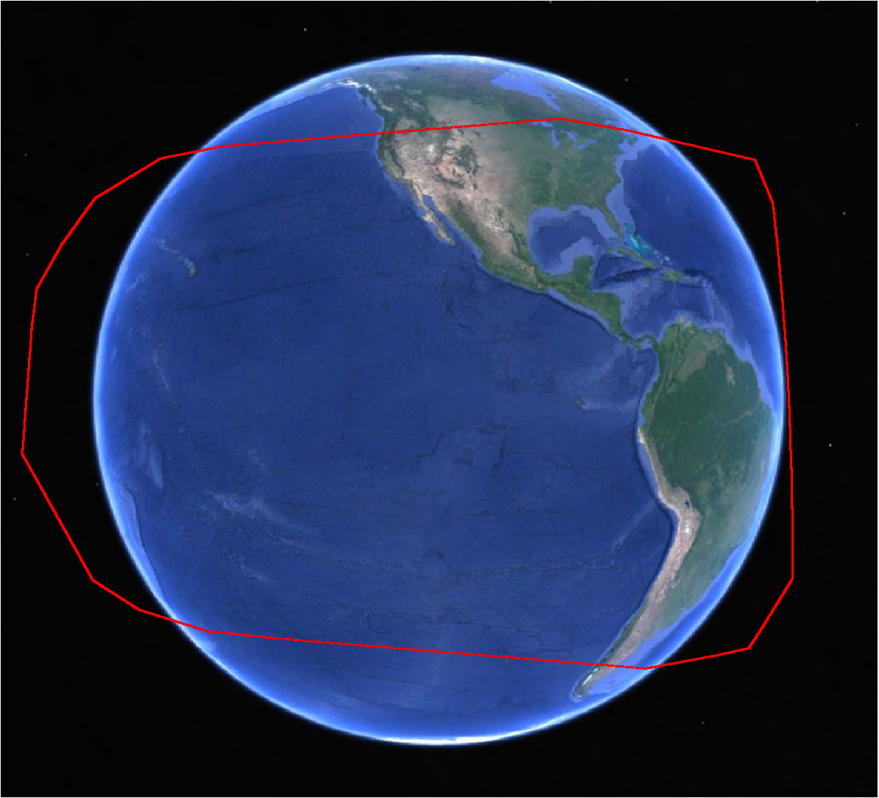
Ground Target Site Descriptions and Rationale
Location | Description | Lightning Types | Location
1 | Pacific Ocean, Aleutian Lows | wintertime oceanic storms | Longitude – 130 – 160 W Latitude – 30 to 60 N
2 | OK-W Texas LMA (AMA-OKC-DFW-LBB) | Megaflashes, high flash rate severe storms, positive polarity CG lightning | Longitude – 97 – 104 W Latitude – 33 to 38 N
3 | NMTech-LANL – LMA, interferometer Sandia LAZAP | Narrow bipolar events, bolts from the blue | Longitude – 105 – 110 W Latitude – 33 to 37 N
4 | Colombia – LMA | Correlated flashes with ISS ASIM, LIS, GLM | Longitude – 70 – 80 W Latitude – 0 to 10 N
5 | COLMA (Greeley, CO) | Deep convection with large optical attenuation, positive polarity CG lightning | Longitude – 100 – 110 W Latitude – 37 to 42 N
6 | MD-PA-VA – MALMA | Nor’easters (oceanic storms), Wintertime Mesoscale Convective Systems | Longitude – 60 – 80 W Latitude – 30 to 55 N
7 | Huntsville – NASA NALMA, HAMMA | Mesoscale convective systems | Longitude – 80 – 90 W Latitude – 30 to 40 N
8 | Houston – TAMU LMA | Urban and coastal storms Aerosol-cloud interactions affecting flash polarity, landfalling tropical storms and hurricanes | Longitude – 95 to 100 W Latitude – 25 to 35 N
9 | KSCLMA | Coastal and inland storms, landfalling tropical storms and hurricanes | Longitude – 79 – 83 W Latitude – 27 – 30 N
1
5
2
6
3
7
8
9
4

Slide 6
Summary
STP Sat-6/RROE will launch November 22nd, 2021
The RROE lightning collection campaign is planned and is ready to execute
Priority target collection sites have been identified
Lightning science community collaborators have agreed to provide correlative measurement (13 total)
SNL is developing RROE data products to share with collaborators
Detailed collection campaign schedules have been developed
The NNSA has ruled that the RROE lightning observations are Unclassified Unlimited Releasable (UUR) after SNL reviews the data
Will target piggy back campaign opportunities when feasible

Slide 7
Collaboration Partners
Partner Institutions | Contact Information
LANL – SENSER RFS | Dr. Erin Lay (elay@lanl.gov)
NOAA/NASA – Geostationary Lightning Mapper on GOES 16/17/18 | Dr. William Koshak (William.j.koshak@nasa.gov) Dr. Scott Rudlosky (scott.rudlosky@noaa.gov)
NASA -Lightning Imaging Sensor (LIS) on ISS | Dr. Timothy Lang (timothy.j.lang@nasa.gov)
Danish Technical University (DTU-Space) ESA Atmosphere-Space Interactions Monitor (ASIM) on ISS | Prof. Torsten Neubert (neubert@space.dtu.dk) Dr. Carol Anne Oxborrow (oxborrow@space.dtu.dk)
Vaisala - NLDN and GLM360 | Dr. Ryan Said (ryan.said@vaisala.com); Dr. Martin Murphy (martin.murphy@vaisala.com)
University of Washington – World Wide Lightning Location Network | Prof. Robert Holzworth, (bobholz@uw.edu)
Earth Networks – ENGLN Global Lightning Network | Dr. Michael Stock (mstock@earthnetworks.com) Dr. Jeff Lapierre (jlapierre@earthnetworks.com)
Georgia Tech – AWESOME VLF/LF Receiver Network | Prof. Morris Cohen (mcohen@gatech.edu)
Duke University – CMCN | Prof. Steve Cummer (cummer@duke.edu)
NMTech - Langmuir Laboratory | Prof. Harald Edens, (herald.edens@nmt.edu)
Texas Tech (TTU) – West Texas Lightning Mapping Array (WTLMA) | Prof. Eric Bruning (eric.bruning@ttu.edu)
UAH, NASA/UAH NSSTC – NALMA, HAMMA | Prof. Phillip Bitzer (bitzerp@uah.edu)
NOAA NSSL, University of Oklahoma CIMMS - OKLMA | Dr. Kristin Calhoun (Kristin.kuhlman@noaa.gov) Dr. Vanna Chmielewski (vanna.chmielewski@noaa.gov)
Polytechnic University of Catalonia (UPC) - Colombia Lightning Mapping Array (ASIM validation site) | Prof. Joan Montanyà (Joan.montanya@upc.edu)
NASA KSC, FIT - LMA | Robert G. Brown (robert.g.brown@nasa.gov)

Slide 8
Acronyms and Definitions
Abbreviation | Definition
ASIM | Atmosphere-Space Interactions Monitor
ENGLN | Earth Networks Global Lightning Network
FPA | Focal Plane Array
GLD360 | Global Lightning Detection Network (Vaisala)
GLM | Geostationary Lightning Mapper
ISS | International Space Station
LANL | Los Alamos National Laboratory
LIS | Lightning Imaging Sensor
LMA | Lightning Mapping Array
MTG-LI | European Space Agency Lightning Imager
NASA | National Aeronautics and Space Administration
NLDN | National Lightning Detection Network (Vaisala)
NNSA | National Nuclear Security Agency
NOAA | National Oceanic and Atmospheric Administration
NUDET | Nuclear Detonation
RF | Radio Frequency
RFS | Radio Frequency Sensor
RROE | Risk Reduction Optical Experiment
SENSER | Space and Endo-Atmospheric Nudet (Nuclear Detonation) Surveillance Experimentation and Risk-Reduction
SNL | Sandia National Laboratories
STP Sat-6 | Space Test Program Satellite 6
USNDS | United States Nuclear Detection System

