Slide 1
CubeSpark
A satellite mission concept for multispectral, 3-D observations of lightning
Patrick Gatlin, Timothy Lang, Mason Quick, NASA Marshall Space Flight Center
Sonja Behnke, Los Alamos National Laboratory
2021 GLM Science Team Meeting
Notes:
Background Image credit: ISS Crew Earth Observations Facility and the Earth Science and Remote Sensing Unit, Johnson Space Center (Image ISS042-E-135030; Cyclone Bansi, Indian Ocean, January 25, 2015 taken with ISS Digital Camera by Expedition 42 Crew; https://eol.jsc.nasa.gov/SearchPhotos/photo.pl?mission=ISS042&roll=E&frame=135030)

Slide 2
Combining optical and RF to get novel 3-D observations

Slide 3
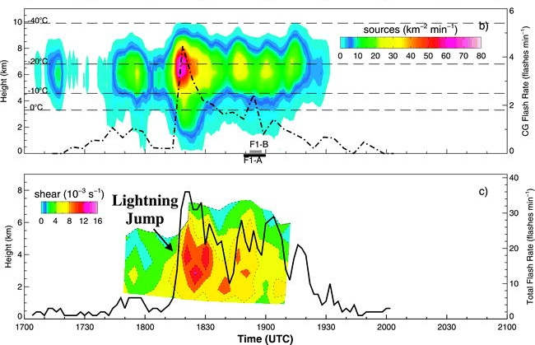
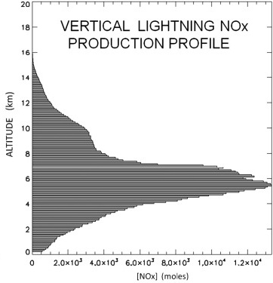
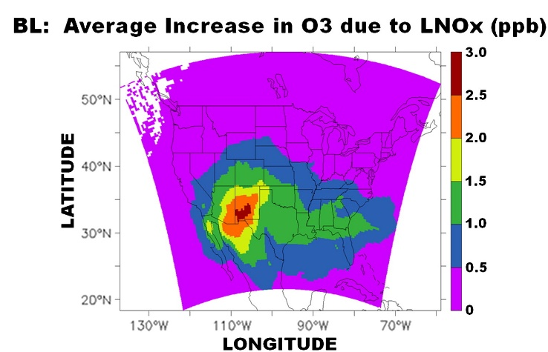
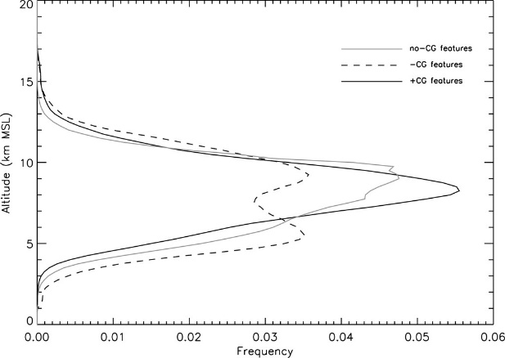
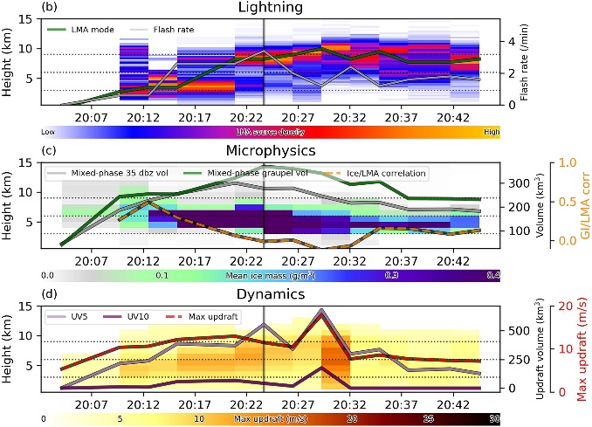
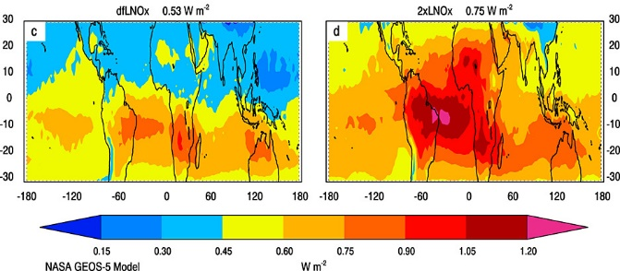
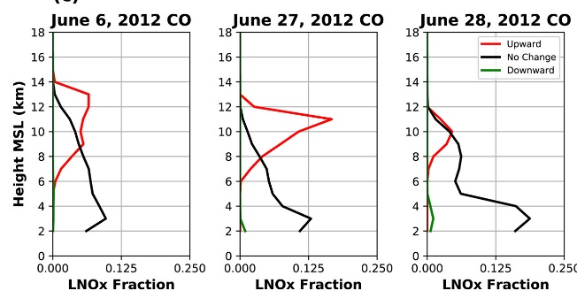
Why are 3-D observations of lightning important?
Vertical information provides key insights about thundercloud effects on its surrounding environment
Thundercloud processes, charge structure and Severe weather
depiction of LNO_{x} PRODUCTION and distribution in troposphere
Vertical growth as storm intensifies
Anomalous Charge Storms and Flash Type/Polarity
Ozone increase in Boundary Layer due to LNOx
(Lang et al. 2011)
Kinematic/Microphysical Processes
(Koshak et al. 2014)
(Gatlin & Goodman 2010)
Lightning in Overshooting Tops
LNOx effects on Energy Budget
Transport of LNOx
(Liaskos et al. 2015)
(Calhoun et al. 2013)
(Fuchs et al. 2018)
(Davis et al. 2019)

Slide 4
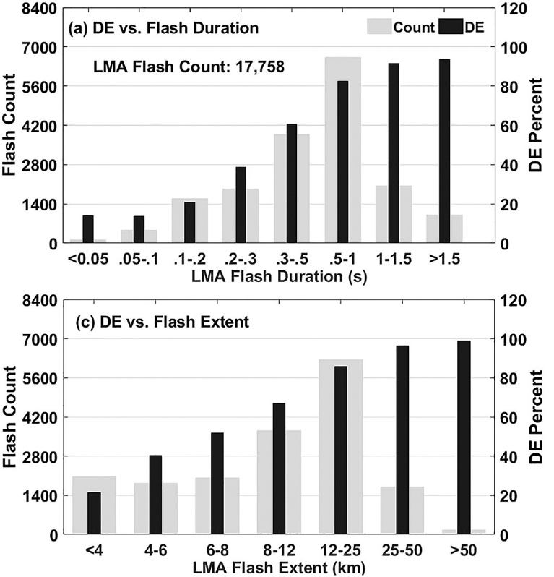
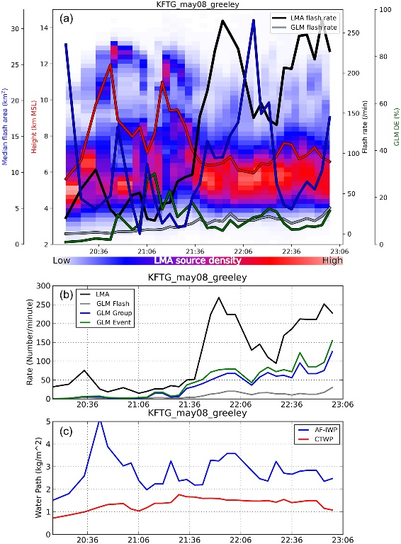
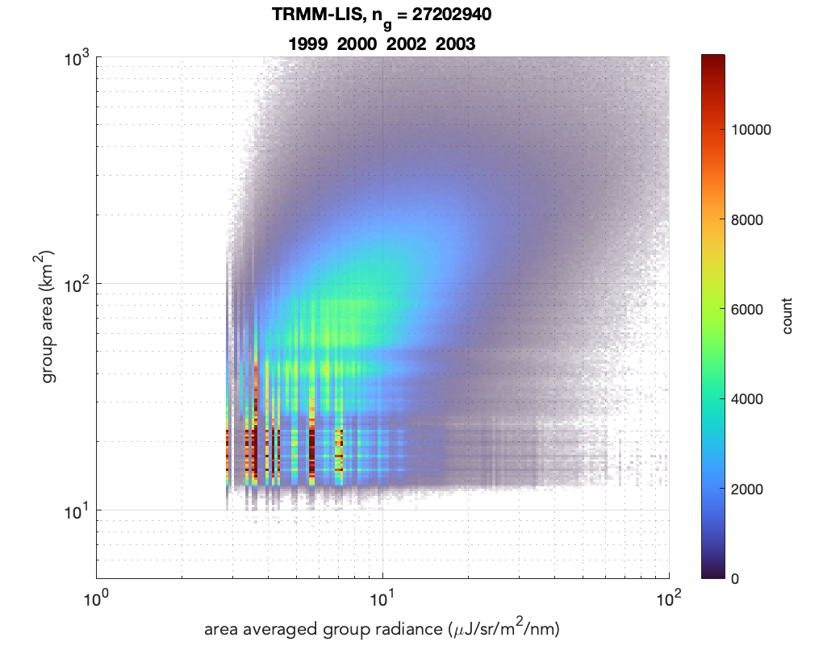
Need to detect small and low-altitude flashes important for diagnosing storm intensification and severe weather
GLM vs KSCLMA Detection
GLM vs COLMA
Short-lived, small flashes difficult to detect with coarse resolution imagers like GLM and LIS
Low-altitude lightning flashes tend to elude optical detection from space
Deficiencies mask important processes related to the development of severe weather
(Zhang & Cummins 2020)
(Rutledge et al. 2020)
?
Need to better resolve unknown characteristics of lightning optical emissions from thunderstorms on Earth
(Mason Quick)

Slide 5
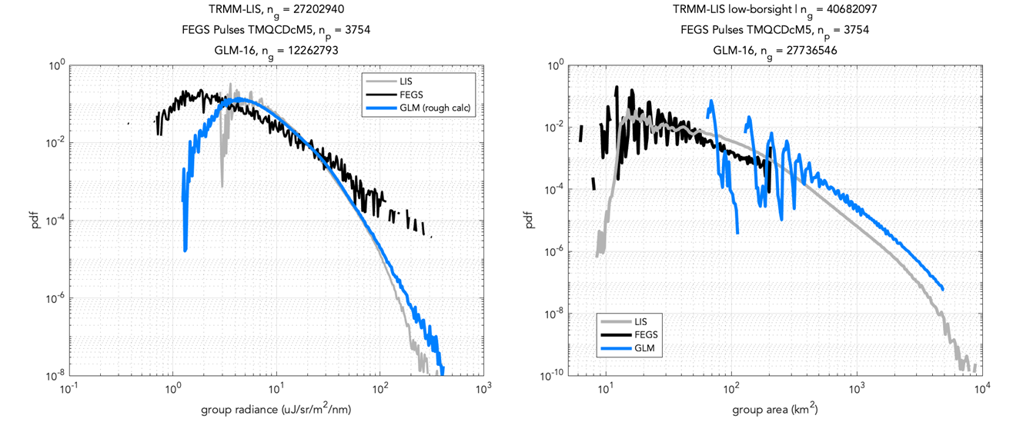
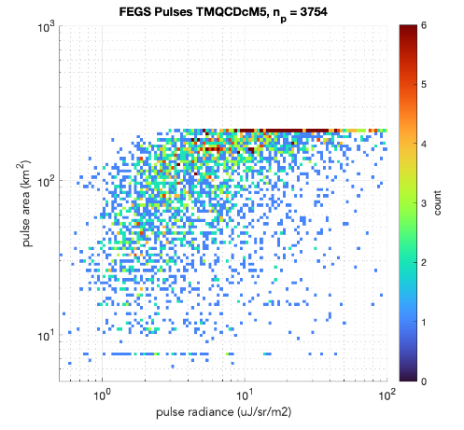
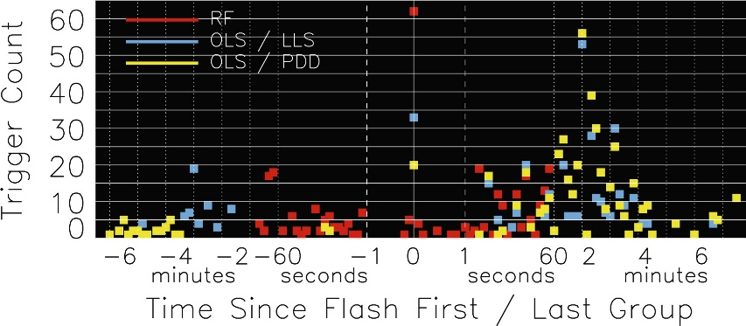
How can we detect flash activity that evades current imagers?
Increasing the horizontal resolution should improve detection of smaller flashes, as suggested by FEGS comparisons with LIS/GLM
FEGS
Area vs Radiance
FEGS
GLM
Group Radiance
LIS
Group Area
Cool (streamer) processes often seen during early stages of flash development can produce 337-nm (UV) emissions that may not be detectable in the 777.4-nm, as shown by ASIM-MMIA
VHF+Optical Detections with FORTE
(ASIM/MMIA analysis by P. Bitzer & D. Walker)
Since lightning’s optical emissions are impacted by water pathways through the cloud, we can exploit its RF emissions, which are impacted by the ionosphere but detectable in space by monitoring VHF frequencies (numerous FORTE findings summarized in Light 2020)
Impulsive VHF events detected by FORTE are optically weak
Enables vertical location of lightning sources
(Peterson et al. 2021)

Slide 6
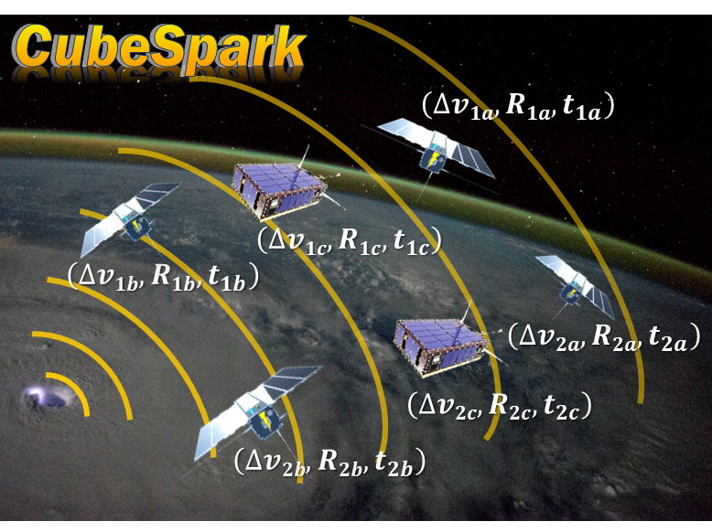
CubeSpark will use a novel approach to address outstanding questions about thunderstorm processes and effects on the surrounding environment
How does the altitude of lightning impact detection of its optical signatures at cloud top?
How does the vertical distribution of lightning relate to processes of thundercloud environments and occurrence of severe weather?
What is the global distribution of anomalously charged thunderstorms, their relationship to severe weather, and impact on LNOx?
What is the distribution of LNOx in the troposphere and its relation to ozone variability?
What is the vertical structure of winter-storm lightning, and how does it relate to human-built structures?
Measurement Requirements
Locate the horizontal and vertical origin of lightning events with an uncertainty ≤2-km (1-km goal)
Measure the 777.4- and 337-nm optical emissions at cloud-top with 1-2-km resolution every 0.5-1-ms
Detect greater fraction of lightning activity in severe storms than current imagers (e.g., DE>60% in severe storms)
CubeSpark Approach
Constellation of 6 satellites in LEO
Each satellite will have an RF payload to detect lightning in VHF
At least 2 of the satellites will have high-resolution, NIR/UV CMOS cameras
Event detection will be performed onboard and sent to ground
Use optical to constrain the TOA solutions for 3D geolocation

Slide 7
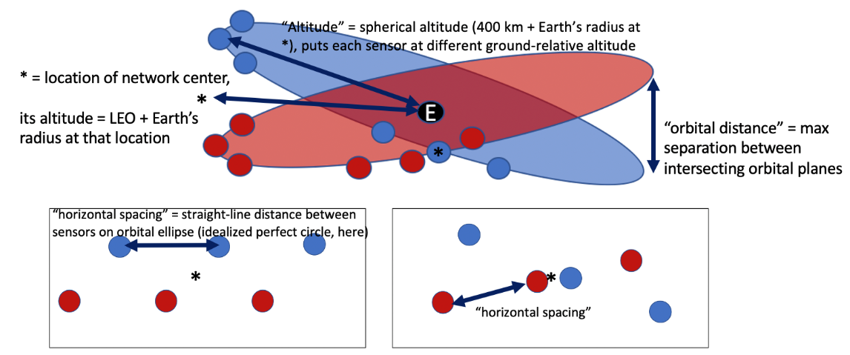
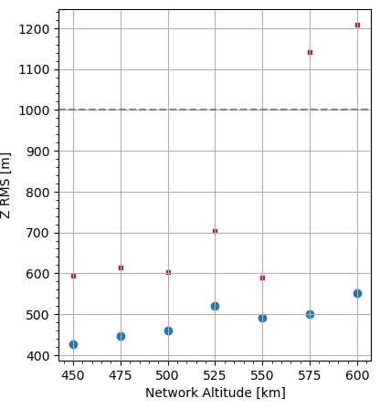
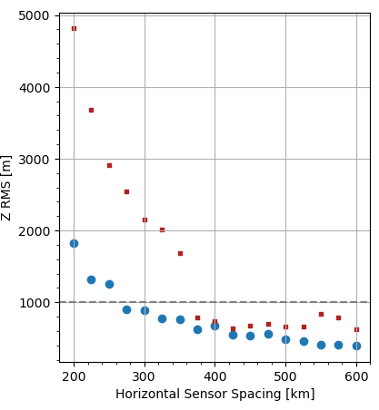
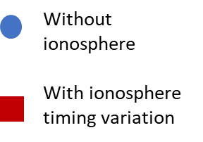
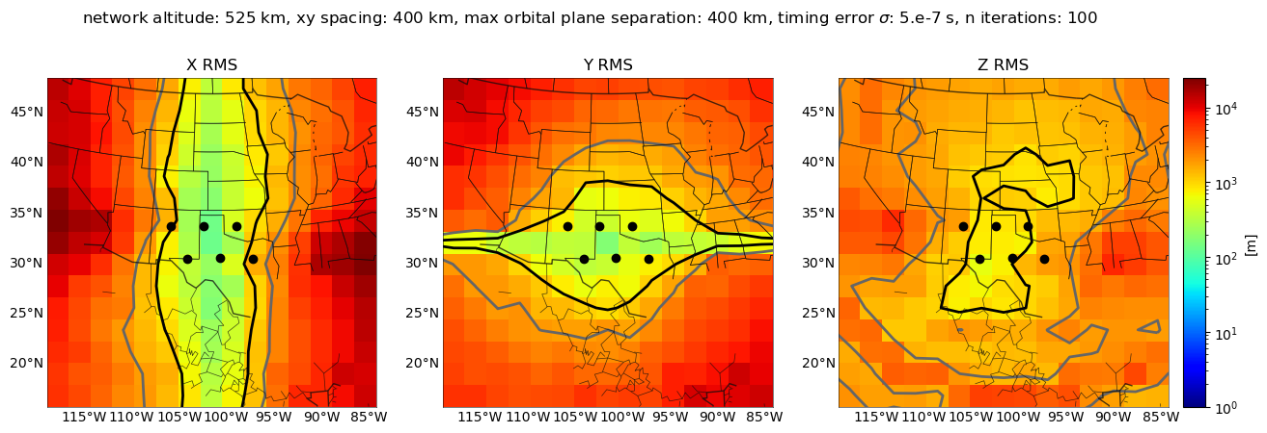
Feasibility of meeting 1-2-km location retrieval uncertainties?
Modified LMAsimulation code (Chmielewski & Bruning, 2016):
6 VHF receivers at LEO altitudes (timing uncertainty 500-ns)
Included basic ionospheric propagation model to get added timing uncertainty
Varied the network geometry to examine location uncertainties
Simulations performed by Sarah Stough
Initial orbital configuration of sensors
Orbital Altitude?
Satellite Spacing?
525-km altitude
Orbital planes 400-km apart
Snaphot of simulated location uncertainties
Vertical RMS error [m]
Vertical RMS error [m]
2-km Req.
1-km Goal
Horizontal uncertainties<<1-km
Vertical uncertainties <2-km for altitudes <600-km and satellites spaced >~300-km apart on orbital plane
1-km
2-km
HOW DOES THIS CHANGE GIVEN ORBITAL MECHANICS?

Slide 8
Orbital Simulations
R. Hopkins (MSFC ED04)
→ Coverage and Uncertainty (i.e., RMS) of location retrievals will vary with latitude

Slide 9
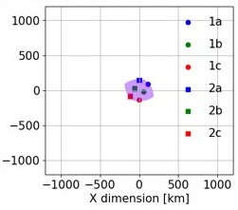
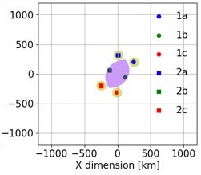
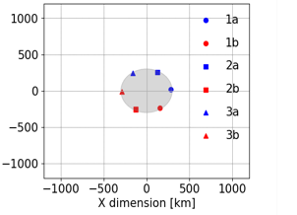
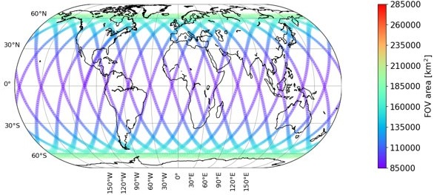
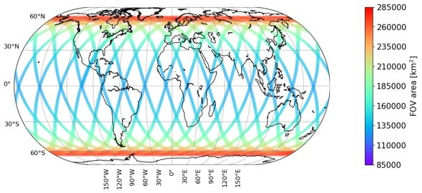
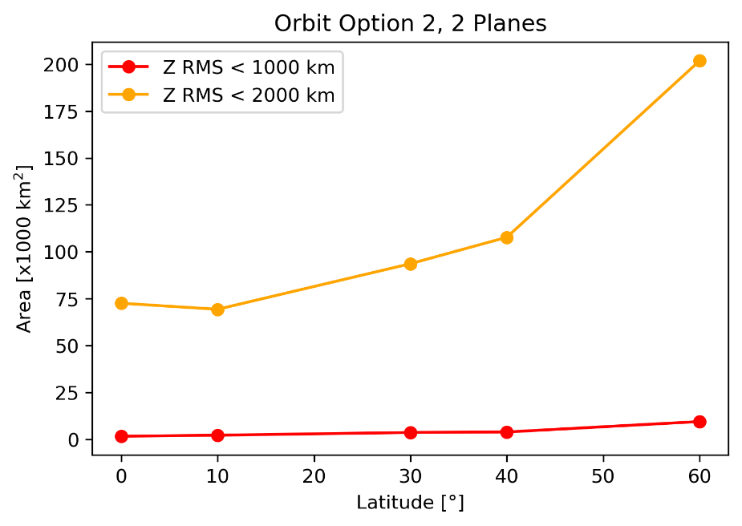
Which constellation design will provide the most coverage with lowest uncertainty?
Option #1
Option #2
Option #3
Distance from Equator
Distance from Equator
Distance from Equator
Area (FOV) of robust 3-D retrievals
Vertical uncertainty from orbital TOA simulations
Latitude | Option #1 | Option #2 | Option #3
0° | 2.8-km | 1.3-km | N/A
30° | 3.2-km | 2.0-km | 5.3-km
60° | 3.4-km | 5.9-km | 1.8-km

Slide 10
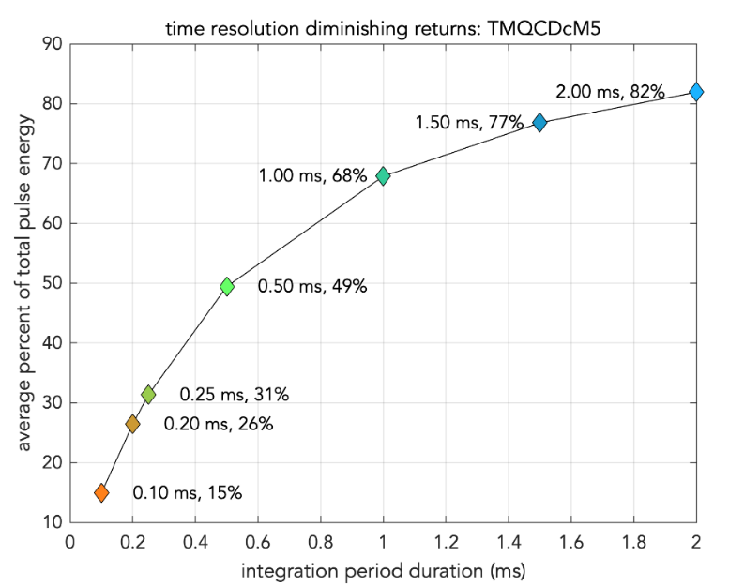
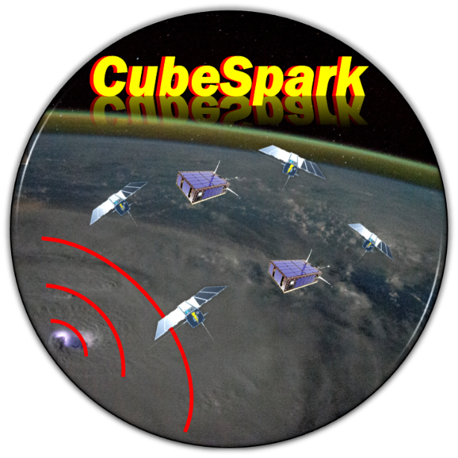
Remaining questions and technical hurdles
Is the CMOS sensor sensitive enough to the optical emission with a 0.5-1 ms integration time?
MSFC is testing a candidate sensor from e2V for use in CLIDE
How much lightning can be detected at 337- and not 777.4-nm and what are the UV characteristics of lightning?
Ongoing MMIA analysis
Can the size and complexity of the lens assembly be reduced while maintaining the same ultra-narrow bandpass filter performance?
Apply a uniform filter coating to a semi-hemispheric lens
Higher resolution images will require a new data acquisition approach
Use AI to define regions of interest for enhanced observation
What type of and how much lightning activity can be detected with an orbital VHF receiver?
ACT project with LANL includes comparing LMA with FORTE
Does an optical-based location constrain the space-based TOA solution such that ≤2-km vertical resolution can be achieved using fewer independent VHF measurements?
NPP fellow (Jackson Remington) starting in Nov/Dec to work on this
Adding UV filter to FEGS
(FEGS analysis by Mason Quick)
Patrick.Gatlin@nasa.gov

