Slide 1
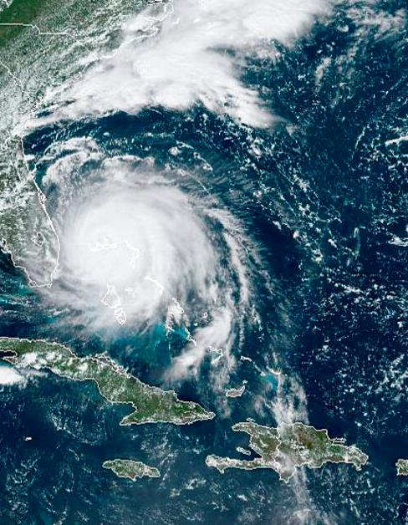
GeoXO and User Engagement
Andrew Heidinger, NESDIS Geo Senior Scientist
Vanessa Escobar, NESDIS User Engagement Senior Scientist
GLM Science Meeting
NOAA
National Environmental Satellite, Data, and Information Service

Slide 2
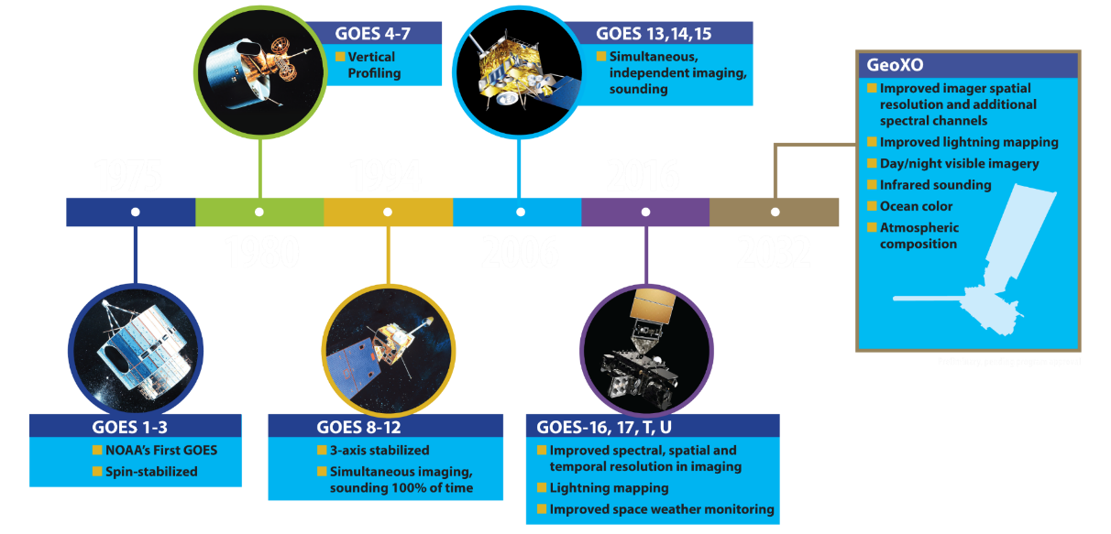
History of NOAA’s Geostationary Satellites

Slide 3
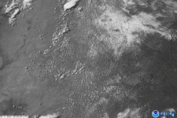
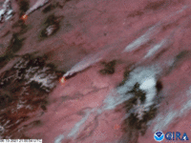
Introduction of GeoXO
Imaging + Lightning for Severe Storm Monitoring
Represents the 6th generation of the NOAA Geostationary Operational Environmental Satellites (GOES).
Continues the advanced imaging and lightning mapping missions of GOES-R.
Adds new capabilities to observe ocean productivity, atmospheric composition and thermodynamic profiling.
Extends support to all of NOAA’s Mission Service Areas (Weather, Climate, Oceans and Coasts).
Requirements process involved all elements of NOAA and its large User Community.
Multispectral Imaging for Fire and Smoke Monitoring
Examples show GOES-16 Advanced Baseline Imager(ABI) and Geostationary Lightning Mapper (GLM)

Slide 4
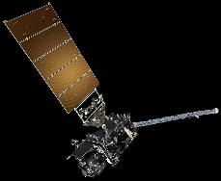
GeoXO Architecture
On Orbit Spare
105° W
GEO-West
Vis/IR Imager
Lightning Mapper
Ocean Color
Space Wx Suite*
GEO-Central
Hyperspectral IR Sounder
Atmospheric Composition
Partner Payload
GEO-East
Vis/IR Imager
Lightning Mapper
Ocean Color
Space Wx Suite*
NOAA Satellite Operations
Facility, Suitland MD
*GEO-East and West will also carry Space Weather Observation (SWO) Program-provided Solar and In Situ instruments.
Command and Data Acq.
Station Wallops VA
Consolidated Backup Unit, Fairmont WV
0-‹#›
Notes:
Alaska benefits from OCX observations of Alaskan Fisheries, Improved spatial resolution means more relevance at higher latitudes. IR sounding of Alaskan Region (TBD). Improved spatial resolution and limb coverage of the Lightning Mapper

Slide 5
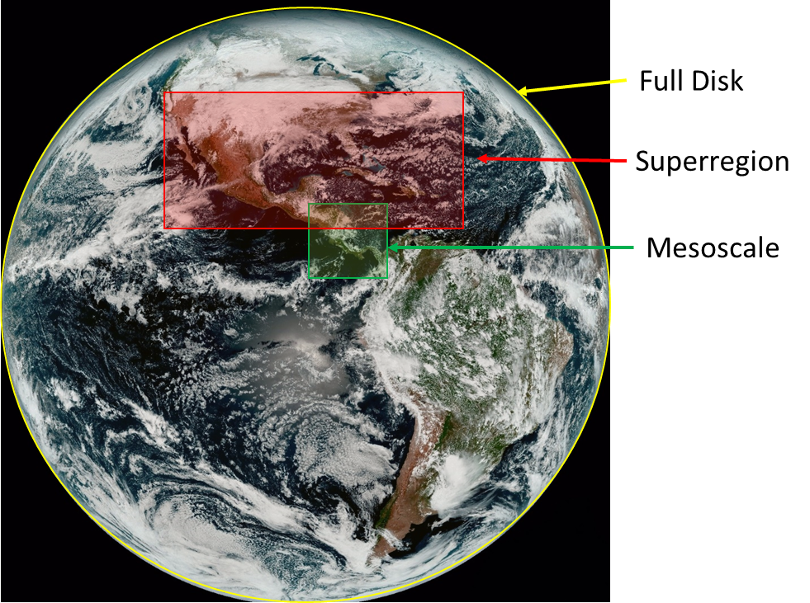
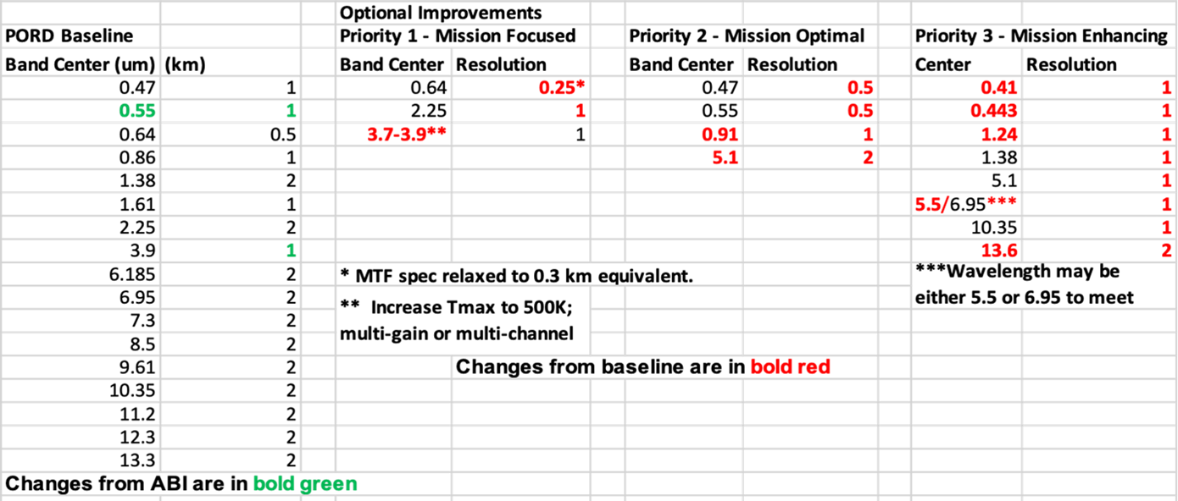
GeoXO Imager (GXI) Instrument
courtesy of Joel McCorkel - GeoXO Program Flight Scientist
Science Objectives
The GeoXO Imager (GXI) is the primary instrument in the GeoXO constellation
Provides operational weather imagery essential for short-range forecasting, issuing severe weather watches and warnings, and monitoring hazardous environmental conditions including tropical storms, severe storms, damaging winds, snow, ice, flooding, fog, fires, smoke, and volcanic ash
Adds capability to the legacy GOES-R ABI
Data product applications include: clouds, water vapor, aerosols, vegetation, snow cover, fire detection, ozone, SO2
Stakeholders
Public
NOAA
NASA
Visible to Near-IR multi-spectral imager with high spatial resolution
Images full disk of Earth from GEO Orbit (every 10 min), with ability for more frequent super region (every 5 min) and mesoscale (every 30 sec) scans
10- year mission life
Mass: 330 kg, Power: 614 W, Data Rate: 150 Mbps, 1.6m x 1.8m x 1.5m
Observational Capabilities
Overall Status
Spectral Band and Spatial Resolution requirements under consideration
Development Status: Phase A studies with two vendors started April, 2021
Overall Instrument TRL: 6, Lowest TRL Item: 3/4, Detector
Key Dates: Anticipated Phase B-D Contract Award, Fall 2022
Launch: Targeted for mid-2032
Funding Status: Pending program approval
Next Steps: Develop contract requirements
Technical Issues / Risks: Develop Detector Technology

Slide 6
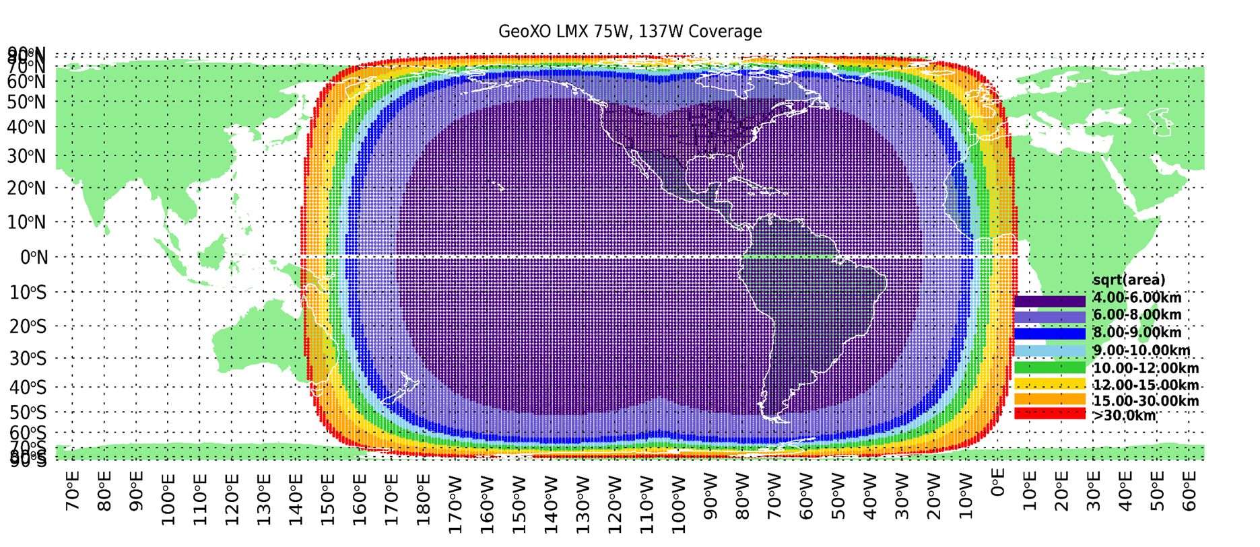
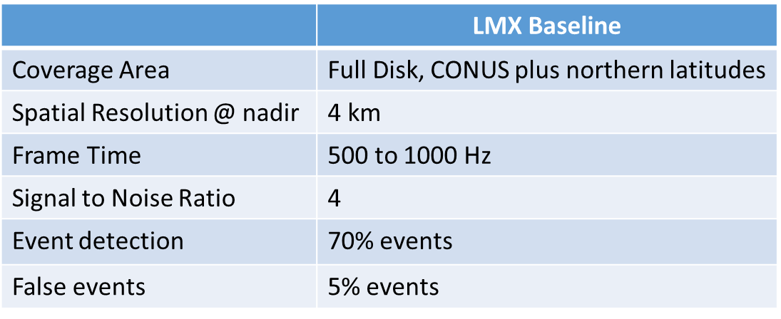
GeoXO Lightning Mapper (LMX) Instrument
courtesy of Joel McCorkel - GeoXO Program Flight Scientist
(FOV for Two LMXs shown, East and West)
Science Objectives
GeoXO Lightning Mapper (LMX) will continue providing lightning detection beyond ground-based lightning detection network capability, including filling spatial and temporal coverage gaps, providing spatial extent of total lightning flashes, both intra-cloud and cloud-to-ground, obtaining temporal resolution to allow tracking of each lightning flash within a specific storm cell, to provide continuous full-disk lightning measurements for storm warning and nowcasting for earlier warnings of tornadic activity and Flash flood warnings and storm tracking in regions of low radar coverage
Builds on capability of the legacy GOES-R GLM
Stakeholders
Single channel with high frame rate sensor
Continuous view and monitor of full disk from GEO orbit locations
10- year mission life
Mass: 140 kg, Power: 325 W, Data Rate: 75 Mbps, 1.5m x 1.3m x 1.2m
Public
NOAA
NASA
Observational Capabilities
Overall Status
Development Status: Preparing for Phase A studies
Overall Instrument TRL: 6, Lowest TRL Item: 4, Detector
Key Dates: Anticipated Phase B-D Contract Award, Winter 2024
Launch: Targeted for mid-2032
Funding Status: Pending program approval
Next Steps: Develop contract requirements
Technical Issues / Risks: Develop Technology

Slide 7
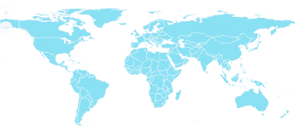
GeoXO within the GEO-RING
GeoXO User Readiness will rely heavily on non-NESDIS proxy data
Legend
Satellites In Orbit
GOES-R
Imager
LM
GOES-R
Imager
LM
MSG
Imgr
MSG
Rapid
MSG
Imgr
Elk-L
Imgr
I-3DR
Imgr
Sndr
FY2
Imgr
FY4
Imgr
Sndr
LM
GK2A
Imgr
GK2B
AC
OC
H8/9
Imgr
OC Proxy
FY4
Imgr
LM
GK2B
AC
✔️
2020s
2030s
AC Proxy
MTG-I
Imgr
GK2B
OC
Sndr Proxy
FY4
Sndr
✔️
MTG-S
Sndr
I-3DS
Imgr
Sndr
✔️
Imgr Proxy
NASA
TEMPO
MTG-I
LM
LM Proxy
MTG-I
Rapid
MTG-S
AC
✔️ = in orbit
NASA
GLIMR
Planned
Satellites
GEO-I
Imager
LM
OC
GEO-S
Sounder
AC
GEO-I
Imager
LM
OC
MTG-I
Imgr
LM
MTG-S
Sndr
AC
MTG-I
Rapid
LM
I-3DS
Imgr
Sndr
FY4
Imgr
Sndr
LM
GK3
Sndr
GK3
Imgr
LM
H10
Imgr
tbd
New Capabilities
Notes:
Pursuing dialog with NASA on Earth observation cooperation
Supports National Academies 2017 Decadal Survey recommendation: “NOAA should establish, with NASA, a flexible framework for joint activities that advance the capability and cost-effectiveness of NOAA’s observation capabilities.”
Participating in a study with the Canadian Space Agency (CSA) on potential Arctic mission
Continue to lead and sponsor initiatives in CEOS, CGMS, WMO, WCRP, GCOS and other relevant bodies to advance GEO Ring vision
Continue dialogue with partners and user needs assessments including partner inputs

Slide 8
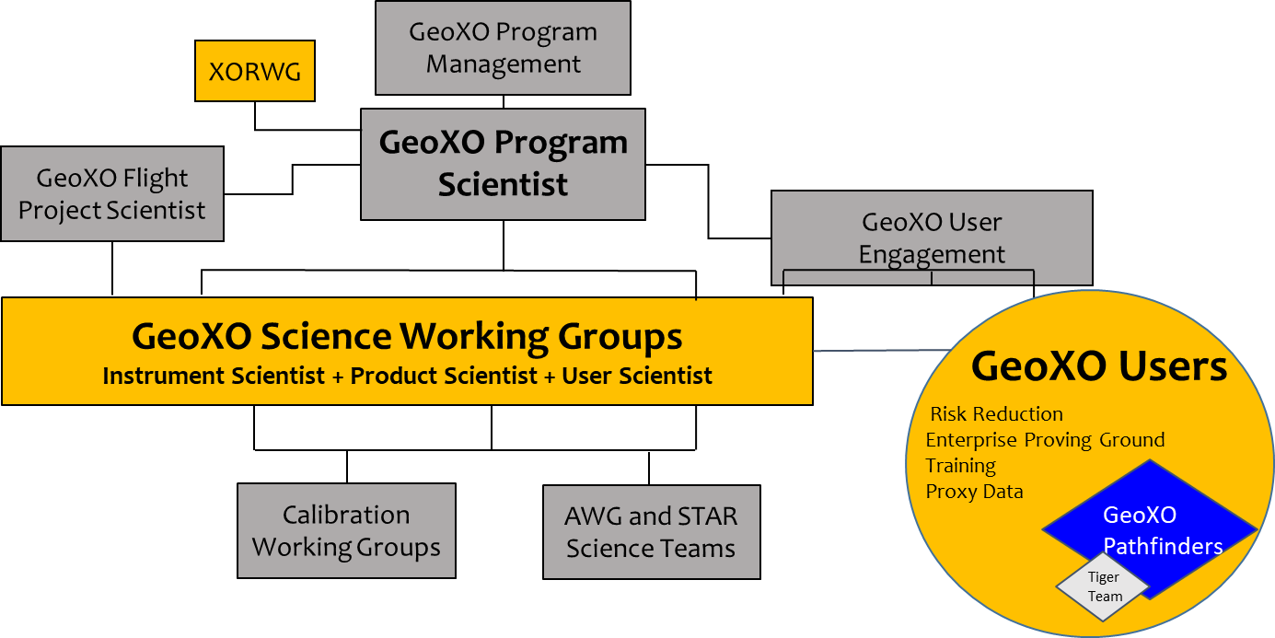
GeoXO Science Working Groups
 | Instru. Sci. | Product Sci. | User Sci.
GXI | Lindsey NESDIS | Lindsey NESDIS | Gerth NWS
LMX | TBD | Rudlosky NESDIS | Gockel NWS
ACX | Joiner NASA | Kondragunta NESDIS | Frost OAR
GXS | Johnson NASA | Schmit NESDIS | Yoe NWS
OCX | Mannino NASA | Wang NESDIS | Ford NMFS
Steve Goodman
Notes:
Add names and organization of the scientists

Slide 9
Plans for User Engagement
Engagement
Continuing to analyze the 2020 GeoXO User Workshops and plan for future Workshops.
Sign-up Pathfinders to build user relationships in key application areas.
Advocacy
Attendance at key conferences and workshops.
Support the GeoXO Economist to determine Return on Investment (ROI) for SRR.
Readiness
Funding use of both real and simulated proxy data including the products and software from analogous instruments(i.e. NASA TEMPO, GLIMR).
Continuing the Total Operational Weather Readiness - Satellites (TOWR-S) Project to ensure NWS can ingest data.
Innovation
Support the NESDIS Enterprise Proving Ground to identify innovative uses and applications of GeoXO data.
Support the NESDIS L2 development effort to ensure the generation of relevant and useful applications and services.

Slide 10
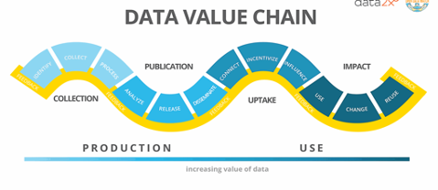
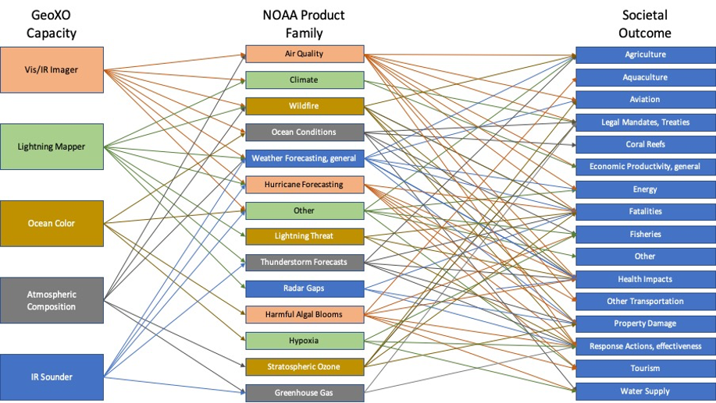
A Return on your Investments
User engagement provides insights into new and emerging applications that help inform the development of new satellites at NOAA. Integrating user feedback into mission development (data value chain) optimizes uses data and increases the value of information.
Pathfinders are the early adopter community of GeoXO. These subject matter experts communicate the benefit of future GeoXO data uses in society and help expand the knowledge of how GeoXO information will best the community.
Pathfinders provide GeoXO real world use cases for developing economic value chains. Their involvement as Pathfinders shortens the timeline between having an operational satellite and realizing the benefit. Pathfinders can hit the ground running once GeoXO is online!
GeoXO User Engagement and the
NOAA Pathfinder Initiative

Slide 11
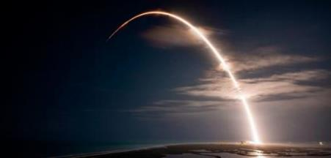
Summary
NOAA’s geostationary satellites provide the only persistent weather observations of the Western Hemisphere, providing essential forecast information for public safety and efficient economic activity across multiple sectors
A follow-on capability is required by 2032 to ensure data continuity
The GeoXO program will provide the required continuity and also extend observations to include monitoring of atmosphere, oceans, and climate to meet growing environmental and health challenges served by all NOAA line offices
GeoXO will maintain and advance NOAA’s observational capabilities through 2050

