Slide 1
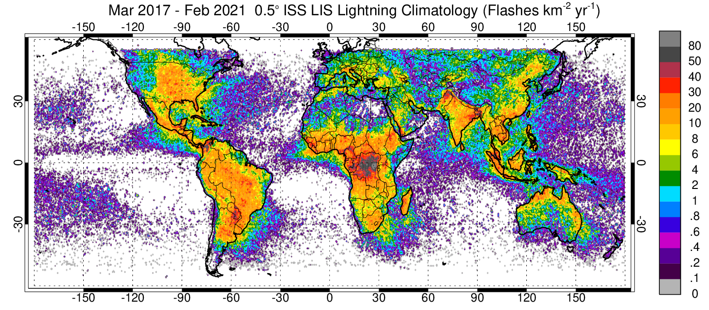
Update on the International Space Station Lightning Imaging Sensor (ISS LIS)
4.5 years on orbit!
Scheduled to move on ISS in April 2022 to accommodate EMIT; approved for ops thru end of 2023
Version 1 QC (Final) & Near-Realtime (NRT) data are available thru GHRC DAAC
https://ghrc.nsstc.nasa.gov/lightning/data/data_lis_iss.html
Version 2 data imminent – improved viewtime estimates
Background imagery geolocation: https://github.com/nasa/ISS_Camera_Geolocate
Currently working on: Absolute DE and merger with TRMM LIS/OTD climatology
Looking forward to: The return of microwave radiometer co-location with STP-H8/ASAP mission (Dec 2021)
Timothy Lang & Dennis Buechler

Slide 2
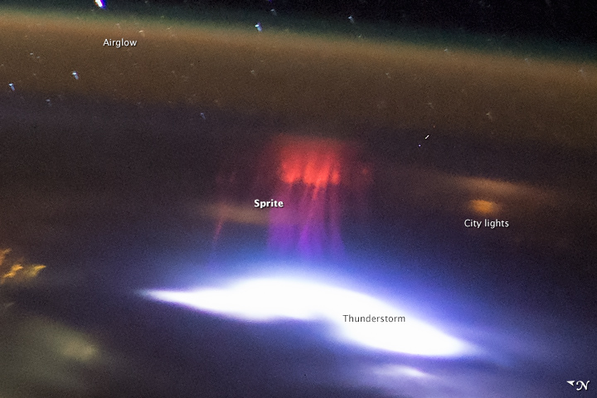
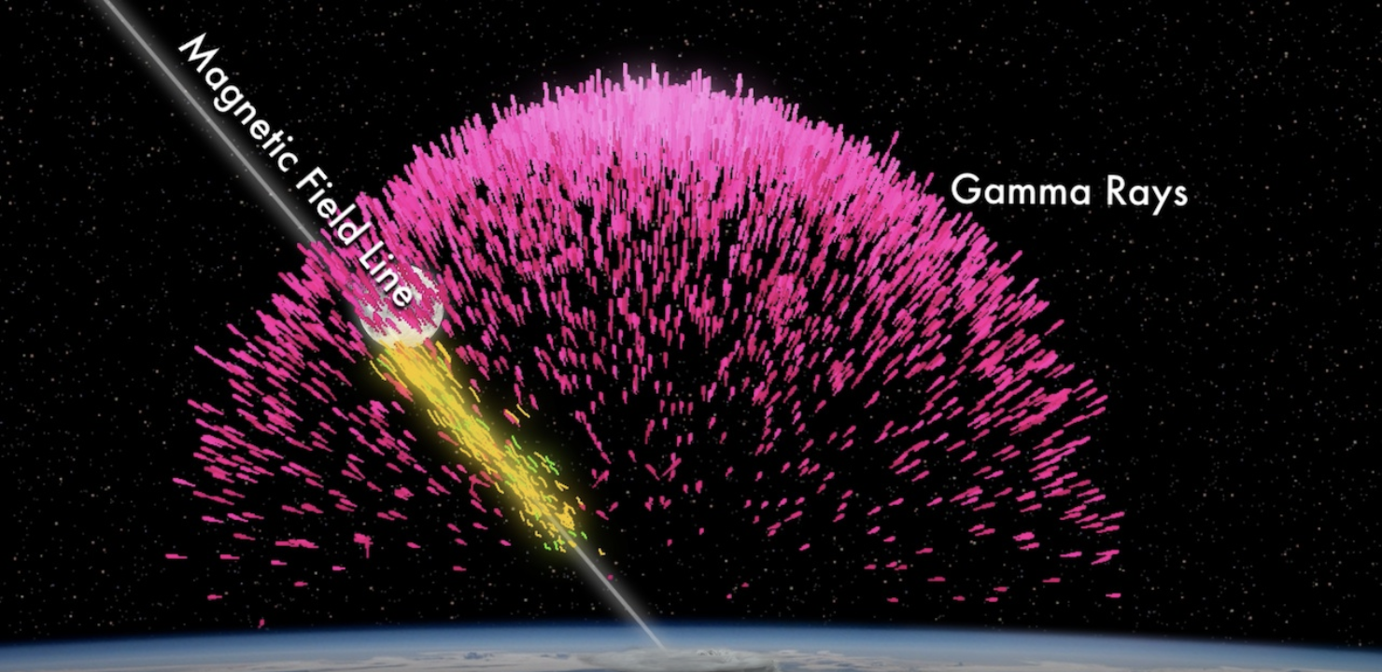
NASA Interdivisional Lightning Workshop
NASA HQ has provided seed funding for a workshop to study interdivisional/interdisciplinary lightning research opportunities
Anticipated outcome: Workshop identifies key topics and science questions that fall in gaps between SMD Divisions (e.g., TLEs, TGFs, etc.)
NASA could develop a ROSES solicitation focused on these topics
Workshop likely virtual, occurring in Spring 2022
Collaboration between MSFC and GSFC
Be on lookout this fall for link to community questionnaire to solicit ideas/speakers at workshop
Want more info? Contact Timothy Lang (timothy.j.lang@nasa.gov)

