Slide 1
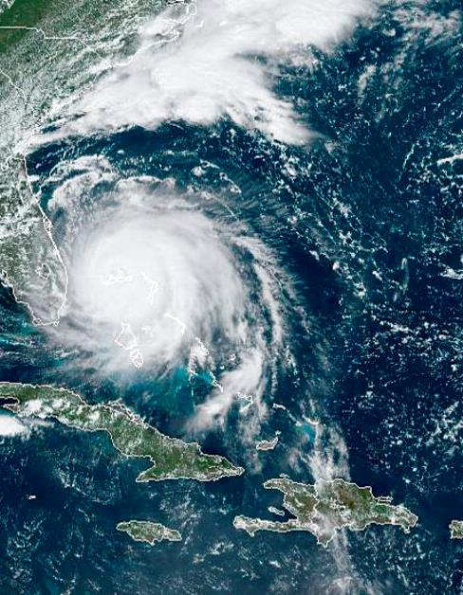
GOES-R Program Status and GOES-T Plans
Dan Lindsey, GOES-R Program Scientist
GLM Science Meeting
NOAA
National Environmental Satellite, Data, and Information Service

Slide 2
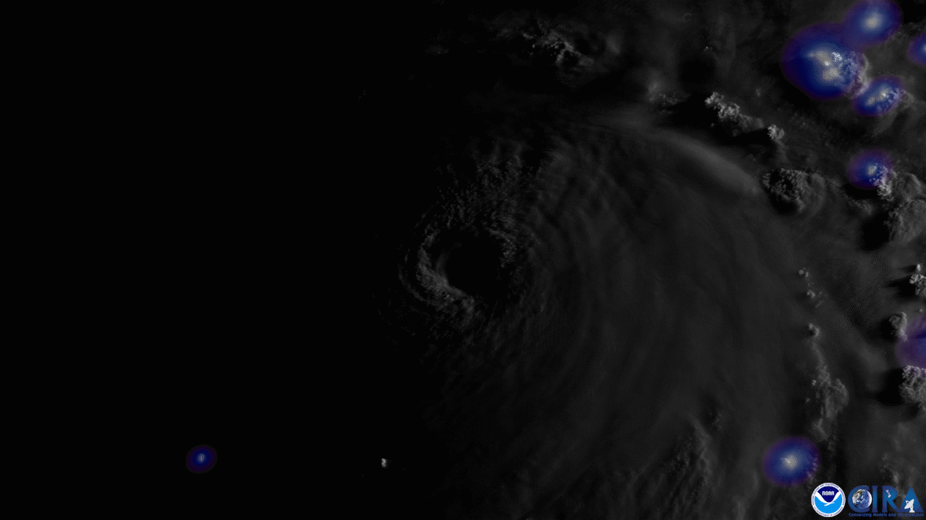
GOES-16
Continues to operate nominally as GOES-East from 75.2 W
Both ABI and GLM are stable and are meeting specs

Slide 3
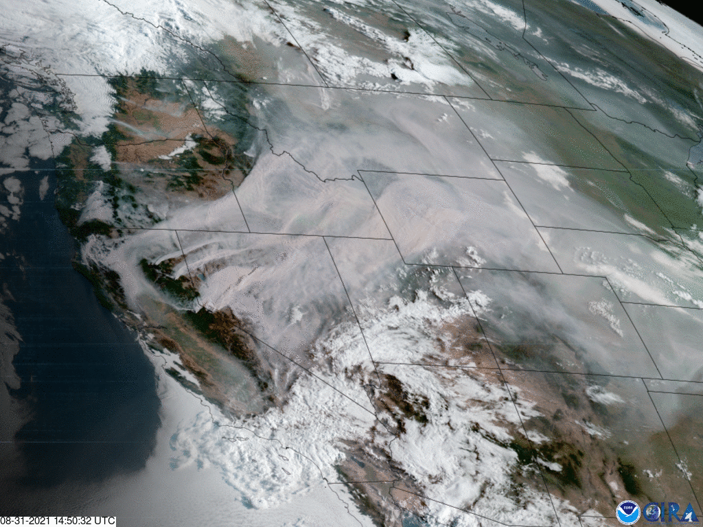
GOES-17
Continues to operate as GOES-West from 137.2 W
ABI Loop Heat Pipe anomaly is a continuing issue
ABI experienced an autonomous reset on 7/9
G17 spacecraft went into safe mode on 7/22 resulting in a multi-hour data outage from all instruments
Root cause for both anomalies is still under investigation
Following the 7/22 ABI shutdown, Loop Heat Pipe performance showing further degradation

Slide 4
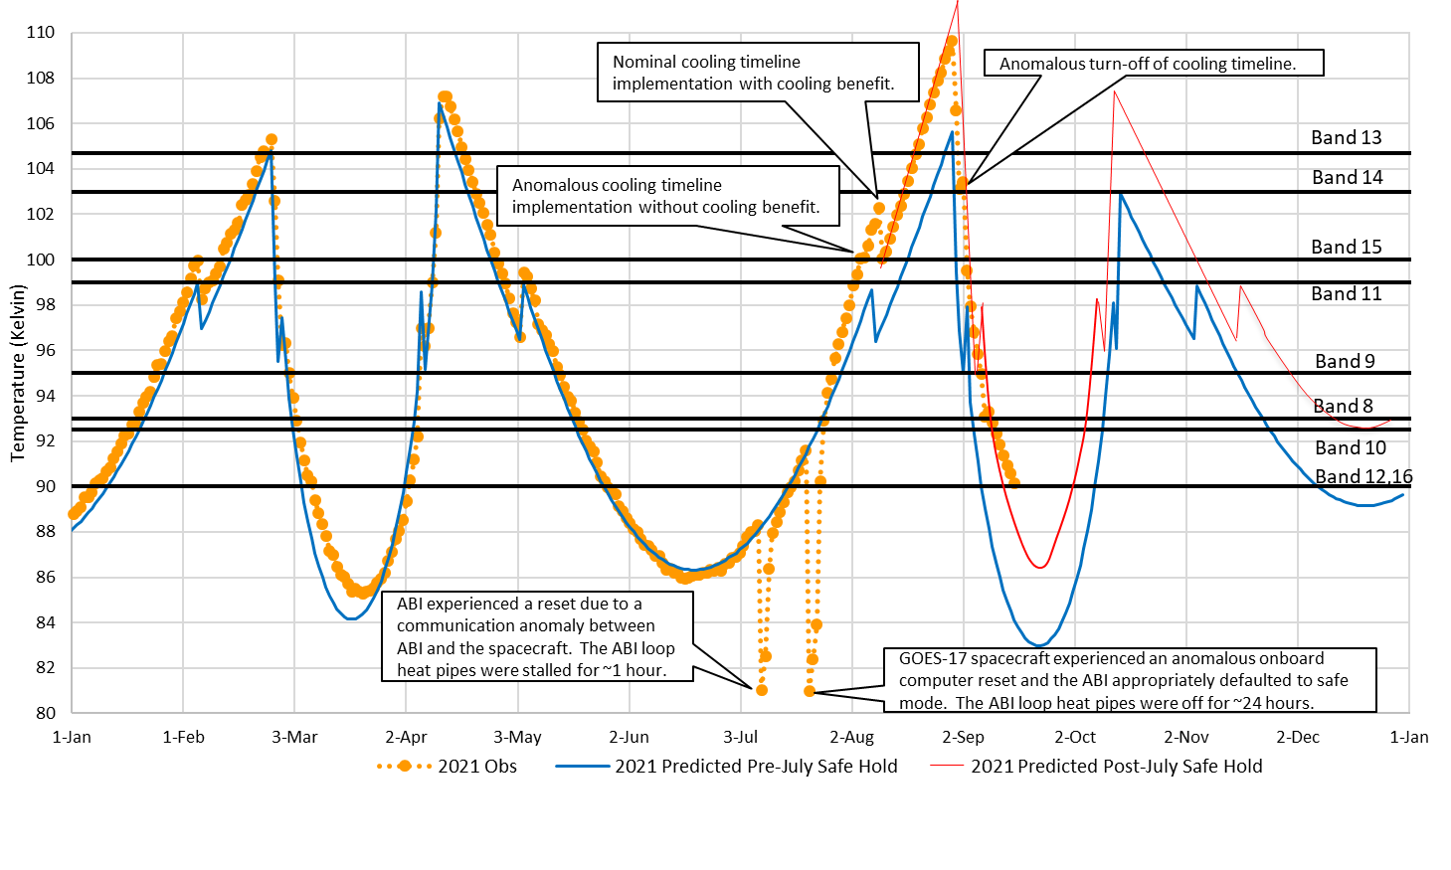
GOES-17 ABI Daily Maximum Detector Temps

Slide 5
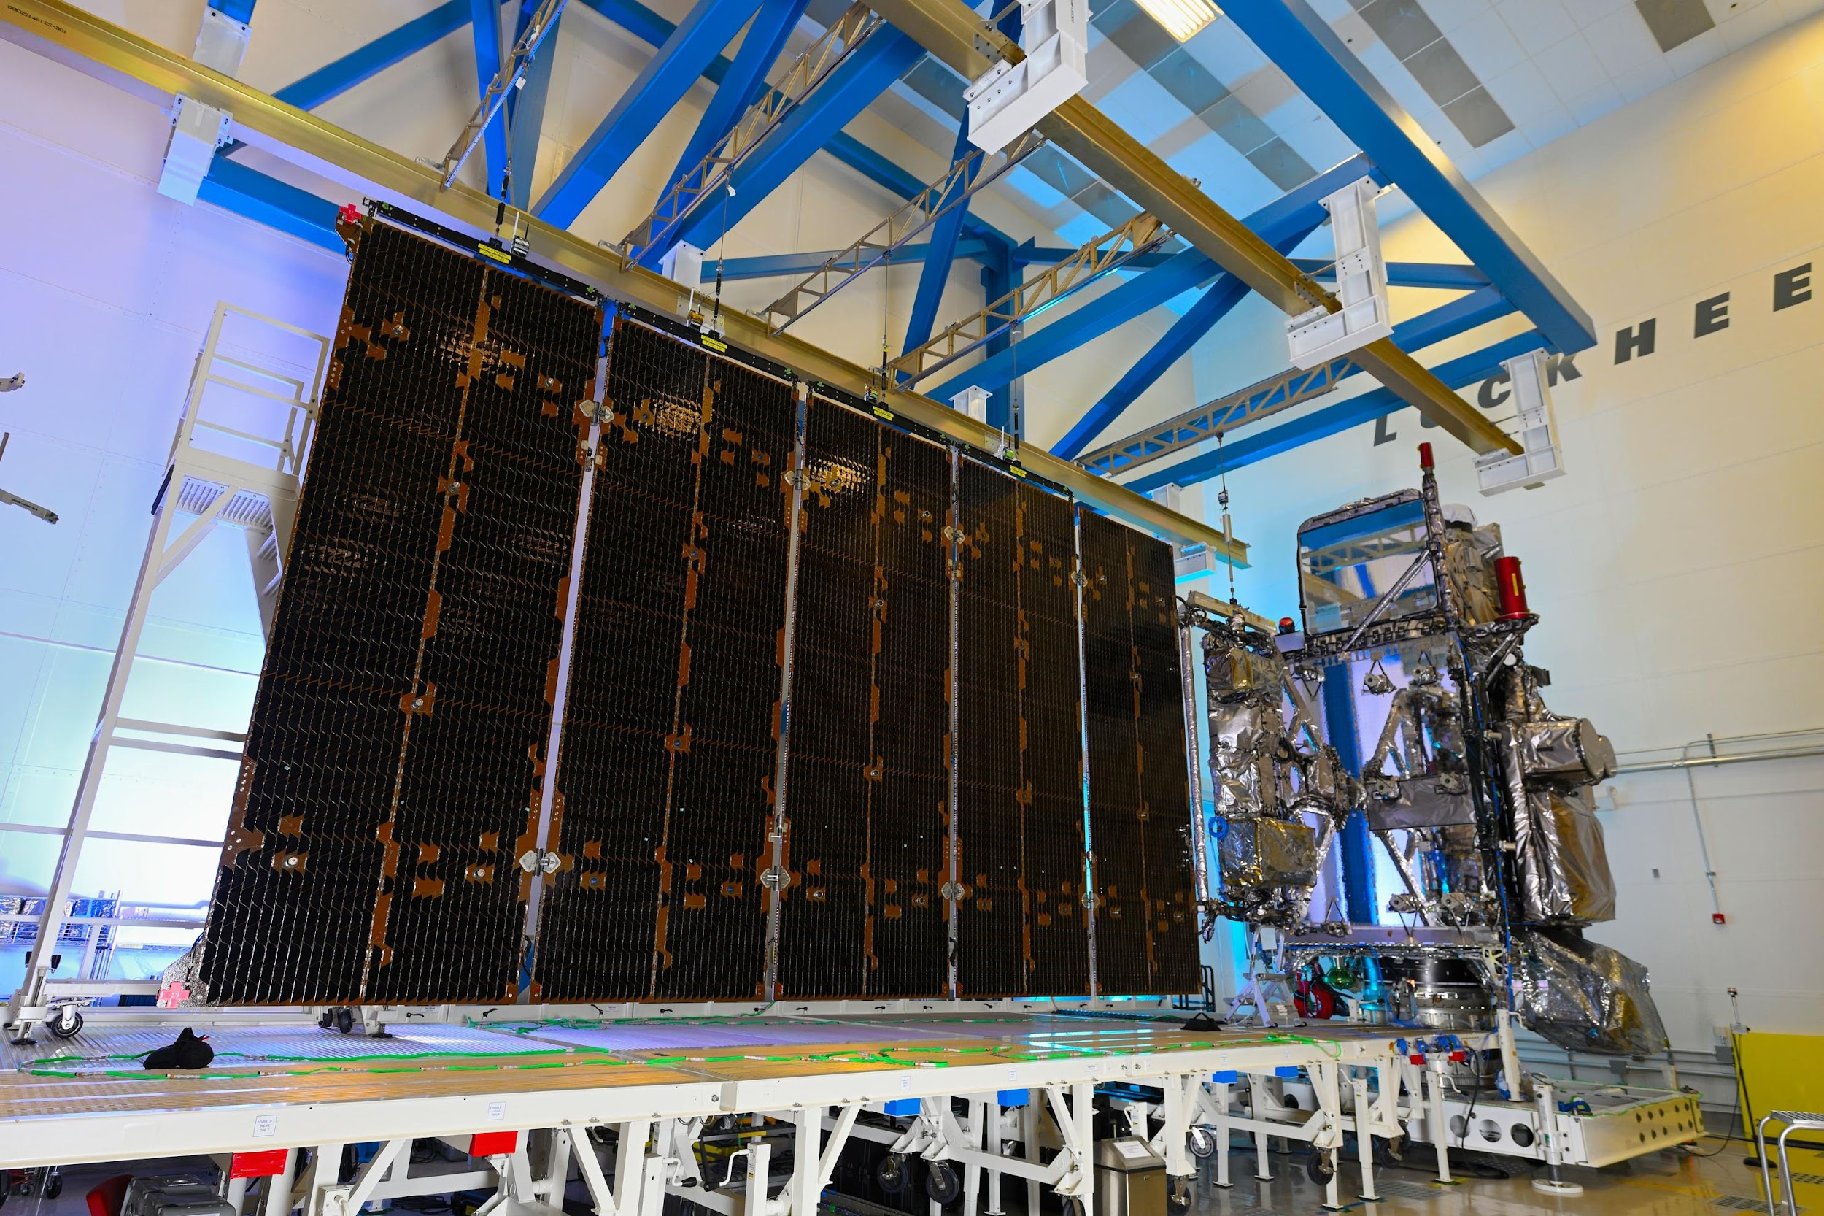
GOES-T
Testing has been completed and the spacecraft is awaiting shipment from Colorado to Florida in November
Official launch date is Jan. 8, 2022, but it’s very likely that the date will change to Feb. 16
NWS has requested that GOES-18 become the operational GOES-West ASAP due to the G17 ABI’s worsening thermal anomaly
NESDIS agreed to this and planning is currently underway to make it happen

Slide 6
Post Launch Test Plan for GOES-T, in the event of a Feb. 16 launch
Launch on February 16, 2022
LOR: 2/16/22 – 3/10/22
Orbit Raising plan unchanged; Geo insertion at 89.5W
PLT Part 1: 3/11/22 – 4/20/22
Instrument outgassing
GN&C and COMM PLT
Some early instrument PLT activities at 89.5W (e.g. Door open, mechanism checkout, first ABI images)
Drift to 136.8W: 4/20/22 – 5/11/22
GOES-18 instruments remain ON
PLT activities paused; No product data
PLT Part 2: 5/11/22 – 9/25/22
ABI Beta Maturity: 6/24/22
ABI PLT Complete
PLPT Continues
GOES-18 ABI data available during GOES-17 ABI warm period (August 2022)
GOES-18 will transition to GOES West operation at 137.2°W once products reach provisional maturity (~Dec 2022)
GOES-17 moved to storage location (105W)

Slide 7
Post Launch Test Plan for GOES-T, in the event of a Feb. 16 launch
Dates | Activity | GOES-18 Data Availability
2/16/22 – 3/10/22 | Launch and Orbit Raising to 89.5°W | N/A
3/11/22 – 4/20/22 | Post-Launch Testing (PLT) Part 1 instrument outgassing & doors open, comms tests | LZSS, PDA, AWIPS (SBN) have GOES-18 data available for integration & test, instrument vendors, and CWG/AWG cal/val. GOES-18 GRB not in service.
4/20/22 – 5/11/22 | Drift to 136.8°W PLT activities paused, no product data | None
5/11/22 – 9/25/22 | Post-Launch Testing (PLT) Part 2 Majority of Post-Launch Product Tests | LZSS, PDA, AWIPS (SBN) have GOES-18 data available indefinitely for integration & test, instrument vendors, and CWG/AWG cal/val. GOES-18 GRB not in service.
6/24/22 | ABI Beta Maturity | Interleave Ready: GOES-17 GRB available for swapping GOES-17 ABI L1b for GOES-18 ABI L1b. GOES-18 GRB not in service.
8/DD-DD/2022 | GOES-18 ABI data available during GOES-17 ABI warm period via GOES-17 GRB
12/DD/2022 | GOES-18 will transition to GOES West operation at 137.2°W once products reach provisional maturity GOES-17 moved to storage location (105°W) | All LZSS, PDA, AWIPS (SBN) subscriptions turned on for all user sectors (DOD, international, commercial, etc). GOES-18 GRB in service.

Slide 8
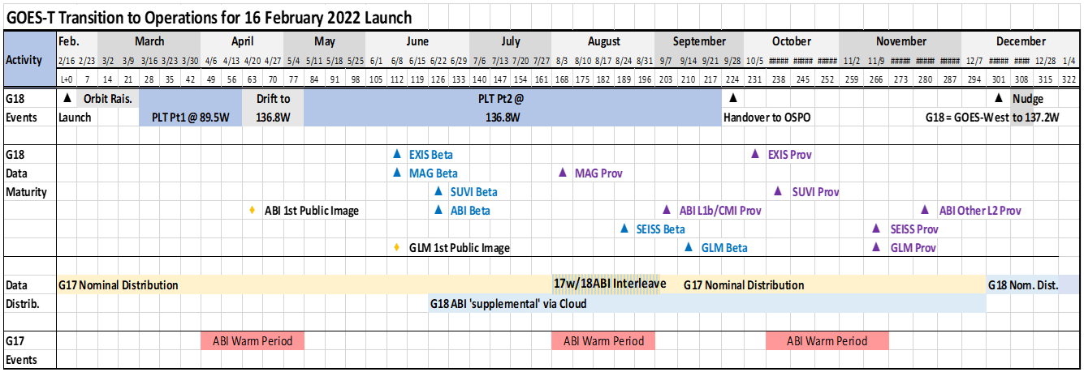
Post Launch Test Plan for GOES-T, in the event of a Feb. 16 launch
More details on GLM schedule

Slide 9
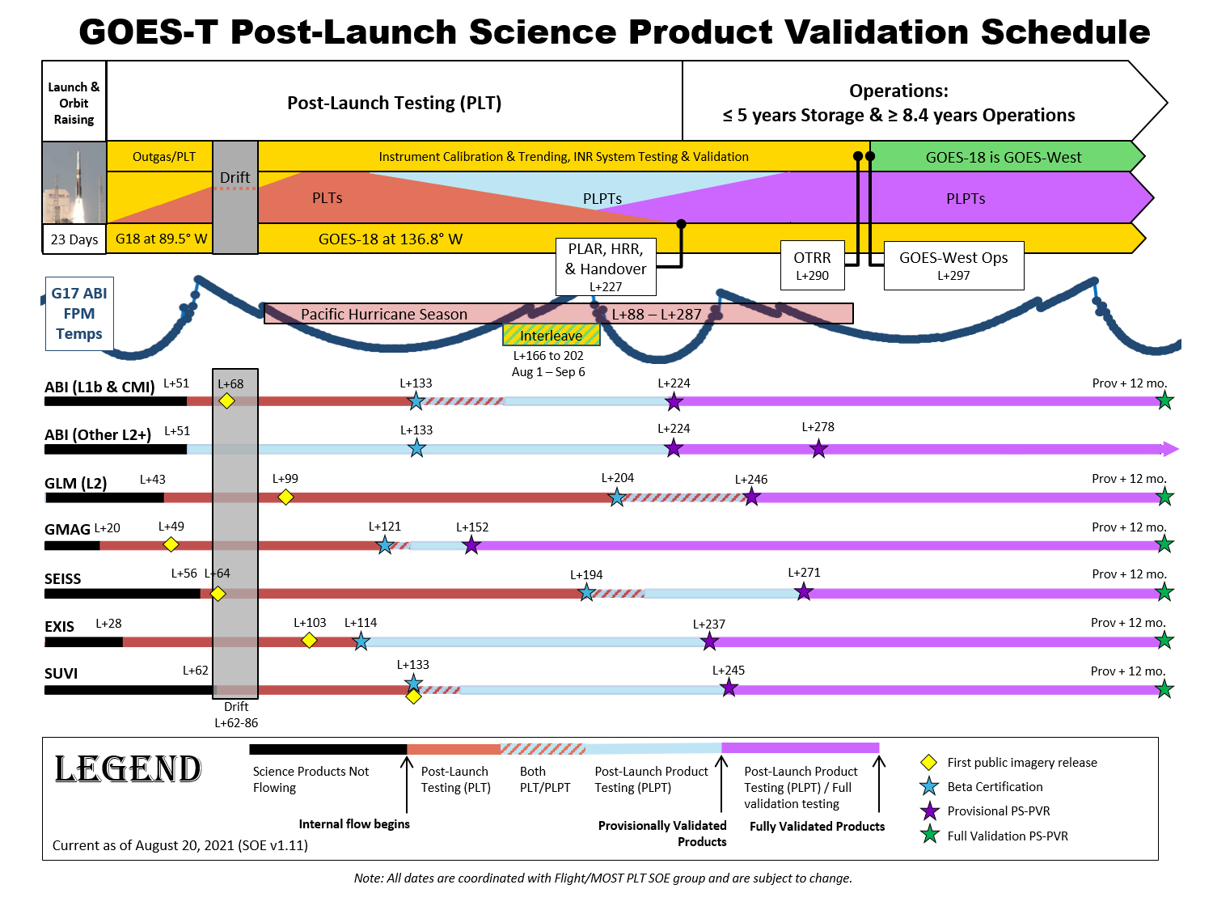
GOES-T Science Product Schedule in the event of a Feb. 16 launch

Slide 10
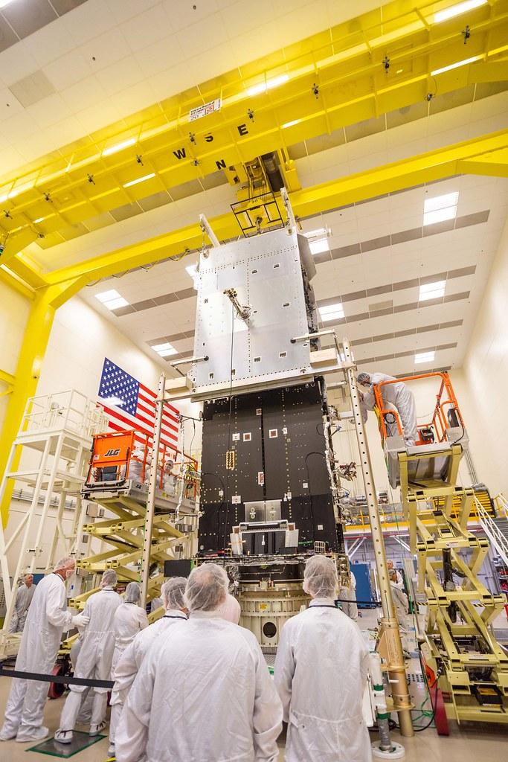
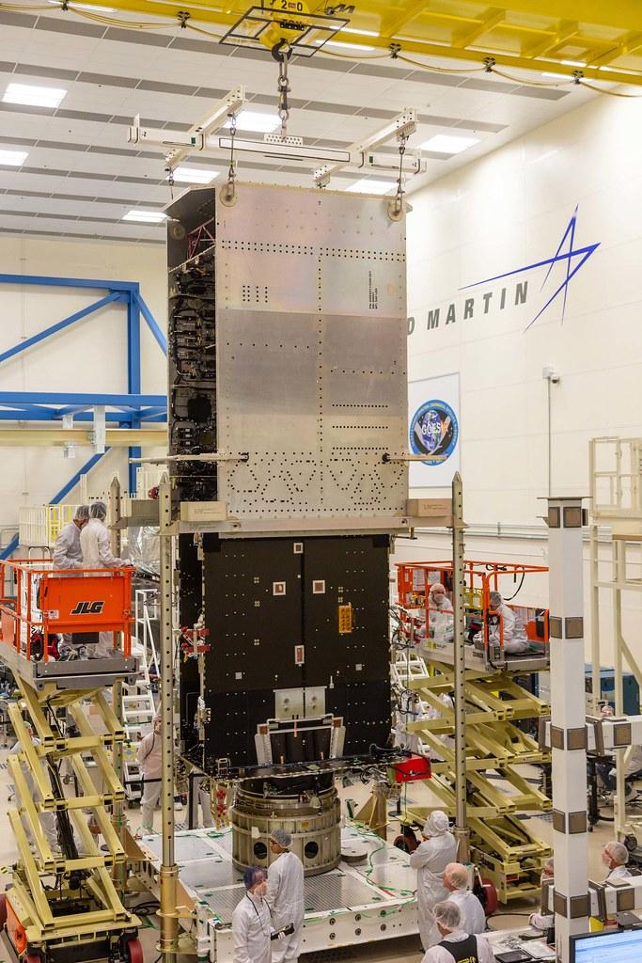
GOES-U
Spacecraft integration continues in Denver
Planned for launch in Spring 2024

