Slide 1
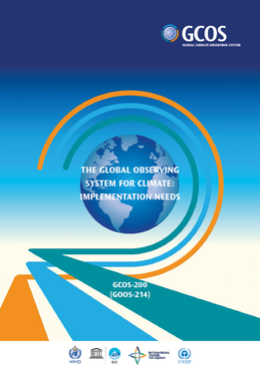
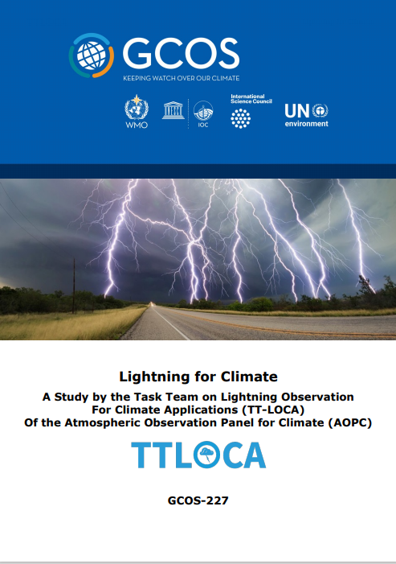
Lightning : An Essential Climate Variable
¹Steven J. Goodman, ²Katrina S. Virts, and ²Dennis Buechler
^{1,2}GOES-R Program/TGA, ²UAH, Huntsville, AL USA
WMO/GCOS Task Team on Lightning Observation For Climate Applications (TT-LOCA)
Task Team Panel Members:
Steve Goodman, NOAA/NASA (ret), USA, Chair
Robert Holzworth, Univ. of Washington, USA
Vasiliki Kotroni, NOA, Athens, Greece
Yuriy Kuleshov, RMIT, BOM, Melbourne, Australia
Colin Price, Tel Aviv Univ, Israel
Bartolomeo Viticchie, EUMETSAT, Darmstadt, Germany
Earle Williams, MIT, USA
GCOS/WMO: Caterina Tassone, Tim Oakley
2021 GLM Virtual Science Meeting, 21-23 September, 2021

Slide 2
Why Lightning for Climate?
Due to the relevance and use of lightning data as a climatological variable, lightning has been added to the list of Essential Climate Variables (ECV) in the 2016 WMO Global Climate Observing System (GCOS) Implementation Plan (IP) (GCOS, 2016), including a first attempt to define the requirements for climate monitoring of lightning measurements.
Action 29 of the IP called for defining “the requirement for lightning measurements, including data exchange, for climate monitoring and to encourage space agencies and operators of ground-based systems to strive for global coverage and reprocessing of existing datasets”.
The TT-LOCA was constituted to address these questions.

Slide 3
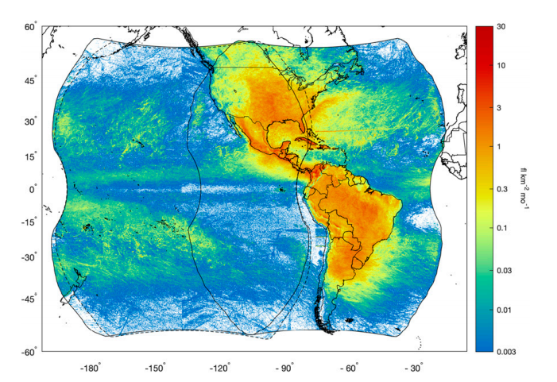
Lightning Data Requirements
Total Lightning Density
Consistent, Harmonized Data
Global 10 km x 10 km (0.1 x 0.1 deg)
Temporal (Monthly, perhaps Daily)
Space-based: GLM Total Lightning Flash Density
Space-based Optical:
NASA TRMM/ISS - LIS
NOAA/NASA GOES - GLM
CMA FY-4 - LMI
EUMETSAT MTG - LI
Ground-based RF (commercial data):
GLD360 (Vaisala)
ENTLN (Earth Networks)
WWLLN (Univ. Washington)
Combined G16 and G17 GLM flash densities from 1 Dec 2018 to 31 May 2020 with units of flash count per square kilometer per month.
Notes:
Reference: (Rudlosky and Virts, 2021, DOI: 10.1175/MWR-D-20-0242.1

Slide 4
Is Lightning the Most Frequent Natural Hazard on Earth?
The global flash rate is estimated to be 45 fl/sec (in-cloud and cloud-to-ground)
Asia-Oceania, Europe/Africa, Americas are the 3 main global chimneys for lightning
24,000 people are killed and 240,000 are injured worldwide per year by lightning (Holle, 2016)
GLD360
Total lightning density 20-km grid, 2016-2020 annual average, Over 10 billion events detected
Said, 2017
Notes:
Said, R.K., 2017: Towards a global lightning locating system. Weather, 72, 36-40.
Holle, R.L., 2016: A summary of recent national-scale lightning fatality studies. Weather, Climate, and Society, 8, 35-42.

Slide 5
Metadata
Metadata – Product = Total Lightning Density
Satellite imagers optical flash density vs ground-based RF network stroke density
How is satellite event/group/flash related to RF strokes?
Toward harmonized, consistent space and ground-based data set(s)
Desire for # stations (ground-based), Detection Efficiency, resolution (time, space), and other cal/val performance parameters (e.g., network flash type – IC/CG discrimination) needed to make a climate data set most useful.
Note no network or space measurement is 100% DE effective over its entire coverage area.

Slide 6
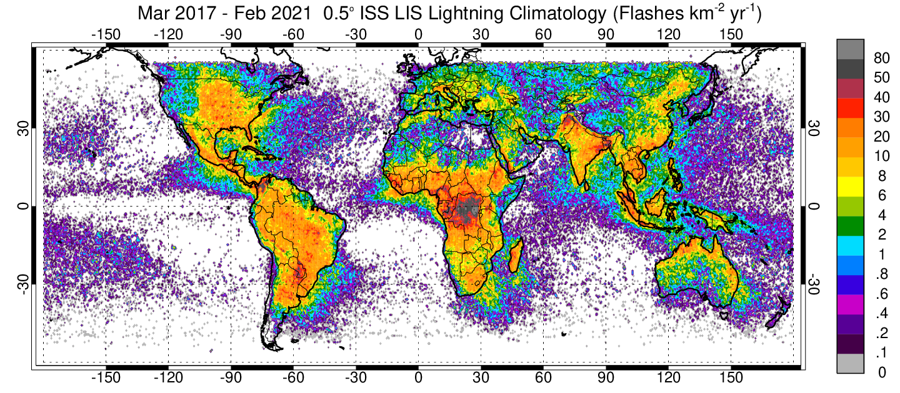
4 Years of ISS Lightning from Space
Fast optical imaging of lightning day and night in near Infrared wavelengths (777.4 nm)
Notes:
See: (Blakeslee, R. J., et al. (2020). Three years of the Lightning Imaging Sensor onboard the International Space Station, JGR,125, doi.org/10.1029/2020JD032918)

Slide 7
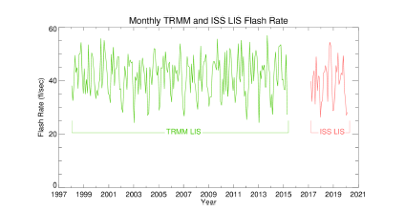
25 Years of Lightning from Space
End of Mission
Monthly time series of global lightning ﬂash rate (between ±38° latitude) from TRMM LIS and ISS LIS.
Notes:
See: (Blakeslee, R. J., et al. (2020). Three years of the Lightning Imaging Sensor onboard the International Space Station, JGR,125, doi.org/10.1029/2020JD032918)

Slide 8
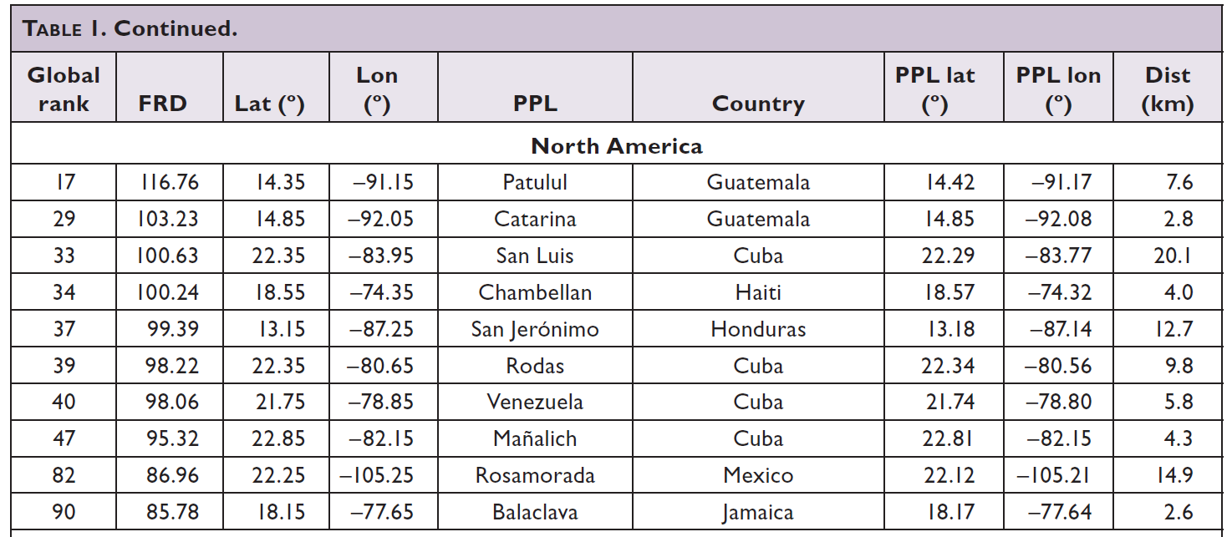
North America Lightning Hot Spots (Albrecht et al., BAMS, 2016

Slide 9
North America Lightning Hot Spots
North America Lightning Hotspots
Rank | ENGLN |  |  | GLD360 |  |  | GLM-16 |  |  | WWLLN
 | Lat | Lon | Stroke rate | Lat | Lon | Stroke rate | Lat | Lon | Flash rate | Lat | Lon | Stroke rate
1 | 26.45 | -80.95 | 507.11 | 14.35 | -91.05 | 281.70 | 14.35 | -91.05 | 164.01 | 14.35 | -91.05 | 42.35
2 | 27.35 | -80.95 | 433.28 | 28.45 | -81.25 | 202.36 | 14.75 | -91.95 | 105.07 | 13.15 | -87.25 | 31.66
3 | 38.65 | -76.75 | 382.15 | 13.15 | -87.25 | 197.10 | 13.15 | -87.15 | 100.53 | 17.45 | -93.85 | 28.28
4 | 27.85 | -81.85 | 357.01 | 22.35 | -84.25 | 167.77 | 22.35 | -84.25 | 97.00 | 13.35 | -89.55 | 24.41
5 | 28.35 | -80.75 | 350.51 | 32.65 | -96.75 | 166.43 | 15.35 | -92.65 | 93.35 | 15.65 | -94.15 | 23.27
6 | 26.85 | -81.95 | 350.04 | 33.55 | -98.25 | 166.33 | 19.05 | -72.25 | 89.32 | 15.95 | -88.85 | 23.19
7 | 29.75 | -94.35 | 337.16 | 29.85 | -94.35 | 159.74 | 25.75 | -74.95 | 84.98 | 28.55 | -94.95 | 22.49
8 | 28.55 | -94.95 | 336.52 | 33.65 | -95.45 | 156.41 | 25.95 | -64.15 | 84.51 | 17.65 | -92.85 | 22.42
9 | 30.75 | -93.35 | 330.37 | 31.15 | -97.95 | 148.40 | 20.35 | -75.95 | 83.86 | 13.05 | -88.25 | 22.33
10 | 34.15 | -93.95 | 326.12 | 27.45 | -81.65 | 146.98 | 13.85 | -88.15 | 79.73 | 7.45 | -78.65 | 22.13
*Lightning density in units of flashes/km²/yr or RF strokes/km²/yr
Place Name | Global Rank | Lat Lon | GLD360 | WWLLN | TRMM-LIS | ISS-LIS | GLM-16
Patulul, Guatemala | 17 | 14.35, -91.05 | 281.70 | 42.35 | 116.76 | 65.6 | 164.01
ISS-LIS from March 2017 - July 2021

Slide 10
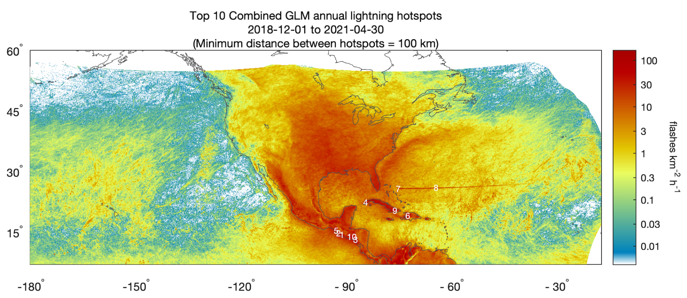
Bahama Bar artifact ?

Slide 11
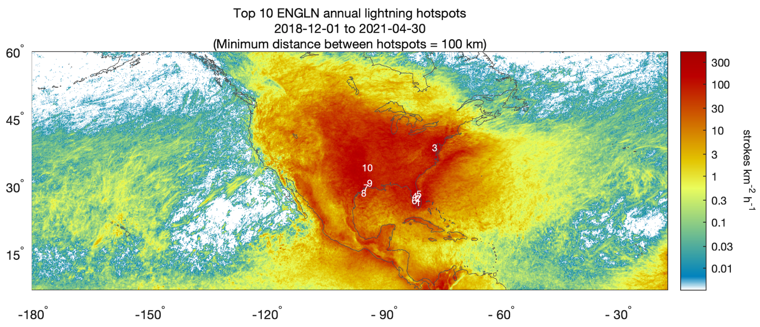

Slide 12
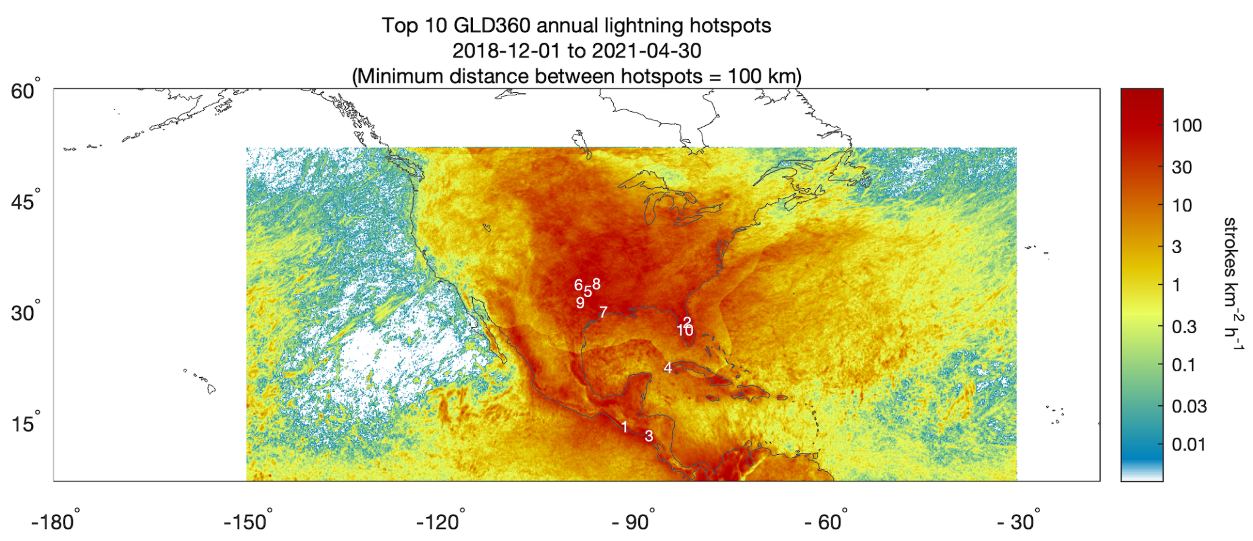
The truncated domain represents the GLD360 data buy at NWS used by GLM team and archived at the GHRC DAAC in Huntsville

Slide 13
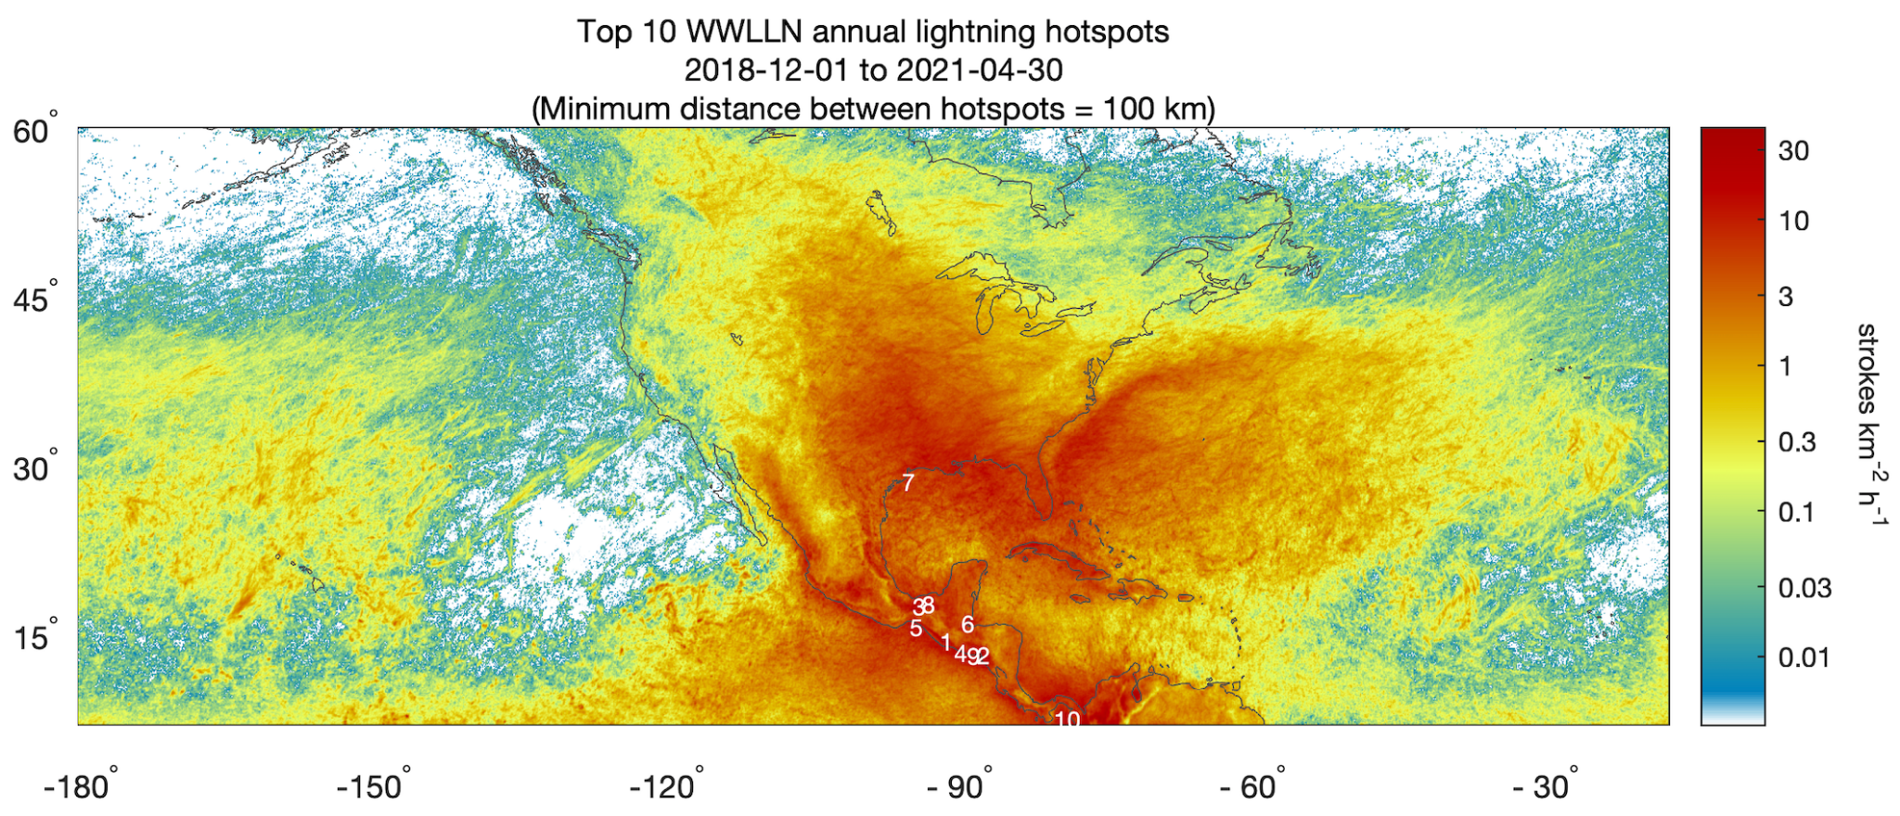

Slide 14
Summary
Lightning is a global Natural Hazard of great importance and interest
Exemplary datasets undergoing evaluation (satellite – Ground-Based RF)
How might a lightning ECV be associated with other variables, such as clouds, precipitation, composition, NOx, and surface observations (e.g., temperature, severe weather reports), ENSO, MJO, Upper Level humidity (see Notes page).
Raise lightning safety awareness – collaborate with WHO, WMO Disaster Risk Reduction (Natural Hazards) Programme
Notes:
ACCP – NASA’s Aerosol, Cloud, Convection and Precipitation (ACCP) Mission
GEMS - South Korea's Geostationary Environment Monitoring Spectrometer (GEMS) for Air Quality
TROPOMI - The TROPOspheric Monitoring Instrument (TROPOMI) is the satellite instrument on board of the Copernicus Sentinel-5 Precursor satellite.
TEMPO - Tropospheric Emissions: Monitoring of Pollution (TEMPO) mission will measure atmospheric pollution covering most of North America.
GOSAT-GW -. JAXA’s Global Observing SATellite for Greenhouse gases and Water cycle.

