Slide 1
Data Assimilation for NOAA’s Next Generation Regional High Resolution NWP System
Jacob Carley¹, Eric Rogers¹, Ting Lei^{2,1}, Xiaoyan Zhang^{2,1}, Cory R. Martin^{3,1}, Daryl T. Kleist¹, Curtis Alexander⁴, Terra Ladwig⁴, Ming Hu⁴, David Dowell⁴
Shun Liu^{2,1} (presenter)
¹NOAA/NWS/NCEP/EMC
²I.M. Systems Group
³RedLine Performance Solutions
⁴NOAA/OAR/GSL

Slide 2
The Unified Forecast System
A community-based, coupled, comprehensive Earth modeling system
Source system for operational numerical prediction applications at NOAA
Holistic, application-based approach aimed at simplifying the suite of models and forecast systems currently used into a single seamless suite that meets the operational needs of the organizations responsible for environmental prediction.
Local → global domains
Sub-hourly → seasonal prediction
Shared components
Earth-system model components (such as atmosphere, ocean, sea ice, land, and atmospheric composition predictive capabilities)
Observation processing
Pre-processing
Data assimilation
Post-processing
Verification
Notes:
Includes software, governance, and a community of individuals composed of researchers, developers and users from NOAA, educational institutions, other federal agencies, and the private sector
Supports community research, to further the understanding of environmental processes on weather and climate scales, and development to accelerate the transition of research successes to operations.
UFS provides a framework to engage the extensive research enterprise in the US and creates an environment to more efficiently and effectively translate research advances into operational outcomes.

Slide 3
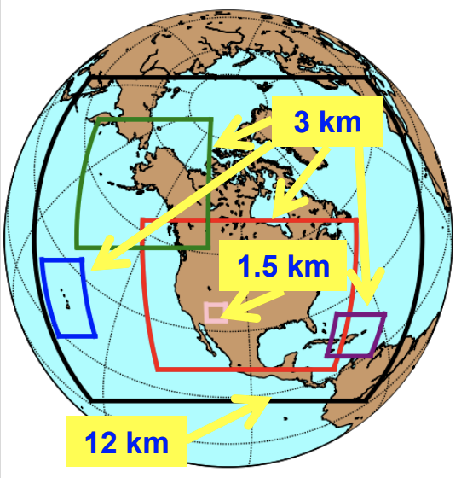
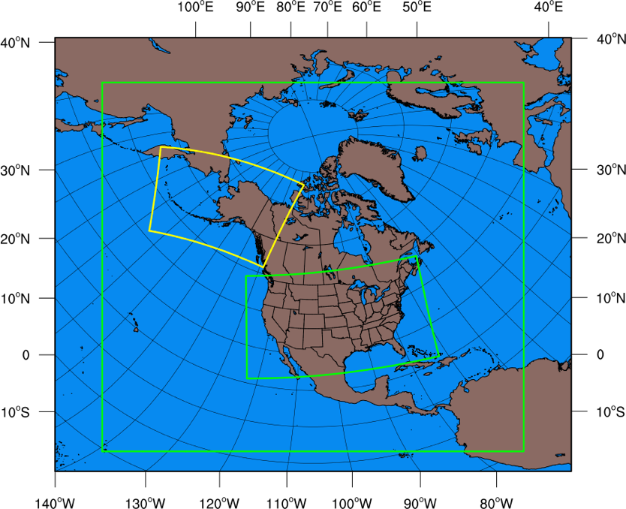
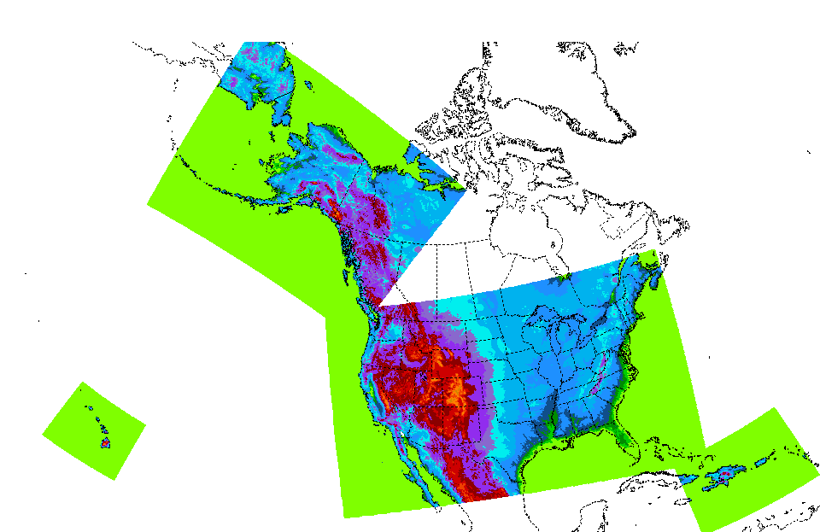
Near Current Snapshot of Regional Model Suite
Global (15-30 km, 4/day)
GFS
GEFS
Regional (12-15 km, 4-24/day)
RAP
SREF
NAM
HRRR
HiResARW
FV3-LAM
NAMnest
HiResARW2
CONUS/OCONUS
CAM (3-4 km, 2-24/day)
HREF
Sub-CONUS
CRM (1.5 km, on-demand)
FireWxNest
NAM+Nests
RAP/HRRR
HiResWs
Notes:
With the greater context of unification, and simplification, in mind let us take a look a the current state of the regional/high-resolution NWP suite in operations at NOAA.
It is rather complex!
We have several resolutions, domains, physics, dynamical cores, and even DA systems (though all use the same DA software; GSI). This presents an opportunity to unify and simplify under the context of the greater UFS program

Slide 4
Unification of the Regional Model Production Suite
Global (10-15 km, 24/day)
GFS
GEFS
CONUS/OCONUS
CAM (3 km, 24/day)
Rapid Refresh
Forecast System
RRFS
Sub-CONUS
CRM (1 km, on-demand)
Warn on Forecast
System
WoFS
Notes:
New vision of the of the production suite with regional/high-resolution model unification.
A much simpler suite all unified under the context of this new system called the Rapid Refresh Forecast System (or RRFS). So what is the RRFS?

Slide 5
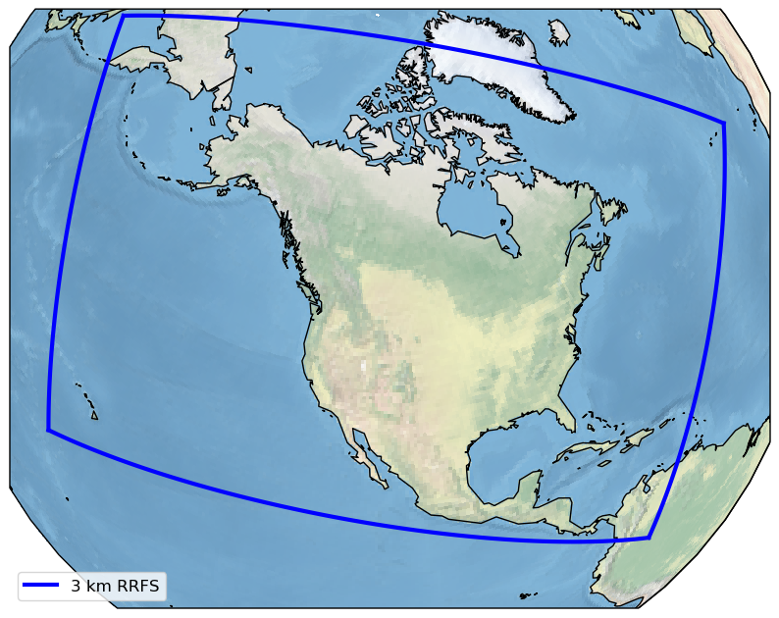
Rapid Refresh Forecast System (RRFS)
A UFS Application
Based on the FV3-Limited Area Model (LAM)
Black et al. (JAMES, 2021)
Rapidly updated
Convection-allowing (~3 km)
65 vertical layers
Hybrid 3DEnVar assimilation (36 members)
Ensemble forecasts (9 members)
Stochastic and multiphysics suite
18h+ hourly
60h every 6 hours

Slide 6
Unifying Regional Domains
NAM+Nests
RAP/HRRR
HiResWs
~9 million cells per layer
3 km RRFS domain

Slide 7
Current testing
Underway at NOAA EMC and GSL
Some highlights for EMC runs
Coldstarted North American domain
DA over CONUS
DA over North American domain
At present all DA runs shown here have the following features:
3-km
Forecasts at 00Z and 12Z
Passively use global model (GDAS) EnKF members
No 3 km DA members (yet)
No cloud analysis or radar DA (yet)
Use on-time obs only (no partial/catch-up cycle obs)
Coldstart from 6h GDAS forecast
60 hr 3 km forecast
Hourly hybrid 3DEnVar assimilation
*Also M. Hu’s presentation from earlier today [Operational DA I (O2-1A)] on Building a JEDI- and FV3-based Rapid Refresh Forecast System (RRFS) upon Decade of Development and Implementation of the High Resolution Rapid Refresh (HRRR)
Notes:
These are (some) of our initial test configurations, which serve to exercise some of the early, basic system capabilities. This framework is being built upon incrementally toward the full RRFS prototype, and is a useful baseline.

Slide 8
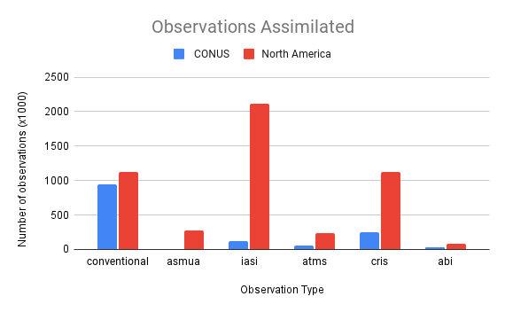
Larger domain impact on observation usage
CONUS domain observations are primarily from conventional sources (~67%)
North American domain has ~250% increase in assimilated observations
And satellite data make up over 75% of the observations*
*See poster by X. Zhang on Satellite radiance data assimilation within NOAA's prototype Rapid Refresh Forecast System (WCRP-WWRP Symposium on Data Assimilation and Reanalysis)
Notes:
With a larger domain we, unsurprisingly, assimilate much more data than what we used to with more restricted coverage over the contiguous U.S.
Of particular interest is the significant growth in assimilated radiance data, which we expect to have a much larger role in this new system.

Slide 9
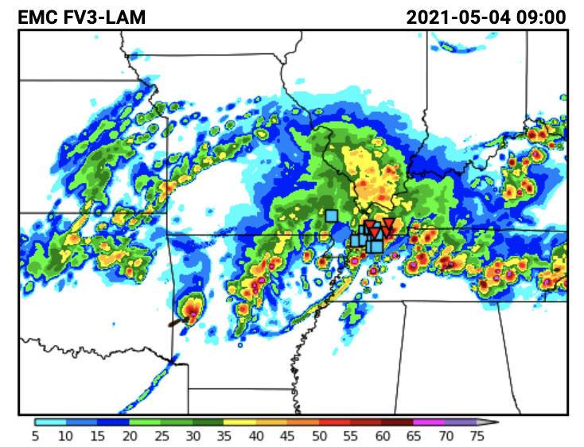
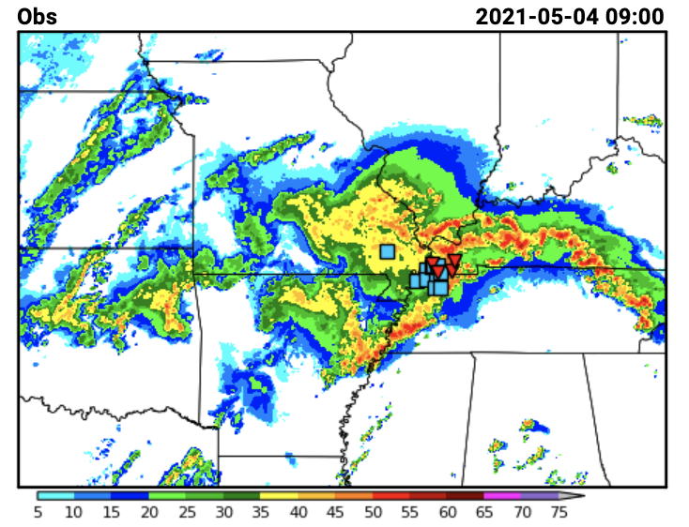
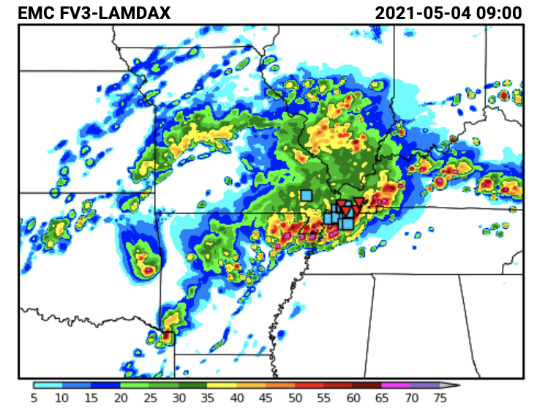
Real Time Assessments in NOAA’s Flagship Testbeds
Example from the Hazardous Weather Testbed Spring Forecast Experiment
Evaluations are underway of prototype systems in NOAA testbeds for early feedback
Month+ long intensive experiments
Research and operational expertise assess forecasts daily
Tests are coordinated with academic, operational, NOAA lab, and other partners
Feedback leveraged to improve systems
no DA
Obs
33 hr forecast valid May 4th, 2021 at 09 UTC. Storm reports are overlaid.
with DA
Imagery from https://hwt.nssl.noaa.gov/sfe_viewer/2021/model_comparisons
Notes:
Real-time testing and incremental benchmarking in testbed environments has been a fundamental component of our development procedure for over a decade. Development of the RRFS system is no different.
Here is an example from 2021’s, month-long, Hazardous Weather Testbed Spring Forecast Experiment, which is an annual testbed that investigates the use of convection-allowing model forecasts as guidance for the prediction of hazardous convective weather. It brings together academia, forecasters, and developers of operational NWP systems.

Slide 10
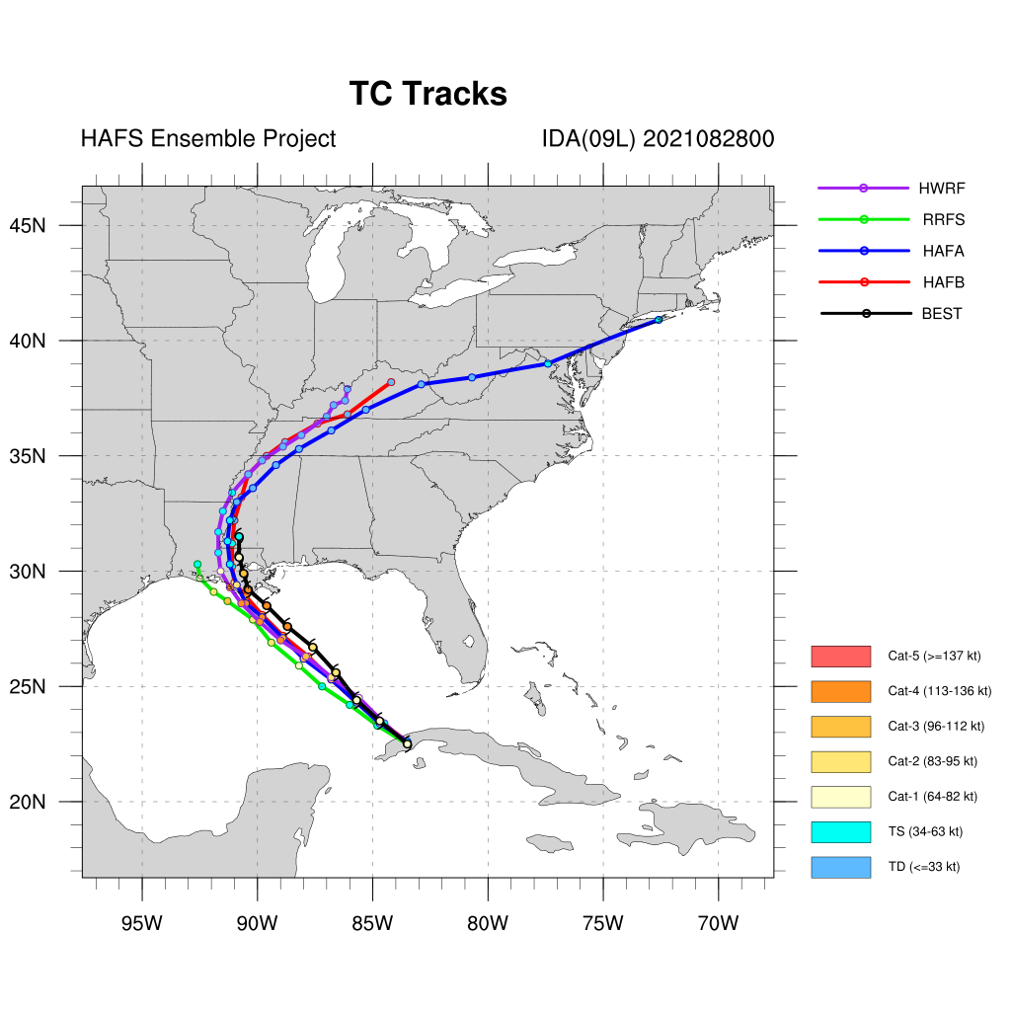
RRFS and TCs
Domain becoming sufficiently large to capture landfalling TCs
An emerging application area
Will require building upon the many years of experience from the hurricane DA teams
HWRF and now HAFS
RRFS
*Thanks to Zhan Zhang (EMC) for this figure
Notes:
With the significantly expanded domain, we must also consider atmospheric phenomena that were not typically within our purview in prior systems which had domains that ended near our coastlines. In this particular case we highlight tropical cyclones.
Shown on the right is a recent forecast track for Hurricane Ida from a single forecast cycle. Our test system is the green line with the best track noted in the black line. Purple is the operational hurricane prediction system and blue and red are new, experimental systems (called HAFS), that are also a part of the UFS.
Unifying the domains into a single large domain presents an emerging application area alongside opportunity to more closely engage with experts in the hurricane DA field.

Slide 11
Near and Long Term: Cycling Strategy
Partial Cycling
RRFSv1
Partial cycling
Been used at NCEP/EMC since December 2008
RRFSv2+
Full cycling + blending GEFS longwave perturbations into ICs*
High latency obs?
See talk from L. Slivinski later
Progress towards a global hourly-updating data assimilation system
00 UTC
01 UTC
02 UTC
03 UTC
04 UTC
05 UTC
06 UTC
07 UTC
Continuous DA cycle with blending
Blend ICs w/ GEFS Longwaves
Hourly free forecasts
*Schwartz, C. S., J. Poterjoy, J. R. Carley, D. C. Dowell, G. S. Romine, and K. Ide, 2021: Comparing partial and continuously cycling ensemble Kalman filter data assimilation systems for convection-allowing ensemble forecast initialization. WaF, In press.
Notes:
Partial cycling been used at NCEP/EMC since December 2008, will be used in RRFSv1
RRFSv2+
Collaborative work with NCAR recently shown that
Full cycling best with short range forecasts
Partial cycling best with longer range forecasts (e.g. >18h)
Best overall: Full cycling + blending GEFS* longwave perturbations into ICs
Full cycling + blending also saves computational resources and is simpler to maintain
What about high latency observations? → overlapping windows

Slide 12
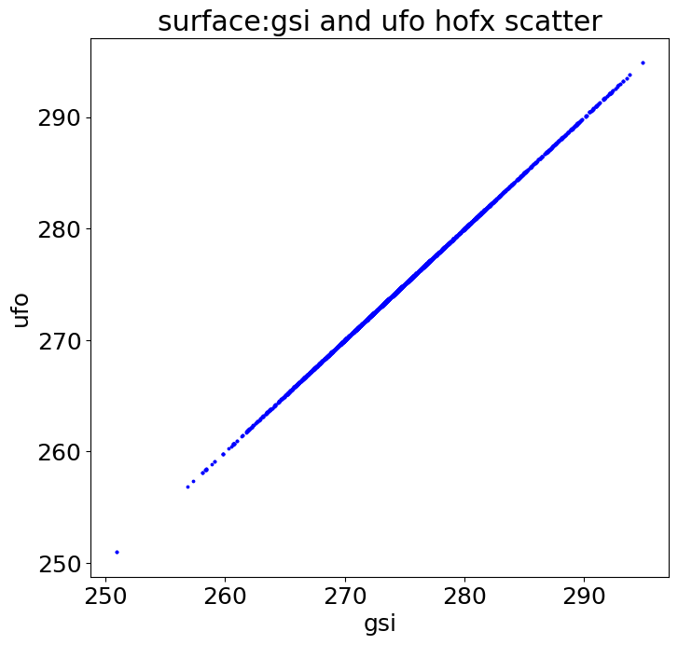
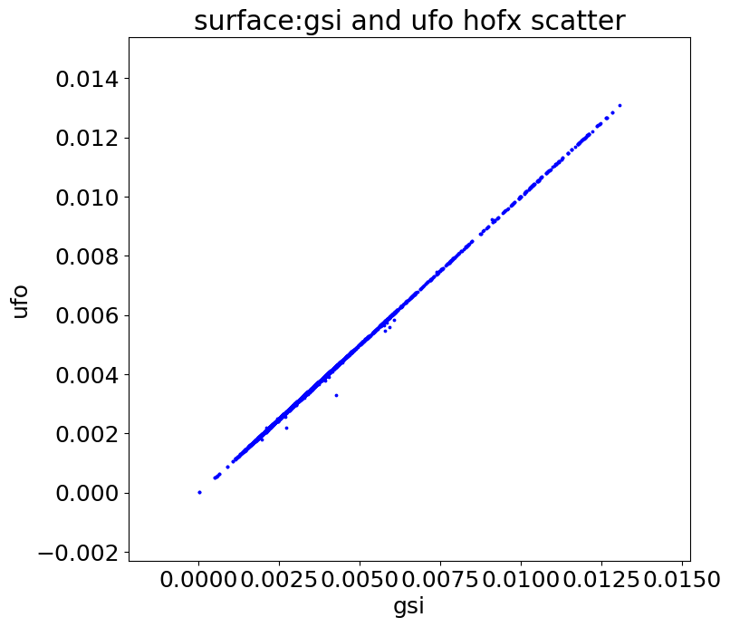
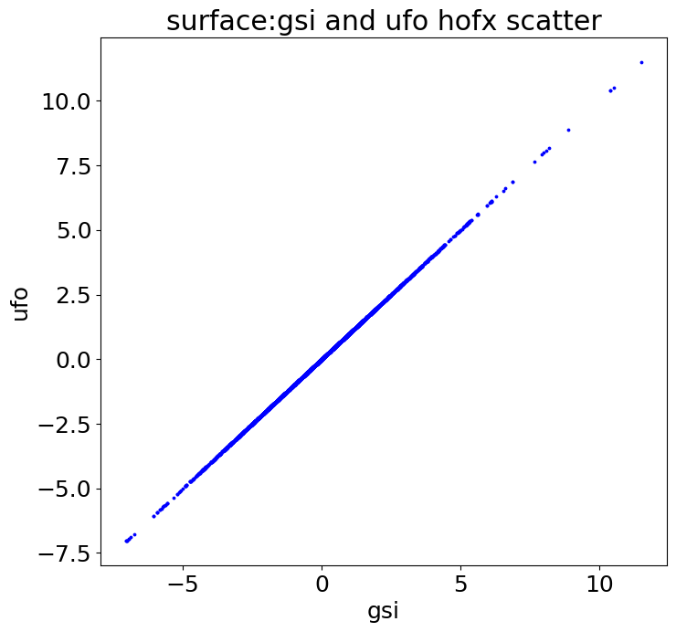
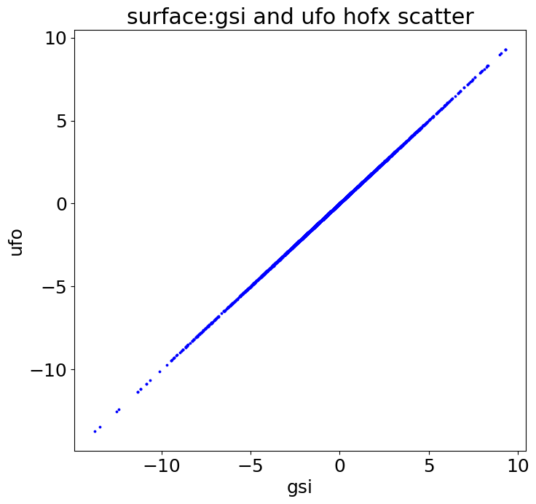
JEDI Transition Work [ongoing for RRFSv1+]
2mT
2mSPFH
10mU
10mV
New JEDI UFO
Successfully Matched H(x)
Successfully Matched H(x)
Successfully Matched H(x)
Successfully Matched H(x)
Legacy GSI Observer
Legacy GSI Observer
Legacy GSI Observer
Legacy GSI Observer
*Also see
Comparison of JEDI Unified Forward Operator and GSI Observer Using Rapid Refresh Forecast System Background by S. Liu (WCRP-WWRP Symposium on Data Assimilation and Reanalysis)
Tests of hybrid EnKF-Variational Data Assimilation capabilities using JEDI with NOAA's Next Generation Regional High Resolution NWP System by T. Lei ((WCRP-WWRP Symposium on Data Assimilation and Reanalysis))
Notes:
Also - while development is underway we are also undergoing transitionary work from our present-day data assimilation software infrastructure to the new JEDI paradigm. As a part of this transition effort, we must ensure that the new system works as expected for our future operational systems. This shows an example comparing the forward operators for near surface observations between JEDI and GSI systems. For this interested in learning more, please the the two talks referenced here as well as the many other talks on the topic of JEDI throughout this symposium.

Slide 13
Lightning data at NCEP

Slide 14
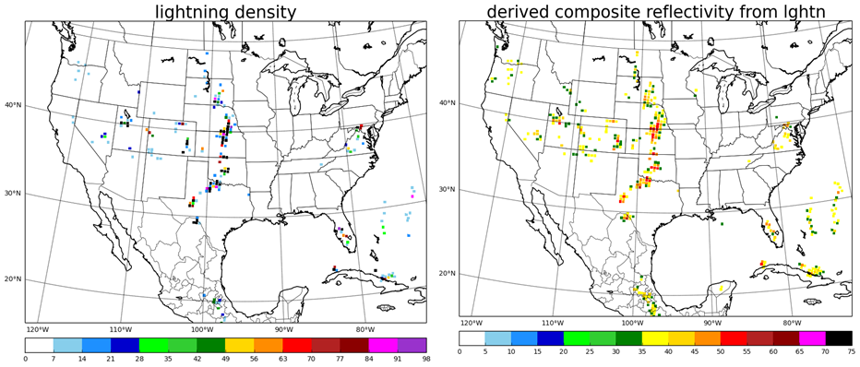
Proxy Composite reflectivity from Lighting observations
Lightning observation adds value in the area without radar observation
North America domain with 3-km resolution provide more opportunities to use GLM for initialize/trigger convection and improve forecast.
Notes:
with the enlarged domain and 3-km resolution, GLM lightning data may more important role in data assimilation.

Slide 15
Challenges
This is a big system!
Cloud HPC project underway
Not just CPU hours
Stressors on I/O bandwidth
Storage
Dissemination
System | Number of instances or nodes | Wall time for 60hr forecast (hrs)
AWS | 80 (c5n.18xlarge) | 3.96
NOAA HPC System (Hera) | 80 | 4.68
A brand new, end to end system meant to facilitate retirement and simplification of many longstanding systems
Benchmark operational systems have decades of development
A high bar is a good thing
Clearing it takes healthy collaboration through the UFS community
Notes:
It is no surprise that we have challenges and the two largest here are:
(1) the large computational size of the new RRFS system, where we have approximately ~9M cells in a single slab. To address some this we’re using cloud HPC.
(2) We are building a brand-new system and trying to retire a legacy of skilled, successful systems in this process. There are technical, scientific, and even social science challenges with this. Are our stakeholders ready for a major change? Even if we meet the technical and scientific challenges this represents a major change for those downstream.

Slide 16
RRFSv1 (current) Timeline
Remainder of 2021
Incorporate partial cycling strategy
Establish RRFS ensemble DA component
2022
Prototype end-to-end RRFS w/ DA running
On prem and cloud
Beta system assessment
Testbed participation
Late 2023 - Implementation
Thank you!

